Slide 1
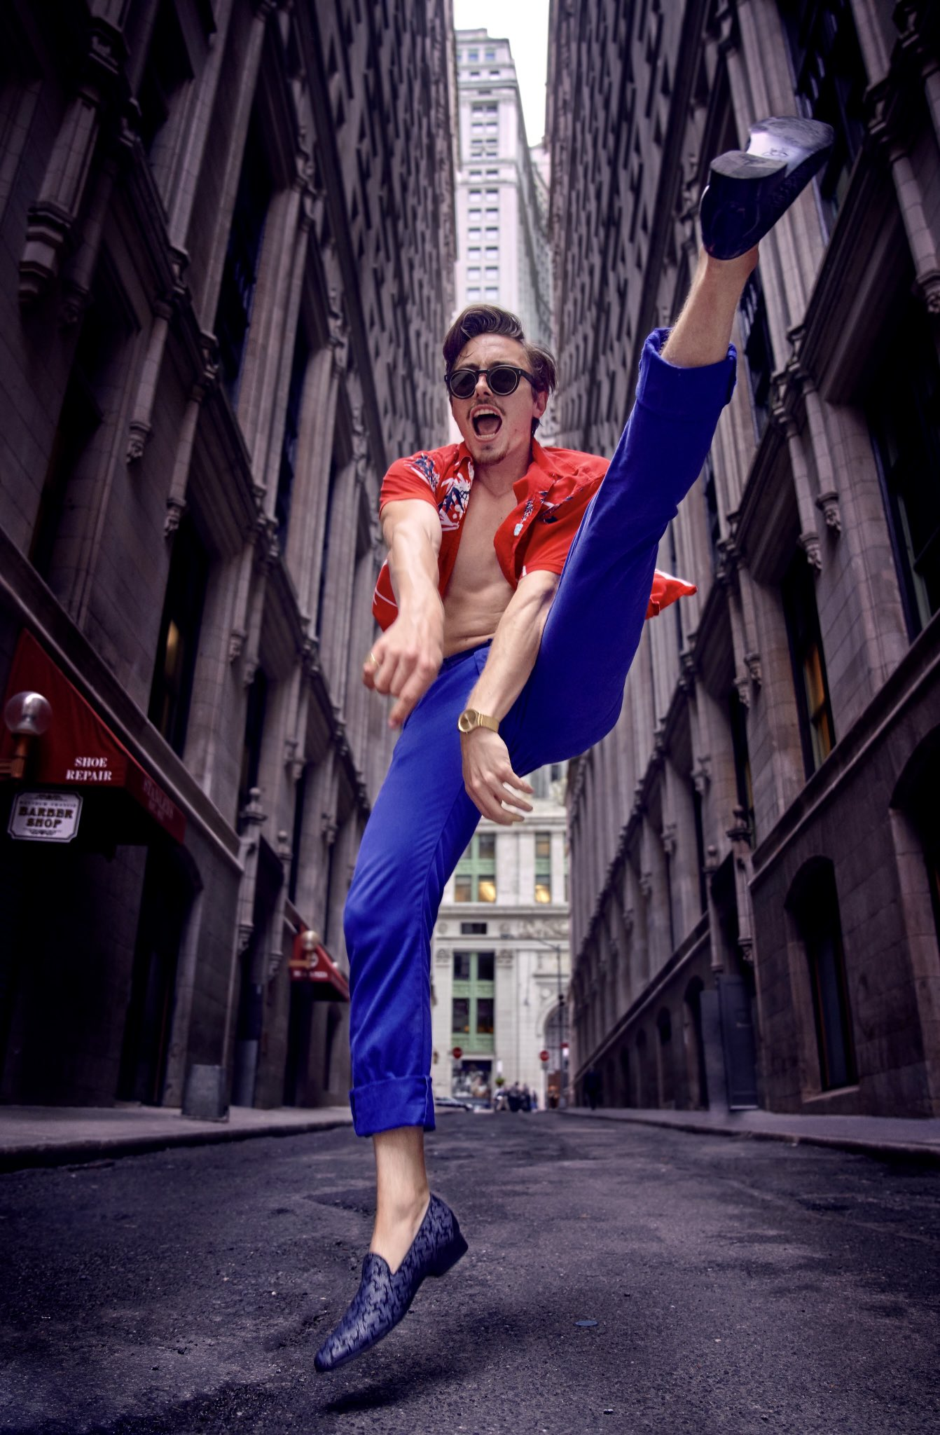
Marc Rebillet: The Spontaneity of Creativity
By Sean Snediker
Notes:
© Copyright PresentationGO.com – The free PowerPoint and Google Slides template library

Slide 2
Loop Daddy
Well-known for his minimalistic setup, Marc makes songs on the spot with just a loop station, keyboard, and computer.
His songs range from the obscene such as "SUMMERTIME," all the way to his core values of his own life that his shows foster these days.
More so, Marc's music generally aims to promote sexual, mental, and physical positivity.
However, he wouldn't be where his is today without his charismatic, chaotic nature that boils over into outrageous songs aptly named "I'M A FLAMINGO and TENNIS ENERGY."
Notes:
© Copyright PresentationGO.com – The free PowerPoint and Google Slides template library

Slide 3
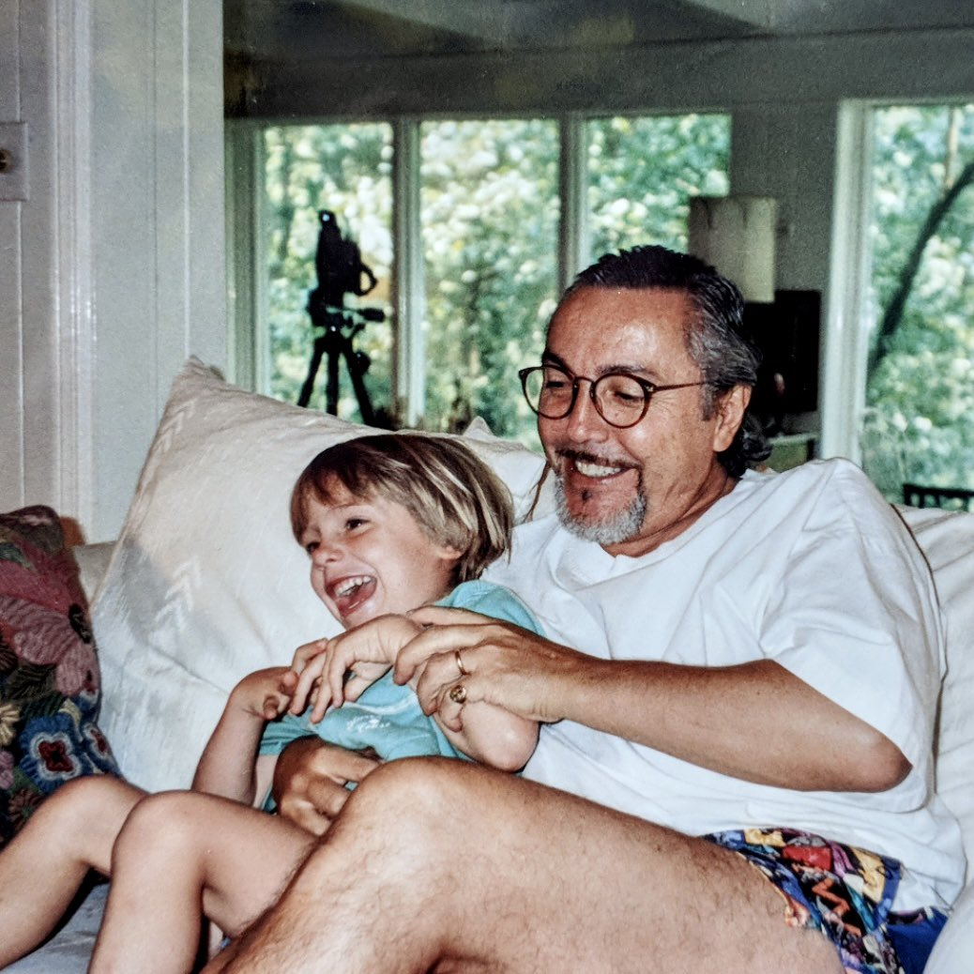
Up In Smoke
Growing up, Marc wasn't eager on following a career in music, and cited that he wanted to "...smoke and chill and live my life and try and make music on the side..." (Heffler, 17).
Due to his father's passing in 2018 – whom of which always tried to push Marc to use his creative abilities – Rebillet decided it was time to begin making music: even though he hated practicing.

Slide 4
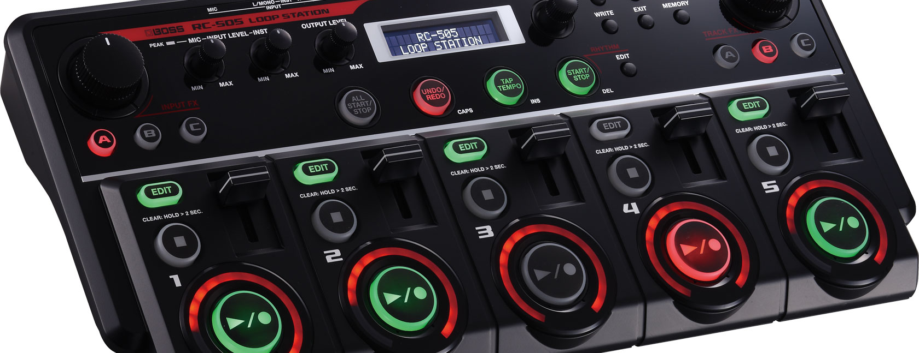
The Loop Machine
Introducing the Boss RC-505: it's what puts the "loop" in Loop Daddy.
Many artists have used it, but only some - like Marc, can truly turn it into a tool of creativity.
This machine allows him to create whole songs using his keyboard connected through MIDI to his laptop with hundreds of preset instruments, sounds, and synths.
Marc took the practice he hated doing and used it to his benefit by creating on the spot; often with moods recommended by audience members.
Notes:
Image: https://www.boss.info/global/products/rc-505/

Slide 5
The one-person band has existed for several centuries.
Emma Madden, https://www.redbull.com/us-en/history-of-loop-pedal-in-seven-songs
Looping music isn't anything new, and the technology that made it easier can be dated back to 1953 when Les Paul began using a loop pedal.
Now, artists like Ed Sheeran still use it, and others like Marc use more advanced versions.

Slide 6
Idealogues
Before his father's passing, Marc would upload what he calls "Idealogues" on YouTube.
They are videos that showcased his creative process using the loop station, with some examples like "CURE FOR DEPRESSION," or "25 MINUTES OF IMPROVISATION."
More importantly though, these Idealogues where Marc improvised music became the groundwork that built up his reputation online.
It was only after he lost his job, and his father's passing that he decided to take his work public, and make a name for himself.

Slide 7

Spontaneity Manifested
Marc Rebillet demonstrates his "funk" process:
Using a lifetime of experience in music and theatre, he states Reggie Watts – a revered loop artist - as the driving force that pushed him to let his creative genius flow.

Slide 8
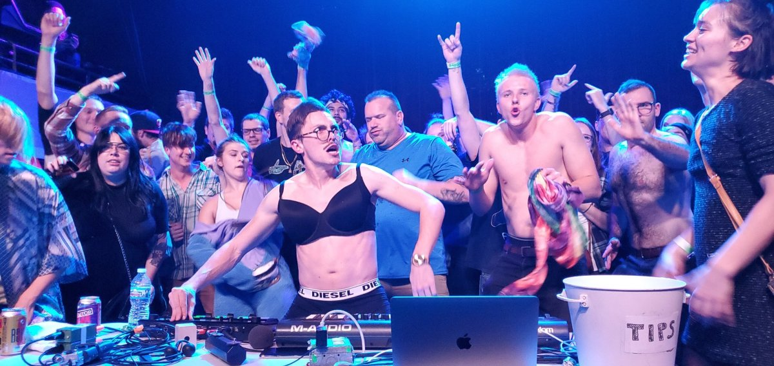
Spontaneity Manifested (Cont).
"While his art may seem crude on the surface, at its bedrock are togetherness and freedom of expression—two of the most important values not only of musicians, but also humans" (Heffler, 21).
Freedom of expression is as important to Marc as it would be to any other person in his shoes, but it is the way in which he does it that defines him.
The loop station is essentially an extension of his mind, as his years of training and beliefs manifest themselves through unrehearsed song.

Slide 9
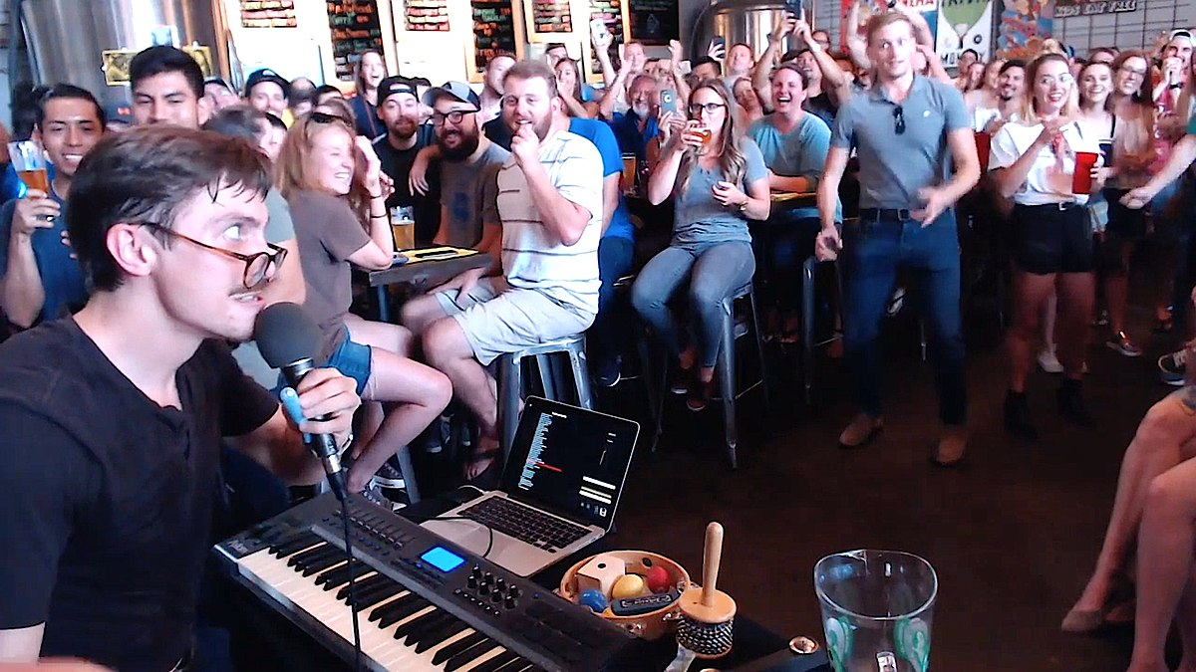
Live Art
The loop station makes for better live performances, as he relies on the awestruck audience to give their full attention to him as he creates his loops.
A profile article for Vulture.com by Nichole Perkins describes this concept beautifully: "People pay to see Rebillet live and in person. In the pandemic year alone, after national restrictions eased, he performed a sold-out drive-in tour" (3).
And tour he does, as Marc Rebillet has done countless, starting in his hometown of Dallas, Texas where he would play at a local brewery.

Slide 10
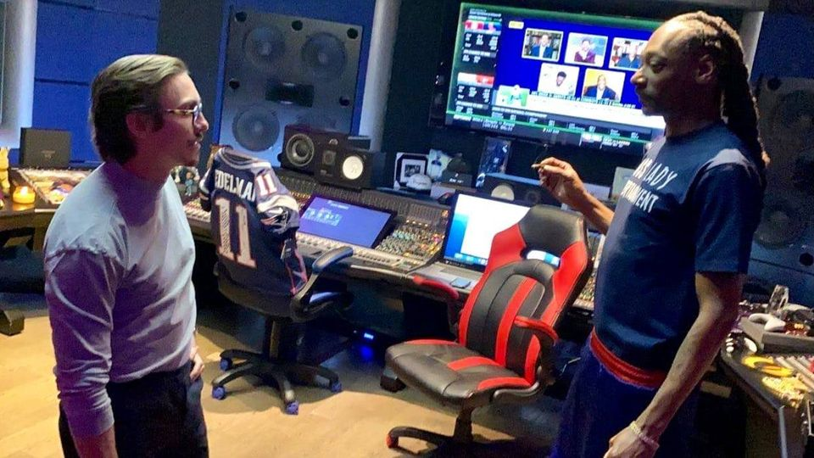
A Celebrity's Favorite Celebrity
Nowadays Marc is focusing on his latest tour "Third Dose," and in an article for thissongissick.com supposedly he is working on his very first studio album in which "...Marc has worked with Flying Lotus, and most recently, Snoop Dogg" (BG, 1).

Slide 11
A Celebrity's Favorite Celebrity (Cont).
On the topic of his Third Dose tour, Marc is known for advocating for COVID vaccination, such as in his song "Vaccinated Attitude," and it's his clear political standpoints that polarized him from any other generic artist.
While this may be a turn off to some older fans, his bravery to stand up for his beliefs certainly helped keep him in the spotlight.
Yet, it's his lack of fear and remorse, or more suitably his unapologetic nature that skyrocketed him and his loop station into an overnight success.
He even played at Lollapalooza this year.

Slide 12
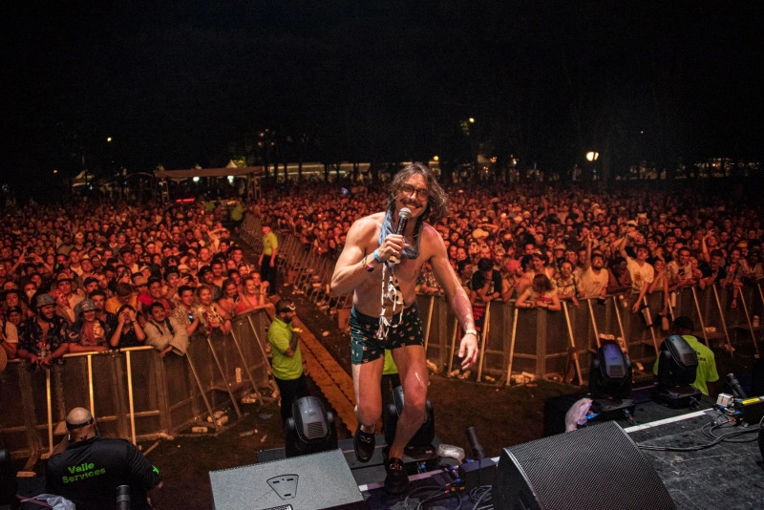


Slide 13
Looking To The Future
Marc knows that he can't keep making hundreds of songs every month if he wants to remain successful and plans to collaborate with other artists to make his place in the music industry concrete.
Whether his loop machine comes with him in that endeavor is unknown, but if he brings the same creative spontaneity to his future, then the tech will no longer matter.

Slide 14
Questions To Consider
Why is spontaneity important to artists these days?
Marc's fame took off over the pandemic, if it weren't for COVID, do you think he would still be where he is today?
What are your thoughts on artists creating music on the spot, as opposed to rehearsing and writing?
Any questions for me?

Slide 15
Sources
Bg, Reid. “Snoop Dogg & Marc Rebillet Are Working On New Music Together.” This Song Is Sick, 14 Oct. 2020, thissongissick.com/post/snoop-daddy.
Heffler, Jason. “The Curious Case of Marc Rebillet: How ‘Loop Daddy’ Is Making Absurdity Cool Again.” EDM.Com - The Latest Electronic Dance Music News, Reviews & Artists, 24 Dec. 2020, edm.com/features/marc-rebillet-interview.
“HOW TO FUNK IN TWO MINUTES.” YouTube, 9 Jan. 2020, www.youtube.com/watch?v=3vBwRfQbXkg.
Madden, Emma. “The History of the Loop Pedal in 7 Songs.” Red Bull, 2 July 2021, www.redbull.com/us-en/history-of-loop-pedal-in-seven-songs.
Perkins, Nichole. “They Call Him Loop Daddy.” Vulture, 17 Aug. 2021, www.vulture.com/article/marc-rebillet-third-dose.html.

