Slide 1


Project 5
SJU
Saint Joseph’s University
CSC685
Advance
Machine
Learning

Slide 2

Team I
SJU
Saint Joseph’s University
Ahmad Alshawaf
Sothey Sean

Slide 3
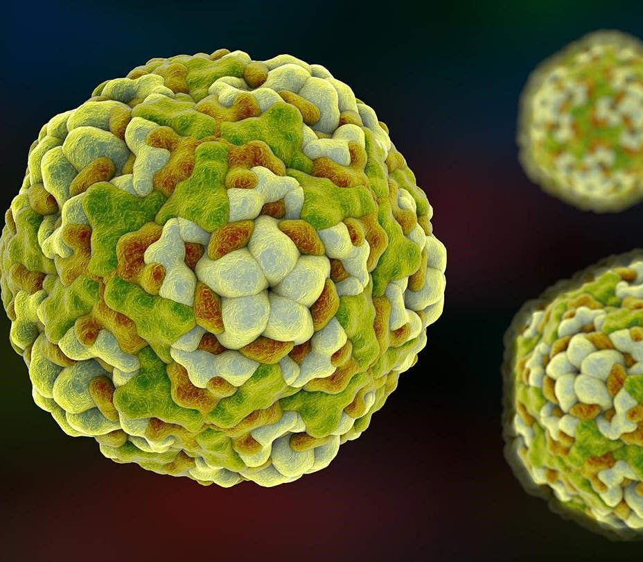
Diabetes Patients Classification Learning
Management of hyperglycemia in hospitalized patients has a significant bearing on outcome, in terms of both morbidity and mortality. However, there are few national assessments of diabetes care during hospitalization which could serve as a baseline for change. This analysis of a large clinical database (74 million unique encounters corresponding to 17 million unique patients) was undertaken to provide such an assessment and to find future directions which might lead to improvements in patient safety. Almost 70,000 inpatient diabetes encounters were identified with sufficient detail for analysis.
In this assignment, the learning classifier RandomForest and SVM will be used to classify the patients who need diabetes medication and readmitted to hospitals. Also, GridSearchCV will be used to find the best hyperparameters for each model. These best hyperparameters will be applied to both models to experiment different number of features of patients to see the effectiveness of the learning.

Slide 4



The Tools used
Google Colab
Python
GitHub

Slide 5

Choosing a design
Sean’s design
Sean’s design
Ahmad’s design
Ahmad’s design is to combine the ‘diabetesMed’ and ‘readmitted’ columns and use them as the target (label)
Sean’s design is the data will be separated to two sets. The first set is the ‘diabetesMed’ is the target without the ‘readmitted’. The second set is the readmitted’ is the target but include the ‘diabetesMed’ as a feature.

Slide 6

The project’s steps
Setup
Data Scrubbing
Loading Data
Exploring Data
Features Engineering
Data Visualization
Normalization
Choose X Features and Y Labels
Convert categorical value to numerical
Select the best 50 feature
Splitting The Data
Building The Models
Use GridSearchCV
Report RandomForest on different features
Report SVM on different features

Slide 7

The project code
GitHub is used to store the code.
https://github.com/ahshawaf/AML/blob/master/Project5_Team1_Ahmad_SeanV3.ipynb

Slide 8
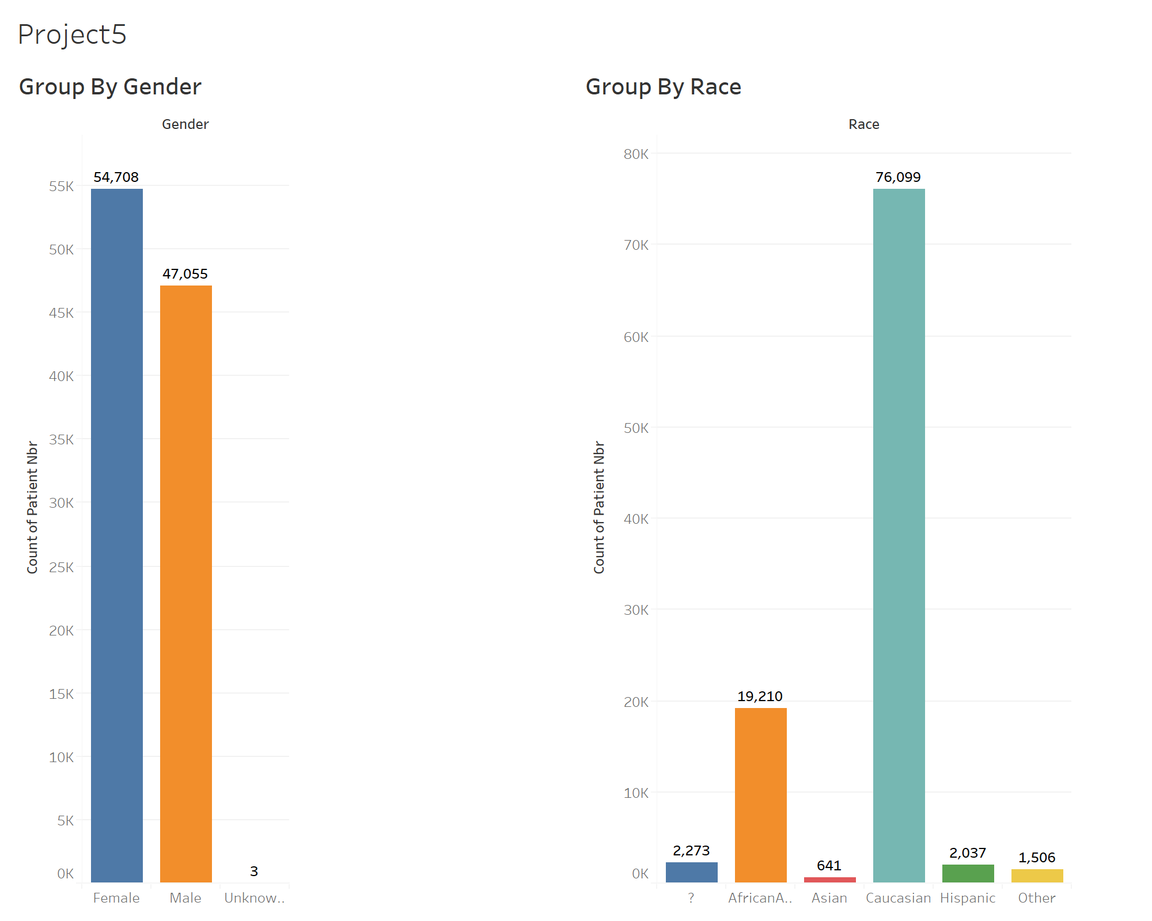
Data Visualization
The number of patients for female is higher than male.
Caucasian race has the highest number of patients.

Slide 9
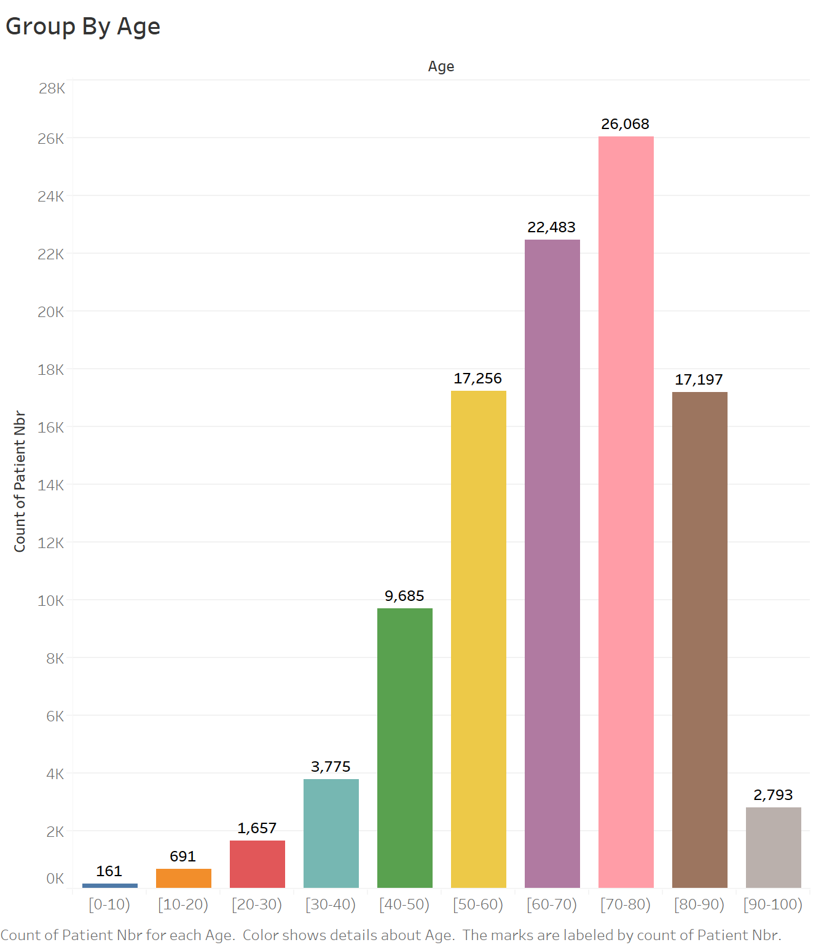
The number of patients for age between 70 to 80 is the highest, followed by the age between 60 to 70.

Slide 10
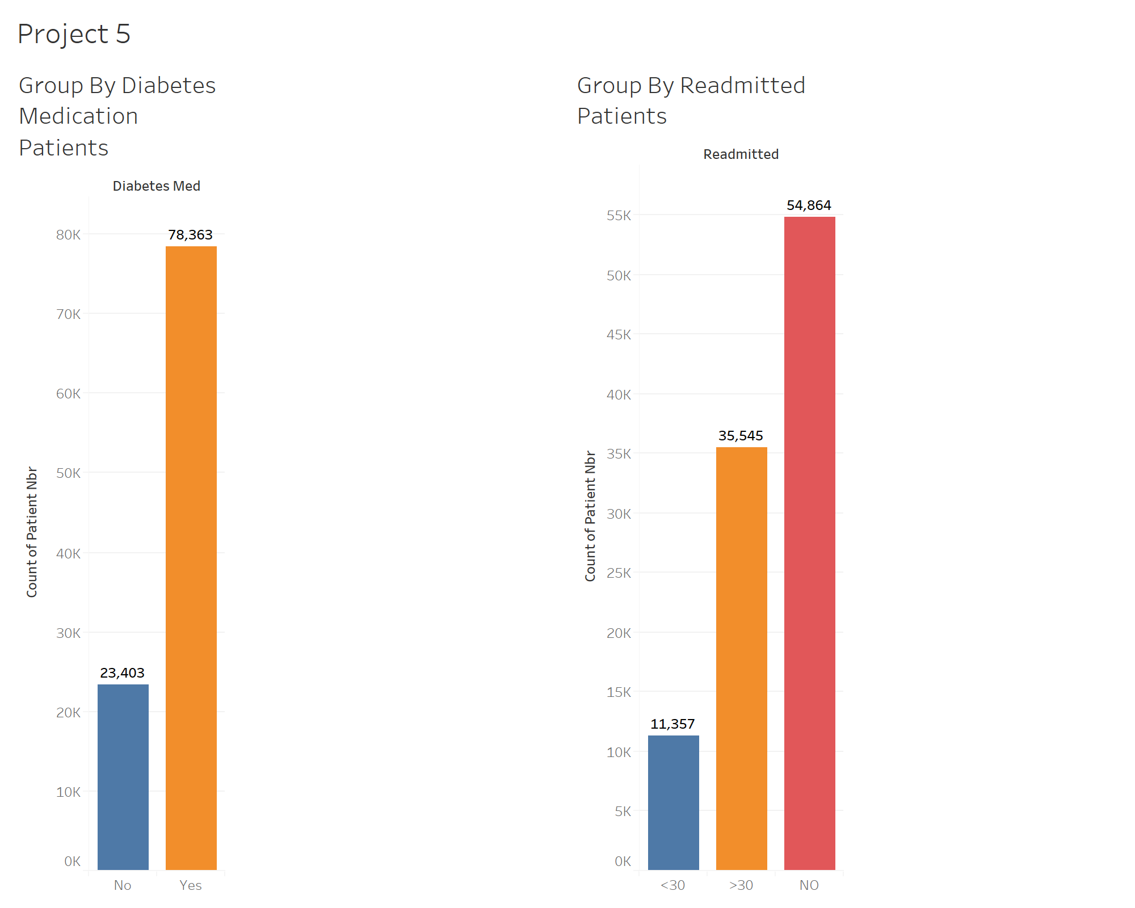
The number of patients who need diabetes medication is significant higher than who not need.
The number of patients who readmitted to hospital less than 30 days is the least, followed by who readmitted greater than 30 days.

Slide 11
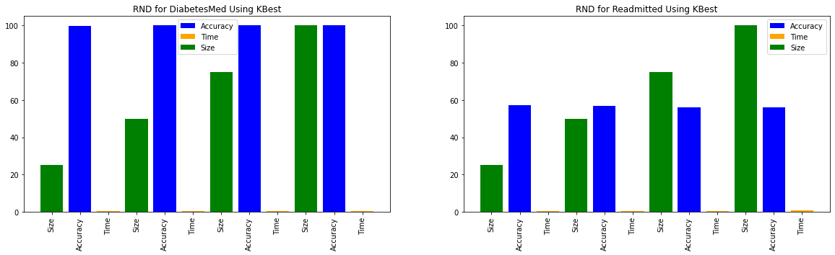
Classification Learning Report-RandomForest
It can classify the patients who need diabetes medication correctly up 99% with different sizes of features.
It does not classify well on patients who readmitted to hospital. The accuracy was about 58% only.

Slide 12
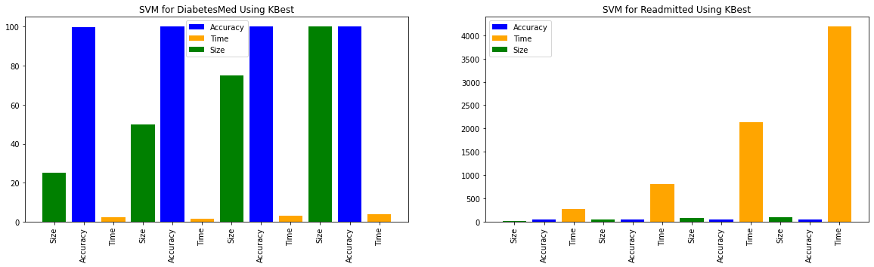
Classification Learning Report-SVM
It can classify the patients who need diabetes medication correctly up 99% with different sizes of features but take time longer than RF classifier.
It does not classify well on patients who readmitted to hospital. The accuracy was about 58% only, and it takes time extremely longer than RF classifier.

Slide 13
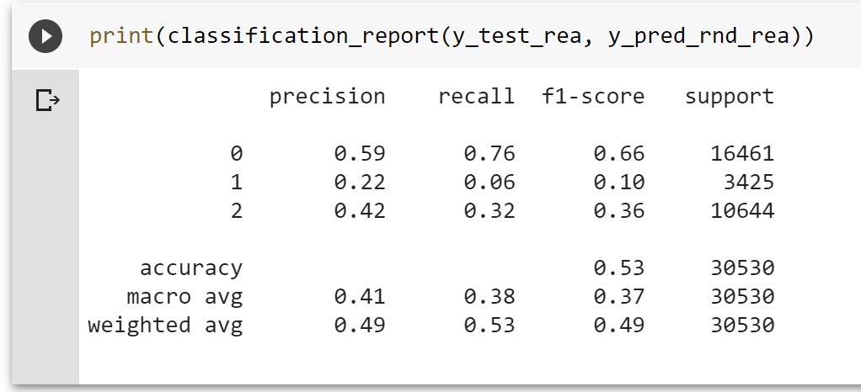
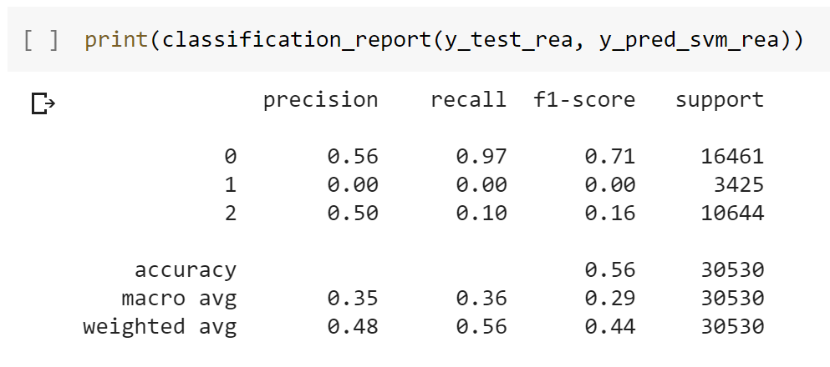
Summary and Conclusion
In this diabete patients dataset, many methods were used at the data cleansing section, especially at the feature engineering phase.
For 'diabetesMed' classification, accuracy produced by both models is same 99%, but SVM model learning time took very much longer than RandomForest.
For 'readmitted' classification, accuracy produced by RandomForest model is around 54% and SVM model is 57%, and once again SVM computation time is much longer. Let's assume time is not matter, which classifier predict better if both produced same accuracies? By looking at the average F1 score, RandomForest F1=0.37 > SVM F1=0.29, this mean RandomForest model predict better in term of precision and recall.
GridSearchCV was used for tuning hyperparameters for both classifiers; unfortunately, both models still not giving a better performance on 'readmitted' patients classification. They both produced same accuracy 57% this time.
Overall, RandomForest is considered for best classifier for this dataset. Trying to get some more new information (features) from patients may be helpful for improving the classification of 'readmitted' patients.

Slide 14

Thank You !

