Slide 1
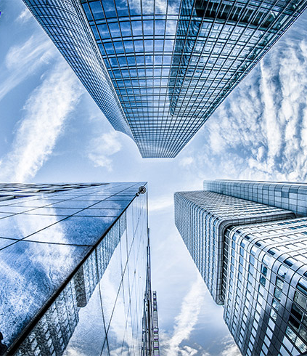
Graduate Research CSC791
SJU
Saint Joseph’s University
Project
Diabetic Retinopathy Detection
Image Classification-Machine Learning

Slide 2
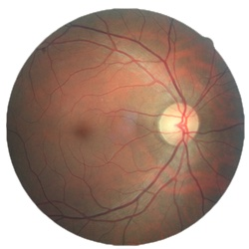
Overview
Diabetic Retinopathy (DR) is the leading eye disease to cause of blindness in the working-age population and is associated with long-standing diabetes.
The vision impairment can be slowed or averted if DR is detected in time. However, this disease often shows very few symptoms until it is too late to provide effective treatment. Currently, detecting DR is a time-consuming manual process. It requires a trained clinician to examine and evaluate digital color fundus photographs of the retina. It usually takes 1-2 days for the results which leads to delayed treatment.
Clinicians can identify DR by the presence of lesions associated with the vascular abnormalities caused by the disease. While this approach is effective, but there’re not enough clinicians and equipment to meet the high demand due to the growth of diabetes patients.
The need for a comprehensive and automated method of DR screening has long been recognized, and previous efforts have made good progress using image classification, pattern recognition, and machine learning. With color fundus photography as input, the goal is to build an automated detection system to the limit of what is possible – ideally resulting in models with realistic clinical potential that can improve DR detection. This process requires many machine learning tasks and techniques to build a good classifier.

Slide 3

Methodology
There are many classifiers that can be used for images classification task, such as SVM, RandomForest, KNN, CNN, etc. For this research project, the CNN model (with deep learning techniques) will be used and tested to elevate accuracies.
Project Steps:
Data Selection
Build a basic deep CNN model
Optimize the basic model with hyper parameters tuning
Use transfer learning to experiment Keras model: Xception and InceptionV3
Experiment additional model from google teachablemachine
Deploy end-to-end machine learning application with the best finding model

Slide 4

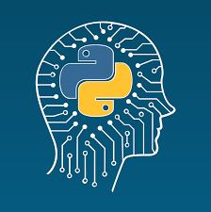


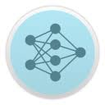
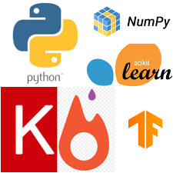
Tools
Google Colab
Python
Excel
GitHub
Netron
Machine Learning Libraries

Slide 5
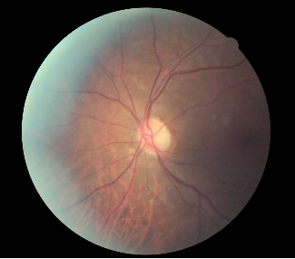
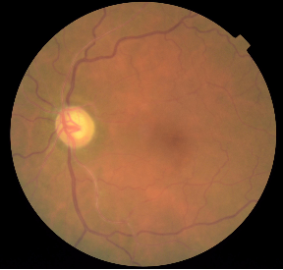
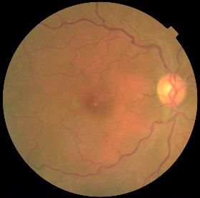
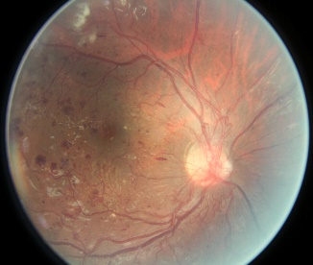
Dataset Description
The datasets are high-resolution retina images taken under a variety of imaging conditions. Images are labeled with a subject ID and left or right (e.g., 1_left.jpeg is left eye of patient id 1).
Each image has been rated by clinicians on a scale 0 to 4 according to the presence of diabetic retinopathy.:
0 - No DR 1 - Mild 2 - Moderate 3 - Severe 4 - Proliferative DR
The images are in RGB form with high resolution JPEG format and has total size 82 GB.
10_left, score: 0
35_left, score: 1
25_right, score: 2
16_left, score: 4

Slide 6
Issue: Imbalanced Data
The dataset contains 35,126 images with 5 classes
Almost 74% of the images represent class 0 (NO DR), followed by “Moderate” at 15%, “Mild” at 7%, and “Severe” and “Proliferative DR” together at 4%.

Slide 7
Solution: Create New Balanced Dataset
First, extract the train label from CSV file for 500 on each level (0, 1, 2, 3, 4) totaling to 2,500 images.
Then, use the TEXTJOIN function in excel program to combine all 2,500 rows into one cell.
Now that all the image filenames are in one line, copy and paste the image filenames in search tab in dataset folder.
Finally, we have a nice balanced dataset. Then, we use the same procedure to create and test the CNN model.

Slide 8
Classifiers Information
Model | Size | Parameter | Depth
Basic Deep CNN | 2.5 MB | 15,245,541 | 5
Xception | 84.2 MB | 21,980,525 | 126
InceptionV3 | 88.2 MB | 22,921,829 | 159
TeachableMachine | 2.35 MB | 538,808 | 2

Slide 9
Result

Slide 10
Result

Slide 11
Summary and Conclusion
Learning Curve
High Ram and GPU machine is a need for this image classification task despite only about 7% (2,500 images) of the whole dataset was used.
In order to get a high accuracy in prediction, balancing dataset was the top priority tasks. As a result, the classifier has improved significantly. It can predict images in all classes.
Overfitting method was used to elevate the test accuracy, and it has also helped the model to work well when more new data is added.
Among the 4 CNN models, InceptionV3 has the highest test accuracy up to 53% and highest F1 score for each class. Furthermore, it has the best form of the learning curve.
The most voted notebook of this project in Kaggle used the InceptionV3 as well and has produced test accuracy up to 60%. However, there were 2 classes missing from the prediction and undistributed F1 score. Therefore, I believe that my model works better and is more simplified.

Slide 12
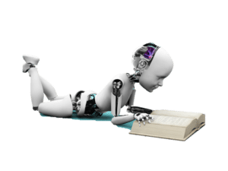
Python Notebook
Basic Model
Xception Model
InceptionV3 Model
TeachableMachine Model
Dataset
Diabetic Retinopathy
Keras Model
Most Voted Kaggle Notebook
Reference

Slide 13
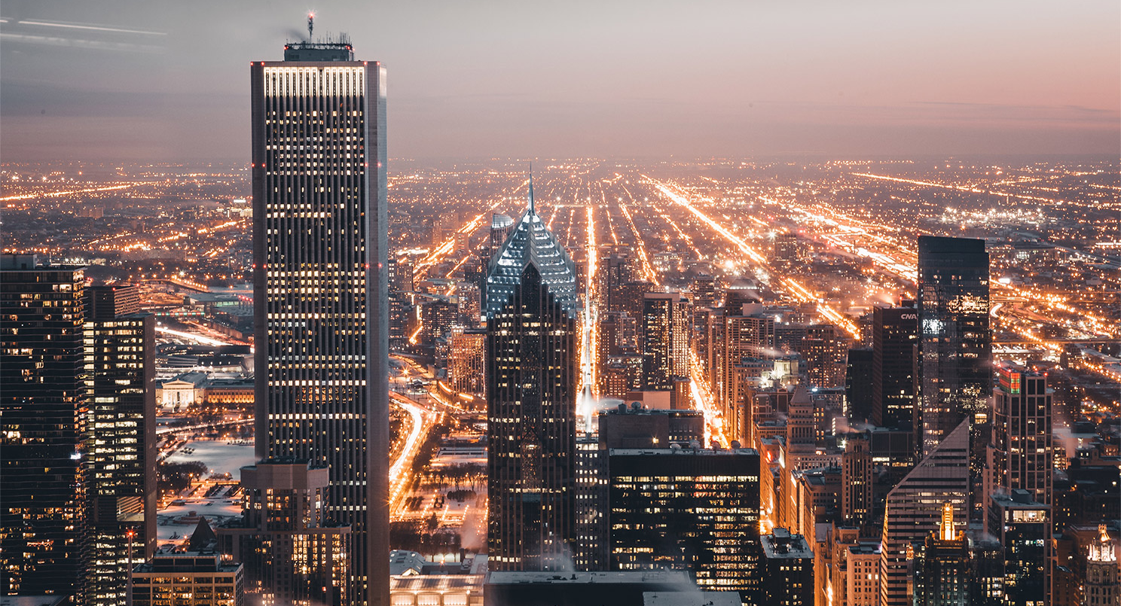
Thank You!

