Slide 1

Note: The data and information in this document is reflective of a hypothetical situation and client. This document is to be used for KPMG Virtual Internship purposes only.
Sprocket Central Pty Ltd
Data analytics approach
[Division Name] - [Engagement Manager], [Senior Consultant], [Junior Consultant]

Slide 2
Note: The data and information in this document is reflective of a hypothetical situation and client. This document is to be used for KPMG Virtual Internship purposes only.
Agenda
Introduction
Data Exploration
Model Development
Interpretation

Slide 3
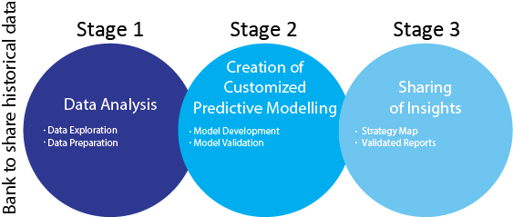
Note: The data and information in this document is reflective of a hypothetical situation and client. This document is to be used for KPMG Virtual Internship purposes only.
Introduction
Place headline insight or information here. This should be the most important point for this slide.
In this presentation, there are three main components will be discussed and presented.
Data Exploration
Model Development
Interpretation

Slide 4
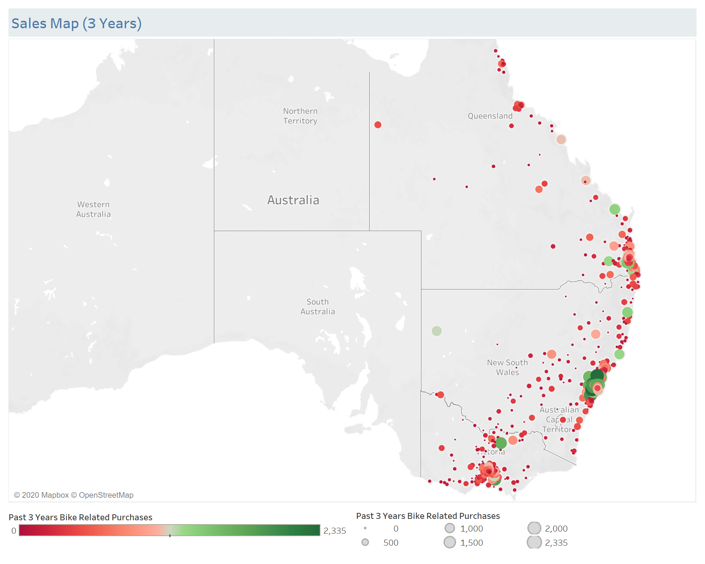
Note: The data and information in this document is reflective of a hypothetical situation and client. This document is to be used for KPMG Virtual Internship purposes only.
Data Exploration
Sales Map Past 3 Years
In the past 3 years, the main business only was made by customers in New South Wales, Victoria and Queensland state. By looking at those area, it can be seen that bikes were very popular in the tourist area which close the seaside. Those bikes could be used for renting to tourists as well. This could lead us a sense of which region shall be targeted.

Slide 5
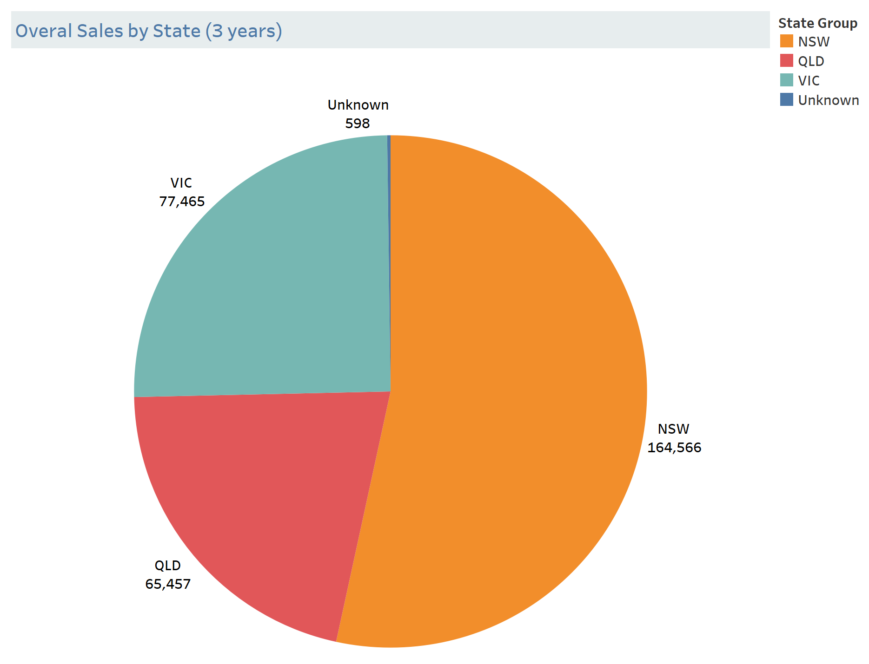
Note: The data and information in this document is reflective of a hypothetical situation and client. This document is to be used for KPMG Virtual Internship purposes only.
Data Exploration
Sales By State Past 3 Years
In the past 3 years, the highest bike sales 164,566 were from New South Wales state, following by Victoria 77,465, and Queensland 65,457. As expected, NWS is the most popular and visited tourist place, especially Sydney Opera House.

Slide 6
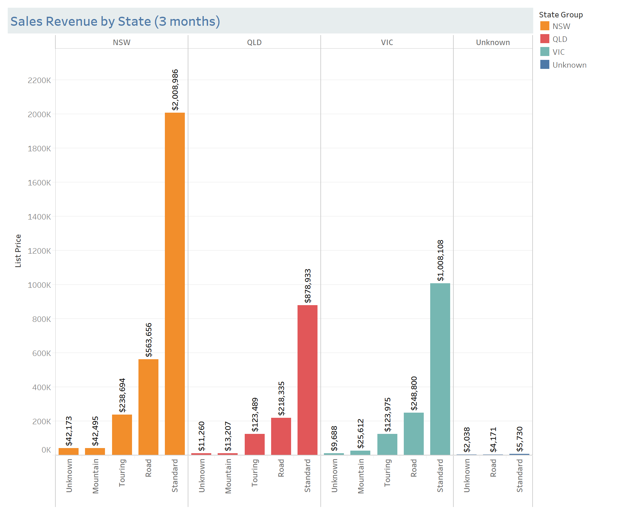
Note: The data and information in this document is reflective of a hypothetical situation and client. This document is to be used for KPMG Virtual Internship purposes only.
Data Exploration
Sales Revenue By State
Past 3 Months
In the past 3 months, the biggest sales revenue $2,896,004 were from New South Wales state, following by Victoria $1,416,184, and Queensland $1,245,224. Therefore, NWS has been always the hottest target for the last 3 years. In addition, the standard bike was the highest demand.

Slide 7
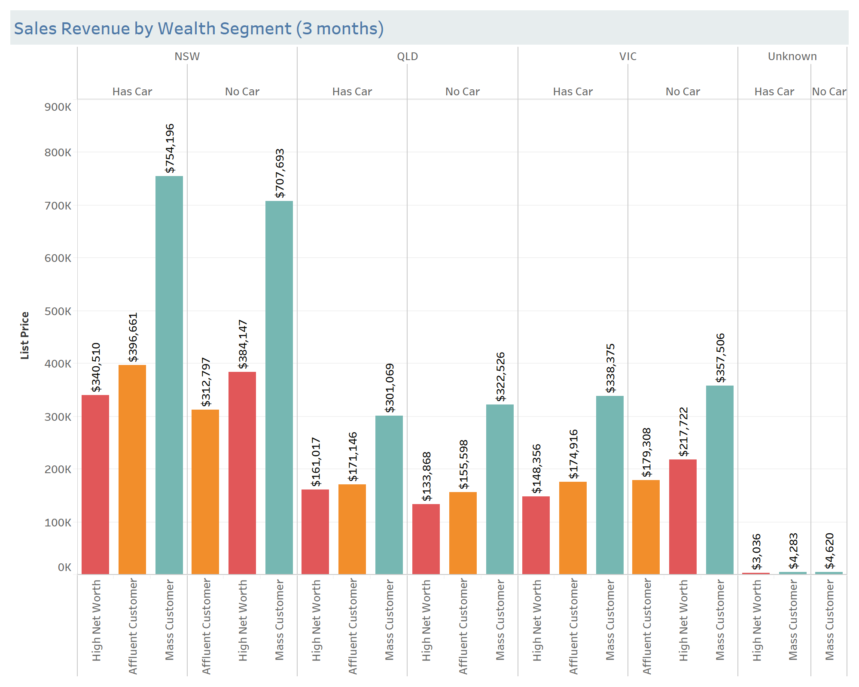
Note: The data and information in this document is reflective of a hypothetical situation and client. This document is to be used for KPMG Virtual Internship purposes only.
Data Exploration
Sales Revenue By Wealth Segment Past 3 Months
In the past 3 months, the highest sales revenue were from the mass worth level customers in all three states total was $2,790,267, while the high net and affluent worth had a very similar amount, $1.4 million roughly.

Slide 8
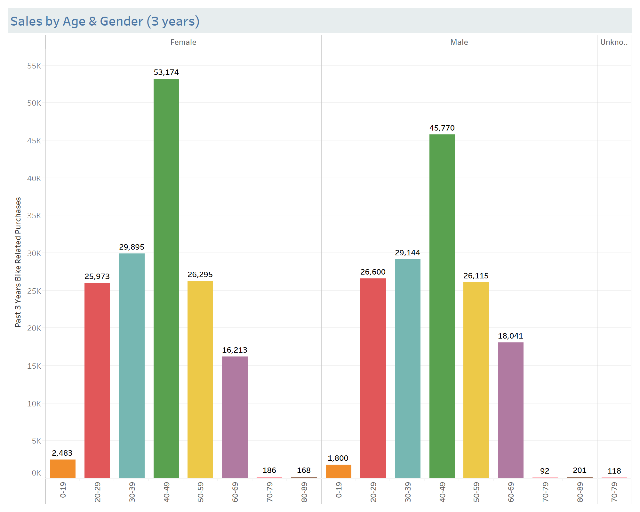
Note: The data and information in this document is reflective of a hypothetical situation and client. This document is to be used for KPMG Virtual Internship purposes only.
Data Exploration
Sales By Age & Gender
Past 3 Years
In the past 3 years, 154,387 bikes were purchased by female customers while the male customers has purchased 147,763 bikes. Both female and male who age between 40 to 49 had highest purchase rate.

Slide 9
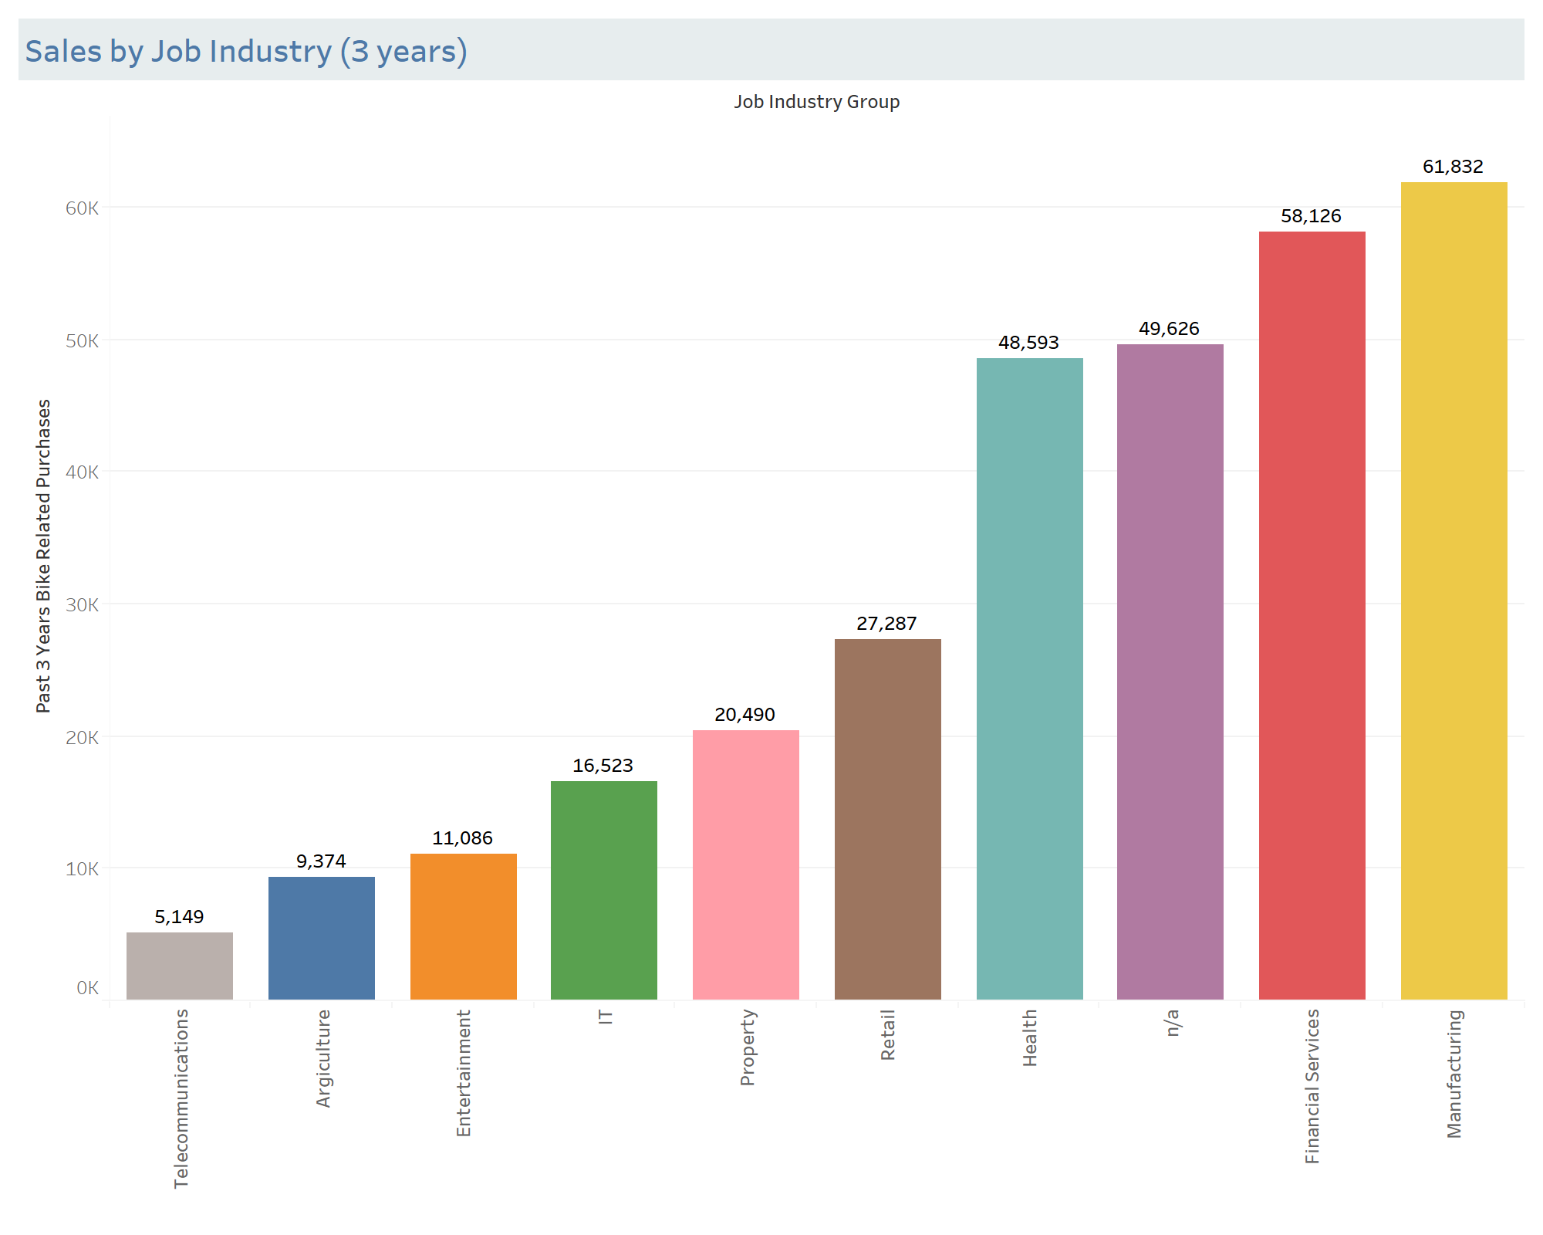
Note: The data and information in this document is reflective of a hypothetical situation and client. This document is to be used for KPMG Virtual Internship purposes only.
Data Exploration
Sales by Job Industry
Past 3 years
In the past 3 years, the customers who work manufacturing industry had the highest bike purchases 61,832, following by the customers who work in financial services 58,126, and the customers who work in telecommunications made the least purchases, 5,149 only.

Slide 10
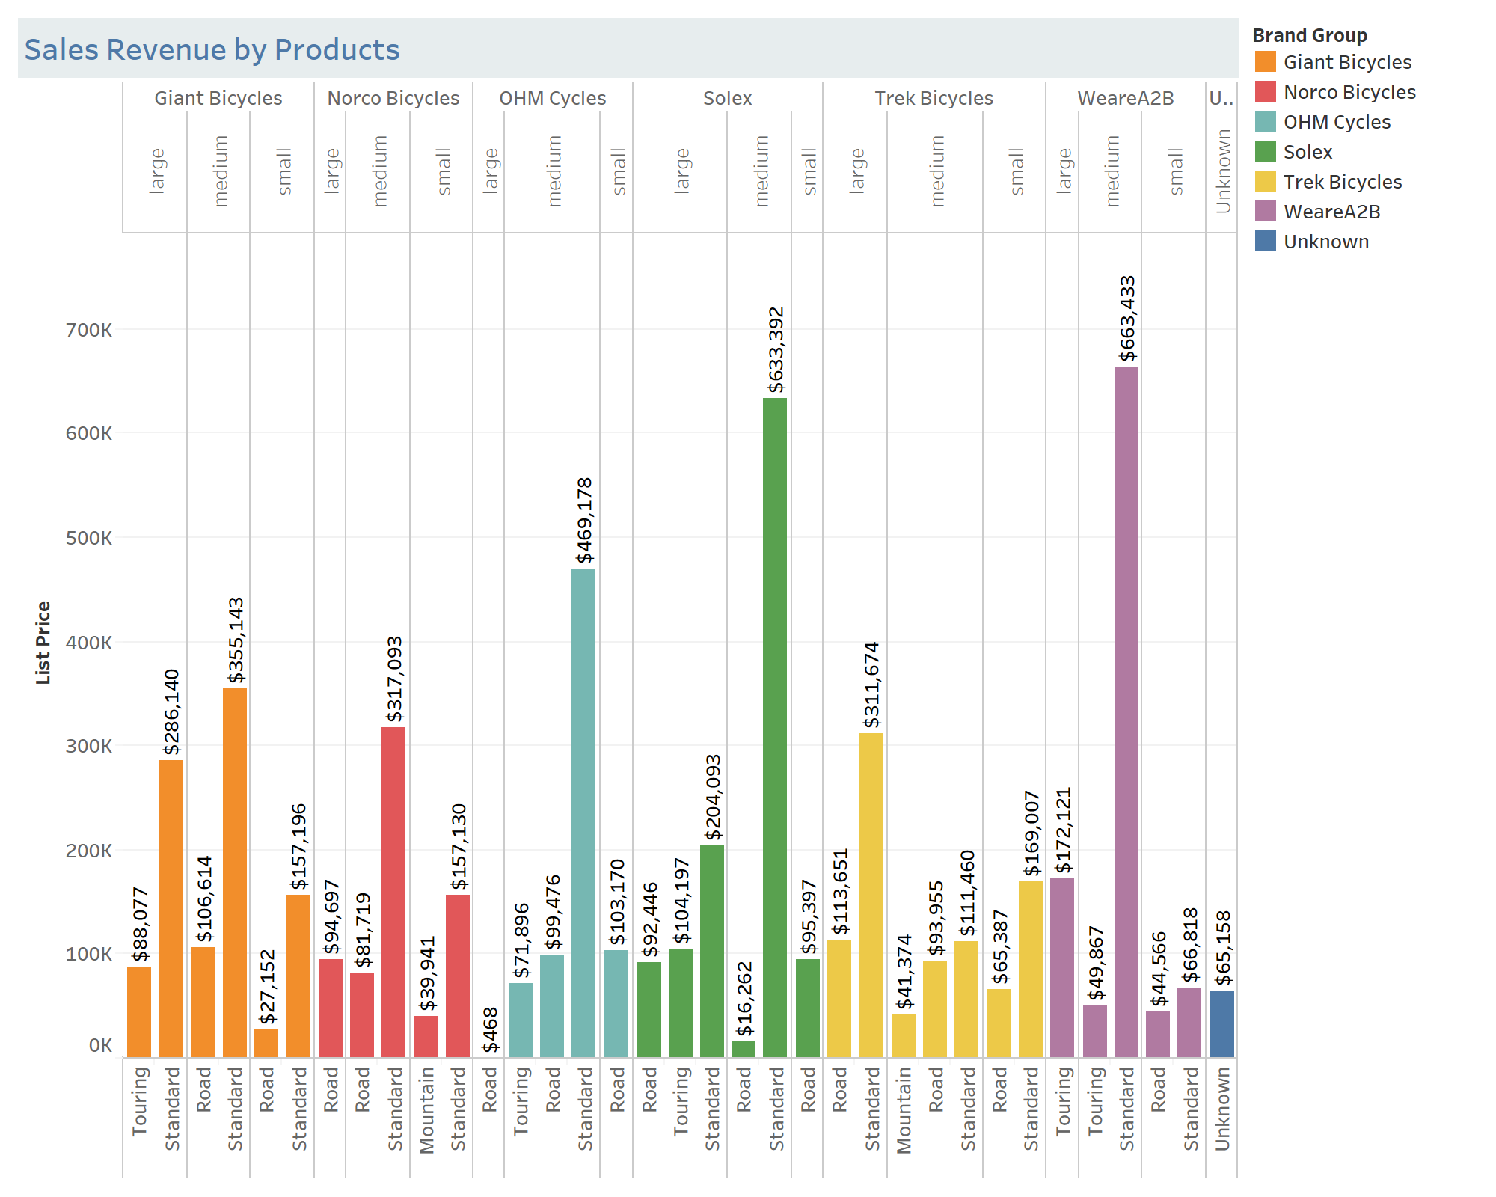
Note: The data and information in this document is reflective of a hypothetical situation and client. This document is to be used for KPMG Virtual Internship purposes only.
Data Exploration
Sales Revenue by Products
Past 3 months
The top 3 sales bikes:
1. Brand: WeareA2B
Size: medium $663,433
Type: Standard
2. Brand: Solex
Size: medium $663,392
Type: Standard
3. Brand: OHM Cycles
Size: medium $469,178
Type: Standard

Slide 11
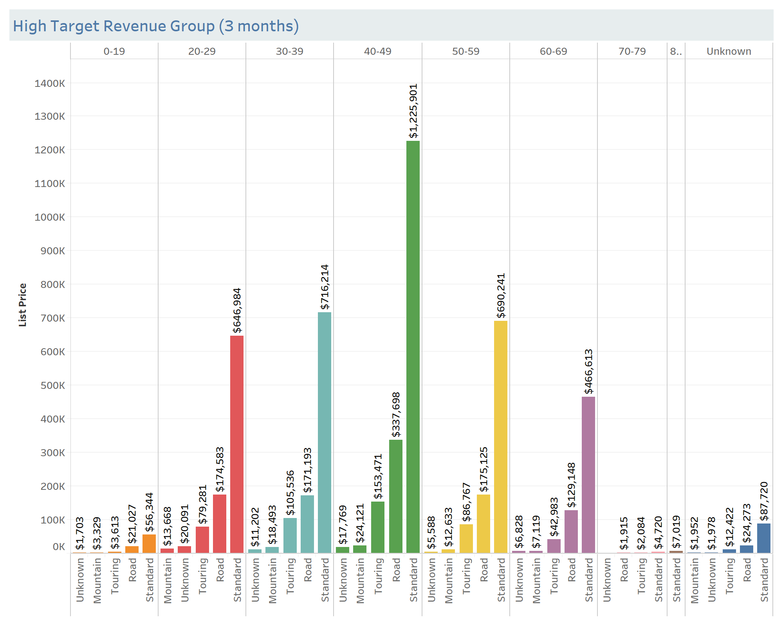
Note: The data and information in this document is reflective of a hypothetical situation and client. This document is to be used for KPMG Virtual Internship purposes only.
Model Development
High Target Sales (3 years)
& Revenue (3 months)
Based on the record of sales and sales revenue, the model should prioritize 3 main features of the targets as below.
Products: Standard type & medium size
Age: 40-49
Job Industry: Manufacturing and Finance Services

Slide 12
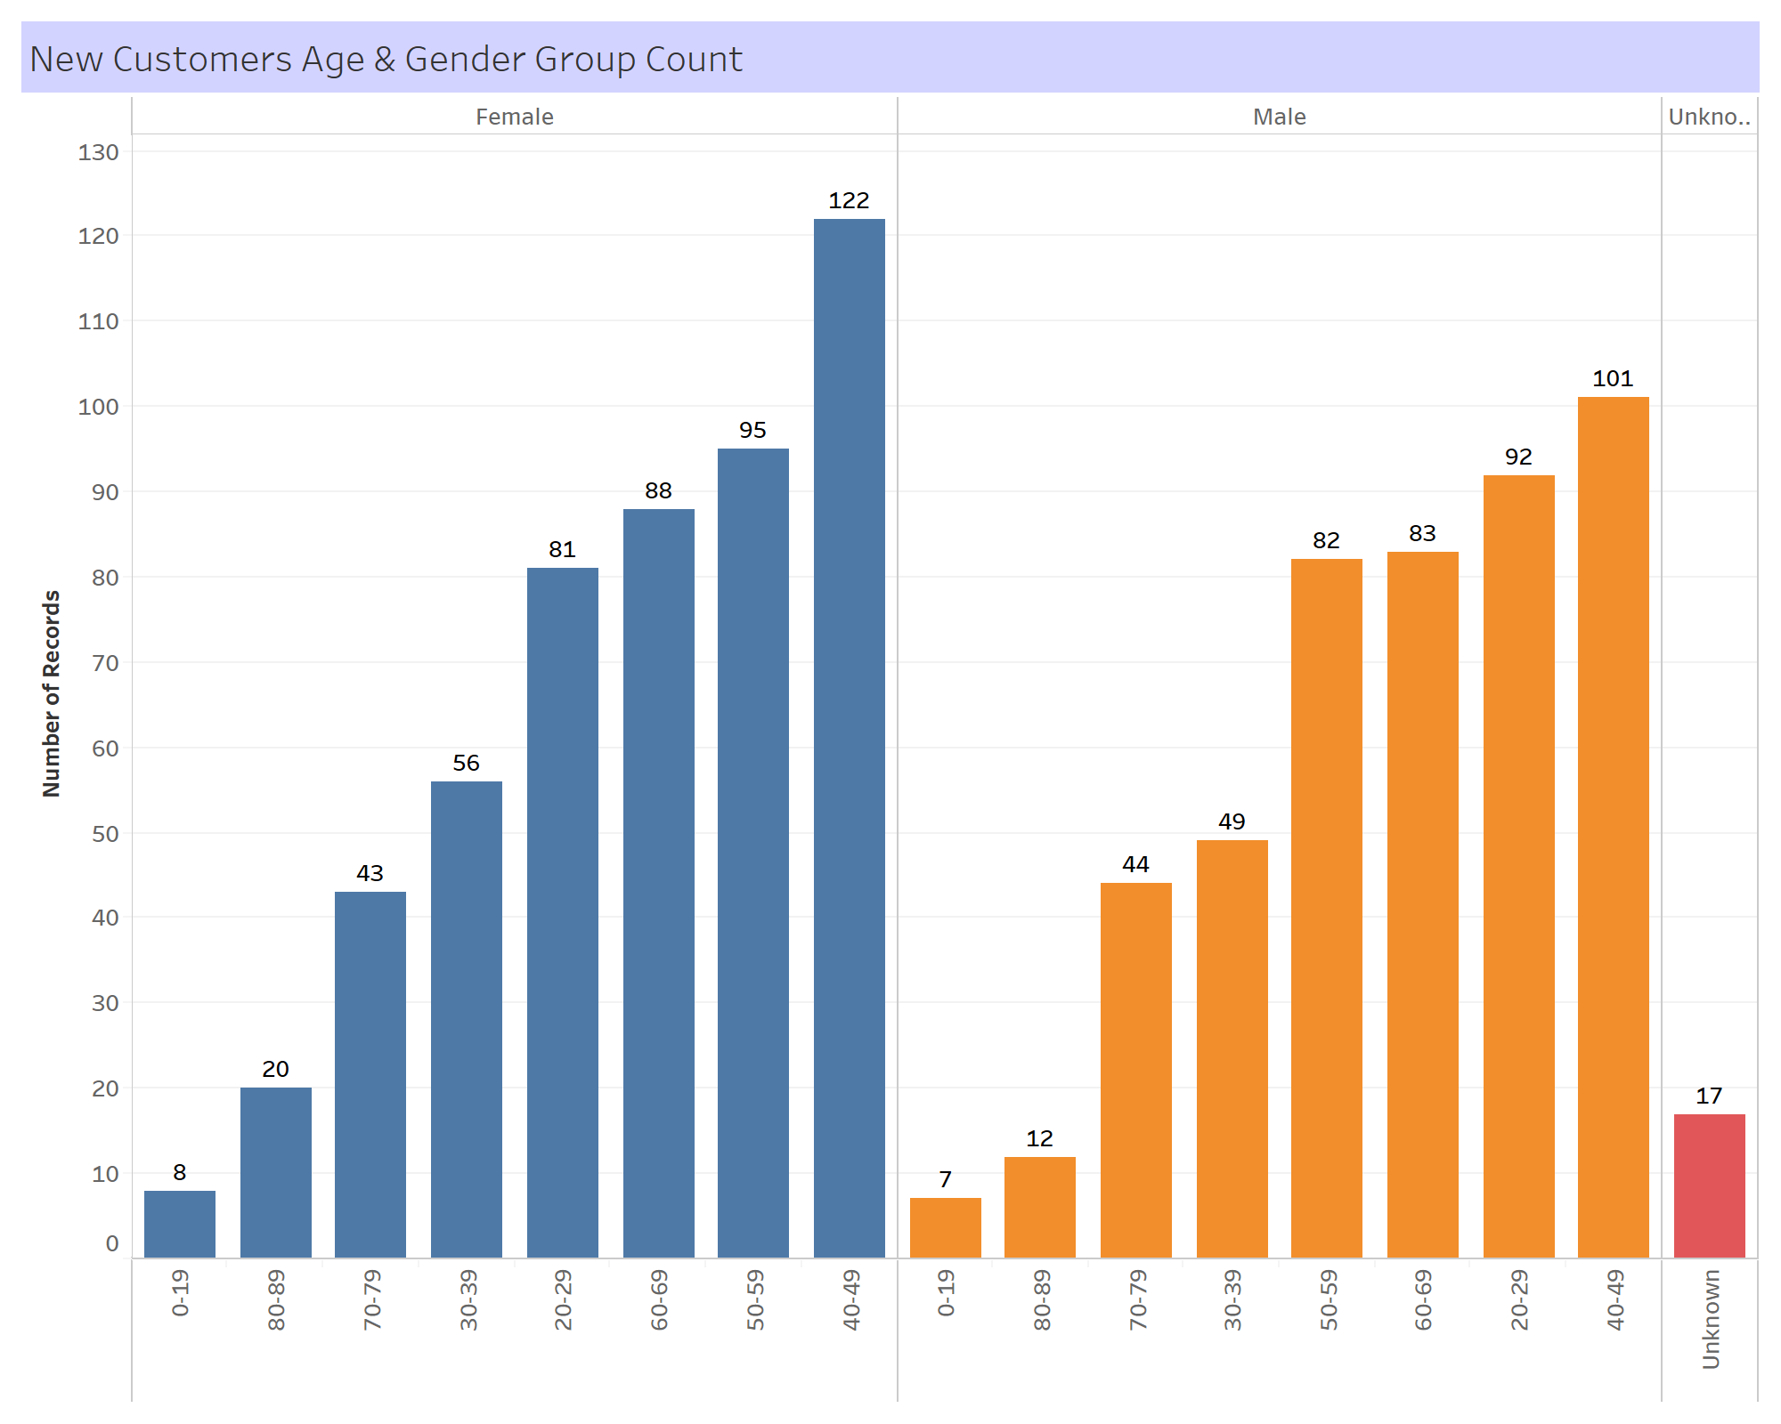
Note: The data and information in this document is reflective of a hypothetical situation and client. This document is to be used for KPMG Virtual Internship purposes only.
Interpretation On New Customers
New Customers Age
& Gender Group
The highest number of new customers are who age between 40 to 49, total 223, and this age is the most wanted target that means more high chance of purchasing bikes.

Slide 13
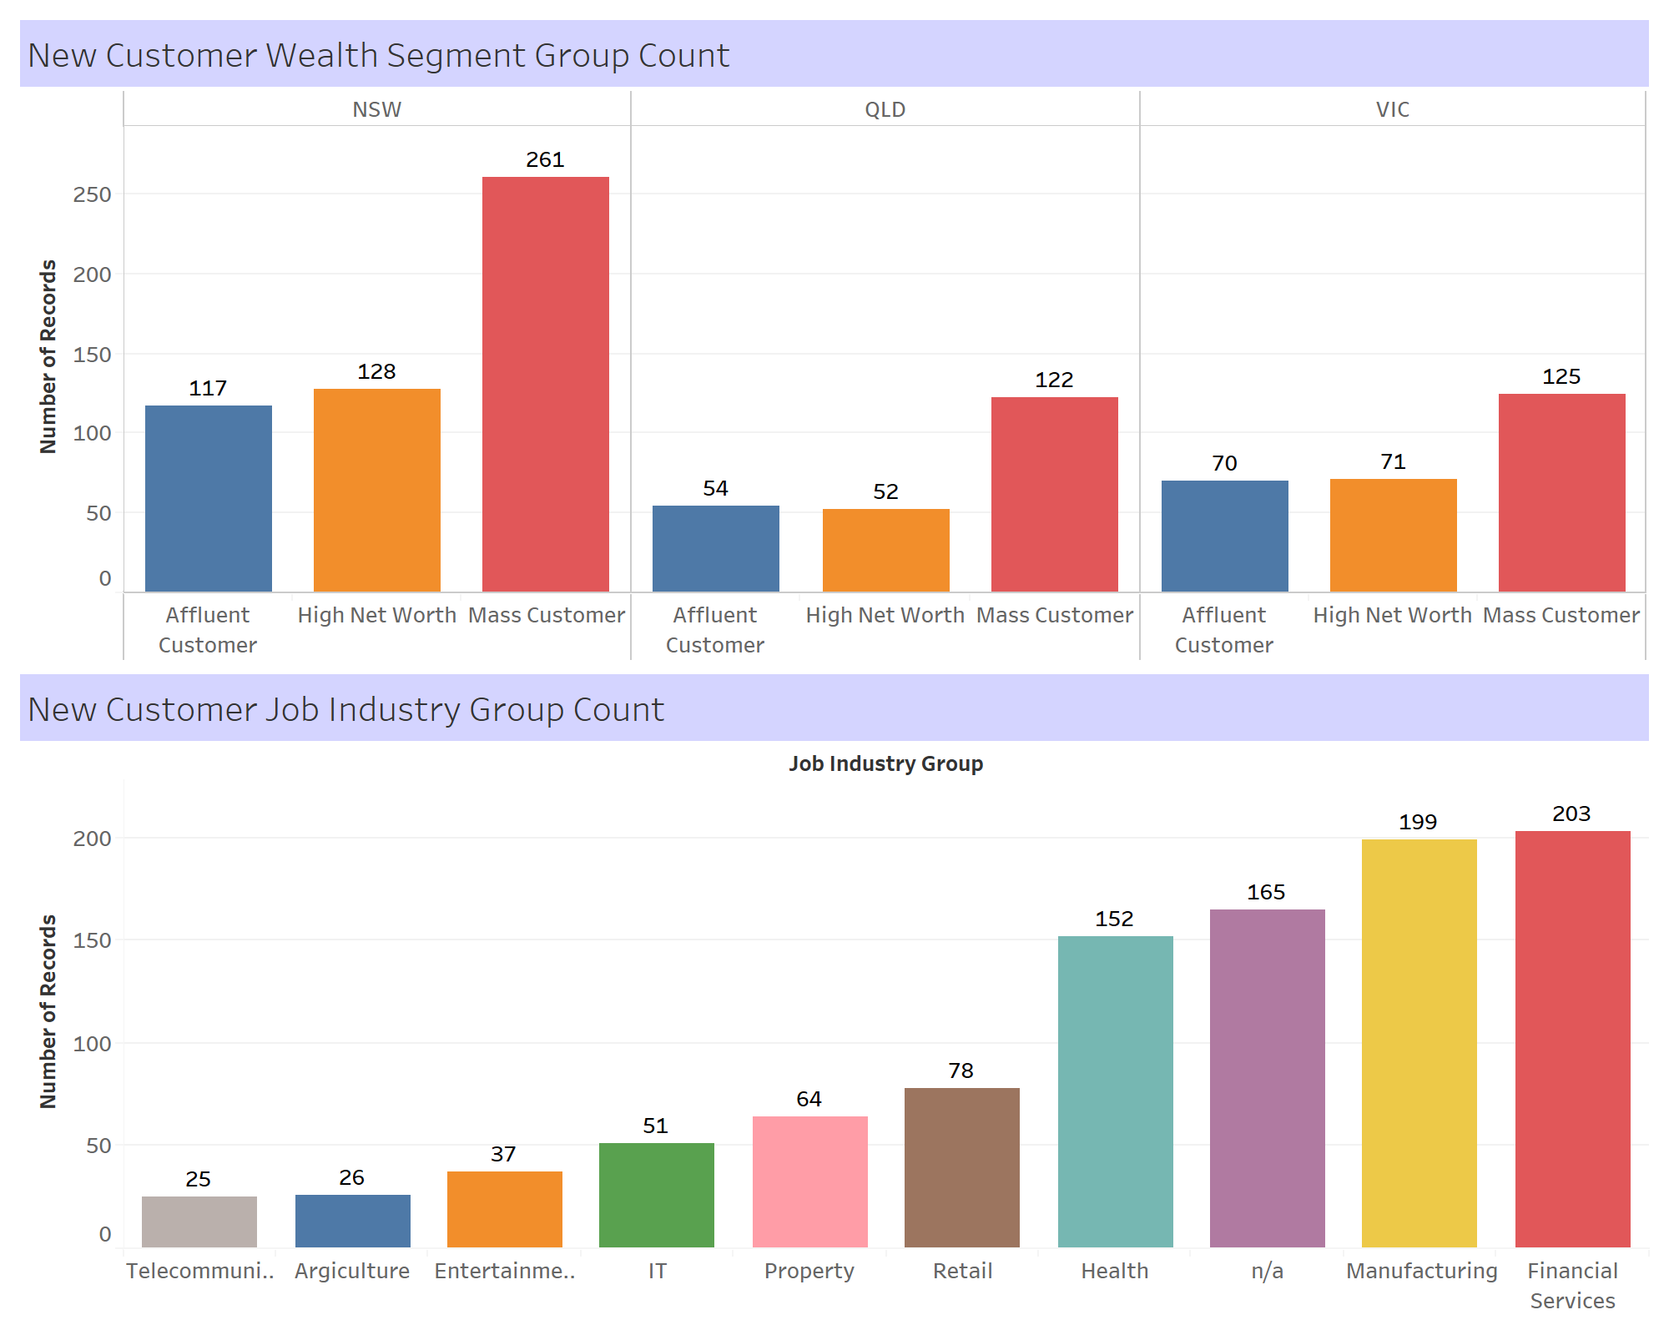
Note: The data and information in this document is reflective of a hypothetical situation and client. This document is to be used for KPMG Virtual Internship purposes only.
Interpretation On New Customers
New Customers Wealth Segment & Job Industry Group
The number of new customers who work in manufacturing and financial services is the highest, both total 402; and mass worth new customers has total 508. These numbers are also a nice lead for the targets.

Slide 14
Note: The data and information in this document is reflective of a hypothetical situation and client. This document is to be used for KPMG Virtual Internship purposes only.
Appendix

Slide 15
Note: The data and information in this document is reflective of a hypothetical situation and client. This document is to be used for KPMG Virtual Internship purposes only.
Appendix
https://github.com/seansothey/KPMG

