Slide 1

Note: The data and information in this document is reflective of a hypothetical situation and client. This document is to be used for KPMG Virtual Internship purposes only.
Sprocket Central Pty Ltd
Data Analytics Virtual Internship
SEAN, SOTHEY

Slide 2
Note: The data and information in this document is reflective of a hypothetical situation and client. This document is to be used for KPMG Virtual Internship purposes only.
Agenda
Introduction
Data Exploration
Model Development
Interpretation

Slide 3




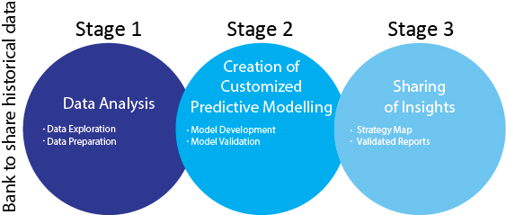
Note: The data and information in this document is reflective of a hypothetical situation and client. This document is to be used for KPMG Virtual Internship purposes only.
Introduction
Sales Analytics
In this presentation, there are three main components to be discussed and presented.
Data Exploration
Model Development
Interpretation
Tools: Tableau, Excel, Python,
and Machine Learning

Slide 4
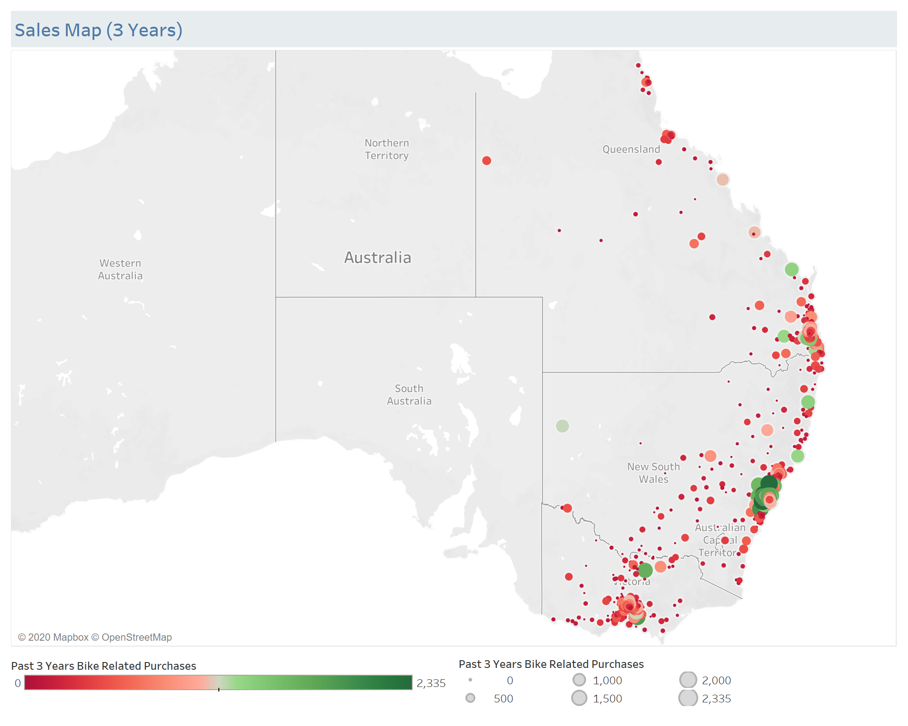
Note: The data and information in this document is reflective of a hypothetical situation and client. This document is to be used for KPMG Virtual Internship purposes only.
Data Exploration
Sales Map (3 Years)
In the past 3 years, the trend of the sales are made by customers in New South Wales, Victoria and Queensland states only. From this trend, it can be predicted that bikes are very popular in the tourist areas, especially by the seaside. Those bikes could be used for personal transportation, exercise, as well as business by renting them to tourists. This pattern can help us make decision on which regions shall be targeted.

Slide 5
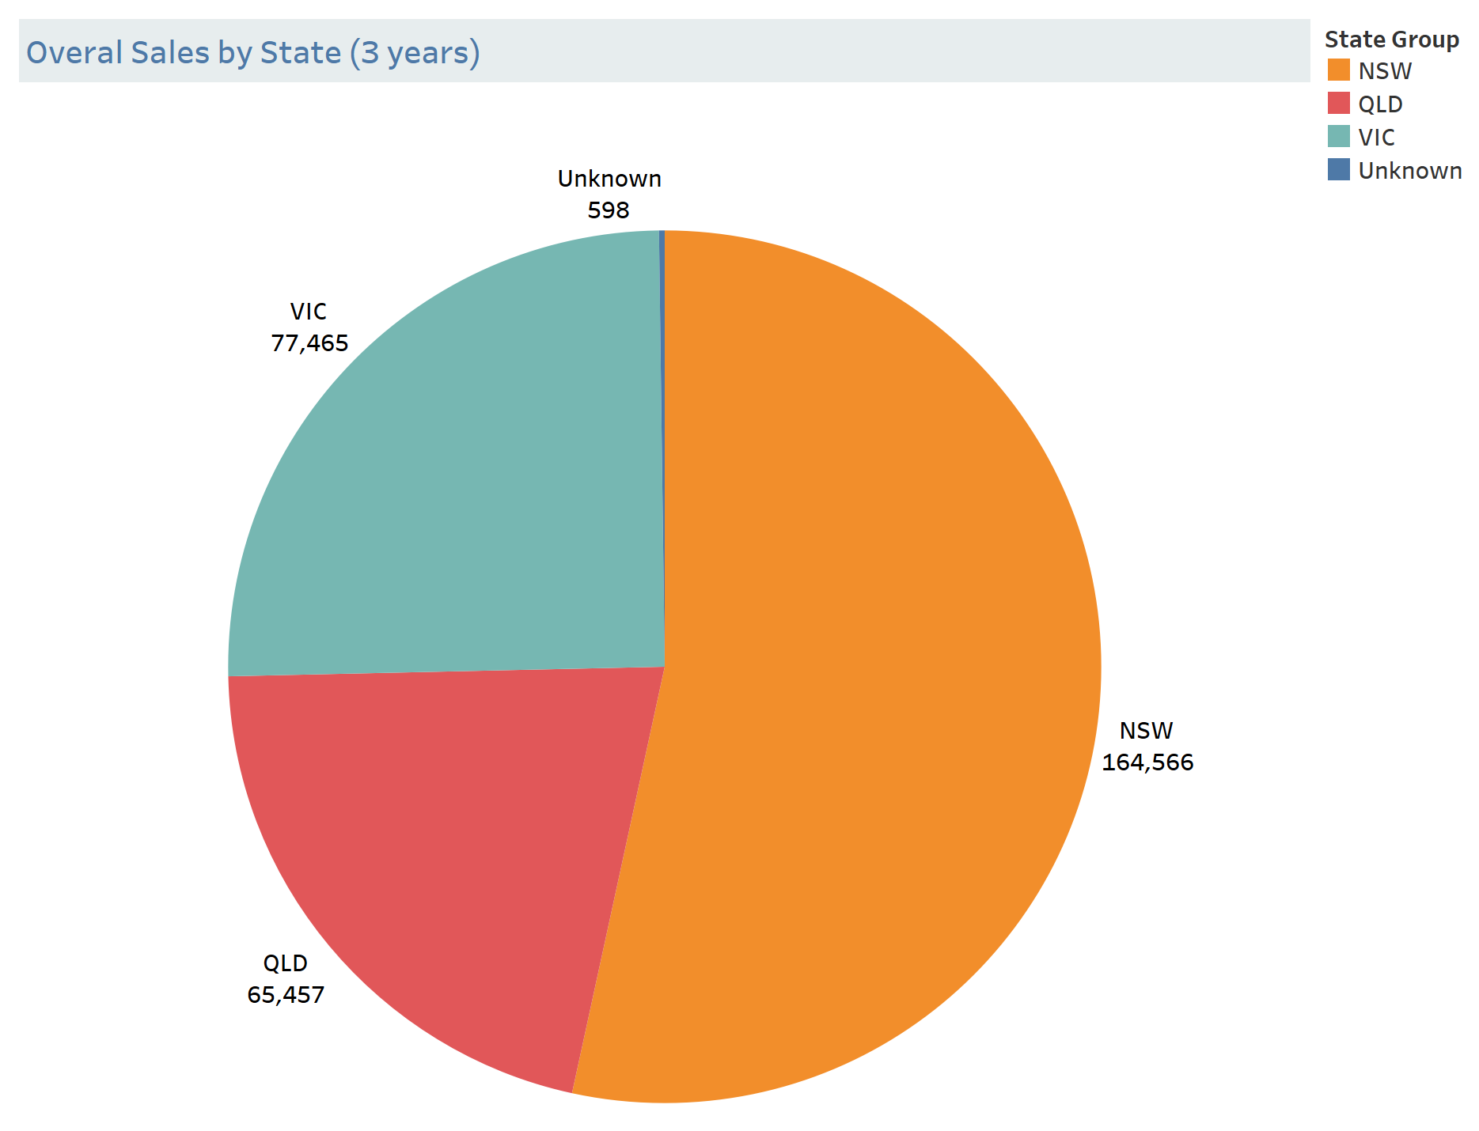
Note: The data and information in this document is reflective of a hypothetical situation and client. This document is to be used for KPMG Virtual Internship purposes only.
Data Exploration
Sales By State (3 Years)
The highest bike sales (164,566 units) were from New South Wales, followed by Victoria (77,465 units), and Queensland (65,457 units). As expected, NSW is the most popular place for tourists, where Sydney Opera House resides.

Slide 6
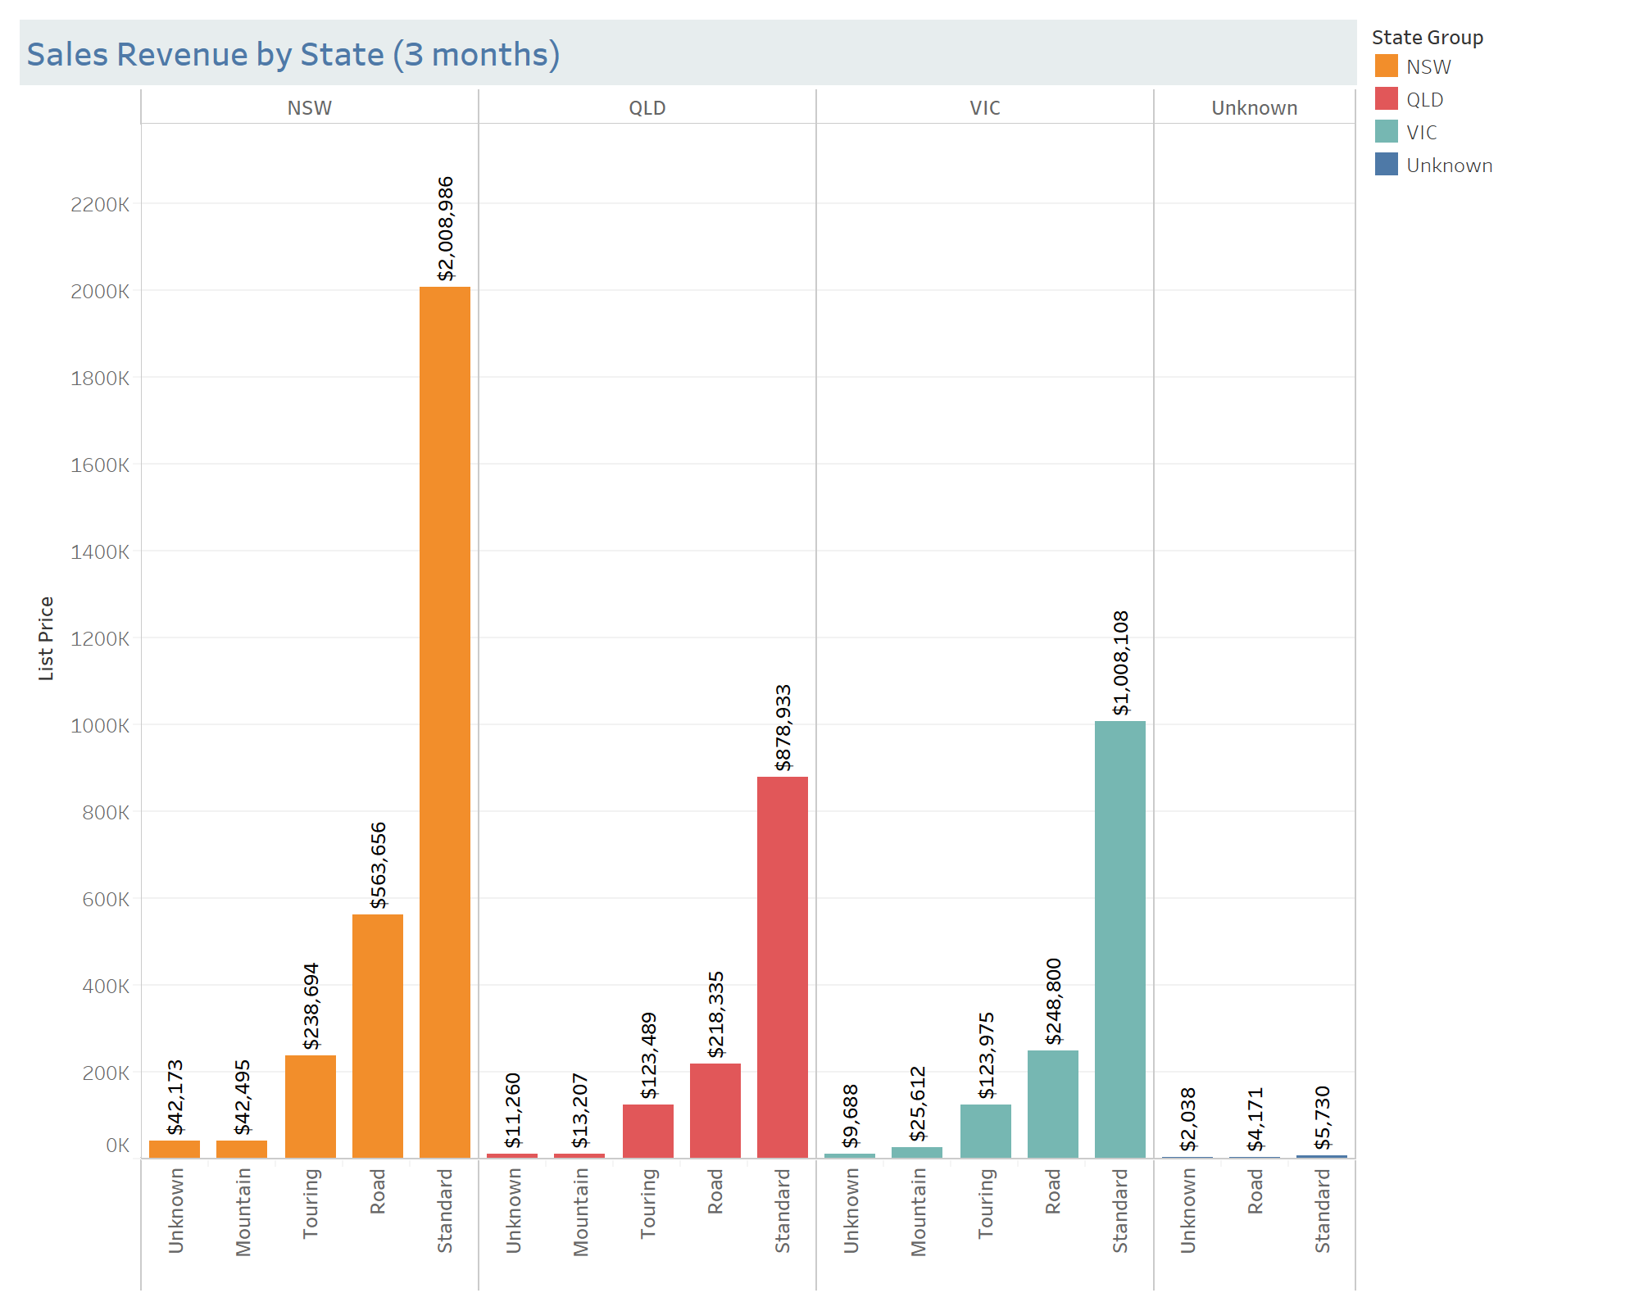
Note: The data and information in this document is reflective of a hypothetical situation and client. This document is to be used for KPMG Virtual Internship purposes only.
Data Exploration
Sales Revenue By States (3 Months)
In the past 3 months, the highest sales revenue ($2,896,004) were from New South Wales, followed by Victoria ($1,416,184), and Queensland ($1,245,224). Therefore, NSW has been always been the hottest market for the last 3 years, and the Standard bike was the highest demand.

Slide 7
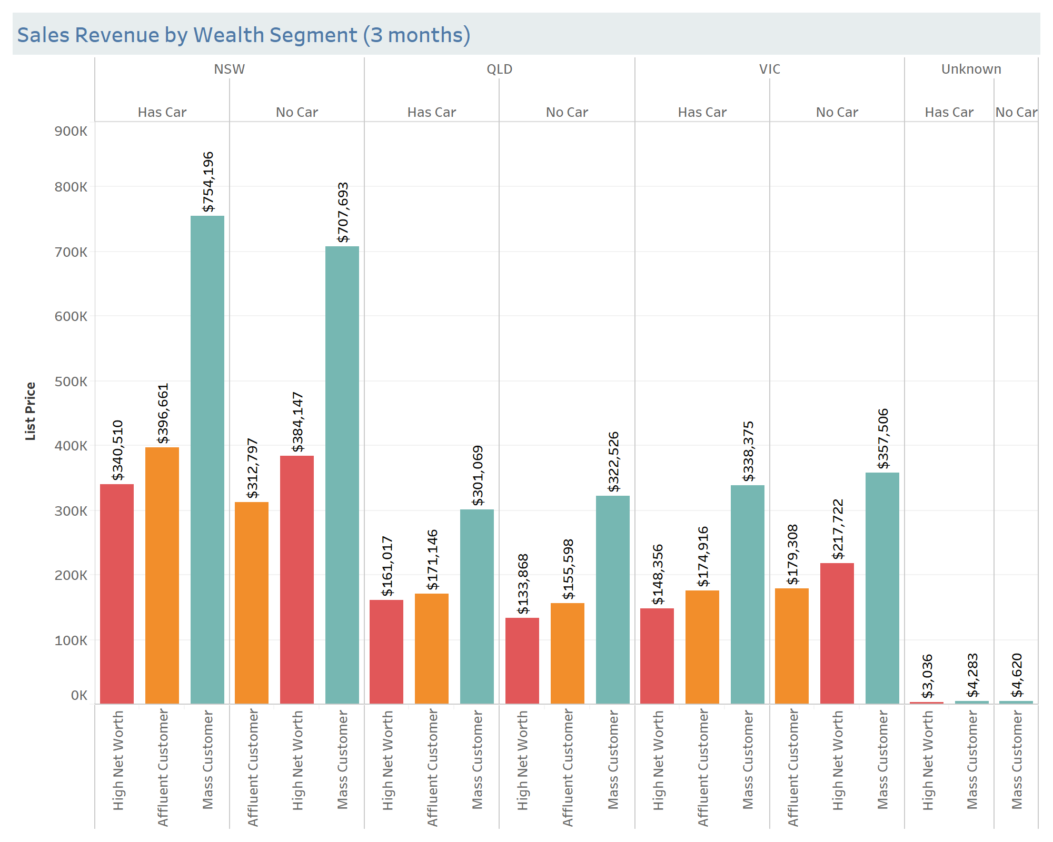
Note: The data and information in this document is reflective of a hypothetical situation and client. This document is to be used for KPMG Virtual Internship purposes only.
Data Exploration
Sales Revenue By Wealth Segment (3 Months)
In the past 3 months, the highest sales revenue were from the mass customers total to $2.8M, while the high net and affluent customer sales are $1.4M each.

Slide 8
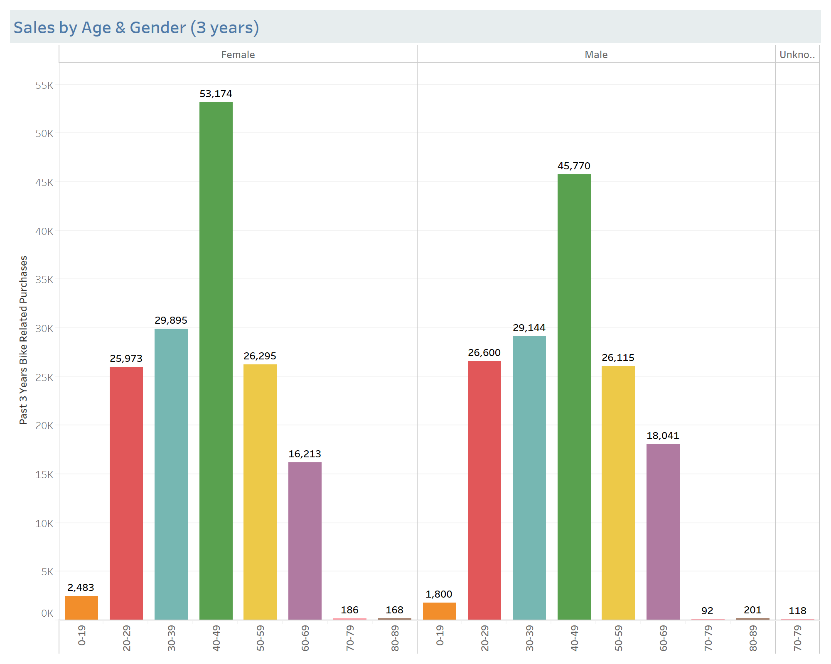
Note: The data and information in this document is reflective of a hypothetical situation and client. This document is to be used for KPMG Virtual Internship purposes only.
Data Exploration
Sales By Age & Gender
(3 Years)
In the past 3 years, 154,387 bikes were purchased by female customers while the male customers has purchased 147,763 bikes. Both female and male who age between 40 to 49 had highest purchase rate.

Slide 9
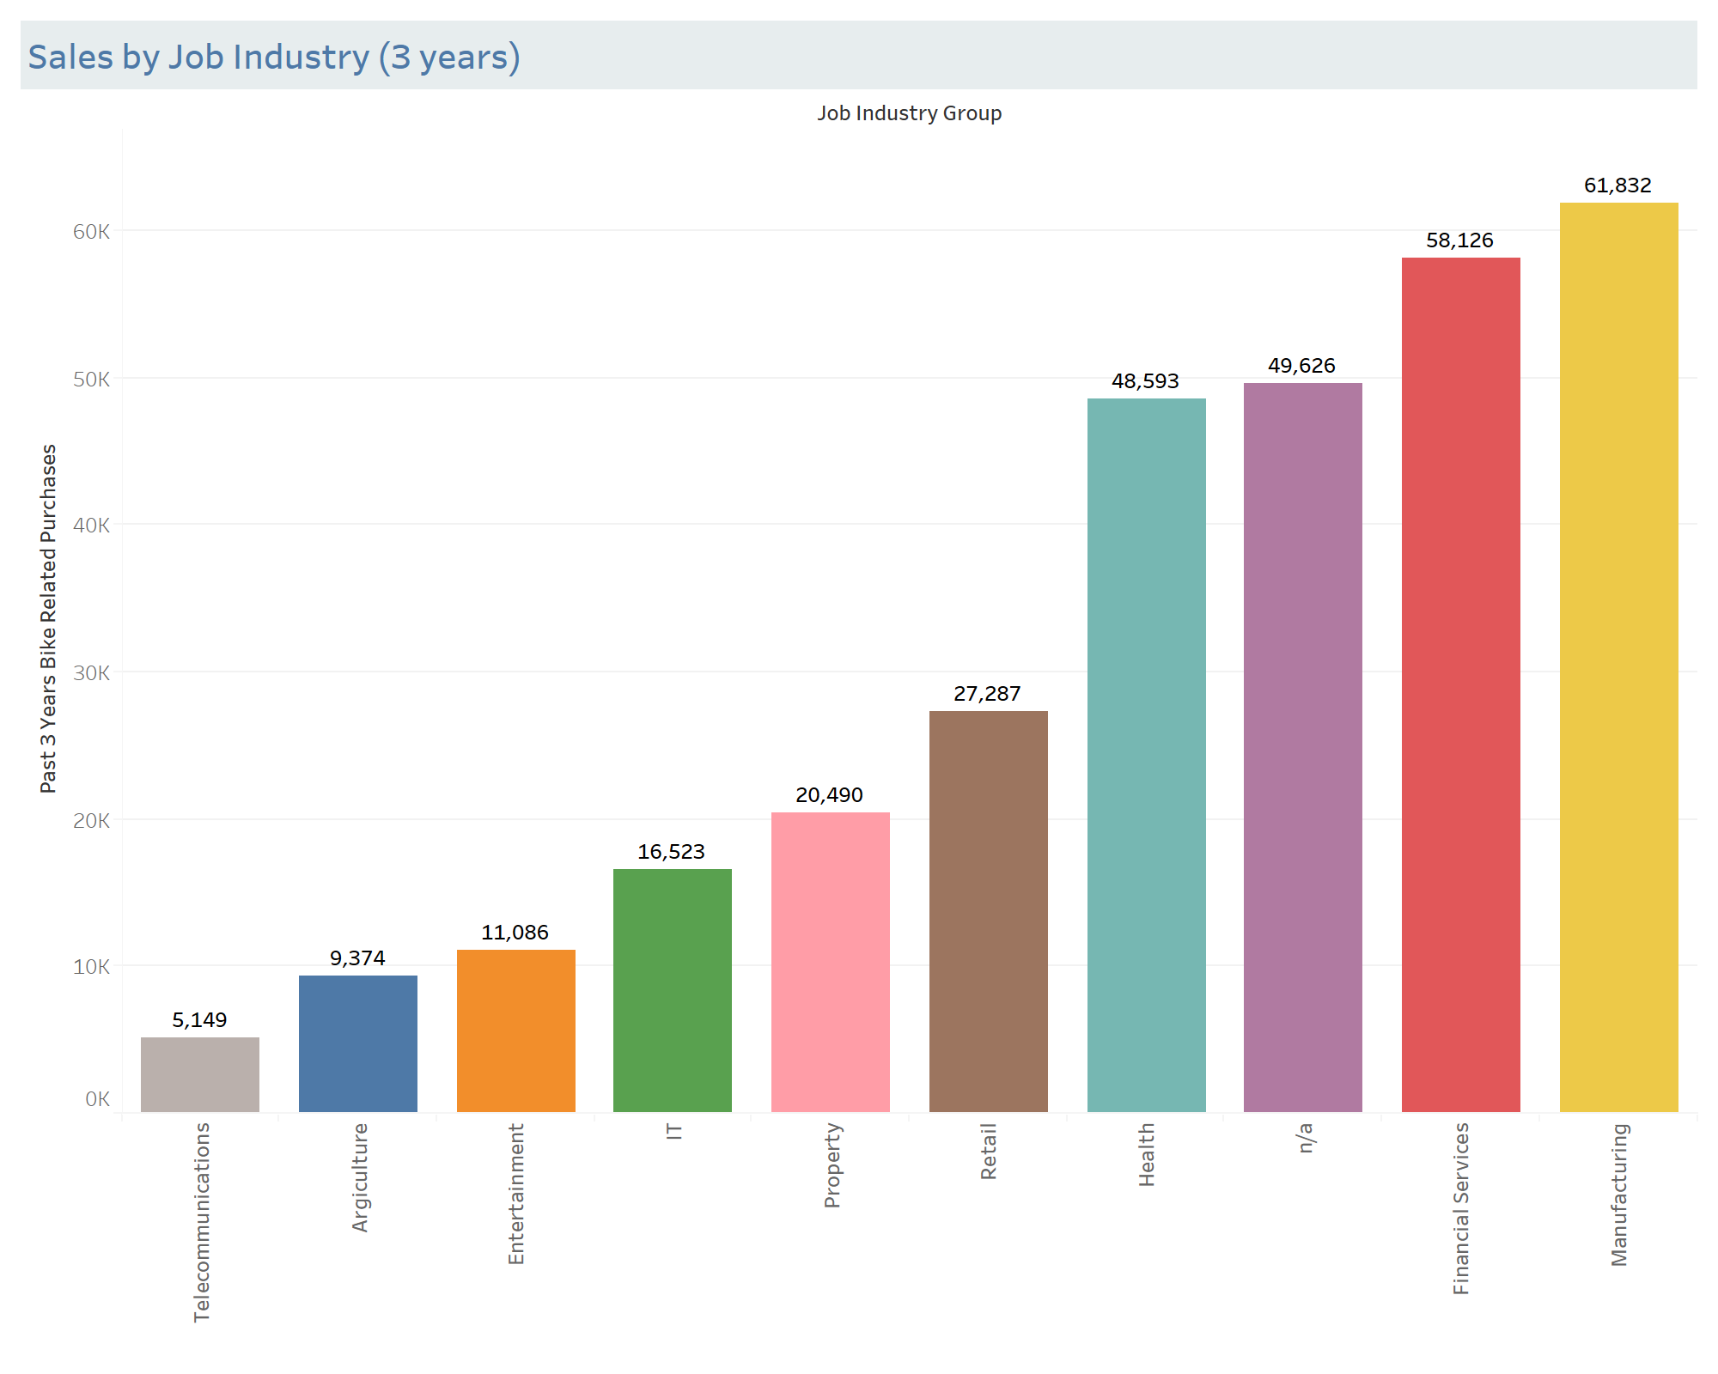
Note: The data and information in this document is reflective of a hypothetical situation and client. This document is to be used for KPMG Virtual Internship purposes only.
Data Exploration
Sales by Job Industry
(3 years)
The customers who work in manufacturing industry made the highest bike purchases (61,832 units), followed by the customers who work in financial services (58,126 units), and the customers who work in telecommunications made the least purchases (5,149 units).

Slide 10
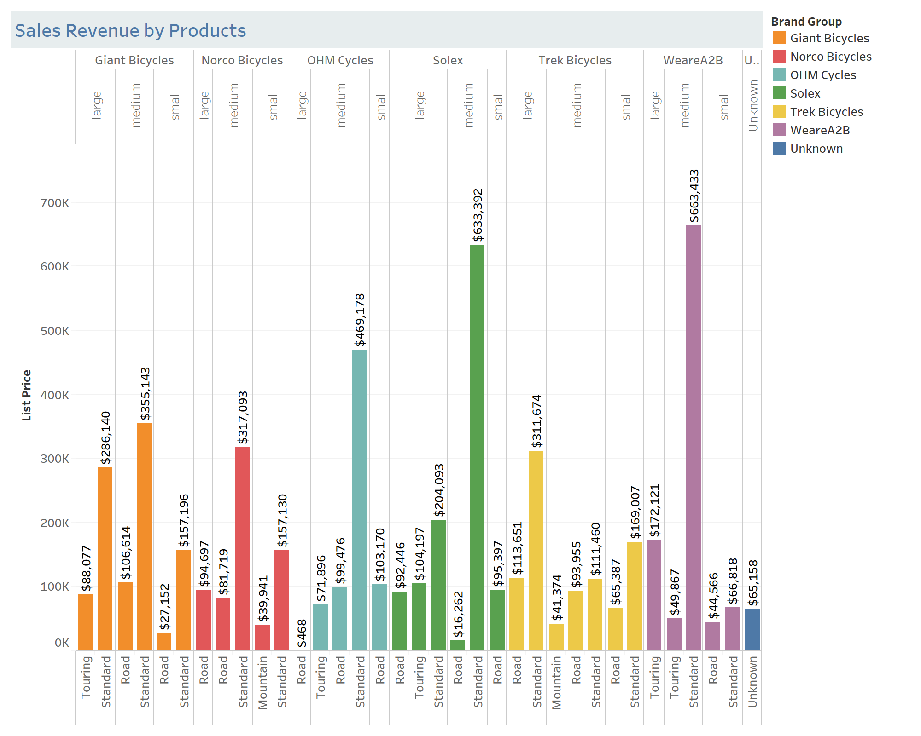
Note: The data and information in this document is reflective of a hypothetical situation and client. This document is to be used for KPMG Virtual Internship purposes only.
Data Exploration
Sales Revenue by Products
(3 months)
Sales of the top 3 products:
1. Brand: WeareA2B
Size: medium $663,433
Type: Standard
2. Brand: Solex
Size: medium $663,392
Type: Standard
3. Brand: OHM Cycles
Size: medium $469,178
Type: Standard

Slide 11
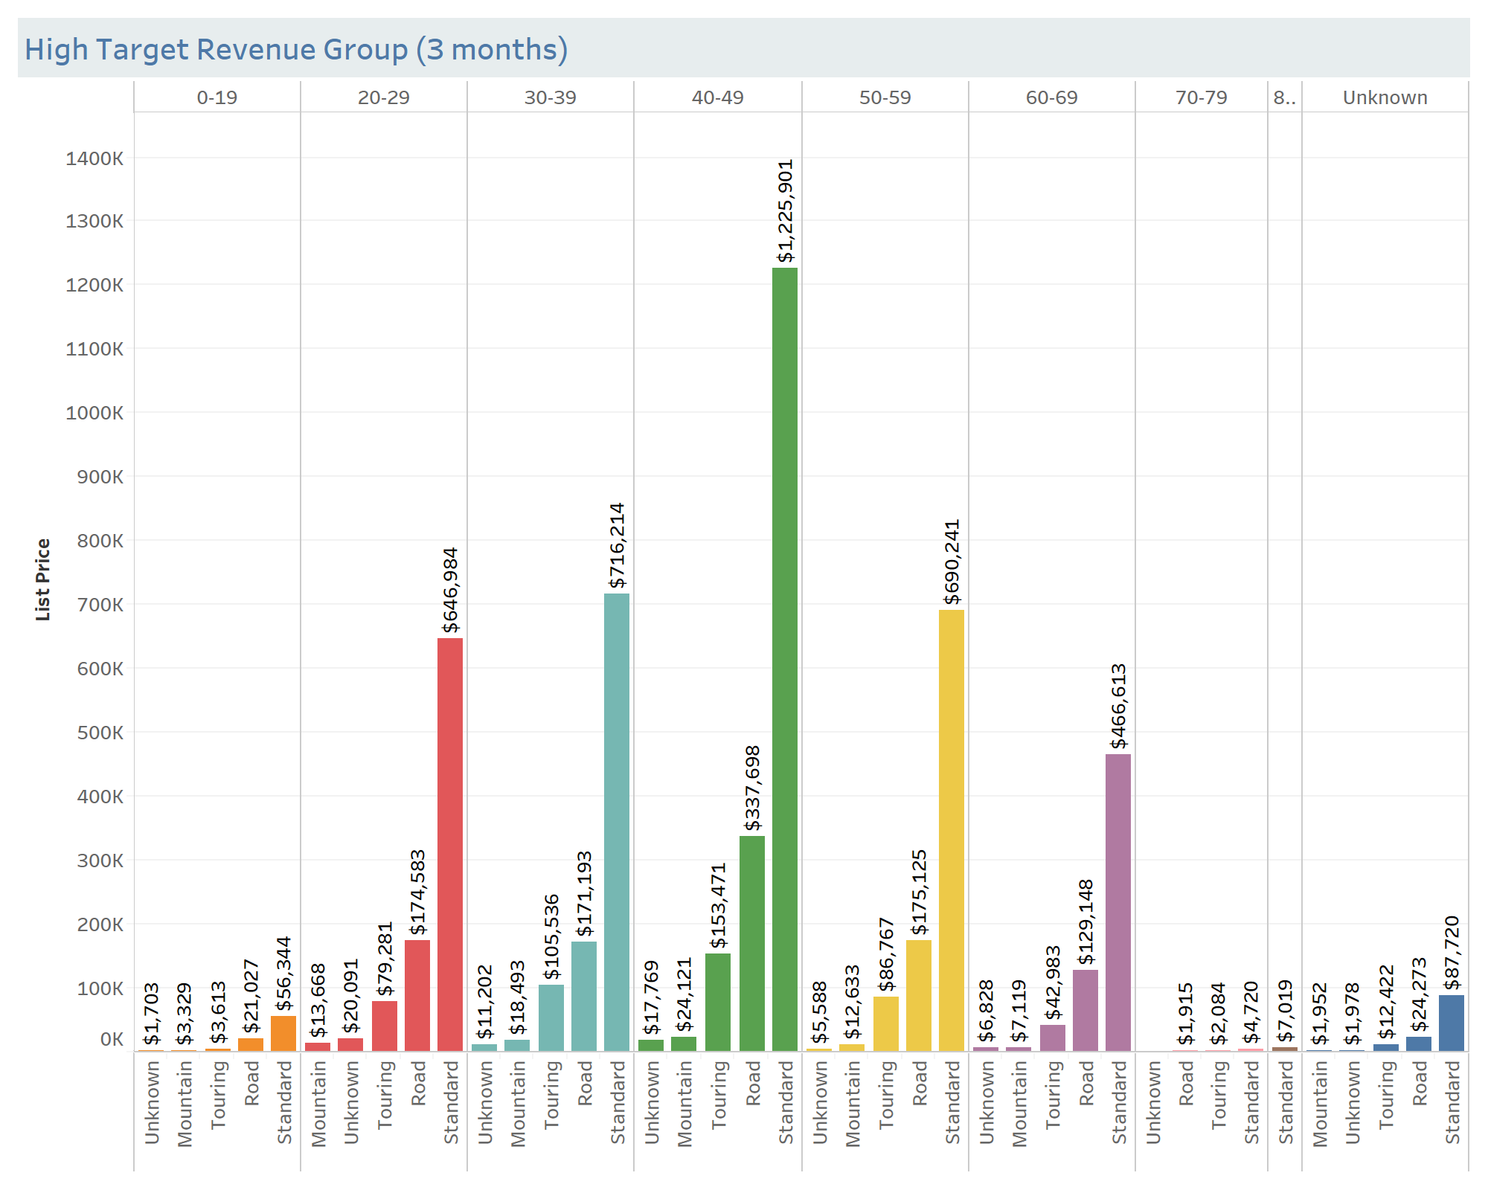
Note: The data and information in this document is reflective of a hypothetical situation and client. This document is to be used for KPMG Virtual Internship purposes only.
Model Development
High Target Sales (3 years)
& Revenue (3 months)
Based on the record of the past sales and sales revenue, the model should prioritize 3 main categories of the targets as below.
Products: Standard type & medium size
Age: 40-49
Job Industry: Manufacturing and Finance Services
Let’s use this model to allocate on new customers.

Slide 12
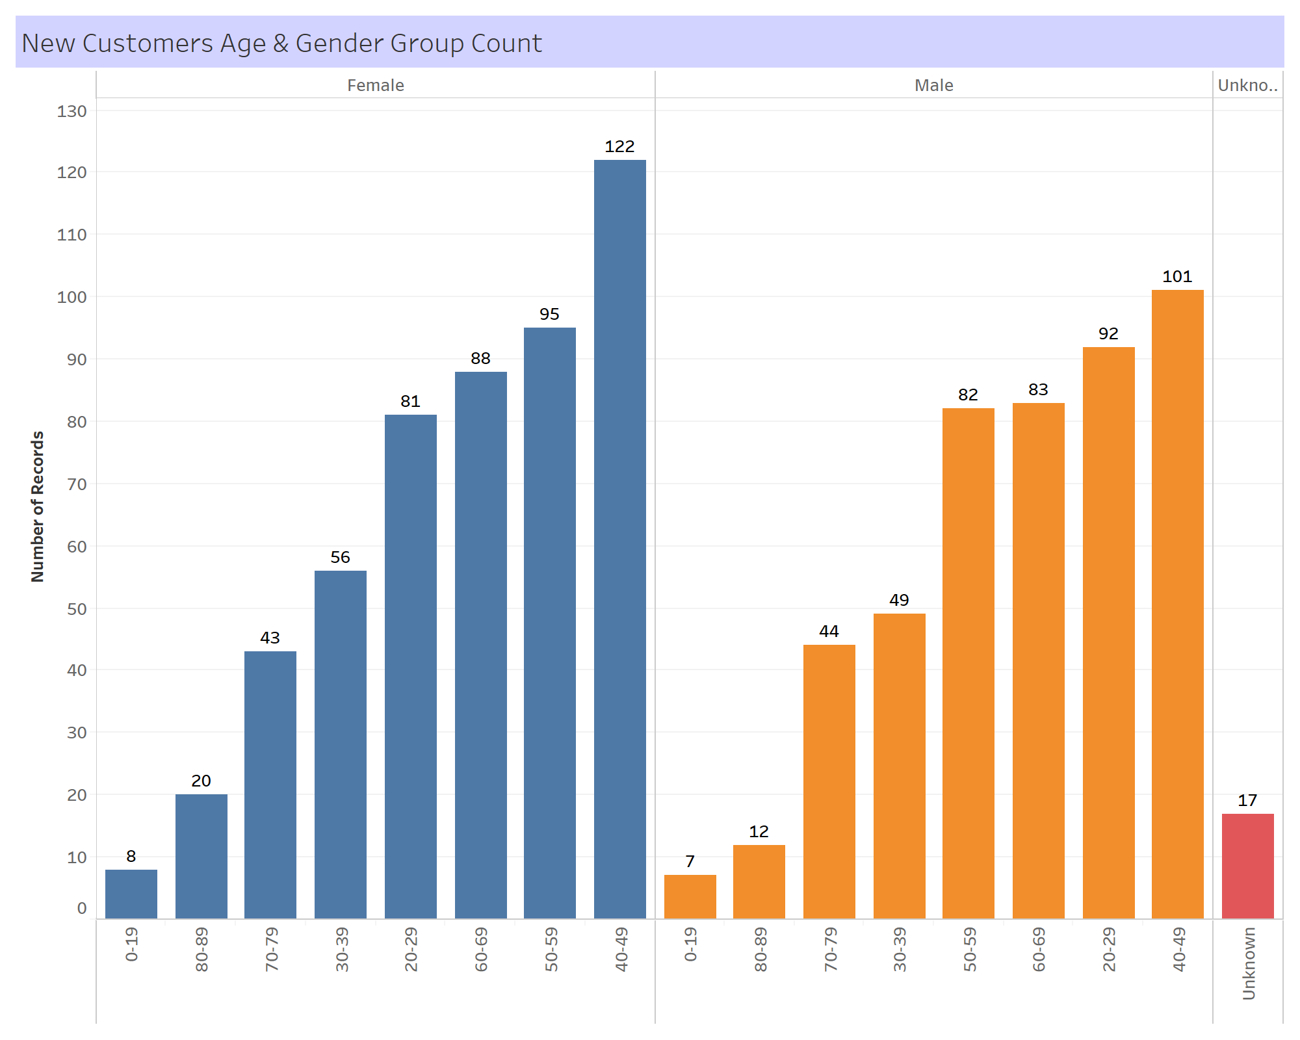
Note: The data and information in this document is reflective of a hypothetical situation and client. This document is to be used for KPMG Virtual Internship purposes only.
Interpretation On New Customers
New Customers Age
& Gender Group Count
The highest number of new customers are aged between 40 to 49, total to 223, and this age is the most wanted target which results in higher opportunity of purchasing bikes.

Slide 13
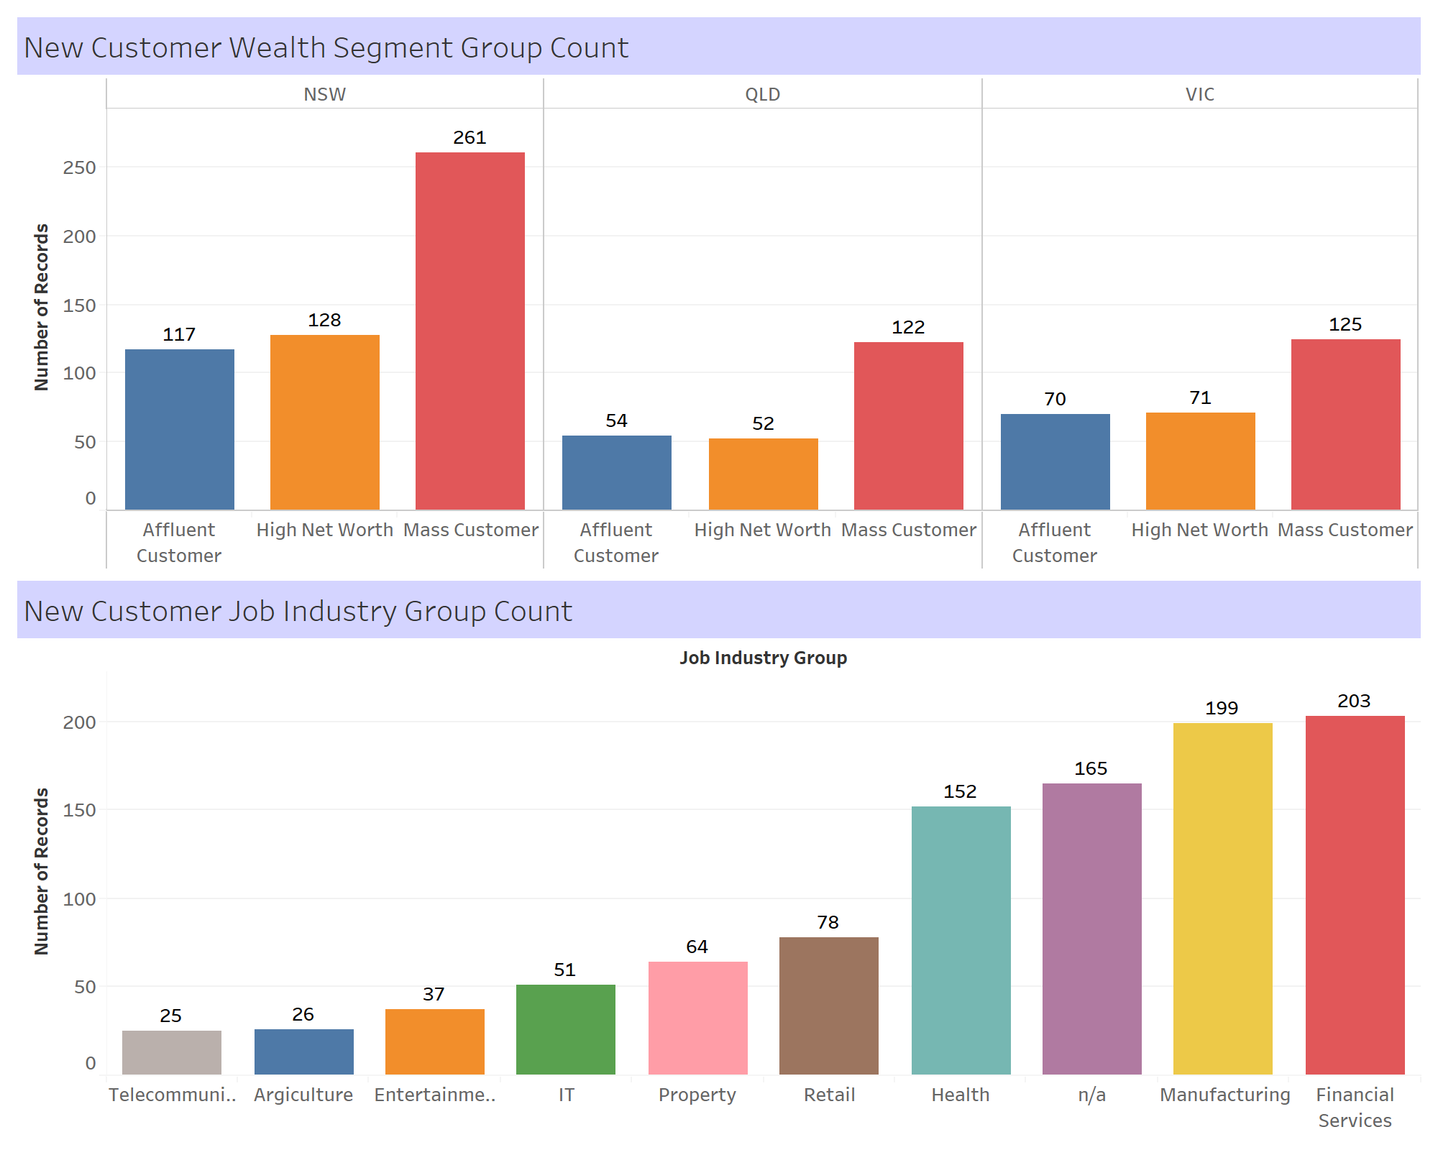
Note: The data and information in this document is reflective of a hypothetical situation and client. This document is to be used for KPMG Virtual Internship purposes only.
Interpretation On New Customers
New Customers Wealth Segment & Job Industry
Group Count
The number of new customers who work in manufacturing and financial services are the highest among all the industries, total to 402. Mass customers have the highest customers among all the wealth segments, total to 508. These numbers are great leads for establishing target market.

Slide 14
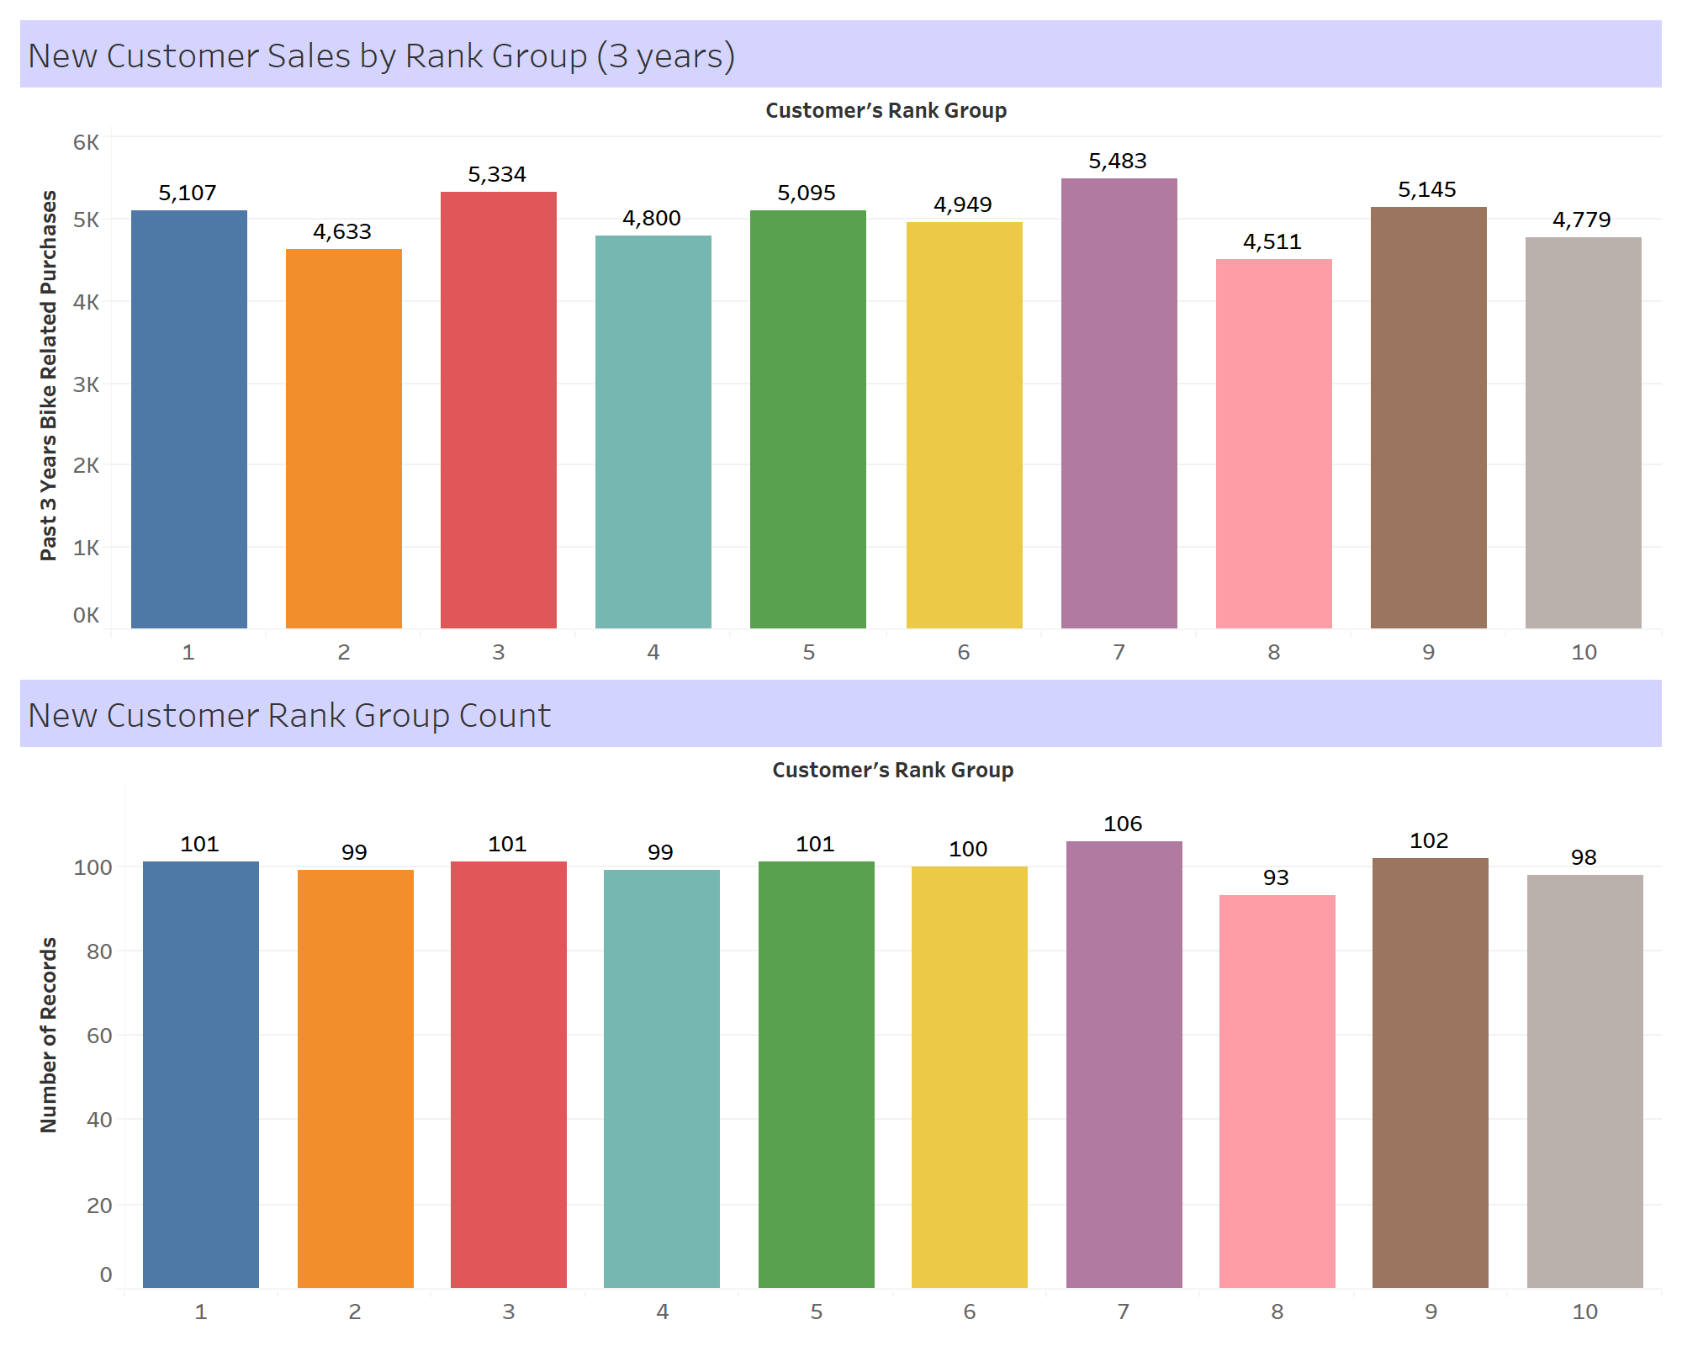
Note: The data and information in this document is reflective of a hypothetical situation and client. This document is to be used for KPMG Virtual Internship purposes only.
Interpretation On New Customers
New Customers Sales & Count By Rank (3 Years)
The new customers value was ranked from high to low (1 to 10). The charts show that the number of customers in each rank are almost even out. However, the sales from past 3 years shows that customers in rank 1, 3, 7, and 9 has significantly purchased bikes over 5,000 units each. This can be also considered as the hot target rank.

Slide 15
Note: The data and information in this document is reflective of a hypothetical situation and client. This document is to be used for KPMG Virtual Internship purposes only.
Appendix

Slide 16
Note: The data and information in this document is reflective of a hypothetical situation and client. This document is to be used for KPMG Virtual Internship purposes only.
Appendix
https://github.com/seansothey/KPMG
https://seansothey.github.io/KPMG/CustomerAddress.html
https://seansothey.github.io/KPMG/CustomerDemographic.html
https://seansothey.github.io/KPMG/Transactions3Months.html

