Slide 1
Vortex Modeling with Application to Atmospheric Air Flow Pattern Data Analysis
QCC Tech Fee Program
Faculty Mentors: Armendariz & Cheung
Keywords: air flow · vortex model · weather forecast

Slide 2
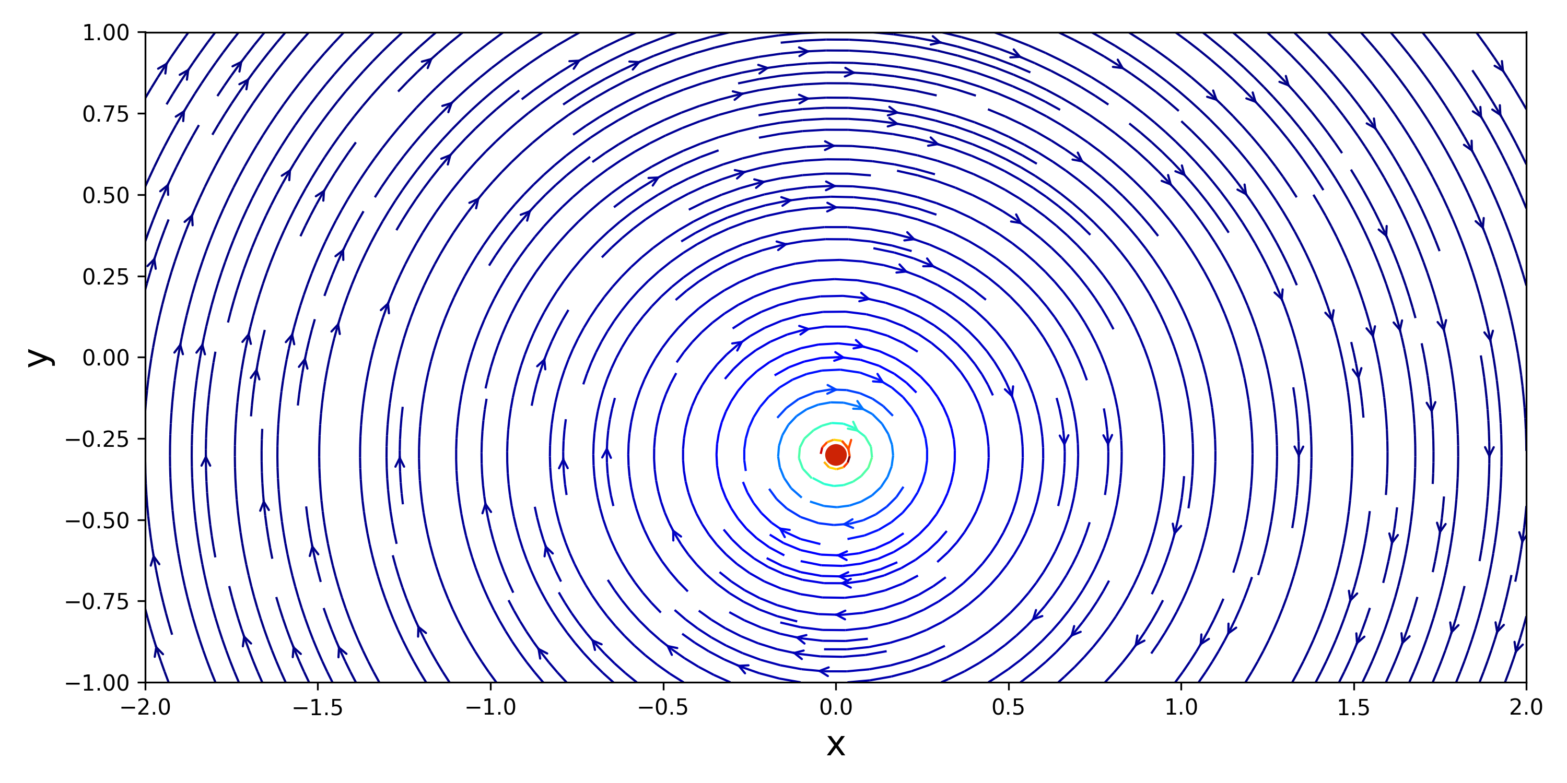
What is a Vortex?
• A vortex is a region of fluid (air or water) rotating around a central axis
• The rotating core is called the vortex center or eye
• Fluid spins faster near the center, slower at the edges
• Vortices are everywhere in nature:
– Hurricanes & typhoons
– Tornadoes
– Ocean gyres
– Aircraft wake turbulence
– Bathtub drain swirls
• Understanding vortices is key to weather prediction and aviation safety
QCC Tech Fee Program | Mentors: Armendariz & Cheung | Keywords: air flow · vortex model · weather forecast

Slide 3
Vortices in Our Atmosphere — Ventusky
[ventusky.png]
• Ventusky is a real-time wind & weather visualization tool
• It shows actual atmospheric vortex patterns from global forecast models
• You can see multiple interacting vortices at once
• Our simulations reproduce this kind of multi-vortex structure from first principles
• Color = wind speed | Streamlines = flow direction
– Red/warm = fast
– Blue/cool = slow
• Same jet colormap used in our Python simulations
QCC Tech Fee Program | Mentors: Armendariz & Cheung | Keywords: air flow · vortex model · weather forecast

Slide 4
Why Study Vortices? | Project Motivation
• Weather forecasting accuracy depends on understanding vortex dynamics
• Aircraft wake vortices are a major aviation safety concern
• Ocean vortices (gyres) control heat transport and climate
• Vortex models are used in computational fluid dynamics (CFD) for engineering
•
• This Project:
– Started from open-source Python vortex codes on GitHub
– Extended with new input conditions: oval shapes, viscosity, multi-vortex systems
– Applied Lamb-Oseen viscous decay — the standard model for real vortices
– Demonstrated a proof-of-concept for atmospheric air flow data analysis
– Developed as a lab exercise tool for community college students
QCC Tech Fee Program | Mentors: Armendariz & Cheung | Keywords: air flow · vortex model · weather forecast

Slide 5
The Physics — Potential Flow Theory
• Potential flow: idealized, inviscid (frictionless), irrotational fluid motion
• Fluid velocity is derived from a scalar potential or stream function ψ
• Key property: flows can be superposed (added together linearly)
– One vortex + another vortex = combined flow field
– Vortex + sink = spiral inward flow (like a drain)
•
• Two fundamental building blocks used in this project:
– Point Vortex — pure rotation around a fixed center
– Sink — fluid drawn inward from all directions
•
• Real vortices also have viscosity — handled by the Lamb-Oseen model
QCC Tech Fee Program | Mentors: Armendariz & Cheung | Keywords: air flow · vortex model · weather forecast

Slide 6
Key Formulas
Stream Function (Point Vortex)
Velocity Field
ψ = Γ / (4π) · ln(r²)
u = +Γ/(2π) · (y − y₀) / r² v = −Γ/(2π) · (x − x₀) / r²
Elliptical (Oval) Distance
Lamb-Oseen Core Radius
r² = (Δx / aₓ)² + (Δy / aᵧ)² aₓ = aspect_x, aᵧ = aspect_y
r_c(t) = √(4νt + r₀²) ν = kinematic viscosity, r₀ = initial core size
Lamb-Oseen Velocity (with viscous cutoff)
u = +Γ/(2π) · (Δy/aᵧ²) / r² · [1 − exp(−r²/r_c²)] v = −Γ/(2π) · (Δx/aₓ²) / r² · [1 − exp(−r²/r_c²)]
Γ = circulation (strength) | r = distance from center | ν = viscosity | t = time
The [1 − exp(…)] term removes the singularity at r = 0, making the vortex core smooth and physically realistic.
QCC Tech Fee Program | Mentors: Armendariz & Cheung | Keywords: air flow · vortex model · weather forecast

Slide 7
Step 1 — Basic Point Vortex (vortex.py)
• Starting point: a single ideal point vortex
• Circular streamlines — fluid orbits the center
• Color = normalized flow speed
– Red/warm near center = fast
– Blue/cool at edges = slow
• No viscosity — flow speed → ∞ at center (singularity)
• GitHub source code adapted and verified
•
• Γ = 5.0 | Center: (0.0, −0.3)
QCC Tech Fee Program | Mentors: Armendariz & Cheung | Keywords: air flow · vortex model · weather forecast

Slide 8
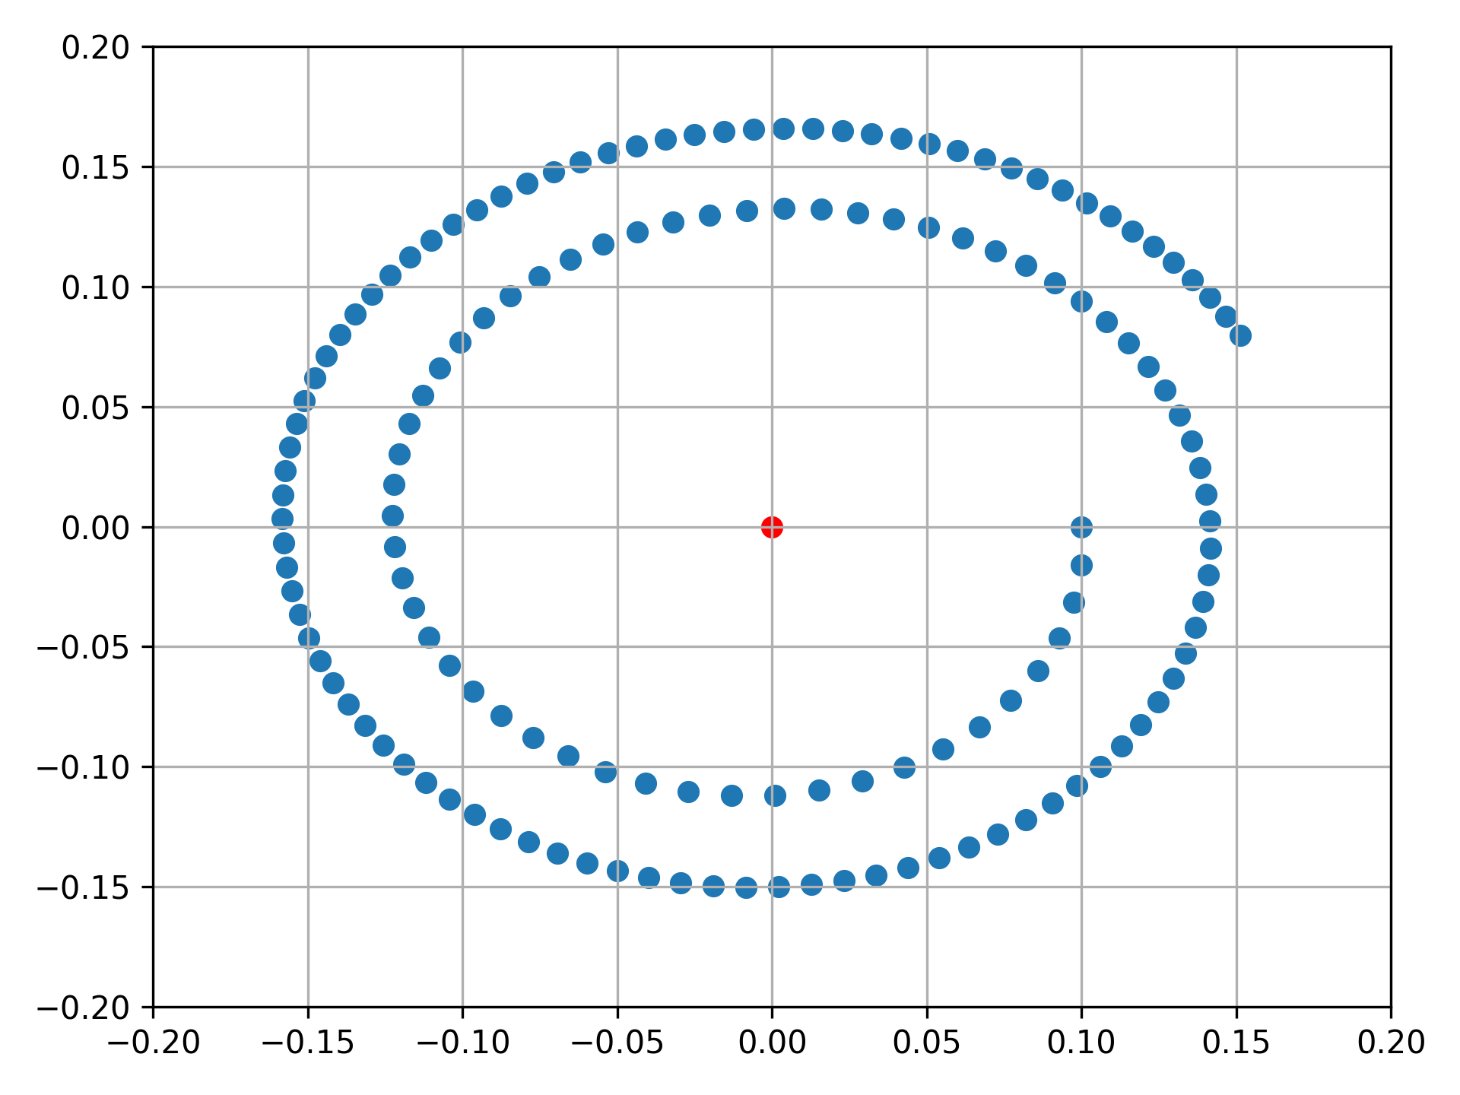
Step 2 — Simulating Vortex Movement (calculate_vortex.py)
• Extended the base code to track the trajectory of the vortex center
• Vortex moves through the domain over time
• Dots show sampled positions along the orbit path
• Red dot = vortex center | Blue dot = reference point
•
• Demonstrates that even a single vortex in a bounded domain
• produces non-trivial motion paths
•
• Foundation for the N-vortex mutual interaction model
QCC Tech Fee Program | Mentors: Armendariz & Cheung | Keywords: air flow · vortex model · weather forecast

Slide 9
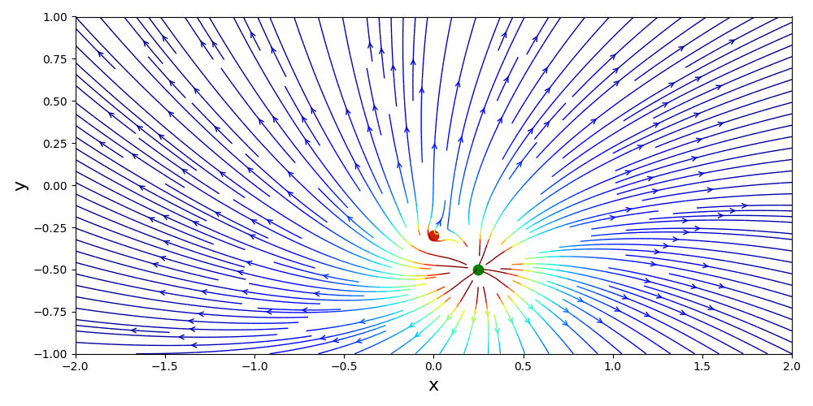
Step 3 — Superposition: Vortex + Sink (vortex.py)
• Added a sink to the vortex — fluid spirals inward
• Superposition principle: velocity fields add linearly
• Result: spiral streamlines (like a draining bathtub)
•
• Physically models:
– Low-pressure systems pulling air inward while rotating
– Hurricane eye-wall dynamics
– Drain vortices
•
• Γ = 5.0 | Sink strength = 20.0
• Sink at (0.25, −0.5)
QCC Tech Fee Program | Mentors: Armendariz & Cheung | Keywords: air flow · vortex model · weather forecast

Slide 10
Lamb-Oseen Viscous Decay Model
• Real vortices are viscous — they diffuse and weaken over time
• The Lamb-Oseen model is the standard physics model for this effect
•
• Core radius grows with time: r_c(t) = √(4νt + r₀²)
– At t = 0: core = r₀ (initial size)
– As t increases: core spreads due to viscous diffusion
– Larger ν = faster spreading
•
• The [1 − exp(−r²/r_c²)] factor:
– = 0 at the center → no singularity
– → 1 far from center → recovers ideal vortex behavior
•
• In this project: ν = 0.005 (scaled for visible animation)
• Simulation runs from t = 0.5 to t = 12.5 (120 frames, Δt = 0.1)
QCC Tech Fee Program | Mentors: Armendariz & Cheung | Keywords: air flow · vortex model · weather forecast

Slide 11
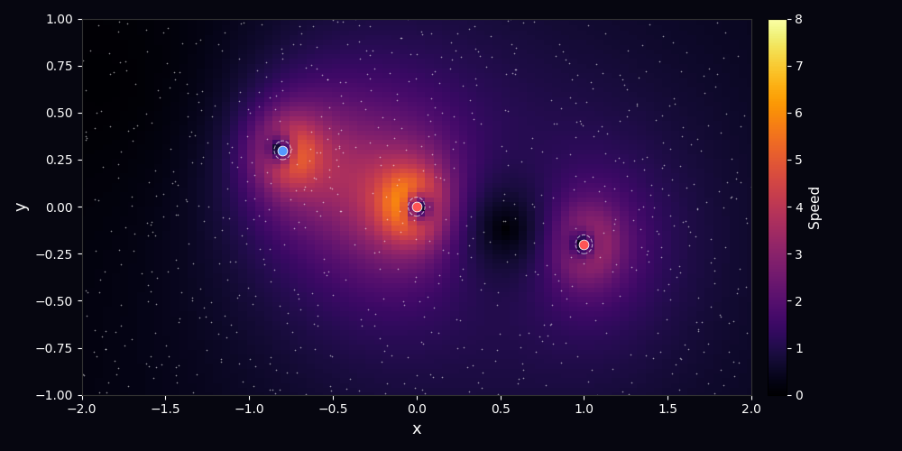
Step 4 — Multi-Vortex Lamb-Oseen Simulation (lamb_oseen.py)
• 4 vortices with different strengths and positions
• Red dots = counter-clockwise (Γ > 0)
• Blue dots = clockwise (Γ < 0)
• Dashed ellipses = viscous core boundary (grows over time)
• Particles (gray dots) advected by the combined flow
•
• Oval shape: each vortex has aspect_x / aspect_y
– aspect_x > 1 → wider horizontally
– aspect_y > 1 → taller vertically
– Mimics real elongated atmospheric vortices
•
• Animation shows core growth as viscosity diffuses the vortex
QCC Tech Fee Program | Mentors: Armendariz & Cheung | Keywords: air flow · vortex model · weather forecast

Slide 12
Oval Vortex Cores — Aspect Ratio Parameters
• Real atmospheric vortices are rarely perfectly circular
• Elongated by wind shear, terrain, pressure gradients
•
• Implemented via elliptical distance metric:
– r² = (Δx / aspect_x)² + (Δy / aspect_y)²
•
• Vortex parameters used in the simulation:
Vortex
Strength (Γ)
aspect_x
aspect_y
Shape
1
−5.0 (CW)
1.5
0.7
Wide oval
2
−4.0 (CW)
1.0
1.0
Circular
3
+5.0 (CCW)
0.6
1.4
Tall oval
4
−1.0 (CW)
1.2
0.8
Slight wide oval
QCC Tech Fee Program | Mentors: Armendariz & Cheung | Keywords: air flow · vortex model · weather forecast

Slide 13
Coefficient of Variation as Diversity Measure (CV = a/b)
• To characterize how elongated each vortex core is, we define:
•
Semi-axes of the viscous core ellipse
Coefficient of Variation
a = r_c(t) · aspect_x (x-radius) b = r_c(t) · aspect_y (y-radius)
CV = a / b = aspect_x / aspect_y
Note: since both a and b scale with the same r_c(t), CV is constant over time for each vortex.
• CV = 1.0 → perfectly circular core
• CV > 1.0 → core is wider than tall (stretched horizontally)
• CV < 1.0 → core is taller than wide (stretched vertically)
• Used as a diversity measure to compare shape configurations across vortices
• Supports weather forecast research by quantifying vortex shape asymmetry
QCC Tech Fee Program | Mentors: Armendariz & Cheung | Keywords: air flow · vortex model · weather forecast

Slide 14
CV Results — Vortex Shape Diversity
Computed at t = 0.5 (initial frame) via print_cv() in lamb_oseen.py:
Vortex
aspect_x
aspect_y
r_c (t=0.5)
a = r_c·aspect_x
b = r_c·aspect_y
CV = a/b
1
1.5
0.7
0.1003
0.1505
0.0702
2.1429
2
1.0
1.0
0.1003
0.1003
0.1003
1.0000
3
0.6
1.4
0.1049
0.0629
0.1469
0.4286
4
1.2
0.8
0.1000
0.1200
0.0800
1.5000
• Vortex 1 (CV=2.14): most elongated horizontally — mimics large-scale weather fronts
• Vortex 2 (CV=1.00): circular — baseline reference
• Vortex 3 (CV=0.43): most elongated vertically — like a narrow storm column
• Vortex 4 (CV=1.50): moderately wide — typical mid-latitude cyclone shape
QCC Tech Fee Program | Mentors: Armendariz & Cheung | Keywords: air flow · vortex model · weather forecast

Slide 15
Application to Atmospheric Air Flow Data — Proof of Concept
• Ventusky shows real atmospheric vortex patterns from global weather models
[ventusky.png]
• Our model reproduces key features:
– Multiple interacting vortex centers
– Varying rotation directions (CW / CCW)
– Non-circular, asymmetric cores
– Speed gradient: fast core, slow periphery
•
• CV as a metric could be used to:
– Compare simulated vs observed vortex shapes
– Track how vortex geometry changes over time
– Classify storm types by shape diversity
•
• Next step: overlay model output on real forecast data
QCC Tech Fee Program | Mentors: Armendariz & Cheung | Keywords: air flow · vortex model · weather forecast

Slide 16
Cyberlearning Lab Exercise Extension
• Goal: develop an interactive vortex lab for community college students
•
• Students can:
– Modify vortex parameters (strength, position, aspect ratio, viscosity)
– Run simulations directly in a web browser (no install needed)
– Compare model output to Ventusky real-world atmospheric data
– Calculate and interpret CV values as a shape diversity measure
•
• Tools:
– Python + Jupyter Notebook (JupyterHub / GitHub Codespaces)
– matplotlib animations rendered in-browser
– GitHub repository for version control and collaboration
•
• Pedagogical value: connects fluid physics, coding, and real-world weather data
• Accessible to students with no prior programming experience
QCC Tech Fee Program | Mentors: Armendariz & Cheung | Keywords: air flow · vortex model · weather forecast

Slide 17
Conclusions & Acknowledgements
Conclusions
• Successfully extended open-source Python vortex codes for multiple input conditions
• Implemented oval/asymmetric vortex cores via elliptical distance metric
• Applied Lamb-Oseen viscous decay — physically realistic vortex model
• CV = a/b provides a simple, interpretable shape diversity measure
• Demonstrated atmospheric air flow pattern analysis as a proof of concept
• Framework ready for interactive cyberlearning lab development
Acknowledgements
This project was supported by the QCC Tech Fee Program. Faculty Mentors: Armendariz and Cheung Community college students participated in weather forecast research using cyberlearning tools.
QCC Tech Fee Program | Mentors: Armendariz & Cheung | Keywords: air flow · vortex model · weather forecast

