Slide 1
Team
APC_TDC · Tze-Hsiang Tang · Schneider Electric Taiwan Co., Ltd.
A one-person team. We entered both categories.
Category 1 weakly supervised tool detection mAP 0.4930
Category 2 surgical video question answering BERTScore-F1 0.6191
Code, weights and report: github.com/seantangth/miccai2026-surgvu-surgical-visual-understanding
Notes:
Hello. We are team A P C T D C, a one-person team from Schneider Electric Taiwan. We entered both categories. In Category One, weakly supervised tool detection, our final score was zero point four nine three. In Category Two, surgical video question answering, zero point six one nine.

Slide 2
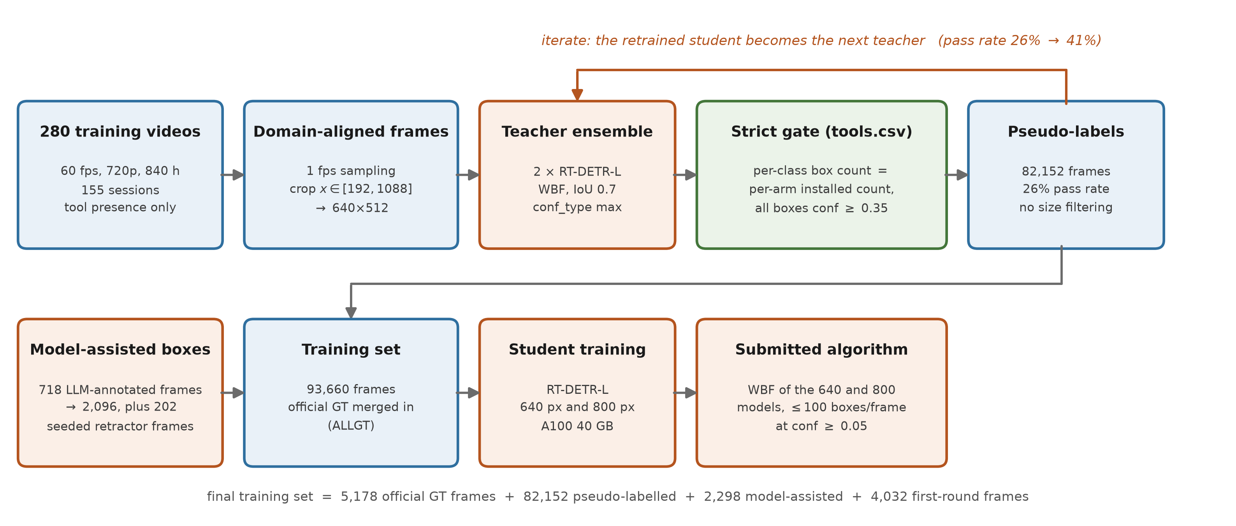
Method
The labels we are given are tool presence, not boxes. We turn them into a gate on a teacher ensemble, and let the accepted frames train the next teacher.
Accept a frame only if the per-class box count equals the installed count exactly and every box has conf ≥ 0.35. 26% of frames pass; retraining the teacher on them raises that to 41%.
Notes:
The challenge gives us tool presence labels, not boxes. Our answer is to use the presence label as a gate, rather than as a target. We sample frames at one per second, and crop them to match the geometry of the test set. A teacher ensemble of two R T DETR models proposes boxes, and we fuse them with weighted box fusion. Then comes the gate. We keep only frames where the box count of each class exactly equals the number of that tool installed at that second, and every box is above confidence zero point three five. Twenty six percent of frames pass. We train a student on them, and that student becomes the next teacher, which raises the pass rate to forty one percent. The loop converges because the gate is external to the model.

Slide 3
Key design decisions
1. Scale beats recipe. Growing the pseudo-label source from 20 to 280 videos: +0.052. Every recipe change we tried: at most 0.006.
2. Let the weak label do the filtering. A count-exact match against tools.csv is model-independent, so iterative pseudo-labelling converges instead of drifting.
3. Never size-filter pseudo-labels. Clipping box areas to P2–P98 removes the near- and far-field samples that carry the scale diversity, and AP75 drops.
4. Never keep a frame whose visible tool has no box. Three classes were excluded from the targets while their images stayed: 65,182 frames taught the detector that a visible prograsp is background, against 711 positive boxes. Deleting those frames: 0.000 → 0.255 detection.
5. The remaining headroom is AP75, not recall. Needle driver sits at AP50 0.93 but AP75 0.51. Training at 800 px: +0.0275 AP75. Two-model fusion: +0.0376 AP75, measured on a pair of 640 px models. Our submission fuses 640 with 800, a combination we could not measure locally.
Notes:
Five decisions mattered. First, scale beats recipe. Going from twenty videos to two hundred and eighty was worth plus zero point zero five two. Every recipe change we tried: at most zero point zero zero six. Second, let the weak label do the filtering. An exact count match is model independent, so the iteration does not drift. Third, never size filter your pseudo labels. It removes the near and far field samples that carry the scale diversity. Fourth, and this cost us the most, never keep a frame whose visible tool has no box. Sixty five thousand such frames taught our detector that a visible prograsp is background. Fifth, our remaining headroom was box tightness, not recall. Training at eight hundred pixels gave plus zero point zero two seven five at A P seventy five. Two model fusion gave plus zero point zero three seven six, though measured on a six forty pair, not on our submitted six forty plus eight hundred.

Slide 4
What did not work?
Inference-time search. 39 variants of TTA, confidence, top-k, multi-scale and NMS. Ceiling: +0.005.
Temporal post-processing. Ten variants of score smoothing, box smoothing and gap filling. All negative, −0.004 to −0.06.
Training on the official ground truth alone. 0.4024 against 0.5905 for mixed training. Fine-tuning on it afterwards also hurt: needle-driver AP75 0.51 → 0.36. Five videos is a narrower scale prior than the pseudo-labels provide.
Reading the robot interface with OCR to relabel. It fixed the four never-detected classes on a proxy metric, but cost −0.0127 mAP on the common classes.
Trusting a proxy metric. That same relabelling moved tool-presence set-F1 from 0.578 to 0.819 while moving real mAP the other way. Two rulers, opposite directions.
And the honest caveat: our ablations hold out the student, not the teacher, so read the paired differences and not the absolute values.
Notes:
What did not work. Thirty nine inference time variants had a ceiling of half a point. Ten temporal post processing variants were all negative. And the one that nearly fooled us. We read the robot interface with O C R to relabel the rare classes. On a tool presence proxy metric it looked like a large win, from zero point five seven eight to zero point eight one nine. On real mean A P it was negative. Two rulers, opposite directions. One honest caveat. Our ablations hold out the student but not the teacher, so please read the paired differences, not the absolute numbers. Thank you.

