Slide 1
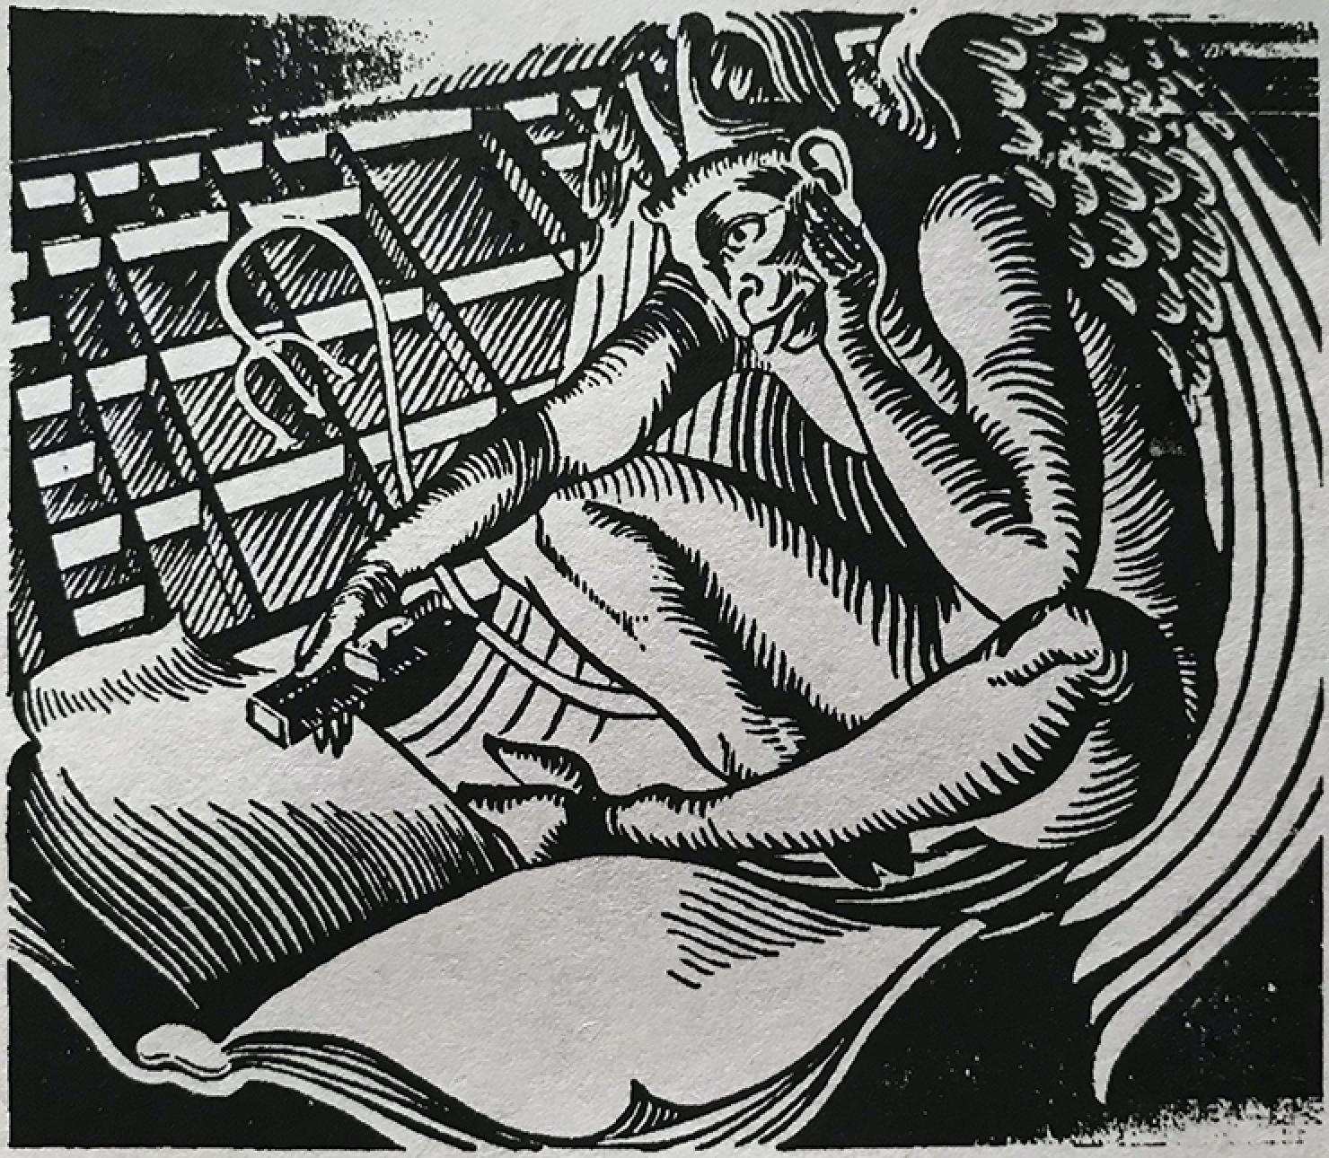
Thanks to my media daemons
Basho P. Luddite
The Taco Slot
Pineapple from Heaven
Jeff Mahoney
Laura Morrison-Westphal
Thr3shold
vishnubob
Video generated by
Lecture Daemon

Slide 2
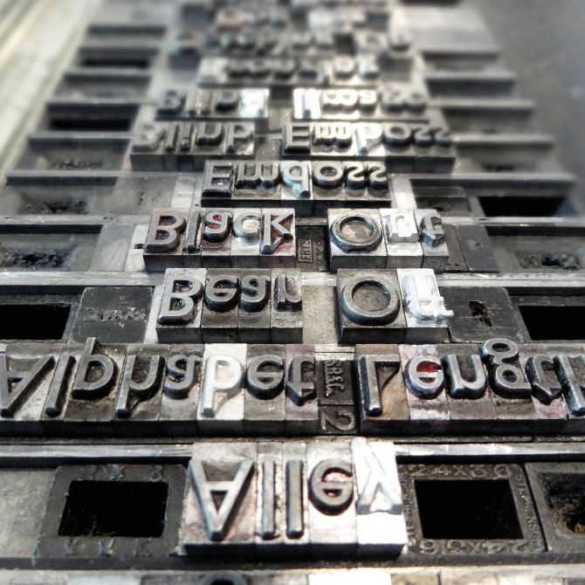
Thanks to my media daemons
Basho P. Luddite
The Taco Slot
Pineapple from Heaven
Jeff Mahoney
Laura Morrison-Westphal
Thr3shold
vishnubob
Video generated by
Lecture Daemon

Slide 3
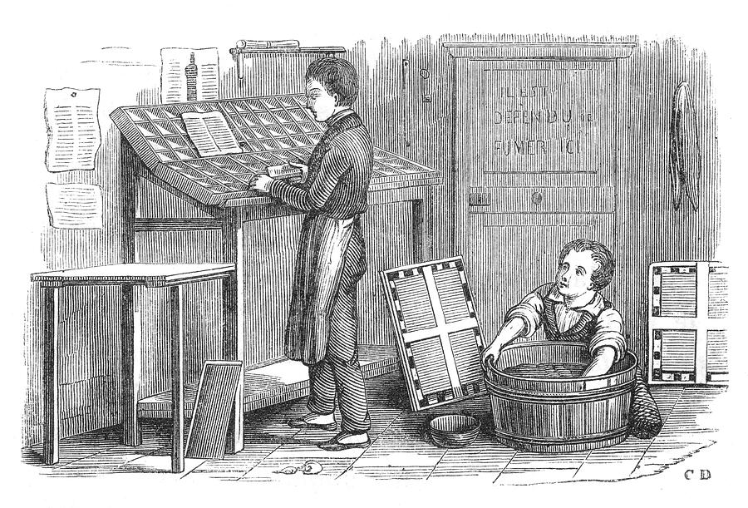
Thanks to my media daemons
Basho P. Luddite
The Taco Slot
Pineapple from Heaven
Jeff Mahoney
Laura Morrison-Westphal
Thr3shold
vishnubob
Video generated by
Lecture Daemon

Slide 4
Thanks to my media daemons
Basho P. Luddite
The Taco Slot
Pineapple from Heaven
Jeff Mahoney
Laura Morrison-Westphal
Thr3shold
vishnubob
Video generated by
Lecture Daemon

