Slide 1

Rooftop Solar Potential Mapping
of the IIT Delhi Campus
B.Tech Project · Mid-term Review
Tejas Suresh Kamble
Surbhi Rathore
Prof. Yashasvi Bansal
2023EE10974
2023EE11224
Supervisor
Department of Electrical Engineering · Indian Institute of Technology Delhi

Slide 2
01
The problem
Many flat roofs on campus carry no solar panels,
and nobody has measured what they could generate.
Along the way we found
something in the Institute's
own data that nobody
had noticed.
Find the roofs that are still unused
Measure how much of each is genuinely usable
Estimate the electricity they would produce
Check whether the campus grid can absorb it

Slide 3
02
The data behind the study
Given to us by the Estate Office
Collected by us
31
Sunshine records for Delhi — NASA POWER and PVGIS
Campus building outlines — OpenStreetMap
Satellite imagery — Esri World Imagery
Sun-angle data to work out panel spacing
solar meters, read every day
January 2024 – April 2026
17,000 daily meter readings across two spreadsheets
97 typing errors found and corrected before use

Slide 4
03
Nine parts, four complete
1
2
3
4
5
6
7
8
9
Choose the
buildings
Read the
meter data
Collect sunshine
data
Measure the
roofs
Machine
learning
Shadows
Calculate
electricity
Grid
impact
Report and
costs
complete
still to do
This presentation covers the first four.

Slide 5
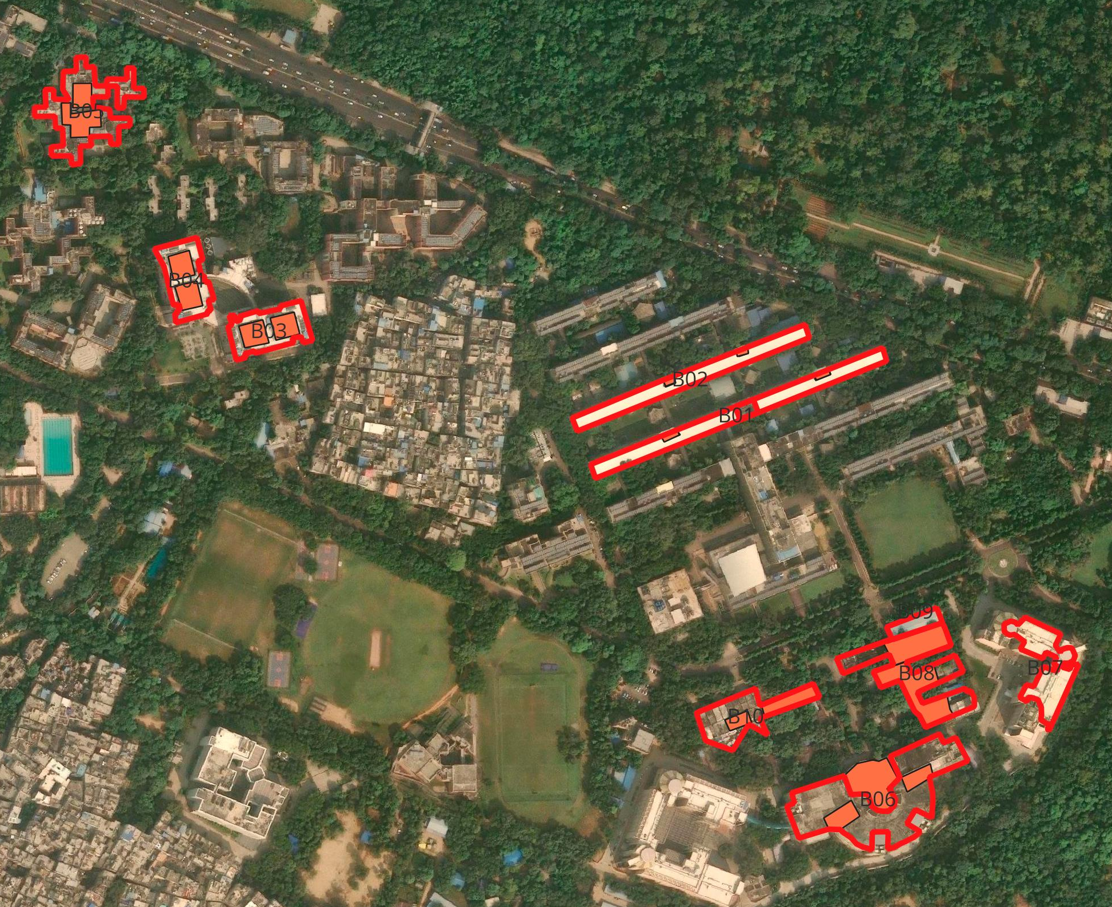
Part 1
Choosing the
buildings
Downloaded the outline of every building on campus.
Removed the 29 roofs that already carry panels — the meter data told us which.
Checked the rest on foot: flat roof, no panels, how many floors.
10
buildings selected
3 hostels · 4 academic
2 labs · 1 workshop

Slide 6
Part 2 · Reading the meter data
Four existing plants
have stopped generating.
₹13
lakh
Main / Amaltas Guest House
23 months
of electricity never generated
May 2024
Central Library
June 2025
10 months
₹1 lakh
Main Building
August 2025
8 months
still lost every month
Vishwakarma
October 2025
6 months
The readings were written down every single day throughout.
Nobody had subtracted one day from the next.
Rupee figures estimated from plant size and a provisional tariff; the outages themselves are certain.

Slide 7
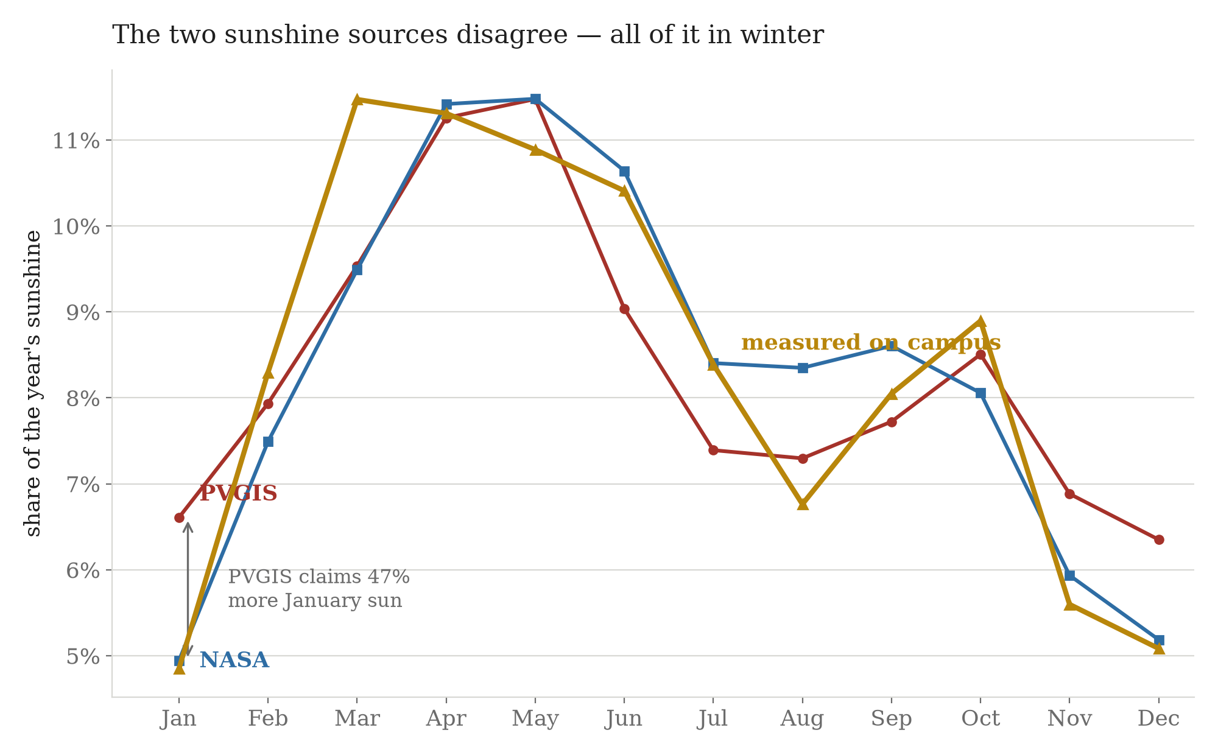
Part 3
Collecting the sunshine data
We took sunshine records from two independent sources and compared them.
They disagreed by 10% over the year — and almost all of the gap was in winter.
The cause is Delhi's winter smog, which the European model does not capture.
We settled it with the campus's own meters.
Real generation tracks NASA almost exactly. Trusting the standard tool would have made every figure about 10% too high.

Slide 8
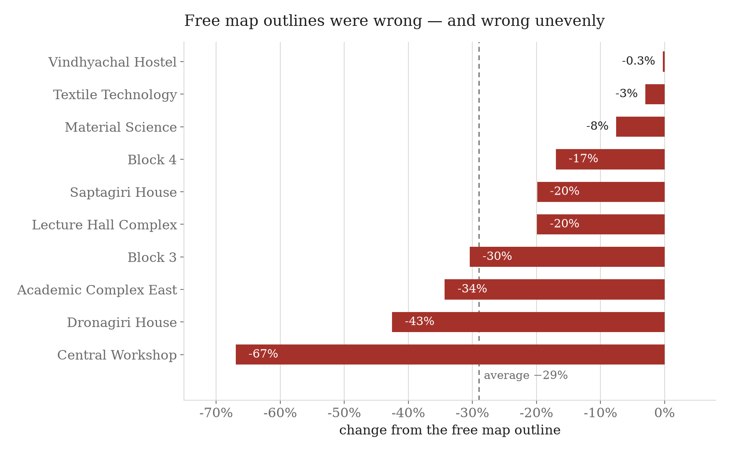
Part 4
Measuring the roofs
2.2 MWp
could be installed across the ten roofs
— about three times the solar the campus
already has.
Every roof traced by hand over satellite imagery in QGIS.
Every water tank, stair room and AC unit drawn and subtracted.
Panel spacing worked out from the 21 December sun, not assumed.
Free outlines overstated the roofs by 29% on average — and by anything from 0.3% to 67%, so no single correction could fix them.

Slide 9
Parts 5 to 9
What comes next
5
Machine learning
Train a model to find roofs automatically, so the method can scale from 10 buildings to all 200 on campus.
6
Shadows
How much sun each roof loses to neighbouring buildings and trees, hour by hour.
7
Electricity
Convert sunshine and roof area into units — checked against the campus plants that already work.
8
Grid impact
Whether the 11 kV network can absorb it. Waiting on three documents from the Estate Office.
9
Report and costs
Payback, cost per unit, and the ranked list of roofs worth doing first.

Slide 10
Thank you
Questions welcome
4
10
2.2 MWp
plants found stopped
roofs measured
untapped potential

