Slide 1

Mapping of the
IIT Delhi Campus
ROOFTOP
SOLAR
POTENTIAL
B.Tech Project · Mid-term Review
Tejas Suresh Kamble
2023EE10974
Surbhi Rathore
2023EE11224
Prof. Yashasvi Bansal
Supervisor
DEPARTMENT OF ELECTRICAL ENGINEERING

Slide 2
01 · THE PROBLEM
Many flat roofs on
campus carry no panels.
Along the way
we found something
in the Institute's
own data that
nobody had
noticed.
Nobody has measured what they could generate.
1
Find the roofs still unused
2
Measure what is genuinely usable
3
Estimate the electricity
4
Check the grid can absorb it

Slide 3
02
The data behind the study
GIVEN TO US
COLLECTED BY US
31
Sunshine records
solar meters,
read every day
NASA POWER · PVGIS
Building outlines
OpenStreetMap
January 2024 — April 2026
17,000 daily readings across two spreadsheets
97 typing errors found and corrected
Satellite imagery
Esri World Imagery
Sun angles
for panel row spacing

Slide 4
03 · THE METHOD
Nine parts, four complete
1
2
3
4
5
Choose the buildings
Read the meter data
Collect sunshine data
Measure the roofs
Machine learning
10 roofs picked from 200
31 meters, 28 months
two sources, cross-checked
traced by hand in QGIS
scale to the whole campus
6
7
8
9
Shadows
Calculate electricity
Grid impact
Report and costs
what each roof loses
and validate it
can the network take it
payback and ranking
complete
still to do

Slide 5
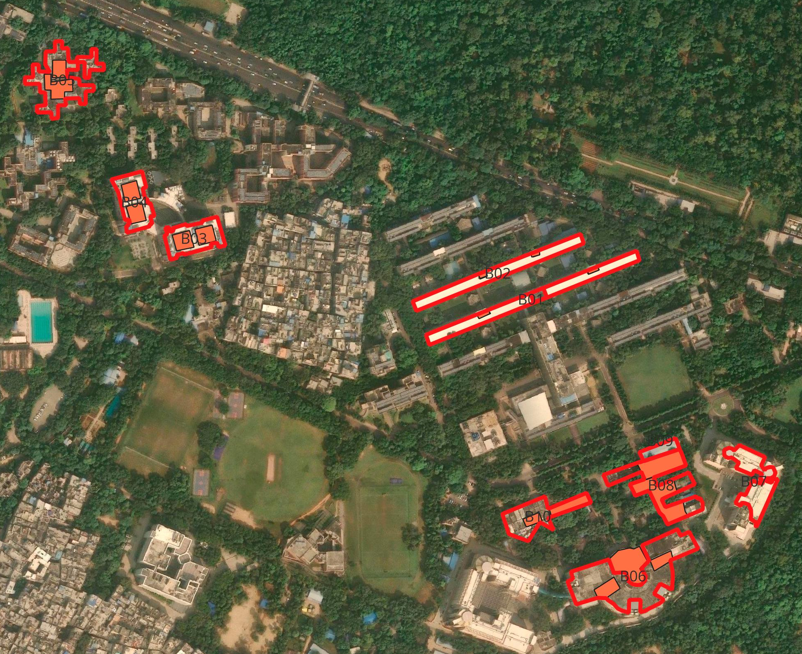
PART 1
Choosing
the buildings
Downloaded every campus building outline
Removed the 29 roofs that already have panels
Checked the rest on foot
10
buildings selected
3 hostels · 4 academic · 2 labs · 1 workshop

Slide 6
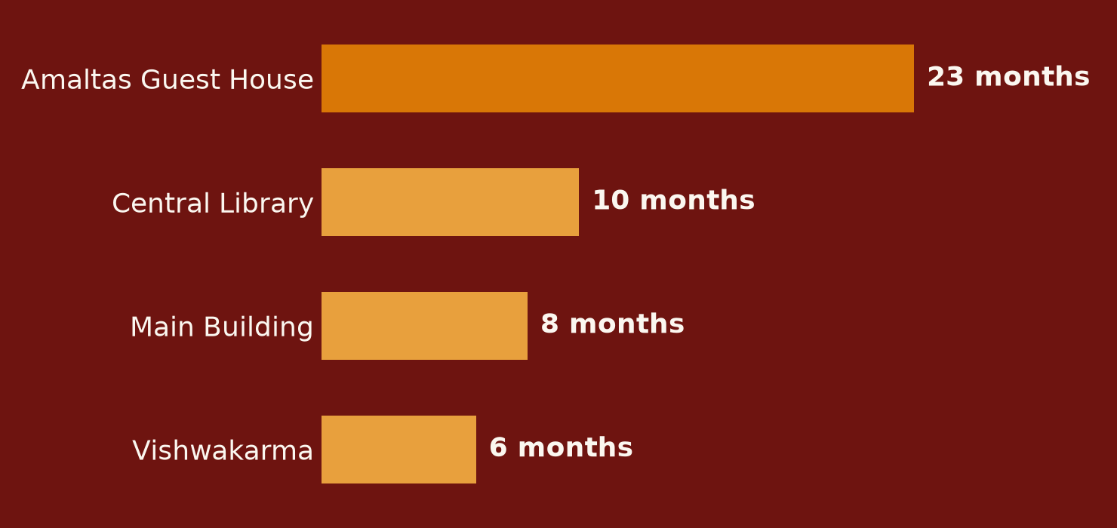
PART 2 · READING THE METER DATA
Four plants have
stopped generating.
₹13
LAKH
of electricity never generated
₹1 lakh still lost
every month
The readings were written down every single day throughout.
Nobody had subtracted one day from the next.
Rupee figures estimated from plant size and a provisional tariff; the outages themselves are certain.

Slide 7
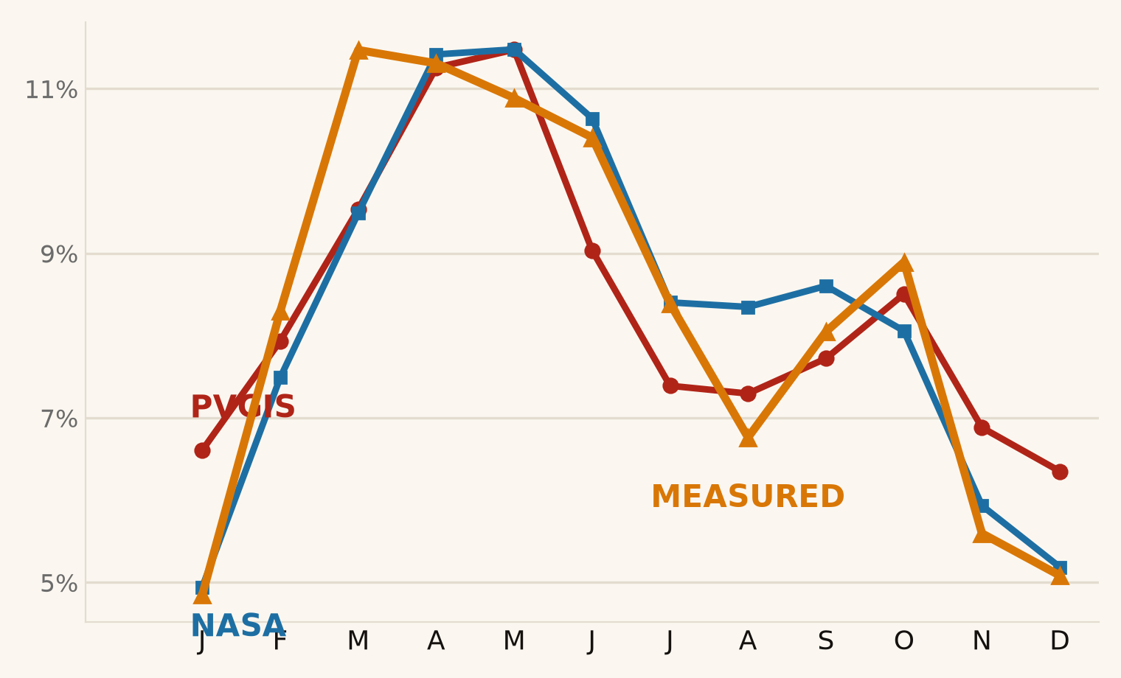
PART 3
Collecting the sunshine data
10%
disagreement between
the two sunshine sources
— almost all of it in winter.
We settled it with the campus's own meters.
Real generation tracks NASA almost exactly.
Trusting the standard tool would have made every figure about 10% too high.

Slide 8
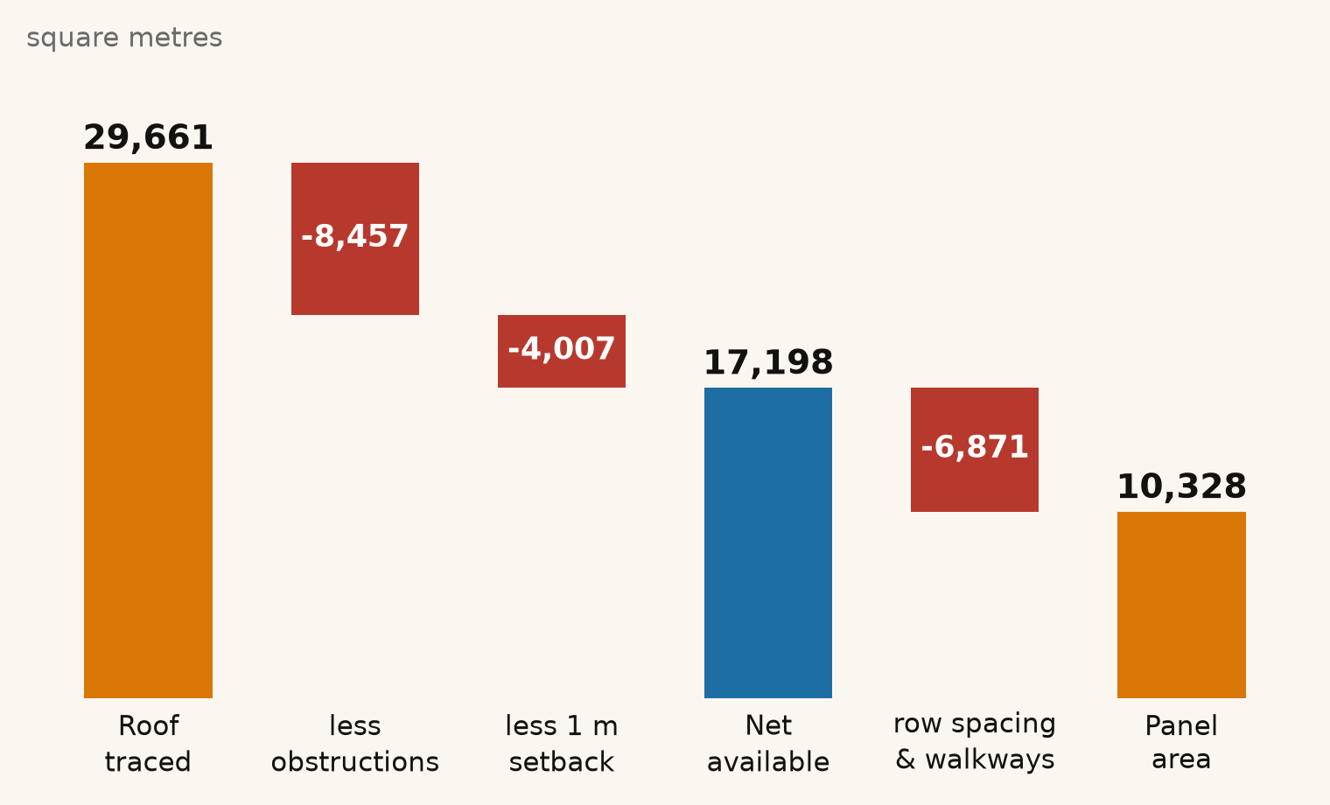
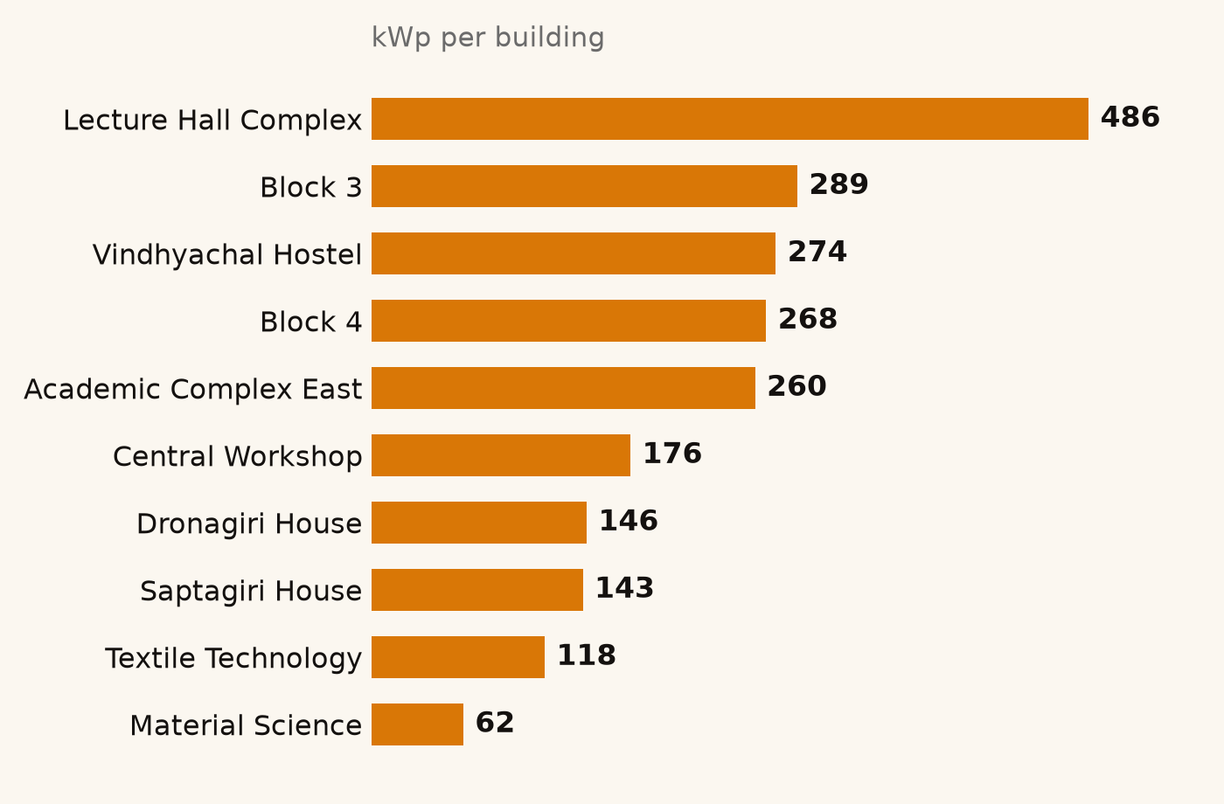
PART 4 · MEASURING THE ROOFS
2.2 MWp
could be installed across the ten roofs
— about three times the solar the campus already has.
FROM ROOF TO PANELS
WHAT EACH ROOF COULD CARRY

Slide 9
PARTS 5 TO 9
What comes next
5
6
7
8
9
Machine
learning
Shadows
Electricity
Grid
impact
Report
and costs
Train a model to find roofs automatically, so the method scales from 10 buildings to all 200.
How much sun each roof loses to neighbouring buildings and trees.
Convert sunshine and roof area into units, checked against the working plants.
Whether the 11 kV network can absorb it. Waiting on three Estate Office documents.
Payback, cost per unit, and the ranked list of roofs worth doing first.

Slide 10
Thank you
Questions welcome
4
10
2.2 MWp
plants found stopped
roofs measured
untapped potential

