Slide 1

Computer Vision Homework #4
TA：Syahrul Munir
Email： t111999406@ntut.org.tw
Robot Vision Lab (Room 1421)

Slide 2
Homework Assignment
2023/10/03 – Homework 1 assigned, due 10/17
2023/11/07 – Homework 2 assigned, due 11/21
2023/11/28 – Homework 3 assigned, due 12/12
2023/12/19 – Homework 4 assigned, due 01/02

Slide 3
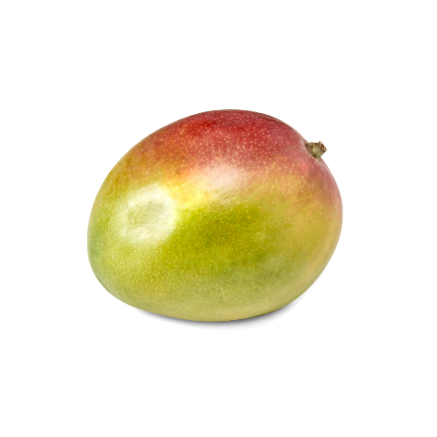
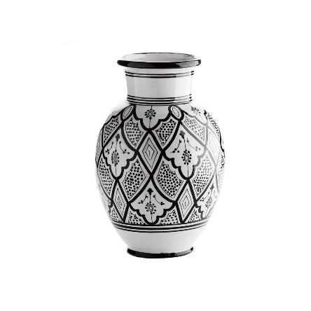
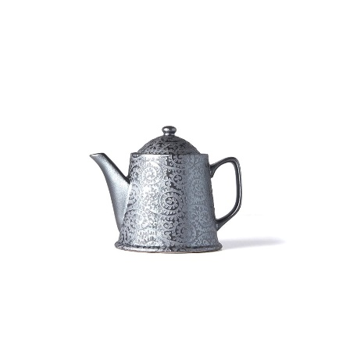
Homework 4
Active Contour
There are three functions that you need to implement.
Set initial points (Q1)
Find the contour (Q2)
Save the result videos (Q3)
There are totally 3 test images.
For each test image, you will get 1 result image and 1 result video.
img1.jpg
img2.jpg
Note:
You are allowed to use library to draw points/lines and to generate the videos
img3.jpg

Slide 4
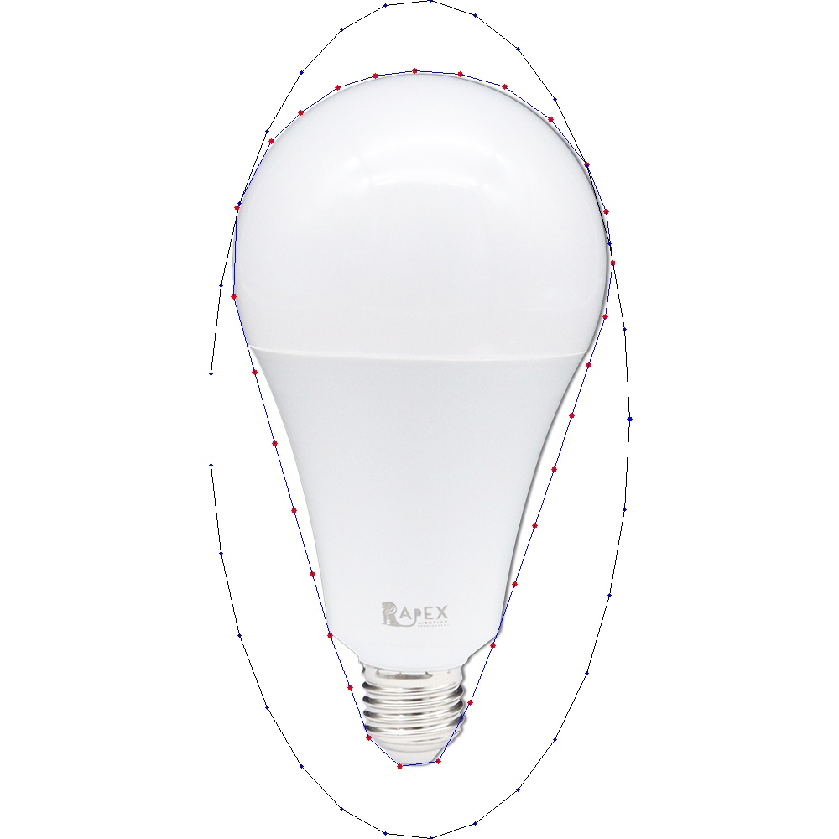
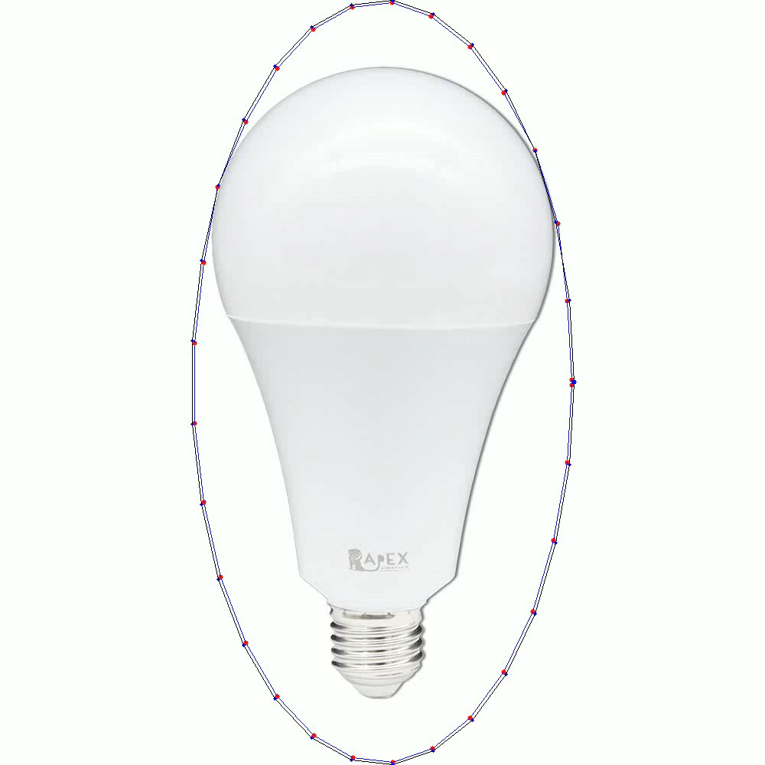
Example
result_img1.jpg
vid_img1.avi

Slide 5
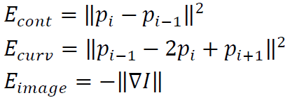
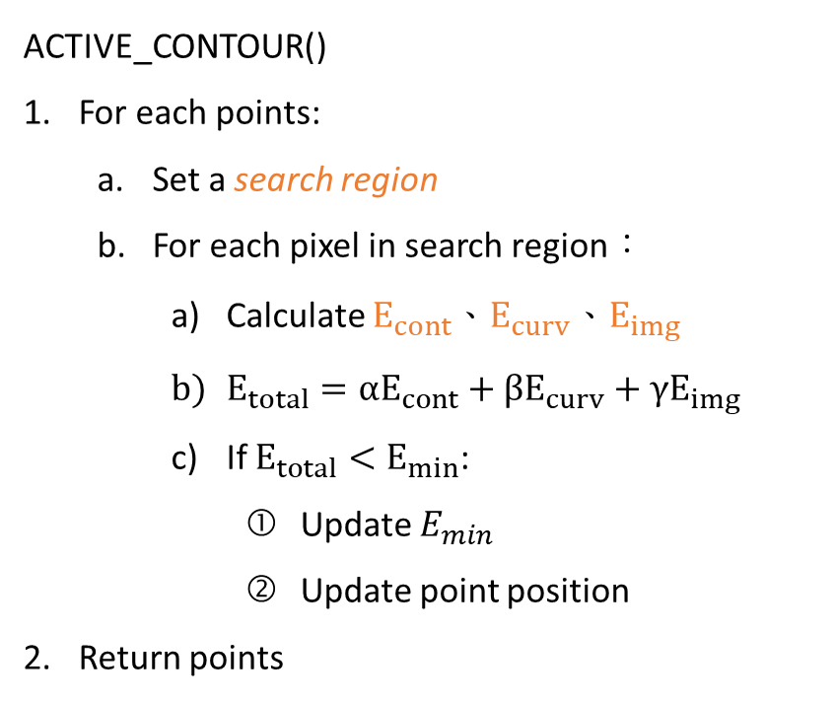


ACTIVE_CONTOUR()
For each points:
Set a search region
For each pixel in search region：
Calculate $E_{cont}$、$E_{curv}$、$E_{img}$
$E_{total}=αE_{cont}+βE_{curv}+γE_{img}$
If $E_{total}<E_{min}$:
Update $E_{min}$
Update point position
Return points
Find The Contour
Read image
Convert RGB image to Grayscale
Do Gaussian Blur
Calculate the edge strength of image using Sobel operator
Generate NUM_POINTS points near the object
For i = 0 to MAX_ITERATION:
points = ACTIVE_CONTOUR()
Stop the loop if points are not changing
Draw the new points on image
Save current result
Save result video
$$\left\|p_{i}−p_{i−1}\right\|=\sqrt{{\left(x_{i}−x_{i−1}\right)}^{2}+{\left(y_{i}−y_{i−1}\right)}^{2}}$$
$$\left\|p_{i−1}−{2p}_{i}−p_{i+1}\right\|=$$
$$\sqrt{{\left(x_{i−1}−2x_{i}+x_{i+1}\right)}^{2}+{\left(y_{i−1}−2y_{i}+y_{i+1}\right)}^{2}}$$
$$\left\|∆I\right\|=image gradient in that pixel$$

Slide 6
Rules in using OpenCV or other Lib
Allow use Opencv for C/C++
Read, load, save, show : cvLoadImage, cvShowImage …
Define size of image: cvSize, cvGetSize
Define image : Mat
Not Allow use
Cannot use the function of OpenCV Lib to do the main part of homework, only allowed to use if I said it/agree with it.
Not limited to the OpenCV library only
Example:
cvtColor(image, gray, CV_RGB2GRAY); // convert RGB to Gray
cv2.filter2D //directly use convolution
np.Convolve2D //directly use convolution

Slide 7
Grading
Program (80%)
Set initial points (15%)
Find the contour (35%)
Save result videos (20%)
Coding Style (10%)
How many points and where to put for the initial step
How you built the function for find the contour
How you save the videos
Report (20%)
Please explain your code for each part of question.
Please paste 3 output images in your report.
Please submit 3 videos images.

Slide 8
Folder Structure
C/C++
Python
111999406 _hw4/
├─ project_hw4/
│ ├─ test_img/
│ │ ├─ img1.jpg
│ │ ├─ img2.jpg
│ │ ├─ img3.jpg
│ ├─ result_img/
│ │ ├─ result_ img1.jpg
│ │ ├─ result_ img2.jpg
│ │ ├─ result_ img3.jpg
│ │ ├─ vid_img1.avi
│ │ ├─ vid_img2.avi
│ │ ├─ vid_img3.avi
│ ├─ include/
│ │ ├─ func.h
│ ├─ func.cpp
│ ├─ main.cpp
├─ 111999406 _hw4.pdf
├─ Readme.txt
Write your report in English (PDF)
Explaining how your main function working and shown the results on your report.
111999406 _hw4/
├─ test_img/
│ ├─ img1.jpg
│ ├─ img2.jpg
│ ├─ img3.jpg
├─ result_img/
│ ├─ result_img1.jpg
│ ├─ result_ img2.jpg
│ ├─ result_ img3.jpg
│ ├─ vid_img1.avi
│ ├─ vid _img2.avi
│ ├─ vid_img3.avi
├─ 111999406_hw4.py
├─ 111999406_hw4.pdf
├─ Readme.txt

Slide 9
Homework #4
Please compress your files (program and report)
StudentID_hw4( for example: 111999406_hw4.zip)
Make sure the size of .zip file is no more than 50MB
Please submit to iStudy, in Homework 4 Assignment.
Deadline: 2024/01/02 23:59:59
For each hour late, 10% of the total score will be deducted.
Don’t share your code with other students. Do it by yourself.

Slide 10
Thanks for your attention

