Slide 1

Computer Vision Homework #1
TA: Syahrul Munir
Email: t111999406@ntut.org.tw
Robot Vision Lab (Room 1421)

Slide 2
Homework Assignment
2023/10/03 – Homework 1 assigned, due 10/17
2023/11/07 – Homework 2 assigned, due 11/21
2023/11/28 – Homework 3 assigned, due 12/12
2023/12/19 – Homework 4 assigned, due 01/02
Notes:
1.

Slide 3
Homework Assignment
Target:
Write the main functions by yourself to understand the theories of computer vision deeply.
Improve your skills about using C/C++/Python
In the future:
Develop a new algorithm/method and write main function by yourself.

Slide 4
OpenCV
Open Source Computer Vision Library
It has C++, Python, Java and MATLAB interfaces and supports Windows, Linux, Android and Mac OS
With C++ : https://opencv.org/releases/ (download)
How to install :
https://docs.opencv.org/master/df/d65/tutorial_table_of_content_introduction.html
With Python : pip install opencv-python

Slide 5
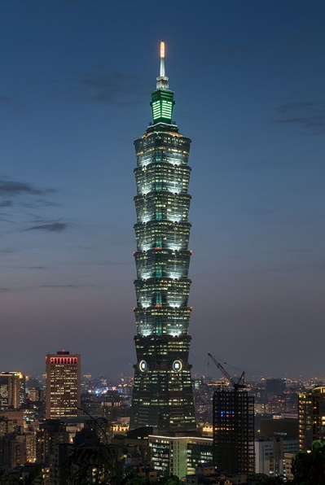
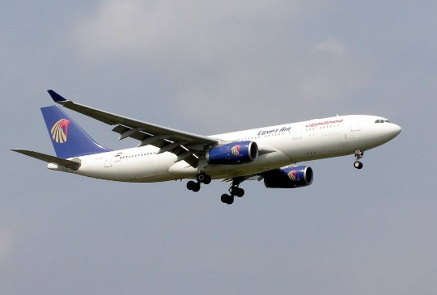
OpenCV
Import Library:
import numpy as np
import cv2
Read a image:
img = cv2.imread('image.jpg’)
Check image size:
height, width, channels = img.shape

Slide 6
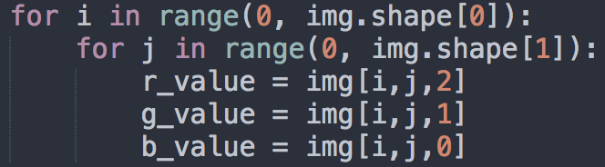
OpenCV
Example for get each pixel value:
Create new mat:
rgb_mat = np.zeros((height, width, 3), np.uint8)
gray_mat = np.zeros((height, width, 1), np.uint8)

Slide 7
OpenCV
Show image:
cv2.imshow('My Image', img)
cv2.waitKey(0)
cv2.destroyAllWindows()
Write image:
cv2.imwrite('output.jpg', img)

Slide 8
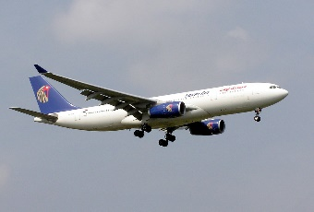
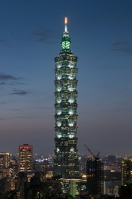
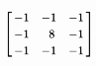
Homework 1
Give two images (taipei101.png and aeroplane.png) for testing:
1.Read a RGB image and write a function to convert the image to grayscale image.
2.Write a convolution operation with edge detection kernel
using zero padding and stride 1
3. Write a pooling operation with using Max pooling, 2x2 kernel, and stride 2
4. Write a binarization operation (set the threshold by yourself, e.g. 128). (>=128) set 255, (<128) set 0
C/C++ and Python are allowed to use (Choose one to finish homework)
Input
Q1
Q2
Q3
Q4
Output1
Output2
Output3
Output4

Slide 9
Example for the rules in using Opencv Lib
Allow use Opencv for C/C++
Read, load, save, show : cvLoadImage, cvShowImage …
Define size of image: cvSize, cvGetSize
Define image : Mat
Not Allow use
Cannot use the function of OpenCV Lib to do the main part of homework.
Example:
cvtColor(image, gray, CV_RGB2GRAY); // convert RGB to Gray

Slide 10
Example for the rules in using Opencv Lib
# Using OpenCV with Python
import cv2
import numpy as np
Allow use
Read, load, save, show
Define size of image:
Define image
Not Allow use
Cannot use the function of Lib to do the main part of homework.

Slide 11

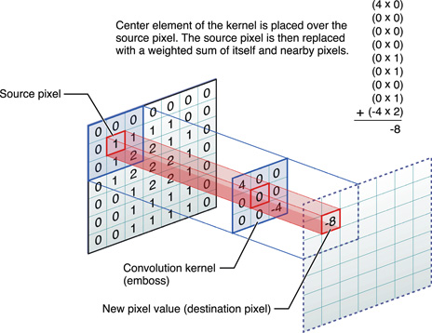
Convolution Operation

Slide 12

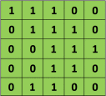

Convolution Operation
5 x 5 image
3 x 3 kernel
Notes:
https://towardsdatascience.com/applied-deep-learning-part-4-convolutional-neural-networks-584bc134c1e2

Slide 13
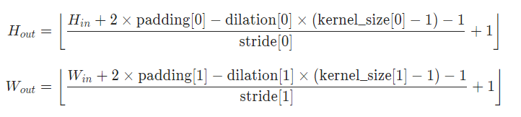
Homework1 Review
Padding
 | ✓
Img
Zero Padding :
https://www.youtube.com/watch?v=akf-b2jF3CA

Slide 14
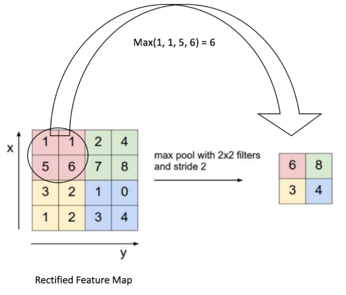
Pooling operations
Pooling Step: Spatial Pooling (also called sub-sampling or down sampling) reduces the dimension of each feature map but retains the most important information.
Some different types of Spatial Pooling : Max, Average, Sum etc.

Slide 15
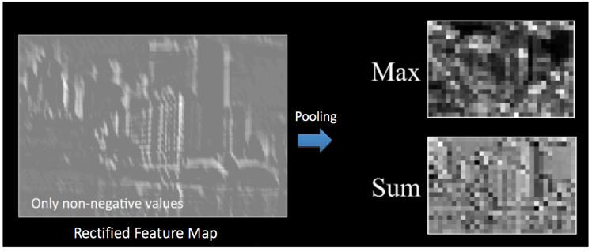
Pooling operations
Pooling Step

Slide 16
Homework 01
Grade
Program (80%)
Q1: 15%
Q2: 25%
Q3: 25%
Q4: 15%
Report : 20%
Explain your program and method
Result images
(2 input images, 8 outputs images)

Slide 17
Homework 1
Write your report in English (PDF)
Explaining how your main function working and shown the results on your report.
Python
C/C++
111999406_hw1/
├─ test_img/
│ ├─ taipei101.png
│ ├─ aeroplane.png
├─ result_img/
│ ├─ taipei101 _Q1.png
│ ├─ taipei101 _Q2.png
│ ├─ taipei101 _Q3.png
│ ├─ taipei101 _Q4.png
│ ├─ aeroplane _Q1.png
│ ├─ aeroplane _Q2.png
│ ├─ aeroplane _Q3.png
│ ├─ aeroplane _Q4.png
├─ 111999406 _hw1.py
├─ 111999406 _hw1.pdf
├─ Readme.txt
111999406 _hw1/
├─ project_hw1/
│ ├─ test_img/
│ │ ├─ taipei101.png
│ │ ├─ aeroplane.png
│ ├─ result_img/
│ │ ├─ taipei101 _Q1.png
│ │ ├─ taipei101 _Q2.png
│ │ ├─ taipei101 _Q3.png
│ │ ├─ taipei101 _Q4.png
│ │ ├─ aeroplane _Q1.png
│ │ ├─ aeroplane _Q2.png
│ │ ├─ aeroplane _Q3.png
│ │ ├─ aeroplane _Q4.png
│ ├─ include/
│ │ ├─ func.h
│ ├─ func.cpp
│ ├─ main.cpp
├─ 111999406 _hw1.pdf
├─ Readme.txt

Slide 18
Homework 1
Please compress your files (program and report)
StudentID_hw1( for example: 111999406_hw1.zip)
Please submit to iStudy, in Homework 1 Assignment.
Deadline: 2023/10/20 23:59:59
For each hour late, 10% of the total score will be deducted.
Don’t share your code and your report with other students. Do it by yourself.

Slide 19
Thanks for your attention

