Slide 1

Computer Vision Homework #2
TA：Syahrul Munir (Moon)
Email： t111999406@ntut.org.tw
Robot Vision Lab (Room 1421)

Slide 2
Homework Assignment
2023/10/03 – Homework 1 assigned, due 10/17
2023/11/07 – Homework 2 assigned, due 11/21
2023/11/28 – Homework 3 assigned, due 12/12
2023/12/19 – Homework 4 assigned, due 01/02

Slide 3
Note
What is considered to be “main part of the homework”
Do the homework according to the instructions. If you have another method, you can show it in the report, but don’t ignore/replace the original instructions.
Don’t forget the zero padding, check your image size result
Please check again your zip files content before submit
Don’t forget to use the correct input image
Please follow the rule to name your file
Introduce “Coding Style” score for next HW
More “original” code will have more score
Less function from library used will have more score
Don’t copy other code and/or report
Notes:
Last homework main part is rgb2ray, convolution (edge kernel and max pool), and binarization
Someone use another kernel although the instruction is to use a specific kernel. Some student try to do both of them and compare, but some student just ignore the main instruction and only do the new kernel
Some of student (maybe) do the wrong padding. You can check it by yourself from the image size result
Some student don’t submit the report
Some student do the homework completely wrong. Use original image as an input to Q1-Q4.

Slide 4
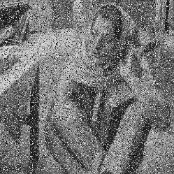
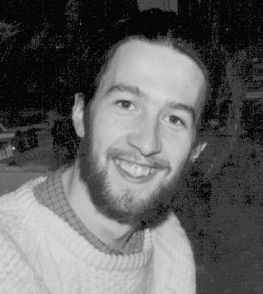
Homework 2
Given 2 images with noise (noise1.png and noise2.png) for testing as follow:
Mean Filter：decide the kernel size, stride, and zero-padding size by yourself. Use the same setting for all the noise images. (save as noise1_q1.png and noise2_q1.png )
Median Filter：decide the kernel size, stride, and zero-padding size by yourself. Use the same setting for all the noise images. (save as noise1_q2.png and noise2_q2.png )
Image Histogram：accumulate the number of each pixel value, then draw a histogram for each image, and explain the histogram result in your report (save as : noise1_his.png, noise1_q1 _his.png, noise1_q2 _his.png, noise2_his.png, noise2_q1 _his.png, noise2_q2 _his.png)
※ There will be totally 2 test images and 10 result images in your report.
Input
Q1
Q2
Output1
Output2
Q3
Q3
Q3
Output3
Output3
Output3

Slide 5
Example for the rules in using OpenCV
or other Lib
Allow use Opencv for C/C++
Read, load, save, show : cvLoadImage, cvShowImage …
Define size of image: cvSize, cvGetSize
Define image : Mat
Not Allow use
Cannot use the function of OpenCV Lib to do the main part of homework, only allowed to use if I said it/agree with it.
Not limited to the OpenCV library only
Example:
cvtColor(image, gray, CV_RGB2GRAY); // convert RGB to Gray
cv2.filter2D //directly use convolution
np.Convolve2D //directly use convolution

Slide 6
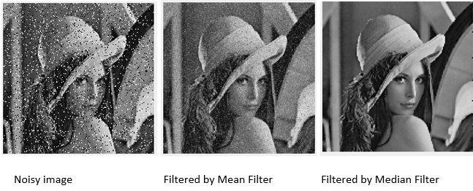
Mean Filter and Median Filter

Slide 7
Example：3*3 Mean Filter
As the kernel size increases, the image will become more blurry.
image
※ Please implement the mean algorithm by yourself.
152 | 124 | 252 | 163 | 32 | 67
128 | 40 | 220 | 190 | 142 | 216
68 | 157 | 24 | 30 | 140 | 36
81 | 7 | 25 | 149 | 155 | 41
22 | 33 | 100 | 131 | 75 | 67
69 | 44 | 44 | 167 | 231 | 161
129
1/9 | 1/9 | 1/9
1/9 | 1/9 | 1/9
1/9 | 1/9 | 1/9
*
=
$$\left\lfloor \frac{1}{9}\left(152+124+252+128+40+220+68+157+24\right)\right\rfloor =129$$

Slide 8
Example：3*3 Median Filter
It’s a nonlinear filter.
152 | 124 | 252 | 163 | 32 | 67
128 | 40 | 220 | 190 | 142 | 216
68 | 157 | 24 | 30 | 140 | 36
81 | 7 | 25 | 149 | 155 | 41
22 | 33 | 100 | 131 | 75 | 67
69 | 44 | 44 | 167 | 231 | 161
128
Sorting：24, 40, 68, 124, 128, 152, 157, 220, 252
image
※ Please implement the sorting algorithm by yourself.

Slide 9
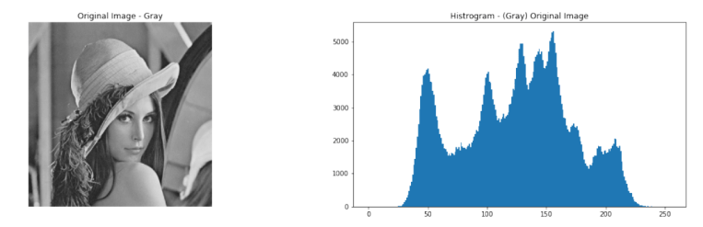
Image Histogram
Count the number of each pixel’s intensity (0~255)
Create a table to record the number of each pixel’s intensity.
You can draw the histogram by using the library of matplotlib or others. (exception)

Slide 10
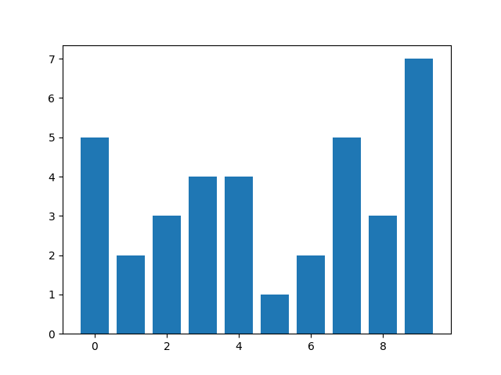
Example：Image Histogram
1 | 3 | 7 | 3 | 0 | 7
5 | 2 | 3 | 9 | 1 | 4
4 | 9 | 4 | 7 | 7 | 6
2 | 7 | 8 | 5 | 6 | 0
1 | 9 | 0 | 4 | 2 | 1
0 | 3 | 8 | 9 | 8 | 9
value | 0 | 1 | 2 | 3 | 4 | 5 | 6 | 7 | 8 | 9
#num | 5 | 2 | 3 | 4 | 4 | 1 | 2 | 5 | 3 | 7
statistics
draw histogram
image
※ The sum of #num must be equal to width of image * height of image

Slide 11
Grading
Program (75%)
Mean Filter (25%)
Median Filter (25%)
Image Histogram (15%)
Coding Style (10%)
Report (25%)
Please explain your code.
For each test image, compare the result images that were generated by two different filters and describe what you observe.
For each test image, please describe the difference between three histograms (original, mean filter output, and median filter output), and explain the reason.
Please paste 10 output images in your report.

Slide 12
Folder Structure
C/C++
111999406 _hw2/
├─ project_hw2/
│ ├─ test_img/
│ │ ├─ noise1.png
│ │ ├─ noise2.png
│ ├─ result_img/
│ │ ├─ noise1_q1.png
│ │ ├─ noise1_q2.png
│ │ ├─ noise1_his.png
│ │ ├─ noise1_q1_his.png
│ │ ├─ noise1_q2_his.png
│ │ ├─ noise2_q1.png
│ │ ├─ noise2_q2.png
│ │ ├─ noise2_his.png
│ │ ├─ noise2_q1_his.png
│ │ ├─ noise2_q2_his.png
│ ├─ include/
│ │ ├─ func.h
│ ├─ func.cpp
│ ├─ main.cpp
├─ 111999406 _hw2.pdf
├─ Readme.txt
Python
111999406 _hw2/
├─ test_img/
│ ├─ noise1.png
│ ├─ noise2.png
├─ result_img/
│ ├─ noise1_q1.png
│ ├─ noise1_q2.png
│ ├─ noise1_his.png
│ ├─ noise1_q1_his.png
│ ├─ noise1_q2_his.png
│ ├─ noise2_q1.png
│ ├─ noise2_q2.png
│ ├─ noise2_his.png
│ ├─ noise2_q1_his.png
│ ├─ noise2_q2_his.png
├─ 111999406_hw2.py
├─ 111999406_hw2.pdf
├─ Readme.txt
Write your report in English (PDF)
Explaining how your main function working, shown the results on your report, and explain the image result.

Slide 13
Homework #2
Please compress your files (program and report)
StudentID_hw2( for example: 111999406_hw2.zip)
Please submit to iStudy, in Homework 2 Assignment.
Deadline: 2023/11/21 23:59:59
For each hour late, 10% of the total score will be deducted.
Don’t share your code and your report with other students. Do it by yourself.

Slide 14
Thanks for your attention

