Slide 1

Computer Vision Homework #3
TA：Syahrul Munir (Moon)
Email： t111999406@ntut.org.tw
Robot Vision Lab (Room 1421)

Slide 2
Homework Assignment
2023/10/03 – Homework 1 assigned, due 10/17
2023/11/07 – Homework 2 assigned, due 11/21
2023/11/28 – Homework 3 assigned, due 12/12
2023/12/19 – Homework 4 assigned, due 01/02

Slide 3
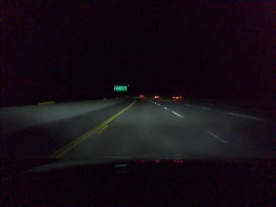
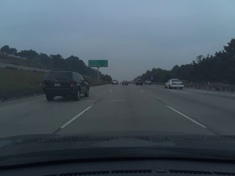
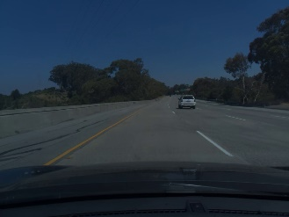
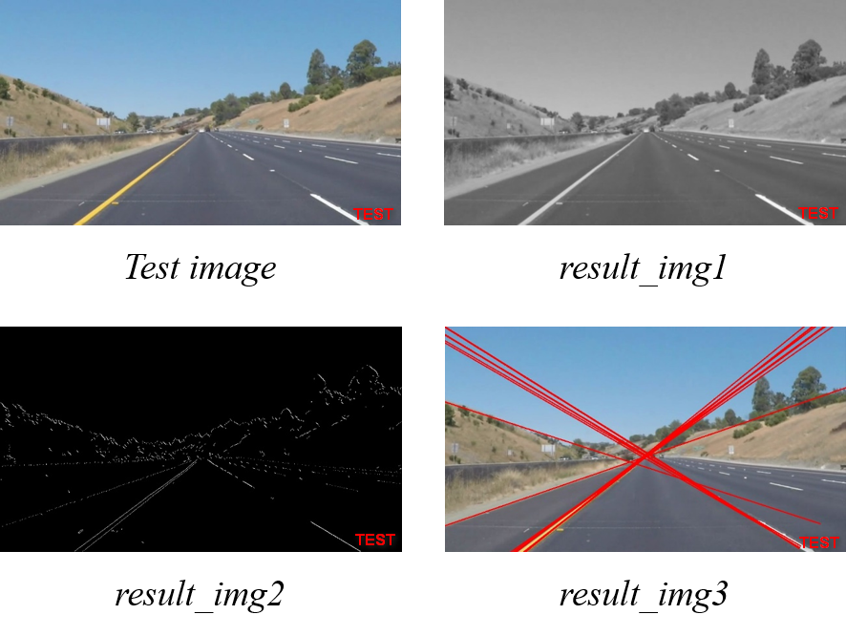
Homework 3
Lane Detection
There are three functions that you need to implement.
Gaussian Blur (q1)
Canny Edge Detection (q2)
Hough Transform (q3)
There are 3 test images.
For each test image, you will get 3 result images.
NB: you can use the different parameter for different test images.

Slide 4
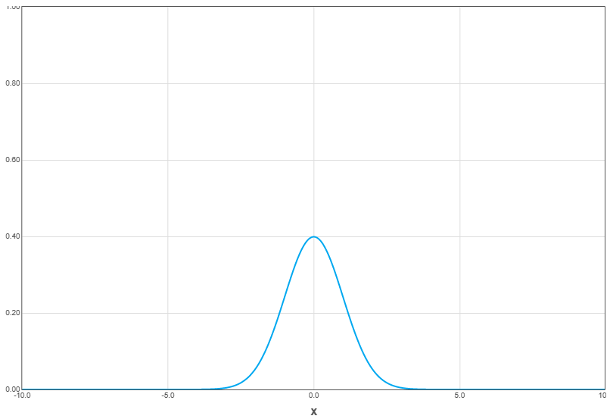
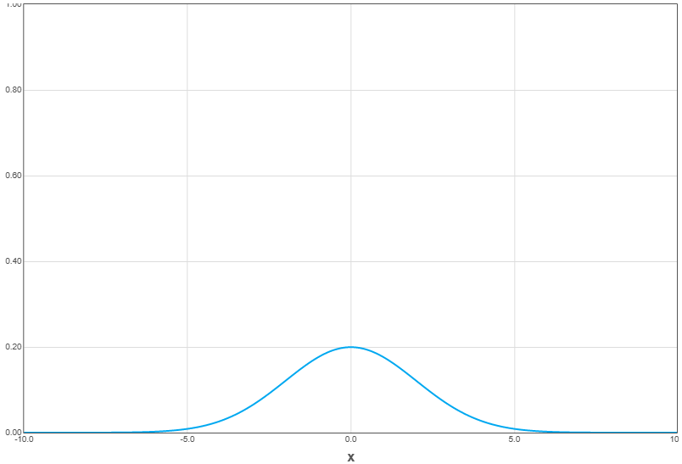
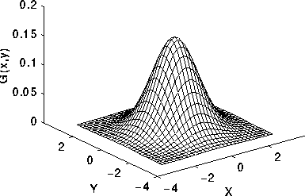

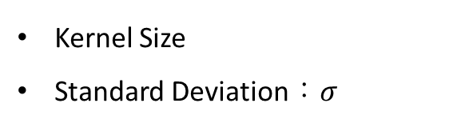

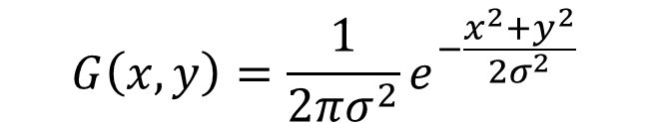
Gaussian Filter
Kernel Size
Standard Deviation：$σ$
$$σ=1.0$$
$$G\left(x, y\right)=\frac{1}{2πσ^{2}}e^{−\frac{x^{2}+y^{2}}{2σ^{2}}}$$
$$σ=2.0$$

Slide 5

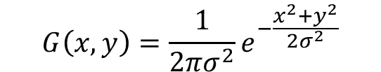
Gaussian Filter
(-1, -1) | (0, -1) | (1, -1)
(-1, 0) | (0, 0) | (1, 0)
(-1, 1) | (0, 1) | (1, 1)
0.0585 | 0.0965 | 0.0585
0.0965 | 0.1591 | 0.0965
0.0585 | 0.0965 | 0.0585
$$G\left(x, y\right)=\frac{1}{2πσ^{2}}e^{−\frac{x^{2}+y^{2}}{2σ^{2}}}$$
(x, y)
$$σ=1.0$$

Slide 6
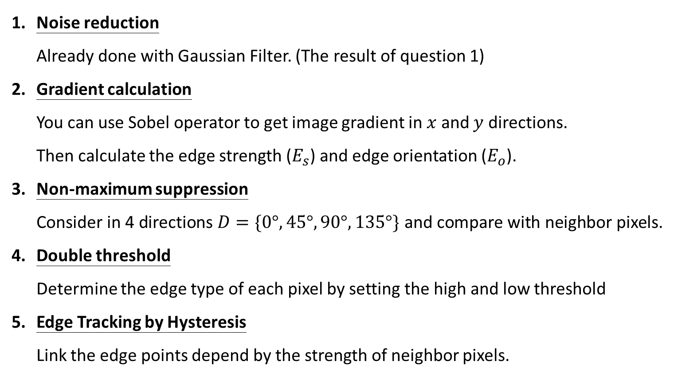
Canny Edge Detection
Noise reduction Already done with Gaussian Filter. (The result of question 1)
Gradient calculation You can use Sobel operator to get image gradient in $x$ and $y$ directions. Then calculate the edge strength ($E_{s}$) and edge orientation ($E_{o}$).
Non-maximum suppression Consider in 4 directions $D=\{0°, 45°, 90°, 135°\}$ and compare with neighbor pixels.
Double threshold Determine the edge type of each pixel by setting the high and low threshold
Edge Tracking by Hysteresis Link the edge points depend by the strength of neighbor pixels.
-1 | 0 | 1
-2 | 0 | 2
-1 | 0 | 1
-1 | -2 | -1
0 | 0 | 0
1 | 2 | 1
Sobel x
Sobel y
strong
High threshold
weak
Low threshold
suppress

Slide 7

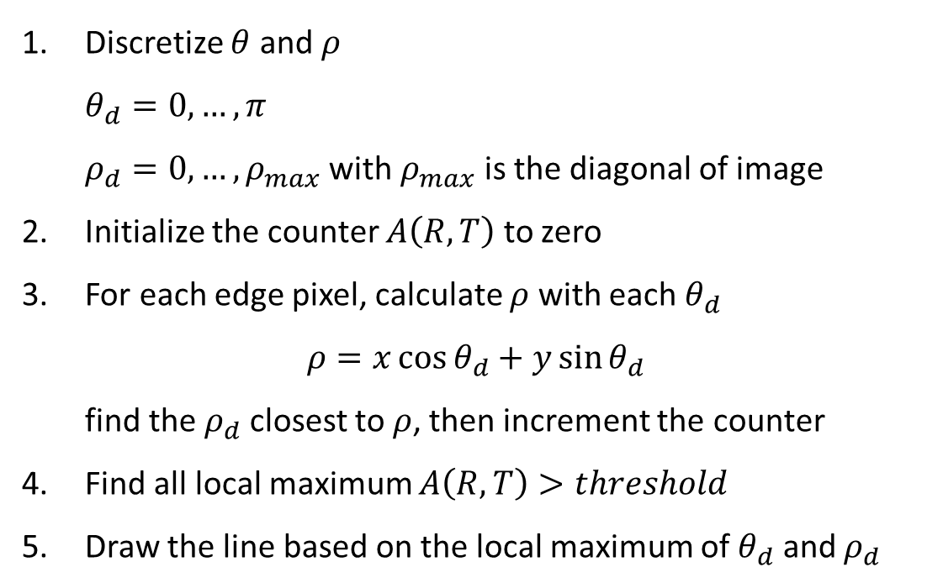

Hough Transform
Discretize $θ$ and $ρ$ $θ_{d}=0,…,π$ $ρ_{d}=0, …, ρ_{max}$ with $ρ_{max}$ is the diagonal of image
Initialize the counter $A\left(R,T\right)$ to zero
For each edge pixel, calculate $ρ$ with each $θ_{d}$ $ρ=x\cos{θ_{d}}+y\sin{θ_{d}}$ find the $ρ_{d}$ closest to$ρ$, then increment the counter
Find all local maximum $A\left(R,T\right)>threshold$
Draw the line based on the local maximum of $θ_{d}$ and $ρ_{d}$
$$θ$$
$$ρ$$
Counter

Slide 8
Grading
Program (80%)
Gaussian Filter (15%)
Canny Edge Detection (30%)
Hough Transform (25%)
Coding Style (10%)
Report (20%)
Please explain your code.
Please paste 3 input images and 9 output images in your report.

Slide 9
Folder Structure
C/C++
Python
111999406 _hw3/
├─ project_hw3/
│ ├─ test_img/
│ │ ├─ test_img1.png
│ │ ├─ test_img2.png
│ │ ├─ test_img3.png
│ ├─ result_img/
│ │ ├─ img1_q1.png
│ │ ├─ img2_q1.png
│ │ ├─ img3_q1.png
│ │ ├─ img1_q2.png
│ │ ├─ img2_q2.png
│ │ ├─ img3_q2.png
│ │ ├─ img1_q3.png
│ │ ├─ img2_q3.png
│ │ ├─ img3_q3.png
│ ├─ include/
│ │ ├─ func.h
│ ├─ func.cpp
│ ├─ main.cpp
├─ 111999406 _hw3.pdf
├─ Readme.txt
Write your report in English (PDF)
Explaining how your main function working and shown the results on your report.
111999406 _hw3/
├─ test_img/
│ ├─ test_img1.png
│ ├─ test_img2.png
│ ├─ test_img3.png
├─ result_img/
│ ├─ img1_q1.png
│ ├─ img2_q1.png
│ ├─ img3_q1.png
│ ├─ img1_q2.png
│ ├─ img2_q2.png
│ ├─ img3_q2.png
│ ├─ img1_q3.png
│ ├─ img2_q3.png
│ ├─ img3_q3.png
├─ 111999406_hw3.py
├─ 111999406_hw3.pdf
├─ Readme.txt

Slide 10
Homework #3
Please compress your files (program and report)
StudentID_hw3( for example: 111999406_hw3.zip)
Please submit to iStudy, in Homework 3 Assignment.
Deadline: 2023/12/12 23:59:59
For each hour late, 10% of the total score will be deducted.
Don’t share your code and your report with other students. Do it by yourself.

Slide 11
Thanks for your attention

