Slide 1


INFO8000 Final Project A Web tool for Peanut Stem Rot Research, Disease Forecast and Management
Apr. 30th, 2020
Po-Yun Teng and Yun-Ching Tsai

Slide 2
This tool aims…
For researcher:
A handy tool for data input and management.
Review the raw data in greenhouse and get a preliminary results based on data visualization.
For farmer:
Get predicted value of this soilborne disease based on model.
Get chemical suggestion based on weather forecast.

Slide 3
To develop a greenhouse method for peanut stem rot evaluation
14 genotypes of peanut: 1 resistant control, 1 susceptible control and 12 recombinant inbred lines from a population.
Length of lesion was observed at 3, 5, 7, and 9 days after inoculation
Researcher tool

Slide 4
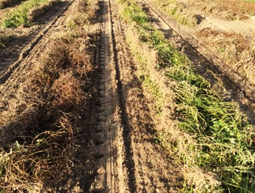
Correlation between Greenhouse and Multi-year Field Data
Analytical approach:
correlation coefficient
fisher z-transform
generalized linear regression
Tukey’s test
Application of Greenhouse Data

Slide 5
Disease Prediction and Chemical Suggestion
Based on the correlation data, a predicted model will be determined. The end-season disease level in field will be calculated.
Based on previous analyses, a chemical suggestion will be provided based on the weather forecast.
Farmer Tool

Slide 6
Disease Prediction and Chemical Suggestion
When length of lesion on base of stem > 0.3-cm
< 24ºC
Chemical Not Necessary
No
Temperature
Chemical
Genotype
628,660,668,708
Rain
> 24ºC
Chemical Not Necessary
Other genotypes
Chemical
Yes
Farmer Tool

Slide 7
http://104.197.161.172
Homepage
Researcher
Farmer
Input new data
Weather data collected from websites
Input new data
Reset data
Read data
Analyze and visualization
Prediction Suggestion
Visualization

Slide 8
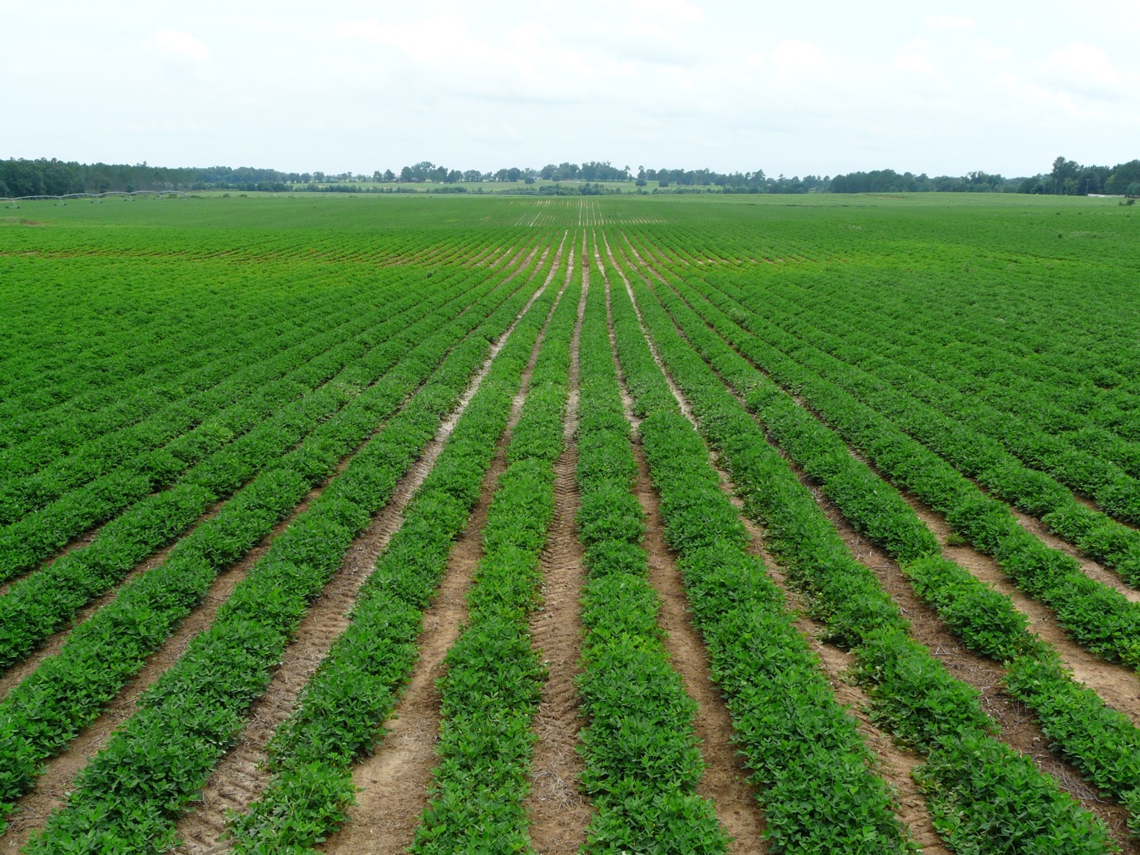
Questions?
http://thomascountyag.files.wordpress.com/2013/08/cottonweeds-corn-013.jpg

