Slide 1


Global Summation in Parallel
Sean Tronsen

Slide 2
Task
Calculate a summation using a parallel tree-based reduction
Parallelism is to be achieved via the message-passing model instead of the shared memory model

Slide 3
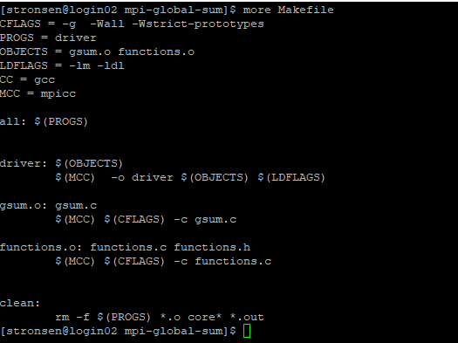
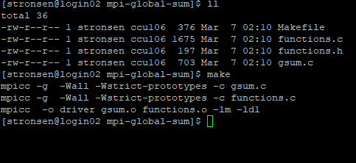
Compilation

Slide 4
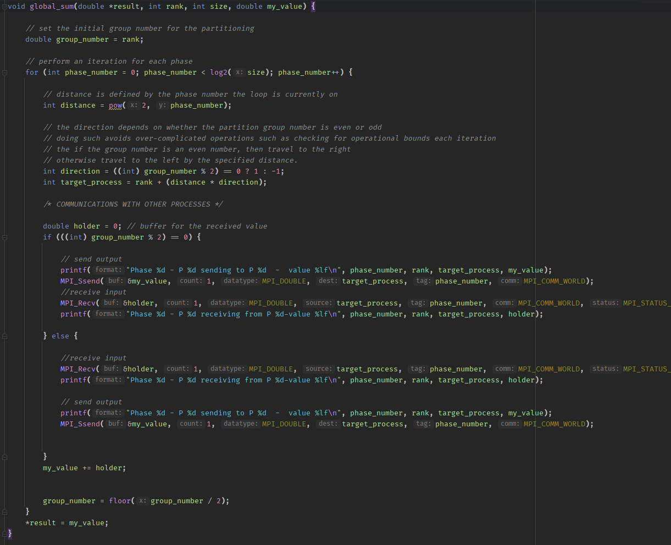
Global Sum Definition

Slide 5
Global Sum Definition Continued
Each process calculates the global sum on its own accord via communications with other processes
The program requires that it is executed with a number of processes with said number being a power of 2
A base 2 logarithm calculates the number of phases from the total number of processes

Slide 6
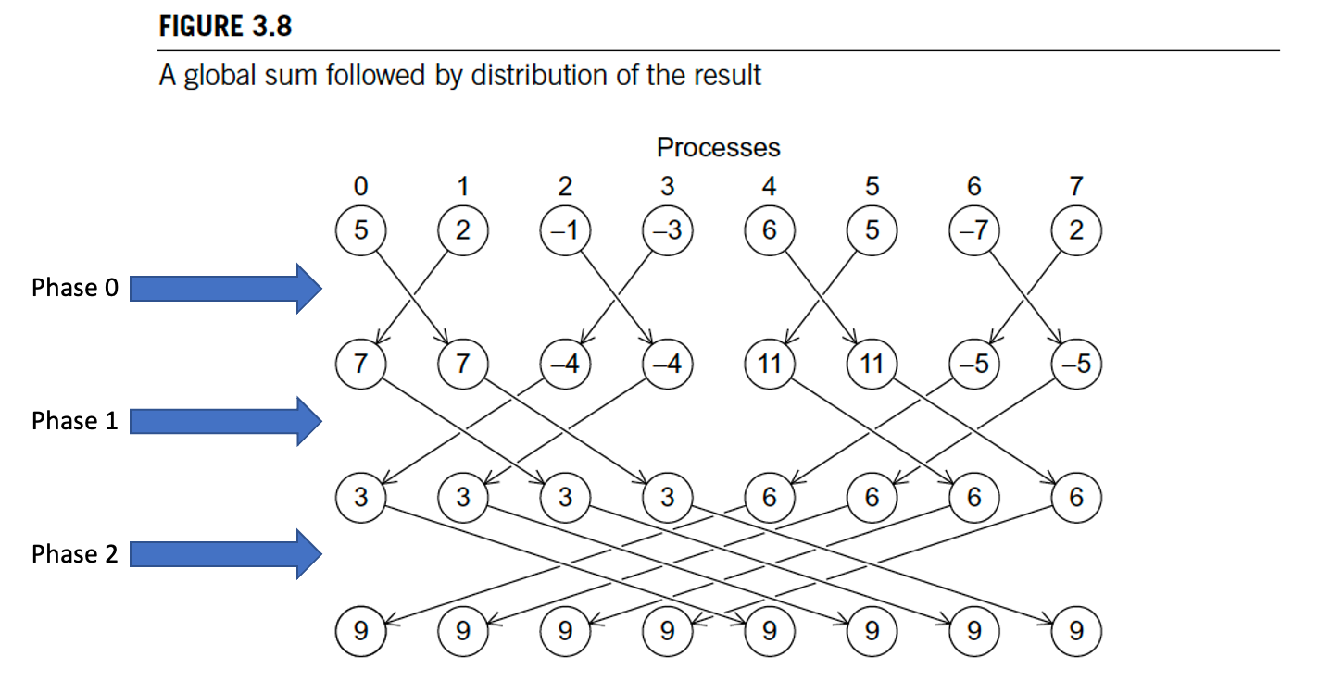
Determining Target Communications
In viewing the graph, in the initial phase, even numbers travel to the right and odd numbers to the left
However, the behavior is not necessarily as intuitive for the phases that follow
There is a bound the travel must abide by when the program selects the next target
This bound depends on the number of processes and the current phase number
To view the problem more simply, notice that there are groupings in the first phase and let the groups be the process number. As such, even numbered groups travel to the right and odd numbered groups travel to the left.
This process continues in the next phase as well, but notice the groups change.
If we have 4 groups instead of 8 and maintain the same behavior, the even number and odd number groups will still travel to the correct destination.
Example: In phase 2, processes 0 and 1, which were originally in groups 0 and 1 respectively, are placed into group 0. Notice in the graph that all members of this group travel to the right as they are meant to do.
The idea of the algorithm is to complete the phase and reassign the process group number by dividing the current group number by 2 (using math floor to round down). If the new group number is even, then that process travels to the right, otherwise it travels to the left.
The distance traveled is 2^phase_number
Target process = current_process_rank + (distance*direction)

Slide 7
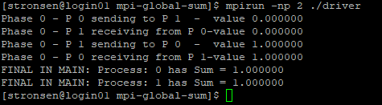
Execution with 2 Processes

Slide 8
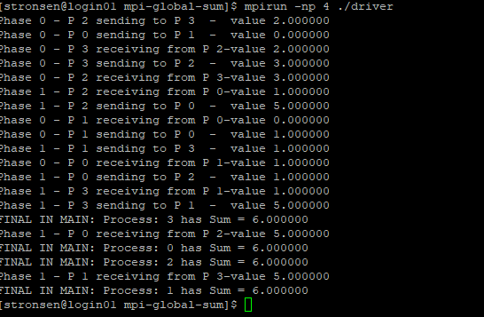
Execution with 4 Processes

Slide 9
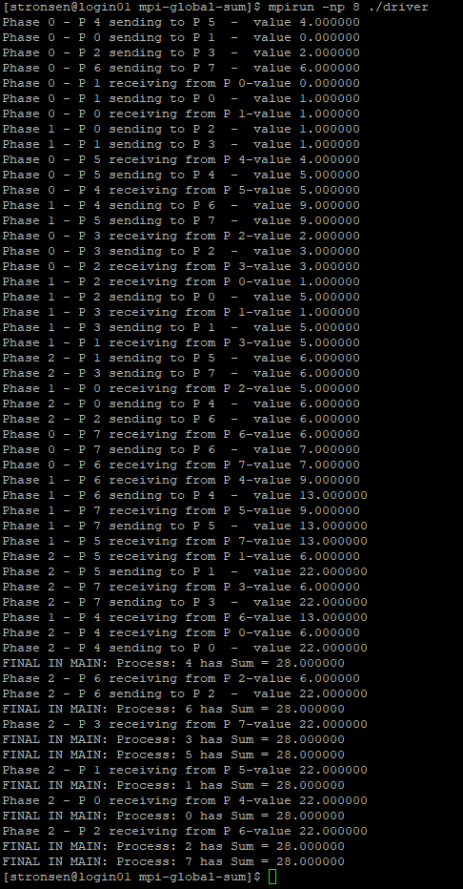
Execution with 8 Processes

Slide 10
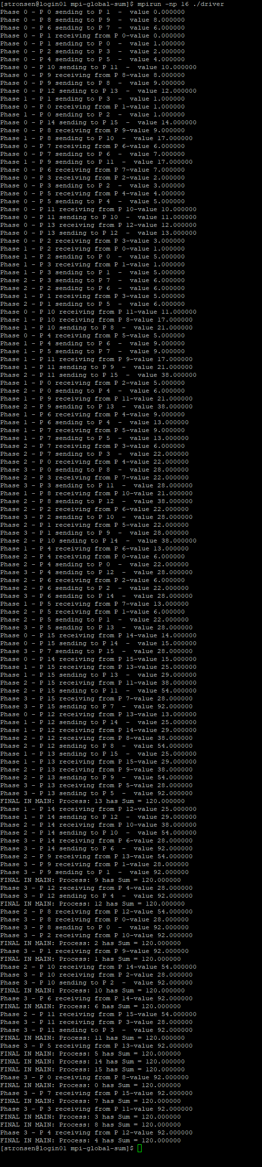
Execution with 16 Processes

