Slide 1

The Diagonal Argument and Algorithm W
S e a n W e s t f a l l

Slide 2
My Background
My Name is Sean Westfall.
I have a degree in Computer Science from Loyola University Chicago.
I am doing this because I am just interested in Computer Science and functional programming.
Github: https://github.com/seanwestfall
Twitter: https://twitter.com/alphonse86
Personal Website: fieldsofgoldfi.sh
I do not use any of this at work, nor would I recommend it.

Slide 3

Table of Contents
About me
01. What is a Programming Language
02. What is a Type
03. What is a Statically Typed Programming Language
04. Static Typing vs Dynamic Typing
05. What should you care
06. Advantages and Disadvantages of Statically Typed Programming Languages
07. What is Type Checking
08. The Hindley Miller Type System
09. The Rules of Algorithm W
10. Unification
11. Proof of Completeness
12. Proof of Soundness
13. The Diagonal Argument

Slide 4
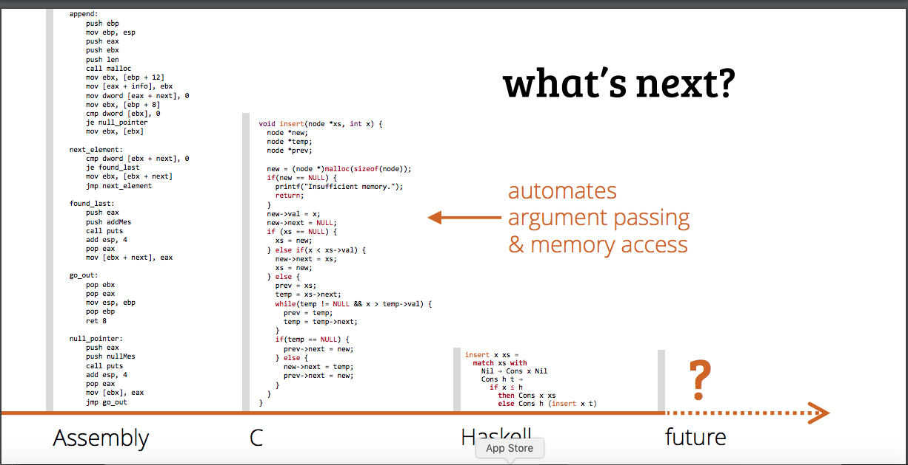
What is a Programming Language ( aka the beginning of the Universe )

Slide 5
What is a Type
A Type is something that is something indefinitely within your programming language throughout both the compile time and run time of your application/program.
Examples of types include:
(Primitive Types) Strings, Chars, Floats…
(Complex Types) Objects, Array, Classes, Type Classes…
Higher Ranked Polymorphism or Rank-N-Types

Slide 6
Static Type Checking
Let’s start with what is Type Checking
What is a Statically Typed Programming Language
Static type checking is the process of verifying the type safety of a program based on analysis of a program's text (source code). If a program passes a static type checker, then the program is guaranteed to satisfy some set of type safety properties for all possible inputs.

Slide 7
What is a statically typed programming language (vs a dynamically typed language)
Loose typing
Strong typing
Languages are often colloquially referred to as strongly typed or weakly typed. In fact, there is no universally accepted definition of what these terms mean. In general, there are more precise terms to represent the differences between type systems that lead people to call them "strong" or "weak".
1) Static Type Checking
2) Dynamic Type Checking
Dynamic type checking is the process of verifying the type safety of a program at runtime. Implementations of dynamically type-checked languages generally associate each runtime object with a type tag (i.e., a reference to a type) containing its type information. This runtime type information (RTTI) can also be used to implement dynamic dispatch, late binding, downcasting, reflection, and similar features.
Most type-safe languages include some form of dynamic type checking, even if they also have a static type checker.^{[citation needed]} The reason for this is that many useful features or properties are difficult or impossible to verify statically. For example, suppose that a program defines two types, A and B, where B is a subtype of A. If the program tries to convert a value of type A to type B, which is known as downcasting, then the operation is legal only if the value being converted is actually a value of type B. Thus, a dynamic check is needed to verify that the operation is safe. This requirement is one of the criticisms of downcasting.

Slide 8
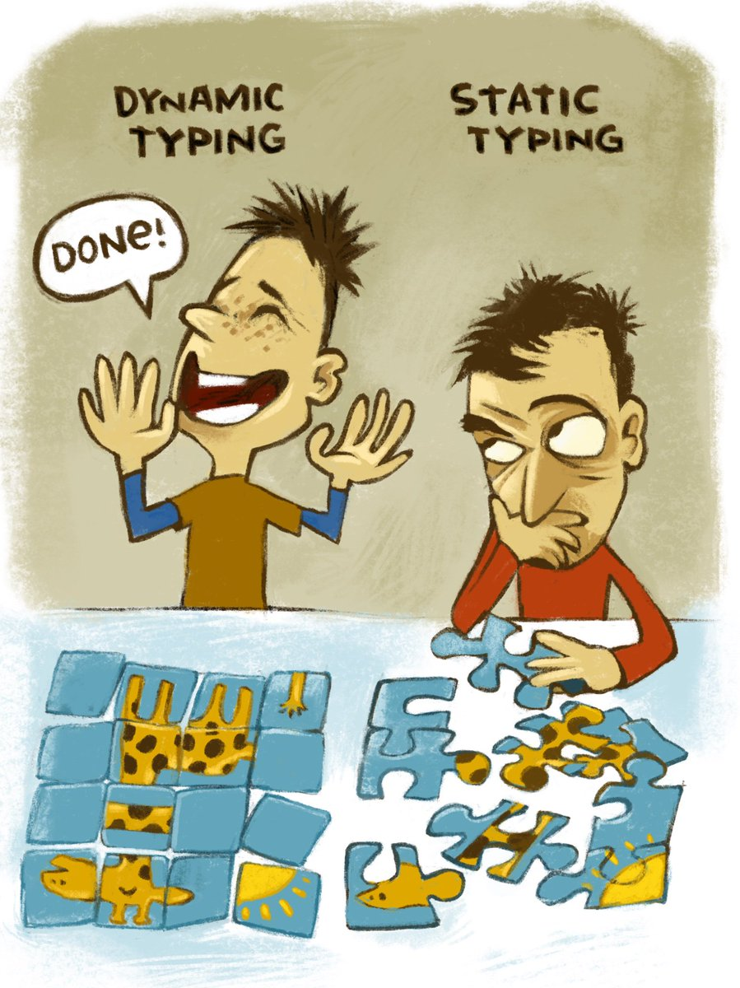
Why should you care?
Basically, the difference between static typing and dynamic typing is the difference between whether you know what you are doing or not.

Slide 9

But Ultimately, programming is a zero sum game. You couldn’t know what a program will do at runtime absolutely in either case so you can reason just as much that is doesn’t matter.

Slide 10
The Practical Disadvantages of Using Statically Typed Programming languages
Advantages
You don’t need as many unit tests and functional tests if you use type checking, since errors are removed at compile time.
The Type Checker goes through all your dependencies and makes sure it works in an intended way, so it’s possible to know something about your dependences
Disadvantages
When Typed Languages are updated, they brake working programs as they are updated.

Slide 11
What is Type Checking
Comparing Strings and Ints
Adding a String and an Int will result in a type error because they are not meant to be added together.

Slide 12
What is the Hindley Miller Type System
One and the same thing can be used for many purposes. A chair might be used to support a sitting person but also as a ladder to stand on while changing a light bulb or as a clothes valet. Beside having particular material qualities, which make a chair usable as such, it also has the particular designation for its use. When no chair is at hand, other things might be used as a seat, and so the designation of a thing can be changed as fast as one can turn an empty bottle crate upside down to change its purpose from a container to that of a support.
Different uses of physically near-identical things are usually accompanied by giving those things different names to emphasize the intended purpose. Depending on the use, seamen have a dozen or more words for a rope though it might materially be the same thing. The same in everyday language, where a leash indicates a use different to a line.

Slide 13

The basics of PureScript

Slide 14
TypeCheck.ps

Slide 15
Type Checking in GHC core

Slide 16
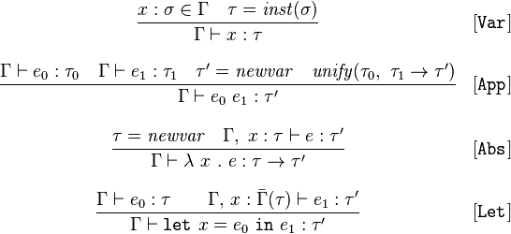
The Rules of Algorithm W

Slide 17

$$\frac{x : \text{σ} ∈ Γ τ =inst(\text{σ})}{Γ ⊢ :τ}$$

Slide 18
$$\frac{Γ⊢ ℯ_{0} : τ_{0 }Γ⊢ ℯ_{1} : τ_{1 }τ^{′}=newvar unify(τ_{0},{ τ}_{1}{ →τ}^{′}) }{Γ⊢ ℯ_{0}{ ℯ}_{1}:τ^{′}}$$

Slide 19

$$\frac{τ=newvar Γ, x :τ⊢ℯ :τ^{′}}{Γ⊢λ x .ℯ :τ→τ^{′}}$$

Slide 20


$$\frac{Γ⊢ℯ_{0} :τ Γ, x :\overline{Γ} (τ)⊢ℯ_{1} :τ^{′}}{Γ⊢let x=ℯ_{0} in{ ℯ}_{1 }:τ^{′}}$$

Slide 21
Unitification (pesudo code)
unify(ta,tb): ta = find(ta) tb = find(tb)
if both ta,tb are terms of the form D p1..pn with identical D,n
then unify(ta[i],tb[i]) for each corresponding ith parameter
else if at least one of ta,tb is a type variable
then union(ta,tb)
else error 'types do not match'
unification, the types for a well-structured program give rise to a set of constraints that when solved always have a unique principal type.

Slide 22
Proof of Completeness

Slide 23
Proof of Soundness

Slide 24
What is Bi-Directional Type Checking

Slide 25
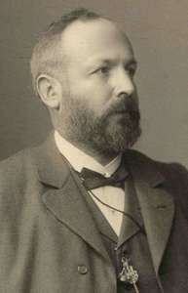
The Basics of the Diagonal Argument
History of the Digonal Argument
Gregor Cantor (1888)
Turing
Godel
Significance of the proof

Slide 26
Static type checking for Turing-complete languages is inherently conservative. That is, if a type system is both sound (meaning that it rejects all incorrect programs) and decidable (meaning that it is possible to write an algorithm that determines whether a program is well-typed), then it must be incomplete (meaning there are correct programs, which are also rejected, even though they do not encounter runtime errors).^{[6]} For example, consider a program containing the code:
if <complex test> then <do something> else <signal that there is a type error>
Even if the expression <complex test> always evaluates to true at run-time, most type checkers will reject the program as ill-typed, because it is difficult (if not impossible) for a static analyzer to determine that the else branch will not be taken.^{[7]} Conversely, a static type checker will quickly detect type errors in rarely used code paths. Without static type checking, even code coverage tests with 100% coverage may be unable to find such type errors. The tests may fail to detect such type errors, because the combination of all places where values are created and all places where a certain value is used must be taken into account.

Slide 27
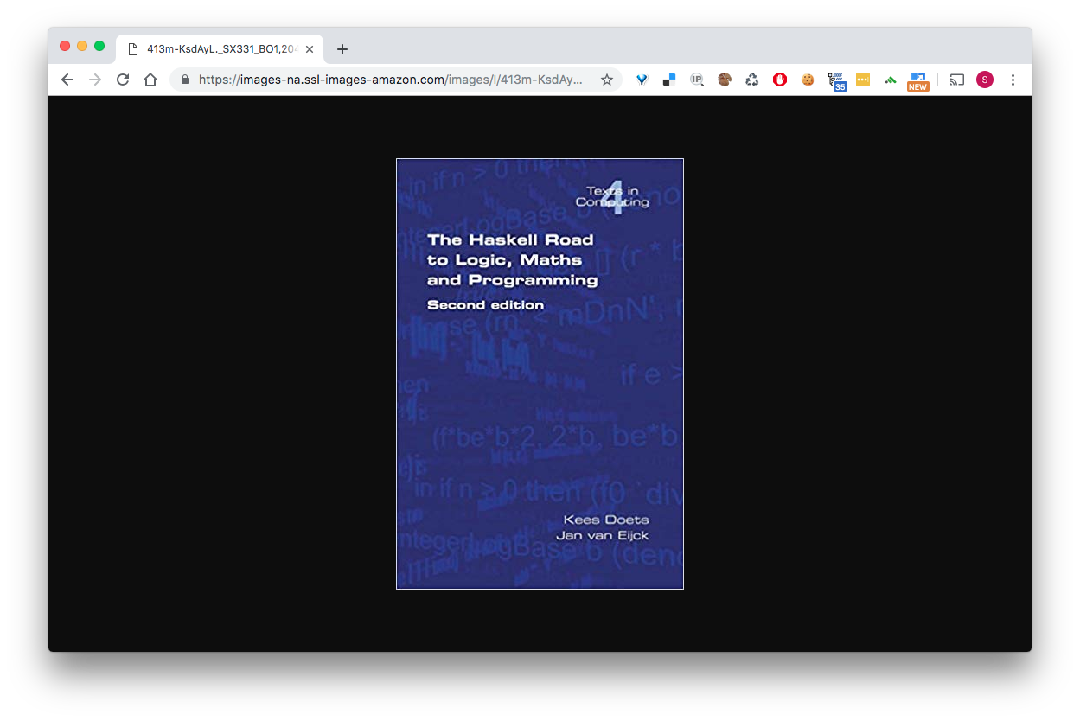

Slide 28
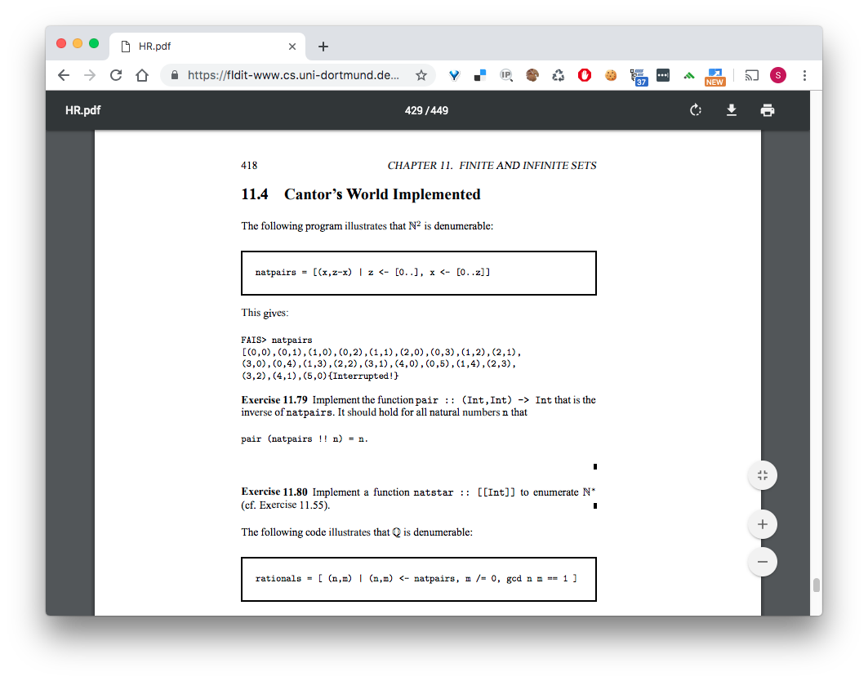
Cantor’s World Impleneted

Slide 29
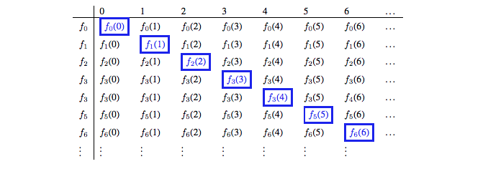
Diagonal Argument visualized Part 1

Slide 30
Loeb Theorem Part 2

Slide 31
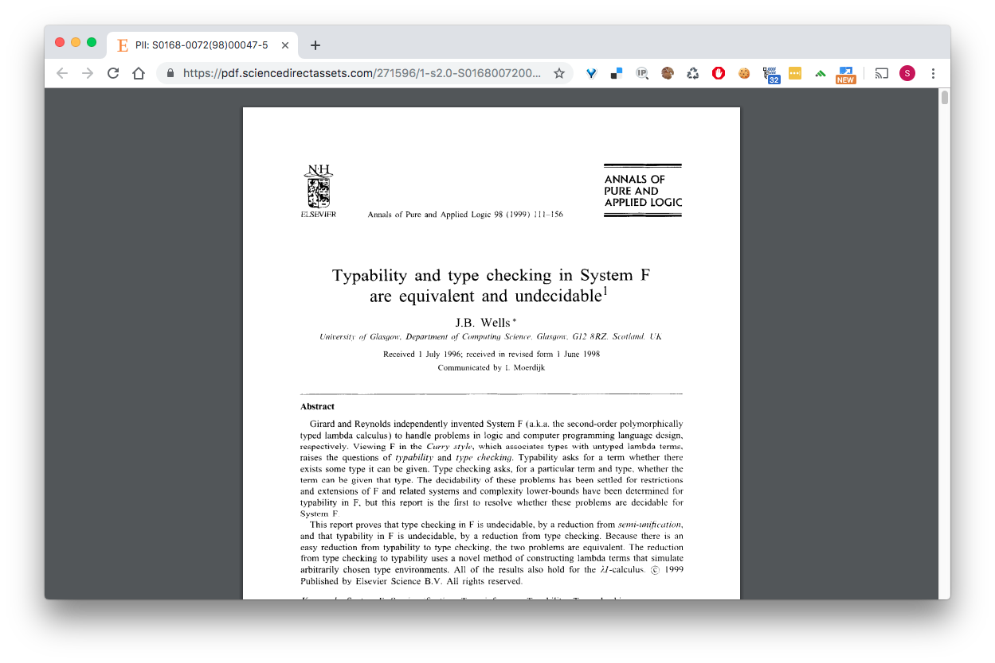
Has this proof been explored before… yes

Slide 32
Explain the proof in the previous paper
J.B. Well’s approach to proving Undecidability

Slide 33

References
Kimberly Knight, “Media Epidemics: Viral Structures in Literature and New Media” PhD diss., University of California, Santa Barbara, 2011, MLA International Bibliography (2013420395).
Limer, Eric. “Heck Yes! The First Free Wireless Plan is Finally Here.” Gizmodo. October 1, 2013. http://gizmodo.com/heck-yes-the-first-free-wireless-plan-is-finally-here-1429566597
Generalizing Hindley-Milner Type Inference Algorithms
Complete and Easy Bidirectional Typechecking for Higher-Rank Polymorphism

Slide 34


Slide 35
An example program written in PureScript

