Slide 1
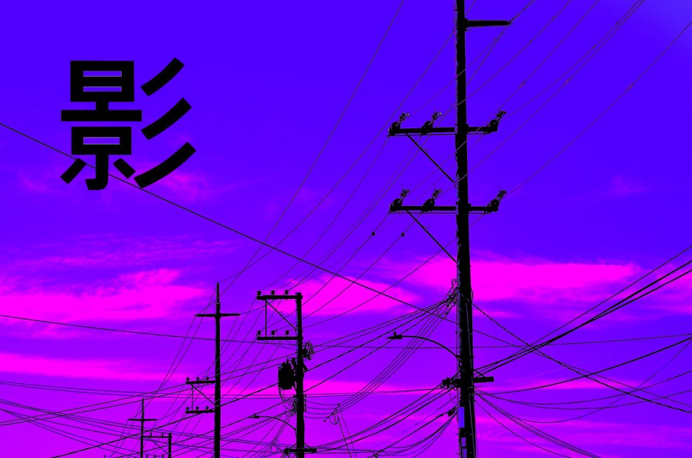
The Diagonal Argument and Algorithm W
S e a n W e s t f a l l

Slide 2
My Background
My Name is Sean Westfall
I have a degree in Computer Science from Loyola University Chicago.
I am doing this because I am just interested in Computer Science and functional programming.
Github: https://github.com/seanwestfall
Twitter: https://twitter.com/alphonse86
Personal Website: fieldsofgoldfi.sh

Slide 3
And on to the Show:
Let’s start with what is Type Checking
What is a Statically Typed Programming Language

Slide 4
What is a staticly typed programming lanauge (vs a dynamically typed language)
Loose typing
Strong typing

Slide 5
What is Type Checking
Comparing Strings and Ints
Adding a String and an Int will result in a type error because they are not meant to be added together.

Slide 6
What is the Hindley Miller Type System

Slide 7
The basics of PureScript

Slide 8
TypeCheck.ps

Slide 9
Type Checking in GHC core

Slide 10
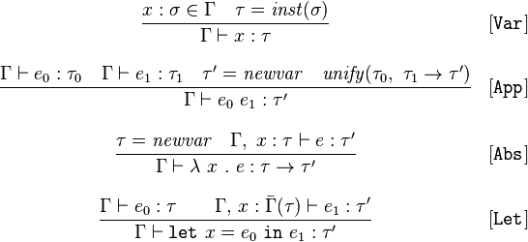
The Rules of Algorithm W

Slide 11
x :ß é x = inst(ß)
Gamma † x x : T

Slide 12
Unitification (pesudo code)
unify(ta,tb): ta = find(ta) tb = find(tb)
if both ta,tb are terms of the form D p1..pn with identical D,n
then unify(ta[i],tb[i]) for each corresponding ith parameter
else if at least one of ta,tb is a type variable
then union(ta,tb)
else error 'types do not match'
unification, the types for a well-structured program give rise to a set of constraints that when solved always have a unique principal type.

Slide 13
Proof of Completeness

Slide 14
Proof of Soundness

Slide 15
What is Bi-Directional Type Checking

Slide 16
The Practical Disadvantages of Using Staticly Typed Programming languages

Slide 17
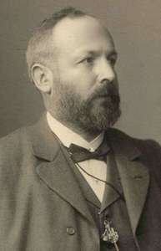
The Basics of the Diagonal Argument
History of the Digonal Argument
Gregor Cantor (1888)
Turing
Godel
Significance of the proof

Slide 18
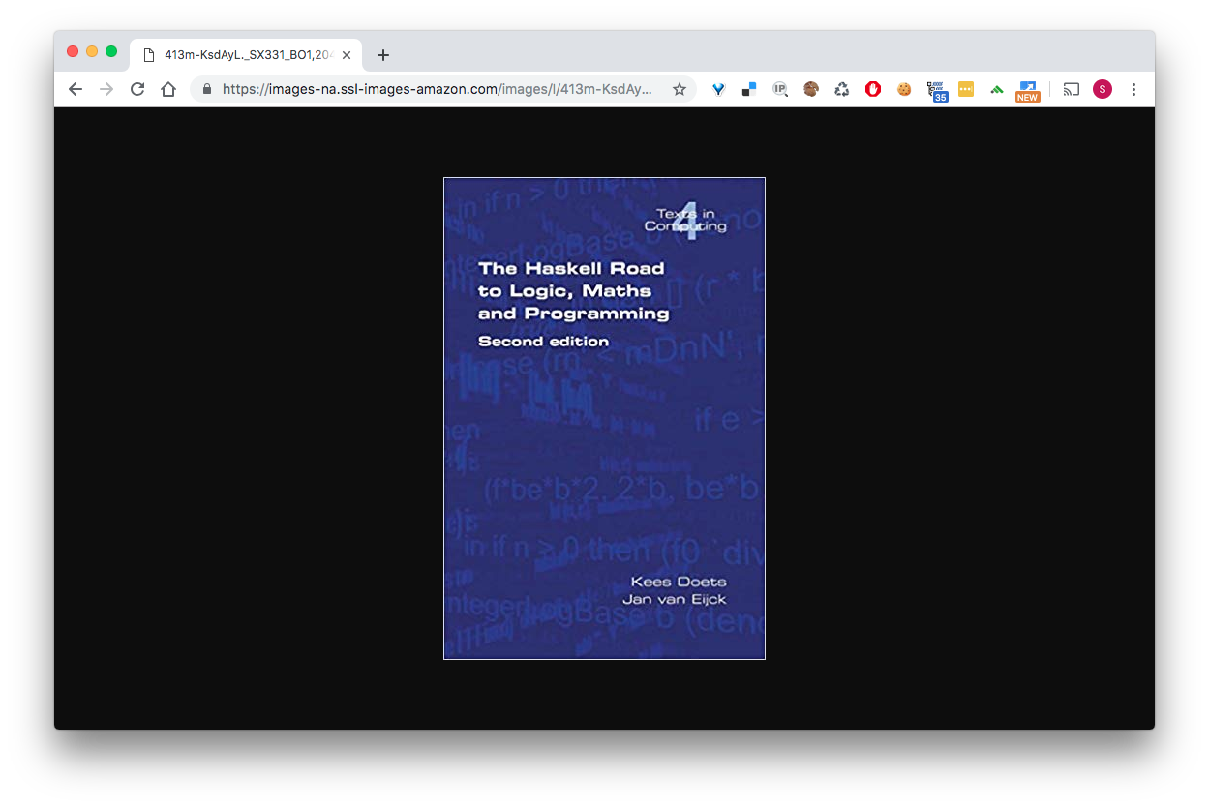

Slide 19
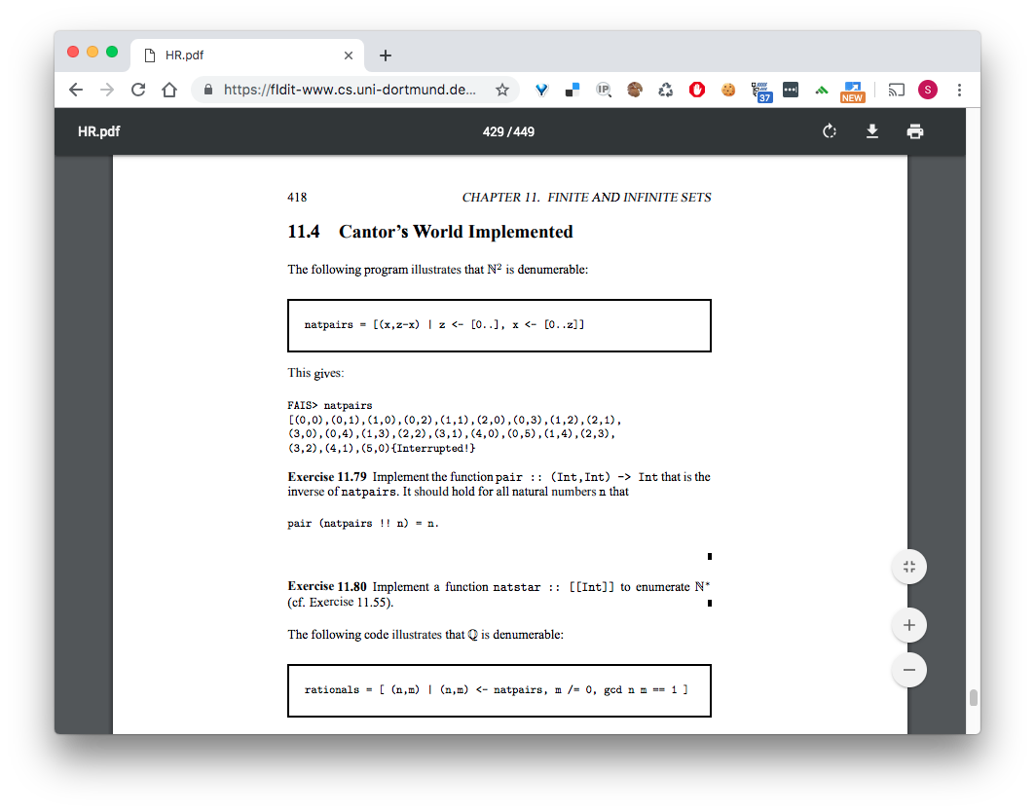
Cantor’s World Impleneted

Slide 20
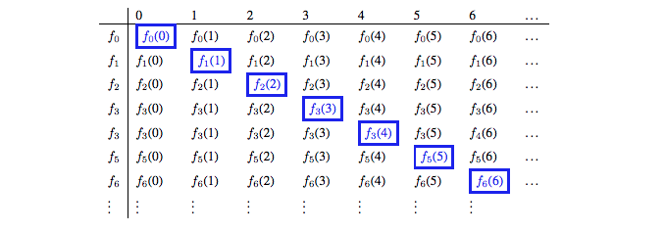
Diagonal Argument visualized

Slide 21
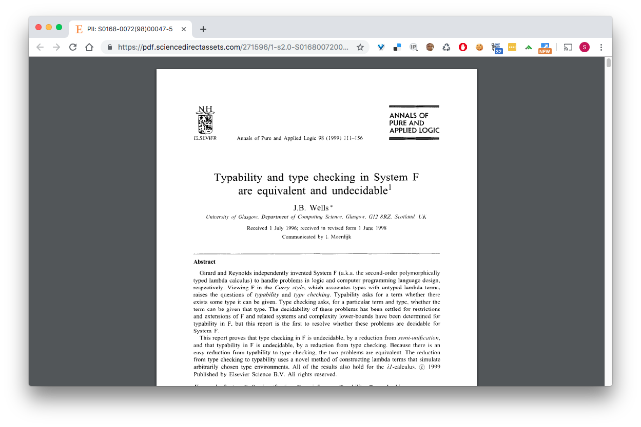
Has this proof been explored before… yes

Slide 22
Explain the proof in the previous paper
J.B. Well’s approach to proving Undecidability

Slide 23

References

