Slide 1

The Diagonal Argument and Algorithm W
S e a n W e s t f a l l

Slide 2
My Background
My Name is Sean Westfall.
I have a degree in Computer Science from Loyola University Chicago.
I am doing this because I am just interested in Computer Science and functional programming.
Github: https://github.com/seanwestfall
Twitter: https://twitter.com/alphonse86
Personal Website: fieldsofgoldfi.sh
I do not use any of this at work, nor would I recommend it.

Slide 3

Table of Contents
About me
01. What is a Programming Language
02. What is a Type
03. What is a Statically Typed Programming Language
04. Static Typing vs Dynamic Typing
05. What should you care
06. Advantages and Disadvantages of Statically Typed Programming Languages
07. What is Type Checking
08. The Hindley Miller Type System
09. The Rules of Algorithm W
10. Unification
11. Proof of Completeness
12. Proof of Soundness
13. The Diagonal Argument

Slide 4
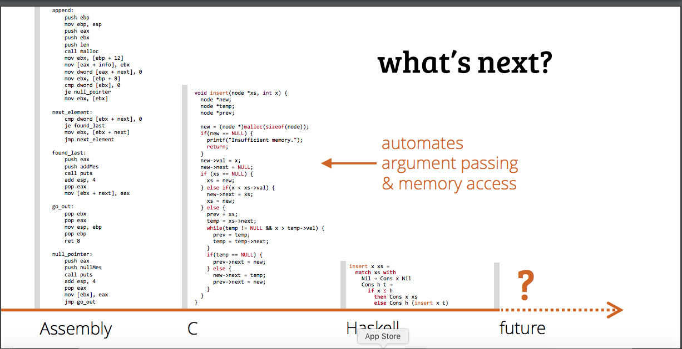
What is a Programming Language ( aka the beginning of the Universe )

Slide 5
What is a Type
A Type is something that is something indefinitely within your programming language throughout both the compile time and run time of your application/program.
Examples of types include:
(Primitive Types) Strings, Chars, Floats…
(Complex Types) Objects, Array, Classes, Type Classes…
Higher Ranked Polymorphism or Rank-N-Types

Slide 6
Static Type Checking
Let’s start with what is Type Checking
What is a Statically Typed Programming Language
Static type checking is the process of verifying the type safety of a program based on analysis of a program's text (source code). If a program passes a static type checker, then the program is guaranteed to satisfy some set of type safety properties for all possible inputs.

Slide 7
What is a statically typed programming language (vs a dynamically typed language)
Loose typing
Strong typing
Languages are often colloquially referred to as strongly typed or weakly typed. In fact, there is no universally accepted definition of what these terms mean. In general, there are more precise terms to represent the differences between type systems that lead people to call them "strong" or "weak".
1) Static Type Checking
2) Dynamic Type Checking
Dynamic type checking is the process of verifying the type safety of a program at runtime. Implementations of dynamically type-checked languages generally associate each runtime object with a type tag (i.e., a reference to a type) containing its type information. This runtime type information (RTTI) can also be used to implement dynamic dispatch, late binding, downcasting, reflection, and similar features.
Most type-safe languages include some form of dynamic type checking, even if they also have a static type checker.^{[citation needed]} The reason for this is that many useful features or properties are difficult or impossible to verify statically. For example, suppose that a program defines two types, A and B, where B is a subtype of A. If the program tries to convert a value of type A to type B, which is known as downcasting, then the operation is legal only if the value being converted is actually a value of type B. Thus, a dynamic check is needed to verify that the operation is safe. This requirement is one of the criticisms of downcasting.

Slide 8

Why should you care?
Basically, the difference between static typing and dynamic typing is the difference between whether you know what you are doing or not.

Slide 9

But Ultimately, programming is a zero sum game. You couldn’t know what a program will do at runtime absolutely in either case so you can reason just as much that is doesn’t matter.

Slide 10
The Practical Disadvantages of Using Statically Typed Programming languages
Advantages
You don’t need as many unit tests and functional tests if you use type checking, since errors are removed at compile time.
The Type Checker goes through all your dependencies and makes sure it works in an intended way, so it’s possible to know something about your dependences
Disadvantages
When Typed Languages are updated, they brake working programs as they are updated.

Slide 11
What is Type Checking
Comparing Strings and Ints
Adding a String and an Int will result in a type error because they are not meant to be added together.

Slide 12
What is the Hindley Miller Type System
One and the same thing can be used for many purposes. A chair might be used to support a sitting person but also as a ladder to stand on while changing a light bulb or as a clothes valet. Beside having particular material qualities, which make a chair usable as such, it also has the particular designation for its use. When no chair is at hand, other things might be used as a seat, and so the designation of a thing can be changed as fast as one can turn an empty bottle crate upside down to change its purpose from a container to that of a support.
Different uses of physically near-identical things are usually accompanied by giving those things different names to emphasize the intended purpose. Depending on the use, seamen have a dozen or more words for a rope though it might materially be the same thing. The same in everyday language, where a leash indicates a use different to a line.

Slide 13

The basics of PureScript

Slide 14
TypeCheck.ps

Slide 15
Type Checking in GHC core

Slide 16
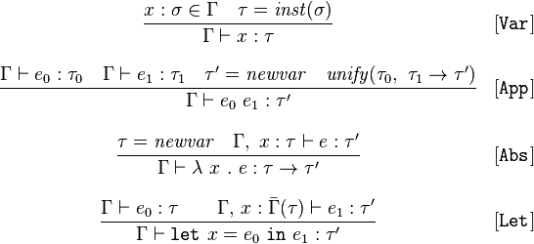
The Rules of Algorithm W

Slide 17

$$\frac{x : \text{σ} ∈ Γ τ =inst(\text{σ})}{Γ ⊢ :τ}$$
The T-Var rule, simply pull the type of the variable out of the typing context.
Var x -> lookupEnv env xThe function lookupVar looks up the local variable reference in typing environment and if found it instantiates a fresh copy.
lookupEnv :: TypeEnv -> Var -> Infer (Subst, Type) lookupEnv (TypeEnv env) x = do case Map.lookup x env of Nothing -> throwError $ UnboundVariable (show x) Just s -> do t <- instantiate s return (nullSubst, t)

Slide 18
$$\frac{Γ⊢ ℯ_{0} : τ_{0 }Γ⊢ ℯ_{1} : τ_{1 }τ^{′}=newvar unify(τ_{0},{ τ}_{1}{ →τ}^{′}) }{Γ⊢ ℯ_{0}{ ℯ}_{1}:τ^{′}}$$
For applications, the first argument must be a lambda expression or return a lambda expression, so know it must be of form t1 -> t2 but the output type is not determined except by the confluence of the two values. We infer both types, apply the constraints from the first argument over the result second inferred type and then unify the two types with the excepted form of the entire application expression.
App e1 e2 -> do tv <- fresh (s1, t1) <- infer env e1 (s2, t2) <- infer (apply s1 env) e2 s3 <- unify (apply s2 t1) (TArr t2 tv) return (s3 `compose` s2 `compose` s1, apply s3 tv)Γ⊢e1:τ1→τ2Γ⊢e2:τ1Γ⊢e1 e2:τ2(T-App)

Slide 19

$$\frac{τ=newvar Γ, x :τ⊢ℯ :τ^{′}}{Γ⊢λ x .ℯ :τ→τ^{′}}$$
There are several builtin operations, we haven't mentioned up to now because the typing rules are trivial. We simply unify with the preset type signature of the operation.
Op op e1 e2 -> do (s1, t1) <- infer env e1 (s2, t2) <- infer env e2 tv <- fresh s3 <- unify (TArr t1 (TArr t2 tv)) (ops Map.! op) return (s1 `compose` s2 `compose` s3, apply s3 tv)ops :: Map.Map Binop Type ops = Map.fromList [ (Add, (typeInt `TArr` (typeInt `TArr` typeInt))) , (Mul, (typeInt `TArr` (typeInt `TArr` typeInt))) , (Sub, (typeInt `TArr` (typeInt `TArr` typeInt))) , (Eql, (typeInt `TArr` (typeInt `TArr` typeBool))) ](+)(×)(−)(=):𝙸𝚗𝚝→𝙸𝚗𝚝→𝙸𝚗𝚝:𝙸𝚗𝚝→𝙸𝚗𝚝→𝙸𝚗𝚝:𝙸𝚗𝚝→𝙸𝚗𝚝→𝙸𝚗𝚝:𝙸𝚗𝚝→𝙸𝚗𝚝→𝙱𝚘𝚘𝚕

Slide 20


$$\frac{Γ⊢ℯ_{0} :τ Γ, x :\overline{Γ} (τ)⊢ℯ_{1} :τ^{′}}{Γ⊢let x=ℯ_{0} in{ ℯ}_{1 }:τ^{′}}$$
As mentioned previously, let will be generalized so we will create a local typing environment for the body of the let expression and add the generalized inferred type let bound value to the typing environment of the body.
Let x e1 e2 -> do (s1, t1) <- infer env e1 let env' = apply s1 env t' = generalize env' t1 (s2, t2) <- infer (env' `extend` (x, t')) e2 return (s1 `compose` s2, t2)Γ⊢e1:σΓ,x:σ⊢e2:τΓ⊢𝚕𝚎𝚝 x=e1 𝚒𝚗 e2:τ(T-Let)

Slide 21
Unitification (pesudo code)
unify(ta,tb): ta = find(ta) tb = find(tb)
if both ta,tb are terms of the form D p1..pn with identical D,n
then unify(ta[i],tb[i]) for each corresponding ith parameter
else if at least one of ta,tb is a type variable
then union(ta,tb)
else error 'types do not match'
unification, the types for a well-structured program give rise to a set of constraints that when solved always have a unique principal type.

Slide 22
Proof of Soundness
Theorem 6 (Soundness) If A, C `BU e: τ , then for all Γ and S such that • dom(A) ⊆ dom(Γ) • S satisfies C • S satisfies A ¹ Γ it holds that SΓ `HM e:Sτ . Proof A judgement A, C `BU e: τ can be found by applying the Bottom-Up rules to any expression e, including ill-typed expressions. The assumption set A contains one variabletype pair for each free occurrence of a variable in e. Consequently, a type environment Γ should provide a type for each variable present in A. This is ensured by the condition dom(A) ⊆ dom(Γ). The condition S satisfies C should be obvious: we can only expect a typing according to the Hindley-Milner rules if the collected constraints are satisfied. The third constraint ensures that the variables present in A have obtained a type (to be found in S) that is consistent with the types in the type environment Γ. This condition restricts the combinations of S and Γ for which the conclusion holds. Clearly, choosing S(τ1) = Bool while x: τ1 ∈ A and Γ(x) = ∀a.a → a is not a valid choice. The theorem can be proved by induction on the structure of the expression. The base case of the induction is a variable x, for which the judgement {x : β}, ∅ `BU e : β can be derived. The empty constraint set does not impose any restriction on the substitution. Γ(x) is defined because x is in the domain of the assumption set. Substitution S should satisfy {x : β} ¹ Γ, which implies that Sβ is a generic instance of SΓ(x). As a result, judgement SΓ `HM x:Sβ is derivable. The inductive cases are application, lambda abstraction, and let-expressions. For a subexpression e1, the induction hypothesis states that there are an A1, C1, and τ1, such that A1, C1 `BU e1 : τ1 is valid. In other words, a subexpression e1 can always be decorated with an assumption set, a constraint set, and a type, using the Bottom-Up rules. Secondly, the induction hypothesis expresses that for all pairs (S, Γ) that meet the three condition imposed by the theorem, the type Sτ1 can be derived with the Hindley-Milner inference rules
for expression e1 in type environment SΓ. The strategy to construct a proof for the three remaining inductive cases is as follows. Firstly, introduce an arbitrary substitution S, together with a type environment Γ, for which we assume that the three conditions hold. Secondly, fulfil the conditions for each of the subexpressions, where the same substitution is used, but possibly a different type environment. Some planning is required to choose the right Γ. By now, a Hindley-Milner judgement is obtained for each subexpression. Thirdly, combine the judgements and apply the corresponding Hindley-Milner inference rule to get the desired judgement. If the expression at hand is a function e1 applied to an argument e2, we can assume that A1, C1 `BU e1 : τ1 and A2, C2 `BU e2 : τ2. It follows from [App]BU that A, C `BU e1 e2 : τ holds, where A is A1∪A2, C is C1∪ C2∪ {τ1 ≡ τ2 → β}, and τ is β. Consider each substitution S and each type environment Γ such that S satisfies C∪A¹ Γ and dom(A) ⊆ dom(Γ). In general it is true that if S satisfies C, then S also satisfies each subset of C. As a result, S satisfies C1 ∪ (A1 ¹ Γ). In addition dom(A1) ⊆ dom(Γ), and therefore by induction we acquire the judgement SΓ `HM e1 :Sτ1. In a similar way SΓ `HM e2 :Sτ2 can be obtained. Since S must satisfy the constraint τ1 ≡ τ2 → β, Sτ1 is syntactically equal to Sτ2 → Sβ. From this observation we conclude that SΓ `HM e1 e2 :Sβ holds, which completes the proof in case the expression is an application. Decorating the body of a lambda abstraction with the bottom-up algorithm results in the judgement A, C `BU e : τ . Applying the appropriate rule justifies A\x, C0 `BU λx → e : β → τ , where C0 is C∪{τ 0 ≡ β | x : τ 0 ∈ A}. We consider each S and Γ such that dom(A\x) ⊆ dom(Γ) and S satisfies C0 ∪ A\x ¹ Γ. The first assumption about Γ implies that also dom(A) ⊆ dom(Γ\x ∪ {x : τ}) holds. Because S satisfies the constraints {τ 0 ≡ β | x : τ 0 ∈ A}, the types associated with x in A are all equivalent after applying the substitution. In other words, the types that were introduced at the variables, which are bound by the lambda abstraction, are unified. S also satisfies A¹{x : β}, since τ1 ¹ τ2 (notice the monomorphic type on the right) is equal to τ1 ≡ τ2. Merging two environments as in Property (5) yields that A ¹ Γ\x ∪ {x : β} is satisfied by S. By induction we get S(Γ\x ∪ {x:β}) `HM e:Sτ , which implies SΓ `HM λx → e:S(β → τ ). The judgement A, C `BU let x = e1 in e2 : τ2 can be inferred, where A is A1 ∪ A2\x, C is C1 ∪ C2 ∪ {τ 0 ≤M τ1 | x : τ 0 ∈ A2}, and assuming the declaration and the body of the let-expression to have judgements A1, C1 `BU e1 : τ1 and A2, C2 `BU e2 : τ2 respectively. Consider all substitutions S and all type environments Γ that fulfil the three conditions. By induction we get SΓ `HM e1 :Sτ1. The essential step to prove the let-rule sound is to observe that S satisfies A2 ¹ {x:generalize(SΓ, Sτ1)}. This holds because S satisfies C, and because, according to Lemma 5, generalizing type τ1 with respect to the free type variables in SΓ is the same as generalization with respect to the free type variables in SM. By induction we get S(Γ\x∪ {x:generalize(SΓ, τ1)}) `HM e2 :Sτ2, from which SΓ `HM let x = e1 in e2 :Sτ2 can be concluded. ✷ We have shown that every satisfiable constraint set implies the existence of a HindleyMilner derivation with the same result type. We now turn to the complementary result where we prove the completeness of our method: if there is a successful Hindley-Milner derivation, then our method will infer a type that is at least as general as the type derived using the Hindley-Milner rules. In Appendix B we present a more detailed proof of this theorem.

Slide 23
Proof of Completeness
Theorem 7 (Completeness) If Γ `HM e : τ then A, C `BU e : τ 0 and there exists an S such that • S satisfies C • S satisfies A ¹ Γ • Sτ = Sτ 0 Proof Consider the collection of well-typed expressions under a type environment Γ. For such an expression e, we can construct a derivation tree, where the type τ in the root of the tree is an instance of the (unique) principle type scheme for the expression. Decorating the expression according to the Bottom-Up rules, we obtain the judgement A, C `BU e : τ 0 for some τ 0 . The types τ and τ 0 are independent; τ is derived with Hindley-Milner, whereas a substitution that satisfies each constraint in C still has to be applied to τ 0 . In our proof, the substitution S also bridges the gap between the fact that Sτ 0 is the principal type scheme of e, whereas this is not necessarily the case for τ in the Hindley-Milner derivation. The proof proceeds by induction on the structure of the expressions. Our induction hypothesis is somewhat stronger than the statement of the theorem. The condition that S satisfies A ¹ Γ is in fact [ ] satisfies (SA) ¹ Γ, in other words, S is not allowed to modify Γ. The third condition similarly becomes τ = Sτ 0 . This simplifies the proof. If the expression is a single variable x, then the substitution that satisfies the three conditions can be constructed in a straightforward way. Choose S to be [β 7→ τ ], where β is the fresh type variable assigned to x by the Bottom-Up rules, and τ is the type that is returned by the Hindley-Milner rules, and which therefore is an instance of the type scheme that is provided by Γ for x. Clearly, S satisfies the empty constraint set, S satisfies {x:β} ¹ Γ, and Sβ = τ . A substitution for an application is constructed by composing the substitutions of the two subexpressions, and additionally map the fresh type variable β to the range of the function type that was derived for the function expression. The domains of the substitutions are independent because the type variables mentioned in the two subtrees are disjoint. The fresh type variable β in the Bottom-Up rule for lambda abstractions is used to unify several type variables that were assigned to the occurrences of the abstracted variable in the scope of the lambda. Substitution S maps this type variable to the type τ1, which was assigned to the variable x and used to extend Γ. For the other type variables we will use the substitution obtained by induction. Because S satisfies A¹{x : τ1}, S also satisfies {τ 0 ≡ β | x: τ 0 ∈ A}. It is sufficient to combine the two substitutions that can be obtained from the declaration and the body, also because no fresh type variables are introduced. The only interesting condition to verify for this composed substitution S is to check whether S satisfies the created implicit instance constraints. The induction hypothesis results in S satisfies A2 ¹ {x : generalize(Γ, τ1)} for the body, and Sτ 0 1 = τ1 for the declaration. Because generalizing over SΓ and SM is equivalent (Lemma 5), we get that S satisfies {τ 0 ¹ generalize(SM, Sτ 0 1) | x: τ 0 ∈ A2}. Applying Property (3) results in satisfaction of {τ 0 ≤M τ 0 1 | x: τ 0 ∈ A2} by S. We conclude that if Γ `HM e : τ is derivable, then InferType(Γ, e) returns the most general type for expression e under type environment Γ.

Slide 24
What is Bi-Directional Type Checking

Slide 25
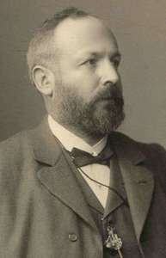
The Basics of the Diagonal Argument
History of the Digonal Argument
Gregor Cantor (1888)
Turing
Godel
Significance of the proof

Slide 26
Static type checking for Turing-complete languages is inherently conservative. That is, if a type system is both sound (meaning that it rejects all incorrect programs) and decidable (meaning that it is possible to write an algorithm that determines whether a program is well-typed), then it must be incomplete (meaning there are correct programs, which are also rejected, even though they do not encounter runtime errors).^{[6]} For example, consider a program containing the code:
if <complex test> then <do something> else <signal that there is a type error>
Even if the expression <complex test> always evaluates to true at run-time, most type checkers will reject the program as ill-typed, because it is difficult (if not impossible) for a static analyzer to determine that the else branch will not be taken.^{[7]} Conversely, a static type checker will quickly detect type errors in rarely used code paths. Without static type checking, even code coverage tests with 100% coverage may be unable to find such type errors. The tests may fail to detect such type errors, because the combination of all places where values are created and all places where a certain value is used must be taken into account.

Slide 27
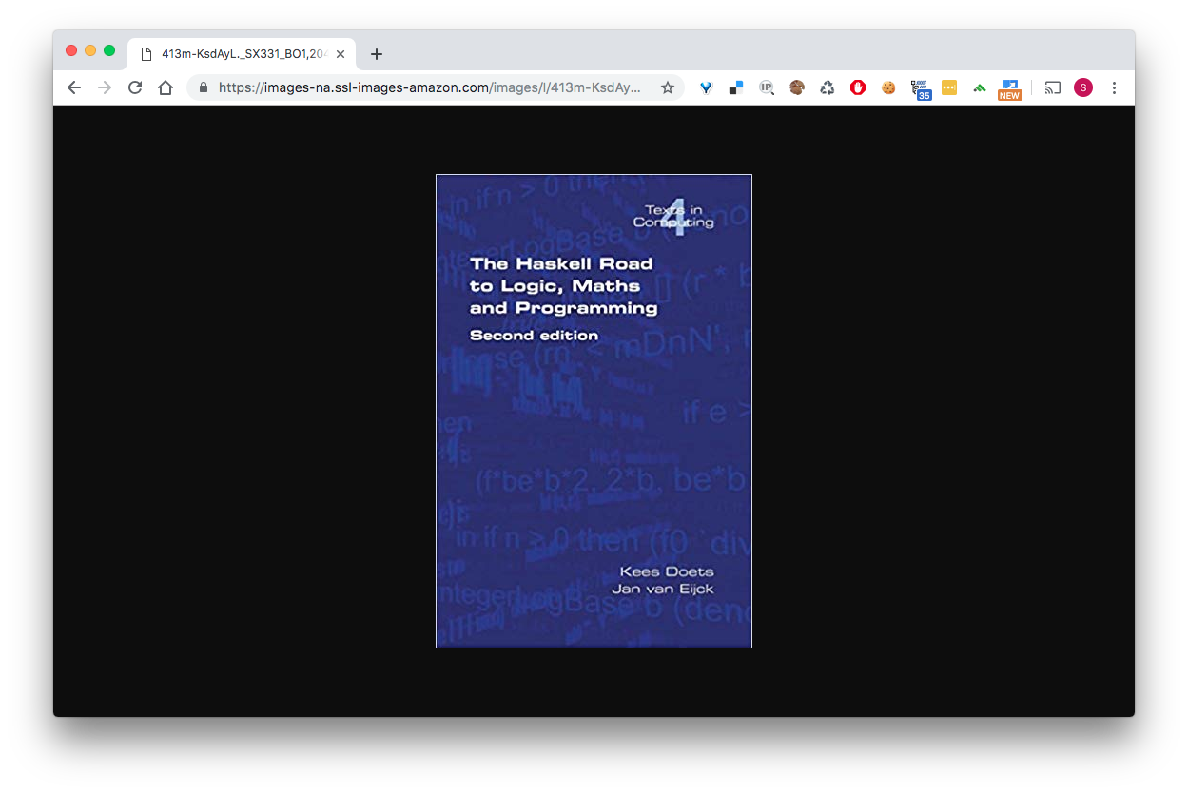

Slide 28
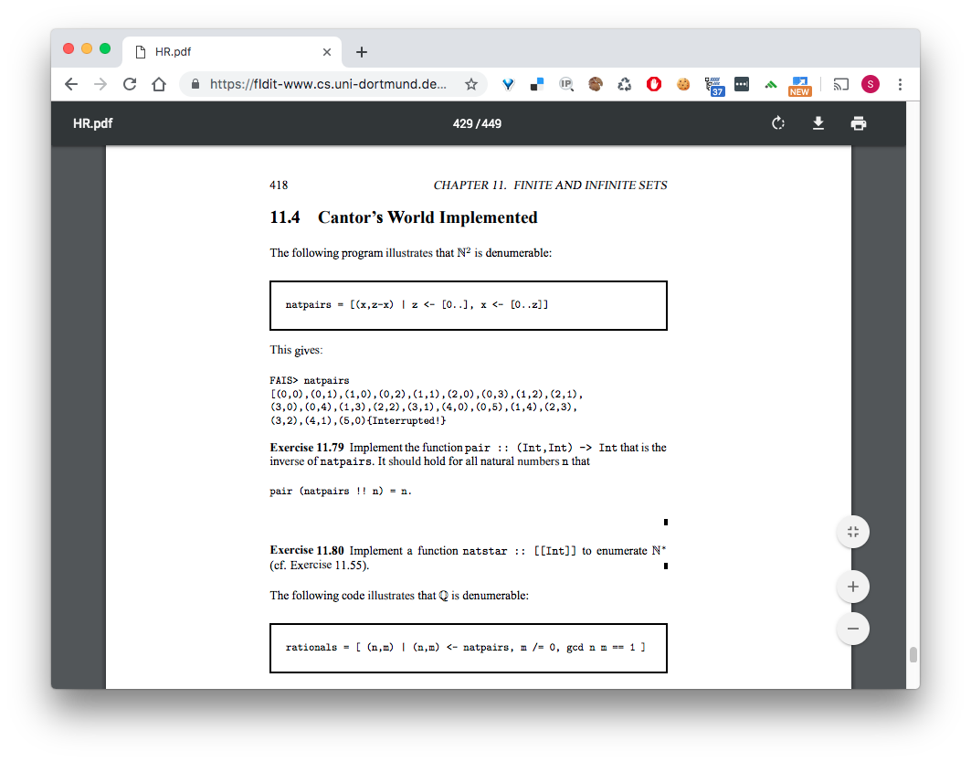
Cantor’s World Impleneted

Slide 29
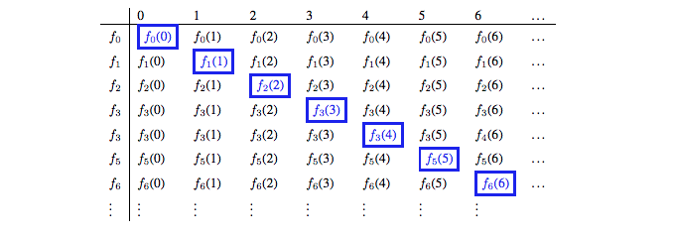
Diagonal Argument visualized Part 1

Slide 30
Loeb Theorem Part 2

Slide 31
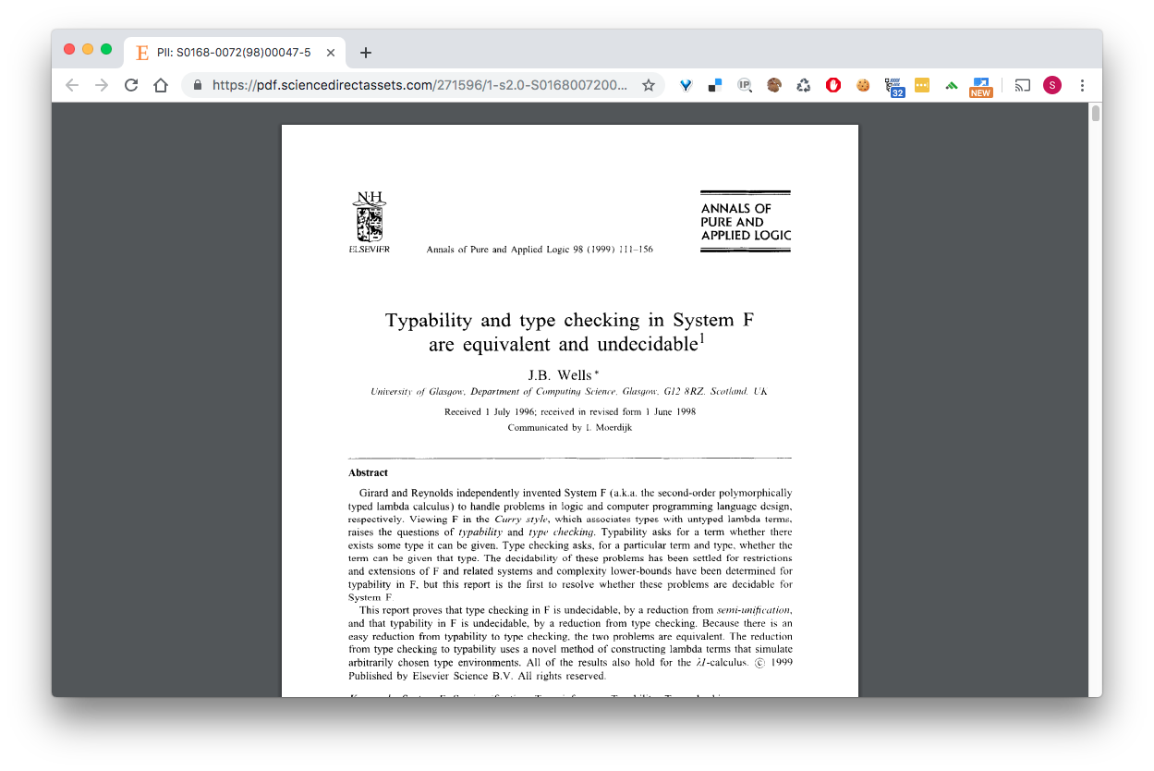
Has this proof been explored before… yes

Slide 32
Explain the proof in the previous paper
J.B. Well’s approach to proving Undecidability

Slide 33

References
Milner, Robin (1978). "A Theory of Type Polymorphism in Programming". Journal of Computer and System Sciences. 17 (3): 348–374. CiteSeerX 10.1.1.67.5276. doi:10.1016/0022-0000(78)90014-4
Damas, Luis; Milner, Robin (1982). Principal type-schemes for functional programs (PDF). 9th Symposium on Principles of programming languages (POPL'82). ACM. pp. 207–212.
J. B. Wells. "Typability and type checking in the second-order lambda-calculus are equivalent and undecidable." In Proceedings of the 9th Annual IEEE Symposium on Logic in Computer Science (LICS), pages 176–185, 1994.
Vaughan, Jeff (July 23, 2008) [May 5, 2005]. "A proof of correctness for the Hindley–Milner type inference algorithm" (PDF). Archived from the original (PDF) on 2012-03-24.
Dunfield, J. & Krishnaswami, N. R. (2013) Complete and easy bidirectional typechecking for higher-rank polymorphism. In International Conference on Functional Programming (ICFP). arXiv: 1306.6032 [cs.PL].
Doets, Kees and Jan van Eijk, 2004, The Haskell Road to Logic, Maths and Programming, London: College Publications.
Jones, M. (1999). Typing Haskell in Haskell. In (Meijer, 1999). Available at ftp://ftp.cs.uu.nl/pub/RUU/CS/techreps/CS-1999/1999-28.pdf

Slide 34

References
Martin Grabmüller. Algorithm W Step by Step
Gödel, K., 1931, “Über formal unentscheidbare Sätze der Principia Mathematica und verwandter Systeme I,” Monatshefte für Mathematik Physik, 38: 173–198. English translation in van Heijenoort 1967, 596–616, and in Gödel 1986, 144–195.
Turing, Alan (1936). On Computable Numbers, with an Application to the Entscheidungsproblem. _Proceedings of the London Mathematical Society_ 42 (1):230-265.
Generalizing Hindley-Milner Type Inference Algorithms

Slide 35
An example program written in PureScript

