Slide 1

The Diagonal Argument and Algorithm W
S e a n W e s t f a l l

Slide 2
My Background
My Name is Sean Westfall
I have a degree in Computer Science from Loyola University Chicago.
I am doing this because I am just interested in Computer Science and functional programming.
Github: https://github.com/seanwestfall
Twitter: https://twitter.com/alphonse86
Personal Website: fieldsofgoldfi.sh

Slide 3
And on to the Show:
Let’s start with what is Type Checking
What is a Statically Typed Programming Language

Slide 4
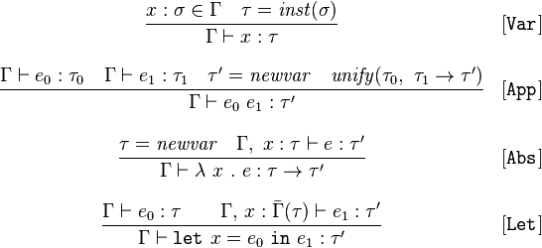
The Rules of Algorithm W

Slide 5
x :ß é x = inst(ß)
Gamma † x x : T

Slide 6
Unitification (pesudo code)
unify(ta,tb): ta = find(ta) tb = find(tb)
if both ta,tb are terms of the form D p1..pn with identical D,n
then unify(ta[i],tb[i]) for each corresponding ith parameter
else if at least one of ta,tb is a type variable
then union(ta,tb)
else error 'types do not match'

Slide 7
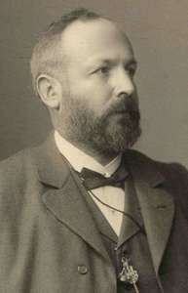

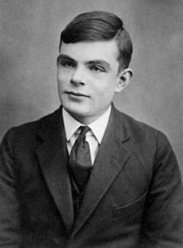
The Basics of the Diagonal Argument

Slide 8
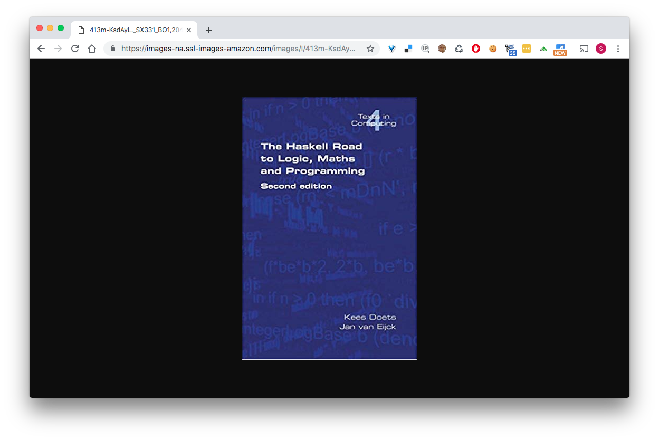

Slide 9
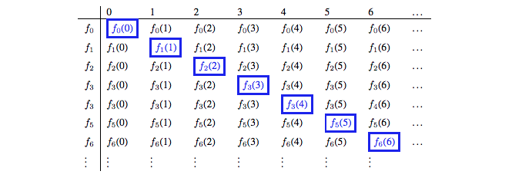
Diagonal Argument visualized

Slide 10
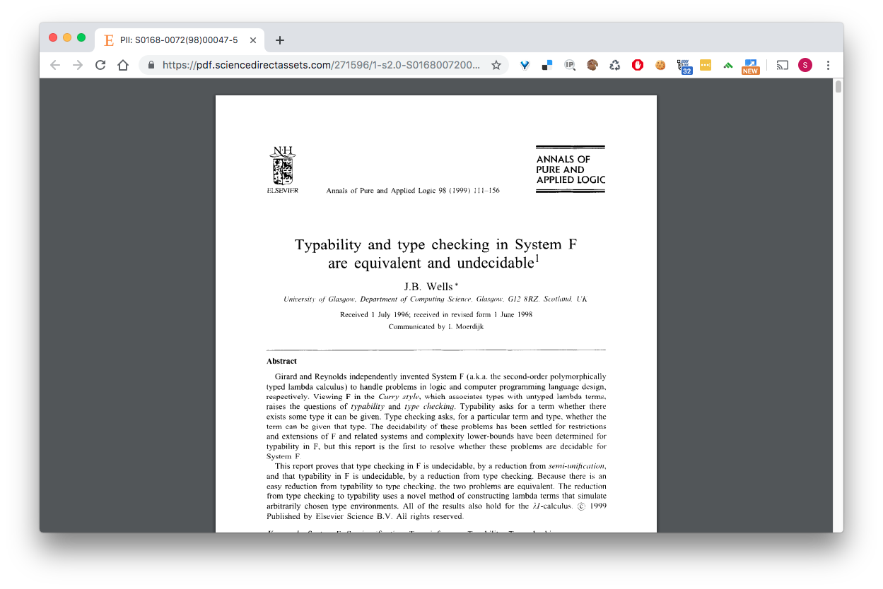
Has this proof been explored before… yes

Slide 11

References

