Slide 1
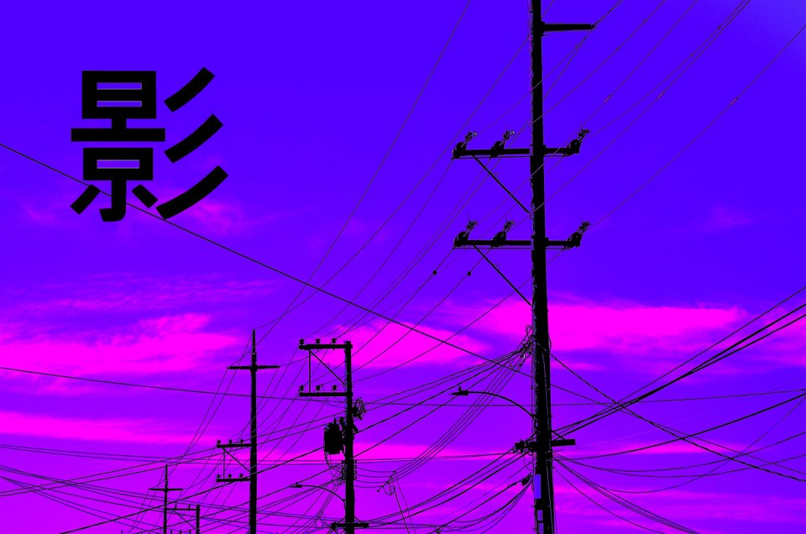
The Diagonal Argument and Algorithm W
S e a n W e s t f a l l

Slide 2
My Background
My Name is Sean Westfall
I have a degree in Computer Science from Loyola University Chicago.
I am doing this because I am just interested in Computer Science and functional programming.
Github: https://github.com/seanwestfall
Twitter: https://twitter.com/alphonse86
Personal Website: fieldsofgoldfi.sh

Slide 3
And on to the Show:
Let’s start with what is Type Checking
What is a Statically Typed Programming Language

Slide 4
What is a statically typed programming language (vs a dynamically typed language)
Loose typing
Strong typing

Slide 5
Why should you care
The difference between a typed language and a dynamically typed language is how well you know what your language is doing.

Slide 6
The Practical Disadvantages of Using Statically Typed Programming languages
You don’t need as many unit tests and functional tests if you use type checking.
When Typed Languages are updated, they brake working programs as they are updated.

Slide 7
What is Type Checking
Comparing Strings and Ints
Adding a String and an Int will result in a type error because they are not meant to be added together.

Slide 8
What is the Hindley Miller Type System

Slide 9
The basics of PureScript

Slide 10
TypeCheck.ps

Slide 11
Type Checking in GHC core

Slide 12
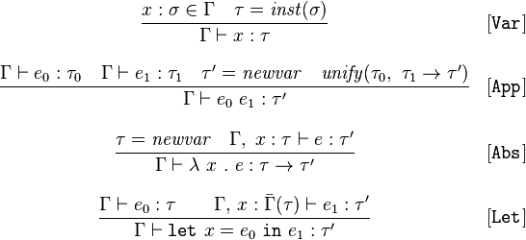
The Rules of Algorithm W

Slide 13
x :ß é x = inst(ß)
Gamma † x x : T

Slide 14
Unitification (pesudo code)
unify(ta,tb): ta = find(ta) tb = find(tb)
if both ta,tb are terms of the form D p1..pn with identical D,n
then unify(ta[i],tb[i]) for each corresponding ith parameter
else if at least one of ta,tb is a type variable
then union(ta,tb)
else error 'types do not match'
unification, the types for a well-structured program give rise to a set of constraints that when solved always have a unique principal type.

Slide 15
Proof of Completeness

Slide 16
Proof of Soundness

Slide 17
What is Bi-Directional Type Checking

Slide 18
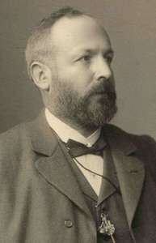
The Basics of the Diagonal Argument
History of the Digonal Argument
Gregor Cantor (1888)
Turing
Godel
Significance of the proof

Slide 19
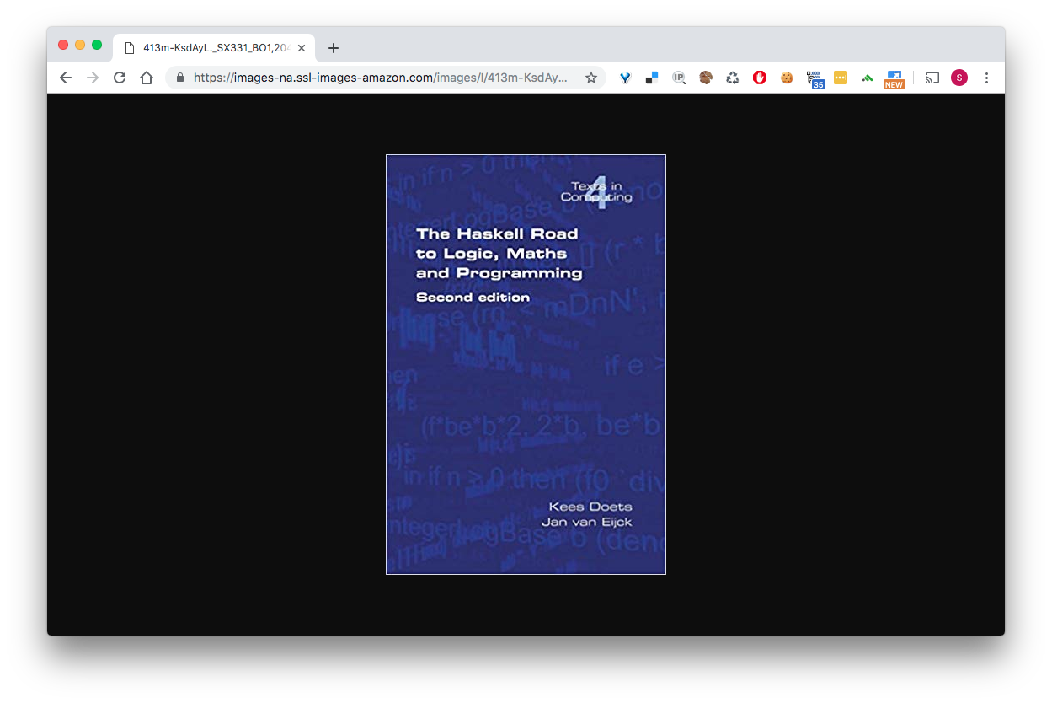

Slide 20
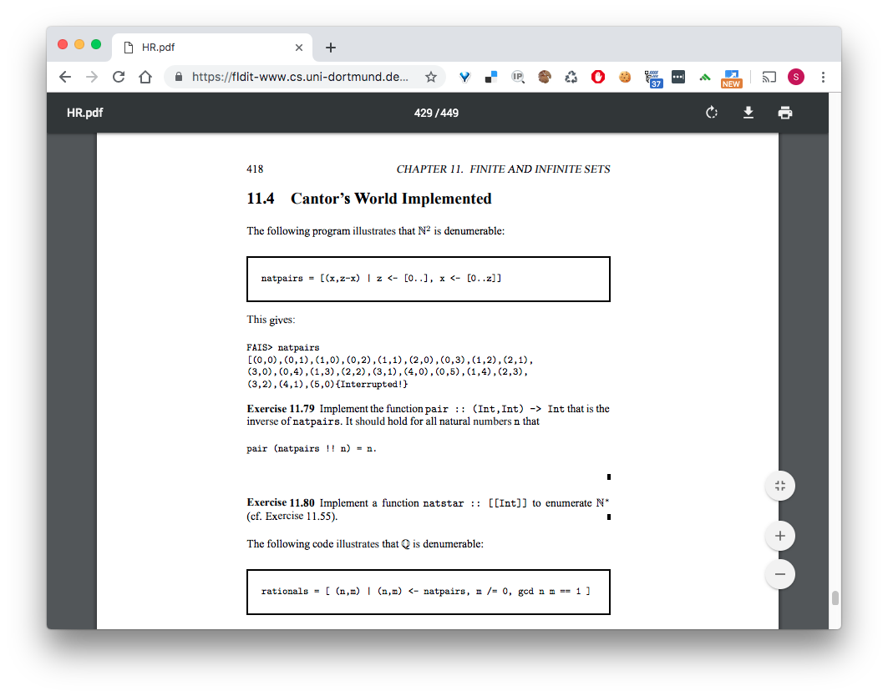
Cantor’s World Impleneted

Slide 21
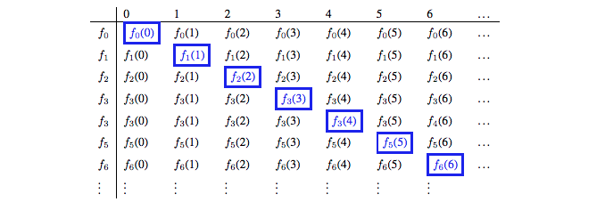
Diagonal Argument visualized

Slide 22
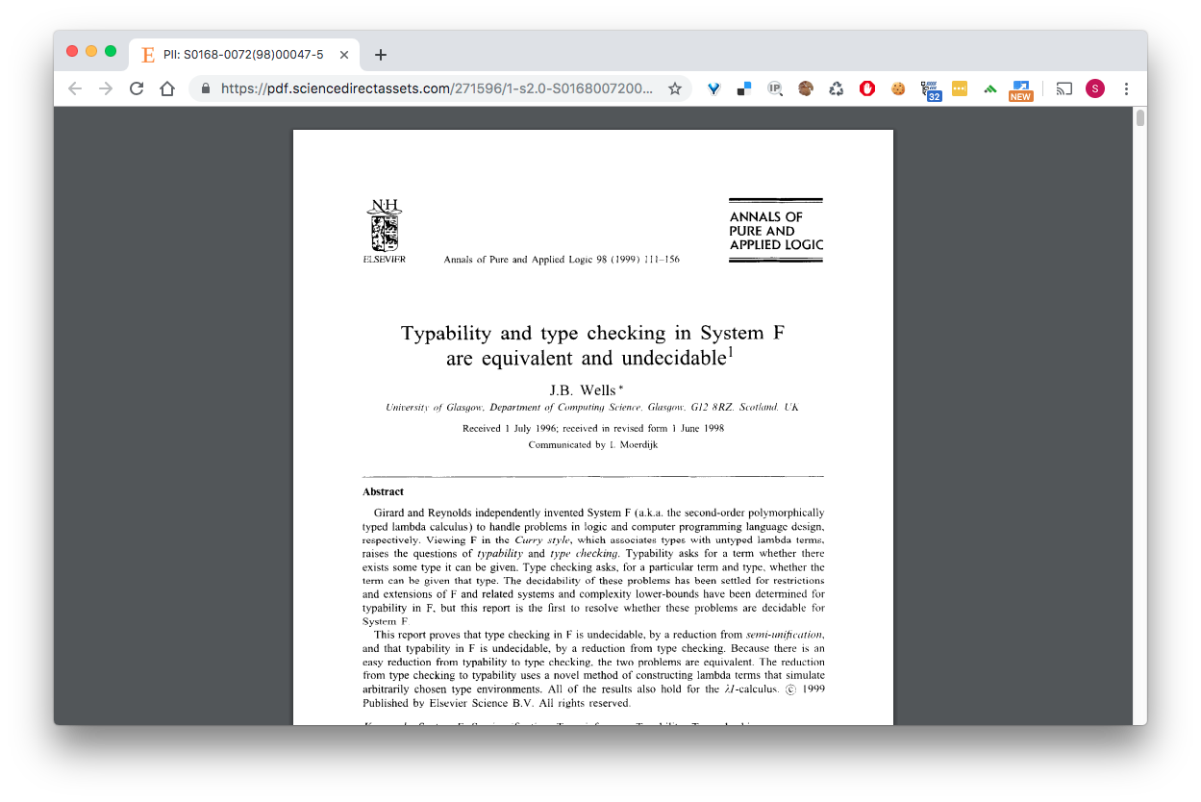
Has this proof been explored before… yes

Slide 23
Explain the proof in the previous paper
J.B. Well’s approach to proving Undecidability

Slide 24

References

