Slide 1
Django Authentication Overview
django.contrib.auth provides authentication framework
Handles users, passwords, sessions, permissions
Integrated with Django admin

Slide 2
AuthN vs AuthR
┌───────────┐
Frontend → API Gateway → AuthN → AuthR → Service
└───────────┘
Authentication
  Determining identity of a user, client or server
Authorization
  Determines what resources a user can access

Slide 3
Common Authorization Methodologies
Role-Based Access Control (RBAC)
Attribute-Based Access Control (ABAC)

Slide 4
Core Components
User model
Authentication backends
Permissions & groups
Password hashing

Slide 5
User Model
Default User model stored in auth_user table
User Objects (Core To Authentication System)
  Superusers
  Staff
  User
Fields: username, email, password, is_staff, is_superuser
Custom user models via AUTH_USER_MODEL

Slide 6
Authentication Process
authenticate() verifies credentials
login() persists session
logout() clears session data

Slide 7
Permissions (Authorization)
Django comes with a built-in permissions system
Designed for Django admin site initially
Four default permissions (Django.contrib.auth):
  Add, change, delete, view
  Created for each model
  more

Slide 8
Permissions & Groups
Per-object or model-level permissions
Groups bundle permissions
Used in admin and custom views

Slide 9
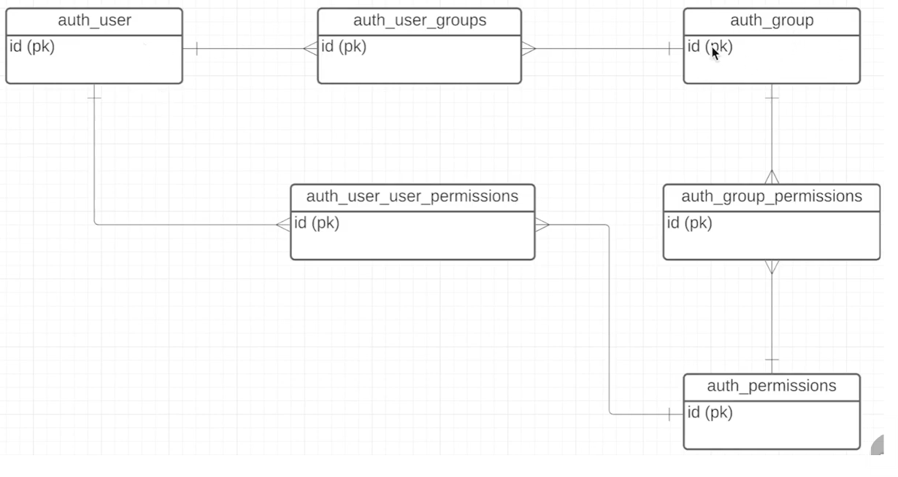

Slide 10
Password Handling
Secure hashing (PBKDF2 by default)
password.set_password() to hash
check_password() to validate

Slide 11
Authentication Views
LoginView
LogoutView
PasswordChangeView / PasswordResetView

Slide 12
Middleware
AuthenticationMiddleware loads user into request.user
SessionMiddleware required

Slide 13
Summary
Full authentication & authorization system
Extendable and customizable
Essential for secure Django apps

