Slide 1
Introduction to Web Development
From the Internet to Interactive Web Applications

Slide 2
Learning Objectives
Understand how the web works
Explain the client-server model
Describe the roles of HTML, CSS, and JavaScript
Differentiate frontend and backend development
Understand browsers and rendering
Create a simple webpage
Use browser developer tools
Prepare for learning modern frameworks like React

Slide 3
Section 1: Introduction to the Web

Slide 4
What Is the Web?
Topics
The World Wide Web
Websites vs Web Applications
Static vs Dynamic Content
The Web is a distributed information system
Examples
Wikipedia
Google Docs
YouTube
Amazon

Slide 5
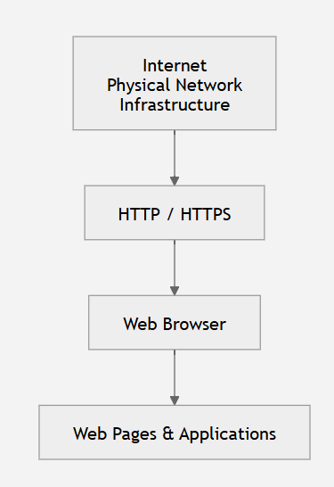
The Internet vs The Web
Internet
Physical infrastructure
Networks
Routers
TCP/IP
Web
Built on top of the Internet
Uses HTTP/HTTPS
Web pages
Browsers

Slide 6
How the Web Has Evolved
Web 1.0
Web 2.0
Mobile Web
Cloud Computing
Progressive Web Apps
AI-powered applications

Slide 7
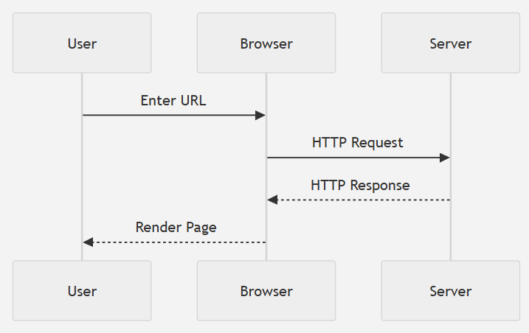
Client–Server Architecture
Client
Server
Request
Response

Slide 8
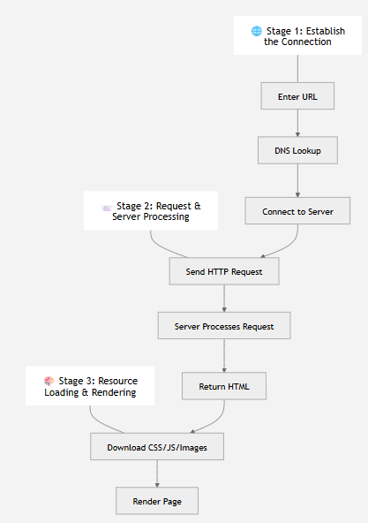
What Happens When You Visit a Website?
Enter URL
DNS lookup
Browser connects to server
HTTP request
Server processes request
HTML returned
Browser downloads assets
Page rendered

Slide 9
Anatomy of a URL
https://www.example.com/products?id=5
Protocol: The set of rules (e.g., https://) used to retrieve the resource.
Domain: The unique address (e.g., example.com) identifying the server hosting the resource.
Path: The specific location or file structure (e.g., /products/shoes) on the server.
Query Parameters: Key-value pairs (e.g., ?sort=price&color=blue) used to filter or customize the requested data.
Fragment: An internal identifier (e.g., #section1) that points to a specific element or anchor on the page.

Slide 10
HTTP Request and Response
GET /api/users/123 HTTP/1.1
HTTP/1.1 200 OK
Content-Type: application/json
Content-Length: 42
{ "id": 123, "name": "Jane Doe", "role": "Engineer" }
Request
GET
POST
PUT
DELETE
Response
Status codes
Headers
Body

Slide 11
Common HTTP Status Codes
200 OK
201 Created
301 Redirect
400 Bad Request
401 Unauthorized
403 Forbidden
404 Not Found
500 Internal Server Error

Slide 12
Section 2: Browsers

Slide 13
What Does a Browser Do?
Responsibilities
Download files
Parse HTML
Parse CSS
Execute JavaScript
Render pages
Manage memory
Security sandbox
Popular browsers
Chrome
Firefox
Safari
Edge

Slide 14
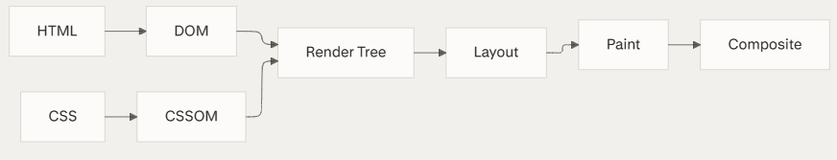
Browser Rendering Pipeline

Slide 15
Key Flow
HTML parses to DOM
CSS parses to CSSOM
DOM + CSSOM → Render Tree
Render Tree → Layout → Paint → Composite
Browser Rendering Pipeline
HTML → Source document markup
CSS → Styling rules and stylesheets
DOM (Document Object Model) → Parsed HTML structure as JavaScript objects
CSSOM (CSS Object Model) → Parsed CSS as JavaScript objects
Render Tree → Combined DOM + CSSOM showing visible content with styles
Layout → Calculates position and size of each element (also called "reflow")
Paint → Draws elements to layers (text, colors, borders, shadows)
Composite → Combines layers into final image displayed on screen

Slide 16
Browser Developer Tools
Elements
Console
Network
Sources
Performance
Application

Slide 17
Section 4: Core Technologies

Slide 18
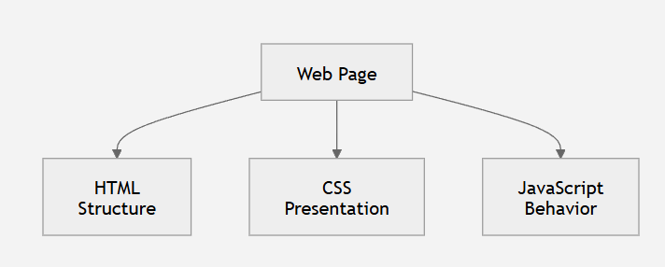
The Three Pillars

Slide 19
HTML
<h1>Hello World</h1>
Elements
Tags
Attributes
Semantic HTML

Slide 20
CSS
h1 {
color: blue;
}
Selectors
Properties
Layout
Colors
Typography

Slide 21
Javascript
button.onclick = () => {
alert("Hello");
};
Variables
Functions
Events
DOM Manipulation

Slide 22
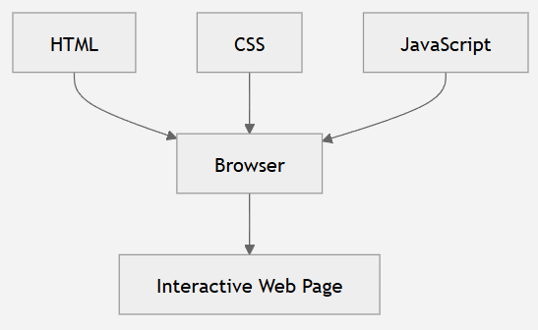
HTML + CSS + JavaScript Together

Slide 23
Section 5: Frontend vs Backend

Slide 24
Frontend Development
UI
Browser
User Experience
React
Angular
Vue

Slide 25
Backend Development
Business Logic
Databases
Authentication
APIs
Node.js
Java
Python
.NET

Slide 26
Full Stack Development

Slide 27
Essential Developer Tools
VS Code
Chrome DevTools
Git
GitHub
Node.js
npm

Slide 28
Section 6: Building Blocks of Modern Web Apps

Slide 29
APIs
{
"name": "Alice",
"age": 22
}
What is an API?
REST
JSON
Fetch requests

Slide 30
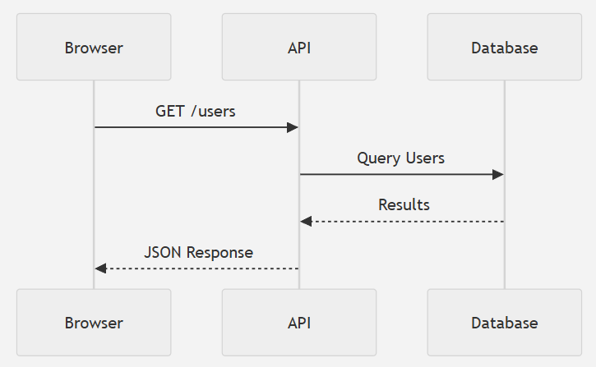
APIs: Example Request Flow

Slide 31
Databases
Overview
SQL
NoSQL
Examples
PostgreSQL
MySQL
MongoDB

Slide 32
Authentication
Login
Passwords
Sessions
Cookies
JWT

Slide 33
Hosting a Website
Concepts
Domain Name
Web Server
Hosting
Cloud
Examples
GitHub Pages
Netlify
Vercel
AWS

Slide 34
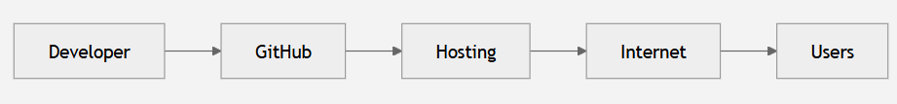
Hosting a Website

Slide 35
Section 7: Modern Development Workflow

Slide 36
Developer Workflow

Slide 37
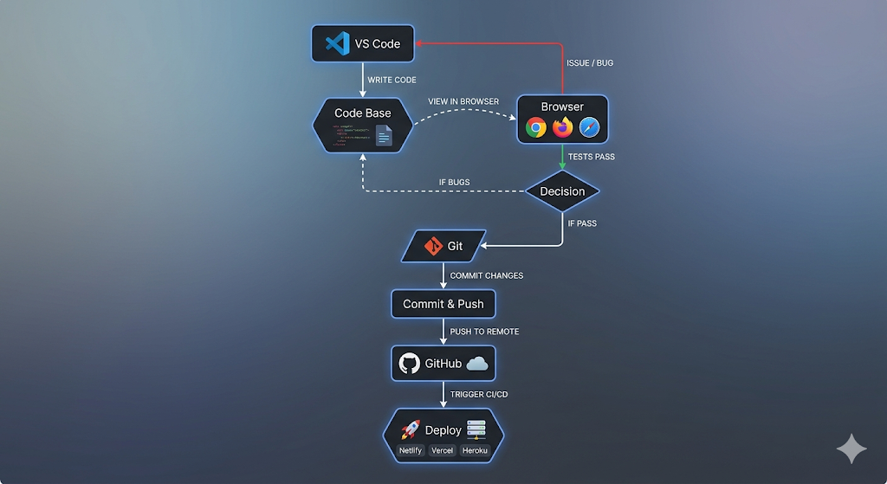

Slide 38
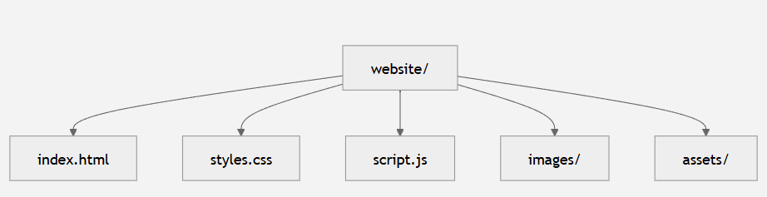
Folder Structure

Slide 39
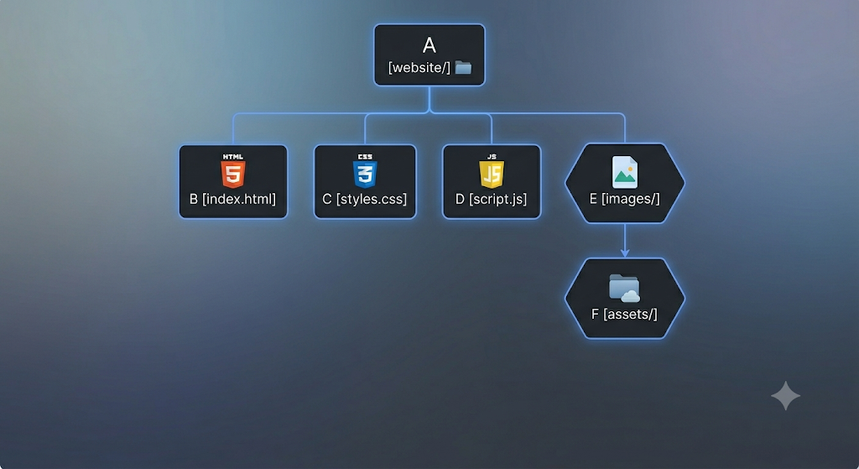

Slide 40
Section 8: Hands On Demo

Slide 41
Building Your First Webpage
Heading
Paragraph
Button
Image
Link

Slide 42
Adding CSS
Colors
Fonts
Margins
Borders
Layout

Slide 43
Adding Javascript
Button click
Alert
DOM updates

Slide 44
Section 9: Looking Ahead

Slide 45
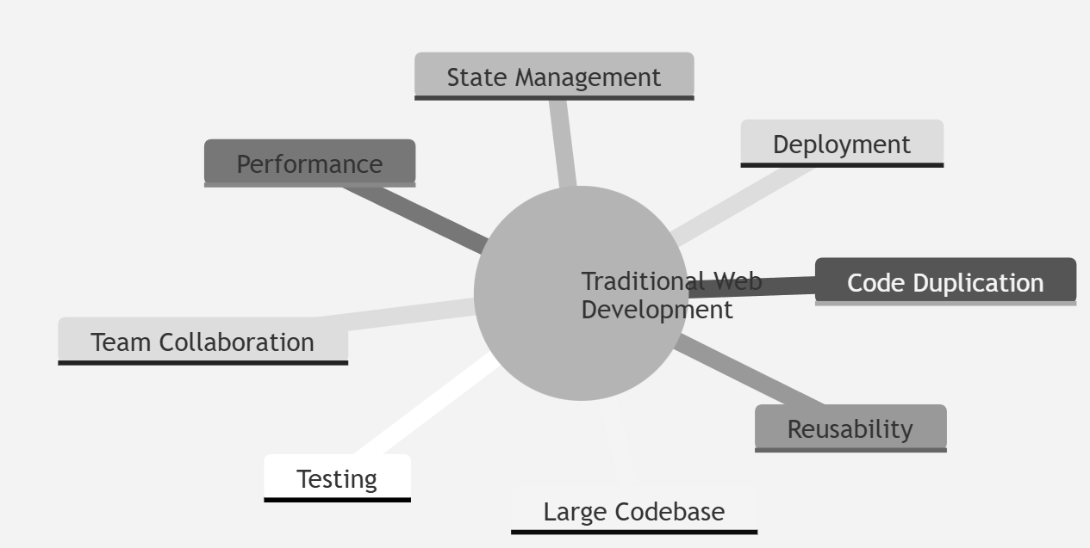
Challenges of Traditional Web Development

Slide 46
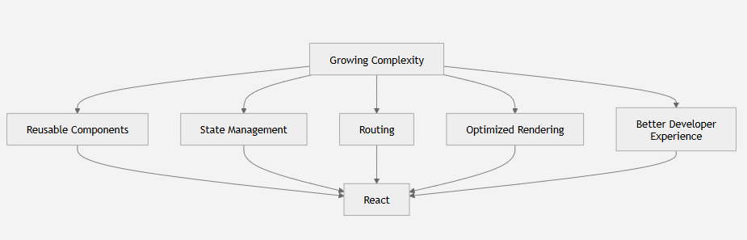
Why Frameworks Exist

Slide 47
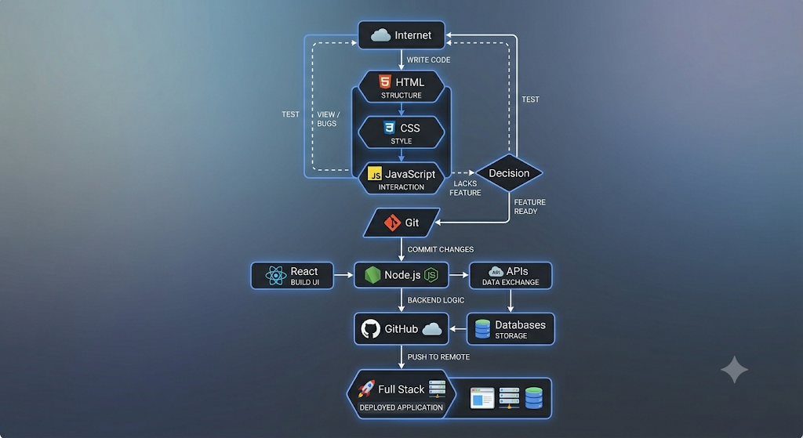

Slide 48
Summary
The web runs on the client-server model.
Browsers render HTML, CSS, and JavaScript into interactive experiences.
HTML provides structure, CSS controls presentation, and JavaScript adds behavior.
Frontend and backend work together through APIs and HTTP.
Modern web development relies on version control, developer tools, and deployment platforms.
Understanding these fundamentals makes learning frameworks like React much easier.

