Slide 1
LAB MEETING · APRIL 2026
Causal Network Topology Predicts
How LLM Forecasters Revise Probabilities
When Presented with New Information
Current results + proposed external-forecasting extension
Sean Kelley
Northeastern University

Slide 2
Where this sits
MOTIVATION
LLMs increasingly used as forecasters on complex multi-domain questions.
Prior work evaluates accuracy against markets or ground truth.
Much less is known about how forecasts emerge — what factors the model weighs, how it updates under new evidence.
Without that, forecasts remain black boxes that are hard to audit or interrogate.
THE GAP
Accuracy tells you whether the forecast was right. It doesn't tell you why it moved.
This paper opens up the update step.
Sean Kelley · Lab Meeting · Northeastern
2 / 21

Slide 3
Central question
MOTIVATION
Q
Do LLM forecasters update their probabilities in a way that is internally consistent with the causal structure they themselves elicit?
IMPLICATION
If yes, the elicited DAG is more than a post-hoc rationalization — it is a genuine diagnostic of the reasoning that produced the forecast.
Sean Kelley · Lab Meeting · Northeastern
3 / 21

Slide 4
Pipeline
METHOD
Four stages · 116 high-complexity ForecastBench questions · 7 models
1
2
3
4
Causal Forecast
Network Analysis
Probe Generation
Probed Forecast
LLM produces initial probability p₀ and a directed causal graph G=(V,E) with 6–10 factor nodes, one outcome node, and annotated mechanisms on edges.
Compute betweenness centrality and outcome mediation; rank nodes into high / medium / low importance tiers.
LLM authors ~21 counterfactual probes per question spanning strengthen, negate, structural challenge, and control types.
Present each probe in a fresh context; record updated probability pᵢ.
DEPENDENT VARIABLE
|Δ logit|ᵢ = | log( pᵢ / (1 − pᵢ) ) − log( p₀ / (1 − p₀) ) |
Probability shifts are mechanically bounded, so we use the absolute log-odds shift |Δ logit|.
Linear mixed-effects regression (lme4): question-level random intercepts, model fixed effects.
Sean Kelley · Lab Meeting · Northeastern
4 / 21

Slide 5
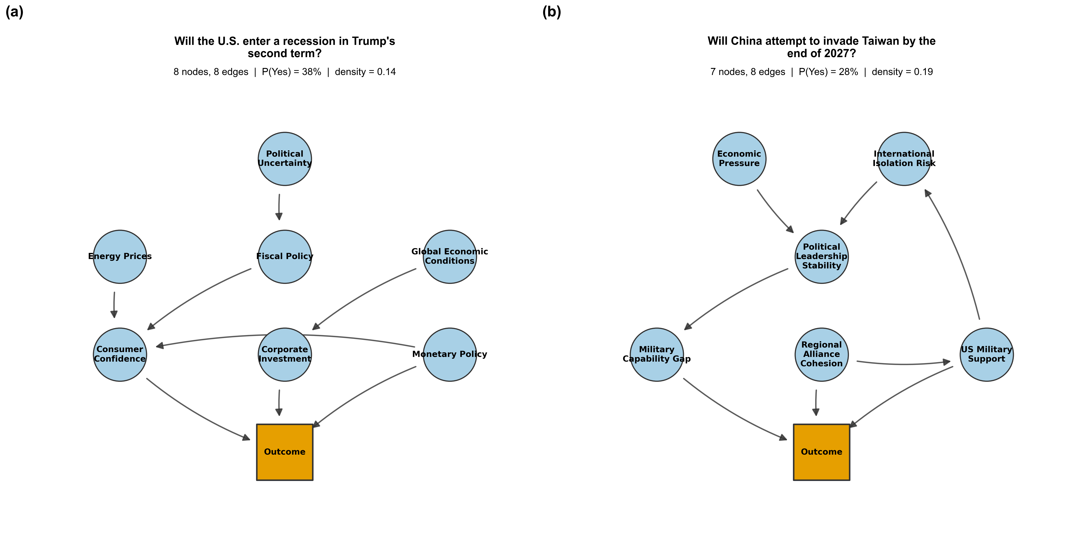
Two exemplar DAGs
METHOD
Left: macroeconomic question (8 nodes, 8 edges). · Right: geopolitical question (7 nodes, 8 edges).
Different domains — recognizable topology.
Sean Kelley · Lab Meeting · Northeastern
5 / 21

Slide 6
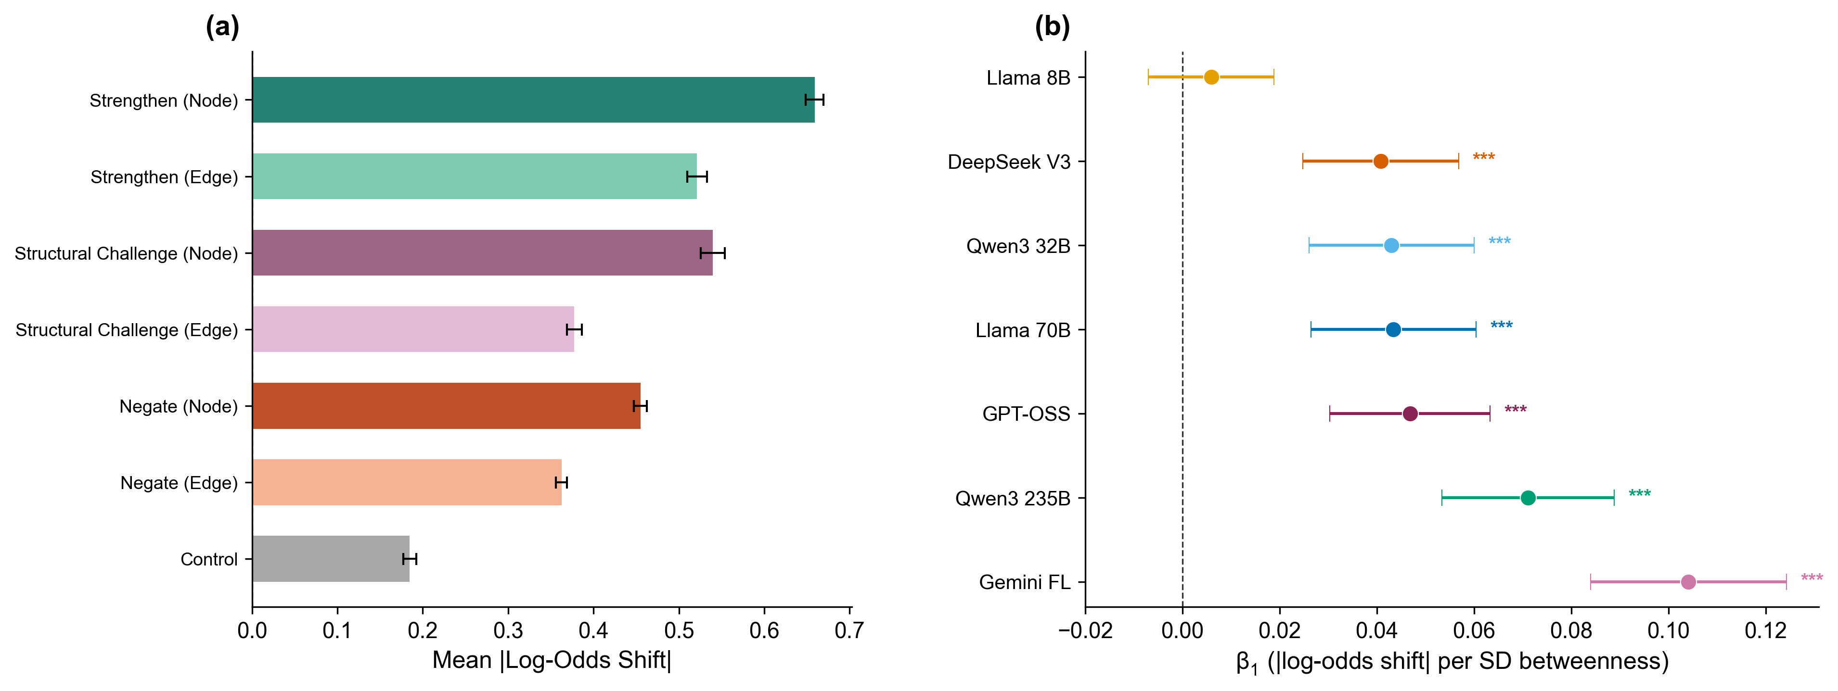
Topology predicts probe sensitivity
RESULTS
+0.0093
per SD of node betweenness centrality · p < .001
+0.0105
per SD of outcome mediation
Probe effects by centrality tier
In probability space: ~0.2 pp per SD at p₀=0.5 — small alone, cumulative across tiers. Probes on the most central factors shift probabilities 2–3 pp more than probes on peripheral ones.
Sean Kelley · Lab Meeting · Northeastern
6 / 21

Slide 7
The effect holds across models
RESULTS
CROSS-MODEL ROBUSTNESS
NODES vs EDGES
6 of 7
0.57 vs 0.43
models show a positive, significant grounding coefficient.
|Δ logit| for probes targeting nodes vs edges · d = 0.47, p < .001
Slopes range from 0.009 (DeepSeek V3, Qwen3 32B) to 0.022 (Gemini 2.5 Flash Lite).
Llama 3.1 8B is the one exception.
Pattern holds in every model — per-model node–edge gaps range from +0.07 to +0.25.
Sean Kelley · Lab Meeting · Northeastern
7 / 21

Slide 8
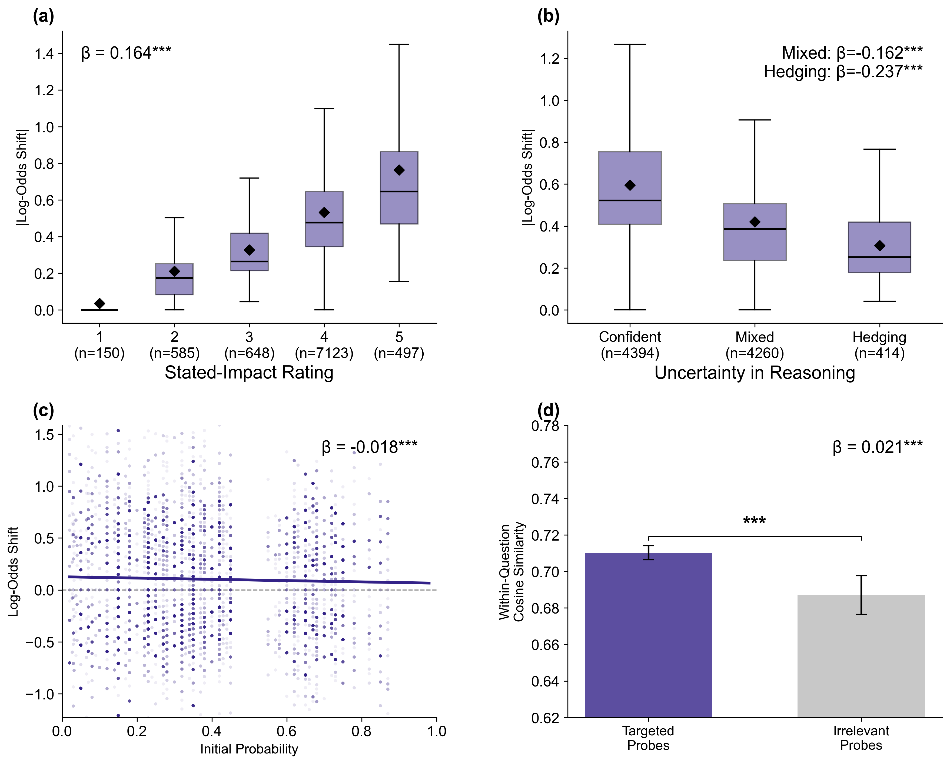
Reasoning covaries with the update
RESULTS
FOUR CONVERGING SIGNALS
Judge-rated stated impact tracks |Δ logit|.
Confident reasoning produces larger updates than hedged.
Bayesian coherence: updates shrink as p₀ moves from 0.5.
Reasoning embeddings cluster more tightly for targeted probes than irrelevant controls.
Four coherence diagnostics: stated impact, confidence, Bayesian coherence, reasoning-embedding clustering.
Sean Kelley · Lab Meeting · Northeastern
8 / 21

Slide 9
Explicit ranking and implicit topology both matter
RESULTS
Stated rank ↔ betweenness
Joint model (both predictors)
β = −0.336
β_rank = −0.057 · β_betw = +0.025
p < .001 · models' own rankings align with topology
both p < .001 · joint R²ₘ = 0.249
TAKEAWAY
The structural signal is partly implicit — visible in behavioral updating, not fully accessible through introspective ranking.
Sean Kelley · Lab Meeting · Northeastern
9 / 21

Slide 10
Cross-model DAG agreement
RESULTS
Same-question DAGs are more similar than a permutation null, but absolute agreement is modest.
0.881
96%
61%
Partial
observed nGED
outcome-node match
edit mass from edge ops
convergence
vs null 0.998 · p < .001
across cross-model pairs
vs 39% from node ops
above chance, not interchangeable
Models disagree more about causal wiring than about which factors matter. Structural overlap exceeds chance; convergence is partial, not interchangeable.
Sean Kelley · Lab Meeting · Northeastern
10 / 21

Slide 11
Validation checks
RESULTS
Four main controls plus three supplementary checks — all point the same direction.
Persuasiveness
Importance–shift correlation survives residualizing on independent persuasiveness ratings.
Forced-ignore
Instructing the model to ignore a factor (no probe) still yields shifts scaled to that factor's centrality.
Edge rewiring
Randomizing the DAG's edges drops the grounding slope by ~19%.
Larger graphs
Doubling the node cap leaves the slope unchanged.
Spurious context
Contamination rate: 0 / 116.
Test–retest
ρ = 0.73 – 0.96 across models.
Temperature
Temperature-driven nGED much smaller than inter-model divergence.
Sean Kelley · Lab Meeting · Northeastern
11 / 21

Slide 12
What the paper establishes
RESULTS
LLM forecasters update internally consistently with their own elicited causal DAGs.
Node betweenness and outcome mediation both predict the magnitude of probability revision.
Nodes move probabilities more than edges; direct and indirect causes contribute independently.
The pattern holds across 6 of 7 models and survives persuasiveness, rewiring, and size controls.
Cross-model structural agreement is above chance but partial.
Structural faithfulness
The elicited DAG is a genuine diagnostic of the reasoning behind the forecast.
Sean Kelley · Lab Meeting · Northeastern
12 / 21

Slide 13
From coherence to accuracy
PART 2 · PROPOSED EXTENSION
WHAT THE PAPER SHOWS
NEXT QUESTION
The DAG governs how a model revises its beliefs — but not that those revisions are better calibrated than they would be otherwise.
If high-betweenness factors are where the model weighs evidence most heavily, can we use that topology to guide an evidence-gathering agent and improve forecast accuracy on held-out questions?
COHERENCE (paper)
ACCURACY (next)
Sean Kelley · Lab Meeting · Northeastern
13 / 21

Slide 14
Four-condition design
PROPOSED EXTENSION
All conditions start from the same Stage 1 DAG and p₀ · Equal total budget across search conditions
no_search
None; p₁ = p₀ (baseline).
untargeted
Agent free-searches the question. 8 queries.
topology_targeted
Searches focused on top-3 high-betweenness factors.
PRIMARY ARM
peripheral_targeted
Searches focused on bottom-3 low-betweenness factors.
Primary contrast: topology vs peripheral (isolates centrality from decomposition). Secondary: topology vs untargeted.
Sean Kelley · Lab Meeting · Northeastern
14 / 21

Slide 15
Why the peripheral_targeted arm?
PROPOSED EXTENSION
Without it, a topology win is ambiguous between two stories.
Story 1 — Centrality
Story 2 — Decomposition
Topology identifies where evidence matters most.
Free-form untargeted queries paraphrase the main question and return overlapping snippets. ANY factor-scoped decomposition breaks that redundancy and may win regardless of which factors are targeted.
THE CONTROL
peripheral_targeted decomposes identically to topology_targeted — same prompt, same queries per factor, same integration format. Only the factor selection differs.
If topology beats peripheral → centrality is load-bearing. If they tie → decomposition was the whole story.
Sean Kelley · Lab Meeting · Northeastern
15 / 21

Slide 16
Questions, models, scoring
PROPOSED EXTENSION
Questions
~500 ForecastBench instances (2× oversample) resolving 7–90 days out. Data-anchored sources: yfinance, dbnomics, FRED, ACLED, Wikipedia. Markets excluded.
Models
Five of the paper's seven — smaller models excluded by default; agentic tool-use unreliable at that scale.
Ground truth
ForecastBench's nightly resolution sets, idempotent re-run at each milestone.
Scoring
Brier score (p₁ − y)². Primary: paired Wilcoxon of B_peripheral − B_topology within (question, model). Secondary: topology vs untargeted. Supplementary: LME with crossed random effects.
Sean Kelley · Lab Meeting · Northeastern
16 / 21

Slide 17
Tiered resolution strategy
PROPOSED EXTENSION
Sources resolve on different clocks — results release in three milestones.
WEEK 2
WEEK 4
WEEKS 8–12
Preliminary
Interim
Final
EXPLORATORY
EXPLORATORY
PUBLICATION-GRADE
SOURCES
SOURCES
SOURCES
yfinance · Wikipedia · daily FRED (rates) · daily dbnomics
+ ACLED weekly · FRED weekly · short-horizon dbnomics
+ FRED monthly macro (CPI, payrolls, unemployment)
COVERAGE
COVERAGE
COVERAGE
Few dozen to 100 pairs per model
100–200 pairs per model
≥ 200 pairs per model
Sean Kelley · Lab Meeting · Northeastern
17 / 21

Slide 18
Expected outcomes — and what each would mean
PROPOSED EXTENSION
Topology > peripheral
Centrality signal transfers from coherence to accuracy. Strongest extension of the paper's claim. Elicited DAGs become a decision tool, not just an interpretability artifact.
Topology ≈ peripheral, both > untargeted
Decomposition was the operative mechanism, not centrality. Methodologically useful but narrows the paper's contribution to reasoning transparency.
Neither targeted arm > untargeted
Coherence does not transfer to accuracy under this operationalization. Cautionary data point rather than capability demonstration.
Any of the three outcomes sharpens the main paper's framing.
Sean Kelley · Lab Meeting · Northeastern
18 / 21

Slide 19
Status and timeline
PROPOSED EXTENSION
Pipeline built and tested — forecast_bench/agent_forecast/. Reuses the paper's Stage 1 prompt and network analysis.
Question selection, trial execution, resolution, and scoring commands are all scripted and resumable.
API keys and search budgets finalized.
Resolution window: trials run now would resolve over the next 4–8 weeks as resolution dates pass.
READY TO LAUNCH
Pending confirmation of the budget and model set.
Sean Kelley · Lab Meeting · Northeastern
19 / 21

Slide 20
Open questions / discussion
PROPOSED EXTENSION
1
Is top/bottom-3 the right k, or should we vary it (top/bottom-2 vs top/bottom-5)?
2
Should budget be per-factor or pooled with LLM discretion?
3
Do we include the smaller models despite tool-use fragility, or keep the comparison clean?
4
Are there additional controls worth pre-registering before launch?
5
Is the 500-question oversample the right size given the milestone structure?
Sean Kelley · Lab Meeting · Northeastern
20 / 21

Slide 21
THANKS
Questions?
Sean Kelley · Northeastern University

