Slide 1
Knowable Worlds
Measuring whether LLM forecasts — and LLM causal beliefs — track a changing causal environment
Motivation and study design · Sean Kelley · July 2026

Slide 2
Research question
forecasting under structural change requires two distinct abilities
1. Updating the predictive model when the regime shifts.
2. Relating that update to the change in the underlying causal structure.
Are these abilities coupled or dissociated in current LLMs?
under coupling, a structural change elicits both forecast adaptation and a corresponding revision of the stated causal model
under dissociation, forecasts adapt through recency alone while the stated causal model remains unrevised — prediction without understanding
The two are observationally equivalent on standard forecasting benchmarks. Distinguishing them requires scoring both outputs — stated probabilities and stated structure — against exact ground truth, before and after a controlled change.

Slide 3
The measurement problem
why the question requires simulated environments
Naturalistic benchmarks score probabilities against realized binary outcomes.
the true probability of a real event is unknowable, so calibration can be assessed only in aggregate, by binning across items
a model that lacked the relevant information is indistinguishable from one that failed the computation
In a simulated environment the generating equations are known.
the true probability p* of every item is exactly computable; each stated probability is scored item by item
the true causal structure is known at every period; stated structure is scored per edge
the timing and content of the change are experimenter-controlled, so predictive and causal-structural updating are measured separately against the optimum
The environments are synthetic, so training-data contamination is excluded by construction.

Slide 4
Related work
closest prior lines, and what remains open
prior line | representative work | gap relative to this study
causal-reasoning benchmarks spanning association, intervention, and counterfactuals | CLadder (2312.04350); Corr2Cause (2306.05836) | binary accuracy rather than probability calibration; static problems; no forecasting
forecast evaluation against simulated ground truth | ForecastBench-Sim (2606.18686) | identified as future work; no causal layer
divergence between stated reasoning and behavior | Turpin et al. (2305.04388) | free-text rationales; no exact truth for either channel; no adaptation over time
in-context learning under regime change | 2604.16988 | trained transformers on synthetic tasks; no prompted LLM; no structure elicitation
LLM time-series forecasting with contextual information | CiK (2410.18959); From News to Forecast (2409.17515) | accuracy on real series; ground-truth probabilities unknowable; no causal elicitation
To our knowledge, no prior study scores predictive updating and causal-structural updating against exact truth in the same environment; the dissociation question has not been posed quantitatively.

Slide 5
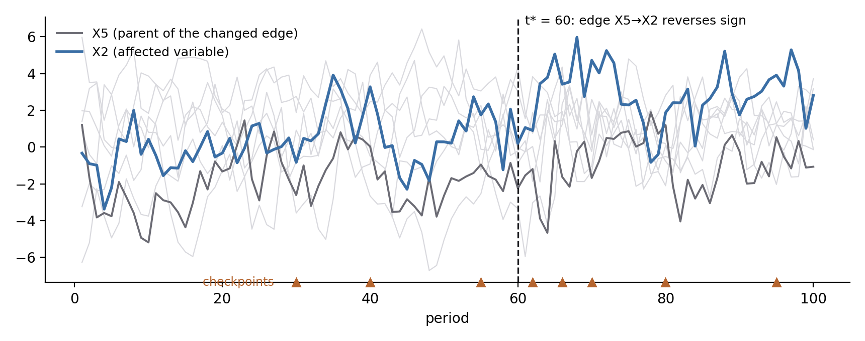
Design: the data-generating process
a lag-1 linear system with a controlled structural change
8 variables; each period is a linear function of the previous period (18 cross-lag edges plus autoregressive terms)
at period t* = 60, one edge changes: addition, removal, sign reversal, or weight doubling
12 scenarios: 4 change types × 3 independently generated systems
exact ground truth: the one-step-ahead distribution is Gaussian given the observed state
8 checkpoints: 3 pre-change (beliefs must be established before perseverance is interpretable), 5 post-change
Shown: scenario seed 300 (sign reversal). Triangles mark the elicitation checkpoints.

Slide 6
Elicitation protocol
the prompt is minimal by design
The model receives only the raw series through period t, and a single question.
no structural information is provided, and no indication that a change may occur — unprompted detection is part of the measurement
checkpoints are independent calls; no information persists between them except under explicit carryover conditions
SYSTEM: You are an expert probability estimator. [...] Respond with ONLY valid JSON: {"probability": <float>}
USER: Below is a recording of a system of 8 numeric variables, observed once per period for 66 consecutive periods.
period X1 X2 X3 ...
1 0.83 1.94 1.10 ...
... ... ... ...
66 1.02 -0.44 2.31 ...
What is the probability that X2 in period 67 (the next period) will exceed -0.52?
The threshold τ is placed at the midpoint of the old-regime and new-regime predictions; the stated probability therefore necessarily reveals which regime the model treats as current.

Slide 7
Forecast items and reference forecasts
each response is located between exact references
Two forecast items per checkpoint: the affected variable (a change to edge i→j alters only the conditional distribution of j) and an unaffected control variable. Error that rises on both indicates nonspecific degradation rather than detection.
reference | data used | mechanism known | role
truth p* | current state only | the current equations | scoring target
stale reference | current state only | the pre-change equations | perseverance bound
rolling window (20 periods) | last 20 observations | none — refit each checkpoint | purely recency-based strategy
rolling statistician | last 20 observations | none — asserts edges at |t| > 2 | classical statistical reference
The model receives strictly more data than every reference. Each error decomposes as (model − achievable) + (achievable − truth), and only the first term reflects on the model. Detection latency is assessed against certified detectability in the realized sample, not against t* itself.

Slide 8
Structure elicitation
probabilities on targeted edges rather than the full graph
Whole-graph scores are insensitive to the manipulation. The two regimes share 17 of 18 edges, so any whole-network measure is dominated by the unchanged edges.
Per-edge probability elicitation on tracked pairs.
at each checkpoint, one pair per query: the changed edge and three strength-matched comparison edges (two present in both regimes, one absent in both)
two probabilities per pair — that the influence is present, and that it is positive conditional on presence — scored by Brier score against the exact truth
the estimand is a difference-in-differences: movement on the changed edge across t*, relative to the comparison edges
querying a pair signals its relevance; the comparison edges receive the identical signal, which the difference removes

Slide 9
Predicted signatures by change type
the behavior of a calibrated respondent on the changed edge
change at t* | predicted signature
edge added | P(present) rises from low to high
edge removed | P(present) falls from high to low
sign reversal | P(present) remains high; P(positive) crosses 0.5
weight doubled | the edge's presence is unchanged, but the evidence for it strengthens; P(present) should therefore increase toward certainty
Weight-doubling scenarios are admitted only when the reference statistician's confidence (rolling 20-period |t|, recorded with every response) increases materially across t*; otherwise detectability, rather than the model, would be under test.
Forecasts remain the primary channel for magnitude changes; structure elicitation provides the corresponding belief measure on the same event.

Slide 10
Extension 1: simultaneous structural changes
k ∈ {1, 3, 6} edges change at t*, as nested sets
The manipulation separates two abilities rather than scaling a single difficulty:
Detection becomes easier. Additional changed edges produce additional variables with elevated forecast residuals.
Attribution becomes harder. Identifying which incoming edges changed grows more demanding with each affected variable.
Prediction: the forecast–structure dissociation widens with k, as the gains from easier detection accrue to forecasting while the costs of attribution accrue to stated structure.
Nesting ensures comparability: the k = 1 change is contained in the k = 3 set, which is contained in the k = 6 set; the k = 1 environment is identical to the single-change design.

Slide 11
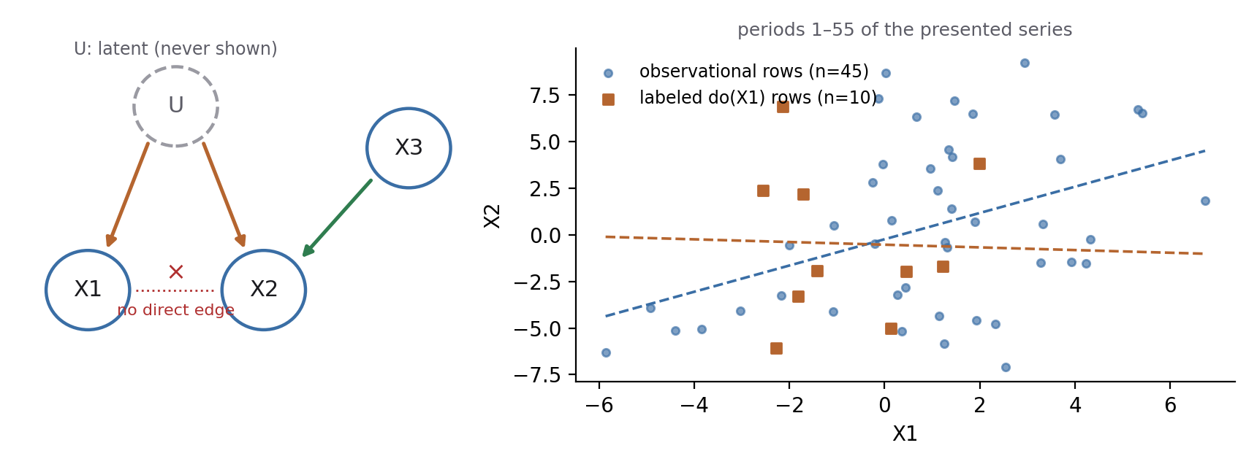
Extension 2: latent confounding
an environment in which forecast accuracy alone requires causal reasoning
In the lagged design, structure is identifiable from observation alone, so a statistical forecaster is the performance ceiling.
This environment removes that ceiling. A latent variable U drives X1 and X2; approximately 25% of periods carry labeled interventions on X1, severing U→X1. The resulting decoupling (right) makes the confounding learnable from the presented data.
the same value a, three questions | correct answer
observe X1 = a next period | use a — an observed X1 is evidence about U
set X1 = a next period | disregard a — the intervention severs U→X1
set X3 = a (a genuine cause) | use a — excludes the heuristic of discounting all interventions
A respondent without the causal structure must answer the observational and interventional questions identically, and is therefore wrong on one of them by a certified margin: items are admitted only when the two correct answers differ by at least 0.15 (realized gaps 0.30–0.55). All ground truth is closed-form and Monte-Carlo validated.

Slide 12
Controls
each removes one alternative explanation
control | alternative explanation removed
forecasts on an unaffected variable, every checkpoint | nonspecific post-change degradation read as detection
no-change environments (identical design, no change) | drift or degradation that occurs regardless of any change
repeated identical prompts; temperature 0 | response instability attributable to sampling variance
strength-matched comparison edges | global drift in stated beliefs read as edge-specific revision
carryover of the correct pre-change structure | failure to revise attributable to the absence of any initial belief
interventions on a genuine cause (set X3) | indiscriminate discounting of interventions scored as causal competence

Slide 13
Registered hypotheses
stated prior to data collection
 | prediction
D1 | after the change, forecast error rises on the affected variable specifically, not on the controls
D2 | responses initially track the pre-change equations and depart from them as evidence accumulates; the crossing point defines the detection time
D3 | the model underperforms the purely recency-based reference fitted to the same data
D4 | stated structure registers added and removed edges and sign reversals; weight doubling is registered through confidence rather than a change in truth value
D5 | primary hypothesis: forecasts and stated structure update at different rates — adaptation without revision would constitute prediction without understanding
Analysis: mixed-effects models with scenario random intercepts. Detection latencies are certified against what the realized sample supports, not against t*.

Slide 14
Summary
what the design provides
One environment, two scored channels. Stated probabilities are scored against exact p*, and stated structure against the exact graph, before and after a controlled change.
The dissociation is measurable. Forecast-recovery latency and belief-revision latency are separate curves on a common clock.
Failures are attributable. Reference forecasts decompose every error into model-versus-achievable and achievable-versus-truth components.
Causal necessity is certified. In the confounded environment, the best purely statistical forecast is wrong by a known per-item margin; only causal reasoning closes the gap.
Status: environments and item batteries implemented and validated (closed forms verified by Monte Carlo); single-model pilot complete; multi-model replication, the simultaneous-change manipulation, and the confounded environment are queued.

