Slide 1

Dissertation Committee Meeting Disordered Systems in Hierarchical Networks
Xiang Cheng
Department of Physics, Emory University
Committee:
Dr. Boettcher, Dr. Nemenman, Dr. Family, Dr. Burton, Dr. Nagy

Slide 2
Outline
Review of research
Project 1: Jamming in Hierarchical Networks
Project 2: antiferromagnetic Ising model
Future Plan

Slide 3
Review of research work
Jamming in Hierarchical Networks
Publication:
X. Cheng and S. Boettcher, Computer Physics Communications (Revision submitted);
Conference presentations:
2014 UGA CSP Workshop,
2014 APS March Meeting;
Antiferromagnetic Ising model in Hierarchical Networks
Publication: plan to write 1~2 papers according to results
Conference Presentations:
2015 UGA CSP Workshop,
2015 APS March Meeting;
Rotation Project: effect of a large number of receptors (Dr. Nemenman)
Publication:
X. Cheng, L. Merchan, M. Tchernookov, I. Nemenman, Phys. Biol. 10 035008 (2013);
Conference presentations:
q-bio 2012;
2013 APS March Meeting;

Slide 4
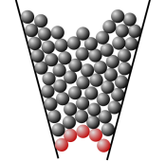

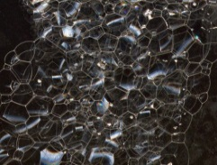
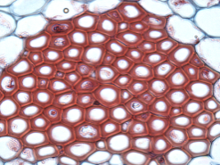
Jamming in Hierarchical Networks
Jamming is common
Characteristics:
Rigid state at high packing density
Out of equilibrium
Extremely slow relaxation
Challenging to understand
Extremely long relaxation;
No significant structural change;
Heterogeneities;

Slide 5
Research Questions
What causes slow relaxation?
Interaction?
Geometry?
Equilibrium real phase transition?
“Yes” evidences in mean-field models;
Non-mean field models?
Phase transition necessary for jamming?
jamming without phase transition?
no published evidence so far
Krzakala, et. al., PRL 101, 165702 (2008)
Berthier, et. al., PRL 106, 135702 (2011)

Slide 6

Jamming Model
Biroli-Mezard Model
Each site has $x_{i}=0, 1$ particle
Rule: at most $l (0, 1,⋯)$ neighbors
Biroli and Mezard, PRL 88, 2 (2002)

Slide 7



Jamming Model
Biroli-Mezard Model
Each site has $x_{i}=0, 1$ particle
Rule: at most $l (0, 1,⋯)$ neighbors
$g$ $n$
$$1{ 0}$$
Example:
triangle
$$l=1$$
Biroli and Mezard, PRL 88, 2 (2002)

Slide 8

Jamming Model
Biroli-Mezard Model
Each site has $x_{i}=0, 1$ particle
Rule: at most $l (0, 1,⋯)$ neighbors
$g$ $n$
$$1{ 0}$$
Example:
triangle
$$l=1$$
$$3{ 1}$$
Biroli and Mezard, PRL 88, 2 (2002)

Slide 9

Jamming Model
Biroli-Mezard Model
Each site has $x_{i}=0, 1$ particle
Rule: at most $l (0, 1,⋯)$ neighbors
$g$ $n$
$$1{ 0}$$
Example:
triangle
$$l=1$$
$$3{ 1}$$
$$3{ 2}$$
Biroli and Mezard, PRL 88, 2 (2002)

Slide 10

Jamming Model
Biroli-Mezard Model
Each site has $x_{i}=0, 1$ particle with $μ$ (chemical potential)
Rule: at most $l (0, 1,⋯)$ neighbors
$g$ $n$
$$1{ 0}$$
Example:
triangle
$$l=1$$
$$3{ 1}$$
$$3{ 2}$$
Biroli and Mezard, PRL 88, 2 (2002)

Slide 11



Jamming Model
Biroli-Mezard Model
Each site has $x_{i}=0, 1$ particle with $μ$ (chemical potential)
Rule: at most $l (0, 1,⋯)$ neighbors
$g$ $n$
$$1∙exp{[0∙μ]}$$
Example:
triangle
$$l=1$$
$$3∙exp{[1∙μ]}$$
$$3∙exp{[2∙μ]}$$
Biroli and Mezard, PRL 88, 2 (2002)

Slide 12

Jamming Model
Biroli-Mezard Model
Each site has $x_{i}=0, 1$ particle with $μ$ (chemical potential)
Rule: at most $l (0, 1,⋯)$ neighbors
$g$ $n$
$$1∙exp{[0∙μ]}$$
Example:
triangle
$$l=1$$
$$3∙exp{[1∙μ]}$$
$$3∙exp{[2∙μ]}$$
$$Ξ=\sum_{n_{i}=0}^{n_{max}}{g_{i}∙\exp{[n_{i}∙μ]}}$$
Biroli and Mezard, PRL 88, 2 (2002)

Slide 13


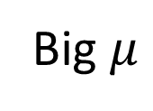
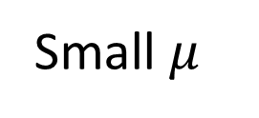
Jamming
Equilibrium state:
$$n_{equlibrium}=\frac{1}{Ξ} \frac{∂Ξ}{∂μ}$$
$$μ→0$$
Small $μ$
Big $μ$

Slide 14
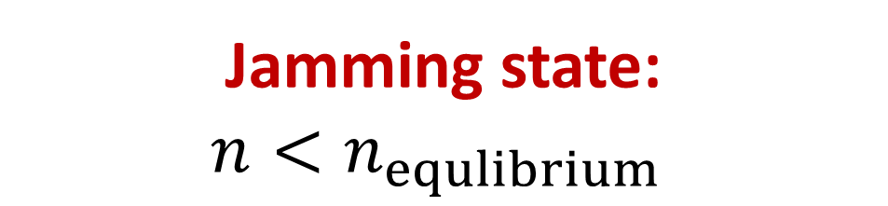
Jamming
Equilibrium state:
$$n_{equlibrium}=\frac{1}{Ξ} \frac{∂Ξ}{∂μ}$$
$$μ→0$$
Small $μ$
Big $μ$
Jamming state:
$$n<n_{equlibrium}$$

Slide 15
Jamming
Equilibrium state:
$$n_{equlibrium}=\frac{1}{Ξ} \frac{∂Ξ}{∂μ}$$
$$μ→0$$
Small $μ$
Big $μ$
Jamming state:
$$n<n_{equlibrium}$$
Mathematically,
Trap in local minimum

Slide 16
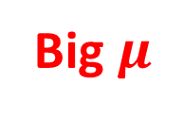
Jamming
Equilibrium state:
$$n_{equlibrium}=\frac{1}{Ξ} \frac{∂Ξ}{∂μ}$$
$$μ→0$$
Small $μ$
Big $μ$
Jamming state:
$$n<n_{equlibrium}$$
Mathematically,
Trap in local minimum

Slide 17

NP-hard Problem
State $n$:
$$n=x^{T}x$$
where, e.g., $x=[0, 1, 0, 0, 1, 1,⋯]$

Slide 18
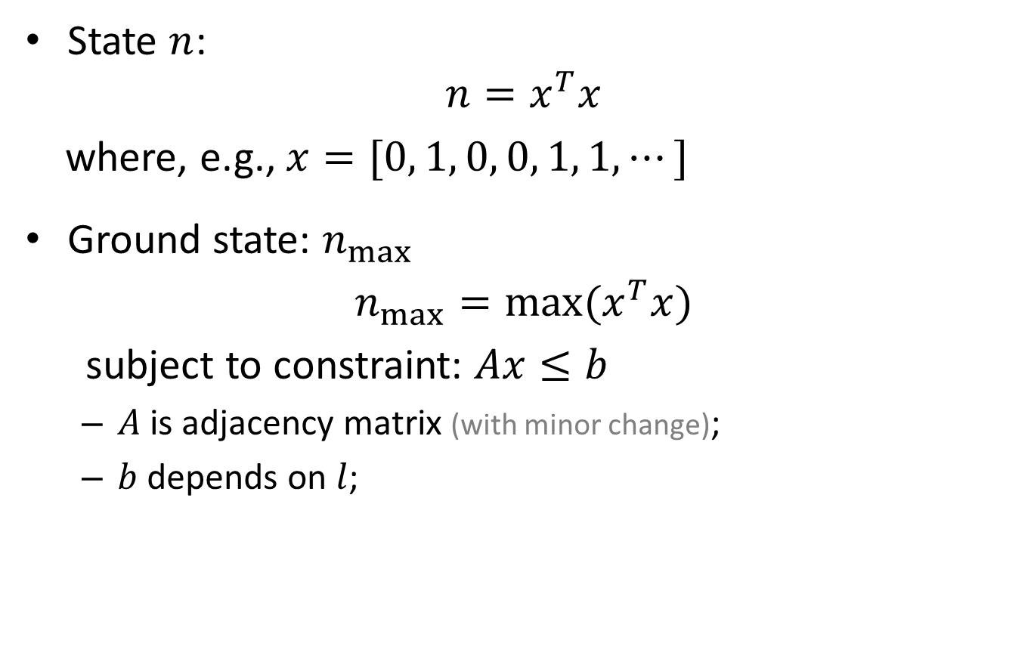
NP-hard Problem
State $n$:
$$n=x^{T}x$$
where, e.g., $x=[0, 1, 0, 0, 1, 1,⋯]$
Ground state: $n_{max}$
$$n_{max}=\max{(x^{T}x)}$$
subject to constraint: $Ax≤b$
$A$ is adjacency matrix (with minor change);
$b$ depends on $l$;

Slide 19
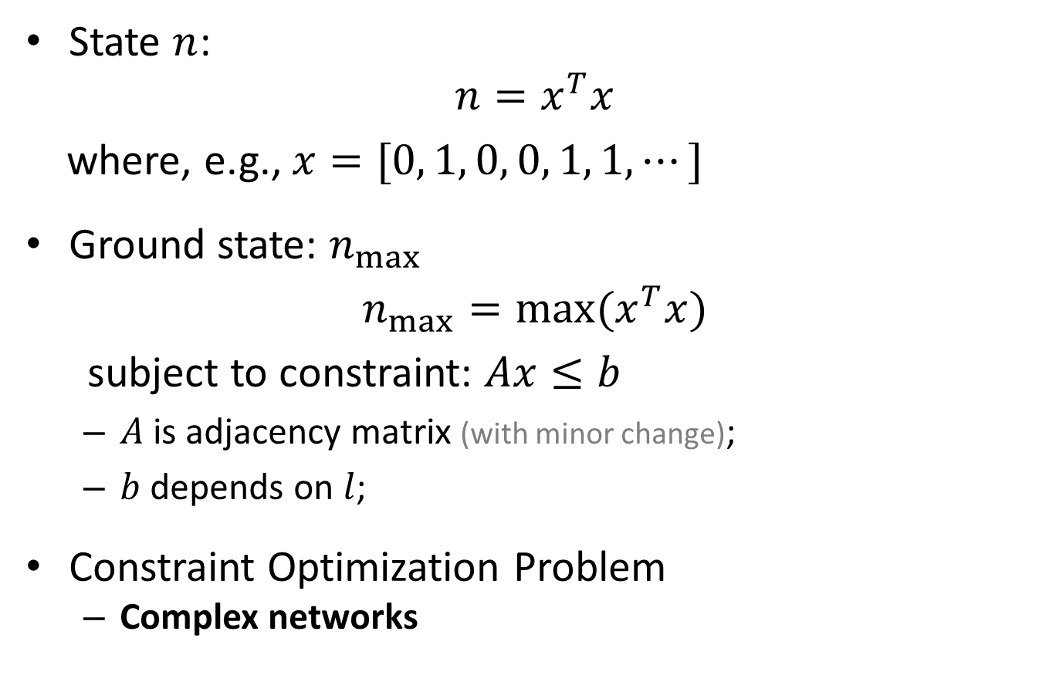
NP-hard Problem
State $n$:
$$n=x^{T}x$$
where, e.g., $x=[0, 1, 0, 0, 1, 1,⋯]$
Ground state: $n_{max}$
$$n_{max}=\max{(x^{T}x)}$$
subject to constraint: $Ax≤b$
$A$ is adjacency matrix (with minor change);
$b$ depends on $l$;
Constraint Optimization Problem
Complex networks

Slide 20
Hierarchical Networks: Hanoi networks
HN3:

Slide 21
Hierarchical Networks: Hanoi networks
HN3:

Slide 22
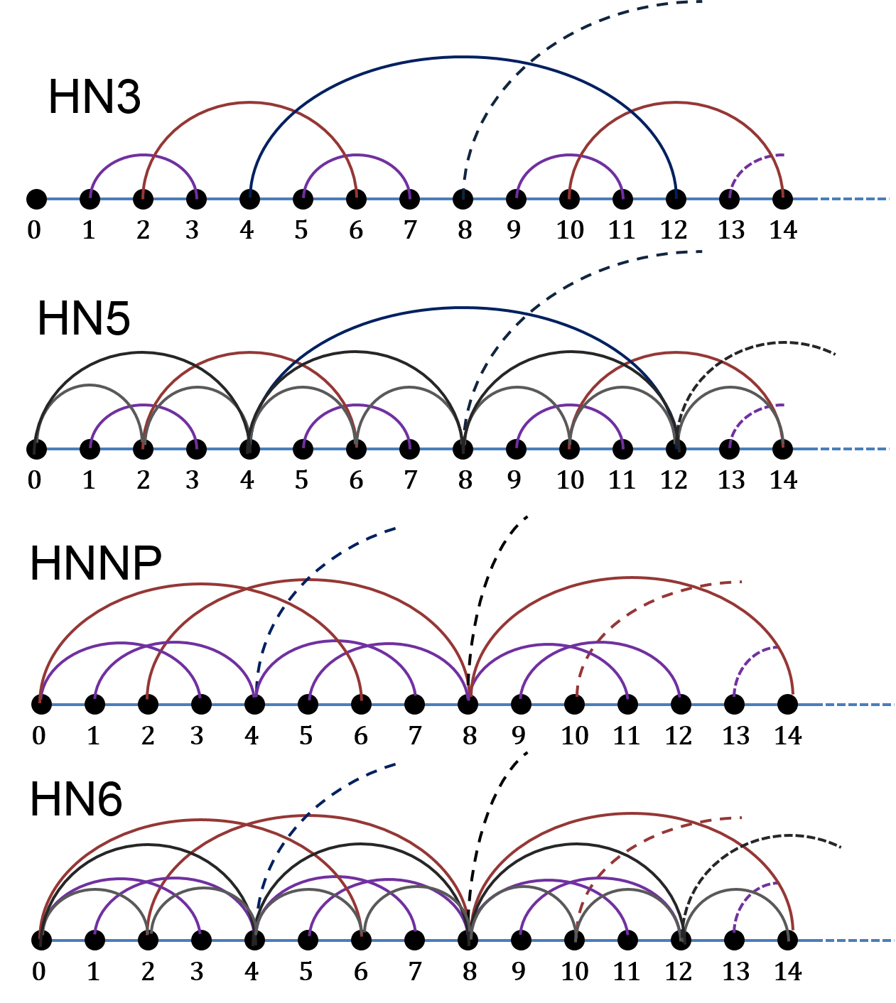
Hierarchical networks (HNs)
HN3:
degree 3
HN5:
average degree 5
HNNP:
average degree 4
nonplanar
HN6
average degree 6
nonplanar

Slide 23
Why Hierarchical Networks (HNs)?
Exactly solvable by Renormalization Group (RG)
Lattice-like structure
Mean-Field HNs Regular lattice
Geometrical effect
Different degrees: 3, 4, 5, 6
Planar vs non-planar
Fixed structure: computational efficient
Avoid averages over random ensembles
Kazakov, PRA, 119, 3 (1986)

Slide 24
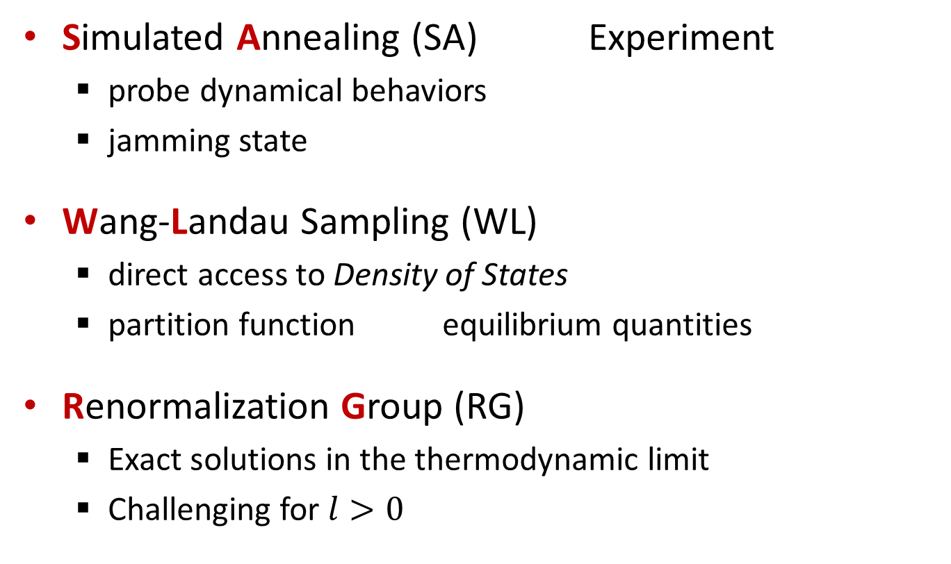
Methods
Simulated Annealing (SA) Experiment
probe dynamical behaviors
jamming state
Wang-Landau Sampling (WL)
direct access to Density of States
partition function equilibrium quantities
Renormalization Group (RG)
Exact solutions in the thermodynamic limit
Challenging for $l>0$

Slide 25
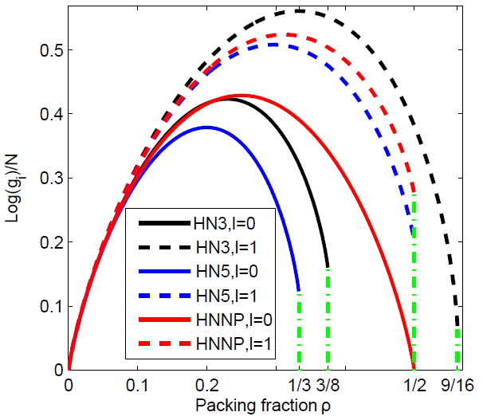
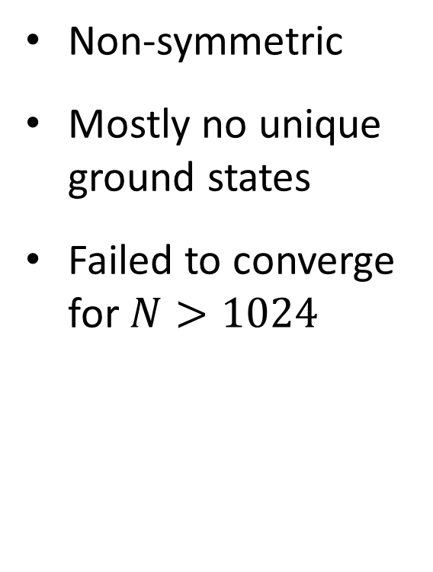
Density of States
Non-symmetric
Mostly no unique ground states
Failed to converge for $N>1024$

Slide 26
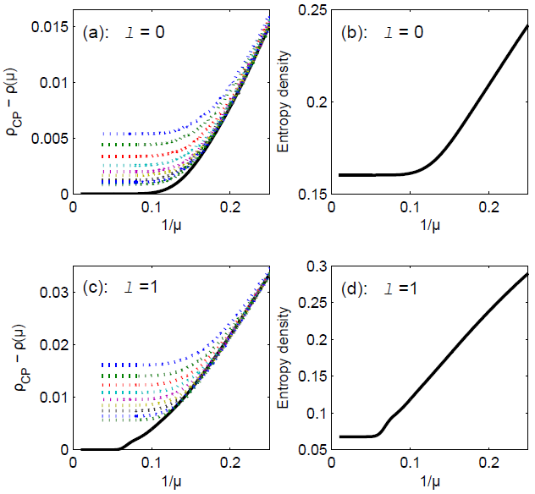
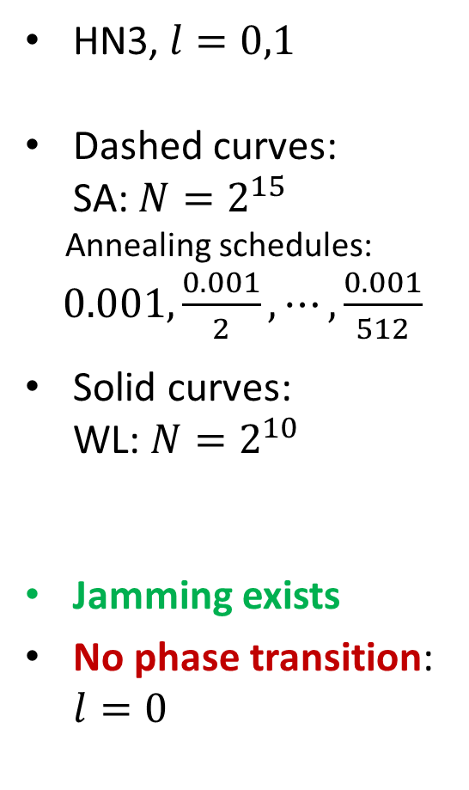
Jamming
HN3, $l=0,1$
Dashed curves:
SA: $N=2^{15}$
Annealing schedules: $0.001,\frac{0.001}{2},⋯,\frac{0.001}{512}$
Solid curves:
WL: $N=2^{10}$
Jamming exists
No phase transition: $l=0$

Slide 27
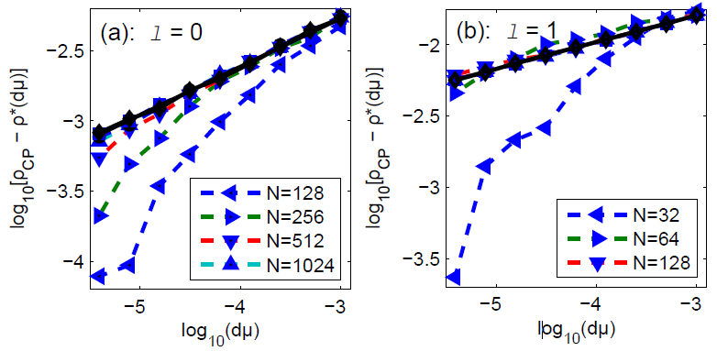
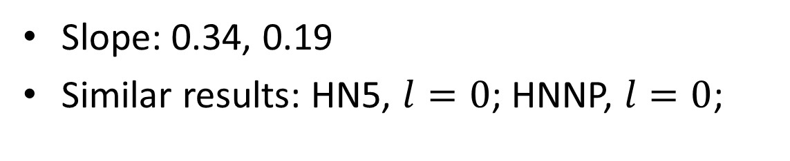
Power-law relaxation
Slope: 0.34, 0.19
Similar results: HN5, $l=0$; HNNP, $l=0$;

Slide 28
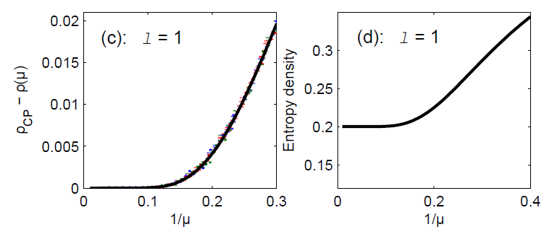
No Jamming
Jamming may be geometry-related!

Slide 29
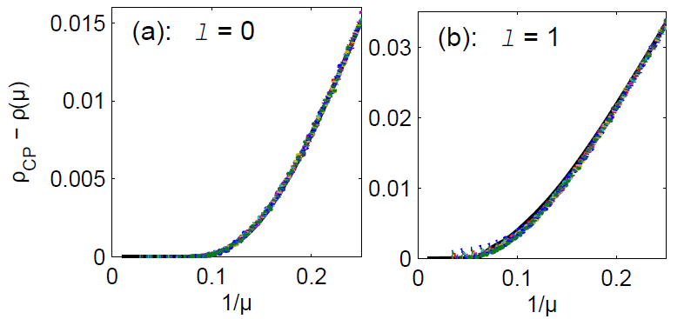
Local dynamics
Hopping eliminates jamming;
Local dynamics affects jamming;
May be useful for stochastic optimizations.

Slide 30
Project 1 Summary
Phase transition is not necessary for jamming;
Power-law relaxation near jamming transition;
Jamming is related to geometry and local dynamics;
More work for more conclusions
Renormalization Group

Slide 31
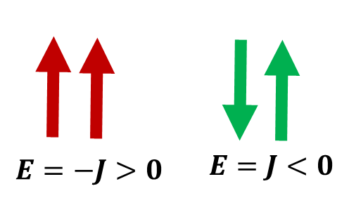
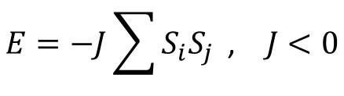
Antiferromagnetic Ising model
Antiferromagnetic (AFM) Ising model
glassy dynamics
$$E=−J\sum{S_{i}S_{j}}\text{ , } J<0$$

Slide 32
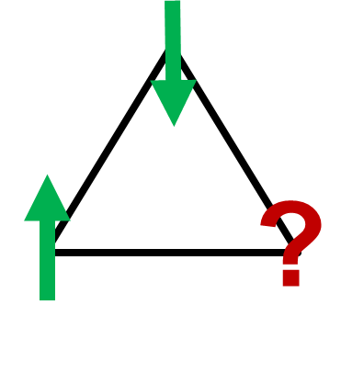
Antiferromagnetic Ising model
Antiferromagnetic (AFM) Ising model
glassy dynamics
Geometric frustration: odd loops
$$E=−J\sum{S_{i}S_{j}}\text{ , } J<0$$

Slide 33
Antiferromagnetic Ising model
Antiferromagnetic (AFM) Ising model
glassy dynamics
Geometric frustration: odd loops
$$E=−J\sum{S_{i}S_{j}}\text{ , } J<0$$

Slide 34
Antiferromagnetic Ising model
Antiferromagnetic (AFM) Ising model
glassy dynamics
Geometric frustration: odd loops
$$E=−J\sum{S_{i}S_{j}}\text{ , } J<0$$

Slide 35
Antiferromagnetic Ising model
Antiferromagnetic (AFM) Ising model
glassy dynamics
Geometric frustration: odd loops
$$E=−J\sum{S_{i}S_{j}}\text{ , } J<0$$

Slide 36
Antiferromagnetic Ising model
Antiferromagnetic (AFM) Ising model
glassy dynamics
Geometric frustration: odd loops
$$E=−J\sum{S_{i}S_{j}}\text{ , } J<0$$

Slide 37
Antiferromagnetic Ising model
Antiferromagnetic (AFM) Ising model
glassy dynamics
Geometric frustration: odd loops
$$E=−J\sum{S_{i}S_{j}}\text{ , } J<0$$

Slide 38
Research Questions
Phase transitions?
Equilibrium/non-equilibrium transition?
Spin glass phase?
Glassy relaxation?
Influence of geometry?
Difference to mean-field models?

Slide 39
Methods
Simulated Annealing (SA) Experiment
probe dynamical behaviors
Glassy relaxation
Wang-Landau Sampling (WL)
direct access to Density of States
partition function equilibrium quantities
Renormalization Group (RG)
Exact solutions in the thermodynamic limit

Slide 40
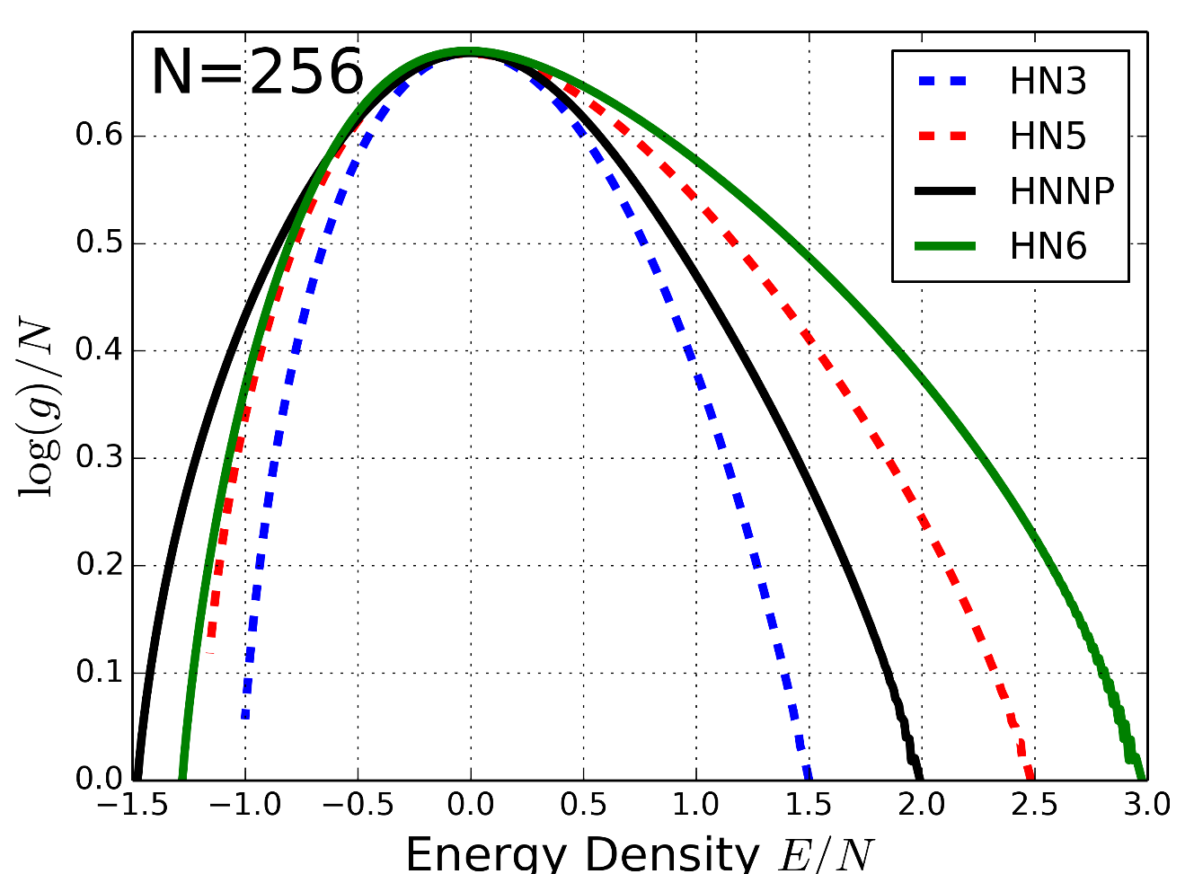
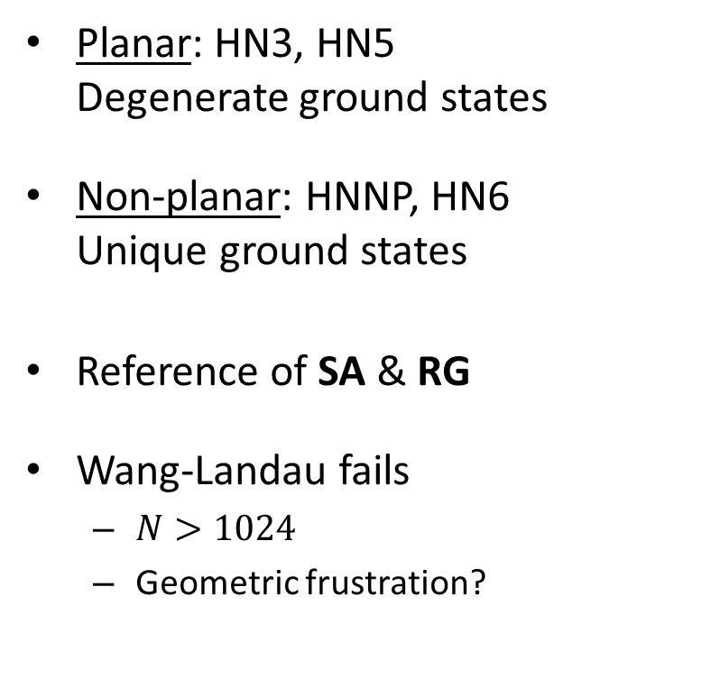
Density of States (WL)
Planar: HN3, HN5
Degenerate ground states
Non-planar: HNNP, HN6
Unique ground states
Reference of SA & RG
Wang-Landau fails
$N>1024$
Geometric frustration?

Slide 41
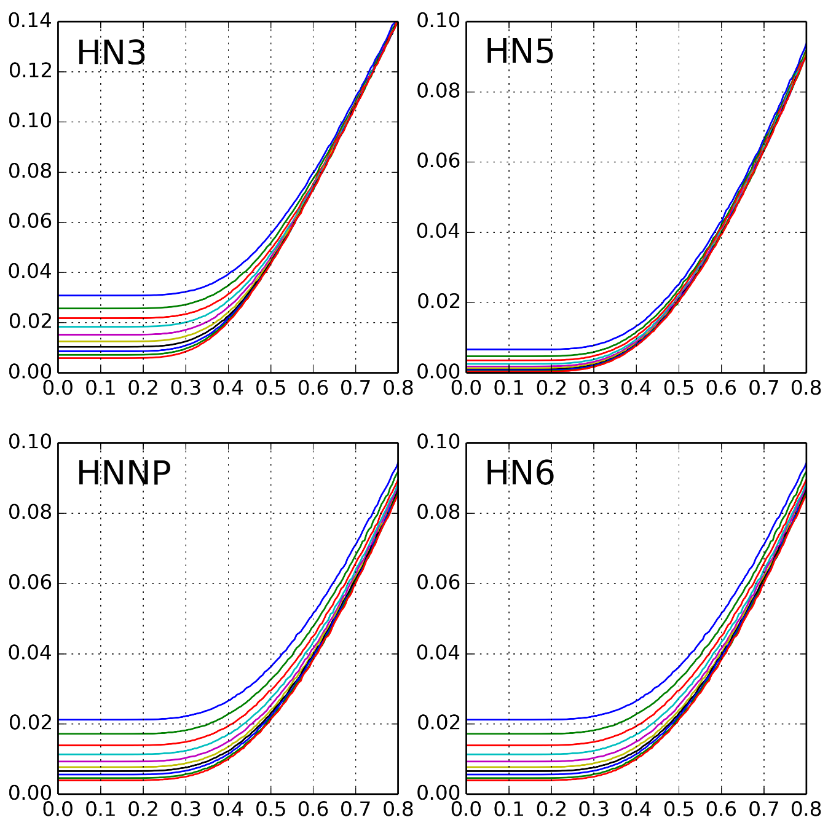

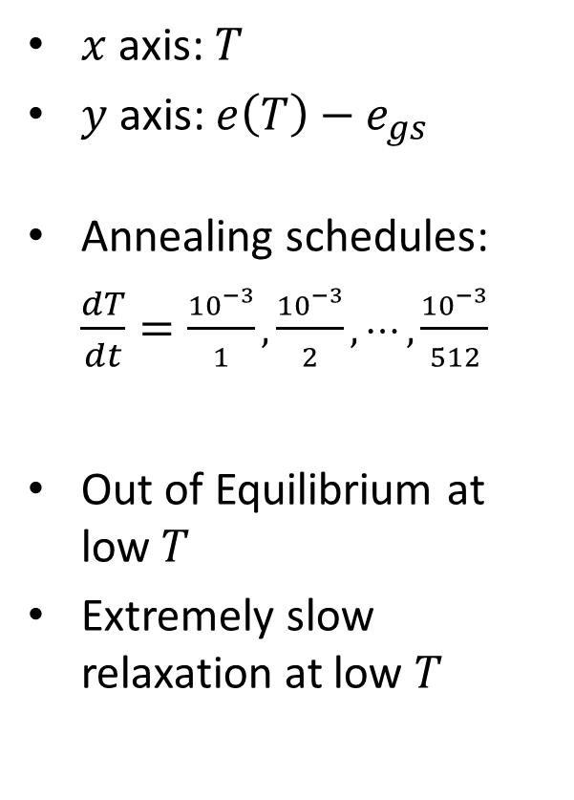








Glassy relaxation (SA)
$x$ axis: $T$
$y$ axis: $e\left(T\right)−e_{gs}$
Annealing schedules:
$\frac{dT}{dt}=\frac{{10}^{−3}}{1}, \frac{{10}^{−3}}{2},⋯,\frac{{10}^{−3}}{512}$
Out of Equilibrium at low $T$
Extremely slow relaxation at low $T$
$$N=16,384$$
$$N=16,384$$
$$e\left(T\right)−e_{gs}$$
$$T$$
$$T$$
$$N=16,384$$
$$N=16,384$$
$$e\left(T\right)−e_{gs}$$
$$T$$
$$T$$

Slide 42
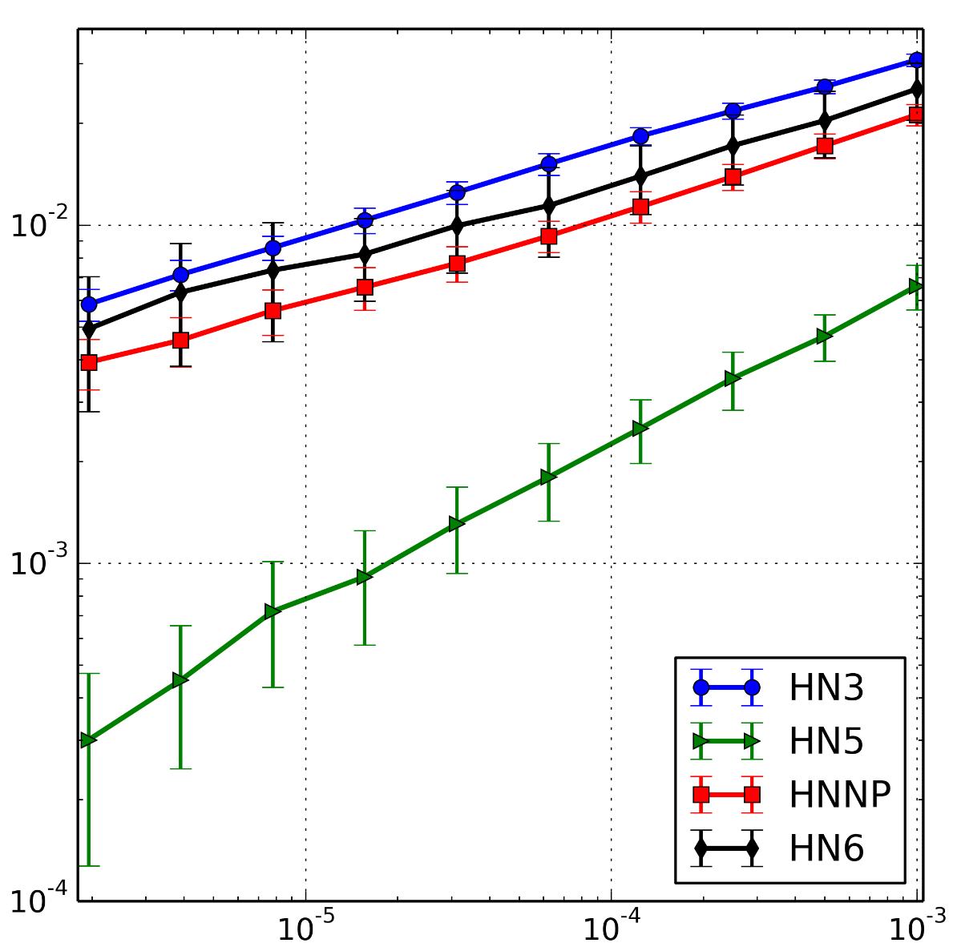
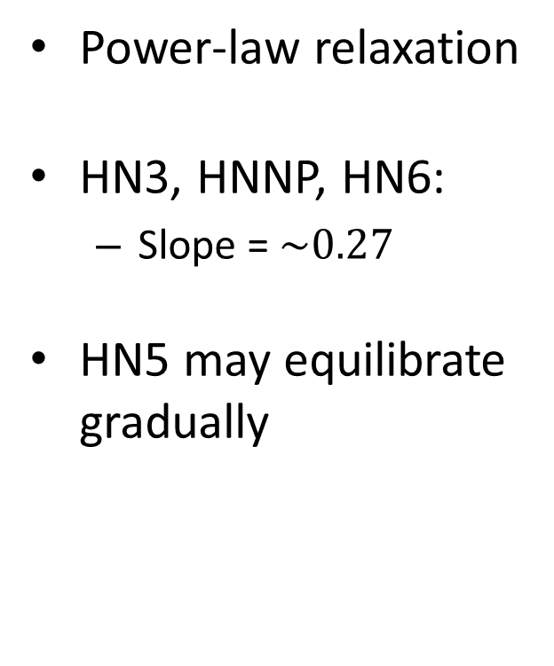


Power-law relaxation (SA)
Power-law relaxation
HN3, HNNP, HN6:
Slope = $\sim 0.27$
HN5 may equilibrate gradually
$$e\left(T\right)−e_{gs}$$
$$dT$$

Slide 43

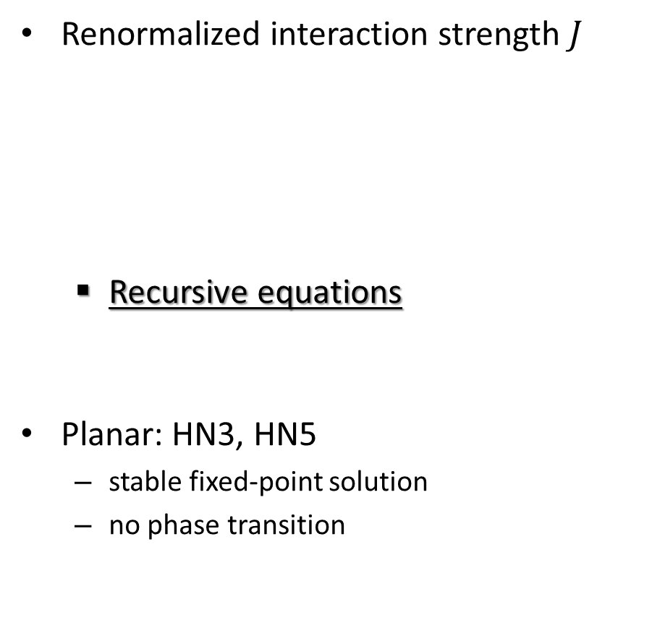
Spin glass transition (RG)
Renormalized interaction strength $J$
Recursive equations
Planar: HN3, HN5
stable fixed-point solution
no phase transition
$$J^{′}=f\left( J, λ \right)$$
$$λ^{′}=g( J,λ )$$
Numerical solution
Analytical solution
McKay and Berker, Phys. Rev. Lett. 48, 11 (1982)

Slide 44
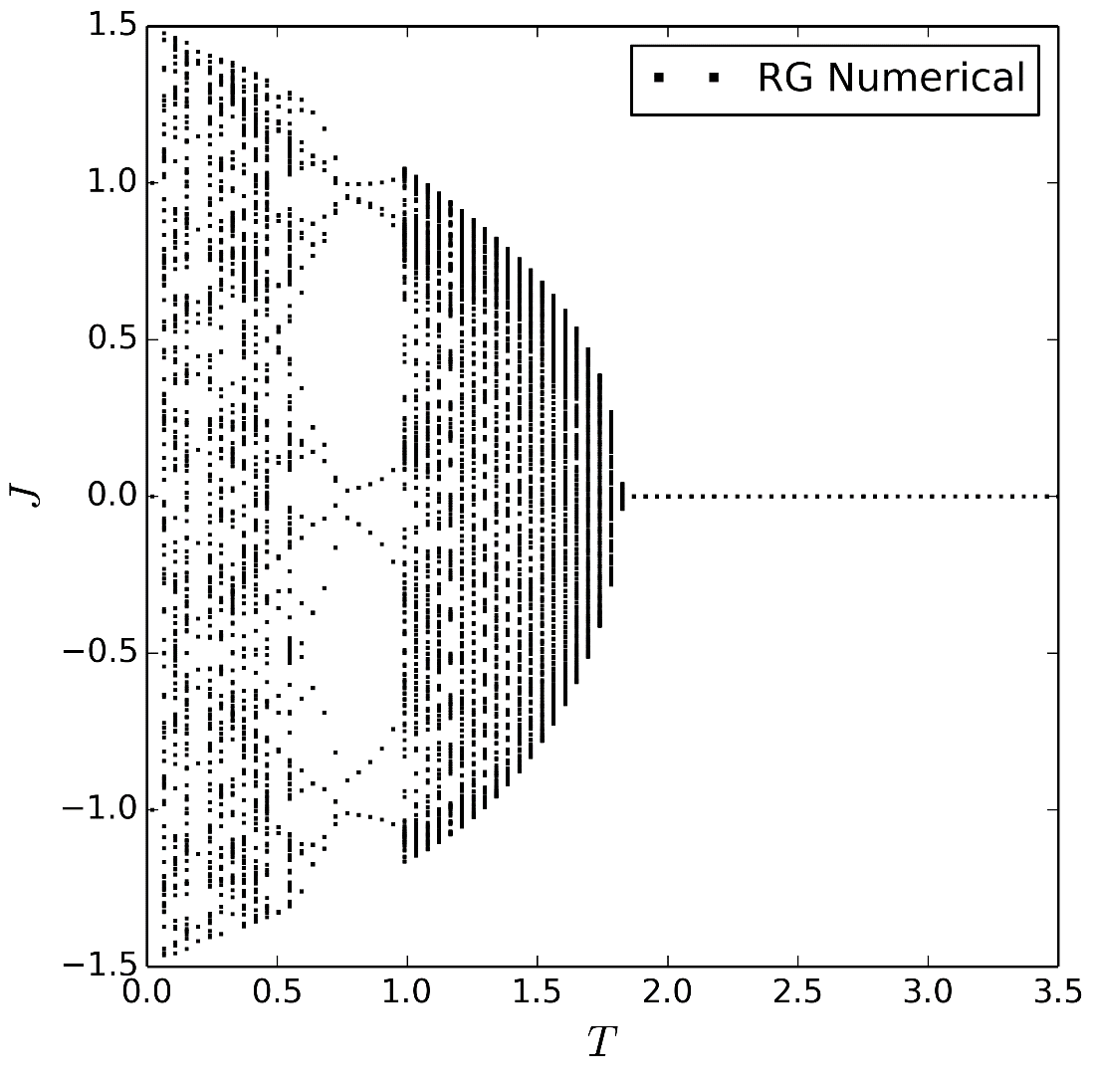
Spin glass transition (RG)
Non-Planar: HNNP, HN6
partially stable fixed-point solution
possible spin glass transition
HNNP
McKay and Berker, Phys. Rev. Lett. 48, 11 (1982)

Slide 45
Spin glass transition (RG)
Non-Planar: HNNP, HN6
partially stable fixed-point solution
possible spin glass transition
HNNP
McKay and Berker, Phys. Rev. Lett. 48, 11 (1982)

Slide 46
Spin glass transition (RG)
Non-Planar: HNNP, HN6
partially stable fixed-point solution
possible spin glass transition
HNNP
McKay and Berker, Phys. Rev. Lett. 48, 11 (1982)

Slide 47
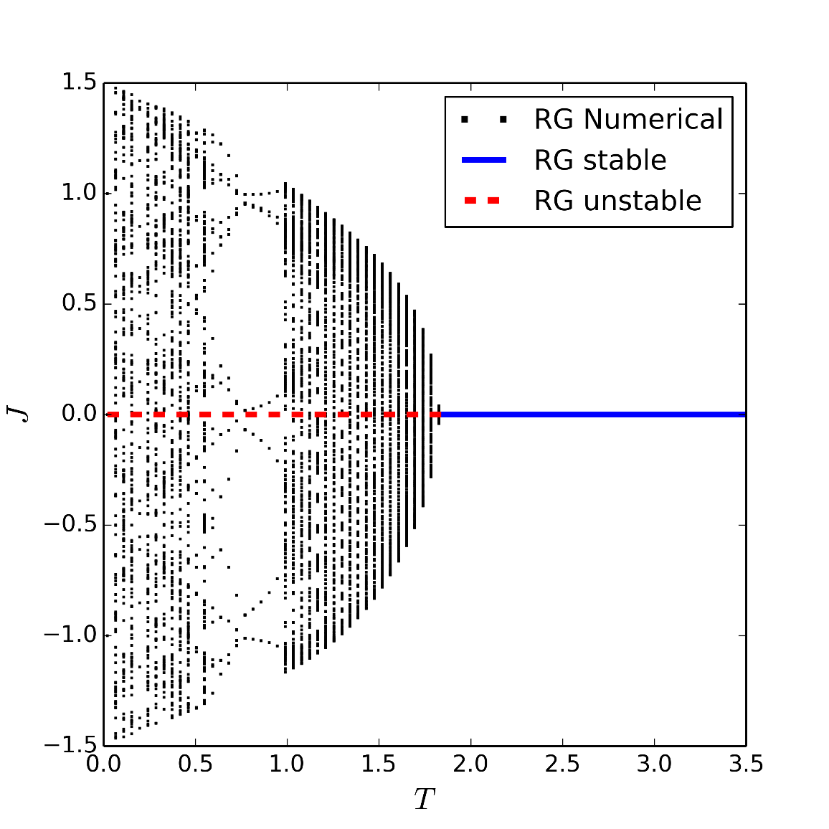
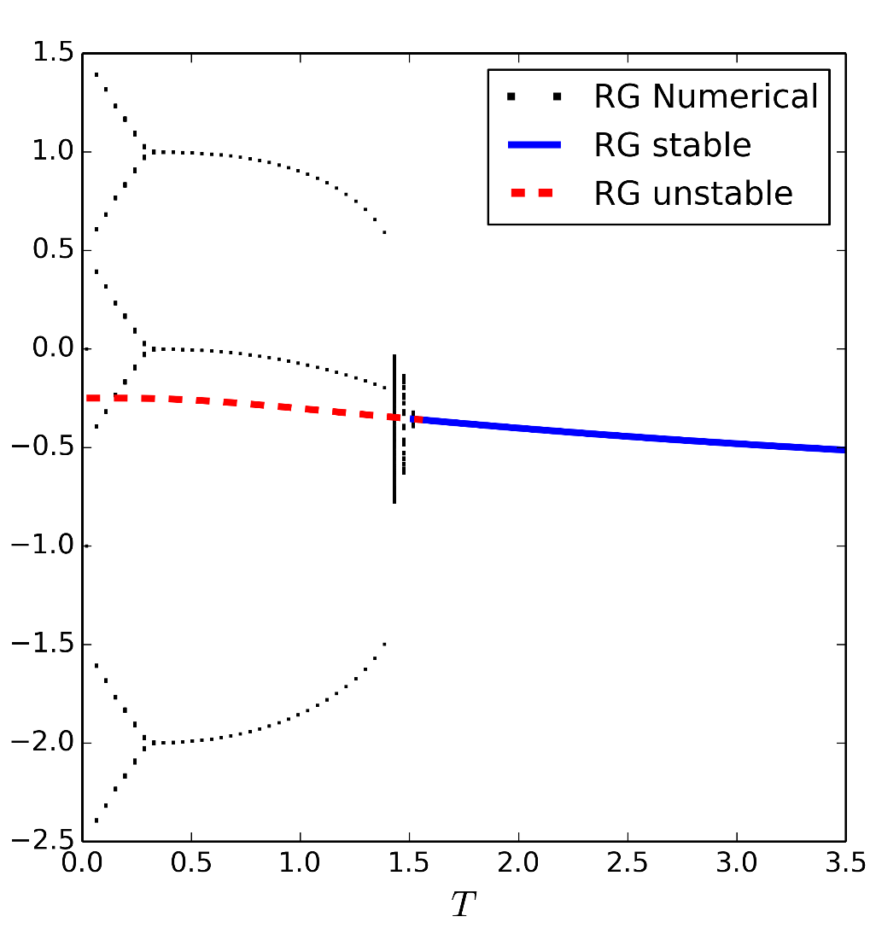
Spin glass transition (RG)
Non-Planar: HNNP, HN6
partially stable fixed-point solution
possible spin glass transition
HN6
HNNP
McKay and Berker, Phys. Rev. Lett. 48, 11 (1982)

Slide 48

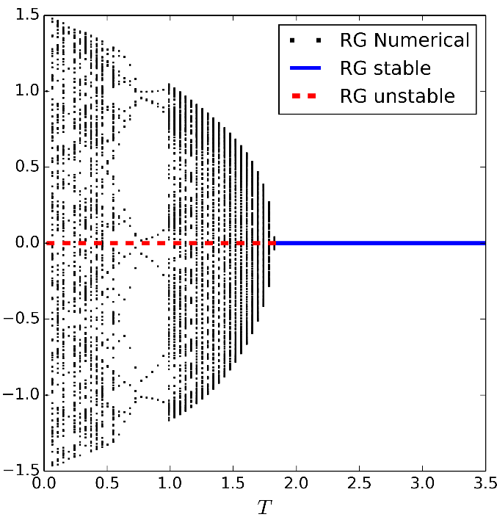
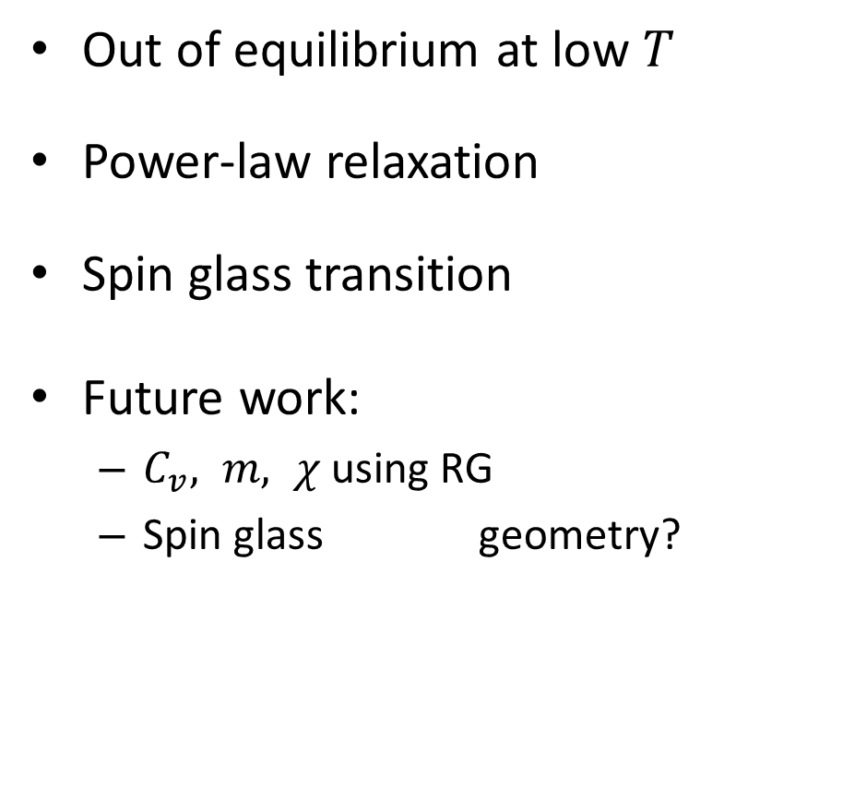

Project 2 Summary
Out of equilibrium at low $T$
Power-law relaxation
Spin glass transition
Future work:
$C_{v}, m, χ$ using RG
Spin glass geometry?
$$J$$

Slide 49
Future Plan
Research
Renormalization group of Ising model
1~2 papers about AFM Ising model
Renormalization group of Jamming
Graduation
Computer Science MS (Computational Science)
May 2016 OR Dec 2015

Slide 51
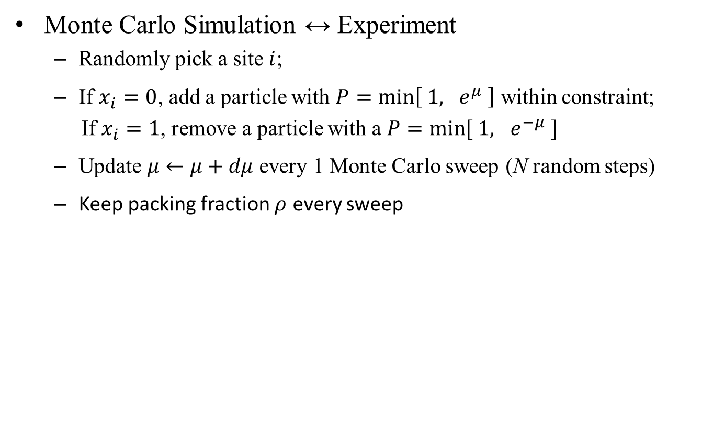
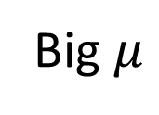
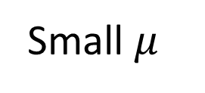

Simulated Annealing
Monte Carlo Simulation ↔ Experiment
Randomly pick a site $i$;
If $x_{i}=0$, add a particle with $P=\min\left[ 1, e^{μ} \right]$ within constraint;
If $x_{i}=1$, remove a particle with a $P=\min{[ 1, e^{−μ} ]}$
Update $μ←μ+dμ$ every 1 Monte Carlo sweep (N random steps)
Keep packing fraction $ρ$ every sweep
$$μ→0$$
Small $μ$
Big $μ$

Slide 52
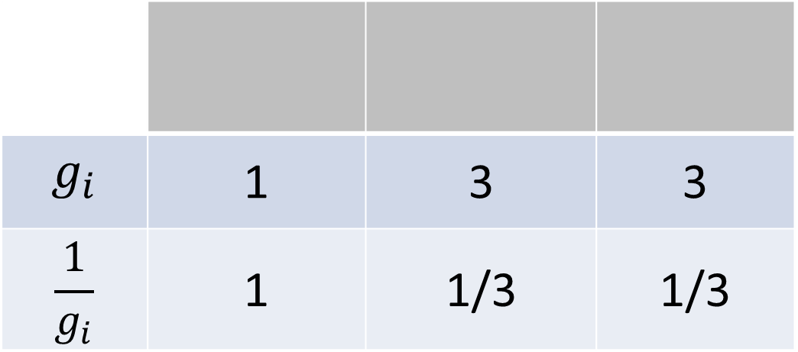

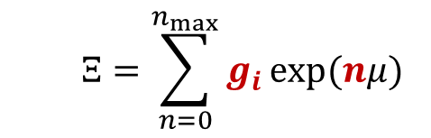
Wang-Landau Sampling
Monte Carlo Methods to find the density of states
Fact: random sampling with $P∝\frac{1}{g_{i}}$ → flat histogram
$$Ξ=\sum_{n=0}^{n_{max}}{g_{i}}\exp{(nμ)}$$
$$g_{i}$$ | 1 | 3 | 3
$$\frac{1}{g_{i}}$$ | 1 | 1/3 | 1/3
Flat
Histogram

Slide 53
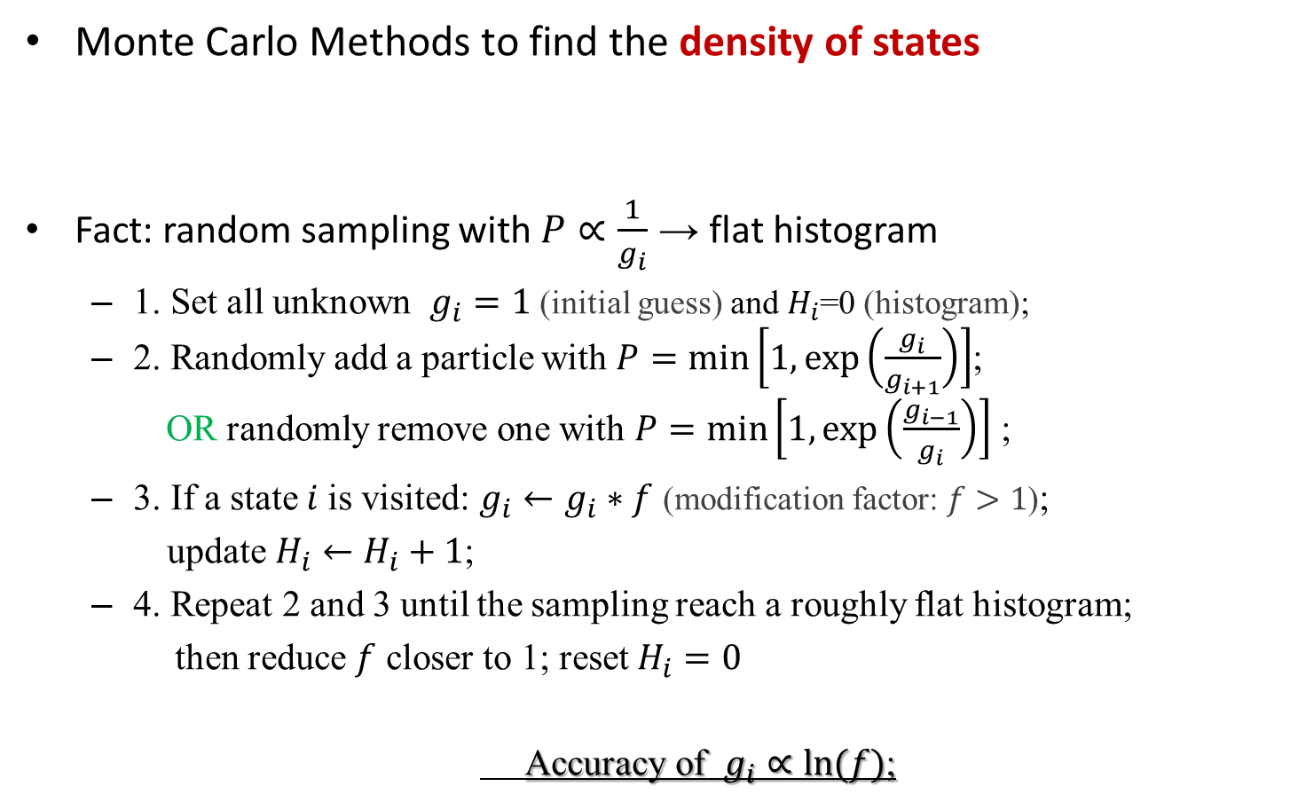
Wang-Landau Sampling
Monte Carlo Methods to find the density of states
Fact: random sampling with $P∝\frac{1}{g_{i}}$ → flat histogram
1. Set all unknown $g_{i}=1$ (initial guess) and $H_{i}$=0 (histogram);
2. Randomly add a particle with $P=\min\left[1,\exp\left(\frac{g_{i}}{g_{i+1}}\right)\right]$;
OR randomly remove one with $P=\min\left[1,\exp\left(\frac{g_{i−1}}{g_{i}}\right)\right]$ ;
3. If a state $i$is visited: $g_{i}←g_{i}∗f$ (modification factor: $f>1$);
update $H_{i}←H_{i}+1$;
4. Repeat 2 and 3 until the sampling reach a roughly flat histogram;
then reduce $f$ closer to 1; reset $H_{i}=0$
Accuracy of $g_{i}∝\ln{(f)}$;
$$Ξ=\sum_{n=0}^{n_{max}}{g_{i}}\exp{(nμ)}$$

Slide 54
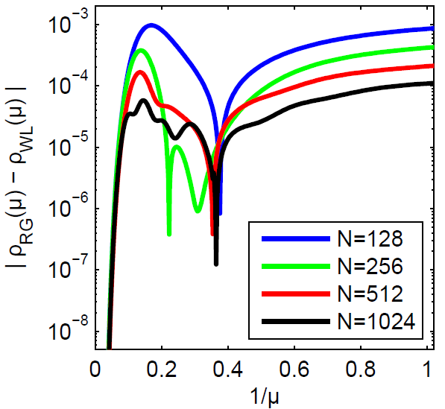
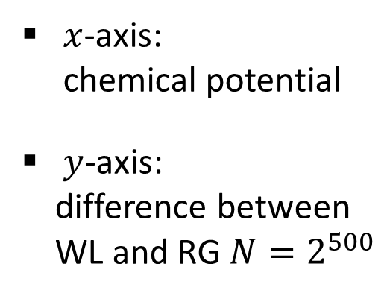
WL vs. RG
$x$-axis:
chemical potential
$y$-axis:
difference between
WL and RG ${N=2}^{500}$

Slide 55


Slide 56



Slide 57


$$N=2^{500}$$

