Slide 1

Dissertation Committee Meeting Disordered Systems in hierarchical networks
Xiang Cheng
Department of Physics, Emory University
Committee:
Dr. Boettcher, Dr. Nemenman, Dr. Family, Dr. Burton, Dr. Nagy

Slide 2
Outline
Review of research
Project 1: jamming
Project 2: antiferromagnetic Ising model
Plan of graduation

Slide 3
Review of research work
Jamming in Hierarchical Networks
Publication:
X. Cheng and S. Boettcher, Computer Physics Communications (Revision submitted);
Conference presentations:
2014 UGA CSP Workshop,
2014 APS March Meeting;
Antiferromagnetic Ising model in Hierarchical Networks
Publication: plan to write 1~2 papers according to results
Conference Presentations:
2015 UGA CSP Workshop,
2015 APS March Meeting;
Rotation Project: effect of a large number of receptors (Dr. Nemenman)
Publication:
X. Cheng, L. Merchan, M. Tchernookov, I. Nemenman, Phys. Biol. 10 035008 (2013);
Conference presentations:
q-bio 2012;
2013 APS March Meeting;

Slide 4
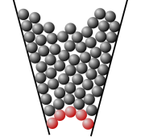


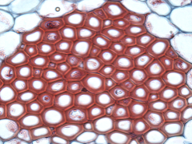
Jamming in Hierarchical Network
Jamming is ubiquitous
Characteristics:
Rigid state at high packing density (not highest)
Out of equilibrium
Extremely slow relaxation
Still a challenge to understand
Extremely long relaxation;
No significant structural change;
Heterogeneities;

Slide 5
Research Questions
What causes slow relaxation?
Interaction?
Geometry?
Equilibrium real phase transition?
“Yes” evidences in mean-field models;
Phase transition necessary for jamming?
jamming without phase transition?
no published evidence so far

Slide 6

Jamming Model
Biroli-Mezard Model
Each site has $x_{i}=0$OR 1

