Slide 1


Antiferromagnetic Ising Model in Hierarchical Networks
Xiang Cheng and Stefan Boettcher
Department of Physics, Emory University, Atlanta, GA
2015 APS March Meeting,
San Antonio, TX
Supported by the NSF DMR-1207431

Slide 2
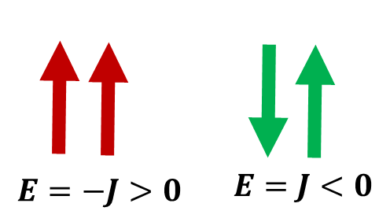
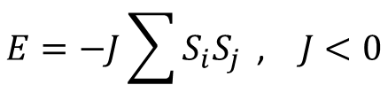
Introduction
Antiferromagnetic Ising model
$$E=−J\sum{S_{i}S_{j}}\text{ , } J<0$$

Slide 3
Introduction
Antiferromagnetic Ising model
glassy dynamics
$$E=−J\sum{S_{i}S_{j}}\text{ , } J<0$$

Slide 4
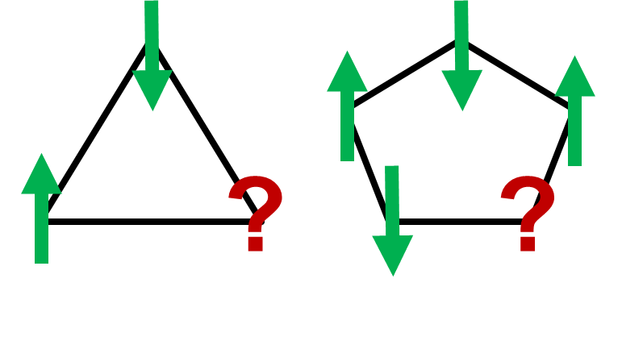
Introduction
Antiferromagnetic Ising model
glassy dynamics
Geometric frustration
$$E=−J\sum{S_{i}S_{j}}\text{ , } J<0$$

Slide 5
Research Questions
Phase transitions?
Equilibrium/non-equilibrium transition?
Spin glass phase?
Glassy relaxation?
Influence of geometry?
Difference to mean-field models?

Slide 6
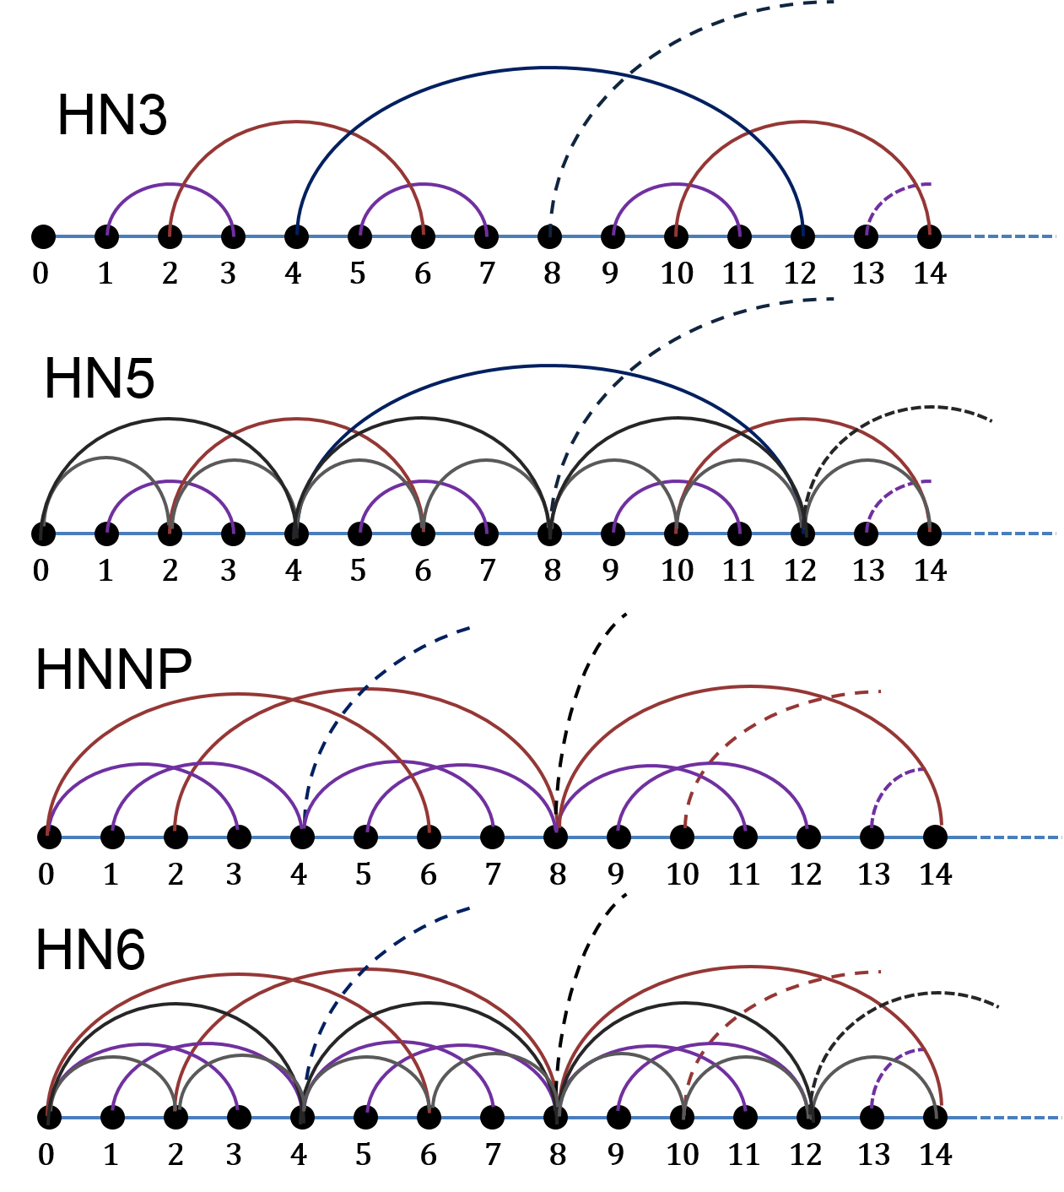
Hierarchical networks (HNs)
HN3:
degree 3
HN5:
average degree 5
HNNP:
average degree 4
nonplanar
HN6
average degree 6
nonplanar

Slide 7
Hierarchical networks (HNs)
HN3:
degree 3
HN5:
average degree 5
HNNP:
average degree 4
nonplanar
HN6
average degree 6
nonplanar

Slide 8
Hierarchical networks (HNs)
HN3:
degree 3
HN5:
average degree 5
HNNP:
average degree 4
nonplanar
HN6
average degree 6
nonplanar

Slide 9
Hierarchical networks (HNs)
HN3:
degree 3
HN5:
average degree 5
HNNP:
average degree 4
nonplanar
HN6
average degree 6
nonplanar

Slide 10
Hierarchical networks (HNs)
HN3:
degree 3
HN5:
average degree 5
HNNP:
average degree 4
nonplanar
HN6
average degree 6
nonplanar

Slide 11
Hierarchical networks (HNs)
HN3:
degree 3
HN5:
average degree 5
HNNP:
average degree 4
nonplanar
HN6
average degree 6
nonplanar

Slide 12
Hierarchical networks (HNs)
HN3:
degree 3
HN5:
average degree 5
HNNP:
average degree 4
nonplanar
HN6
average degree 6
nonplanar

Slide 13
Why Hierarchical Networks (HNs)?
Exactly solvable by Renormalization Group (RG)

Slide 14
Why Hierarchical Networks (HNs)?
Exactly solvable by Renormalization Group (RG)
Lattice-like structure
Mean-Field HNs Regular lattice

Slide 15
Why Hierarchical Networks (HNs)?
Exactly solvable by Renormalization Group (RG)
Lattice-like structure
Mean-Field HNs Regular lattice
Different structures among HNs
Different degrees: 3, 4, 5, 6
Planar vs non-planar

Slide 16
Methods
Wang-Landau Sampling (WL)
direct access to Density of States
partition function equilibrium quantities
Simulated Annealing (SA)
probe dynamical behaviors
Glassy relaxation
Renormalization Group (RG)
Exact solutions in the thermodynamic limit

Slide 17
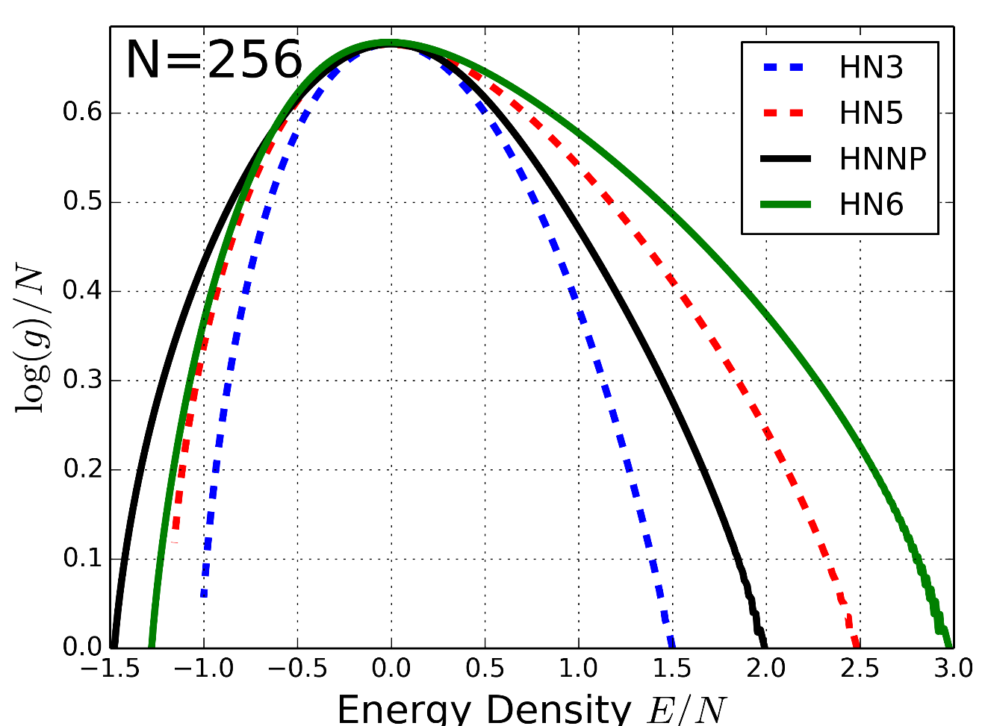
Density of States (WL)
Planar: HN3, HN5
Degenerate ground states
Non-planar: HNNP, HN6
Unique ground states

Slide 18
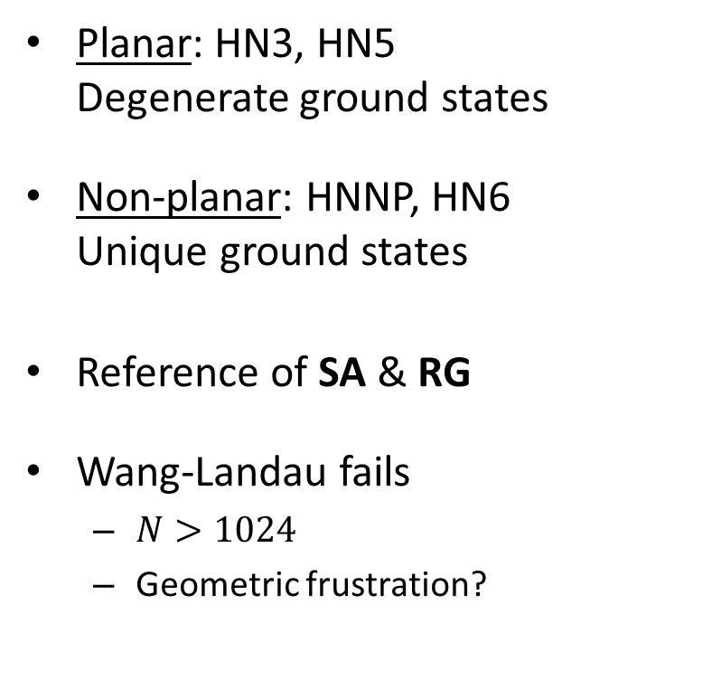
Density of States (WL)
Planar: HN3, HN5
Degenerate ground states
Non-planar: HNNP, HN6
Unique ground states
Reference of SA & RG
Wang-Landau fails
$N>1024$
Geometric frustration?

Slide 19
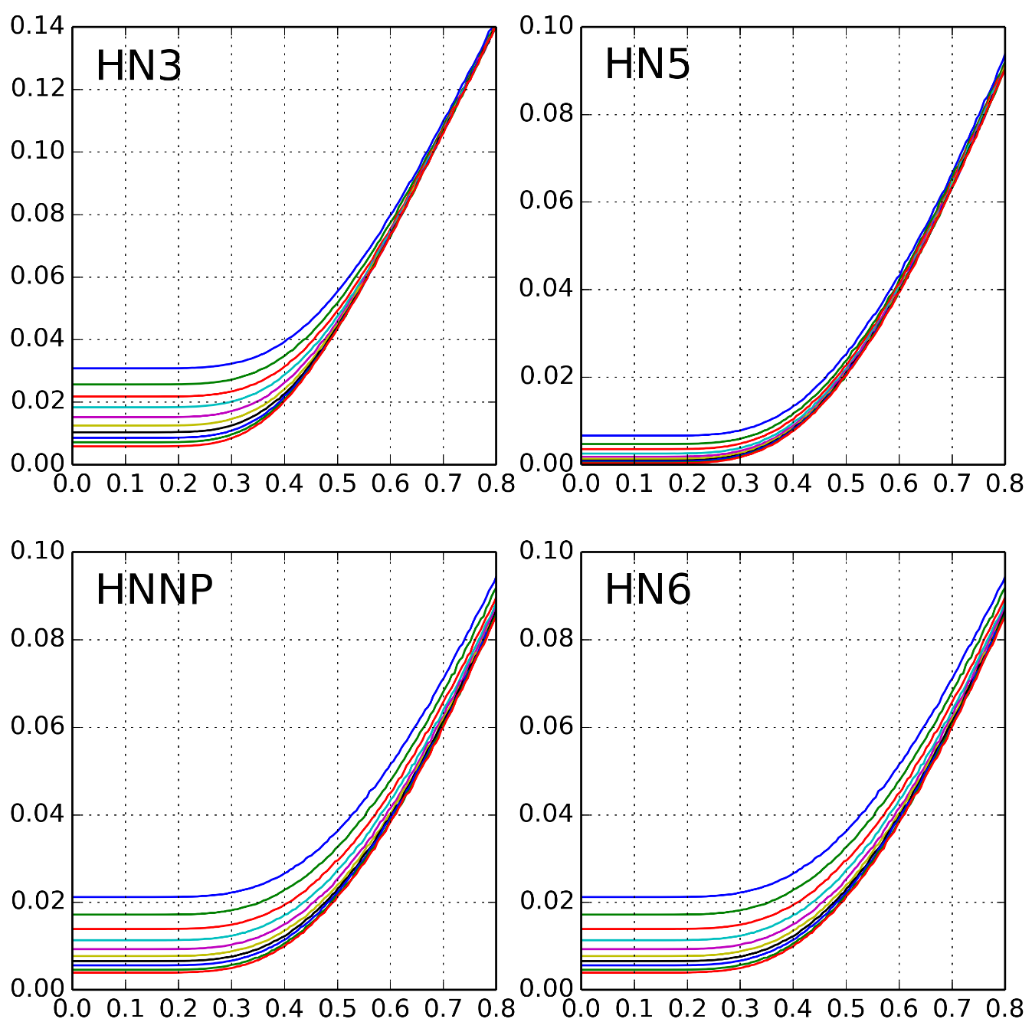

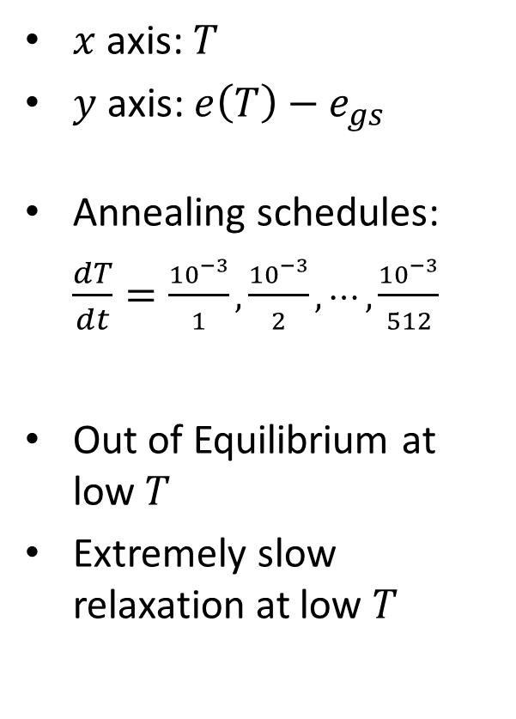








Glassy relaxation (SA)
$x$ axis: $T$
$y$ axis: $e\left(T\right)−e_{gs}$
Annealing schedules:
$\frac{dT}{dt}=\frac{{10}^{−3}}{1}, \frac{{10}^{−3}}{2},⋯,\frac{{10}^{−3}}{512}$
Out of Equilibrium at low $T$
Extremely slow relaxation at low $T$
$$N=16,384$$
$$N=16,384$$
$$e\left(T\right)−e_{gs}$$
$$T$$
$$T$$
$$N=16,384$$
$$N=16,384$$
$$e\left(T\right)−e_{gs}$$
$$T$$
$$T$$

Slide 20
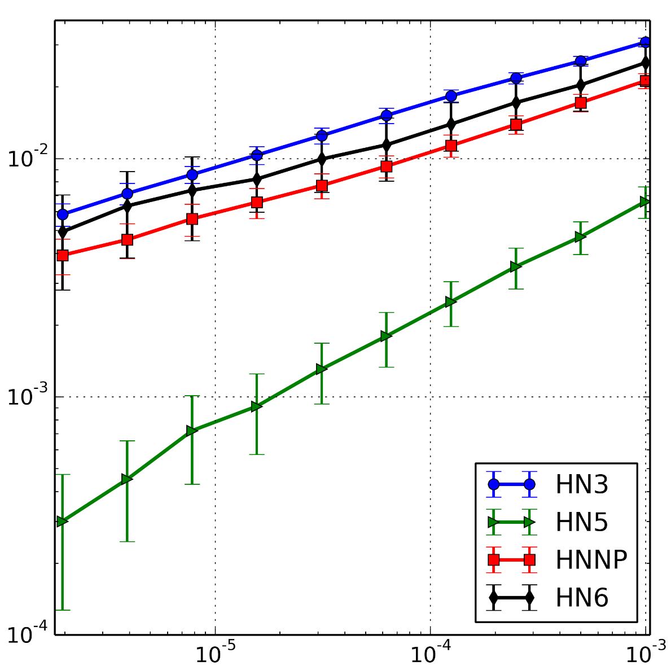
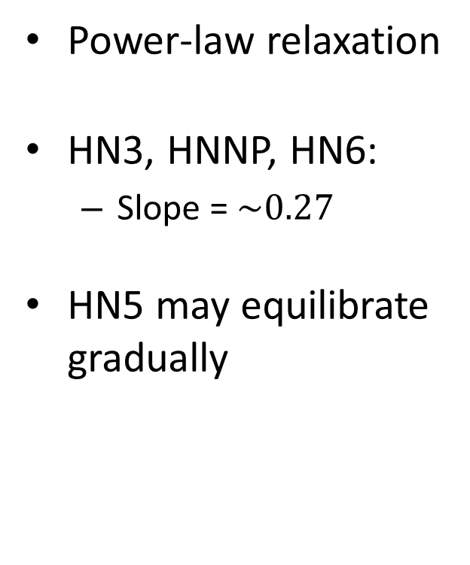


Power-law relaxation (SA)
Power-law relaxation
HN3, HNNP, HN6:
Slope = $\sim 0.27$
HN5 may equilibrate gradually
$$e\left(T\right)−e_{gs}$$
$$dT$$

Slide 21
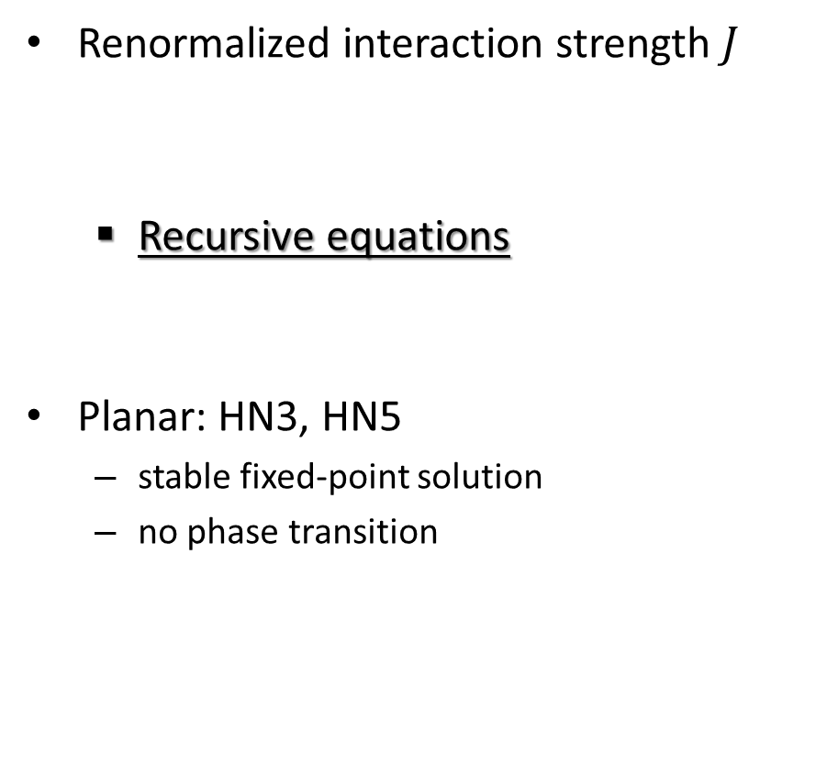
Spin glass transition (RG)
Renormalized interaction strength $J$
Recursive equations
Planar: HN3, HN5
stable fixed-point solution
no phase transition
Numerical solution
Analytical solution
McKay and Berker, Phys. Rev. Lett. 48, 11 (1982)

Slide 22
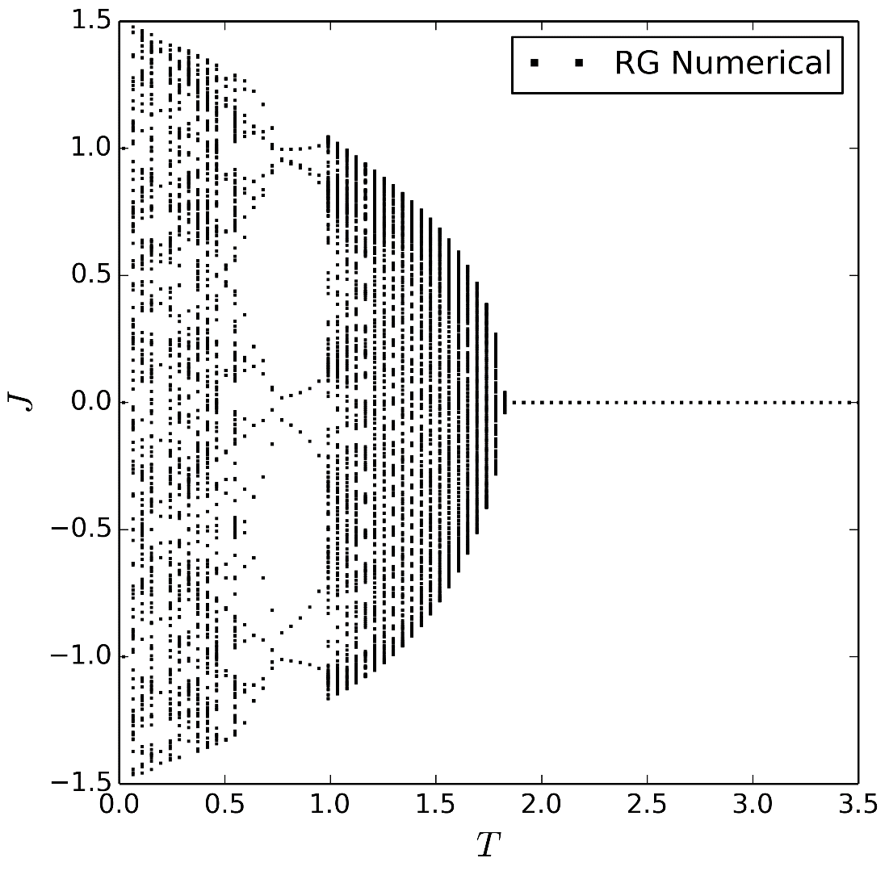
Spin glass transition (RG)
Non-Planar: HNNP, HN6
partially stable fixed-point solution
possible spin glass transition
HNNP

Slide 23
Spin glass transition (RG)
Non-Planar: HNNP, HN6
partially stable fixed-point solution
possible spin glass transition
HNNP

Slide 24
Spin glass transition (RG)
Non-Planar: HNNP, HN6
partially stable fixed-point solution
possible spin glass transition
HNNP

Slide 25
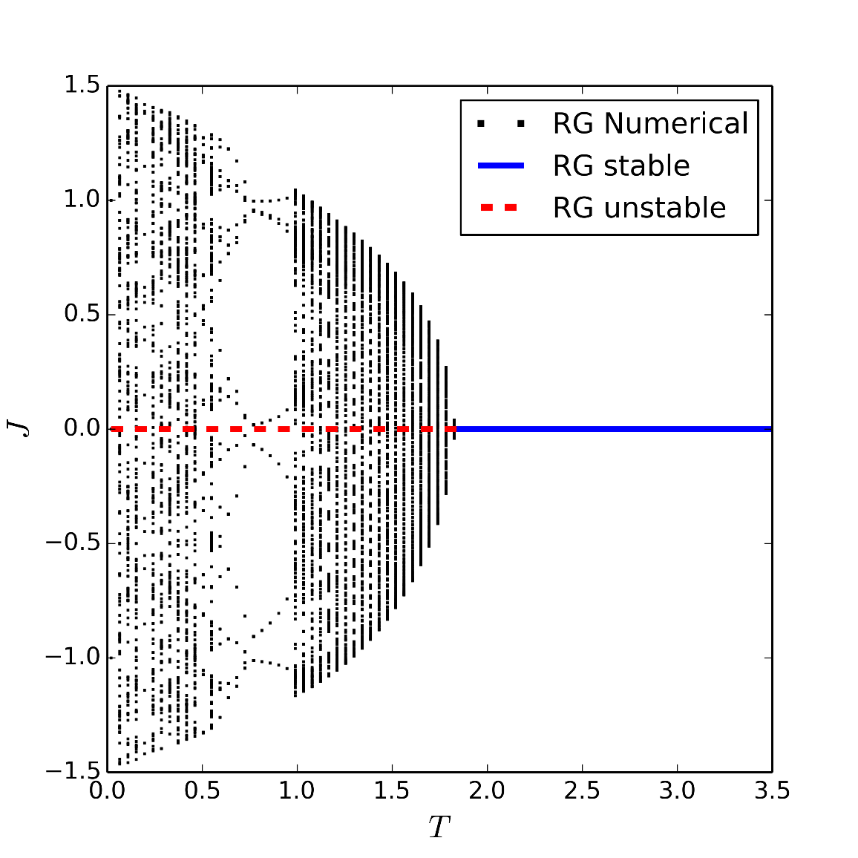
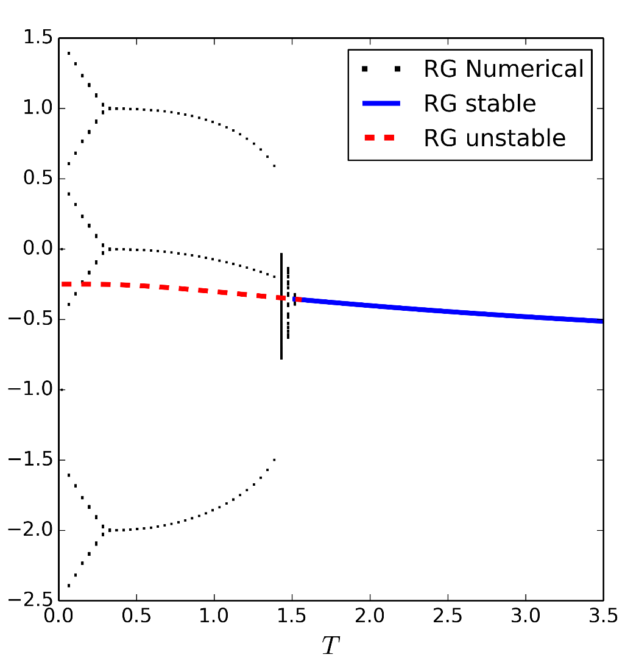
Spin glass transition (RG)
Non-Planar: HNNP, HN6
partially stable fixed-point solution
possible spin glass transition
HN6
HNNP
McKay and Berker, Phys. Rev. Lett. 48, 11 (1982)

Slide 26

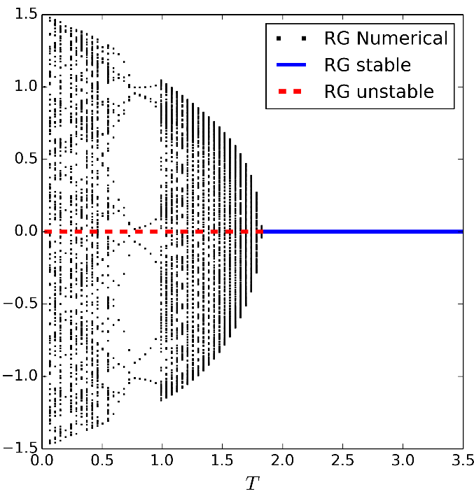
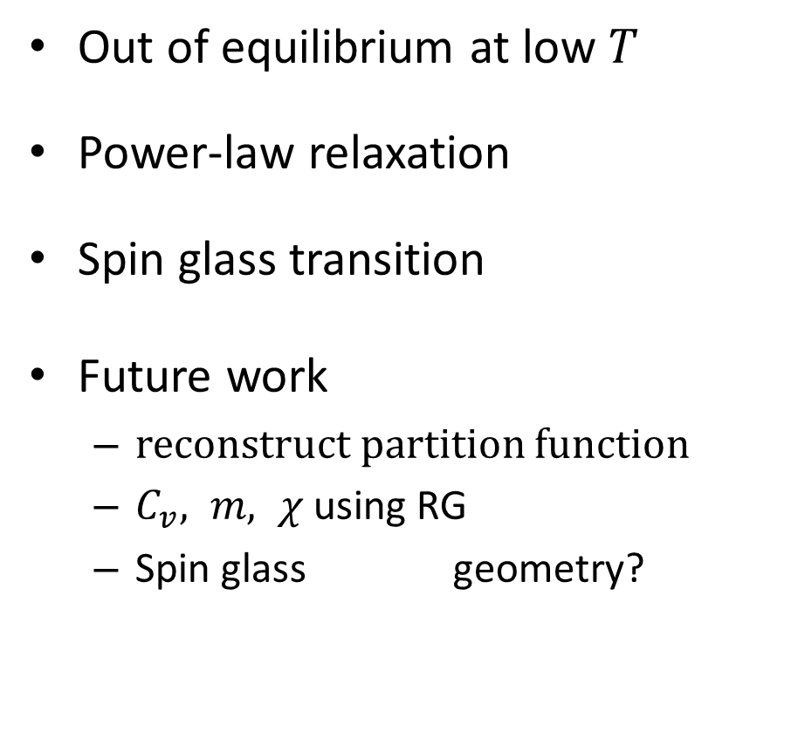

Summary & future work
Out of equilibrium at low $T$
Power-law relaxation
Spin glass transition
Future work
reconstruct partition function
$C_{v}, m, χ$ using RG
Spin glass geometry?
$$J$$

Slide 27
Hierarchical networks (HNs)
HN3:
degree 3

Slide 28
Outline
Introduction
Model, research questions
Hierarchical Networks (HNs)
structure & why HNs
Methods:
Wang-Landau, simulated annealing
Renormalization Group
Results
Future work

