Slide 1


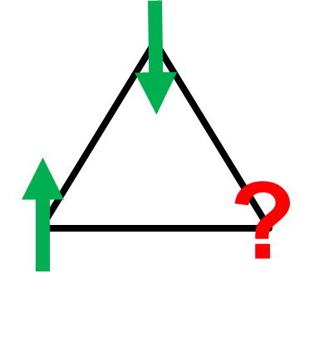
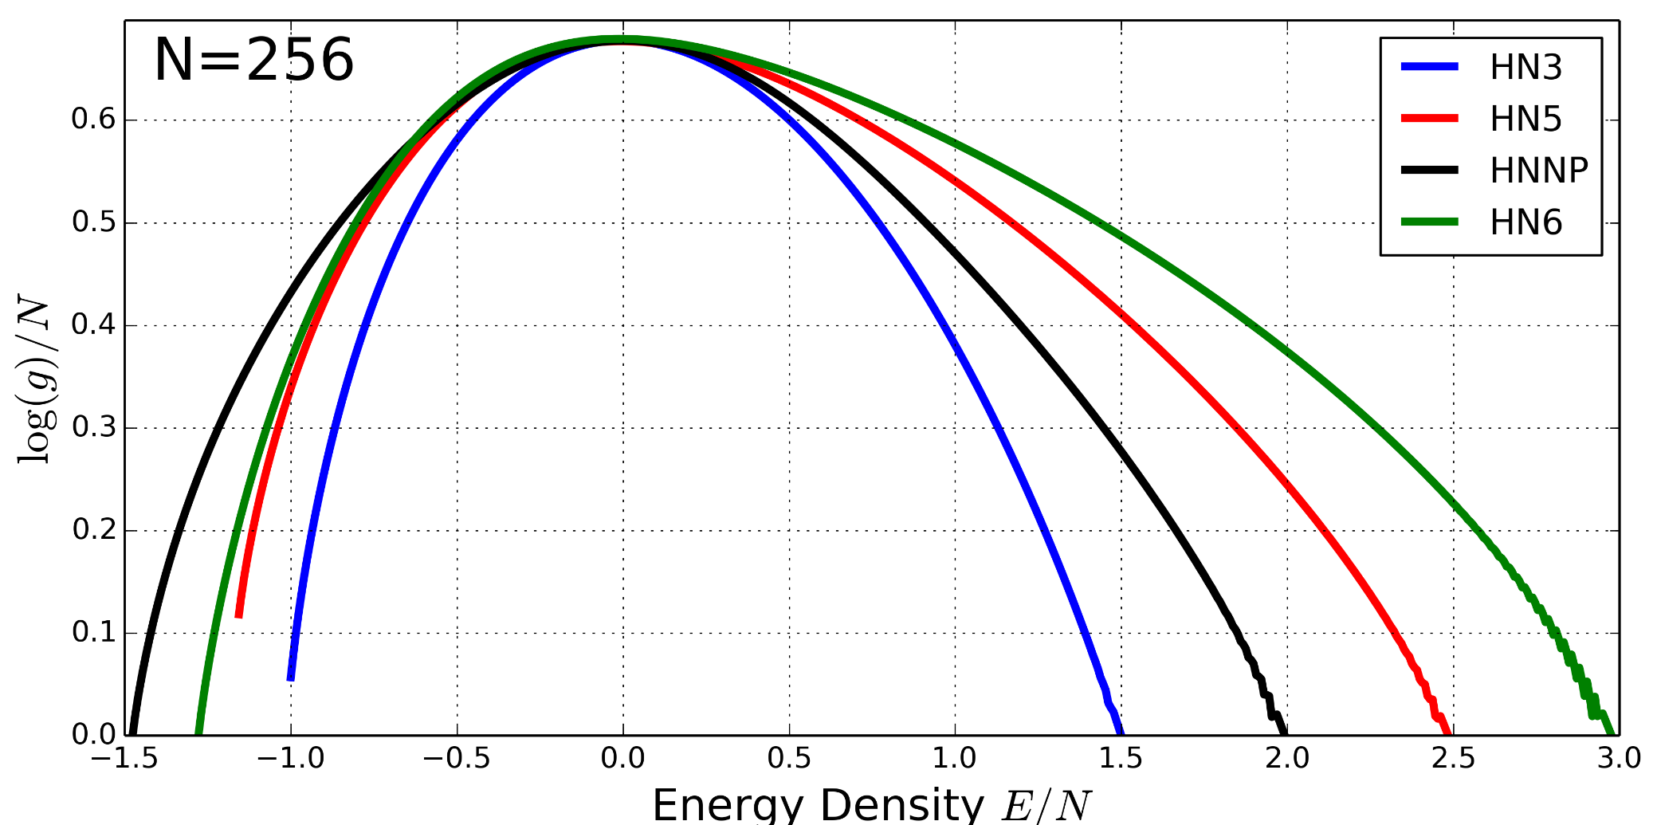
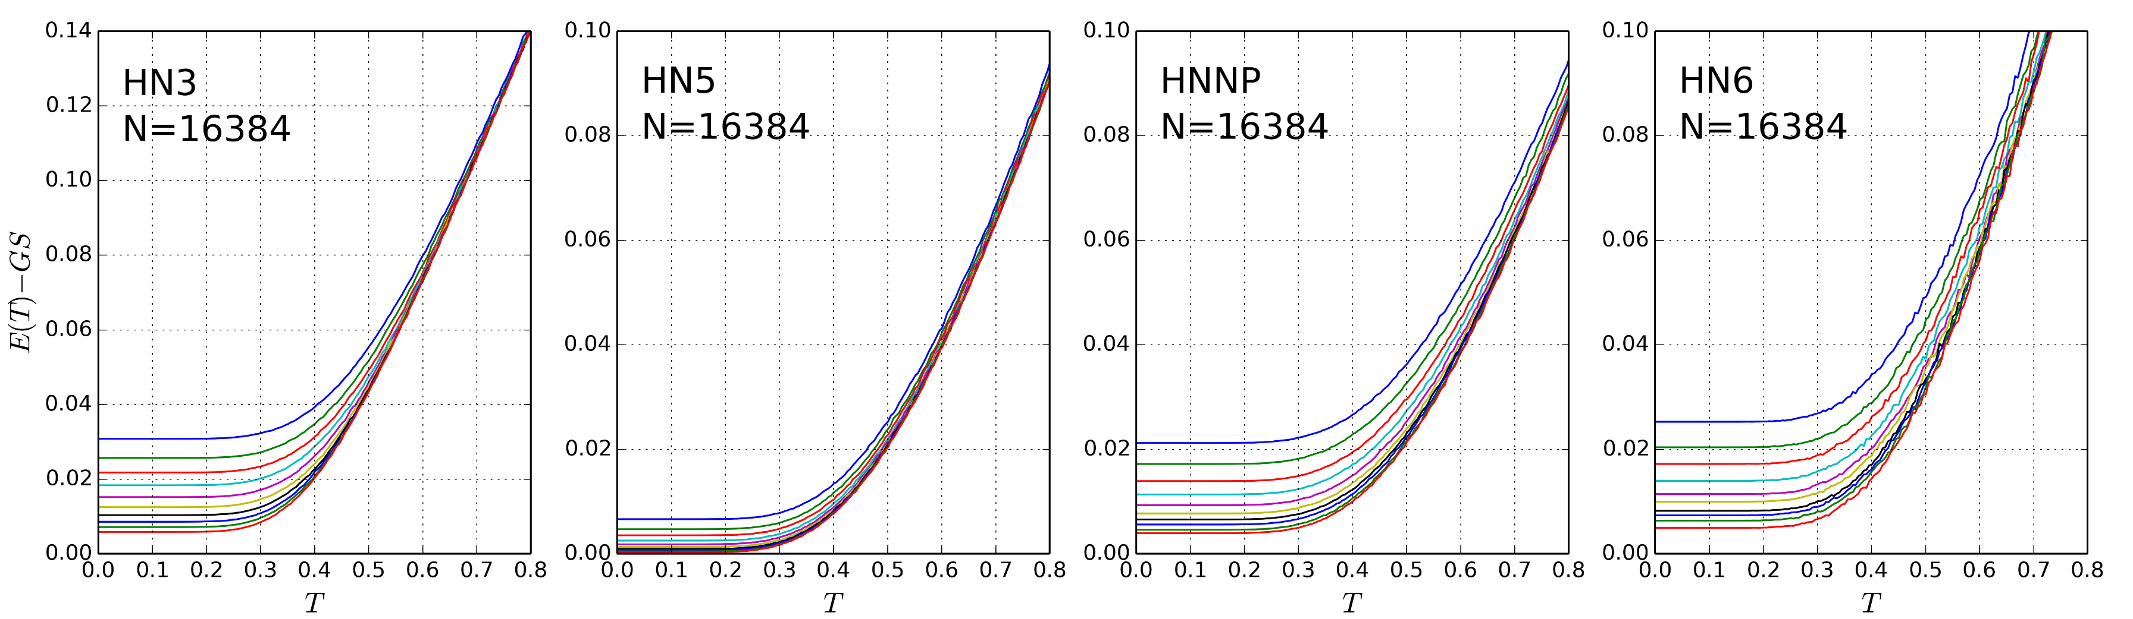
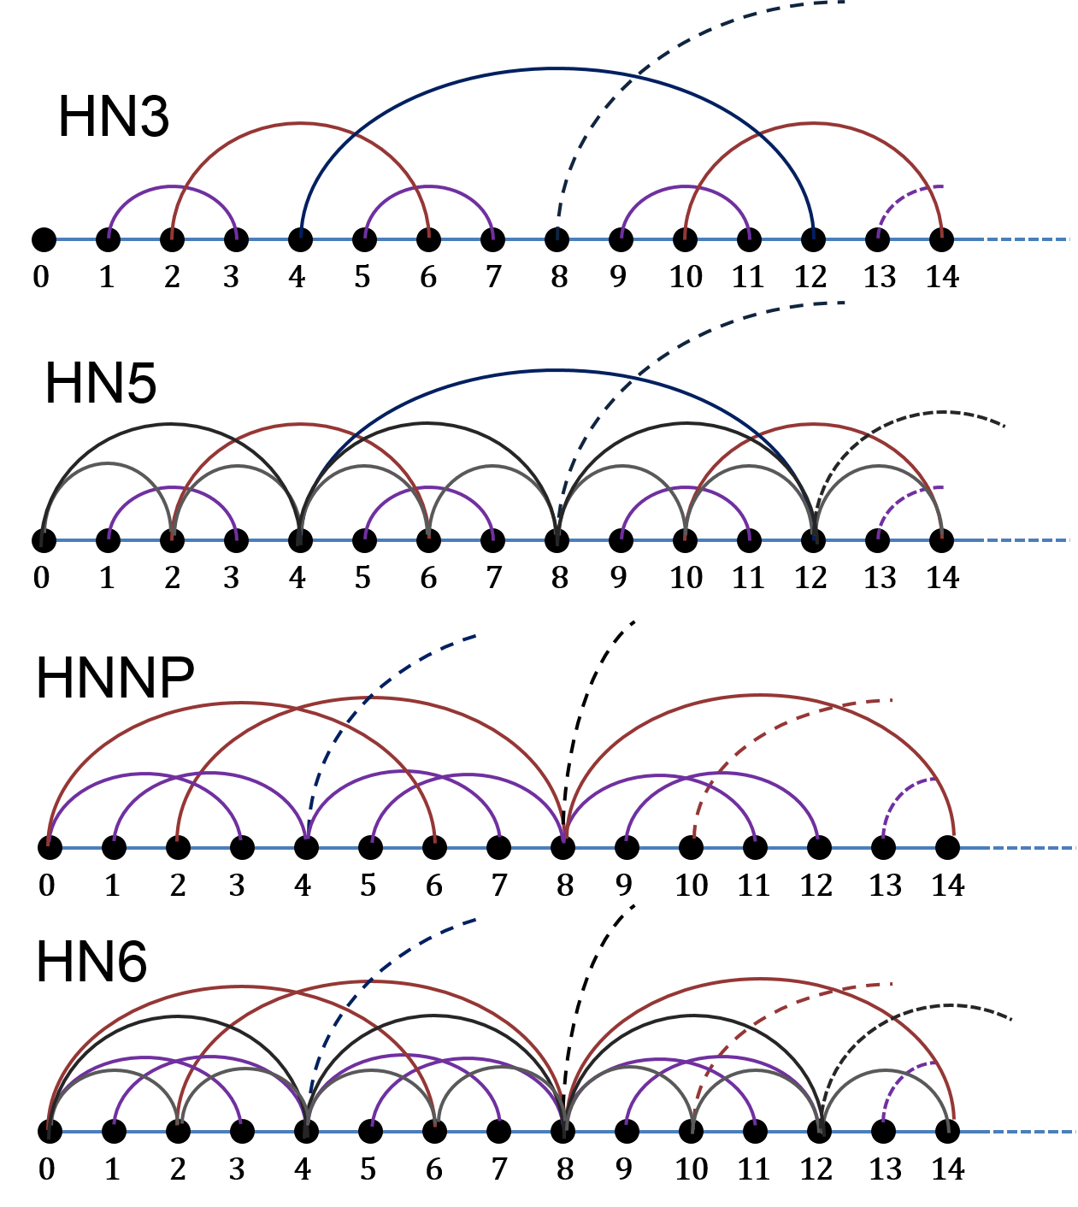
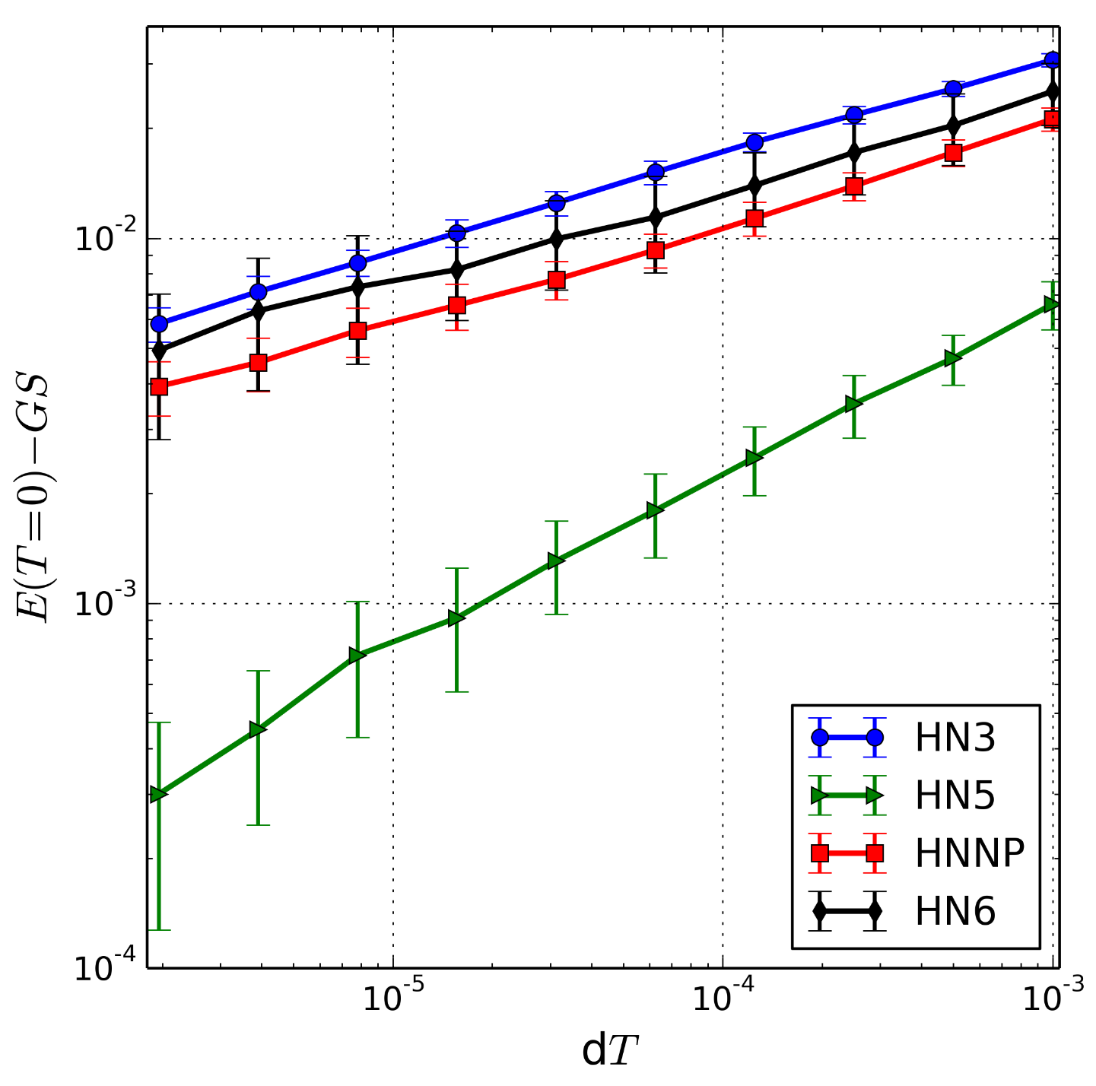
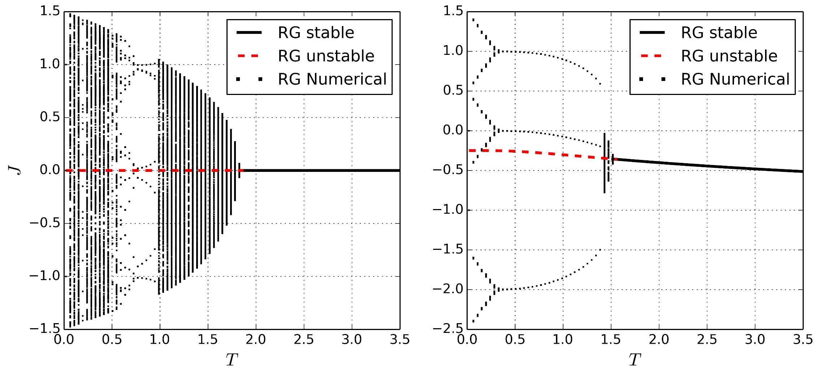


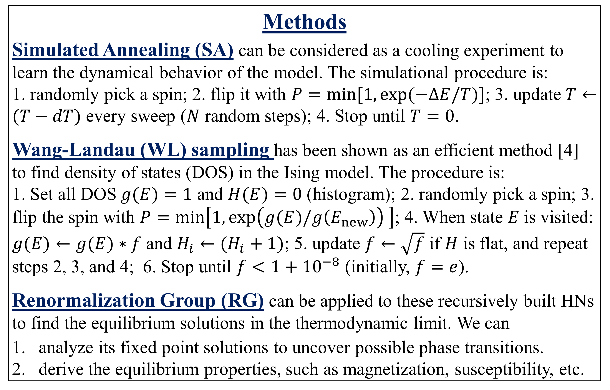
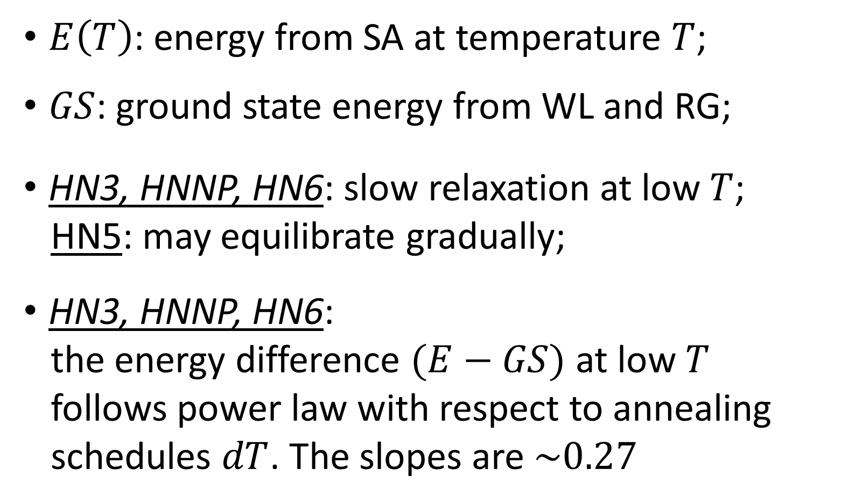

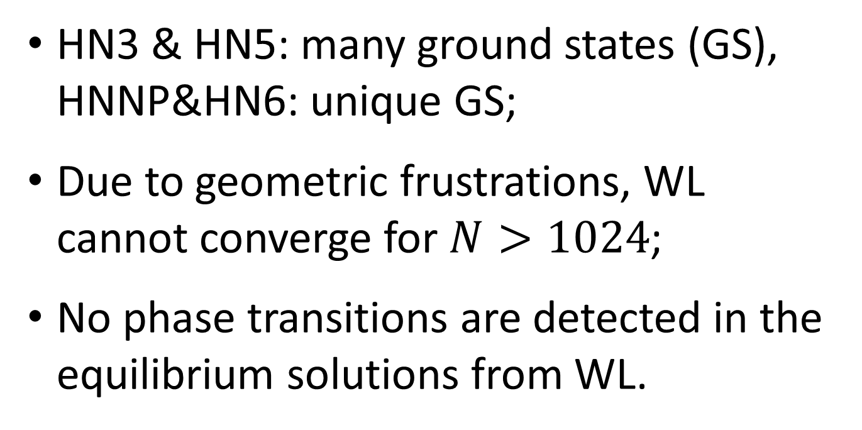


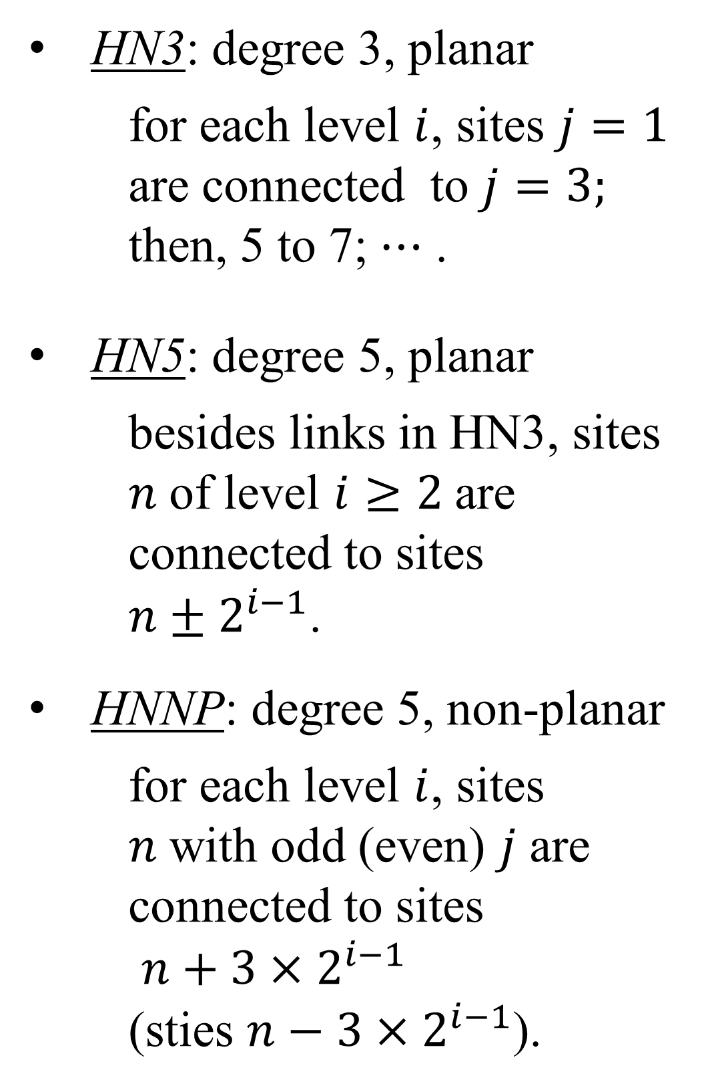
Antiferromagnetic Ising Model in Hierarchical Networks
Xiang Cheng and Stefan Boettcher Department of Physics, Emory University, Atlanta, GA, 30322
Introduction
The antiferromagnetic (AFM) Ising model is a convenient, yet powerful model of glassy dynamics. This model can introduce geometric frustrations which may cause spin glass phases and glassy relaxation at low T [1, 2].
We apply the AFM Ising model to 4 hierarchical networks (HNs) which share features of both small-world networks and regular lattices. By studying them, we try to gain insights to the following questions:
Are there phase transitions and/or spin glass transitions?
At low temperatures, is there an slow glassy relaxation?
How do different structures affect the transitions?
The model and HNs allow us to use both computational methods and a theoretical method to explore these questions (see Methods section).
Methods
Simulated Annealing (SA) can be considered as a cooling experiment to learn the dynamical behavior of the model. The simulational procedure is:
1. randomly pick a spin; 2. flip it with $P=\min{[1,\exp{(−ΔE/T)}]}$; 3. update $T←(T−dT)$ every sweep ($N$ random steps); 4. Stop until $T=0$.
Wang-Landau (WL) sampling has been shown as an efficient method [4] to find density of states (DOS) in the Ising model. The procedure is:
1. Set all DOS$g(E)=1$ and $H(E)=0$ (histogram); 2. randomly pick a spin; 3. flip the spin with $P=\min\left[1, \exp\left(g(E)/g\left(E_{new}\right)\right) \right]$; 4. When state $E$is visited: $g(E)←g(E)∗f$ and $H_{i}←(H_{i}+1)$; 5. update $f←\sqrt{f}$ if $H$ is flat, and repeat steps 2, 3, and 4; 6. Stop until $f<{1+10}^{−8}$ (initially, $f=e$).
Renormalization Group (RG) can be applied to these recursively built HNs to find the equilibrium solutions in the thermodynamic limit. We can
analyze its fixed point solutions to uncover possible phase transitions.
derive the equilibrium properties, such as magnetization, susceptibility, etc.
Model & Hierarchical Netowrks
Antiferromagnetic Ising model:
The Hamiltonian is
where $\{i, j\}$ are neighbors; the spin $S_{i}=±1$; and the interaction $J<0$.
Frustration in AFM model:
At low $T$, physical systems stay near the ground states.
Geometric frustrations can introduce degenerate ground
states and thereafter interesting phase transitions.
Hierarchical Networks [3]
The 4 HNs are constructed from a 1D lattice. Each site $n$ ($0<n<N$) can be uniquely parameterized by two integers $(i, j)$
$$n\left(i,j\right)=2^{i−1}\left(2j+1\right)$$
where $i$ denotes the level in the hierarchy, and $j$ labels consecutive sites. The 4 networks are constructed from 1D lattice in the following ways.
HN6: average degree 6, non-planar
besides in links in HNNP, sites $n$of level $i≥2$are connected to
sites ${n±2}^{i−1}$.
Reasons of using HNs:
The HNs can be solved using renormalization group (RG), which shows us the equilibrium properties in the thermodynamic limit;
The HNs share more features with regular lattices than mean-field models, which may contribute more insights to real-world systems.
They have different structures. Specifically, they have different average degrees; HN3 and HN5 are planar while HNNP and HN6 are not.
$$H=−\sum_{\{i,j\}}{J}S_{i}S_{j}$$
Results
Density of states from Wang-Landau sampling:
Dynamical Slowing Down from Simulated Annealing:
Spin glass transition found by Renormalization Group:
The parameter of interest in RG is the renormalized interaction strength $J$ whose behavior may indicate possible phase transitions. In RG flows, $J$ has:
HN3 & HN5: unique and stable fixed-point solutions $→$ no phase transition.
HNNP & HN6: unique fixed-point solution, but part of it is not stable.
The unstable fixed-point solutions may indicate a spin glass transition.
We will calculate more parameters, such as susceptibility, to understand this better.
HN3 & HN5: many ground states (GS), HNNP&HN6: unique GS;
Due to geometric frustrations, WL cannot converge for $N>1024$;
No phase transitions are detected in the equilibrium solutions from WL.
$$dT=$$
$$0.001$$
$$0.001/2^{1}$$
$$0.001/2^{2}$$
$$⋮$$
$$0.001/2^{9}$$
HN3: degree 3, planar
for each level $i$, sites $j=1$ are connected to $j=3;$ then, 5 to 7; $⋯$ .
HN5: degree 5, planar
besides links in HN3, sites $n$of level $i≥2$are connected to sites ${n±2}^{i−1}$.
HNNP: degree 5, non-planar
for each level $i$, sites $n$with odd (even) $j$ are connected to sites
$n+3×2^{i−1}$
(sties $n−3×2^{i−1}$).
$E\left(T\right)$: energy from SA at temperature $T$;
$GS$: ground state energy from WL and RG;
HN3, HNNP, HN6: slow relaxation at low $T$;
HN5: may equilibrate gradually;
HN3, HNNP, HN6:
the energy difference $(E−GS)$ at low $T$
follows power law with respect to annealing
schedules $dT$. The slopes are $\sim 0.27$
black square-dots numerical solutions in steps 1000 ~ 2000;
black solid curves
stable solution
red dashed curves
unstable solution
References
[1] C.P. Herrero, Phys. Rev. E. 459, 230 (2008) [2] Cheng and Boettcher, arXiv:1409.8313 (2014)
[3] Boettcher and Brunson, Phys. Rev. E 83, 021103 (2011) [4] Wang and Landau, Phys. Rev. Lett. 86, 10 (2001)
Supported by the NSF Grant No. DMR-1207431

