Slide 1


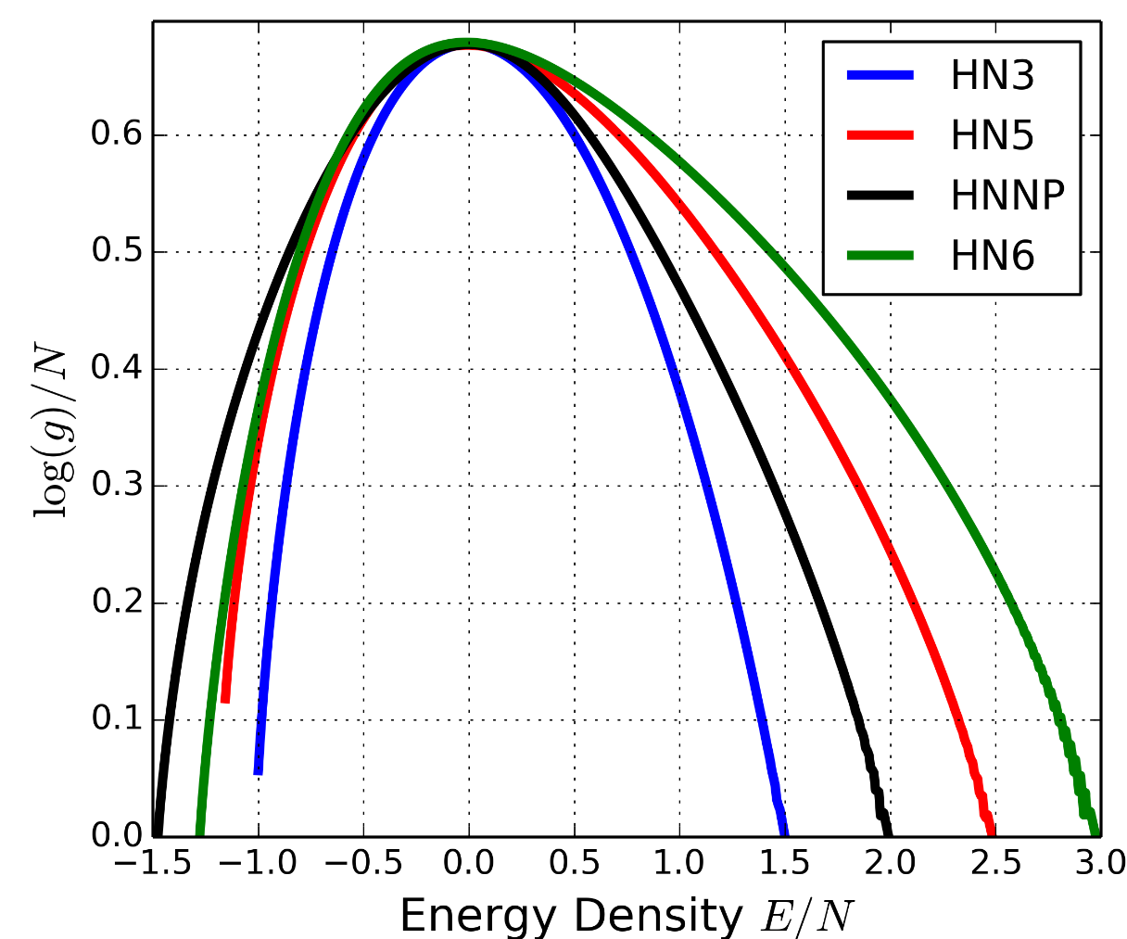
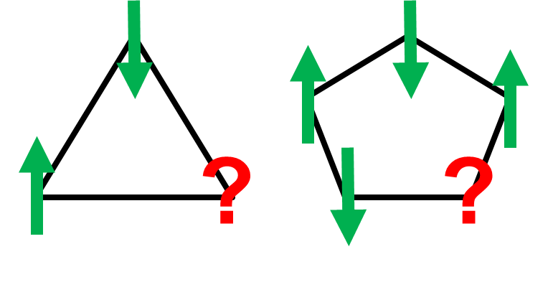
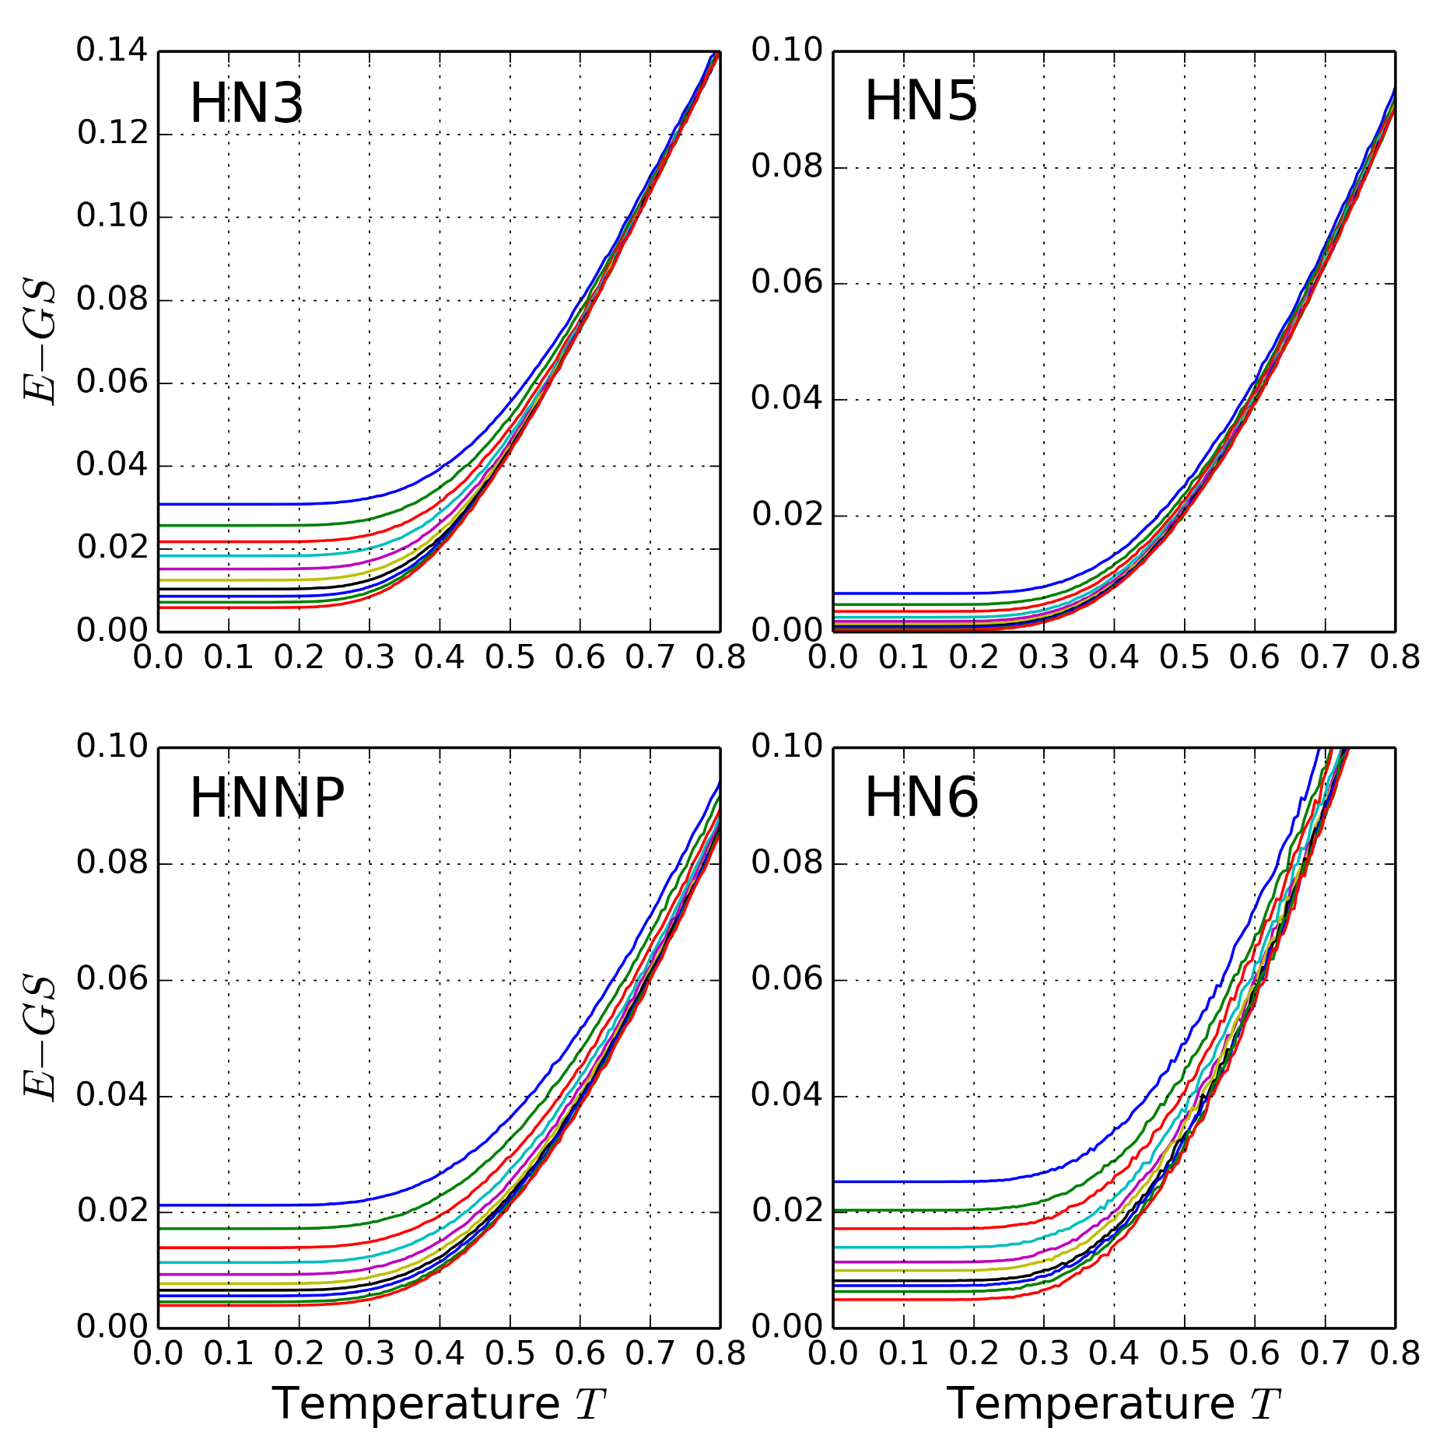
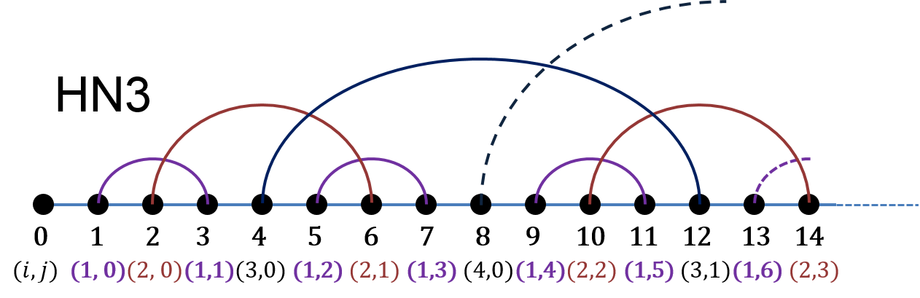
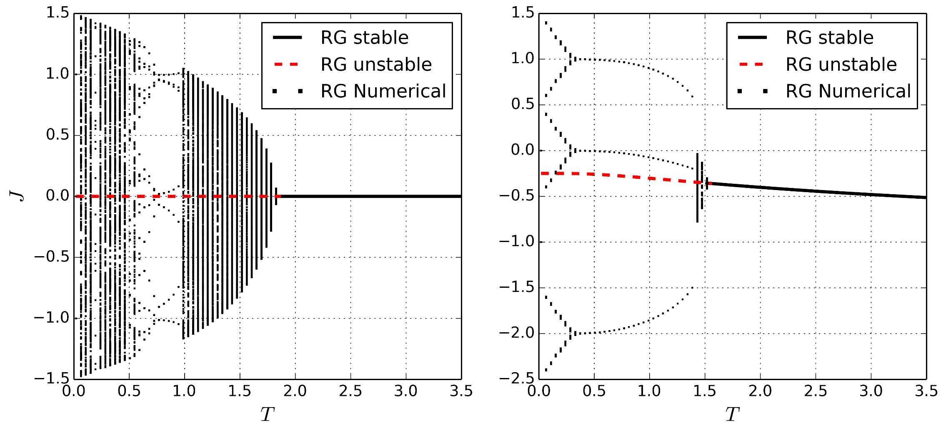




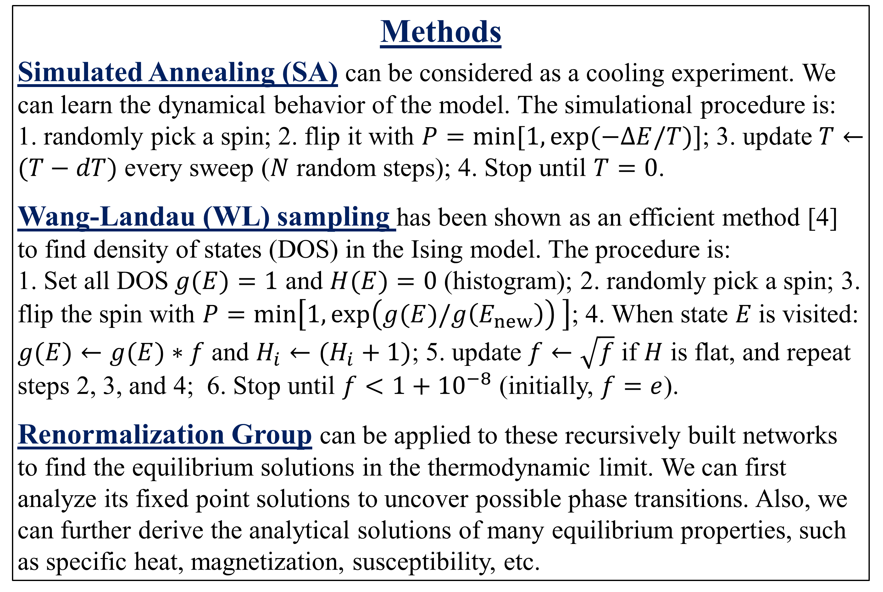
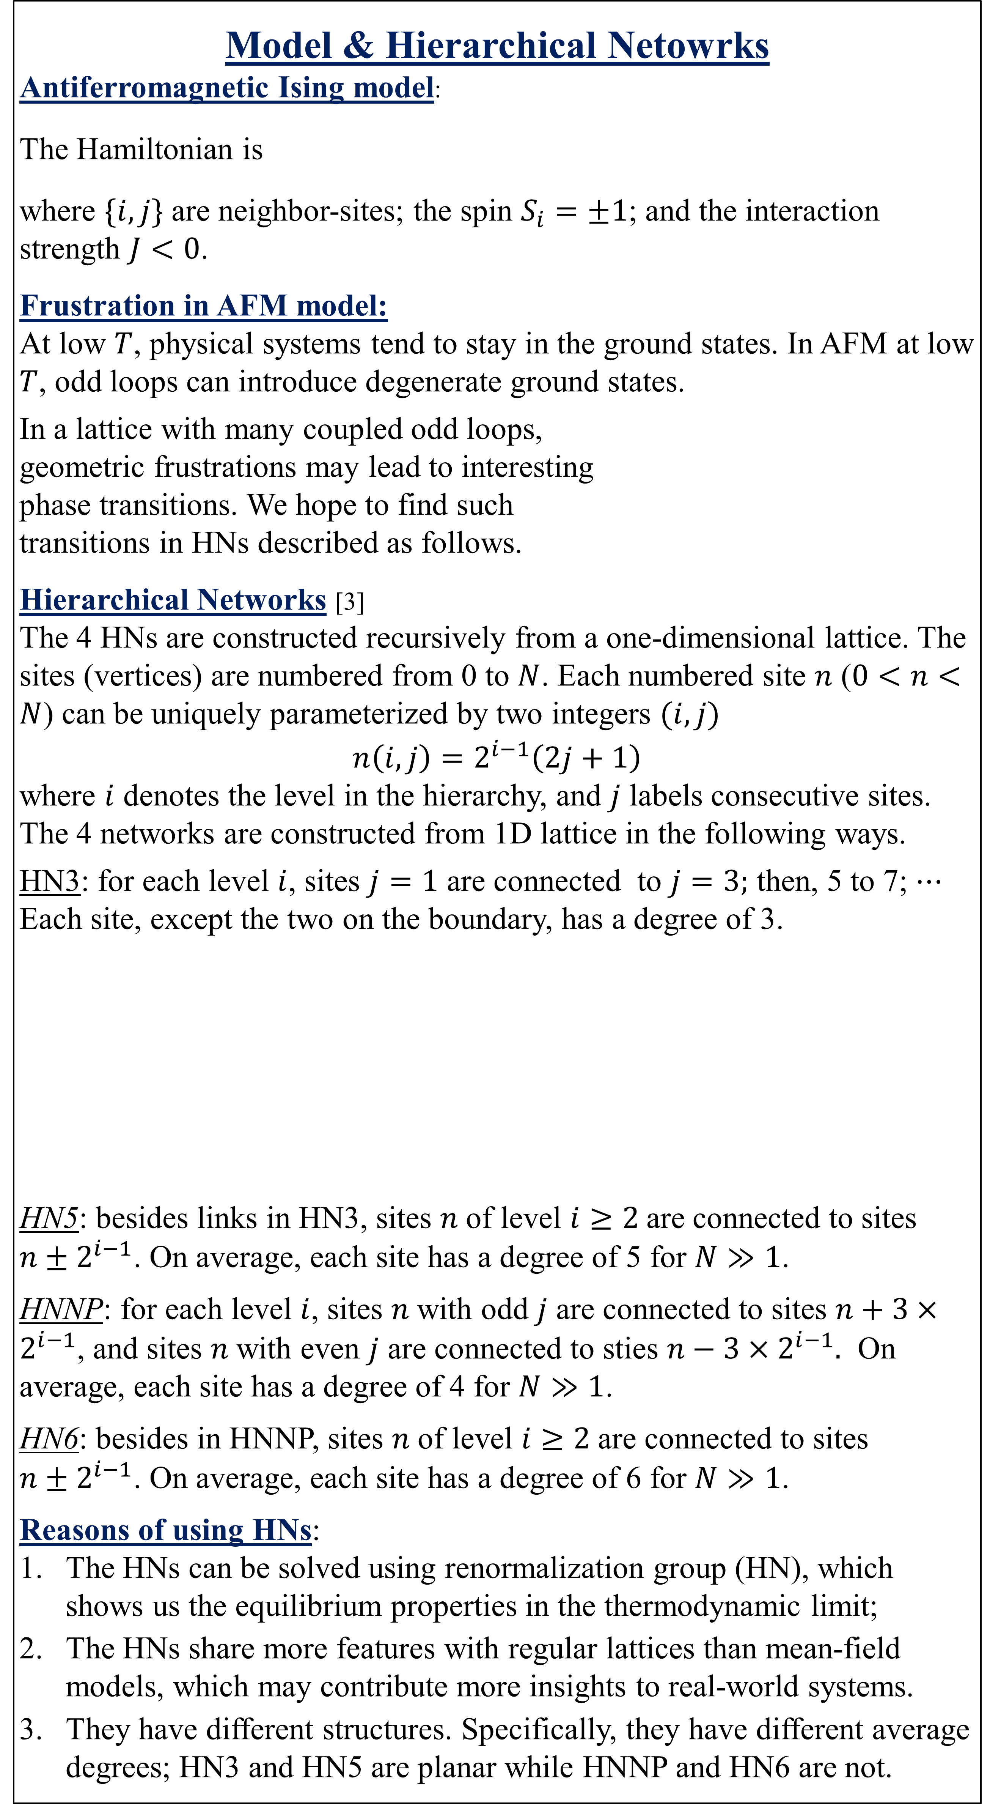

Antiferromagnetic Ising Model in Hierarchical Networks
Xiang Cheng and Stefan Boettcher
Department of Physics, Emory University, Atlanta, GA, 30322
Introduction
The antiferromagnetic (AFM) Ising model is a convenient, yet powerful model of glassy dynamics. This model can introduce geometric frustrations through odd loops in the lattice, and the strongly coupled frustrations cause spin glass phases and glassy relaxation at low T [1, 2].
We apply the AFM Ising model to 4 hierarchical networks (HNs) which share features of both small-world networks and regular lattices. By studying them, we try to gain insights to the following questions:
Are there phase transitions and/or spin glass transitions?
At low temperatures, is there an extremely slow relaxation?
How does different structures affect the transitions?
We propose to use computational methods as well a theoretical method to explore these questions (more details in Methods section).
Methods
Simulated Annealing (SA) can be considered as a cooling experiment. We can learn the dynamical behavior of the model. The simulational procedure is:
1. randomly pick a spin; 2. flip it with $P=\min{[1,\exp{(−ΔE/T)}]}$; 3. update $T←(T−dT)$ every sweep ($N$ random steps); 4. Stop until $T=0$.
Wang-Landau (WL) sampling has been shown as an efficient method [4] to find density of states (DOS) in the Ising model. The procedure is:
1. Set all DOS$g(E)=1$ and $H(E)=0$ (histogram); 2. randomly pick a spin; 3. flip the spin with $P=\min\left[1, \exp\left(g(E)/g\left(E_{new}\right)\right) \right]$; 4. When state $E$is visited: $g(E)←g(E)∗f$ and $H_{i}←(H_{i}+1)$; 5. update $f←\sqrt{f}$ if $H$ is flat, and repeat steps 2, 3, and 4; 6. Stop until $f<{1+10}^{−8}$ (initially, $f=e$).
Renormalization Group can be applied to these recursively built networks to find the equilibrium solutions in the thermodynamic limit. We can first analyze its fixed point solutions to uncover possible phase transitions. Also, we can further derive the analytical solutions of many equilibrium properties, such as specific heat, magnetization, susceptibility, etc.
Model & Hierarchical Netowrks
Antiferromagnetic Ising model:
The Hamiltonian is
where $\{i, j\}$ are neighbor-sites; the spin $S_{i}=±1$; and the interaction strength $J<0$.
Frustration in AFM model:
At low $T$, physical systems tend to stay in the ground states. In AFM at low $T$, odd loops can introduce degenerate ground states.
In a lattice with many coupled odd loops,
geometric frustrations may lead to interesting
phase transitions. We hope to find such
transitions in HNs described as follows.
Hierarchical Networks [3]
The 4 HNs are constructed recursively from a one-dimensional lattice. The sites (vertices) are numbered from 0 to $N$. Each numbered site $n$ ($0<n<N$) can be uniquely parameterized by two integers $(i, j)$
$$n\left(i,j\right)=2^{i−1}\left(2j+1\right)$$
where $i$ denotes the level in the hierarchy, and $j$ labels consecutive sites. The 4 networks are constructed from 1D lattice in the following ways.
HN3: for each level $i$, sites $j=1$ are connected to $j=3;$ then, 5 to 7; $⋯$
Each site, except the two on the boundary, has a degree of 3.
HN5: besides links in HN3, sites $n$of level $i≥2$are connected to sites ${n±2}^{i−1}$. On average, each site has a degree of 5 for $N≫1$.
HNNP: for each level $i$, sites $n$with odd $j$ are connected to sites $n+3×2^{i−1}$, and sites $n$with even $j$ are connected to sties $n−3×2^{i−1}.$ On average, each site has a degree of 4 for $N≫1$.
HN6: besides in HNNP, sites $n$of level $i≥2$are connected to sites ${n±2}^{i−1}$. On average, each site has a degree of 6 for $N≫1$.
Reasons of using HNs:
The HNs can be solved using renormalization group (HN), which shows us the equilibrium properties in the thermodynamic limit;
The HNs share more features with regular lattices than mean-field models, which may contribute more insights to real-world systems.
They have different structures. Specifically, they have different average degrees; HN3 and HN5 are planar while HNNP and HN6 are not.
$$H=\sum_{\{i,j\}}{J}S_{i}S_{j}$$
Results
Density of states from Wang-Landau sampling:
Dynamical Slowing Down from Simulated Annealing:
Spin glass transition found by Renormalization Group:
The parameter of interest in RG is the renormalized interaction strength $J$ whose behavior may show the possible phase transitions. In RG, HN3 and HN5 have unique and stable fixed-points solutions for the renormalized $J$, which indicates there is no phase transition.
HNNP and HN6 have unique analytical fixed-point solution, but part of the solution are not stable (as shown in the Figure below). This instability can be detected by either the numerical RG flow or the eigenvalues of the Jacobian.
The unstable fixed-point solutions may indicate a spin glass transition. We will calculate more parameters, such as susceptibility, to understand this transition better.
Results of $N=256$ for all 4 HNs;
HN3 and HN5 have many ground states, while HNNP and HN6 have unique ground states;
Due to geometric frustrations, WL sampling does not converge for $N>1024$;
No possible phase transitions are detected in the equilibrium solutions from WL.
Results of $N=16,384$ for all 4 HNs;
For these curves from top to bottom, they corresponds annealing schedules $dT=\frac{{10}^{−3}}{1},\frac{{10}^{−3}}{2}, ⋯,\frac{{10}^{−3}}{512}$;
HN3, HNNP, and HN6 have an extremely slow relaxation at low temperatures; while HN5 can equilibrate gradually;
For HN3, HNNP and HN6, the energy difference between $E$ and $GS$ at low $T$ follows power law with respect to annealing schedules.
RG solutions of $J$ for HNNP and HN6;
The black square dots are numerical RG solutions in steps 1000 ~ 2000; the black solid curves are stable analytical solutions, and the red dashed curves are unstable analytical solutions.
References
[1] C.P. Herrero, Phys. Rev. E. 459, 230 (2008) [2] Cheng and Boettcher, arXiv:1409.8313 (2014)
[3] Boettcher and Brunson, Phys. Rev. E 83, 021103 (2011) [4] Wang and Landau, Phys. Rev. Lett. 86, 10 (2001)

