Slide 1
A brief introduction to MXNet

Slide 2
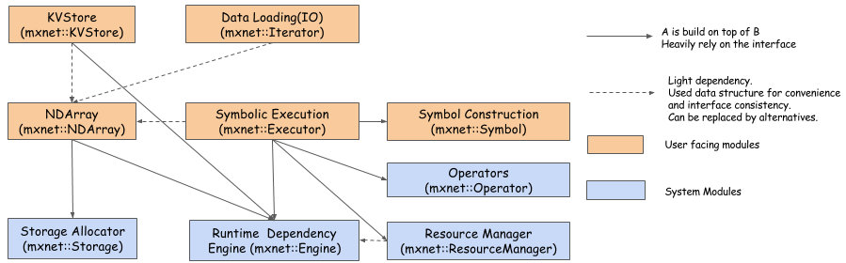
Major modules of MXNet

Slide 3
NDArray
Dynamic asynchronize n-dimensional arrays, provide flexible imperative programs for MXNet
Similar to numpy.ndarray, but with two more feature:
Multiple devices
tensor, context(cpu,gpu)
Automatic parallelization
scheduled by engine

Slide 4
Data loading(IO)
Efficient distributed data loading and augmentation
Data format: recordIO
Length of each record varies, so data can be stored in a more compact way
Packing data together allow continuous reading on the disk
RecordIO has a simple way of partition, which makes it easier for distributed setting
Multi-thread
-More efficient data loading
Threadeditor
-One thread act as data provider and one thread act as data consumer to hide IO cost

Slide 5
Create data iterator
Dataset param*: basic information for dataset
Batch param*: information to form a batch
Augmentation param:
Backend param
Auxiliary param
If distributed training
num_parts: number of parts the data should be partitioned into
part_index: the index of the part to be read

Slide 6
KVStore
KVStore provides data synchronization between multiple GPUs and multiple machines
Push: push a single or a sequence of key-value pairs into the store
Pull: pull a single value or a sequence of values from the store
Push and pull always called after previous push and pull on the same key are finished
Updater: specify how the store to merge the received data

Slide 7
Distributed training
Bulk Synchronous Parallel(BSP)
n workers, each worker batch size=b
Similar performance as n*b batch size in single machine
Asynchronous updating
Each worker updates weight independently
Each worker pushes value to the same key
aggregation
Update weight
Each worker pulls weight from store

Slide 8
Sequential diagram of KVStore operations(BSP)

Slide 9
Runtime dependency engine
Schedule and execute operations according to their read/write dependency
NDArray
Symbol
Kvstore
Use multiple threads to schedule operations, encouraging parallel

Slide 10
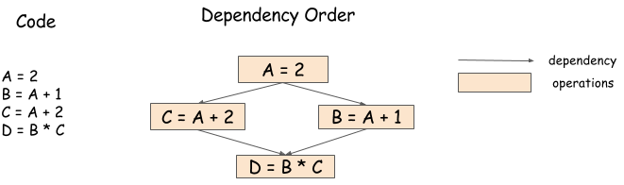
Dependency graph
B=A+1 and C=A+2 both read A, they don’t conflict with each other, so they can be run in parallel
D=B*C reads B and C, mutates D, so it needs to wait for B=A+1 and C=A+2 to complete

Slide 11
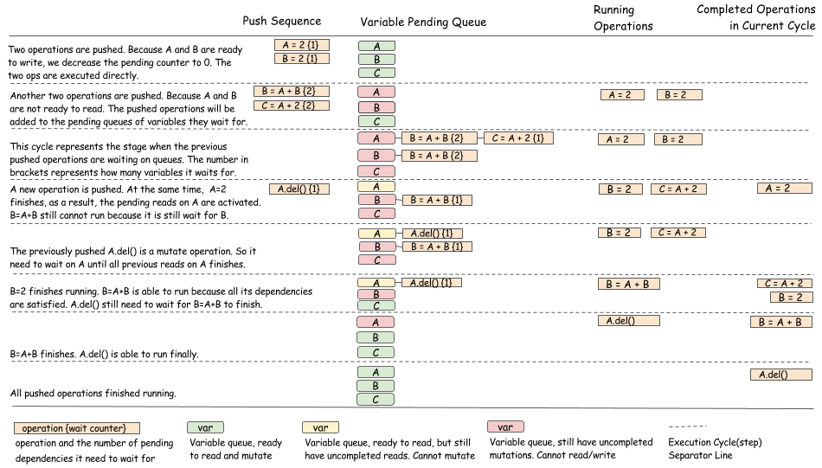
a visual example of the scheduling algorithm

Slide 12
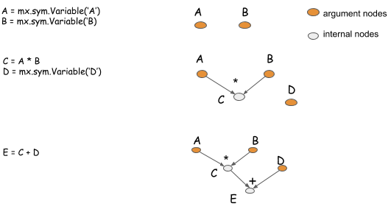
Symbol construction
Composed by
Variables
operators
Other functions
Visualization
Save and load

Slide 13
Symbolic execution
Optimization and execution of computation graph
Graph optimization: skip redundant part of graph, only subgraph required to obtain the output is needed.
Memory allocation: inplace, co-share
Executor can be created by binding output symbols with a specific set of input variables.

Slide 14
Symbol construction
IO
variable
operator
Data iterator
Network configuration
For-loop
(or call next())
Computation
graph
Input data
bind
executor
Symbolic execution
forward
Runtime dependency engine
backward
update

Slide 15
What happened during bind operation?
Organize topo order so that backward nodes always fall after forward
Allocate and recycle memory : inplace
use reference count: how may times this entry is being used
Get requested resources: co-share
Get operation execute entry

Slide 16
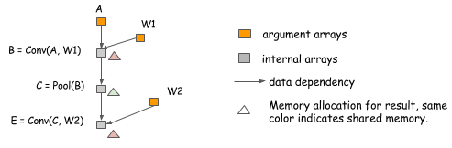
inplace
Input is no longer needed
Output is not initialized

Slide 17
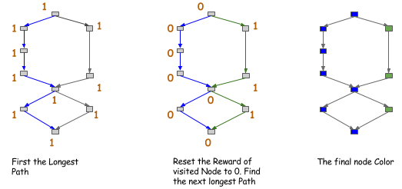
co-share
Greedy algorithm
Only allow(encourage) space sharing between nodes in the same color

Slide 18
bind vs simple_bind
Bind: need input data as parameters
Need to allocate memory for input before hand
Simple_bind: only some input shapes are passed in
Calculate information needed using shape inference and allocate memory automatically.

Slide 19
Forward & backward
Forward
evaluate output
Backward
get gradient
Monitor callback: print forward output or backward gradient for debugging

Slide 20
Evaluation metric
Accuracy
F1-score
Mean Absolute Error loss
…
Use callback to
log evaluation metric every certain amount of batches
log training speed in frequent every batch
Save model every epoch

