Slide 1

AI6102: Machine Learning Methodologies & Applications
Assignment Solution
ZHANG Hanwang
Nanyang Technological University, Singapore
Homepage: http://www.ntu.edu.sg/home/sinnopan

Slide 2
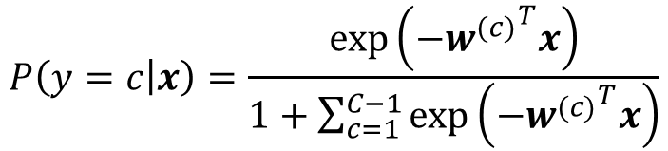

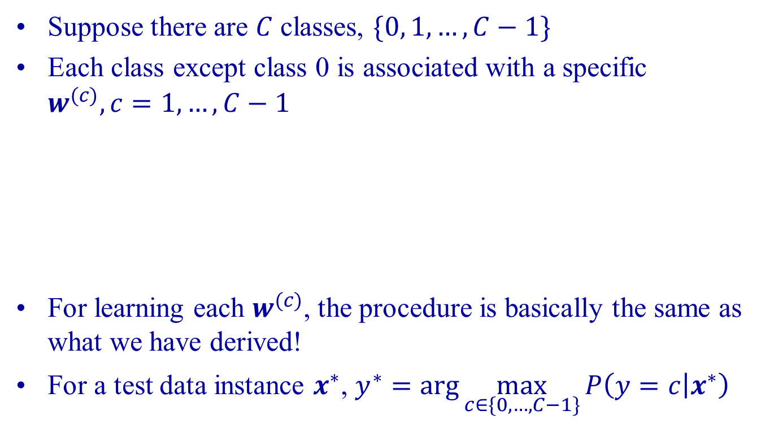

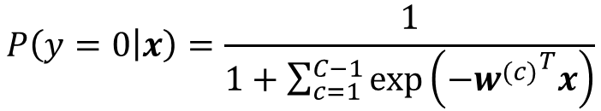

Question 1
Suppose there are $C$ classes, $\{0, 1, …, C−1\}$
Each class except class 0 is associated with a specific $w^{(c)}, c=1,…,C−1$
For learning each $w^{(c)}$, the procedure is basically the same as what we have derived!
For a test data instance $x^{∗}$, $y^{∗}=\arg{\max_{c∈\{0,…,C−1\}}{P\left(y=c | x^{∗}\right)}}$
$$P\left(y=c | x\right)=\frac{\exp\left(−{w^{(c)}}^{T}x\right)}{1+\sum_{c=1}^{C−1}{\exp\left(−{w^{(c)}}^{T}x\right)}}$$
For $c>0$:
$$\sum_{c=0}^{C−1}{P\left(y=c | x\right)}=1$$
For $c=0$:
$$P\left(y=0 | x\right)=\frac{1}{1+\sum_{c=1}^{C−1}{\exp\left(−{w^{(c)}}^{T}x\right)}}$$

Slide 3
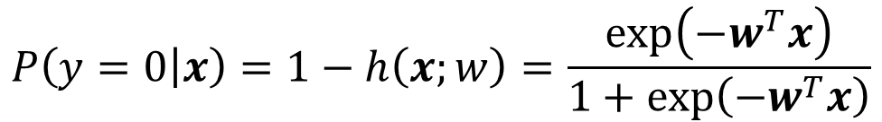
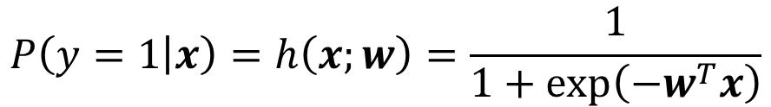
Recall: Binary Classification
$$P\left(y=1 | x\right)=h\left(x;w\right)=\frac{1}{1+\exp\left(−w^{T}x\right)}$$
$$P\left(y=0 | x\right)=1−h\left(x;w\right)=\frac{\exp\left(−w^{T}x\right)}{1+\exp\left(−w^{T}x\right)}$$
$$P\left(y | x;w\right)={h\left(x;w\right)}^{y}{(1−h\left(x;w\right))}^{1−y}$$

Slide 4
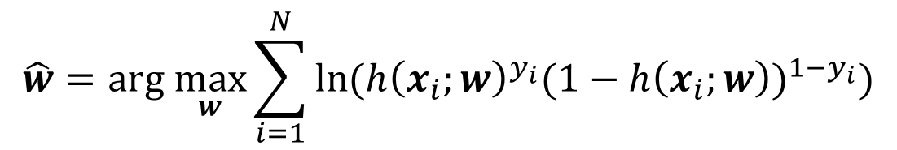
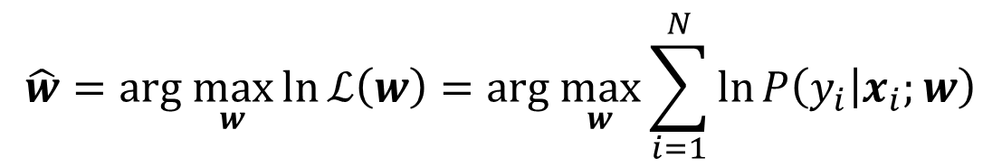
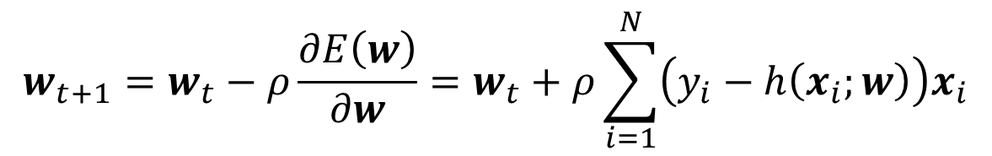

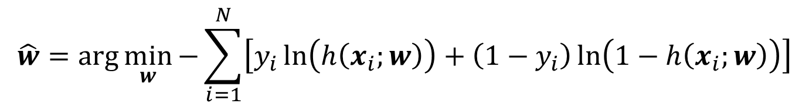
Recall: Binary Classification (cont.)
$$\hat{w}=\text{arg} \max_{w}{\ln{ℒ\left(w\right)}}=\text{arg} \max_{w}\sum_{i=1}^{N}{\ln{P\left(y_{i} | x_{i};w\right)}}$$
$$\hat{w}=\text{arg} \max_{w}\sum_{i=1}^{N}{\ln{({h\left(x_{i};w\right)}^{y_{i}}{(1−h\left(x_{i};w\right))}^{1−y_{i}})}}$$
Objective $E(w)$
$$\hat{w}=\arg{\min_{w}{−\sum_{i=1}^{N}{\left[y_{i}\ln\left(h\left(x_{i};w\right)\right)+\left(1−y_{i}\right)\ln\left(1−h\left(x_{i};w\right)\right)\right]}}}$$
$$w_{t+1}=w_{t}−ρ\frac{∂E\left(w\right)}{∂w}=w_{t}+ρ\sum_{i=1}^{N}{\left(y_{i}−h\left(x_{i};w\right)\right)x_{i}}$$

Slide 5
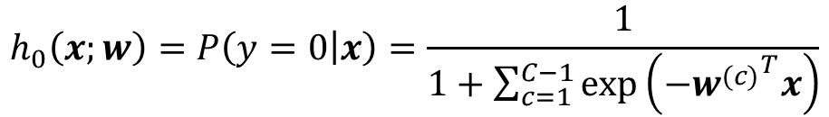

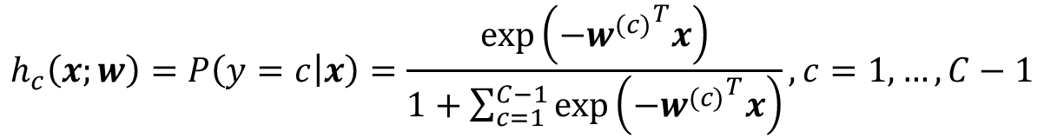
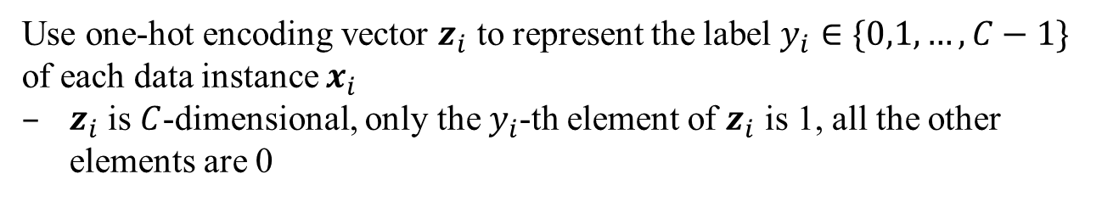
Multi-class Extension
$$w=\left\{w^{\left(1\right)},w^{\left(2\right)}…,w^{\left(C−1\right)}\right\}$$
Denote by
$$h_{c}\left(x;w\right)=P\left(y=c | x\right)=\frac{\exp\left(−{w^{(c)}}^{T}x\right)}{1+\sum_{c=1}^{C−1}{\exp\left(−{w^{(c)}}^{T}x\right)}}, c=1,…,C−1$$
$$h_{0}\left(x;w\right)=P\left(y=0 | x\right)=\frac{1}{1+\sum_{c=1}^{C−1}{\exp\left(−{w^{(c)}}^{T}x\right)}}$$
Use one-hot encoding vector $z_{i}$ to represent the label $y_{i}∈\{0,1,…,C−1\}$ of each data instance $x_{i}$
$z_{i}$ is $C$-dimensional, only the $y_{i}$-th element of $z_{i}$ is 1, all the other elements are 0
$$P\left(y | x_{i};w\right)={h_{0}\left(x_{i};w\right)}^{z_{i0}}{h_{1}\left(x_{i};w\right)}^{z_{i1}}⋯{h_{C−1}\left(x_{i};w\right)}^{z_{i(C−1)}}$$
$z_{ic}$ denotes the $c$-th element of $z_{i}$ (index starts from 0)

Slide 6
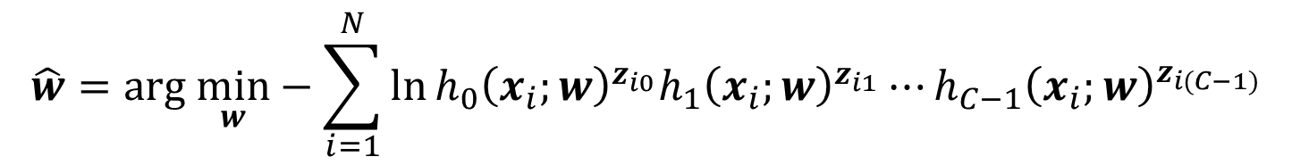
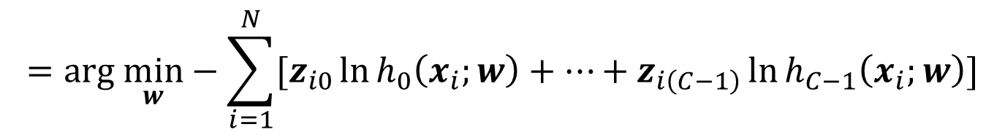
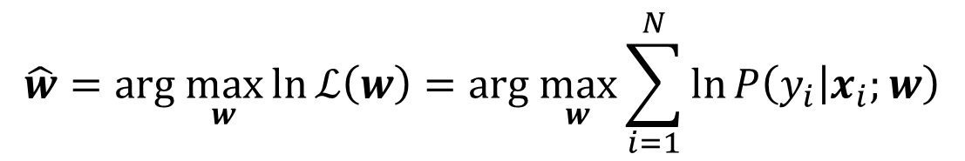
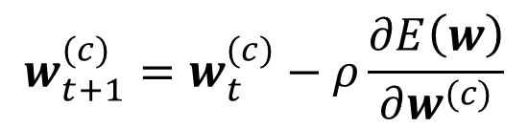
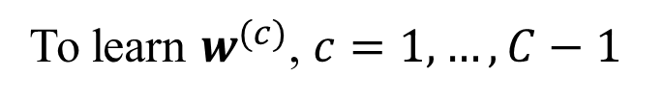

Multi-class Extension (cont.)
$$\hat{w}=\text{arg} \max_{w}{\ln{ℒ\left(w\right)}}=\text{arg} \max_{w}\sum_{i=1}^{N}{\ln{P\left(y_{i} | x_{i};w\right)}}$$
$$\hat{w}=\text{arg} \min_{w}−\sum_{i=1}^{N}{\ln{{h_{0}\left(x_{i};w\right)}^{z_{i0}}{h_{1}\left(x_{i};w\right)}^{z_{i1}}⋯{h_{C−1}\left(x_{i};w\right)}^{z_{i(C−1)}}}}$$
Objective $E(w)$
$$=\text{arg} \min_{w}−\sum_{i=1}^{N}{[z_{i0}\ln{h_{0}\left(x_{i};w\right)}+⋯+z_{i\left(C−1\right)}\ln{h_{C−1}\left(x_{i};w\right)}}]$$
To learn $w^{(c)}$, $c=1,…,C−1$
$$w_{t+1}^{(c)}=w_{t}^{(c)}−ρ\frac{∂E\left(w\right)}{∂w^{(c)}}$$

Slide 7
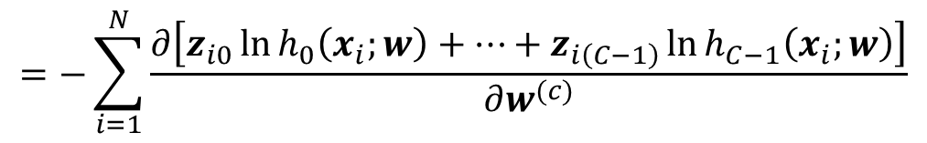
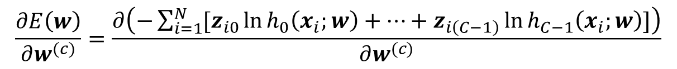

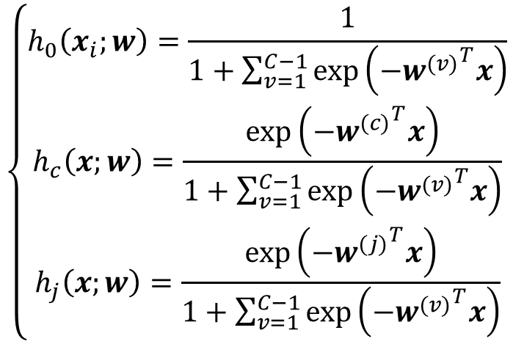
Multi-class Extension (cont.)
$$\frac{∂E\left(w\right)}{∂w^{(c)}}=\frac{∂\left(−\sum_{i=1}^{N}{[z_{i0}\ln{h_{0}\left(x_{i};w\right)}+⋯+z_{i\left(C−1\right)}\ln{h_{C−1}\left(x_{i};w\right)}}]\right)}{∂w^{(c)}}$$
$$=−\sum_{i=1}^{N}{\frac{∂\left[z_{i0}\ln{h_{0}\left(x_{i};w\right)}+⋯+z_{i\left(C−1\right)}\ln{h_{C−1}\left(x_{i};w\right)}\right]}{∂w^{(c)}}}$$
$$\left\{\begin{aligned}h_{0}\left(x_{i};w\right)=\frac{1}{1+\sum_{v=1}^{C−1}{\exp\left(−{w^{(v)}}^{T}x\right)}} \\ h_{c}\left(x;w\right)=\frac{\exp\left(−{w^{(c)}}^{T}x\right)}{1+\sum_{v=1}^{C−1}{\exp\left(−{w^{(v)}}^{T}x\right)}} \\ h_{j}\left(x;w\right)=\frac{\exp\left(−{w^{(j)}}^{T}x\right)}{1+\sum_{v=1}^{C−1}{\exp\left(−{w^{(v)}}^{T}x\right)}}\end{aligned}\right.$$
Case 1
3 cases
Case 2
$$j>0, \text{and} j≠c$$
Case 3

Slide 8
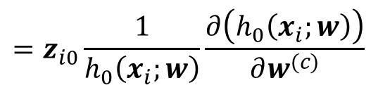
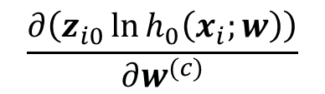
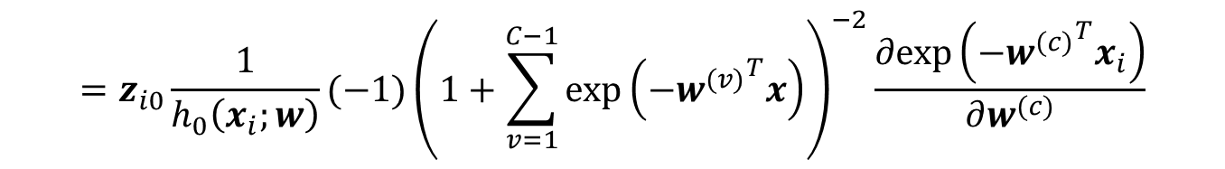
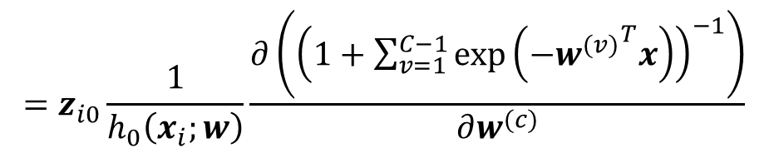
Multi-class Extension (cont.)
$$\frac{∂\left(z_{i0}\ln{h_{0}\left(x_{i};w\right)}\right)}{∂w^{(c)}}$$
Case 1
$$=z_{i0}\frac{1}{h_{0}\left(x_{i};w\right)}\frac{∂\left(h_{0}\left(x_{i};w\right)\right)}{∂w^{(c)}}$$
$$=z_{i0}\frac{1}{h_{0}\left(x_{i};w\right)}\frac{∂\left({\left(1+\sum_{v=1}^{C−1}{\exp\left(−{w^{(v)}}^{T}x\right)}\right)}^{−1}\right)}{∂w^{(c)}}$$
$$=z_{i0}\frac{1}{h_{0}\left(x_{i};w\right)}(−1){\left(1+\sum_{v=1}^{C−1}{\exp\left(−{w^{(v)}}^{T}x\right)}\right)}^{−2}\frac{∂exp\left(−{w^{(c)}}^{T}x_{i}\right)}{∂w^{(c)}}$$

Slide 9
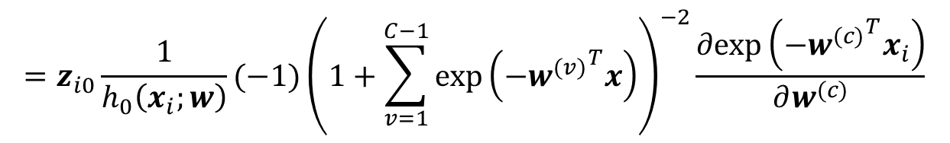
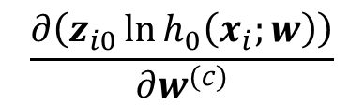

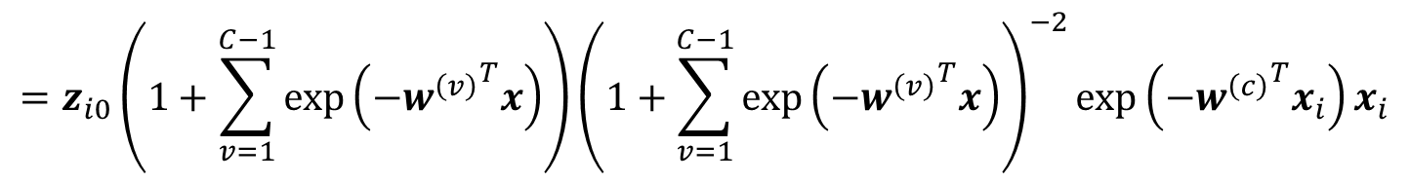
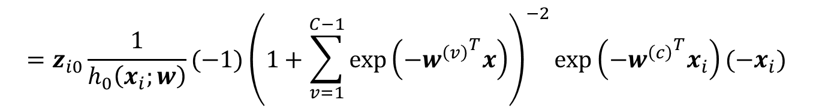
Multi-class Extension (cont.)
$$\frac{∂\left(z_{i0}\ln{h_{0}\left(x_{i};w\right)}\right)}{∂w^{(c)}}$$
$$=z_{i0}\frac{1}{h_{0}\left(x_{i};w\right)}(−1){\left(1+\sum_{v=1}^{C−1}{\exp\left(−{w^{(v)}}^{T}x\right)}\right)}^{−2}\frac{∂exp\left(−{w^{(c)}}^{T}x_{i}\right)}{∂w^{(c)}}$$
$$=z_{i0}\frac{1}{h_{0}\left(x_{i};w\right)}(−1){\left(1+\sum_{v=1}^{C−1}{\exp\left(−{w^{\left(v\right)}}^{T}x\right)}\right)}^{−2}exp\left(−{w^{\left(c\right)}}^{T}x_{i}\right)(−x_{i})$$
$$=z_{i0}\left(1+\sum_{v=1}^{C−1}{\exp\left(−{w^{\left(v\right)}}^{T}x\right)}\right){\left(1+\sum_{v=1}^{C−1}{\exp\left(−{w^{\left(v\right)}}^{T}x\right)}\right)}^{−2}exp\left(−{w^{\left(c\right)}}^{T}x_{i}\right)x_{i}$$
$$=z_{i0}h_{c}\left(x_{i};w\right)x_{i}$$

Slide 10
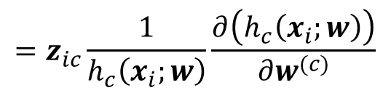
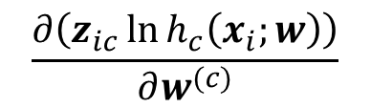
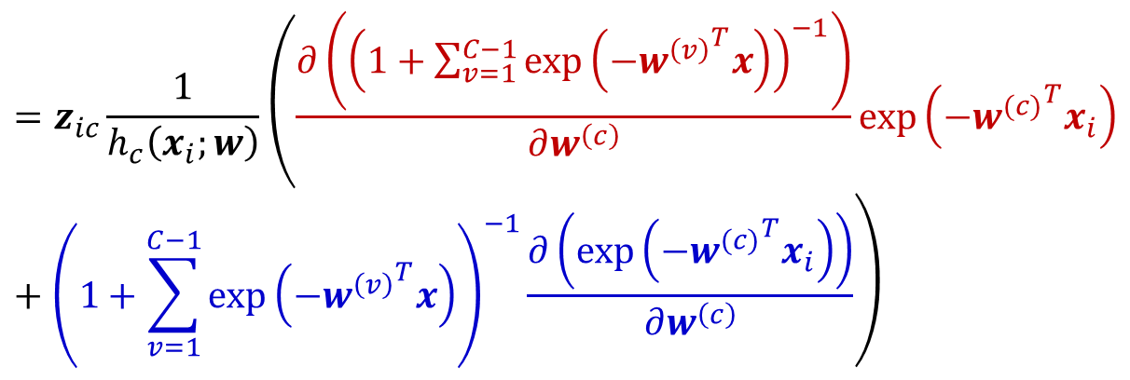
Multi-class Extension (cont.)
$$\frac{∂\left(z_{ic}\ln{h_{c}\left(x_{i};w\right)}\right)}{∂w^{(c)}}$$
Case 2
$$=z_{ic}\frac{1}{h_{c}\left(x_{i};w\right)}\frac{∂\left(h_{c}\left(x_{i};w\right)\right)}{∂w^{(c)}}$$
$$=z_{ic}\frac{1}{h_{c}\left(x_{i};w\right)}\left(\frac{∂\left({\left(1+\sum_{v=1}^{C−1}{\exp\left(−{w^{\left(v\right)}}^{T}x\right)}\right)}^{−1}\right)}{∂w^{\left(c\right)}}exp\left(−{w^{(c)}}^{T}x_{i}\right)+{\left(1+\sum_{v=1}^{C−1}{\exp\left(−{w^{\left(v\right)}}^{T}x\right)}\right)}^{−1}\frac{∂\left(exp\left(−{w^{(c)}}^{T}x_{i}\right)\right)}{∂w^{\left(c\right)}}\right)$$

Slide 11
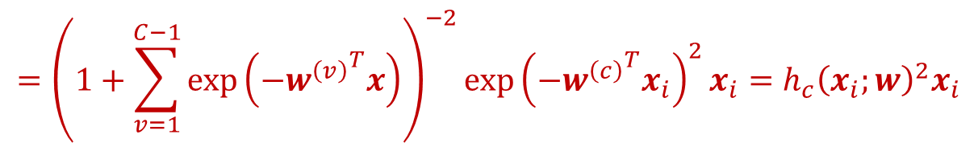
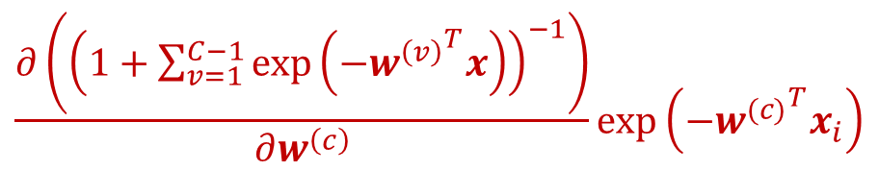
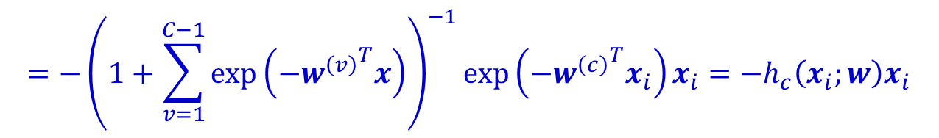
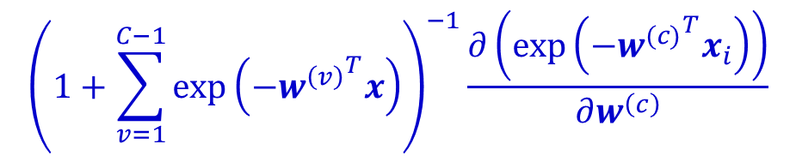
Multi-class Extension (cont.)
$$\frac{∂\left({\left(1+\sum_{v=1}^{C−1}{\exp\left(−{w^{\left(v\right)}}^{T}x\right)}\right)}^{−1}\right)}{∂w^{\left(c\right)}}exp\left(−{w^{(c)}}^{T}x_{i}\right)$$
$$={\left(1+\sum_{v=1}^{C−1}{\exp\left(−{w^{\left(v\right)}}^{T}x\right)}\right)}^{−2}{exp\left(−{w^{\left(c\right)}}^{T}x_{i}\right)}^{2}x_{i}={h_{c}\left(x_{i};w\right)}^{2}x_{i}$$
$${\left(1+\sum_{v=1}^{C−1}{\exp\left(−{w^{\left(v\right)}}^{T}x\right)}\right)}^{−1}\frac{∂\left(exp\left(−{w^{(c)}}^{T}x_{i}\right)\right)}{∂w^{\left(c\right)}}$$
$$=−{\left(1+\sum_{v=1}^{C−1}{\exp\left(−{w^{\left(v\right)}}^{T}x\right)}\right)}^{−1}exp\left(−{w^{\left(c\right)}}^{T}x_{i}\right)x_{i}=−h_{c}\left(x_{i};w\right)x_{i}$$

Slide 12
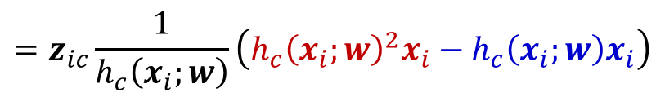
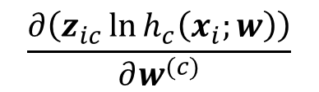

Multi-class Extension (cont.)
$$\frac{∂\left(z_{ic}\ln{h_{c}\left(x_{i};w\right)}\right)}{∂w^{(c)}}$$
$$=z_{ic}\frac{1}{h_{c}\left(x_{i};w\right)}\left({h_{c}\left(x_{i};w\right)}^{2}x_{i}−h_{c}\left(x_{i};w\right)x_{i}\right)$$
$$=z_{ic}\left(h_{c}\left(x_{i};w\right)−1\right)x_{i}$$

Slide 13
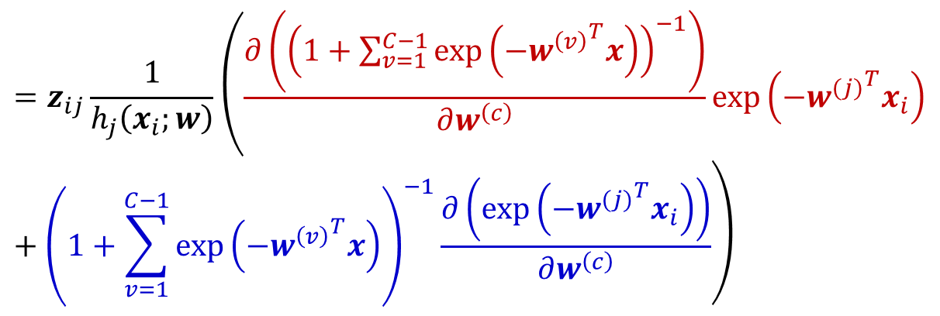
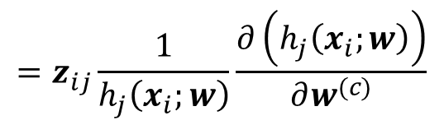
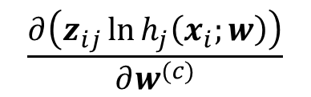


Multi-class Extension (cont.)
$$\frac{∂\left(z_{ij}\ln{h_{j}\left(x_{i};w\right)}\right)}{∂w^{(c)}}$$
$$j>0, \text{and} j≠c$$
Case 3
$$=z_{ij}\frac{1}{h_{j}\left(x_{i};w\right)}\frac{∂\left(h_{j}\left(x_{i};w\right)\right)}{∂w^{(c)}}$$
$$=0$$
Because when $j≠c$, $w^{\left(j\right)}$ is a constant w.r.t. $w^{\left(c\right)}$

Slide 14

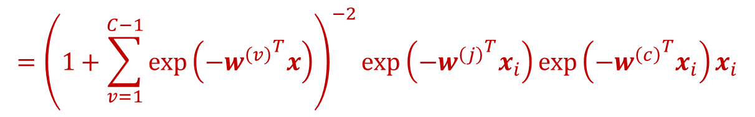
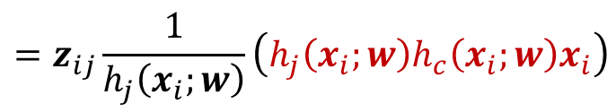


Multi-class Extension (cont.)
$$\frac{∂\left({\left(1+\sum_{v=1}^{C−1}{\exp\left(−{w^{\left(v\right)}}^{T}x\right)}\right)}^{−1}\right)}{∂w^{\left(c\right)}}exp\left(−{w^{(j)}}^{T}x_{i}\right)$$
$$={\left(1+\sum_{v=1}^{C−1}{\exp\left(−{w^{\left(v\right)}}^{T}x\right)}\right)}^{−2}exp\left(−{w^{\left(j\right)}}^{T}x_{i}\right)exp\left(−{w^{\left(c\right)}}^{T}x_{i}\right)x_{i}$$
$$=h_{j}\left(x_{i};w\right)h_{c}\left(x_{i};w\right)x_{i}$$
$$\frac{∂\left(z_{ij}\ln{h_{j}\left(x_{i};w\right)}\right)}{∂w^{(c)}}$$
$$j>0, \text{and} j≠c$$
$$=z_{ij}\frac{1}{h_{j}\left(x_{i};w\right)}\left(h_{j}\left(x_{i};w\right)h_{c}\left(x_{i};w\right)x_{i}\right)$$
$$=z_{ij}h_{c}\left(x_{i};w\right)x_{i}$$

Slide 15
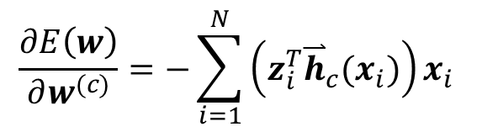
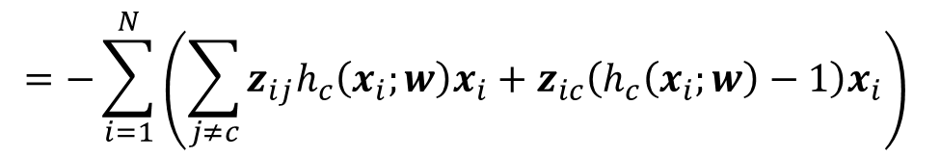
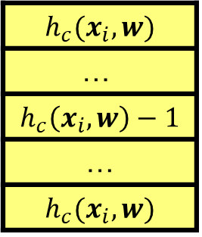
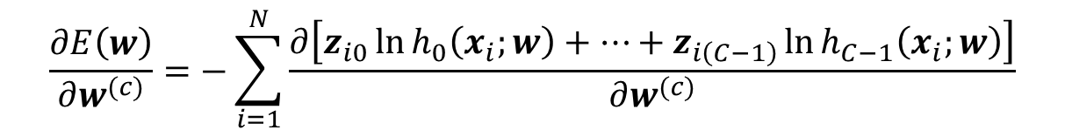

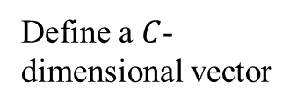
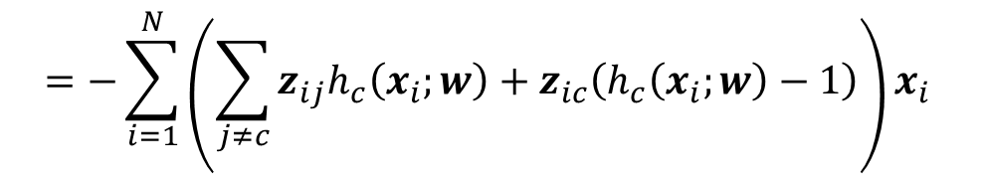
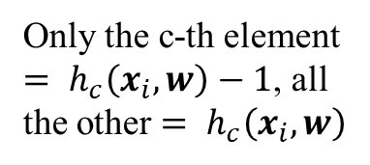
Multi-class Extension (cont.)
$$\frac{∂E\left(w\right)}{∂w^{(c)}}=−\sum_{i=1}^{N}{\frac{∂\left[z_{i0}\ln{h_{0}\left(x_{i};w\right)}+⋯+z_{i\left(C−1\right)}\ln{h_{C−1}\left(x_{i};w\right)}\right]}{∂w^{(c)}}}$$
Therefore
$$=−\sum_{i=1}^{N}{\left(\sum_{j≠c}{z_{ij}h_{c}\left(x_{i};w\right)x_{i}}+z_{ic}\left(h_{c}\left(x_{i};w\right)−1\right)x_{i}\right)}$$
$$=−\sum_{i=1}^{N}{\left(\sum_{j≠c}{z_{ij}h_{c}\left(x_{i};w\right)}+z_{ic}\left(h_{c}\left(x_{i};w\right)−1\right)\right)x_{i}}$$
Define a $C$-dimensional vector
$${\overset{⃑}{h}}_{c}(x_{i})$$
$$h_{c}(x_{i},w)$$
$$\text{…}$$
$$h_{c}\left(x_{i},w\right)−1$$
…
$$h_{c}(x_{i},w)$$
$$\frac{∂E\left(w\right)}{∂w^{(c)}}=−\sum_{i=1}^{N}{\left(z_{i}^{T}{\overset{⃑}{h}}_{c}(x_{i})\right)x_{i}}$$
Only the c-th element $= h_{c}\left(x_{i},w\right)−1$, all the other $= h_{c}\left(x_{i},w\right)$

Slide 16

Multi-class Extension (cont.)
$$\left\{\begin{aligned}w^{(1)}:w_{t+1}^{(1)}=w_{t}^{(1)}+ρ\sum_{i=1}^{N}{\left(z_{i}^{T}{\overset{⃑}{h}}_{1}(x_{i})\right)x_{i}} \\ \\ … \\ \\ w^{(c)}:w_{t+1}^{(c)}=w_{t}^{(c)}+ρ\sum_{i=1}^{N}{\left(z_{i}^{T}{\overset{⃑}{h}}_{c}(x_{i})\right)x_{i}} \\ \\ … \\ \\ w^{(C−1)}:w_{t+1}^{(C−1)}=w_{t}^{(C−1)}+ρ\sum_{i=1}^{N}{\left(z_{i}^{T}{\overset{⃑}{h}}_{C−1}(x_{i})\right)x_{i}}\end{aligned}\right.$$
Therefore

Slide 17

Regularized Multi-class Extension
As the regularization term becomes $\frac{λ}{2} \left({\left\|w_{}^{\left(1\right)}\right\|}_{2}^{2}+…+{\left\|w_{}^{\left(C−1\right)}\right\|}_{2}^{2}\right)$
$$\left\{\begin{aligned}w_{t+1}^{(1)}=w_{t}^{(1)}+ρ\left(\sum_{i=1}^{N}{\left(z_{i}^{T}{\overset{⃑}{h}}_{1}\left(x_{i}\right)\right)x_{i}}−λw_{t}^{\left(1\right)}\right) \\ \\ … \\ \\ w_{t+1}^{(c)}=w_{t}^{(c)}+ρ\left(\sum_{i=1}^{N}{\left(z_{i}^{T}{\overset{⃑}{h}}_{c}\left(x_{i}\right)\right)x_{i}}−λw_{t}^{\left(c\right)}\right) \\ \\ … \\ \\ w_{t+1}^{(C−1)}=w_{t}^{(C−1)}+ρ\left(\sum_{i=1}^{N}{\left(z_{i}^{T}{\overset{⃑}{h}}_{C−1}\left(x_{i}\right)\right)x_{i}}−λw_{t}^{\left(C−1\right)}\right)\end{aligned}\right.$$

Slide 18

Question 2 (Recommended)
Linear kernel
$C=0.01: 0.8468$
$C=0.05: 0.8475$
$C=0.1: 0.8475$
$C=0.5: 0.8473$
$C=1: 0.8473$

Slide 19


Question 2 (cont.)
RBF kernel:
The best kernel is linear with the value of $C$ being $0.1$
Accuracy on testing set is $0.8498$
 | $$C=0.01$$ | $$C=0.05$$ | $$C=0.1$$ | $$C=0.5$$ | $$C=1$$
$$g=0.01$$ | $$0.7592$$ | $$0.8312$$ | $$0.8377$$ | $$0.843$$ | $$0.8444$$
$$g=0.05$$ | $$0.8199$$ | $$0.8358$$ | $$0.8397$$ | $$0.8458$$ | $$0.8467$$
$$g=0.1$$ | $$0.8198$$ | $$0.8342$$ | $$0.8388$$ | $$0.8468$$ | $$0.8474$$
$$g=0.5$$ | $$0.7592$$ | $$0.7892$$ | $$0.8061$$ | $$0.8322$$ | $$0.8366$$
$$g=1$$ | $$0.7592$$ | $$0.7592$$ | $$0.762$$ | $$0.7897$$ | $$0.7983$$

Slide 20




Question 3
$$\min_{w,b,ξ_{i}}{ \frac{{\left\|w\right\|}_{2}^{2}}{2}+C\left(\sum_{i=1}^{N}{ξ_{i}}\right)} \\ \text{s}\text{.}\text{t}\text{. }y_{i}\left(w⋅x_{i}+b\right)≥1−ξ_{i}, i=1,…,N, \\ ξ_{i}≥0$$
These two optimization problems are equivalent!
$$\min_{w,b }{ \frac{{\left\|w\right\|}_{2}^{2}}{2}+C\left(\sum_{i=1}^{N}{{\left[1−y_{i}\left(w⋅x_{i}+b\right)\right]}_{+}}\right)}$$
$${\left[z\right]}_{+}\left\{\begin{aligned}z, z>0 \\ 0, z≤0\end{aligned}\right.$$
Hinge loss function:

Slide 21




Hinge Loss Function (cont.)
Let $ξ_{i}={\left[1−y_{i}\left(w⋅x_{i}+b\right)\right]}_{+}≥$0
If $1−y_{i}\left(w⋅x_{i}+b\right)>0$, then
In this case, $y_{i}\left(w⋅x_{i}+b\right)<1$, the data instance $x_{i}$ is either within the margin or misclassified
If $1−y_{i}\left(w⋅x_{i}+b\right)≤0$, then
In this case, $y_{i}\left(w⋅x_{i}+b\right)≥1$, the data instance $x_{i}$ is correctly classified, and out of the margin
Recall that soft errors include $\#\{ξ_{i}>1\}$, and $\#\{ξ_{i}>0\}$, which have been captured by the sum of the hinge loss
$${\left[1−y_{i}\left(w⋅x_{i}+b\right)\right]}_{+}=ξ_{i}>0$$
$${\left[1−y_{i}\left(w⋅x_{i}+b\right)\right]}_{+}=ξ_{i}=0$$
$$\sum_{i=1}^{N}{{\left[1−y_{i}\left(w⋅x_{i}+b\right)\right]}_{+}}$$

Slide 22




Equivalent Optimization Problem
$$\min_{w,b }{ \frac{{\left\|w\right\|}_{2}^{2}}{2}+C\left(\sum_{i=1}^{N}{{\left[1−y_{i}\left(w⋅x_{i}+b\right)\right]}_{+}}\right)}$$
$$\min_{w,b }{C\left(\frac{{\left\|w\right\|}_{2}^{2}}{2C}+\sum_{i=1}^{N}{{\left[1−y_{i}\left(w⋅x_{i}+b\right)\right]}_{+}}\right)}$$
Denote by $λ=\frac{1}{C}$
Hinge loss over training data
$$\min_{w,b }{\frac{λ}{2}{\left\|w\right\|}_{2}^{2}+\sum_{i=1}^{N}{{\left[1−y_{i}\left(w⋅x_{i}+b\right)\right]}_{+}}}$$
Regularization term

Slide 23
Question 4: Kernelized Regularized Regression
Regularized linear regression with kernels
It can be reformulated in terms of a dual form where kernel function arises naturally
$$\hat{w}=arg \min_{w}\frac{1}{2}\sum_{i=1}^{N}{{(w∙φ\left(x_{i}\right)−y_{i})}^{2}}+\frac{λ}{2}{\left\|w\right\|}_{2}^{2}$$
$$\frac{∂\left(\frac{1}{2}\sum_{i=1}^{N}{{(w∙φ\left(x_{i}\right)−y_{i})}^{2}}+\frac{λ}{2}{\left\|w\right\|}_{2}^{2}\right)}{∂w}=0$$
$$\sum_{i=1}^{N}{(w∙φ\left(x_{i}\right)−y_{i})φ\left(x_{i}\right)}+λw=0$$

Slide 24
Closed-form Solution
By using kernel trick $k\left(x_{i},x_{j}\right)=φ(x_{i})⋅φ(x_{j})$, the regression prediction function $f\left(x\right)=w∙φ\left(x\right)$ can be written as
$$f\left(x\right)=k_{x}^{T}{\left(K+λI\right)}^{−1}y$$
$$K=\left(\begin{matrix}k(x_{1},x_{1}) & ⋯ & k(x_{1},x_{N}) \\ ⋮ & ⋱ & ⋮ \\ k(x_{N},x_{1}) & ⋯ & k(x_{N},x_{N})\end{matrix}\right)\left(\begin{matrix}φ(x_{1})∙φ(x_{1}) & ⋯ & φ(x_{1})∙φ(x_{N}) \\ ⋮ & ⋱ & ⋮ \\ φ(x_{N})∙φ(x_{1}) & ⋯ & φ(x_{N})∙φ(x_{N})\end{matrix}\right)$$
$$k(x_{1},x)$$
$$k(x_{2},x)$$
…
$$k(x_{N},x)$$
$$y_{1}$$
$$y_{2}$$
…
$$y_{N}$$
$$1$$ | $$0$$ | … | $$0$$
$$0$$ | $$1$$ | … | $$0$$
… | … | … | …
$$0$$ | $$0$$ | … | $$1$$
$$k_{x}$$
$$y$$
$$I (N×N)$$

Slide 25
Derivation
$$\sum_{i=1}^{N}{(w∙φ\left(x_{i}\right)−y_{i})φ\left(x_{i}\right)}+λw=0$$
$$w=−\frac{1}{λ}\sum_{i=1}^{N}{(w∙φ\left(x_{i}\right)−y_{i})φ\left(x_{i}\right)}$$
$$\text{By} \text{denoting} a_{i}=−\frac{1}{λ}(w∙φ\left(x_{i}\right)−y_{i})$$
$$=\sum_{i=1}^{N}{a_{i}φ\left(x_{i}\right)}$$
$a_{i}^{′}s$ are dual variables

Slide 26
Derivation (cont.)
Denote by $Φ={\left(φ\left(x_{1}\right),φ\left(x_{2}\right),…,φ\left(x_{N}\right)\right)}^{T}$ and $a={\left(a_{1},…,a_{N}\right)}^{T}$
$Φ:$ $N$-by-$F$ matrix (suppose $φ(∙)$ maps $x_{i}$ to a $F$-dimensional space)
$a:$ a column vector
$$w=\sum_{i=1}^{N}{a_{i}φ\left(x_{i}\right)}=Φ^{T}a$$
$$a_{i}=−\frac{1}{λ}(w∙φ\left(x_{i}\right)−y_{i})$$
$$a=\frac{1}{λ}(y−Φw)$$

Slide 27
Derivation (cont.)
By substituting $w=Φ^{T}a$ into $a=\frac{1}{λ}(y−Φw)$, we have
$$a=\frac{1}{λ}(y−ΦΦ^{T}a)$$
$$λIa=y−ΦΦ^{T}a$$
$$\left(λI+ΦΦ^{T}\right)a=y$$
$$a={\left(λI+ΦΦ^{T}\right)}^{−1}y$$
Closed-form solution of $a$

Slide 28
Derivation (cont.)
By denoting the Kernel matrix (Gram matrix) as follows,
$$K=\left(\begin{matrix}k(x_{1},x_{1}) & ⋯ & k(x_{1},x_{N}) \\ ⋮ & ⋱ & ⋮ \\ k(x_{N},x_{1}) & ⋯ & k(x_{N},x_{N})\end{matrix}\right)=\left(\begin{matrix}φ(x_{1})∙φ(x_{1}) & ⋯ & φ(x_{1})∙φ(x_{N}) \\ ⋮ & ⋱ & ⋮ \\ φ(x_{N})∙φ(x_{1}) & ⋯ & φ(x_{N})∙φ(x_{N})\end{matrix}\right)$$
$$a={\left(λI+ΦΦ^{T}\right)}^{−1}y={\left(λI+K\right)}^{−1}y$$
$$w=Φ^{T}a=Φ^{T}{\left(λI+K\right)}^{−1}y$$
Unknown as $φ(∙)$ is unknown

Slide 29

Derivation (cont.)
Our goal is to compute $f(x)$ for each $x$ not computing $w$
By substituting $w=Φ^{T}{\left(λI+K\right)}^{−1}y$ into $f(x)$, we have
Therefore
$$f\left(x\right)=w∙φ\left(x\right)={φ\left(x\right)}^{T}w$$
$$f(x)={{φ\left(x\right)}^{T}Φ^{T}\left(K+λI\right)}^{−1}y$$
Denote $k_{x}=Φφ\left(x\right)$, which is an $N$-dimensional column vector, where the $i$-th element of $k_{x}$ is $k(x_{i},x)$
$$f(x)={k_{x}^{T}\left(K+λI\right)}^{−1}y$$

Slide 30
Thank you!

