Slide 1


Using facial gestures to flip pages on e-books
Sean Yang

Slide 2



Libraries
OpenCV
Reading in the inputs from the camera
Dlib
Face detection and key point detection
Scikit-learn
Knn for classification
Tkinter
GUI
https://opencv.org/assets/theme/logo.png
http://dlib.net/dlib-logo.png
http://scikit-learn.org/stable/_static/scikit-learn-logo-small.png
Notes:
Computer vision libraries
Opencv and dlib both use numpy matrix to store images
Scikit learn used for classification of the gestures

Slide 3
Live Demo
Flipping Slides
GUI for capturing
Pay attention to my mouth
Notes:
Point out what parts are more important

Slide 4
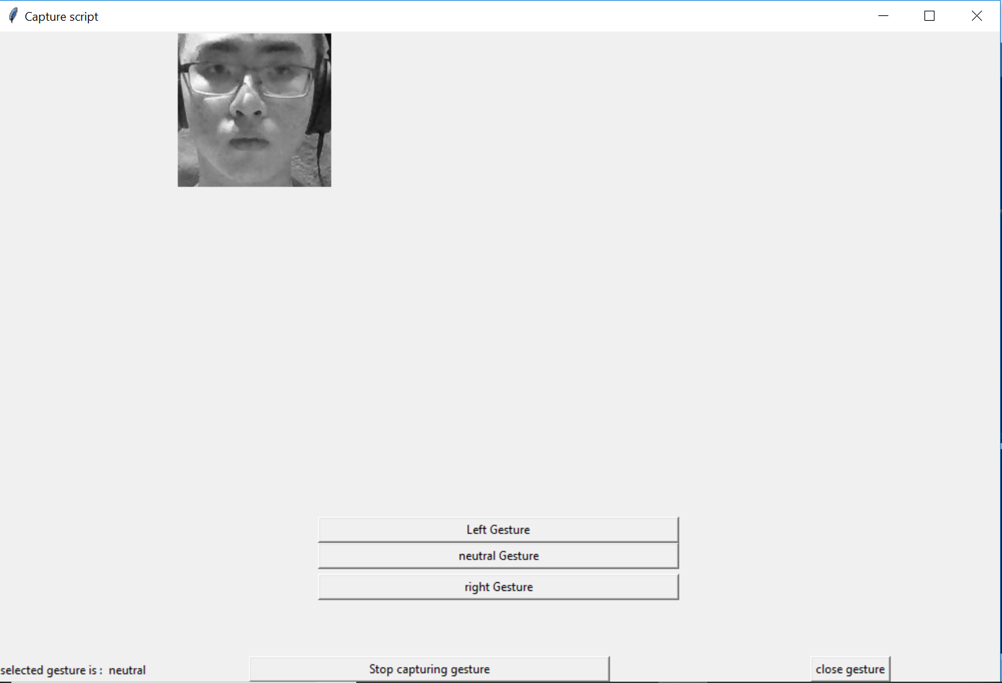
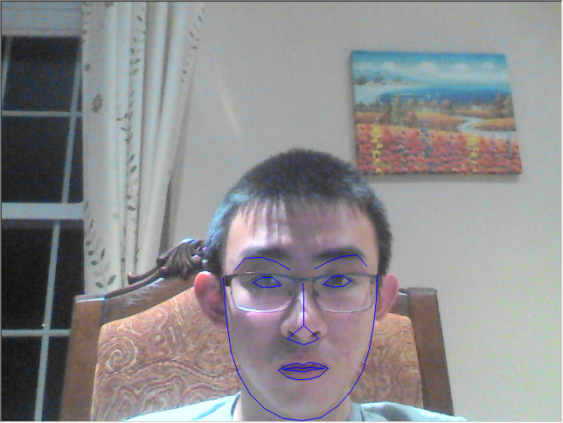
GUI
Video display window for classification script
Kept in the background
GUI with texts, buttons, and images for the capturing script
Designed with simplicity in mind
Text field input vs buttons
Notes:
GUI for debugging and testing mainly. Don’t want to cover the screen and can be distracting

Slide 5
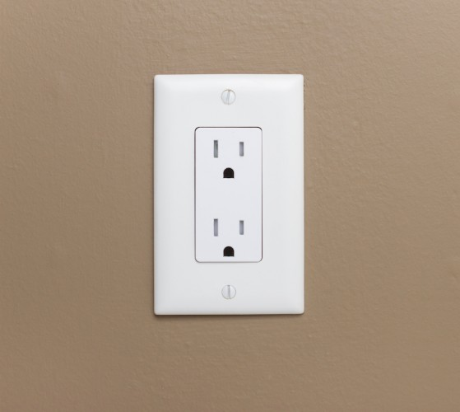
Face detection
Dlib vs Opencv implementation
Slide a box around and classify if object is present
Dlib: Histogram of Oriented Gradient (HOG) + Support vector machine (SVM)
Key point detection trained on the dlib implementation
Opencv: Haar Cascade
False positives
Prepare for keypoint detection part
Dlib version is better
Notes:
Speed is comparable

Slide 6
Key point detection
Dlib’s implementation
Detect 68 key points
Trained on IBUG 300-w data set
Feature vector generation
Notes:
Use a cascade regressor
Not completely accurate
No as you can see
Point out 68 points not curvy

Slide 7
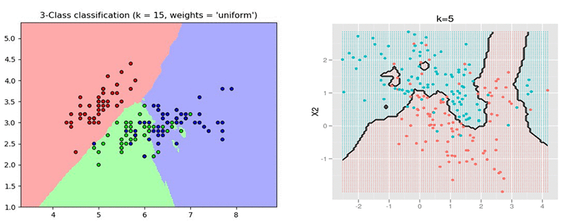
KNN
K nearest neighbour classifier
K value of 3
Find the distance from matrix
K-d tree
Match the matrix in the labeled training data

Slide 8
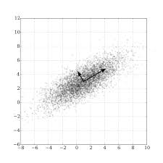
Principal component analysis
The result is not good
Thought KNN would be slow
Dimensionality reduction
Less things to consider
Represent the relationship among variables
Stretching couple of the points doesn’t change the principal axis much
Loses information

Slide 9
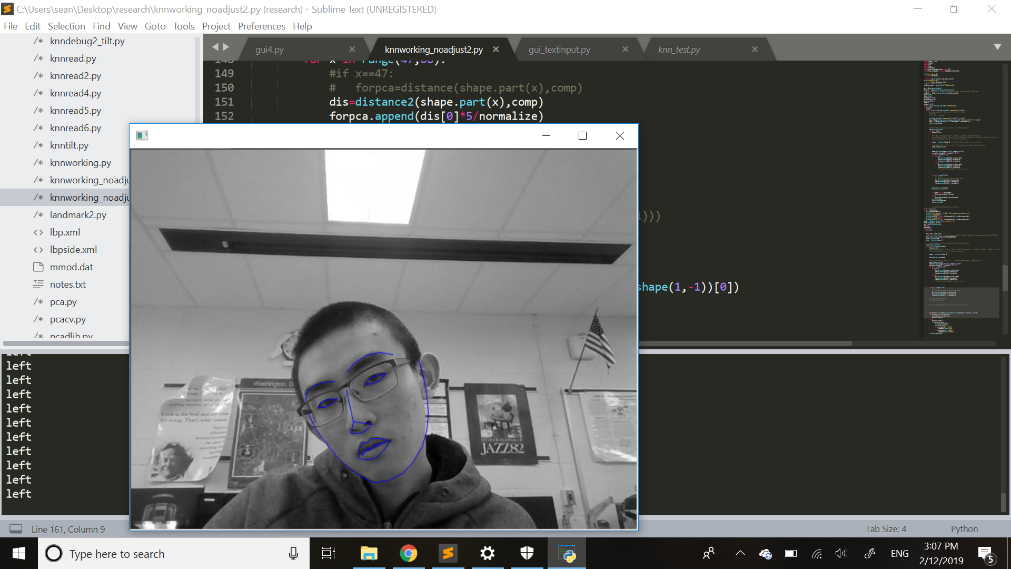
Tilt adjustment
Find angle from vertical
Rotate feature points
Was based on nose
Now on eyes
Fixed issues for slightly tilted face
Still can’t detect gesture properly when face is tilted

Slide 10
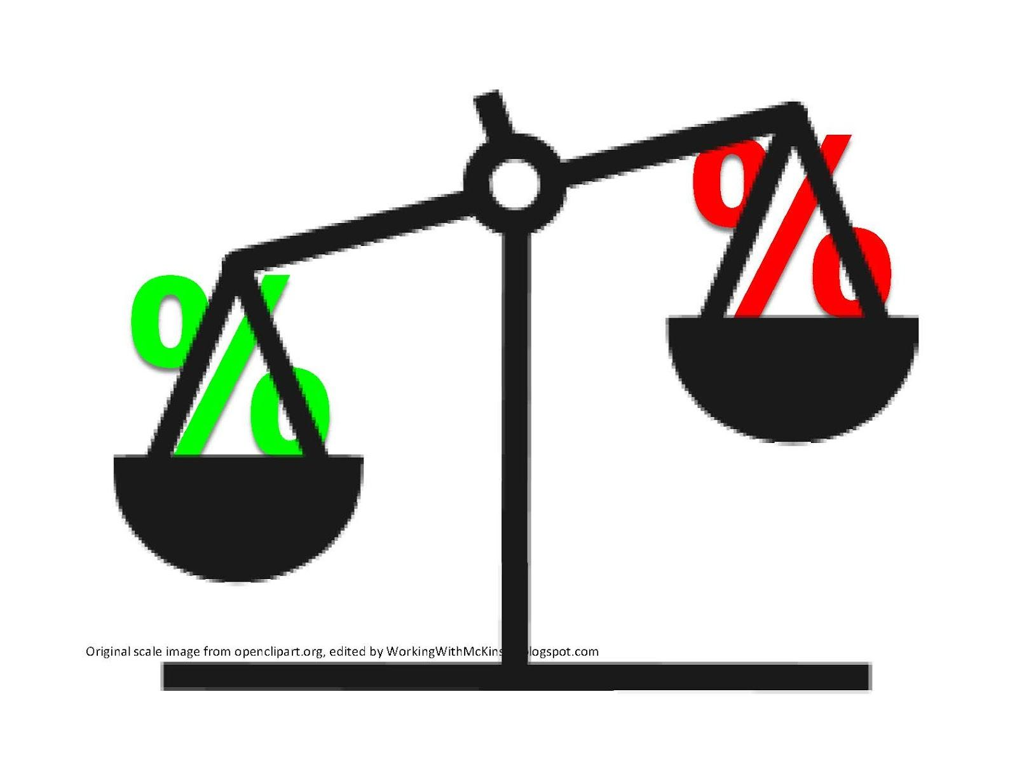
Tradeoff
Accuracy vs Speed
False positive vs False negative
Create bias based on what I value
Notes:
False negative is ok

Slide 11
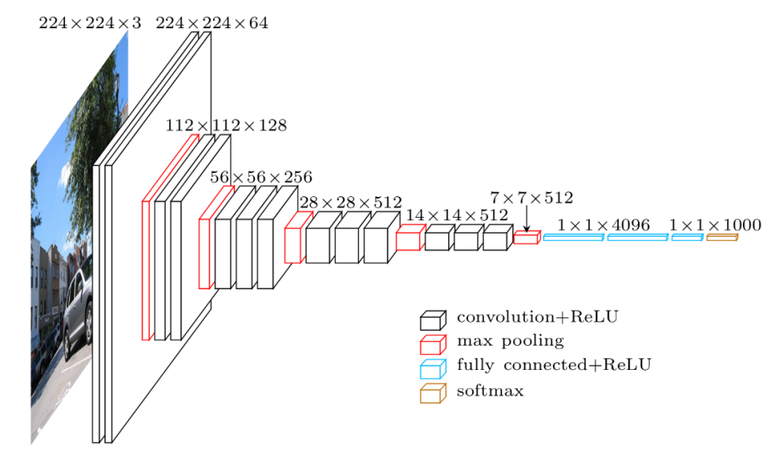
Why not CNN?
Fine tuned Resnet-34
Good at telling neutral or not
Confuses the left and the right gesture
Issues related to training
Dataset size
Imbalanced classes
Training time without gpu
Iterations needed
https://www.jeremyjordan.me/content/images/2018/04/vgg16.png
Notes:
Tiring to record gestures for 1 minutes. Imagine holding it for at least 5 minutes

Slide 12
Questions?

