Slide 1
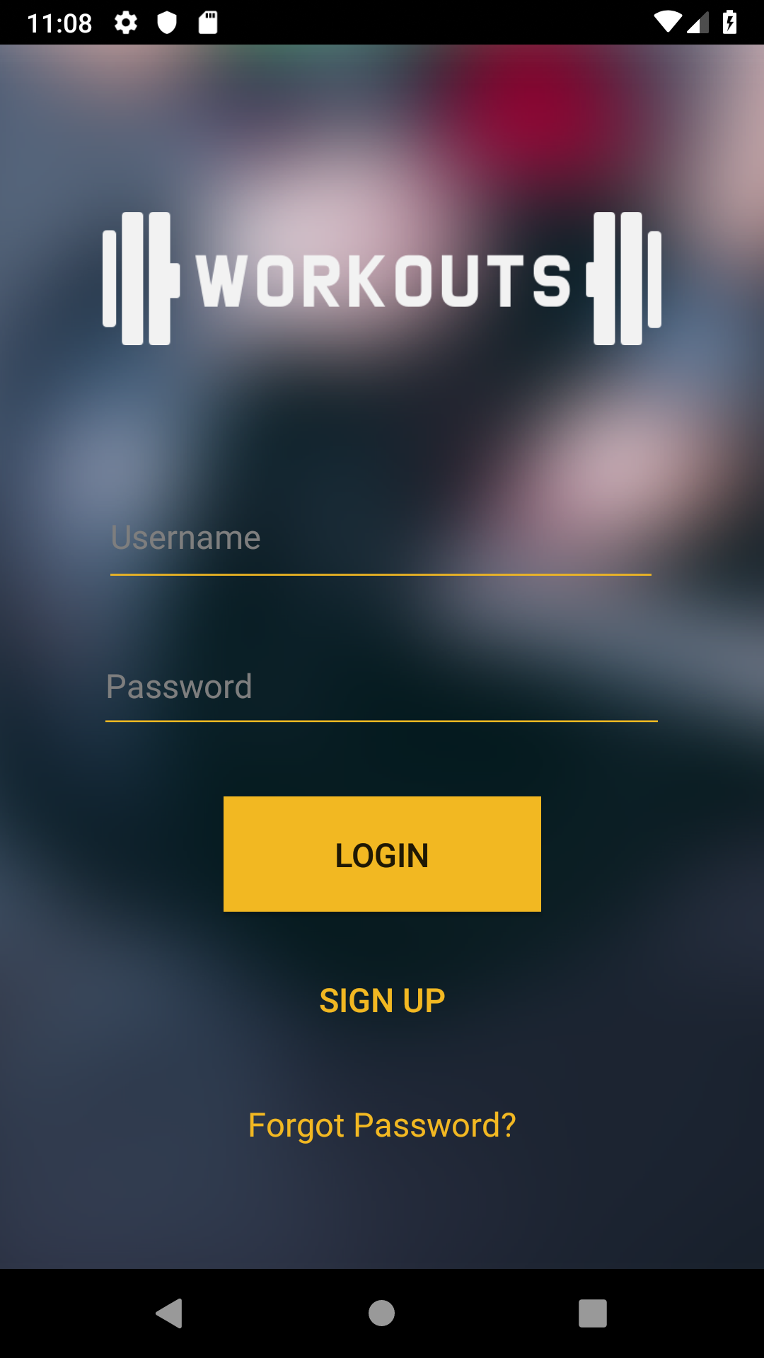
GROUP C7 APP PRESENTATION
• Project Manager - Ian Burns
• Communication Director - Yuqin Ying
• Negotiator - Hamed Albastaki, Sean Kotrola
• Documentation Lead - Christopher Randall

Slide 2
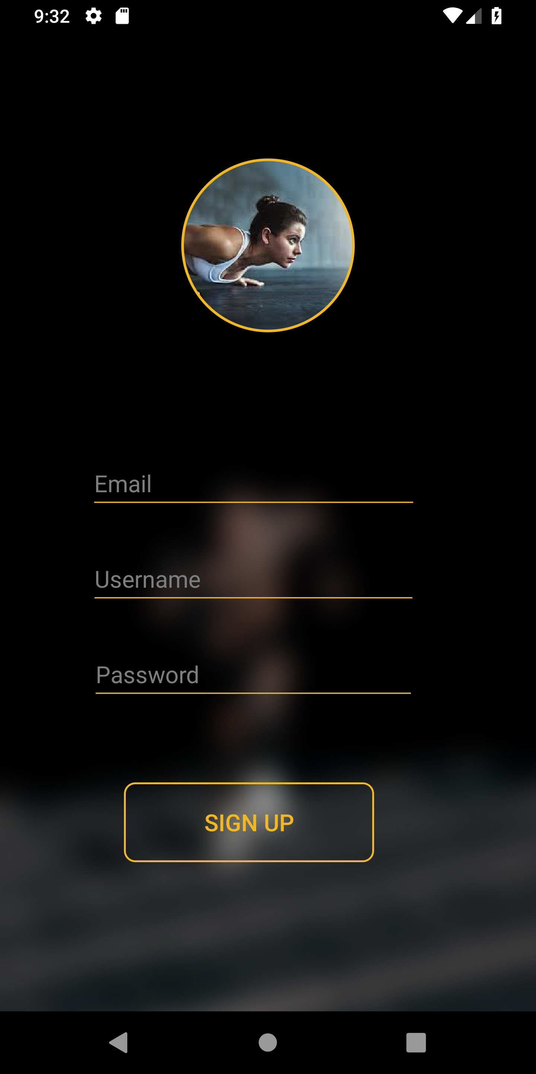
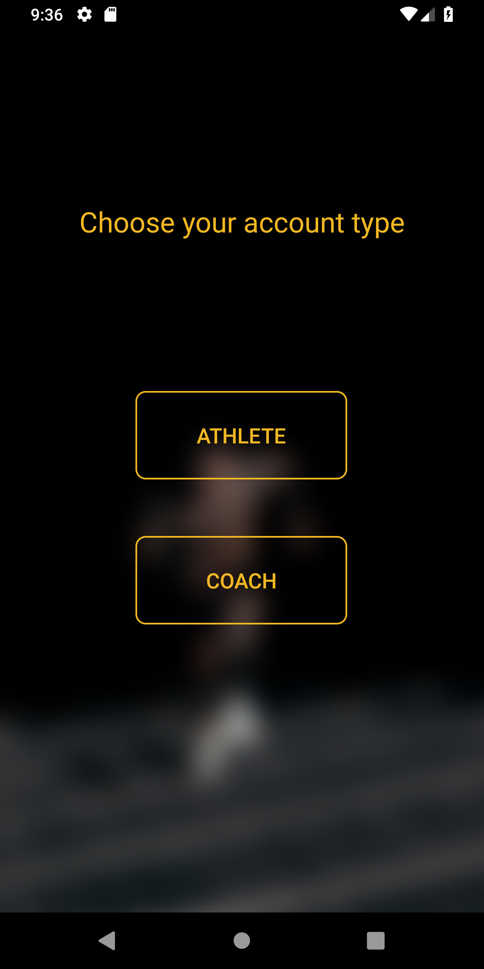
Objective
To create an app where coaches can create challenges in which athletes can compete (either as a team or an individual) in order to earn a spot on the leaderboards

Slide 3
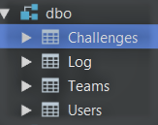
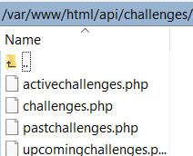

APP COMPONENTS
MySQL Database (Amazon RDS)
PHP API (Amazon EC2)
Android Studios VOLLEY (HTTP GET & POST)

Slide 4
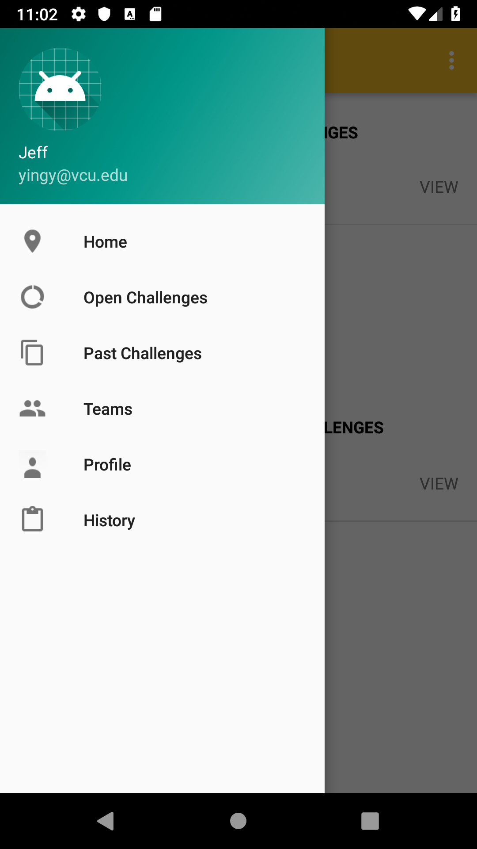
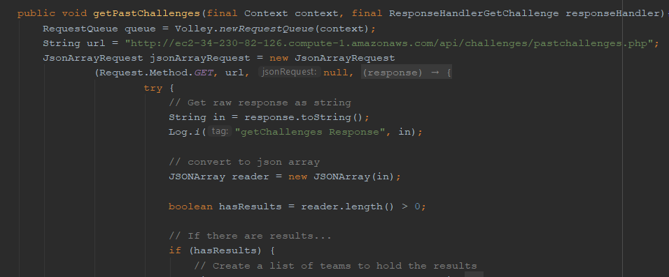
AN EXAMPLE
Clicking Past Challenge invokes method:

Slide 5
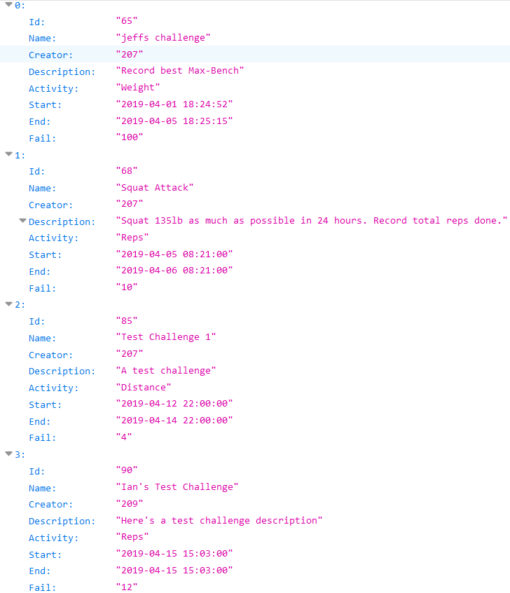
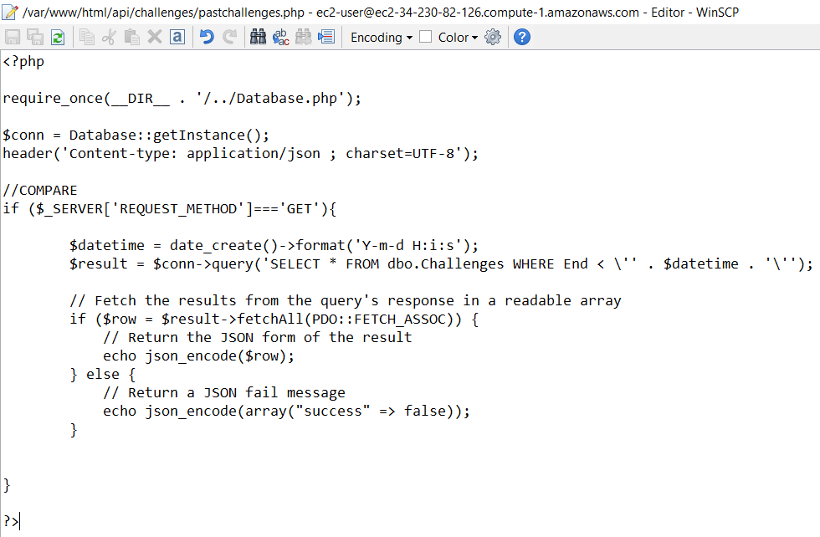
AN EXAMPLE CONT...
PHP → MySQL → Database → JSON

Slide 6
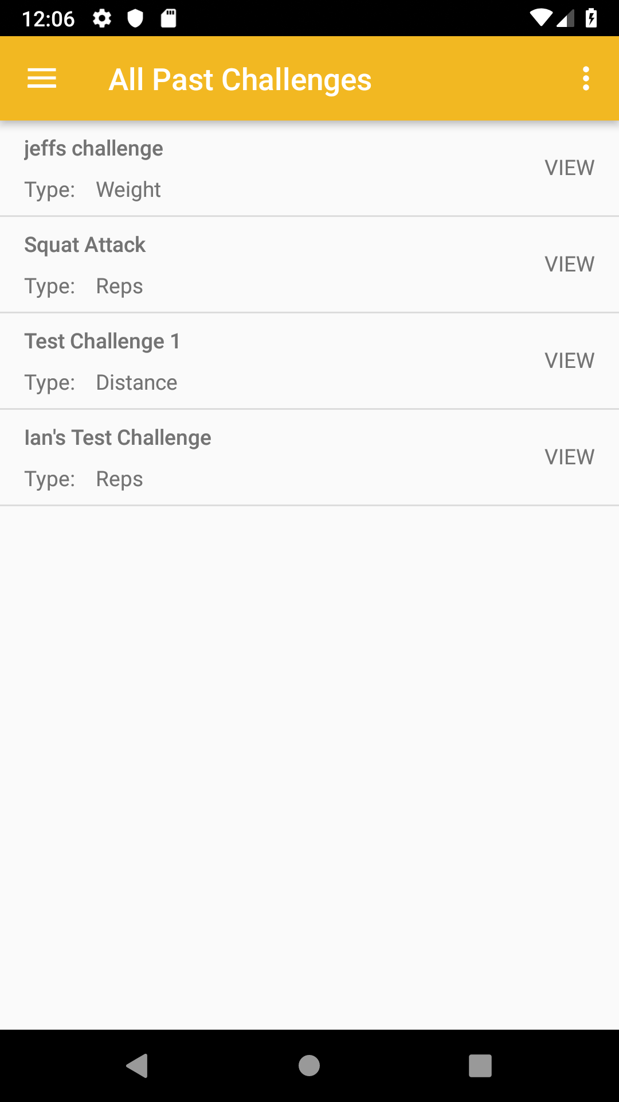
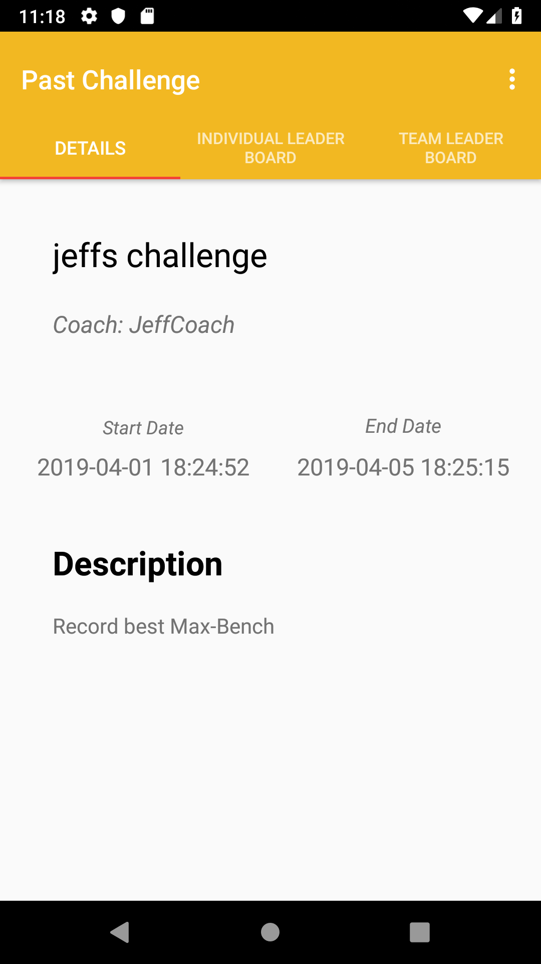
AN EXAMPLE CONT...
Click Listener

Slide 7
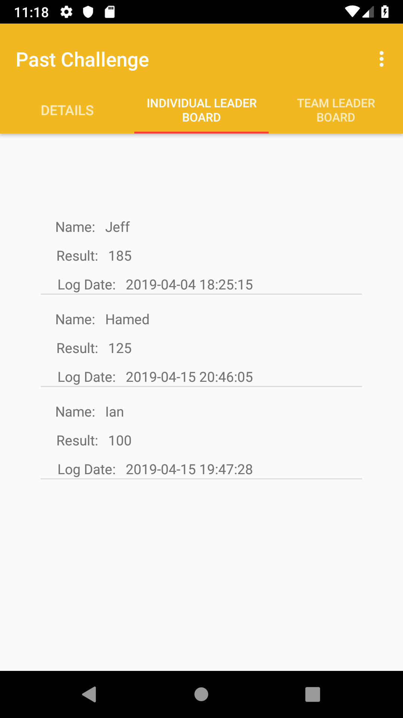
AN EXAMPLE CONT...
TAB FRAGMENT

Slide 8
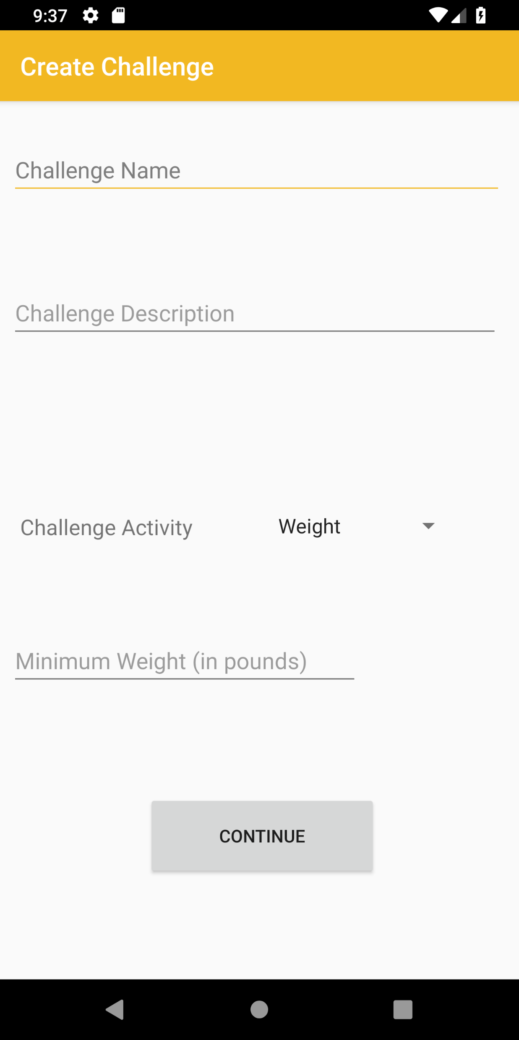
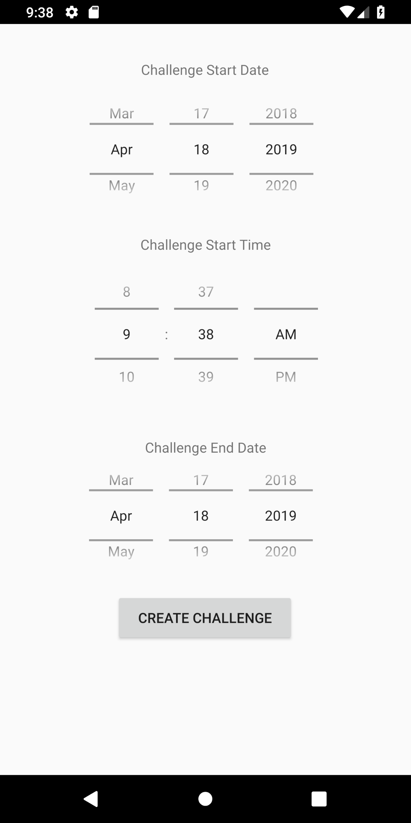
AN EXAMPLE CONT...

Slide 9
WHAT WE LEARNED
Android Studios UI
-ListViews, Adapters, Fragments, Tabs...etc
Volley
-Sending GET and POST requests, Receiving Responses
PHP
-Sending Data from APP to Database, vice-versa
MySql
-Insert, Update, Select, Delete, Join, Where...etc
JSON
-Parsing data

Slide 10
Suggestions
Worry about functionality before worrying about UI
Android studio has a lot of drag and drop elements that make building the app much easier: Use them
Research different types of databases before creating the app

