Slide 1
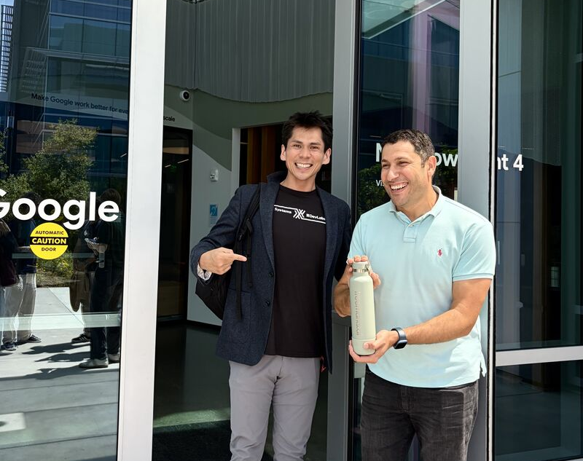
Sean Yépez · ME344 Summer 2026 · Final Project, Option 2
↗ github.com/seanyepez/me344ricechem
Problem: grading consumes the time meant for teaching
I love teaching, but for every 8 hours I spend teaching, 7 go to grading. I want to invert that ratio. Treemarks is my AI grading system for STEM classes: every decision checked against a rubric tied to the underlying logic, physics, and math.
AI checks every rubric decision → the TA reviews uncertain cases → students receive feedback sooner
Sean Yépez · Dr. Mourad Bouache · Google
RICECHEM · THE SUPERVISED BENCHMARK
RiceChem is the benchmark recent papers use: a chemistry exam graded against instructor rubrics. 1,264 responses · 4 questions · 27 rubric items → 8,392 TA-labeled TRUE/FALSE decisions. Agreement is measured against the TA's labeling.
• Sonkar et al. (2024) · introduces RiceChem and rubric-based grading of long-form answers
• Rao & Callison-Burch (2026) · Autorubric, rubric-based LLM evaluation
• Ferrer et al. (2026) · when to trust LLM graders
RESEARCH QUESTIONS
RQ1 · Quality: can tuning make a local model accurate enough for rubric grading?
RQ2 · Systems: how do CPU, GPU, and TPU change latency, throughput, and utilization?
RQ3 · Operations: which configuration meets the quality bar in under 24 hours at lowest cost?
Notes:
The 7-of-8-hour figure is Sean's measured TA workday and is presented as personal operational evidence, not a population estimate.
The proposal is AI first pass plus human review of exceptions; humans remain accountable for consequential judgments.
RiceChem source: https://arxiv.org/abs/2404.14316
Autorubric: https://arxiv.org/abs/2603.00077
When Can We Trust LLM Graders?: https://arxiv.org/abs/2603.29559
Photo: Treemarks LinkedIn post, Sean Yépez with Dr. Mourad Bouache at Google, August 2026.
[Sources] https://arxiv.org/abs/2404.14316 | https://arxiv.org/abs/2603.00077 | https://arxiv.org/abs/2603.29559 | https://www.linkedin.com/company/treemarks/posts/

Slide 2



PROPOSAL · SYSTEM + EXPERIMENT
Containerize and run a supervised experiment on three compute lanes
ORCHESTRATE
STORAGE + I/O
TRAIN + SERVE
CPU + A100
PyTorch / QLoRA
TPU v5e-8
JAX / XLA
Docker + GKE Job
GCS + range cache
CUDA · vLLM dynamic batching
pinned image · reusable K8s manifest
authorized data · checkpoints · aggregate receipts
compiled train / serve step
EXPERIMENT DESIGN · 8,392 TA-LABELED DECISIONS
TRAIN · 6,700 · 80%
update adapters
VALIDATE
831 · 10%
TEST
861 · 10%
Notes:
This is the actual ME344 experiment architecture, not the broader Treemarks product architecture.
QLoRA means the 27B base model is loaded in a compact 4-bit representation while small low-rank adapter weights are trained; the base weights remain frozen.
On TPU, JAX/XLA compiles the numerical train/serve step for the v5e-8 runtime. The completed 27B tuning path used A100/CUDA; 27B TPU remains future work.
RiceChem follows an 80/10/10 split by question with responses kept disjoint across train, validation, and test.
[Sources] https://arxiv.org/abs/2404.14316 | https://github.com/seanyepez/me344ricechem

Slide 3
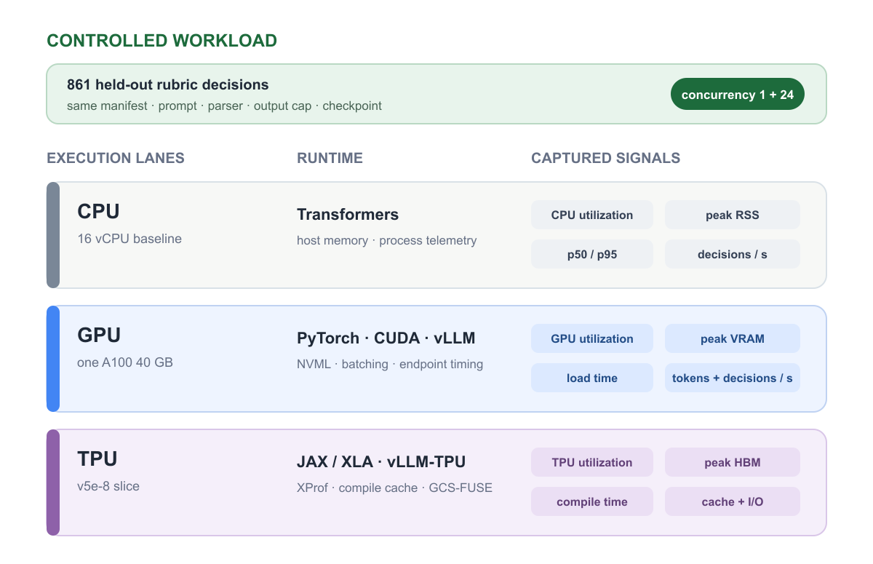
Measurements across three kinds of compute
WORKLOAD
861 rubric decisions from the RiceChem test split · c=1 and c=24
COMPUTE
wall time · p50/p95 · decisions/s · wall/step time as cycle proxy
MEMORY
CPU mCPU + RSS · A100 NVML + VRAM · TPU host memory only
INPUT / I/O
GCS range cache fixed startup; load and XLA compile time not isolated
Notes:
HBM is high-bandwidth memory: the accelerator-local memory used by TPU devices, analogous to GPU VRAM.
The telemetry sidecars sampled CPU/host metrics about every 20–30 seconds; the A100 run included coarse NVML utilization and VRAM samples.
TPU host CPU and memory were captured, but no TPU-device profiler was enabled. This is a measurement-pipeline gap, not an assertion that TPU devices cannot expose utilization or HBM.
The public aggregate receipt intentionally leaves missing data blank and lists the incomplete provenance fields.
[Sources] https://github.com/seanyepez/me344ricechem/blob/main/docs/methodology.md | https://github.com/seanyepez/me344ricechem/blob/main/results/hardware_comparison.json

Slide 4
Measurements: instrument the workload end to end
Three required scale steps: 16-vCPU baseline · one A100 40 GB · TPU v5e-8. Raw telemetry stays private; the repository publishes reviewed aggregates.
Lock the workload: same 861-decision manifest, prompt, parser, output cap, checkpoint, and concurrency sweep.
Capture end to end: CPU time/cycles, utilization, peak memory, load/compile time, p50/p95 latency, throughput, and input I/O.
Compare only like with like; unavailable telemetry stays unavailable—not estimated.
RESULTS · CONTROLLED 4B SERVING PROFILE
Accelerators cut single-stream grading time 30–41×
THROUGHPUT SPEEDUP · CONCURRENCY 1 · CPU = 1×
CONCURRENT SERVING · c = 24
A100 123.9/s
$0.007 per 861 decisions
TPU 98.4/s
$0.023 per 861 decisions
16-vCPU
1.0×
0.28/s · 50.9 min · 95.1% CPU · 18.0 GB RSS
A100 40 GB
30.5×
8.54/s · 100.8 s · 19.5% GPU · 35.6 GB VRAM
TPU v5e-8
40.7×
11.39/s · 75.6 s · 12.8% duty · 10.2 GiB HBM/chip
GEMMA 4B QUALITY
The 4B agrees only ≈72% of the time, below the grading bar.
Speed alone does not make it deployable.
Same 861-decision workload and configured merged-checkpoint path. CPU c=24 did not complete under memory/tunnel pressure. Costs are active-time list-price proxies; TPU device telemetry captured with tpu-info (libtpu).
Notes:
Speedups are normalized to the completed single-stream CPU lane: A100 8.54/0.28 = 30.5x; TPU 11.39/0.28 = 40.7x.
Concurrency 24 changed the serving economics: A100 reached 123.87 decisions/s and TPU 98.41 decisions/s on one endpoint.
Horizontal scaling is a separate claim: more GKE runners or endpoints can add capacity, but not infinitely. Quotas, queue depth, synchronization, load balancing, and shared storage create overhead and practical limits.
The same 4B checkpoint family remained around 72% agreement, so this systems comparison does not establish deployment-ready grading quality.
[Sources] https://github.com/seanyepez/me344ricechem/blob/main/results/hardware_comparison.json | https://github.com/seanyepez/me344ricechem/blob/main/results/cost_basis.json

Slide 5
CONCLUSION
What ME344 changed for my AI grading project
From local prototype to cloud-hosted. At the start of the course, grading ran on a student laptop. Now inference runs in a hosted Google Cloud solution, with controlled ML experiments testing subject-specific models.
Throughput closes the feedback loop. Without local-LLM limits and with room to scale, grades that typically take a TA a week or more could come back as fast as the next morning.
Quality gates model usage. Smaller models do not offer the accuracy grading needs: at roughly 72% agreement, TAs would re-review too much. The fine-tuned 27B reached 83%, competitive with frontier models at about 1/9 the serving cost.
The opportunity. Use frontier models and tuned open-source models interchangeably, wherever accuracy is sufficient and the cost tradeoff is favorable.
NEXT Serve the 27B on TPU and test transfer to unseen questions. Finish the training-cost analysis: upfront investment and lower running costs versus the frontier API.
Notes:
The conclusion is promise, not final deployment readiness: 27B fine-tuning is competitive with frontier inference on same-booklet held-out data, while the 4B model is below the practical quality bar.
The operating strategy is quality first, then turnaround, then cost. A single endpoint is enough if it meets the queue deadline; add runners only as enrollment or assignment volume requires.
Within 24 hours is the operational requirement; within 8 hours would materially shorten the student feedback loop while the work is still fresh.
Future transfer work should hold out an entire chemistry question during training to test whether the tuned grader transfers to fresh assessment content.
27B TPU serving remains future work unless a completed, validated receipt lands before the final submission pass.
[Sources] https://github.com/seanyepez/me344ricechem/blob/main/README.md | https://github.com/seanyepez/me344ricechem/blob/main/results/results_report.json

