Slide 1
DISTANCE ACCORDING TO ELVIS
Gilivaldo Castaneda^{[1]}, Kaleb Gardner, Sayi Liggonah, and Frank Neubrander
^{[1]} St. Mary's University, San Antonio, TX

Slide 2
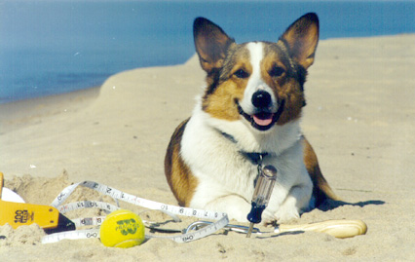
Elvis, the Welsh Corgi, at work
2003: While fetching a ball thrown from the beach shore into Lake Michigan, Elvis, like a beam of light, reliably manages to pick out the path that is traversed in the least amount of time.
2003: Timothy J. Pennings, Do Dogs Know Calculus?, The College Mathematics Journal 34, 2003.
2003-05: Elvis rules Mathematical Association of America (MAA) membership drives.
2004: Honorary Doctorate in Canine Letters from Hope College in Holland, Michigan.

Slide 3
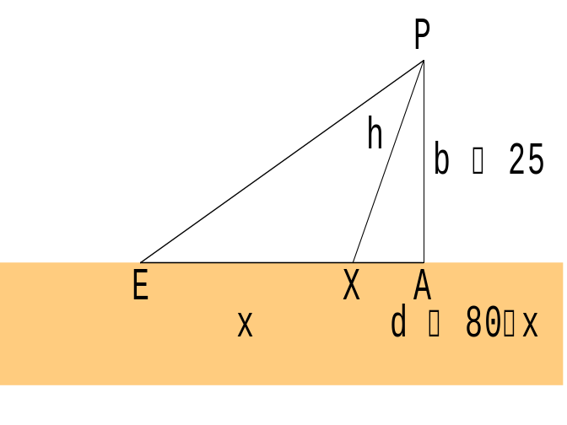
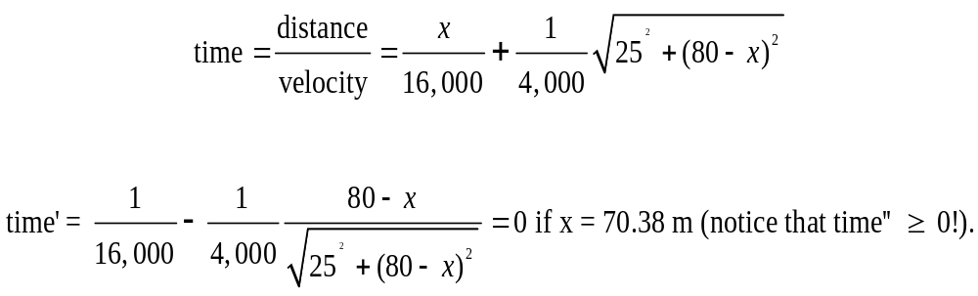
EXAMPLE. Elvis sits at a point E at a straight shoreline and watches Professor Pennings throw a ball into the water to a point P. Elvis’ speed in water is 4 km per hour, and his speed on land is 16 km/hour. Which path should Elvis take to minimize the time getting to P if |EA| = 80 m and |PA|=25 m?
Solution.

Slide 4
Going Beyond the Particular Answer: In order to start going beyond a particular answer to a particular problem to a general answer to a type of problem, it is often enough to use parameters to generalize the solution beyond specific numbers.
EXAMPLE (NEW). Elvis sits at a point E at a straight shoreline and watches his professor throw a ball into the water. Elvis knows from experience that his speed in water is only a fraction from his speed on land. Which path should Elvis take to minimize the time getting to the ball?
EXAMPLE (OLD). Elvis sits at a point E at a straight shoreline and watches Professor Pennings throw a ball into the water to a point P. Elvis speed in water is 4 km per hour, and his speed on land is 16 km/hour. Which path should Elvis take to minimize the time getting to P if |EA| = 80 m and |PA|=25 m?

Slide 5
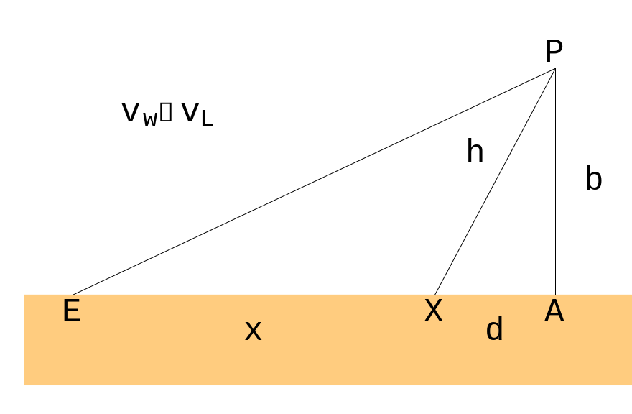
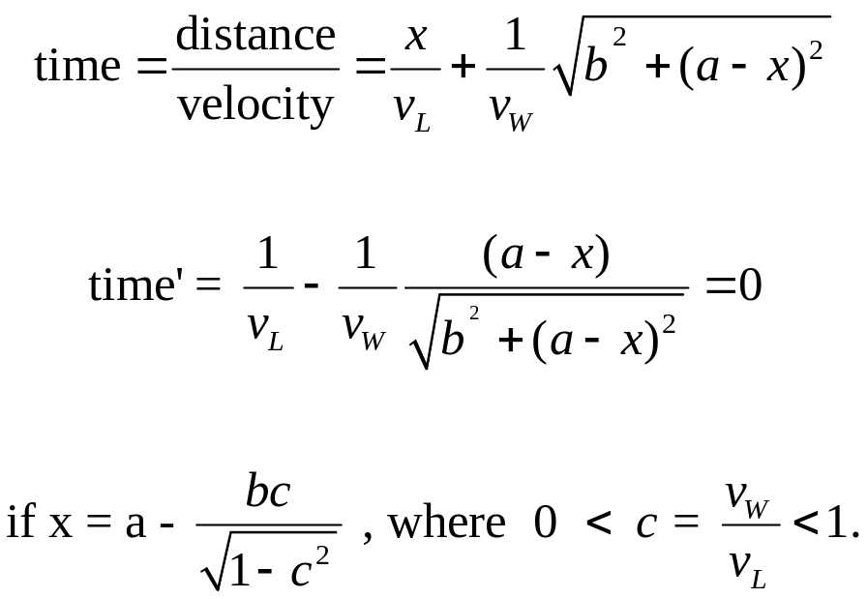
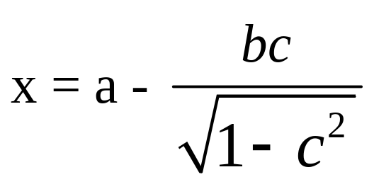
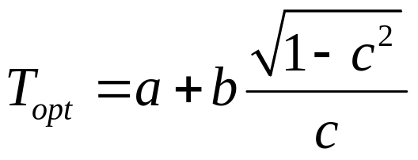
EXAMPLE (NEW). Elvis sits at a point E at a straight shoreline and watches his professor throw a ball into the water. Elvis knows from experience that his speed in water is only a fraction from his speed on land. Which path should Elvis take to minimize the time getting to the ball?
Solution. Set a: = x + d = |EA|. Then:

Slide 6
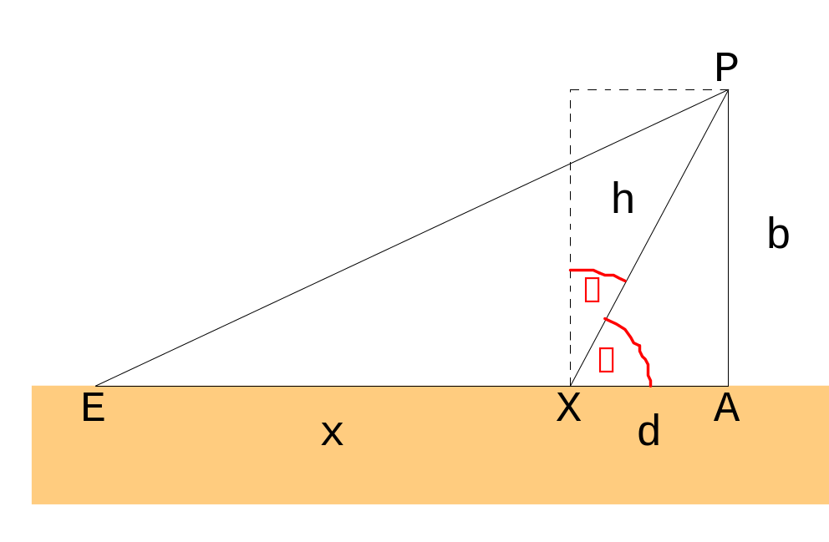
Being Curious:
a = x + d
Going first to A and then to P is never optimal;
The outcome depends only on c, the relation of the speed in water to the speed on land, but not on the speeds themselves

Slide 7
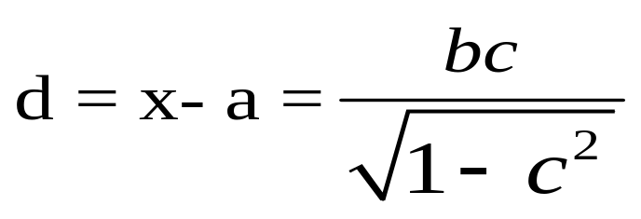
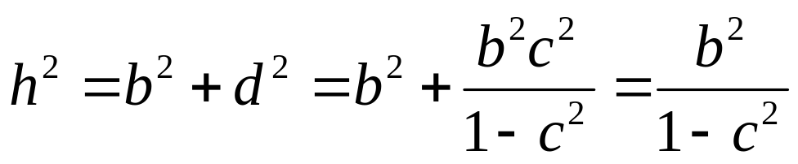
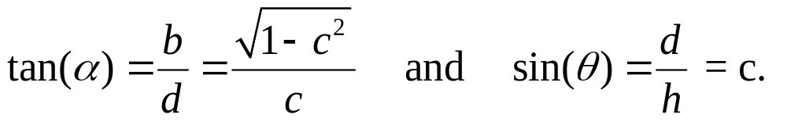
Being Curious:
a = x + d

Slide 8
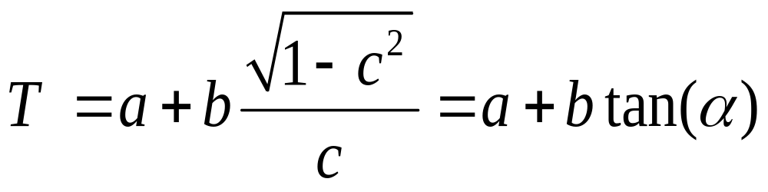
a = x + d
The optimal “angle of departure” α depends only on the speed ratio c.
If Elvis, by experience, has a good geometric intuition about his optimal angle of departure, then he will find the location of the optimal point X with reasonable precision.

Slide 9
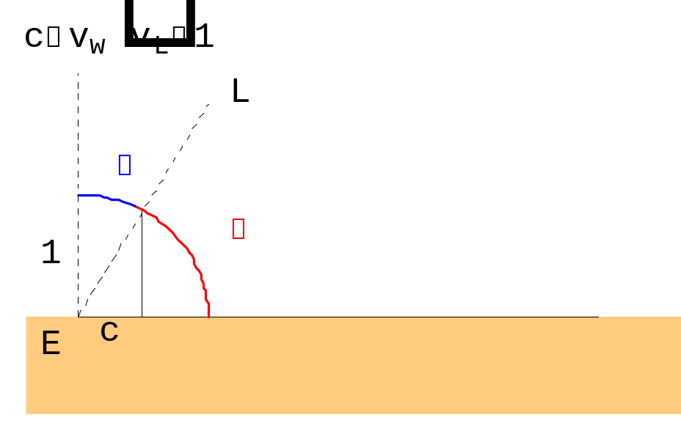
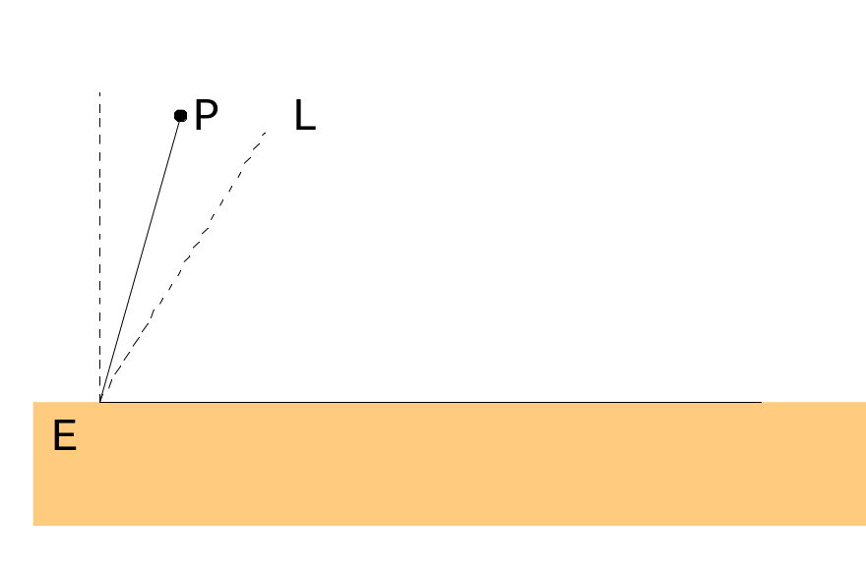
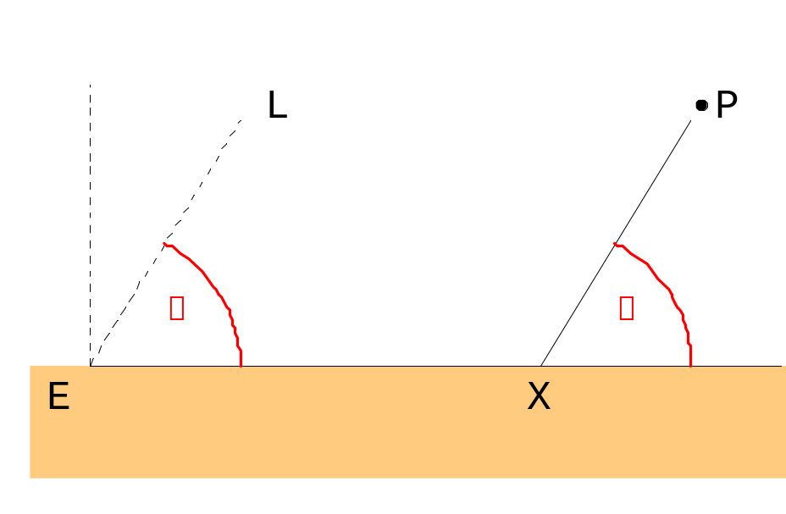
What Elvis does: the geometric solution.

Slide 10
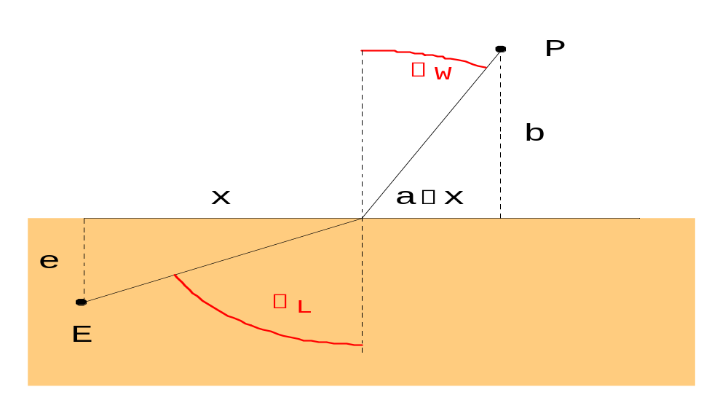
Willebrord van Roijen Snell: A source of light sits at a point E in air and wants to send a beam of light to a point P in a body of water that is separated from the air by a flat surface. Light knows that it has to take the path which is traversed in the least time Which path will the light beam take?

Slide 11
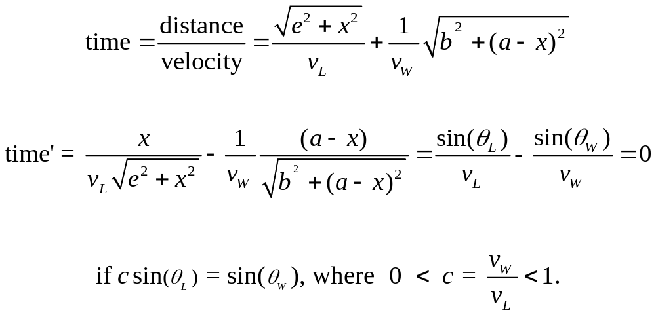

Slide 12
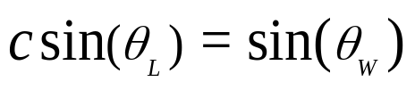
Snell’s Law of Optics:
If θ_{W} increases, so does θ_{L} until sin(θ_{L}) = 1 and sin(θ_{W}) = c. This “largest” angle θ_{W} of Snell’s law coincides with the critical angle θ that is used by Elvis to fetch the ball.

Slide 13
Distance according to Elvis. Elvis is a strong dog. His main objective is to take the path of minimal time in order to get to the ball as quickly as possible. Elvis does not care about the distance he travels; for him the distance d(E,P) between E and P is the optimal time needed to go from E to P; i.e.,
d(E, P) : = the Elvis distance between E and P
: = optimal time T it takes to get from E to P.
If M is the two-dimensional plane consisting of land (lower half plane) and water (upper half plane), then the Elvis distance defines a metric on M; i.e., for all points E,S,P in the plane we have that
d(E,P) ≥ 0, d(E,P) = d(P,E), and d(E,P) ≤ d(E,S) + d(S,E).

Slide 14
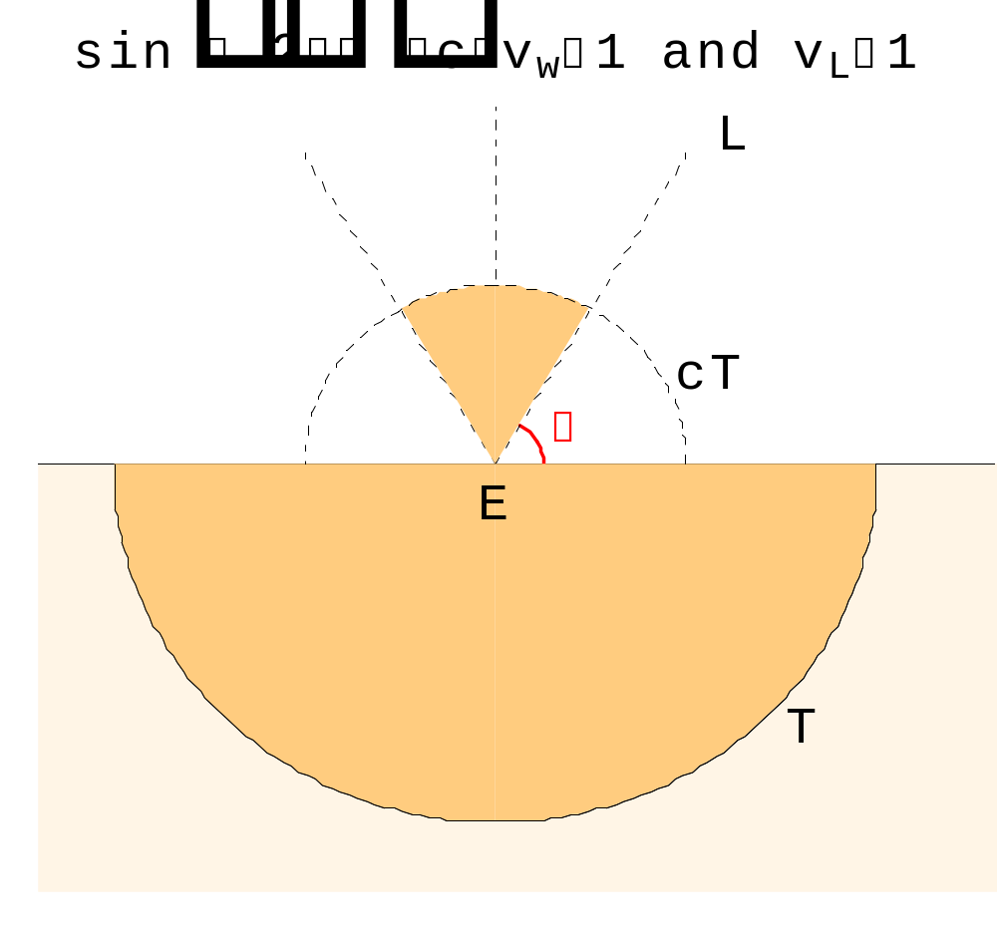
always: c = 1
Elvis-circles of radius T around E.
Elvis-on-the-beach-circle, Part 1

Slide 15
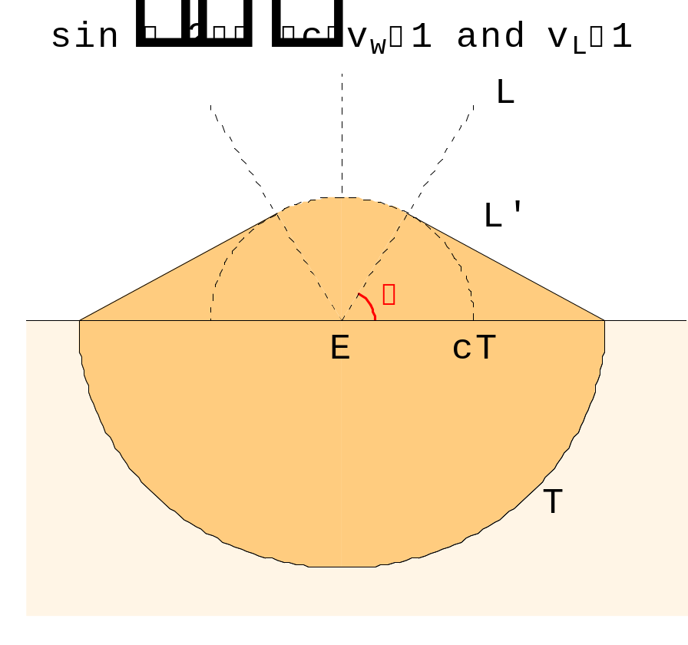
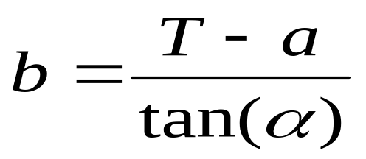
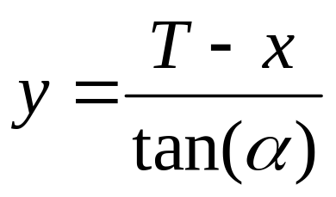
always: c = 1
Elvis-circles of radius T around E.
Elvis-on-the-beach-circle, Part 2

Slide 16
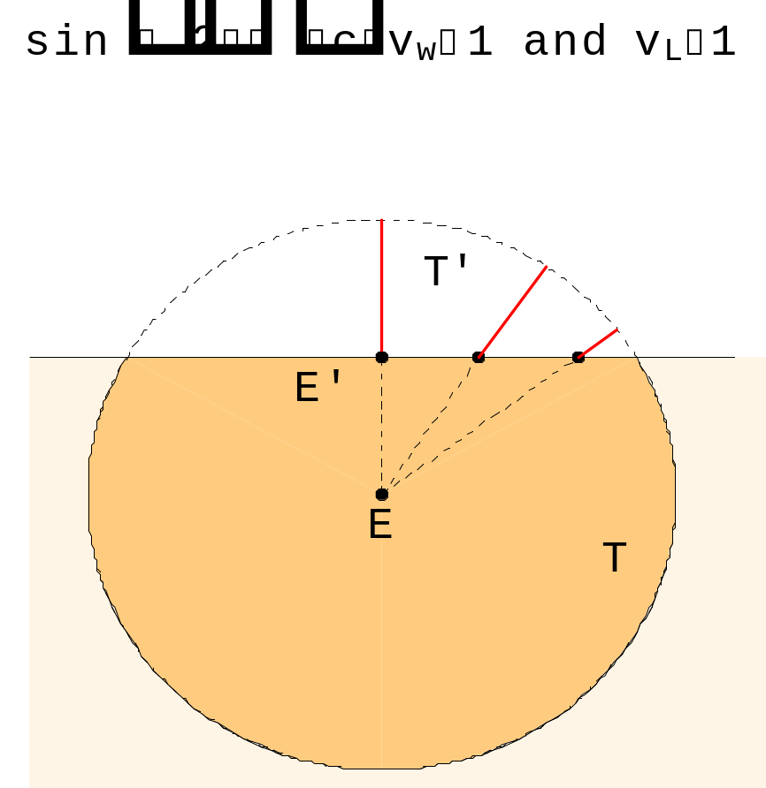
always: c = 1
Elvis-circles of radius T around E.
length of red lines = T’ = time left when reaching E’
Elvis-inland-circle, Part 1

Slide 17
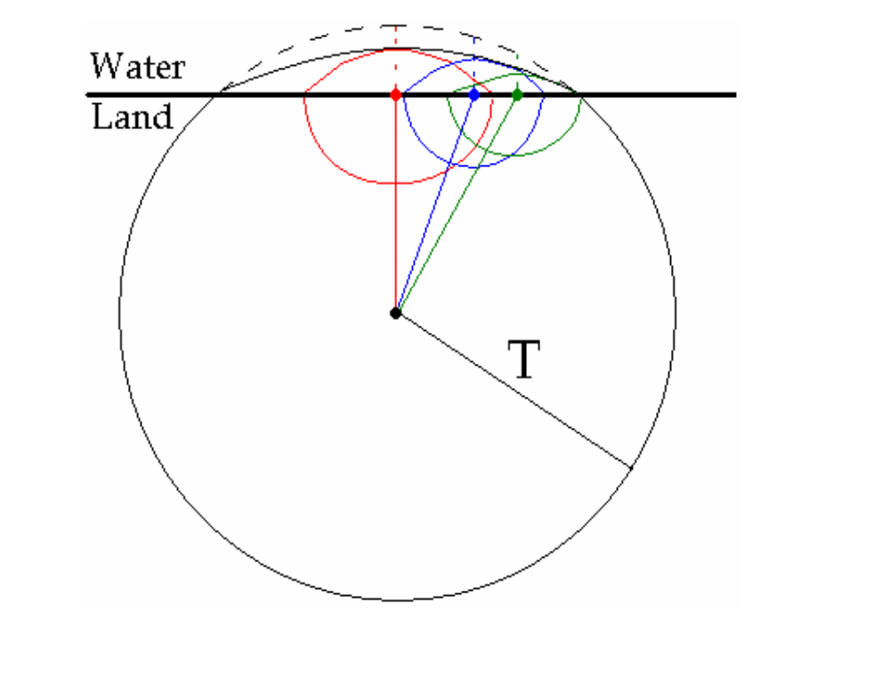
always: c = 1
Elvis-circles of radius T around E.
Elvis-inland-circle, Part 2

Slide 18
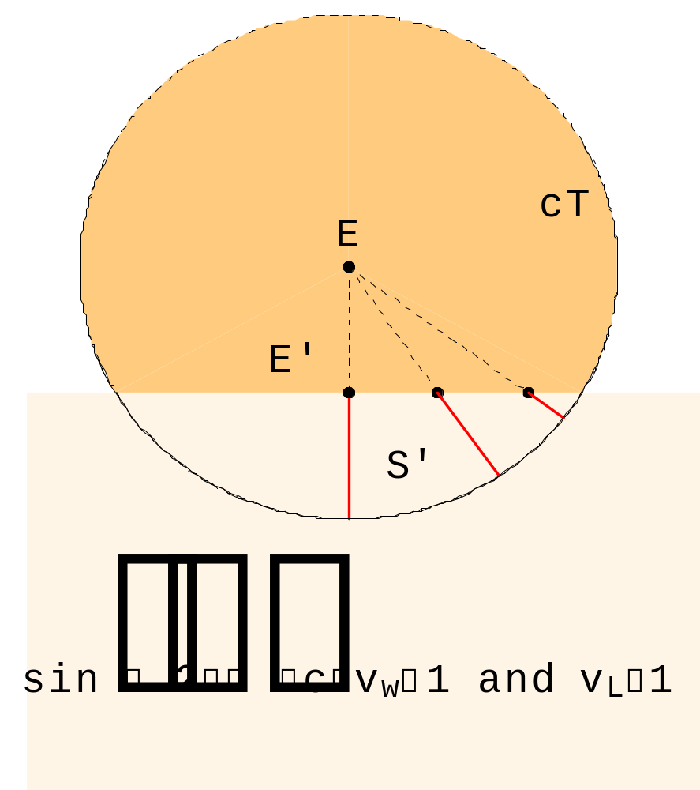
always: c = 1
Elvis-circles of radius T around E.
length of red lines = S’ = water-time left when reaching E’
= T’ land-time, where T’ = S’/c
Elvis-in-water-circle, Part 1

Slide 19
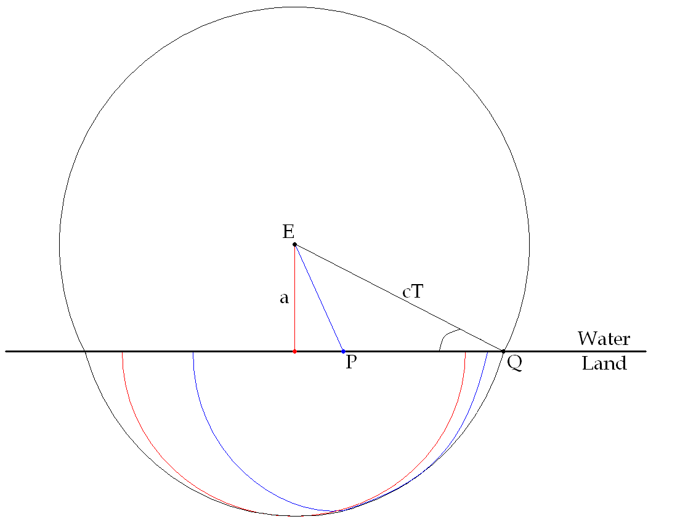
always: c = 1
Elvis-circles of radius T around E.
length of red lines = S’ = water-time left when reaching E’
= T’ land-time, where T’ = S’/c
(A): the line from E to Q intersects the shoreline with an angle larger than the critical angle α
Elvis-in-water-circle, Part 2a

Slide 20
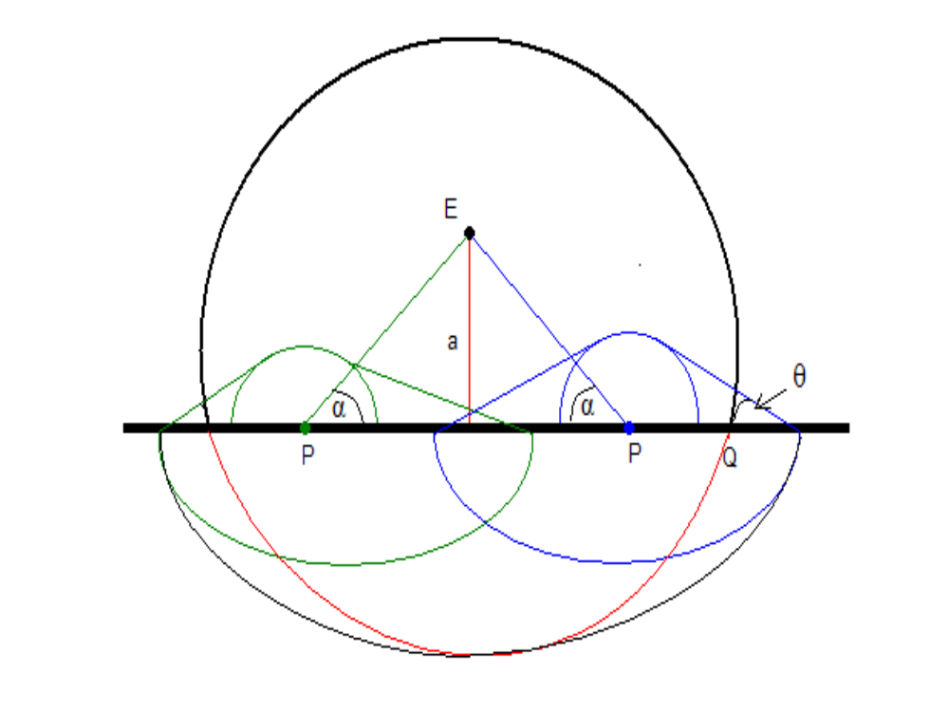
always: c = 1
Elvis-circles of radius T around E.
length of red lines = S’ = water-time left when reaching E’
= T’ land-time, where T’ = S’/c
(A): the line from E to Q intersects the shoreline with an angle less than the critical angle α
Elvis-in-water-circle, Part 2b

Slide 21
Extending the Results.
Study distance, according to Elvis, for the following cases:
the shoreline is not a straight line,
a 2-d plane (or 3-d space) is subdivided in disjoint regions, each region involving a different rate of speed,
…….. think about it, tinker with it……

