Slide 1
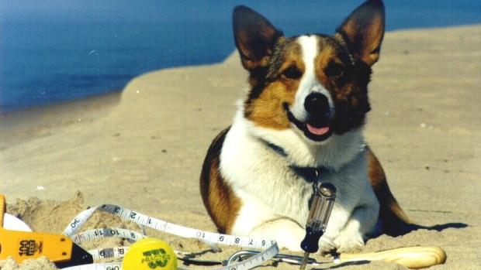
Do Dogs Know Calculus?
Team Elvis

Slide 2
Team Member
Amy Adair
Austin Baroni
Darnelle Cuyler
Konner Kite
Kaijun Ye
Instructor: Ameziane Harhad

Slide 3
Goal:
Find the optimized path for Elvis to reach the ball in different isotropic mediums
Discover contour map for Elvis’s path when traveling time is set
Solve the path and contour when Elvis is traveling in non-isotropic mediums
Produce GUI for all of the above

Slide 4
Project 1
Elvis traveling from the edge of the beach into the Sea

Slide 5
Calculation:

Slide 6
Contour and GUI:

Slide 7
Project 2
Elvis traveling from the beach into the sea

Slide 8
Calculation:

Slide 9
Contour and GUI

Slide 10
Most recent progress:
The group is currently working on non-isotropic mediums

