Slide 1



Affinity Alloc: Taming Not-So Near-Data Computing
Zhengrong Wang¹, Christopher Liu¹, Nathan Beckmann², Tony Nowatzki¹
¹UCLA, ²CMU
October. 2023

Slide 2
Conventional Computing
sum(A[i])
Bank
Bank
Bank
Bank
Bank
Bank
A[0]
A[1]
A[2]
A[3]
A[4]
A[5]
A[6]
A[7]
A[8]
A[9]
A[10]
A[11]
Core +
Cache
Core +
Cache
Core +
Cache
Core +
Cache

Slide 3
Near-Data Computing
sum(A[i])
Bank
Bank
Bank
Bank
Bank
Bank
A[0]
A[1]
A[2]
A[3]
A[4]
A[5]
A[6]
A[7]
A[8]
A[9]
A[10]
A[11]
Core +
Cache
Core +
Cache
Core +
Cache
Core +
Cache

Slide 4
Not-so Near-Data Computing
sum(A[i]*B[i])
Bank
Bank
Bank
Bank
Bank
Bank
B[6]
B[7]
B[8]
B[9]
B[10]
B[11]
B[0]
B[1]
B[2]
B[3]
B[4]
B[5]
A[0]
A[1]
A[2]
A[3]
A[4]
A[5]
A[6]
A[7]
A[8]
A[9]
A[10]
A[11]
Core +
Cache
Core +
Cache
Core +
Cache
Core +
Cache

Slide 5
Not-so Near-Data Computing
Tree Traversal
Bank
Bank
Bank
Bank
Bank
Bank
3
8
2
9
5
11
6
10
1
7
0
9
Core +
Cache
Core +
Cache
Core +
Cache
Core +
Cache

Slide 6
Prior Works
Core
SRAM
NoC
DRAM/HMC
SSD
Multi-Level
Manual data placement/
Limited layout optimization to certain domain & granularity.
Summarizer
Neurocube
Neuro-Stream
Sci-Cmp
ReRAM
MViD
Active
Mem Cube
GPU-PIM
RecNMP
SISA
TOM
GraphPIM
UPMEM
GraphSSD
DUAL
FANS
MLIMP
SimplePIM
Tesseract
Byungchul
Hong et al.
Ambit
Neural Cache
FloatPIM
GenASM
TRiM
GearBox
Infinity Stream
CDCS
Mondrian
GraphiDe
SnackNoC
Fafnir
MeNDA
…
’15
’16
’17
’18
’19
’20
’21
’22
’23
EM2
EMC
ND SIMD
GraFBoost
SSP
LIVIA
Stream
Floating
Dist-DA
ABNDP¹
PIM-
Enable Inst
IMPICA
Xulong
Tang et al.
Omni-Cmp
NSC
Oblivious to data layout
-> Abort NDC or suboptimal performance when little locality.
SCU
NDC
Compiler
To PIM
or Not
Compute
Cache
Duality
Cache
ASSASIN
CoNDA
Active
Routing
¹With DRAM-based cache to capture locality.

Slide 7
Goal: Automatic Data Affinity Optimization
From various data structures…
To automatic optimized layout in μArch
Key Insight:
All data structures have affinity relationships
This information is independent of hardware
Relationships are available at allocation time
Approach: Expose affinity info to allocator.

Slide 8

Affinity Alloc: Taming Not-So Near-Data Computing
Clean: Each Layer exposes minimal interface.
End-to-end: data affinity optimization.
General: Regular & Irregular data structures.
Unlock data structure co-optimization.
$2.26×$ speedup with $72\%$ traffic reduction.
Core
L1
L2
Near
LLC
Shared L3 Bank
Router

Slide 9
Roadmap
Affine Data Layout
Irregular Data Layout
Data Structure Codesign
Evaluation

Slide 10
Roadmap
Affine Data Layout
Irregular Data Layout
Data Structure Codesign
Evaluation

Slide 11
Inter-Array Affine Affinity
C[i] = A[i] + B[i];
double
float
float
float A[8]
0 | 1 | 2 | 3 | 4 | 5 | 6 | 7
float B[8]
“Align to”
in alloc
interface
0 | 1 | 2 | 3 | 4 | 5 | 6 | 7
double C[8]
0 | 1 | 2 | 3 | 4 | 5 | 6 | 7
Same support required for strided access.

Slide 12
Intra-Array Affine Affinity
B[i,j] = A[i,j] + A[i+1,j]
A
Row Length=N
0 | 1 | 2 | …
N+0 | N+1 | N+2 | …
… | … | … | …
“self align”
B
0 | 1 | 2 | …
N+0 | N+1 | N+2 | …
… | … | … | …
“Align to”

Slide 13

Affinity Alloc Interface for Affine Data Layout
Interface exposes affine layout transformation:
$$B\left[i\right]→A\left[\frac{P}{Q}×i+X\right]$$
Affine affinity alloc API:
struct AffineArray {
int elem_size; // Element size (byte).
uint num_elem; // Number of elements.
void* A; // Pointer to the aligned affine array.
int P, Q; // Interleaving Ratio
int X; // Interleaving Offset
…
};
void* malloc_aff(const AffineArray& a);
These parameters are independent of microarchitecture!
Notes:
bool partition; // Partition the array across banks.

Slide 14
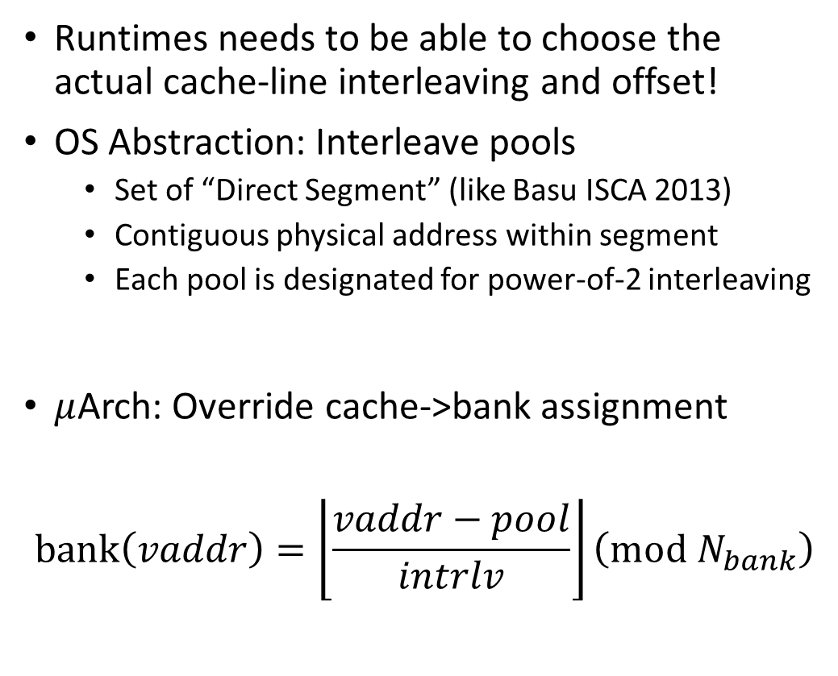

Mapping Virtual Addr. $→$ LLC Banks
Runtimes needs to be able to choose the actual cache-line interleaving and offset!
OS Abstraction: Interleave pools
Set of “Direct Segment” (like Basu ISCA 2013)
Contiguous physical address within segment
Each pool is designated for power-of-2 interleaving
$μ$Arch: Override cache->bank assignment
$$bank\left(vaddr\right)=\left\lfloor \frac{vaddr−pool}{intrlv}\right\rfloor \left(mod N_{bank}\right)$$
Notes:
Expand and shrink

Slide 15

Mapping Virtual Addr. $→$ LLC Banks
OS: Manage interleave pools.
$μ$Arch: Obeys interleaving of each pool.
Application: Specify affinity relationships.
Runtime: Choose and allocate to interleave pools.

Slide 16
Roadmap
Affine Data Layout
Irregular Data Layout
Data Structure Codesign
Evaluation

Slide 17

Irregular Data Layout
Specify a list of irregular affinity addresses.
Example: Linked list.
Random long pointer-chasing distance.
Affinity: Newly node $→$ previous node.
Reduce the pointer-chasing distance.
Load balancing:
Combine average hops and load at banks.
$$score=hops+H×\left(\frac{load}{avg_{load}}−1\right)$$
Improve bank-level parallelism.
No OS/microarchitecture overheads!

Slide 18
Roadmap
Affine Data Layout
Irregular Data Layout
Data Structure Codesign
Evaluation

Slide 19
Data Structure Codesign: Linked-CSR Format
Original CSR uses array to store edges – inflexible for data placement.
Linked CSR replaces the edge array with linked list.
Each linked list node can be placed closer to outgoing vertices.
Traditional CSR
Index
0
3
4
6
8
0
2
Edge
1
2
3
0
0
3
0
2
1
3
To Vertex Properties
Linked
CSR (ours)
Pointer
Edge
1
2
3
0
0
3
0
2
To Vertex Properties

Slide 20
Data Layout Example: CSR Graph Traversal
Notes:
In Naïve NDC, edges can be placed far away from the pointed vertices.

Slide 21
Roadmap
Affine Data Layout
Irregular Data Layout
Data Structure Codesign
Evaluation

Slide 22
Methodology
LLVM-based Compiler
Gem5 20.0 cycle-level execution-driven simulator.
10 data processing workloads from Rodinia, Gap Graph Suite and micro kernels.
Parallelized with OpenMP, with AVX-512 enabled.
Configurations (see paper for details):
64 Cores, 8x8 mesh topology, 3-level MESI
Cache Hierarchy: 32kB L1 I/D, 256kB L2, 1MB L3.
Comparison Points
In-Core: No near-data (Bingo spatial prefetcher [HPCA2019] at L1 + stride prefetcher at L2.)
Near-L3: Near-stream Computing [HPCA ’22].
Aff-Alloc: This Work

Slide 23
Overall Performance and Energy Efficiency
Notes:
2.26x speedup and 1.76x energy efficiency over Near-L3.

Slide 24
Network Traffic
Affine Workloads
Less data traffic for aligned arrays
Graph Processing
Less indirect traffic
Pointer-based Data Structures
Less pointer-chasing distance
Offload
Data
Control
Notes:
Overall 72% traffic reduction over near-L3

Slide 25
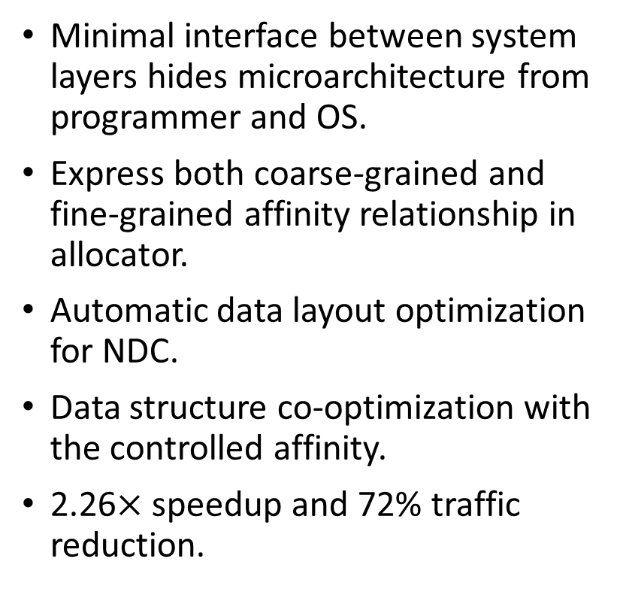
Affinity Alloc: Not-So Truly Near-Data Computing
Minimal interface between system layers hides microarchitecture from programmer and OS.
Express both coarse-grained and fine-grained affinity relationship in allocator.
Automatic data layout optimization for NDC.
Data structure co-optimization with the controlled affinity.
2.26$×$ speedup and 72% traffic reduction.

