Slide 1


Near-Stream Computing: General and Transparent Near-Cache Acceleration
Zhengrong Wang, Jian Weng, Sihao Liu, Tony Nowatzki
UCLA
April. 2022

Slide 2
Near-Data Computing to Decentralize Computation
while (i < N)
C[i] = A[i] + B[i]
i++
Data movement become increasingly the bottleneck.
Computation centralized in the core.
More expensive to fetch data as system scales up.
Prefetching/streaming can only partially help.
Requesting Core
Remote L3 Cache

Slide 3
Near-Data Computing to Decentralize Computation
while (i < N)
C[i] = A[i] + B[i]
i++
Data movement become increasingly the bottleneck.
Computation centralized in the core.
More expensive to fetch data as system scales up.
Prefetching/streaming can only partially help.
Near-data computing decentralizes the computation.
Location: memory, storage, LLC (Our Focus), …
Technology: in-situ, inorder cores, FPGA, …
Existing NDC works fall short to fully cover:
Transparency.
Synchronization-Efficiency.
Generality.
… due to inappropriate abstraction choice:
Instructions, user-defined functions, threads, …
Requesting Core
T
E
G
Remote L3 Cache

Slide 4
Features of An Ideal NDC Abstraction
Transparency.
No manual programming, auto-transformation, sequential semantics.
Synchronization-Efficiency.
Low traffic (hops) to synchronize core and offloaded NDC, alias detection.
Generality.
Arbitrary combination of memory access pattern and compute operation.
T
E
G

Slide 5
Existing NDC Abstractions
Thread-Level NDC: Offload the entire thread context.
Examples: TOM [ISCA ’16], AMS [MICRO ’18], …
☑ Transparency.
☑ Synchronization-Efficiency.
☒ Generality: Works best with single data structure.
Inst-Level NDC: Offload short instruction sequences.
Examples: PIM-Enabled Inst [ISCA ’15], Omni-Compute [ISCA ’19], …
☑ Transparency.
☒ Synchronization-Efficiency: At least one request per operation.
☑ Generality.
User-Defined Function NDC: Offload user-defined operation.
Examples: Active Routing [HPCA ’19], Livia [ASPLOS ’20], …
☒ Transparency: Requires manually programming.
☑ Synchronization-Efficiency.
☑ Generality: Depends on the implementation.
T
E
G
T
E
G
T
E
G

Slide 6
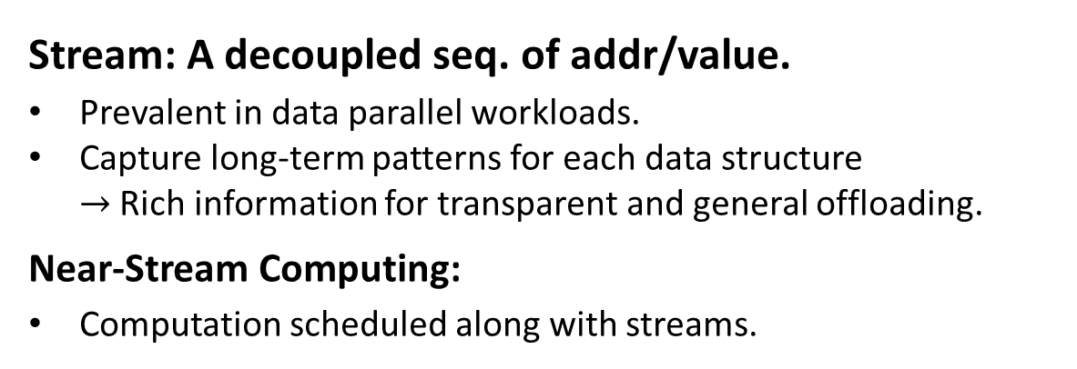
Streams: New Abstraction with Near-Data Comp.
Stream: A decoupled seq. of addr/value.
Prevalent in data parallel workloads.
Capture long-term patterns for each data structure $→$ Rich information for transparent and general offloading.
Near-Stream Computing:
Computation scheduled along with streams.
while (i < N)
C[i] = A[i] + B[i]
i++
C[i]
A[i]
B[i]

Slide 7
Streams: New Abstraction with Near-Data Comp.
Stream: A decoupled seq. of addr/value.
Prevalent in data parallel workloads.
Capture long-term patterns for each data structure $→$ Rich information for transparent and general offloading.
Near-Stream Computing:
Computation scheduled along with streams.
while (i < N)
C[i] = A[i] + B[i]
i++
A[i]
B[i]
+
C[i]

Slide 8
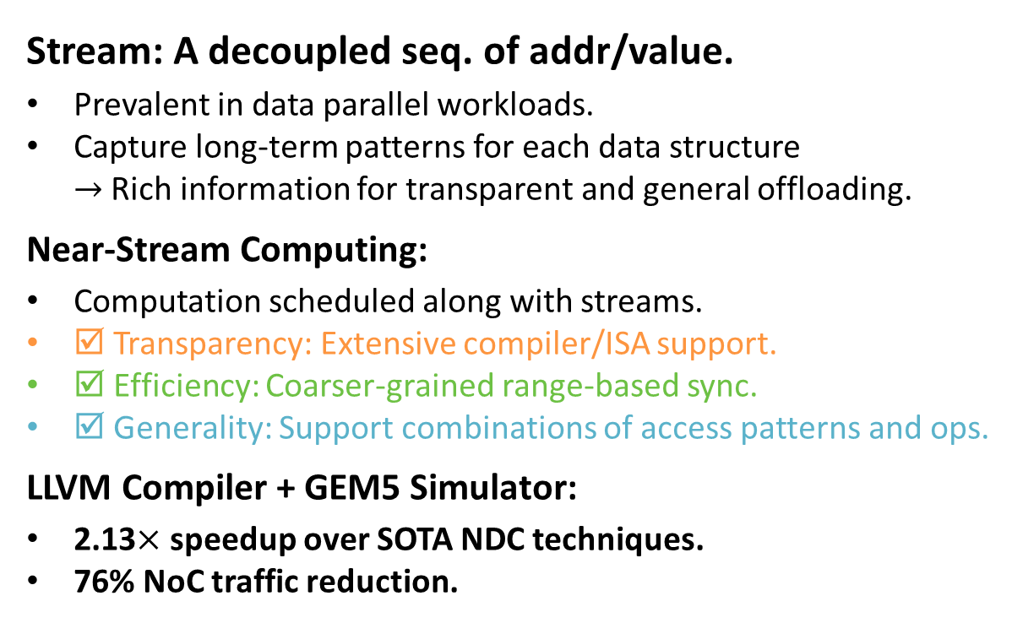
Streams: New Abstraction with Near-Data Comp.
Stream: A decoupled seq. of addr/value.
Prevalent in data parallel workloads.
Capture long-term patterns for each data structure $→$ Rich information for transparent and general offloading.
Near-Stream Computing:
Computation scheduled along with streams.
☑ Transparency: Extensive compiler/ISA support.
☑ Efficiency: Coarser-grained range-based sync.
☑ Generality: Support combinations of access patterns and ops.
LLVM Compiler + GEM5 Simulator:
2.13$×$ speedup over SOTA NDC techniques.
76% NoC traffic reduction.
while (i < N)
C[i] = A[i] + B[i]
i++
A[i]
B[i]
+
C[i]

Slide 9
Outline
Problems and Insights
NDC Taxonomy and Opportunities
Near-Stream Computing Implementation
Evaluation

Slide 10








Taxonomy of General Near-Data Computation
Generality.
Address pattern + compute type.
Affine
Reduce
Multi-Op
Store
Indirect
RMW
Ptr-Chase
Load
$$A\left[i,j,…\right]$$
$$σf\left({}_{ }^{∗}A\right)$$
$$A\left[i\right],B\left[i\right],…$$
$${}_{ }^{∗}A=f()$$
$$A\left[…B\left[i\right]\right]$$
$${}_{ }^{∗}A=f({}_{ }^{∗}A)$$
$$A=A.next$$
$$=f\left({}_{ }^{∗}A\right)$$
// Sum Array.
while (i < N)
S += A[i]
i++
// Vector Add.
while (i < N)
C[i] = A[i] + B[i]
i++
// Indirect RMW.
while (i < N)
B[A[i]]++
i++
// Link-List Op.
while (A)
f(A->value)
A = A->next

Slide 11

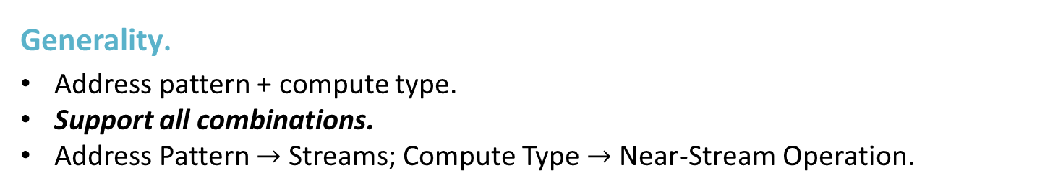







Taxonomy of General Near-Data Computation
Generality.
Address pattern + compute type.
Support all combinations.
Address Pattern $→$ Streams; Compute Type $→$ Near-Stream Operation.
Stream
Near-Stream Op
$$A\left[i,j,…\right]$$
$$σf\left({}_{ }^{∗}A\right)$$
$$A\left[i\right],B\left[i\right],…$$
$${}_{ }^{∗}A=f()$$
$$A\left[…B\left[i\right]\right]$$
$${}_{ }^{∗}A=f({}_{ }^{∗}A)$$
$$A=A.next$$
$$=f\left({}_{ }^{∗}A\right)$$

Slide 12
Conventional vs. Near-Stream Computing

Slide 13
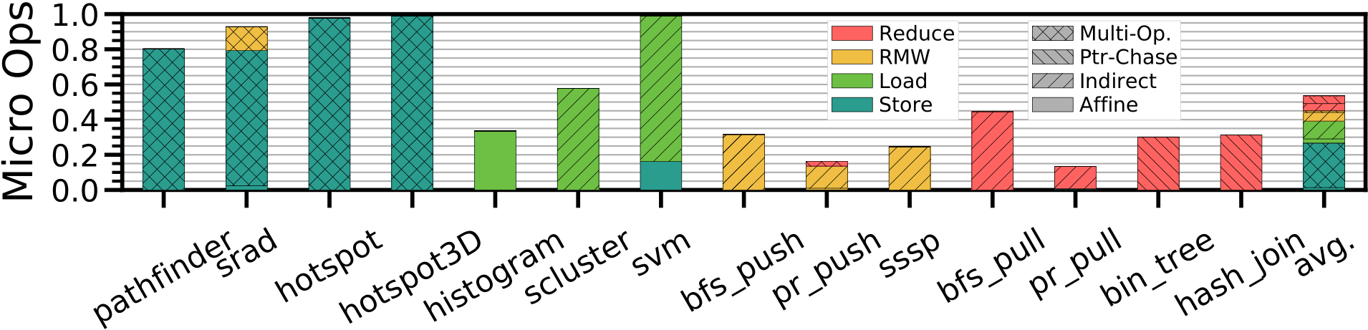
Breakdown of Near-Stream Computation
54% of dynamic micro-ops can be classified as near-stream computation.
Major NS Comp.
Multi-Op Store
Aff. Ld.
Ind. Ld.
Ind. RMW
Ind. Reduce
Ptr-Chase Reduce
Challenging to NDC:
Inst/User-Func.
Inst
Inst/Thread
Inst/Thread
Inst/Thread
Inst/Thread
Inst-level NDC:
always incurs high sync overheads.

Slide 14
Outline
Problems and Insights
NDC Taxonomy and Opportunities
Near-Stream Computing Implementation: How to …
Embed near-stream computing in the ISA?
Preserve sequential semantics?
Reduce coordination overheads?
Reuse hardware for computation?
When to offload computation?
…
Evaluation

Slide 15
Near-Stream Computing ISA Overview
Explicitly encode streams and compute dependencies in the ISA.
Compiler: Recognize streams and associated computation; Transform the program.
No manually programming required.
Original Pseudo Code
N-S Computing Pseudo Code
Stream Dep. Graph
(a) Vector Sum
s_cfg(s_{a}=A[i], s_{v}+=s_{a});
while (i < N)
s_step(i);
v = s_load(s_{v});
s_end(s_{v}, s_{a});
Config.
while (i < N)
v += A[i];
i++;
Semantically 1 load and 1 add.
Get final value.
The computation is outlined into a separate function, with the function pointer in the stream’s configuration.

Slide 16
How to Compute with Low Overheads?
Insight: There is already a core in the remote tile.
Stream Compute Context (SCC):
Light weighted thread context.
No LSQ entries + Limited ROB entries.
Looping over configured NSC functions.
Released when streams are terminated.
Reuse existing hardware units, e.g., decoder, vector units, …
SCC

Slide 17
Architectural Extensions
SE_{core}:
Mange stream configuration and offload streams.
Issue flow control credits and check for aliasing.
SCC
SE_{L3}:
Fetch and forward operands to the consuming stream.
Coordinated by SE_{core} for flow control and aliasing check.
Stream Computing Manager (SCM):
Configure and terminate the stream computing context (SCC) with the near-stream function.
Simple scalar ops handled by the ALU in SE_{core} and SE_{L3} Avoid frequently accessing SCC.

Slide 18
Range-Sync: Coarse-Grained Sync. w. Seq. Semantics
Challenges: Efficiently synchronize the core and offloaded streams.
Flow control scheme to avoid streams running too far ahead/behind.
Detect possible core-stream and inter-stream aliasing.
Provide sequential semantics for transparency and context switching.
S_{A}
Core
S_{B}
Offloaded Streams
S_{C}

Slide 19
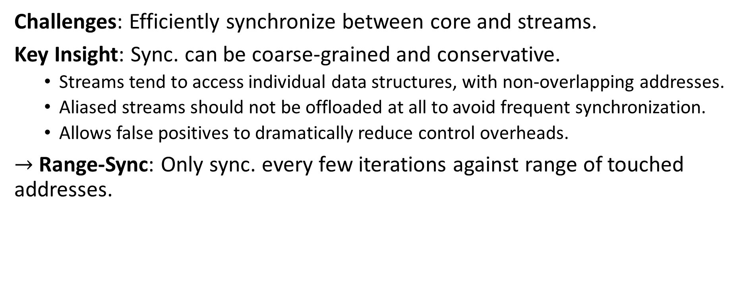
Range-Sync: Coarse-Grained Sync. w. Seq. Semantics
Challenges: Efficiently synchronize between core and streams.
Key Insight: Sync. can be coarse-grained and conservative.
Streams tend to access individual data structures, with non-overlapping addresses.
Aliased streams should not be offloaded at all to avoid frequent synchronization.
Allows false positives to dramatically reduce control overheads.
$→$ Range-Sync: Only sync. every few iterations against range of touched addresses.
S_{A}
Core
S_{B}
Offloaded Streams
S_{C}

Slide 20
Timeline of Range-Sync: Normal Case
L3 SE
Translate & access element [0, R).
Writeback & release states [0, R).
Key Takeaway:
Sync every R iterations.
Check alias against ranges.
Overheads: 4/R NoC msg. per affine element.
Credits [0, R)
Ranges [0, R)
Commits [0, R)
Done [0, R)
Core SE
Allocate credits [0,R).
Collect ranges.
Send commits [0,R).
Allocate more credits.
Ranges [0, R)
Committed [0, R)
Core
Pipelined to
hide latency.
Check alias in ranges. Commit iteration [0,R).

Slide 21
Timeline of Range-Sync: Alias/Context Switch in Core
L3 SE
Translate & access element [0, R).
Writeback & release states [0, M). End.
Key Takeaway:
Execution continues at iteration M with streams in core.
Still provide precise states.
Credits [0, R)
Ranges [0, R)
Commits [0, M) & End
Done [0, M)
Core SE
Allocate credits [0,R).
Collect ranges.
Send commits [0,M).
Continue stream in core.
Ranges [0, R)
Committed [0, M)
Core
Pipelined to
hide latency.
Alias/context switch at iteration M (M < R).

Slide 22
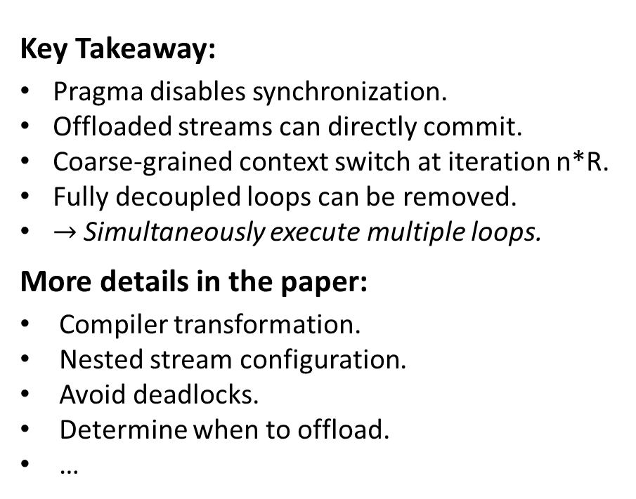
Sync-Free Optimized NSC
Key Takeaway:
Pragma disables synchronization.
Offloaded streams can directly commit.
Coarse-grained context switch at iteration n*R.
Fully decoupled loops can be removed.
$→$ Simultaneously execute multiple loops.
More details in the paper:
Compiler transformation.
Nested stream configuration.
Avoid deadlocks.
Determine when to offload.
…
Access & writeback element [0, R).
Access & writeback element [0, R).
L3 SE
Access & writeback element [0, R).
Credits [0, R)
Done [0, R)
Core SE
Allocate credits [0,R).
Allocate more credits.
Core
Pipelined to
hide latency.

Slide 23
Outline
Problems and Insights
NDC Taxonomy and Opportunities
Near-Stream Computing Implementation
Evaluation

Slide 24
Configurations
LLVM-based compiler to recognize streams and transform programs.
Gem5 20.0 cycle-level execution-driven simulator.
14 data processing workloads from Rodinia and Gap Graph Suite.
Parallelized with OpenMP, with AVX-512 enabled.
Configurations (see paper for details):
8x8 mesh topology, 3-level MESI, 32kB L1 I/D, 256kB L2, 1MB L3.
Base: Baseline cores with L1/L2 prefetchers. No stream support.
Inst-Level NDC (INST): Computation is offloaded at instruction level to LLC.
User-Def Func. NDC (UDF): Single operand UDF is offloaded at loop level.
NS_{core}: Use SE_{core} as a prefetcher at the core [ISCA ’19].
NS_{no comp}: Streams are offloaded to LLC, but no computation [HPCA ’21].
NS: Near-stream computations offloaded to LLC, with range-sync [this work].
NS_{no sync}/NS_{decouple}: Disable range-sync and fully decouple loops [this work].
Resembles SOTA NDC:
Omni-Compute [ISCA ’19]
Livia [ASPLOS ’20]

Slide 25
Overall Speedup with OOO8
NS achieves 1.85x speedup over INST. (2.12x for NS_{decouple} over UDF).
Range-sync incurs low overheads as NS is only 8% slower than NS_{no sync}.
27.7
38.1
36.1

Slide 26
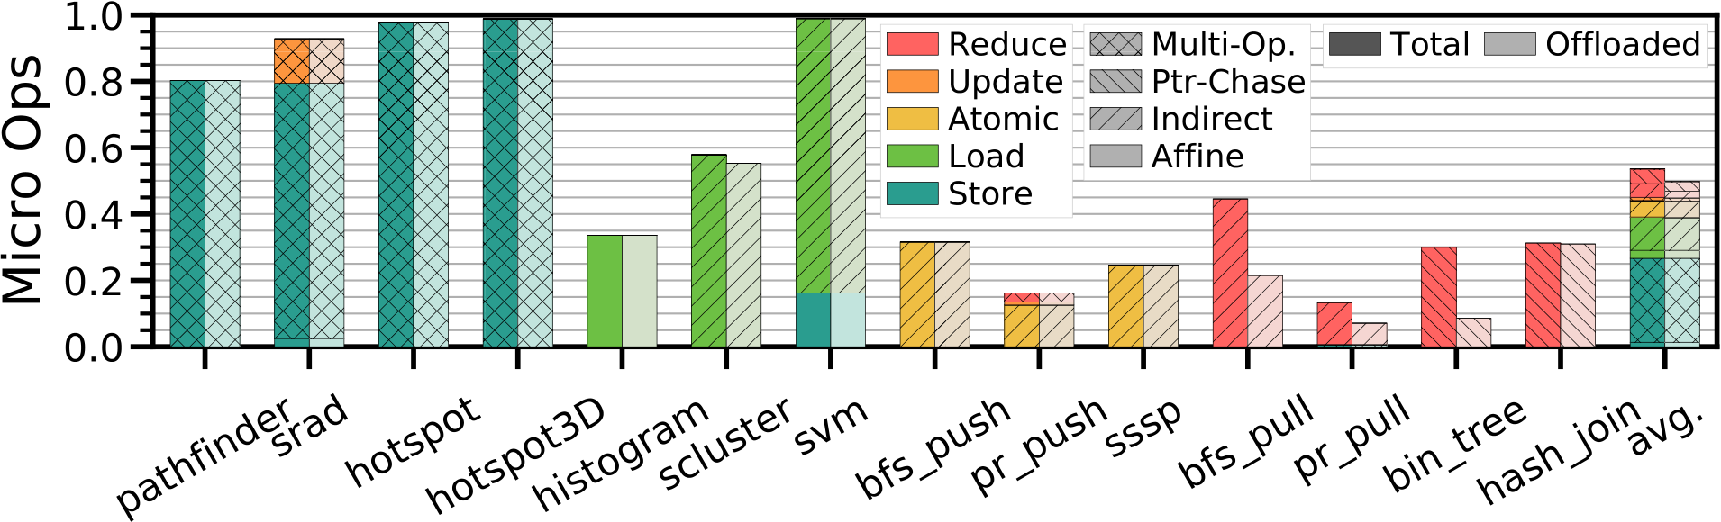
Dynamic Micro Ops Breakdown
Generality: NSC captures 54% of dynamic micro-ops.
93% of possible ops are offloaded.

Slide 27
NoC Traffic Breakdown
INST and UDF reduces NoC traffic by 50% and 40% respectively.
NS reduces NoC traffic by 69% (76% by NS_{decouple}).
NS offloads at stream granularity and incurs low overheads using range-sync.
NDC
Data
Control

Slide 28
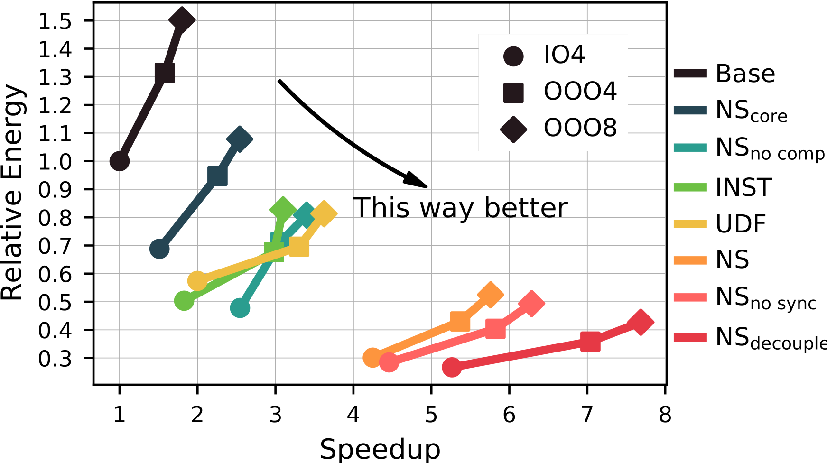

Energy vs. Speedup
NS and NS_{decouple} achieves 2.85$×$/3.52$×$ energy efficiency over OOO8.
Both small inorder cores and large OOO cores benefit from NSC.

Slide 29
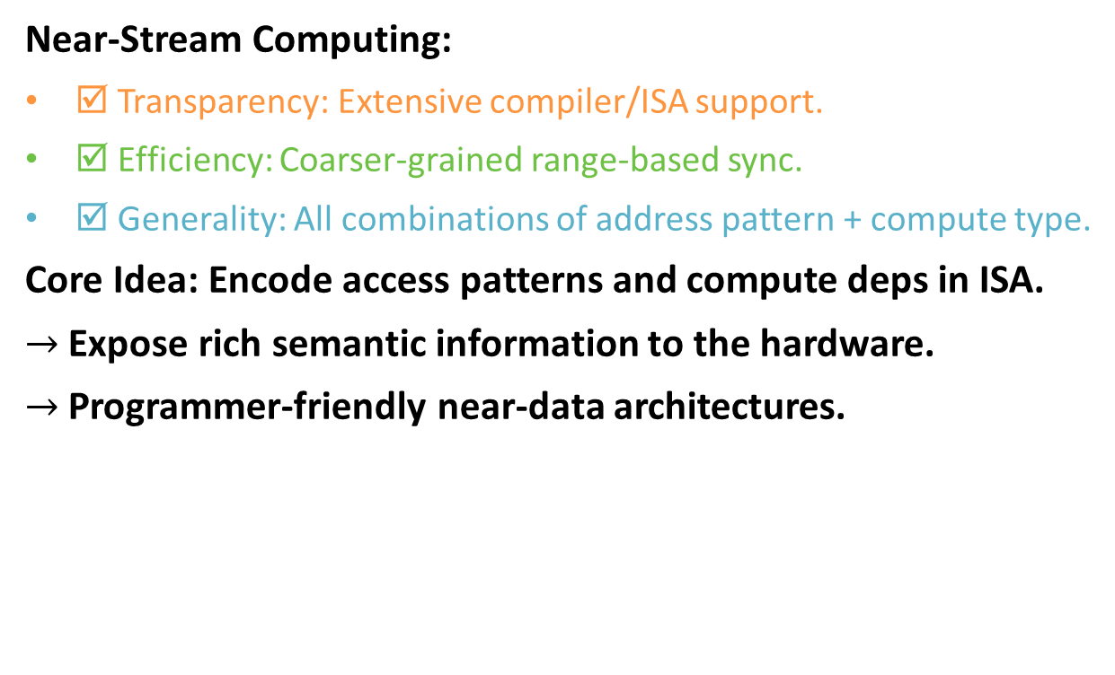
Conclusion
Near-Stream Computing:
☑ Transparency: Extensive compiler/ISA support.
☑ Efficiency: Coarser-grained range-based sync.
☑ Generality: All combinations of address pattern + compute type.
Core Idea: Encode access patterns and compute deps in ISA.
$→$ Expose rich semantic information to the hardware.
$→$ Programmer-friendly near-data architectures.
T
E
G

