Slide 1




Stream Floating: Enabling Proactive and Decentralized Cache Optimizations
Zhengrong Wang¹, Jian Weng¹, Jason Lowe-Power²,
Jayesh Gaur³, Tony Nowatzki¹
¹UCLA, ²UC Davis, ³Intel
Feb. 2021

Slide 2
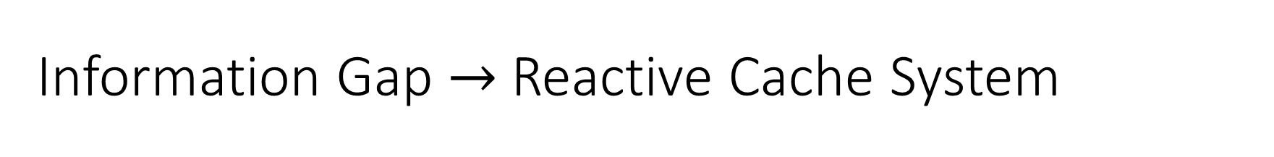
Information Gap $→$ Reactive Cache System
Reactive Cache System:
72% cached lines without reuse.
Up to 30% extra control NoC traffic.
Missing holistic view of the program behavior.
Notes:
Cache system has been dealing with the information gap for decades.
It has taken many approaches to solve this problem: prefetchers, reuse policy.
Von-Neumann
Specialization has been a huge success for computation. This can also been applied to memory.

Slide 3
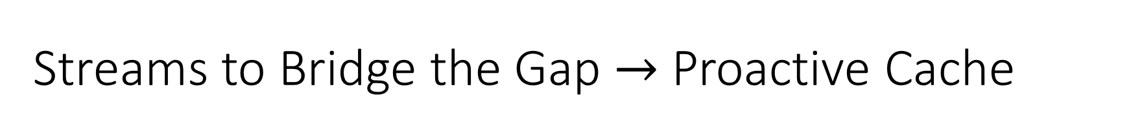
Streams to Bridge the Gap $→$ Proactive Cache
Proactive Cache System:
Driven by streams, proactively transfer.
Notes:
Cache system has been dealing with the information gap for decades.
It has taken many approaches to solve this problem: prefetchers, reuse policy.
Von-Neumann
Specialization has been a huge success for computation. This can also been applied to memory.

Slide 4
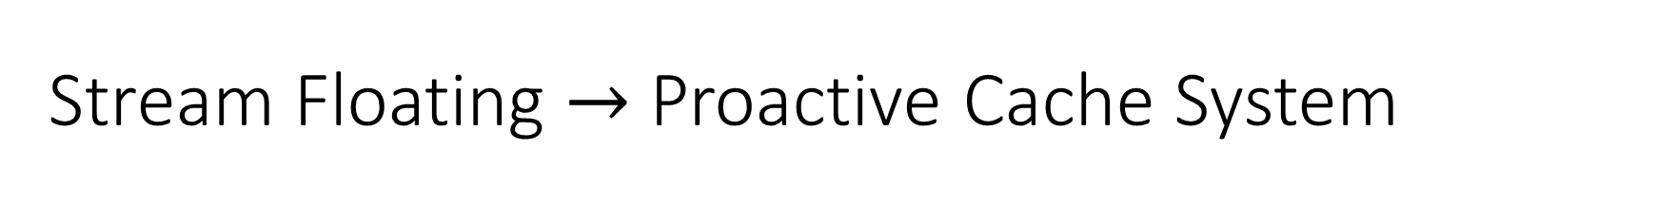
Stream Floating $→$ Proactive Cache System

Slide 5
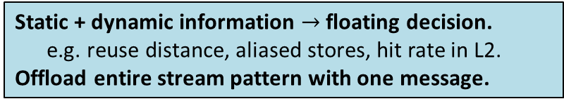
Stream Floating Implementation
Original C Code
int i = 0;
while (i < N) {
sum += B[A[i]];
i++;
}
Stream Pseudo-Code
stream_cfg(B[A[]]);
while (i < N) {
sum += stream_ld();
stream_step();
}
Static + dynamic information $→$ floating decision.
e.g. reuse distance, aliased stores, hit rate in L2.
Offload entire stream pattern with one message.
Configure
Usage
Proactively transfer stream data.
Stream data is not cached (bypass coherence).
Extend MESI with GetUncached request.
Advance
Automatically migrate to next bank.
Keep streaming until no credits.
Released by StreamEnd message.
Weak consistency w. aliasing detection.
Strong consistency is also possible.
w. stream-grain coherence.
Indirect requests from remote SE_{L3}.
Decentralized address generation.

Slide 6
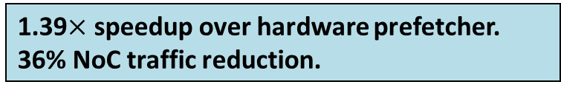
NoC Traffic Breakdown
Baseline: No HW prefetcher or stream support.
L1BG-L2ST: L1 Bingo spatial + L2 stride prefetcher.
SF-X: Stream-floating with each optimization enabled.
1.42
2.49
1.79
1.33
Stream
Data
Control
1.39$×$ speedup over hardware prefetcher.
36% NoC traffic reduction.

Slide 7
Conclusion: Streams Enables Proactive Cache
Proactive Cache System:
Driven by streams, proactively transfer.
Explore rich ISA semantics in the cache system.

Slide 8
Stream Floating: Enabling Proactive and Decentralized Cache Optimizations
Zhengrong Wang¹, Jian Weng¹, Jason Lowe-Power²,
Jayesh Gaur³, Tony Nowatzki¹
¹UCLA, ²UC Davis, ³Intel
Feb. 2021

Slide 9
Information Gap $→$ Reactive Cache System
Reactive Cache System:
72% cached lines without reuse.
Up to 30% extra control NoC traffic.
Missing holistic view of the program behavior.
Notes:
Cache system has been dealing with the information gap for decades.
It has taken many approaches to solve this problem: prefetchers, reuse policy.
Von-Neumann
Specialization has been a huge success for computation. This can also been applied to memory.

Slide 10
Streams to Bridge the Gap $→$ Proactive Cache
Proactive Cache System:
Driven by streams, proactively transfer.
Notes:
Cache system has been dealing with the information gap for decades.
It has taken many approaches to solve this problem: prefetchers, reuse policy.
Von-Neumann
Specialization has been a huge success for computation. This can also been applied to memory.

Slide 11
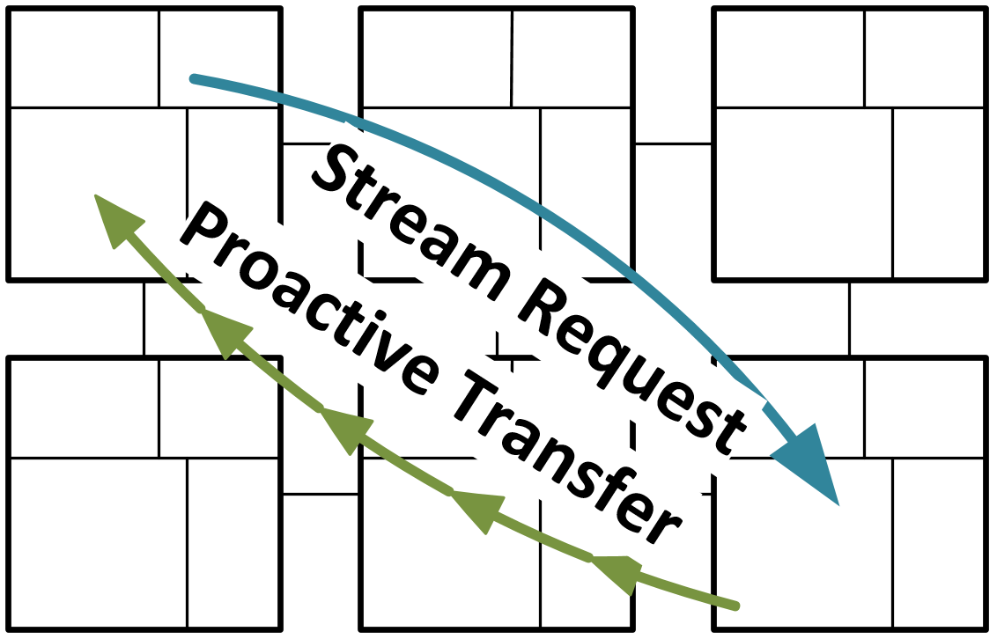
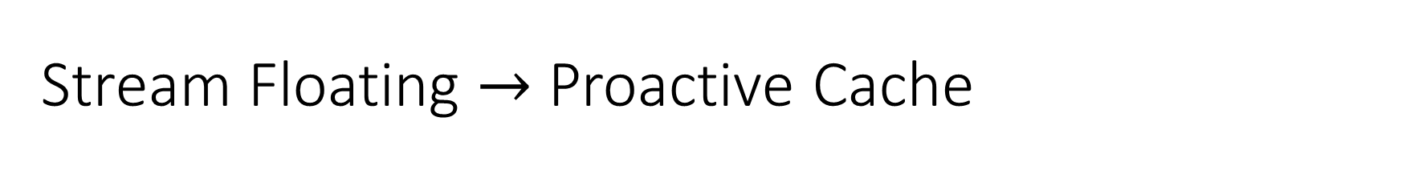
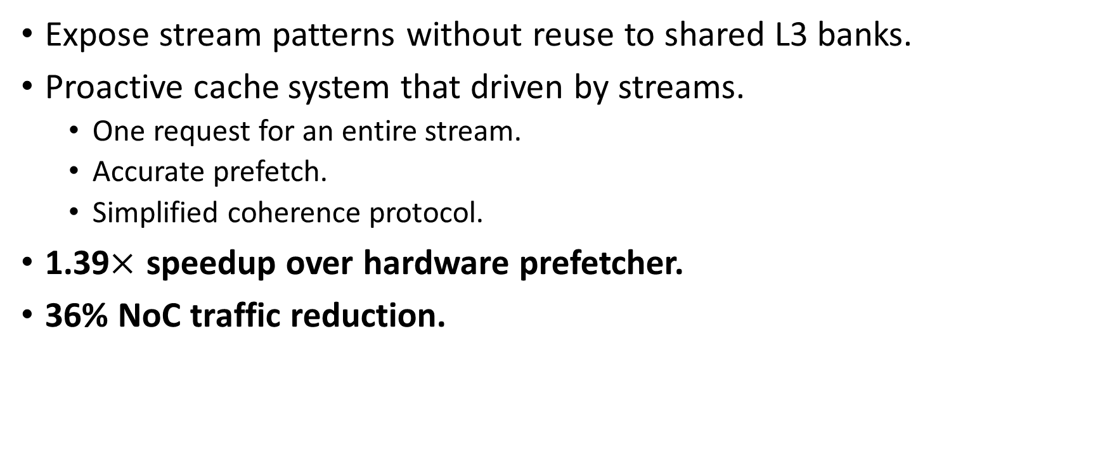
Stream Floating $→$ Proactive Cache
Expose stream patterns without reuse to shared L3 banks.
Proactive cache system that driven by streams.
One request for an entire stream.
Accurate prefetch.
Simplified coherence protocol.
1.39$×$ speedup over hardware prefetcher.
36% NoC traffic reduction.
Notes:
Cache system has been dealing with the information gap for decades.
It has taken many approaches to solve this problem: prefetchers, reuse policy.
Von-Neumann
Specialization has been a huge success for computation. This can also been applied to memory.

Slide 12
Outline
Insights and Opportunities
Stream Floating Implementation
Coherence and Consistency
Evaluation

Slide 13
Outline
Insights and Opportunities
Stream Floating Implementation
Coherence and Consistency
Evaluation

Slide 14
Overheads of Caching Data without Reuse

Slide 15
Conventional vs. Stream Floating

Slide 16
Outline
Insights and Opportunities
Stream Floating Implementation
What to offload?
How to offload?
When to offload?
Coherence and Consistency
Evaluation

Slide 17
What to Offload: Streams
Stream: A decoupled sequence of values/addresses [ISCA’ 19].
Explicitly embedded in the ISA.
Memory order defined by the first usage of the value.

Slide 18
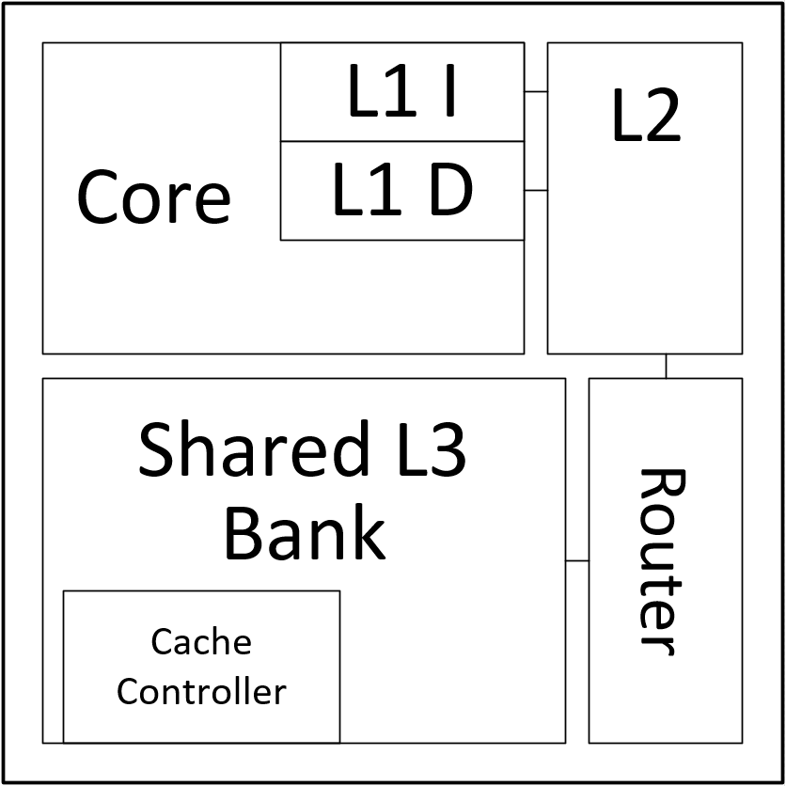
Stream Engines
SE_{CORE}:
Mange stream configuration and issue stream requests.
Make and cancel offload decisions.
SE_{CORE}
SE_{L2}:
Buffer stream data and match it with requests from SE_{CORE}.
Issue flow control credits to remote L3 bank (SE_{L3}).
SE_{L3}:
Generate requests and stream back data to SE_{L2}.
Receives control messages from SE_{L2}, e.g. flow credits.

Slide 19
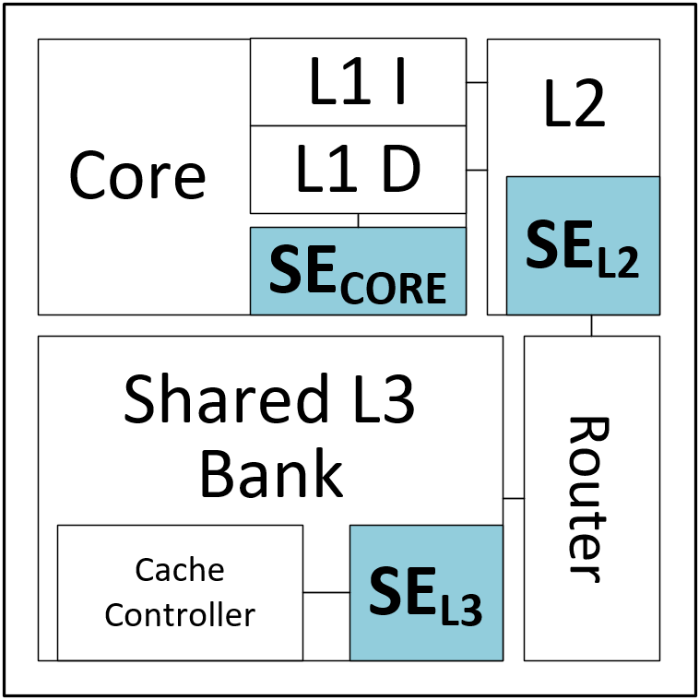
How to Offload: Configure Affine Stream A[i]
SE_{CORE} configures SE_{L2} with the affine stream pattern A[i].
SE_{L2} allocates the stream buffer, and forward configuration to SE_{L3} where A[0] is.

Slide 20
How to Offload: Proactively Stream Data to Core
SE_{L3} generates requests of A[i], translates (L2 TLB) and sends to L3 cache controller.
Data responses are buffered at SE_{L2} and later drained by requests from SE_{CORE}.

Slide 21
How to Offload: Flow Control and Migration
SE_{L2} sends out credits to SE_{L3} at coarse-granularity, further reduce traffic overhead.
Streams migrate to the next bank, and keep streaming until no credits.
Slightly increase interleave granularity to avoid too-frequent migrations.

Slide 22
How to Offload: End (Sink) the Stream
SE_{CORE} terminates streams by sending out StreamEnd messages.
SE_{L3} can directly release streams with known length.
Single Request – Multiple Data
Minimal control traffic for floating streams.
Deep and accurate prefetching.

Slide 23
How to Offload: Indirect Stream B[A[i]]
Associate indirect stream B[A[i]] with A[i].
SE_{L3} can directly send out indirect requests to the target L3 cache controller.
Decentralized Address Generation
Generate indirect request at remote L3.
Only transfer the required subline data.

Slide 24
How to Offload: Stream Confluence
Neighboring cores may be requesting the same piece of data.
SE_{L3} can easily perform pattern matching and multicast data to different cores.
Stream Confluence
Coordination between cores’ accesses.
Avoid duplicate data traffic.

Slide 25
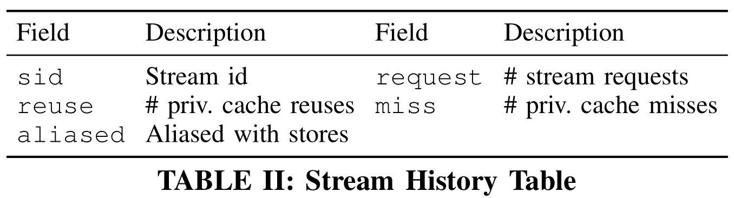
When to Offload: Detect Floating Candidates
Target: Streams with no reuse in the private cache, or aliasing.
Static Information: Compiler Analysis.
E.g. are there writes to the address?
Dynamic Information: Stream History Table.
Only offload when passed both static & dynamic check.
SE_{CORE} can early terminate a floating stream, e.g. found aliasing.

Slide 26
Outline
Insights and Opportunities
Stream Floating Implementation
Coherence and Consistency
Support Weak Consistency
Support Strong Consistency
Evaluation

Slide 27
Support Weak Consistency: Uncached Stream Data
Limit streams in synchronization-free region.
Bypass coherence protocol: stream data is not cached.
Extend MESI protocol with uncached requests (GetU).
Details about aliasing detection in the paper.
Strong consistency with stream-grain coherence.
I à I
I à EE
I à E

Slide 28
Outline
Insights and Opportunities
Stream Floating Implementation
Coherence and Consistency
Evaluation

Slide 29
Configurations
LLVM-based compiler to recognize streams and transform programs.
Gem5 20.0 cycle-level execution-driven simulator.
12 data processing workloads from Rodinia and micro kernels.
Parallelized with OpenMP, with AVX-512 enabled.
Configurations (see paper for details):
8x8 mesh topology, 3-level MESI, 32kB L1 I/D, 256kB L2, 1MB L3.
Base: Baseline cores without prefetcher or stream support.
L1Stride-L2Stride: Stride prefetcher at both L1 and L2 cache level.
L1Bingo-L2Stride: Bingo spatial prefetcher at L1 and stride prefetcher at L2.
SS: Stream-specialized processor (stream support at core) [ISCA’ 19].
SF: Stream floating, (offload stream to cache) [this work].

Slide 30
Overall Speedup with IO4 and OOO8

Slide 31
LLC Request Breakdown

Slide 32
NoC Traffic Breakdown
1.42
2.49
1.79
1.33
Stream
Data
Control

Slide 33
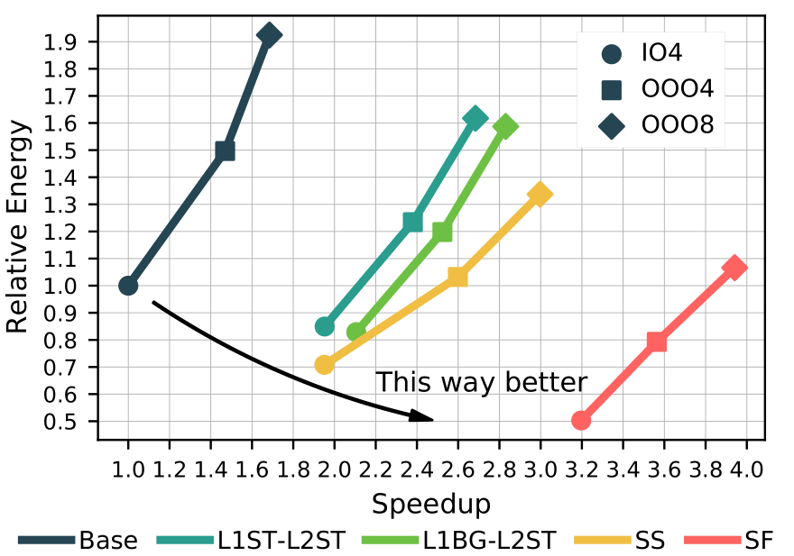
Energy vs. Speedup

Slide 34
Conclusion: Streams Enables Proactive Cache
Proactive Cache System:
Driven by streams, proactively transfer.
Explore rich ISA semantics in the cache system.

