Slide 1


Stream-based Memory Specialization for General Purpose Processors
Zhengrong Wang
Prof. Tony Nowatzki

Slide 2
Computation & Memory Specialization
SIMD
Dataflow
+
+
+
+
+
+
Core
Acc.
New ISA abstraction for certain computation pattern.
/
-
-
-
-
-
+
Mem
Acc.
b[0]
a[b[0]]
b[i]
New ISA abstraction for memory access pattern?
b[1]
a[b[1]]
a[b[i]]
b[2]
a[b[2]]
…
…
Stream

Slide 3
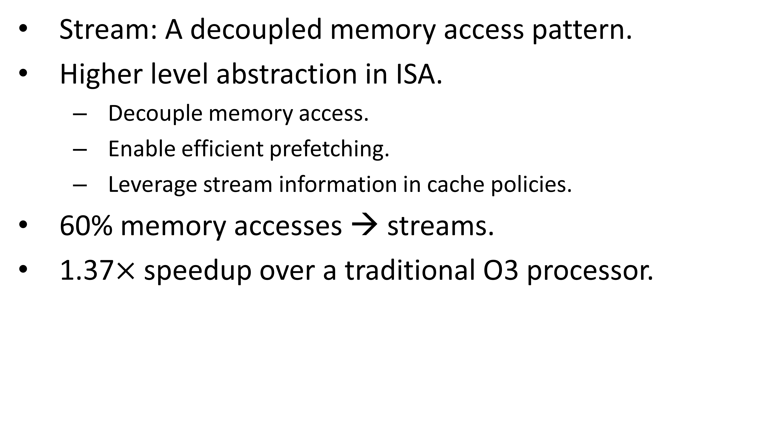
Stream: A New ISA Memory Abstraction
Stream: A decoupled memory access pattern.
Higher level abstraction in ISA.
Decouple memory access.
Enable efficient prefetching.
Leverage stream information in cache policies.
60% memory accesses → streams.
1.37$×$ speedup over a traditional O3 processor.
Core
Acc.
b[0]
a[b[0]]
b[i]
b[1]
a[b[1]]
a[b[i]]
b[2]
a[b[2]]
Mem
Acc.
…
…
Stream

Slide 4
Outline
Insight & Opportunities.
Stream Characteristics.
Stream ISA Extension.
Stream-Aware Policies.
Microarchitecture Extension.
Evaluation.

Slide 5
Outline
Insight & Opportunities.
Stream Characteristics.
Stream ISA Extension.
Stream-Aware Policies.
Microarchitecture Extension.
Evaluation.

Slide 6
Conventional Memory Abstraction
while (i < N) {
if (cond)
v += a[i];
i++;
}
O3 Core
L1 Cache
L2 Cache
if
Overhead 3:
Assumption on reuse.
Overhead 2:
Similar address computation/loads.
addr
if
load
addr
Addr.
Miss
Hit
load
Addr.
Miss
Hit
Overhead 1:
Hard to prefetch with control flow.
add
Val.
Resp.
Resp.
br
add
Val.
Resp.
Resp.
br

Slide 7
Opportunity 1: Prefetch with Ctrl. Flow
cfg(a[i]);
while (i < N) {
if (cond)
v += a[i];
i++;
}
O3 Core
L1 Cache
L2 Cache
cfg.
Prefetch.
SE.
Miss
Hit
Before loop.
if
Resp.
Resp.
addr
if
load
addr
Addr.
Hit
Miss
Hit
load
Addr.
Hit
Hit
Overhead 1:
Hard to prefetch with control flow.
Miss
Opportunity 1:
Prefetch with control flow.
add
Val.
Resp.
Resp.
br
add
Val.
Resp.
Resp.
br

Slide 8
Opportunity 2: Semi-Binding Prefetch
s_a = cfg();
while (i < N) {
if (cond)
v += s_a;
i++;
}
O3 Core
L1 Cache
L2 Cache
cfg.
Prefetch.
SE.
Miss
Hit
Before loop.
if
FIFO
Resp.
Resp.
addr
if
Overhead 2:
Similar address computation/loads.
Opportunity 2:
Semi-binding prefetch.
load
addr
Addr.
Hit
Opportunity 1:
Prefetch with control flow.
add
load
Addr.
Resp.
Hit
br
add
Val.
Resp.
br

Slide 9
Opportunity 3: Stream-Aware Policies
s_a = cfg();
while (i < N) {
if (cond)
v += s_a;
}
O3 Core
L1 Cache
L2 Cache
cfg.
Prefetch.
SE.
Miss
Hit
Before loop.
if
FIFO
Resp.
Resp.
Overhead 2:
Repeated address computation/loads.
add
if
Opportunity 2:
Semi-binding prefetch.
Opportunity 3:
Better policies, e.g. bypass a cache level if no locality.
Overhead 3:
Assumption on reuse.
br
add
Opportunity 1:
Prefetch with control flow.
br

Slide 10
Related Work
Decouple access execute.
Outrider [ISCA’11], DeSC [MICRO’15], etc.
Ours: New ISA abstraction for the access engine.
Prefetching.
Stride, IMP [MICRO’15], etc.
Ours: Explicit access pattern in ISA.
Cache bypassing policy.
Counter-based [ICCD’05], LLC bypassing [ISCA’11], etc.
Ours: Incorporate static stream information.
Notes:
Ssp is inspired by many other related and built on…
Why is it better than DESC?
Ours encodes information about the access patterns in a way that is accessable by the microarchitecture.

Slide 11
Outline
Insight & Opportunities.
Stream Characteristics.
Stream ISA Extension.
Stream-Aware Policies.
Microarchitecture Extension.
Evaluation.

Slide 12
Stream Characteristics – Stream Type
Trace analysis on CortexSuite/SPEC CPU 2017.
51.49% affine, 10.19% indirect.
Indirect streams can be as high as 40%.
Support indirect stream.

Slide 13
Stream Characteristics – Stream Length
51% stream accesses from stream longer than 1k.
Some benchmarks contain short streams.
Support longer stream to capture long term behavior.
Low overhead to support short streams.

Slide 14
Stream Characteristics – Control Flow
53% stream accesses from loop with control flow.
Decouple from control flow.

Slide 15
Outline
Insight & Opportunities.
Stream Characteristics.
Stream ISA Extension.
Stream-Aware Policies.
Microarchitecture Extension.
Evaluation.

Slide 16
Stream ISA Extension – Basic Example
Original C Code
Stream Decoupled Pseudo Code
Stream Dependence Graph
int i = 0;
while (i < N) {
sum += a[i];
i++;
}
stream_cfg(s_i, s_a);
while (s_i < N) {
sum += s_a;
stream_step(s_i);
}
stream_end(s_i, s_a);
s_i
s_a
Iter.
Step.
User
Pseudo-Reg
Stream a[i]
0
i++
s_a
Memory 0x400
1
i++
Memory 0x404
2
Memory 0x408
…
Notes:
Color to be matched. Step, stream, user instruction. IV stream and mem stream have the same color.

Slide 17
Stream ISA Extension – Control Flow
Original C Code
Stream Decoupled Pseudo Code
Stream Dependence Graph
int i = 0, j = 0;
while (cond) {
if (a[i] < b[j])
i++;
else
j++;
}
stream_cfg(s_i, s_a, s_j, s_b);
while (cond) {
if (s_a < s_b)
stream_step(s_i);
else
stream_step(s_j);
}
stream_end(s_i, s_a, s_j, s_b);
s_i
s_j
s_a
s_b
Iter.
Step
User
Pseudo-Reg
Stream a[i]
0
i++
Memory 0x400
1
s_a
Memory 0x404
2
i++
Memory 0x408
…

Slide 18
Stream ISA Extension – Indirect Stream
Original C Code
Stream Decoupled Pseudo Code
Stream Dependence Graph
int i = 0;
while (i < N) {
sum += a[b[i]];
i++;
}
stream_cfg(s_i, s_a, s_b);
while (s_i < N) {
sum += s_a;
stream_step(s_i);
}
stream_end(s_i, s_a, s_b);
s_i
s_b
s_a
Iter.
Step
User
Pseudo-Reg
a[b[i]]
Pseudo-Reg
b[i]
0
i++
Memory 0x888
Memory 0x400
1
i++
s_a
Memory 0x668
s_b
Memory 0x404
2
Memory 0x86c
Memory 0x408
…
…

Slide 19
Stream ISA Extension – ISA Semantic
New architectural states:
Stream configuration.
Current iteration’s data.
New speculation in ISA:
Stream elements will be used.
Streams are long.
Maintain the memory order.
Load → first use of the pseudo-register after configured/stepped.
Store → every write to the pseudo-register.

Slide 20
Outline
Insight & Opportunities.
Stream Characteristics.
Stream ISA Extension.
Stream-Aware Policies.
Microarchitecture Extension.
Evaluation.

Slide 21
Stream-Aware Policies
Rich Information
Better Policies
Memory Footprint
Reuse Distance
Prefetch Throttling
Compiler (ISA)
/Hardware
Modified?
Cache Replacement
Conditional Used?
Cache Bypassing
Indirect
Sub-Line Transfer
…
…

Slide 22


Stream-Aware Policies – Cache Bypass
Stream: Access Pattern → Precise Memory Footprint.
Core
while (i < N)
while (j < N)
while (k < N)
sum += a[k][i]
* b[k][j];
s_b
s_a
L1$
s_b
s_a
L2$
Reuse Dist. $N$
Reuse Dist. $N×N$
a[N][N]
b[N][N]

Slide 23
Outline
Insight & Opportunities.
Stream Characteristics.
Stream ISA Extension.
Stream-Aware Policies.
Microarchitecture Extension.
Evaluation.

Slide 24
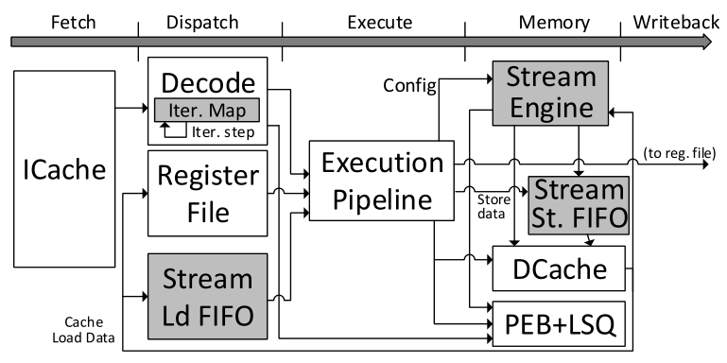
Microarchitecture
Memory 0x400
Memory 0x404
Pseudo-Reg
Memory 0x408
Stream
Memory 0x40c
Memory 0x410

Slide 25
Microarchitecture – Misspeculation
Control misspeculated stream_step.
Decrement the iteration map.
No need to flush the FIFO and re-fetch data (decoupled) !
Other misspeculation.
Revert the stream states, including stream FIFO.
Memory fault delayed until the use of the element.

Slide 26
Outline
Insight & Opportunities.
Stream Characteristics.
Stream ISA Extension.
Microarchitecture Extension.
Stream-Aware Policies.
Evaluation.

Slide 27
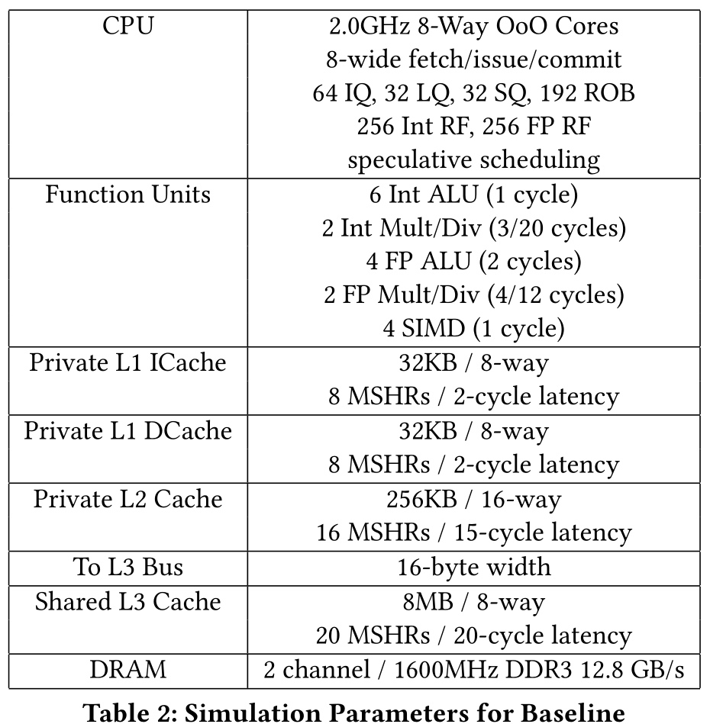
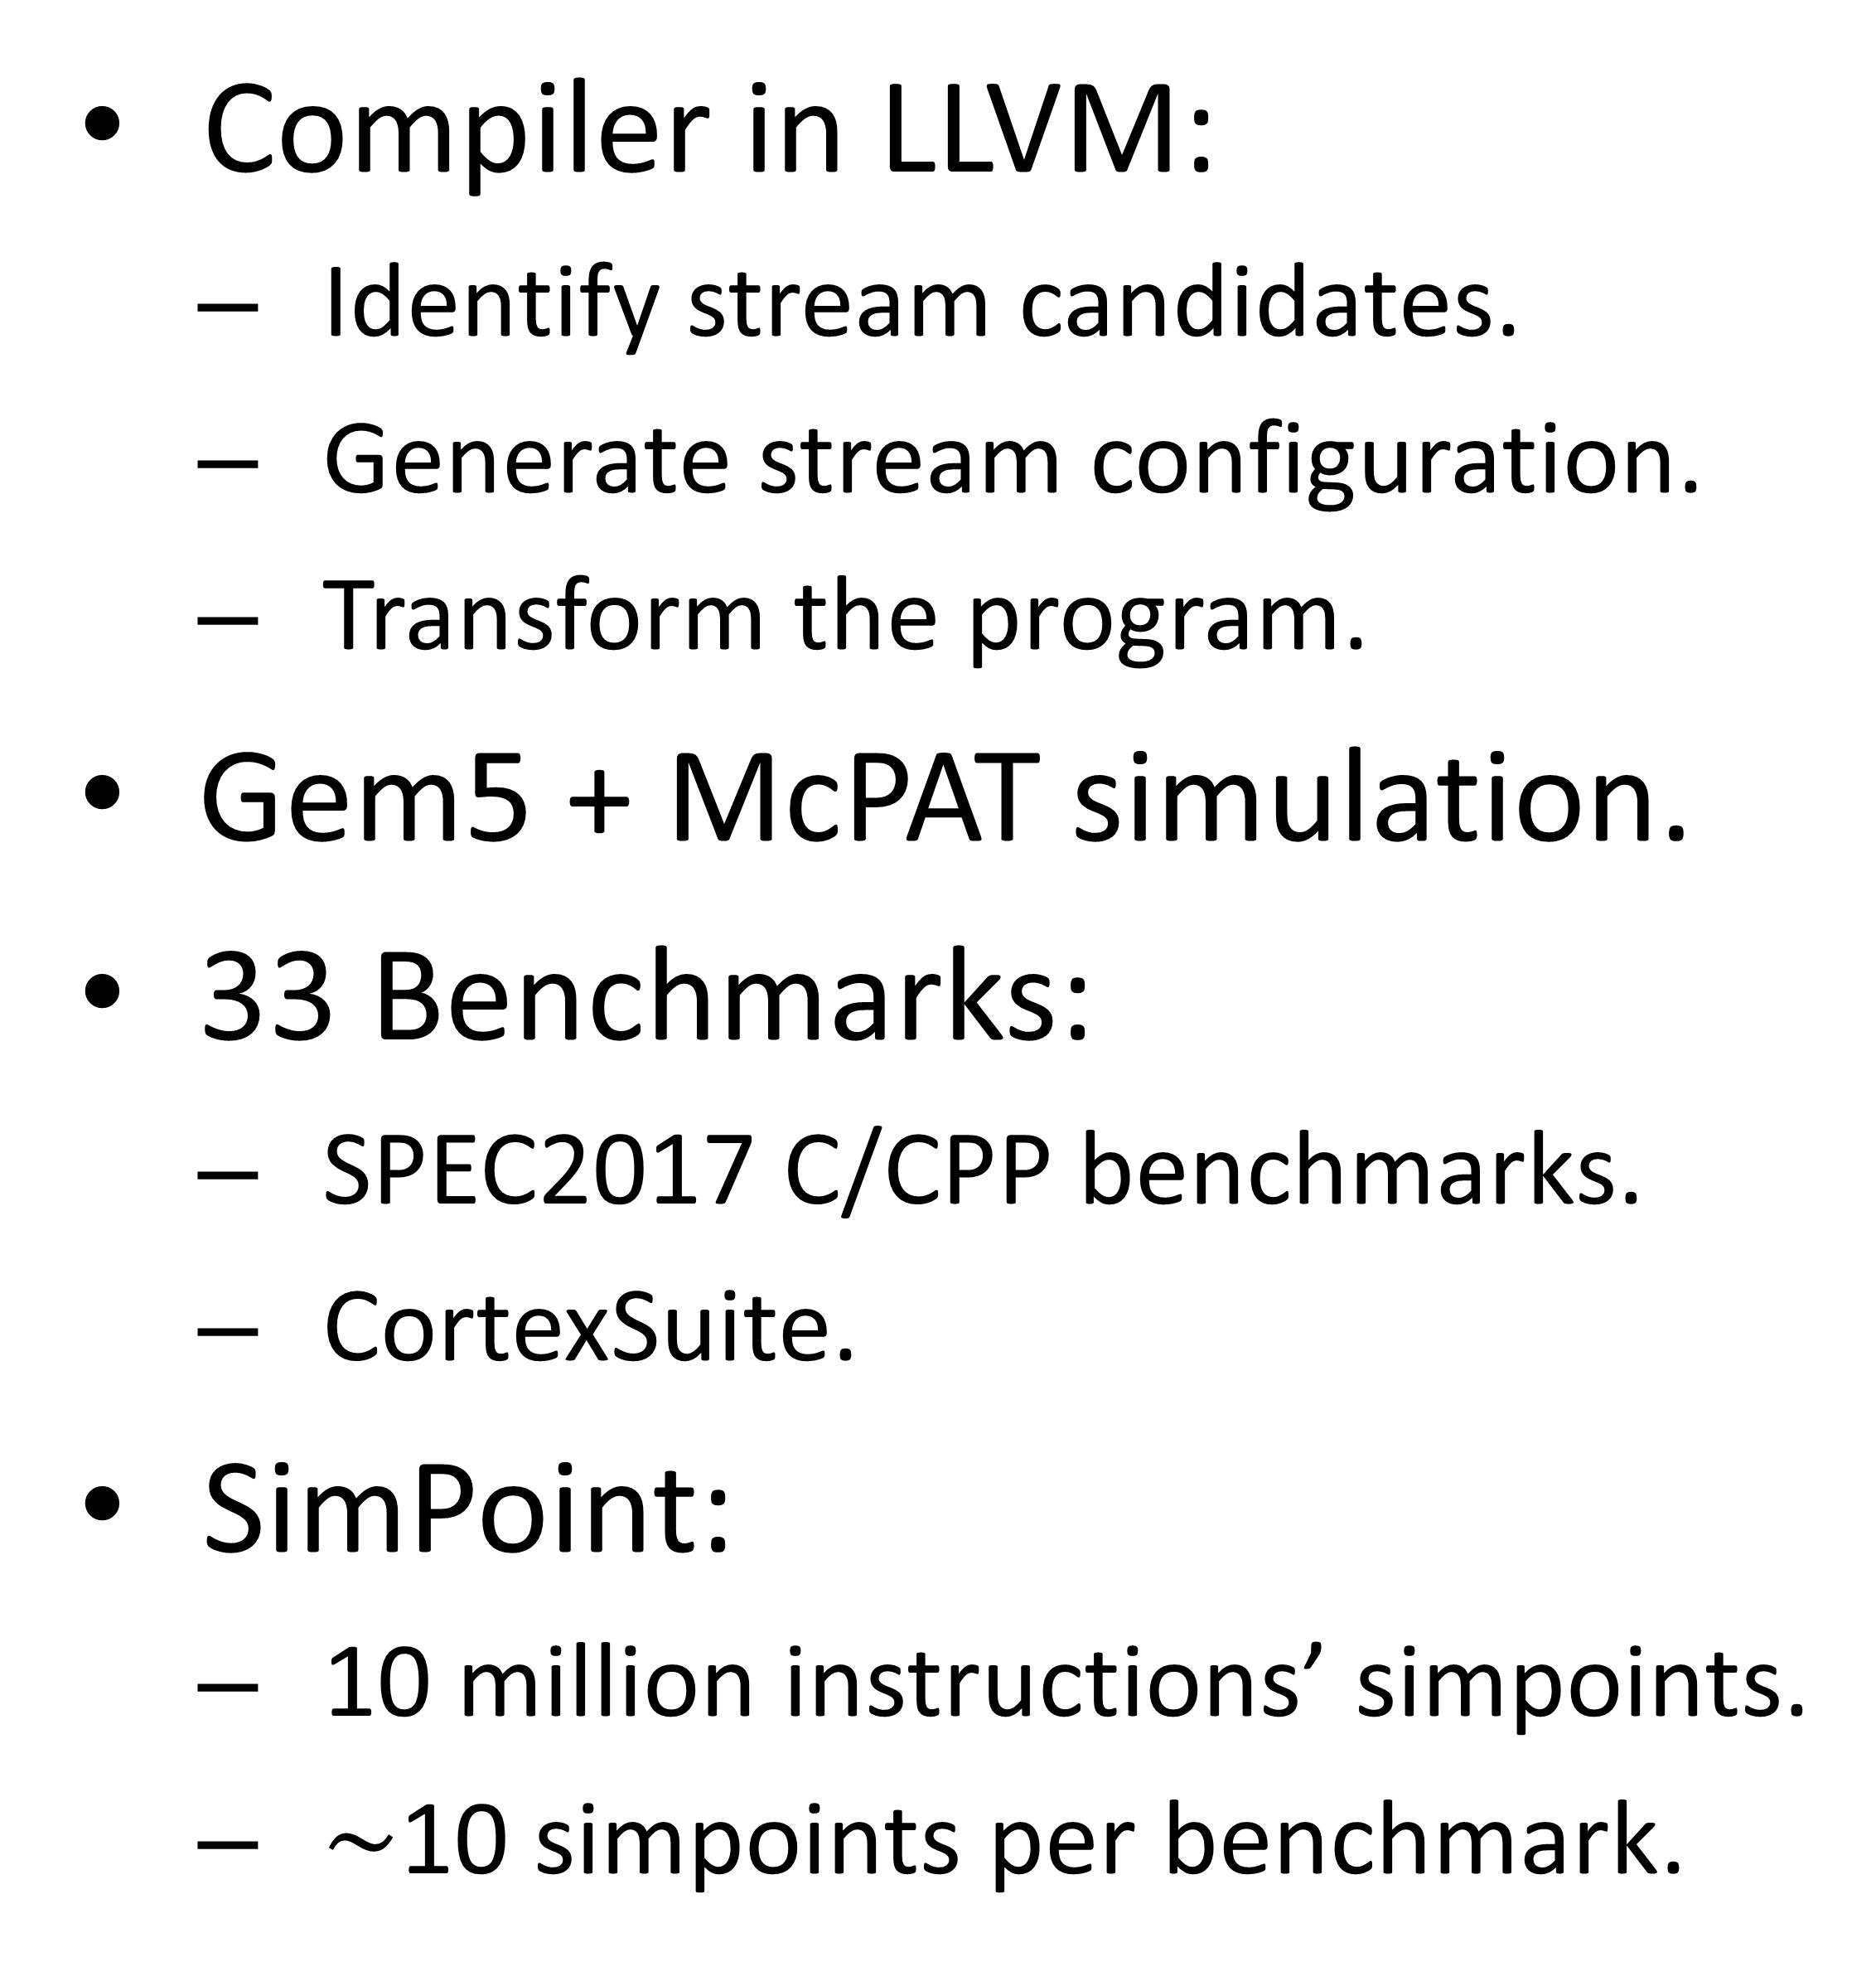
Methodology
Compiler in LLVM:
Identify stream candidates.
Generate stream configuration.
Transform the program.
Gem5 + McPAT simulation.
33 Benchmarks:
SPEC2017 C/CPP benchmarks.
CortexSuite.
SimPoint:
10 million instructions’ simpoints.
$\sim$10 simpoints per benchmark.

Slide 28
Configurations
Baseline.
Baseline O3.
Pf-Stride:
Table-based prefetcher.
Pf-Helper:
SMT-based ideal helper thread.
Requires no HW resources (ROB, etc.).
Exactly 1k instruction before the main thread.
Stream Specialized Processor.
SSP-Non-Bind:
Prefetch only.
SSP-Semi-Bind:
+ Semi-binding prefetch.
SSP-Cache-Aware:
+ Stream-Aware cache bypassing.
Notes:
Unrealistic (highly) ideal configuration.

Slide 29
Results – Overall Performance
Notes:
In part due to decoupling and specialized cache policies, ssp can outperform …

Slide 30
Results – Semi-Binding Prefetching

Slide 31
Results – Design Space Interaction

Slide 32
Conclusion
Stream as a new memory abstraction in ISA.
ISA/Microarchitecture extension.
Stream-aware cache bypassing.
New paradigm of memory specialization.
New direction for improving cache architectures.
Combine memory and computation specialization.

