Slide 1
Enter your team name

Slide 2
Overview and style of presentation
Basic information
Story
Innovation
User experience
Feasibility
Functional demonstrator
Outlook and next possible steps
Extra slides
2

Slide 3
3

Slide 4

…
Photo of your product/ demo
…
4

Slide 5
How did the idea come about?
How can the product be used? (Typical use cases)
How does it work? (Short introduction of what the product/application can do (features, special services, etc.) → general explanation is sufficient, technical details will be dealt with later.)
5

Slide 6
…
…
…
…
…
…
6

Slide 7
Our Question Zero:
…
…
…
…
…
…
…
…
…
…
…
…
7

Slide 8
…
…
…
…
…
…
8

Slide 9
…
…
…
…
…
…
…
…
…
9

Slide 10
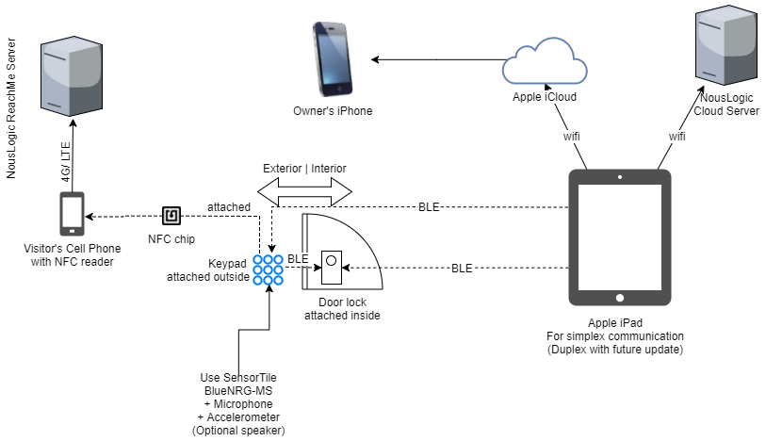
Source: Hackster.io
10

Slide 11
…
…
…
11

Slide 12
…
…
…

Slide 13
…
…
…

Slide 14
Feel free to add slides if needed.
Please keep in mind to not exceed the maximum allowed number of 15 slides.
14

