Slide 1





Enhancing model transparency: Effects of DK Integration for Conversational XAI
Isabel Feustel | Ulm University

Slide 2



About me
Education
Research Interersts
Side facts
M. Sc. Media Informatics
PhD Student at Ulm University
Dialogue Systems
Explainable AI
Human Computer Interaction
I love music
I‘m addicted to video games
I owned pet rats

Slide 3






Outline
Motivation
Foundations of XAI
Concept for Domain Knowledge Integration
Automatic Generation of Structured Knowledge
Evaluation
Conclusion

Slide 4


























A Conversation with AI: Understanding Model Decisions
Motivation
Regulations for transparent AI
EU AI Intelligence Act
Help users understanding AI behavior
Empowerment through understanding
Gain trust in AI systems
Notes:
Conversation with AI, the vision
- Imagine you've finally found the perfect used sports car – a cherry-red 1967 Mustang.
- You're excited to finally own your dream car and decide to apply for a loan online.
- A slick AI-powered system on the bank's website quickly assesses your application.
Unfortunately, the system denies your loan application without providing any further explanation.
Frustrated and confused, you spend hours researching credit scores and financial risk assessment. You're determined to understand why your application was rejected. However, without any insight into the AI's decision-making process, you're left in the dark.
- Help is coming as not only users need transparency for their usage but law regulations are started to require it. For example, the new EU regulation on AI transparency requires the bank to provide some explanation for the loan rejection. Instead of a simple "declined," the system now displays a brief explanation:
"Your application was declined due to a low credit score. Your credit score is primarily impacted by your purpose and your low amount of savings. "
this transparency helps you understand the system's decision
It also empowers you to take control of your financial situation and improve your chances of loan approval in the future.
And finally users gain more trust in ai systems

Slide 5




Conversation as a basis
Motivation
Natural way of explanations
Information can be splitted (No overload)
User can ask questions for clarification
Personalized experience
(Miller et al., 2019)
Notes:
Why do we want conversation?
Natural way how humans explain
Information can be splitted, reducing overload
User can ask for clarification
Personalized experience: system can adapt to user needs (e.g. expert vs laymen user)

Slide 6
Transparency is the key – How do we get there?
Motivation
Social Science
Human-Agent
Interaction
XAI
Artifical
Intelligence
Human-Computer Interaction
(Miller et al., 2019)
Notes:
Transparency is key, how do we get there
big field of XAI to tackle these problems
Interdisciplinary topic (!)
New sub areas created over the last years like social XAI or Conversational XAI (my work)

Slide 7



XAI Foundations: Model Explainability
XAI Foundations
Post-Hoc Methods
Interpretable models
(white boxes)
Notes:
XAI offers access to model explanations however there are some limitations

Slide 8


XAI Foundations: Explanation Types
XAI Foundations
Local Explanation
Why specific prediction?
Instance level
Global Explanation
How does model behave overall?
Model level
Notes:
XAI offers access to model explanations however there are some limitations

Slide 9


XAI Foundations: Explanation Types
XAI Foundations
Local Explanation
Why specific prediction?
Instance level
Feature Importance
What feature influenced the outcome?
Counterfactual Explanation
What changes the outcome?
Notes:
XAI offers access to model explanations however there are some limitations

Slide 10



Limitations of XAI
XAI Foundations
Non conversational explanations
Main focus on expert users
Limited to data and model only
Notes:
XAI offers more complex explanations; non conversational
The information is limited to data and model only; no additional information about the process/domain
Main focus on expert users, which can be domain experts or even machine learning experts
How can we tackle this?
Non conversational -> dialogue system
Limited to data only -> extend with additional sourcdes e.g. domain knowledge
Main focus on expert users -> personalization/adapation to user needs

Slide 11

Limitations of XAI
XAI Foundations
Limited to data and model only
Integrate knowledge
Notes:
XAI offers more complex explanations; non conversational
The information is limited to data and model only; no additional information about the process/domain
Main focus on expert users, which can be domain experts or even machine learning experts
How can we tackle this?
Non conversational -> dialogue system
Limited to data only -> extend with additional sourcdes e.g. domain knowledge
Main focus on expert users -> personalization/adapation to user needs

Slide 12
Outline
Motivation
Foundations of XAI
Concept for Domain Knowledge Integration
Automatic Generation of Structured Knowledge
Evaluation
Conclusion

Slide 13






Example Scenario Credit Application
Concept for DK
Prediction: Would you be approved for a credit loan?
savings
checking account
purpose
duration
amount

Slide 14
Unified Explanations
Concept for DK
XAI
In this case, the purpose influenced the loan approval decision.
This can be explained by the disparity between used car and new car loans, with acceptance rates of 83% and 62% respectively.
Further, used cars, primarily viewed as a means of transportation, often involve lower loan amounts due to their lower purchase price.
In contrast, new cars, frequently seen as status symbols, may be perceived as higher-risk purchases, potentially influenced by factors beyond essential transportation needs.
External Knowledge
For the given case, purpose is the most influential feature.
Used cars typically cost less than new cars. This leads to smaller loan amounts, reducing the lender's risk.
Model
Domain Knowledge
Data
World Knowledge
Credit applications for used cars have a higher acceptance rate (83%) compared to those for new cars (62%).
New cars often serve as status symbols, while used cars are primarily viewed as a means of transportation.

Slide 15
Leveraging Argumentation to Enhance XAI Explanations
Concept for DK
Explanations and reasoning of humans are argumentative (Mercier et al., 2011; Antaki et al., 1992)
Argumentation frameworks as basis (Stab et. al, 2014)
Argument Components
Argumentative Relations
Argumentation Trees offer dialogical access
Claim
Argument
Argument
Argument
Notes:
Genauere Einführung; Relationen, Kanten, Argumente,
Gewichtete Modelle: Amgoud, Leila, and Jonathan Ben-Naim. Weighted Bipolar Argumentation Graphs: Axioms and Semantics. Twenty-Seventh International Joint Conference on Artificial Intelligence-IJCAI 2018.
Christian Stab:
Stab, C., & Gurevych, I. (2014a). Annotating argument components and relations in persuasive essays. Proceedings of COLING 2014, the 25th International Conference on Computational Linguistics: Technical Papers, 1501–1510. Strukturen für Essays;

Slide 16
The Bridge – Linking XAI and Argumentation
Concept for DK
XAI
Features
Argumentation Tree
Loans for specific purposes (car, house) have unique considerations.
Used cars typically cost less than new cars. This leads to smaller loan amounts, reducing the lender's risk.
Shapley Values
For the given case, purpose is the most influential feature.
savings
checking account
The purpose of a loan impacts the likelihood of credit approval.
Essential purchases, such as a home or education, are typically considered investments in the borrower's future financial stability.
Counter-
factuals
If you change purpose to used car, you will be accepted.
purpose
(Claim)
The purpose for which a credit is sought influences its acceptance as certain types of loans, such as mortgages or business loans, may be viewed more favorably by lenders due to their potential for generating income or investment returns.
duration
amount
Data
The acceptance rate for used cars is 83%, in comparison to 62% for new cars.
Loans for necessary expenses are generally viewed more favorably.
Outcomes
accept
reject
Notes:
Integration of DK requires a connection between XAI & DK; We assume that every XAI explanation has some sort of relation to a specific feature (or domain word) and a outcome This can be reduced to some sort of claim
A claim is needed as starting point for an argument tree
With this pipeline we can connect XAI and arguments on a topic level where each topic is a tree with corresponding arguments

Slide 17

Building the Knowledge Base: Constructing Argument Trees
Auto. Generation
of DK
Claim about feature outcome relation
Argumentation Tree with support and attacking arguments
3 Types of domain knowledge acquisition
Handcrafted
LLM generated
Pipeline for generation
All 3 types included manual annotation processes
Attacking Argument
Supporting Argument
Supporting Argument
Attacking Argument
(Schindler et al., 2025)

Slide 18
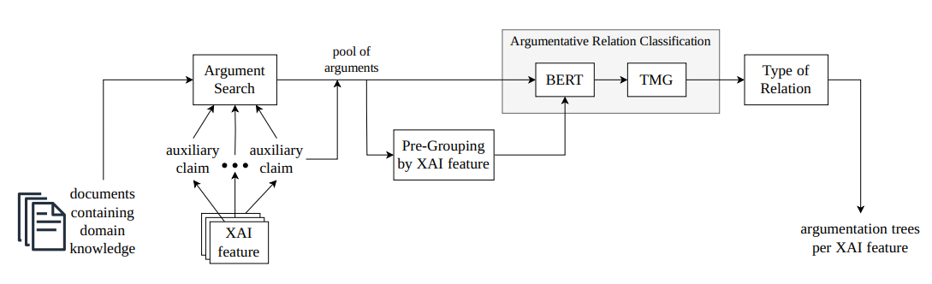
Automatic generation of argumentation structures for conversational XAI
Auto. Generation
of DK
Two iterations of document processing
List of manual gathered domain knowledge documents
LLM summarizations for specific questions
(Schindler et al., 2025)

Slide 19







The Impact of Domain Knowledge in Explanatory Dialogues
Evaluation
Notes:
Evaluate XAI with DK
User interacts
How can we measure if the user has better understanding of the underlying AI?
Distinguish between False/true AI
Flip outcomes for falsy AI
User should detect the wrong behavior and disagree with false system

Slide 20
Explanation Strategy
Evaluation
Request Explanation
Request Important Feature
Request What If
Get Feature Importance
Clarify Argument Topic
Get Domain Knowledge
Provide Claim
No Explanation Found
Provide Support Argument
Offer CF
Explanation
Confirm
Provide Counterfactuals
Notes:
Blue box = user requests;
Orange boxes = system action
3 explanation requests; 2 specific mapped to XAI
Always start with XAI
Provide arguments until no more arguments of topic are left
Offer counterfactuals as alternative

Slide 21
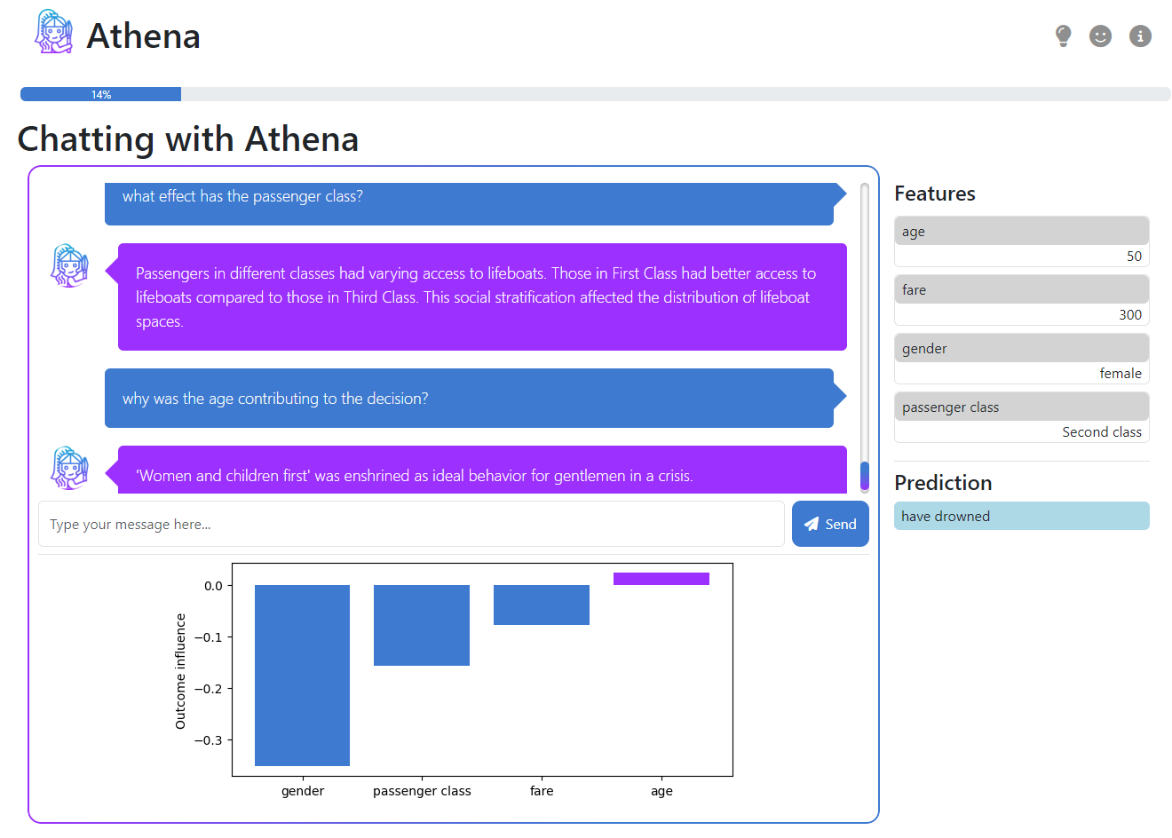
Introduction Athena
Evaluation
Explanatory chatbot for prediction tasks
Three datesets included (extensible):
German credit data („Am I creditworthy?“)
Titanic („Would I have surived on the titanic?“)
Diabetes Risk Assessment („Am I at risk for diabetes?
Random Forest Classifier
Three XAI-Methods supported: SHAP, CF, Example
Notes:
To evaluate the process we introduced the system athena

Slide 22
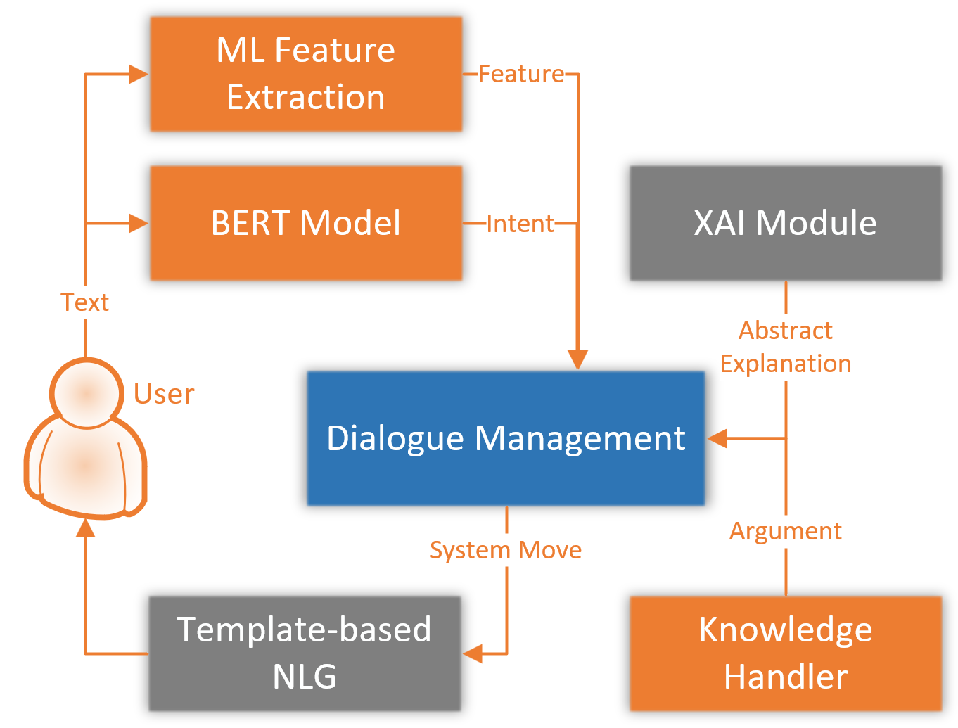
Athena Architecture
Evaluation
Explanation intents classified by BERT model (generic); fine-tuned on handcrafted data
ML Feature Extraction to get use-case specific information
XAI module with custom implementation of counterfactuals and SHAP-library.
Rule-based dialogue management
Knowledge handler for including domain knowledge
Templates for XAI explanations

Slide 23
Preleminary Study Setup
Evaluation
32 participants in Online Study in 4 groups
2 dialogues per participant (with/without domain knowledge)
True/False AI Setting
Titanic & Credit Scenario
Handcrafted and LLM generated arguments with fully manual annotated trees
Evaluation:
2 XAI related questions (Agreement AI decision)
SASSI Questionnaire for dialogue system performance
5-likert Scale
Significance measured with Mann-Whitney-U Test

Slide 24
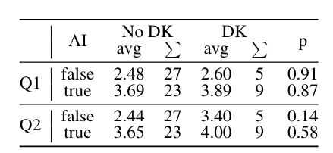
Preliminary User Study
Evaluation
Do users understand that the AI is behaving incorrect? Does domain knowledge help to detect incorrect AI behavior?
Q1: I agree with the decisions made by the system.
Q2: The system decisions are plausible.
Domain knowledge requested by the user: 44%
(p is value of Mann-Whitney U Test)
(Feustel et al., 2024)
Notes:
Domain knowledge lets user agree more with the system(!) for true AI what we want, false AI misleading
Difference between true/false AI as expected

Slide 25




Preliminary Study Results Impact of Domain Knowledge
Evaluation
System likeability is higher (trend true AI, significant false AI)
System appears more robust (false AI)
Reduced cognitive demand (false AI)
System appears more useful (true AI)
(Feustel et al., 2024)
Notes:
Likeability
Robustness
Cognitvie
Demand

Slide 26
Study Setup
Evaluation
80 participants in Online Study
4 groups / 2 dialogues per participant (DK & NO DK) / True|False AI Setting
New scenario diabetes
New explanation type: example based
Automatic generated argumentation trees with human in the loop to guarantee qualitiy
Separation of AI and Dialogue System
More proactive strategy for Domain Knowledge

Slide 27
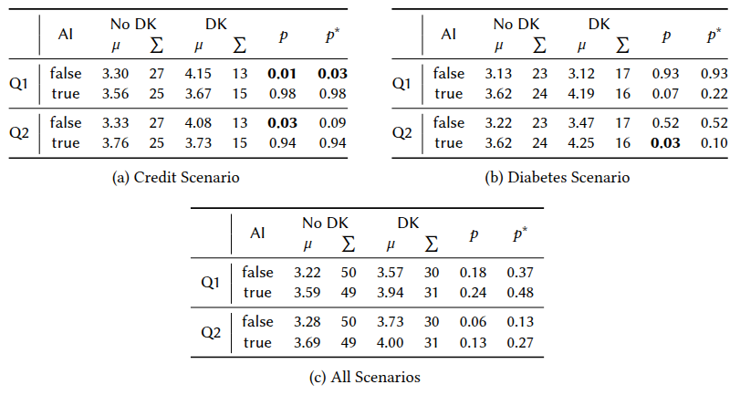
User Study Results
Evaluation
Domain Knowledge usage increased to 76% (before 44%)
Q1 I agree with the decisions made by the prediction system.
Q2 The prediction system’s decisions are plausible.
Where:
p is value of Mann-Whitney U Test
p* is the value of Holm-Bonferroni Correction

Slide 28
User Study Results: Topicwise
Evaluation
Q1 I agree with the decisions made by the prediction system.
Q2 The prediction system’s decisions are plausible.
Where:
p is value of Mann-Whitney U Test
p* is the value of Holm-Bonferroni Correction

Slide 29
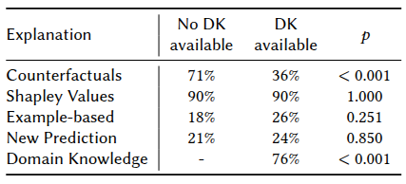
User Study Results – Impact of Domain Knowledge
Evaluation
longer interaction
different use of explanation
small trends in overall dialogue experience
more engaging/enjoyable
challenge to deal with over reliance
DK is topic dependent
Notes:
In the diabetes scenario with a true AI, the presence of DK was associated with higher perceived system accuracy ($p^* = 0.062$) and lower ratings of boredom ($p^* = 0.113$), suggesting that DK may have contributed to greater engagement. In the credit scenario with a false AI, users rated the system as more pleasant and friendly when DK was present ($p^* = 0.137$), with further indications that DK may have enhanced enjoyment ($p^* = 0.171$)

Slide 30

Conclusion
Conclusion
Transparency is needed for AI
Conversational XAI enables interactive, personalized experiences
Argumentation Trees can be used to integrate DK
DK has impact on understanding and acceptance of AI
Remaining Challenges
Ethical Concerns like over-reliance
Truthful sources for DK
Domain/Topic dependent

Slide 31




Knowledge isn‘t power until it is applied.
Thank you
„
“
Dale Carnegie
Isabel.Feustel@uni-ulm.de
Find me on LinkedIn
https://nt.uni-ulm.de/ifeustel

Slide 32
Citations
Antaki, C., & Leudar, I. (1992). Explaining in conversation: Towards an argument model. European Journal of Social Psychology, 22(2), 181-194.
Stab, C., & Gurevych, I. (2014). Annotating argument components and relations in persuasive essays. Proceedings of COLING 2014, the 25th International Conference on ComputationalLinguistics: Technical Papers, 1501–1510.
Feustel et al. (2024). Enhancing Model Transparency: A Dialogue System Approach to XAI with Domain Knowledge. SigDial 2024
Miller, T. (2019). Explanation in artificial intelligence: Insights from the social sciences. Artificial intelligence, 267, 1-38.
Mercier, H., & Sperber, D. (2011). Why do humans reason? Arguments for an argumentative theory. Behavioral and brain sciences, 34(2), 57-74.
Schindler et al. (2025). Automatic Generation of Structured Domain Knowledge for Dialogue-based XAI Systems. IWSDS 2025.

Slide 34
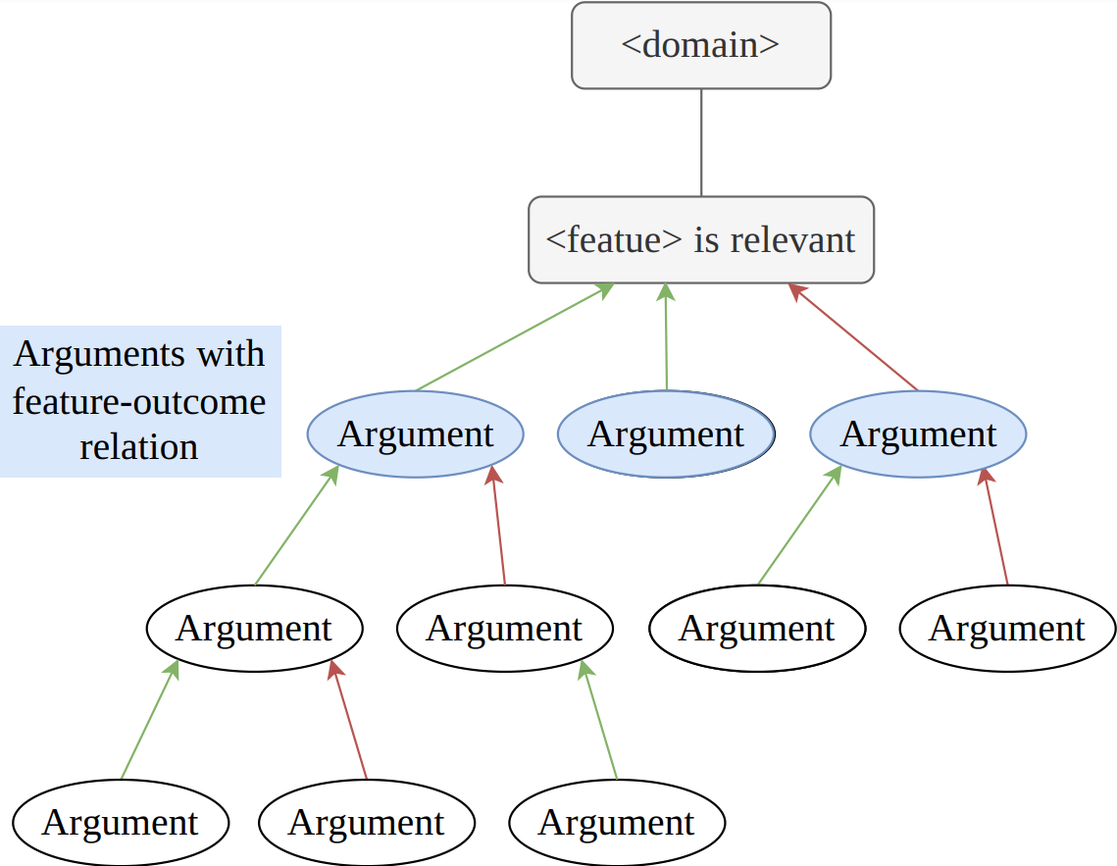
Automatic Generation of Structured Domain Knowledge for Dialogue-based XAI Systems
Motivation | Dialogue Based XAI| Integrating Domain Knowledge | Outlook

Slide 35
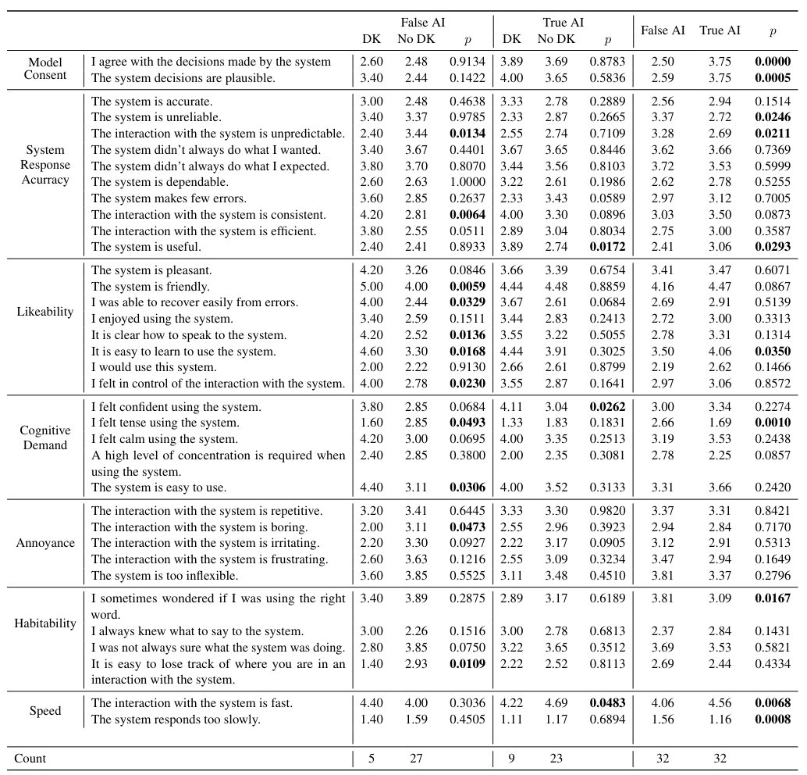
Preliminary User Study

Slide 36
Domain Knowledge for Credit Application
Motivation | Dialogue Based XAI | Integrating Domain Knowledge | Outlook
The purpose of a loan impacts the likelihood of credit approval.
Loans for necessary expenses are generally viewed more favorably.
Loans for specific purposes (car, house) have unique considerations.
Essential purchases, such as a home or education, are typically considered investments in the borrower's future financial stability.
The purpose for which a credit is sought influences its acceptance as certain types of loans, such as mortgages or business loans, may be viewed more favorably by lenders due to their potential for generating income or investment returns.
Used cars typically cost less than new cars. This leads to smaller loan amounts, reducing the lender's risk.

Slide 37
Explanatory Dialogue Systems
Motivation | Dialogue Based XAI | Integrating Domain Knowledge | Outlook
I. Feustel, N. Rach, W. Minker and S. Ultes. 2023. Towards interactive explanations of machine learning methods through dialogue systems. In IWSDS 2023, Springer.
Notes:
Explanation states/Policy:Connection XAI & Dialogue Module for XAI
User requests as explanation requests; mapping questions to methods
Extracting users intent: semantic representation of request
Which explanation have been shown already; what explanation suits the current context
Extension of „raw“ explanations
Extend with information from domain
Extend with information from real world
Generation of natural language explanation
should contain original information from XAI
Should fit the dialogue context

Slide 38
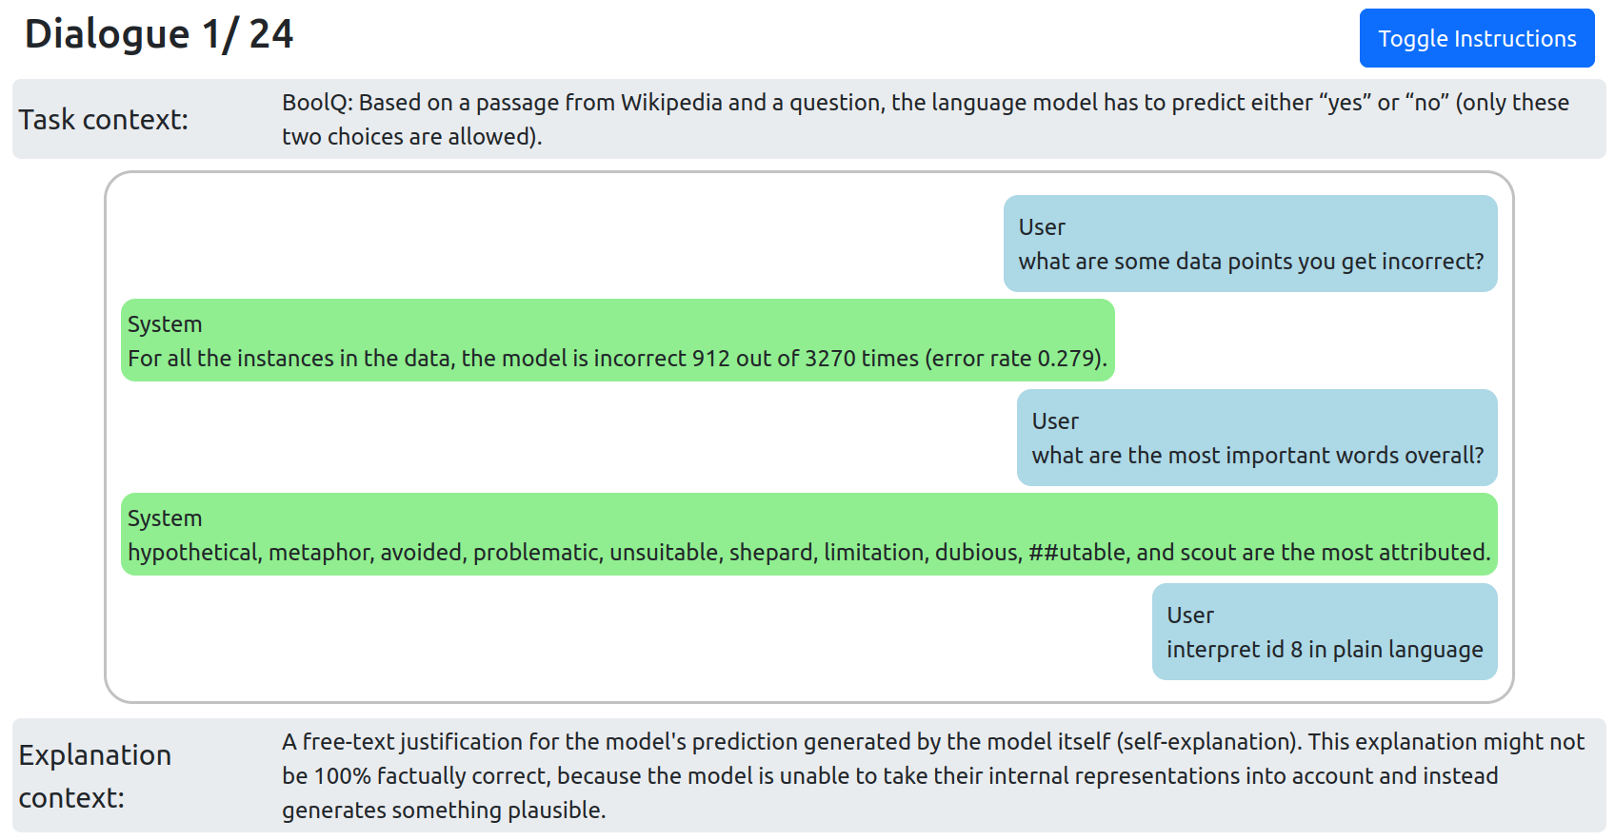
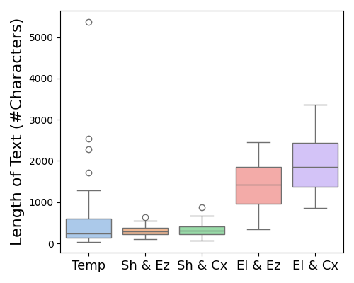
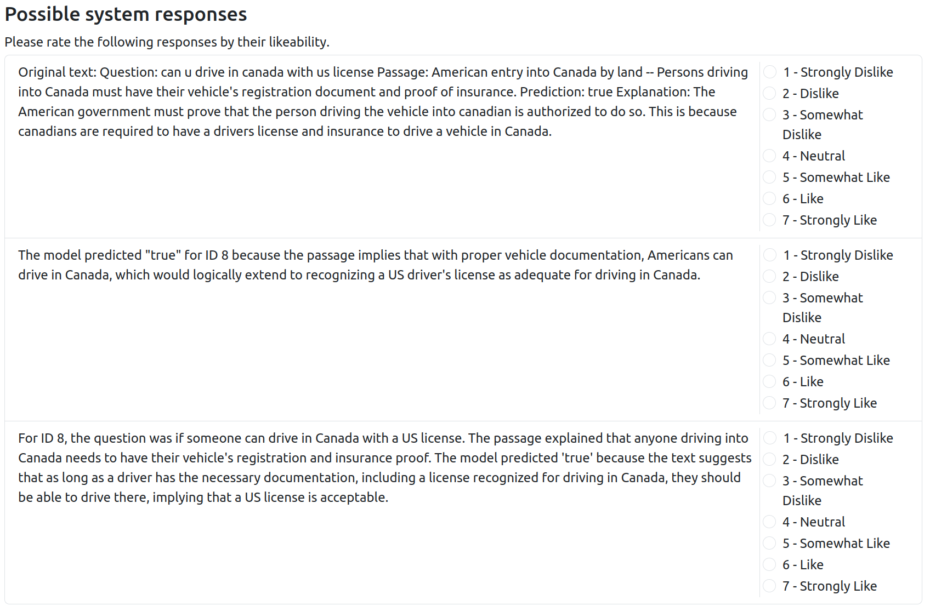
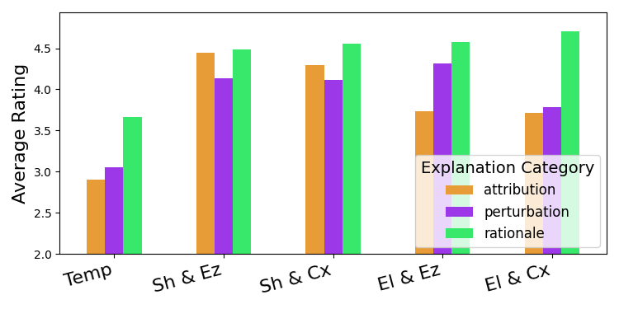
asd

Slide 39
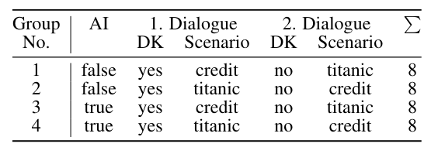
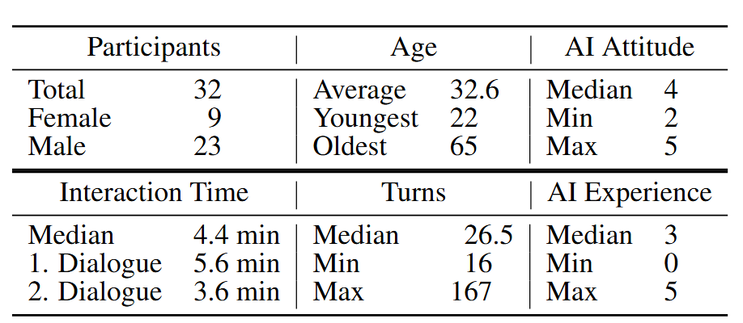
Domain Knowledge User Study

Slide 40
Rote Linie 1
Introduction: Transparency is key → Field of XAI
Abstract explanations: good for machine learning experts
Conversation as basis (cite Miller)
Field of Conversational XAI / Social XAI to tackle natural conversations
T2M, ConvXAI as samples → for expert users; Q&A-Systems
Research Questions/Goal
Argumentation & Explanations
Computational Argumentation & XAI; reseachers try to solve XAI with pure argumentation for reasoning (e.g. Walton, Prakken)
Madumal et. al. → Interaction Protocol; Argumentation dialogue after explanation to get better understanding
Argumentative Dialogues
The vision: example dialogue
Concept for dialogues in conversational XAI
Introduction Dialogue Systems in general
What is needed?
Which components are necessary
Explanations require more then XAI methods offer
Show limitations of XAI; (e.g. the vision example)
→Extend with external knowledge; State of the art?

Slide 41
Rote Linie 2
Integrating Domain Knowledge (DK)
Idea: Take arguments as trees which are domain knowledge explanations
Connect DK with XAI feature explanations
explanation policy + argument selection
Give Introduction to Athena (dialogues)
Study Setup
Study Evaluation

Slide 42
Rote Linie 3
Problems from study – What‘s next?
NLU → Optimize model with new data; check LLM performance
Question: LLM as all in one solution?
Paper Nicolas; „Dialogue Controller“ to manage general information
Compare Athena with an LLM all in one solution
NLG → Personalized explanations
Check how explanations can be generated in a natural manner
Personalize them: e.g. user experience/knowledge; conversational style; example style: compare to a domain the user knows
Explanation Policy: Show domain knowledge more proactive; combine „raw“ explanations

Slide 43
The Vision | Example Dialogue
…
System: The person you described to me would have survived.
User: Why is that so?
System: You told me the person is female. The gender has a big influence on this outcome.
User: But why has the gender such influence?
System: As far as I know there is a statement "women and children first", this led to the fact that women were preferred in the distribution of the life boats and therefore had a higher chance to survive.
User: Does this mean if I change the gender to male, the person would have drowned?
System: Yes.
…

Slide 44
Research Questions
How can machine-generated explanations be integrated into a dialogue system and presented to the user in a comprehensible way? [RQ1]
How can explanations be enhanced by additional knowledge? [RQ2]
How can knowledge be integrated into an explanatory dialogue system in a generic way? [RQ2.1]
What knowledge sources can be used to enhance system knowledge? [RQ2.2]
What strategy for selecting additional knowledge and explanations supports dialogue management? [RQ3]

Slide 45
Further Steps for Domain Knowledge Integration (RQ2.1)
Goal: Bigger study with more participants and native speakers
Adaptions:
More robust NLU
Provide new user move (e.g. RequestMetaInformation: „what is duration?“)
Adapt study setting
think of a more natural scenario where users want to explore additional knowledge
adapt study questions for domain knowledge (the term „system decision“ seems unclear)
Adapt Policy for DK Integration
Provide DK more proactively
Find strategy to make DK more visible (e.g. give hint on utterance origin)
Optional: Integration of Diabetes Dataset (?)

Slide 46
Knowledge Sources
Possible Sources:
Argument Search
Domain experts
LLMs for widely spread topics (tested for credit)
Semantic Web
Planned Steps:
Pipeline for transforming resources to the used model (Niklas, Carolin)
Compare argument trees from pipeline with handcrafted trees
Goal: (Half-)Automated Pipeline for generation of additional knowledge

