Slide 1

A Preliminary Empirical Assessment of Similarity for Combinatorial Interaction Testing of Software Product Lines
Stefan Fischer
Roberto E. Lopez-Herrejon
Rudolf Ramler
Alexander Egyed

Slide 2
Software Product Line (SPL)
An SPL is a family of related software products
Products are distinguished by a set of features they provide
All the valid combinations of features are expressed in a variability model (e.g. feature model)
All possible products can be derived from the SPL
Features can have side effects on one another (i.e. features interactions)
Challenge for testing: there are potentially too many valid combinations to test

Slide 3
Motivation
Increasing number of search-based approaches for testing software product lines
Challenging scalability issues of Combinatorial Interaction Testing
Similarity as a surrogate metric for t-wise coverage
Henard et al., Bypassing the combinatorial explosion: Using similarity to generate and prioritize t-wise test configurations for software product lines. IEEE Transactions on Software Engineering, 2014

Slide 4
Goals
Empirically assess the quality of the results of the similarity based approach with an SPL with documented faults
Test how well the similarity based approach fairs against CASA, a tool for full t-wise interaction coverage
M. B. Cohen, C. J. Colbourn, and A. C. H. Ling, “Augmenting simulated annealing to build interaction test suites,” in Proc. IEEE14th Int. Symp. Softw. Rel. Eng., 2003, pp. 394–405.

Slide 5
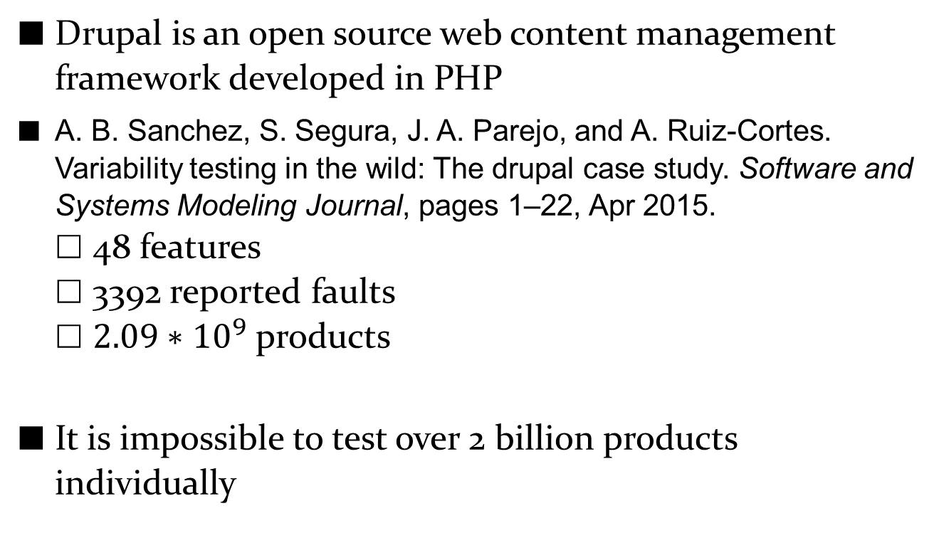
The Drupal SPL
Drupal is an open source web content management framework developed in PHP
A. B. Sanchez, S. Segura, J. A. Parejo, and A. Ruiz-Cortes. Variability testing in the wild: The drupal case study. Software and Systems Modeling Journal, pages 1–22, Apr 2015.
48 features
3392 reported faults
$2.09∗{10}^{9}$ products
It is impossible to test over 2 billion products individually
Notes:
30000 modules -> each one considered a feature
Over 66 years to test all in 1 second

Slide 6
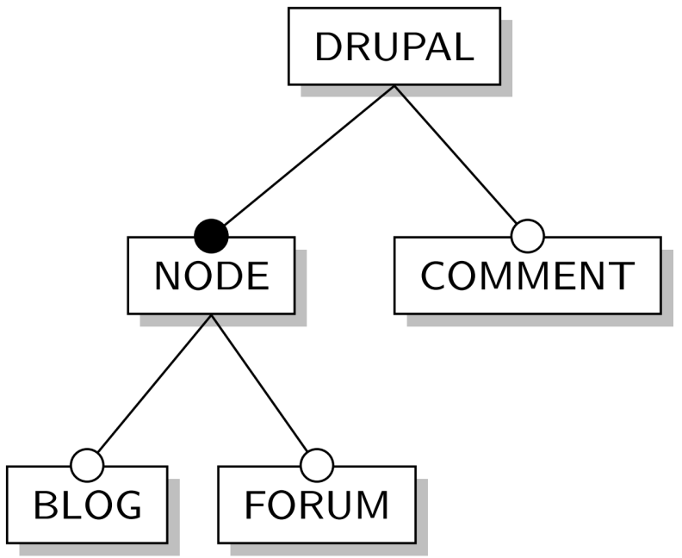
Drupal Feature Model [Sanchez SoSyM’15]
FORUM => COMMENT
Mandatory feature
Optional feature
Cross-Tree-Constraint
Notes:
21 cross-tree-constraints in the Drupal feature model

Slide 7
Combinatorial Interaction Testing (CIT)
Test all valid t-wise combinations of features
Find a set of sample products that cover all these interactions (i.e. covering array)
Most common t=2 (i.e. pairwise testing)
CIT in general: pairwise coverage discloses ~80% of the bugs
D. R. Kuhn, D. R. Wallace, and A. M. Gallo, “Software fault interactions and implications for software testing,” IEEE Trans. Softw. Eng., vol. 30, no. 6, pp. 418–421, Jun. 2004.

Slide 8
CIT Example
Example Drupal
FORUM & COMMENT
NOT FORUM & COMMENT
FORUM & NOT COMMENT
NOT FORUM & NOT COMMENT
BLOG & FORUM
…
SUM: 3,751 pairwise combinations
FORUM => COMMENT

Slide 9
Scalability Problems
Computing all 2-wise interactions for large feature models (several thousands features) is still an open issue
Preliminary evidence shows that 3-wise interactions may commonly appear in SPL testing practice
higher interaction strengths are important for achieving higher fault detection
CIT tools fail to scale even on feature models of moderate size (500+ features) for higher interaction strengths (t = 3, 4)

Slide 10
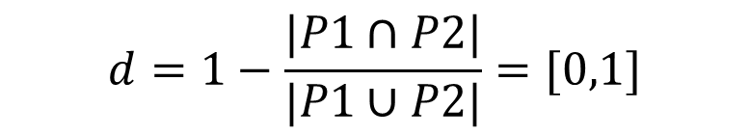
Similarity as a Surrogate Metric for coverage [Henard TSE’14]
Goal: Mimic t-wise product configurations generation while achieving decent coverage
Randomly generating products and using those that are the least similar to each other
Input: Number of products in solution,
Time to compute
Jaccard distance:
Products that are less similar to one another are more likely to cover more t-wise interactions
$$d=1−\frac{|P1∩P2|}{|P1∪P2|}=[0,1]$$

Slide 11
Research Questions
RQ1: How are the faults distributed among features?
RQ2: What is the fault detection capability of the similarity heuristic when using Drupal’s real fault data?
RQ3: What is the actual t-wise coverage obtained by the similarity heuristic?

Slide 12
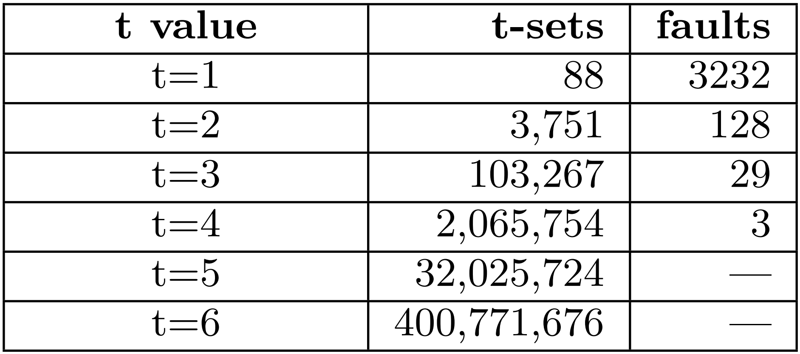
RQ1: Distribution of Faults
Assumption: All t-wise interactions have the same probability to trigger a fault
Notes:
Rationale: For the analysis of fault detection, one of the assumptions that Henard et al. make is that all the t-wise interactions have the same probability to trigger a fault. We are interested in analyzing whether this assumption holds true in case of Drupal.

Slide 13
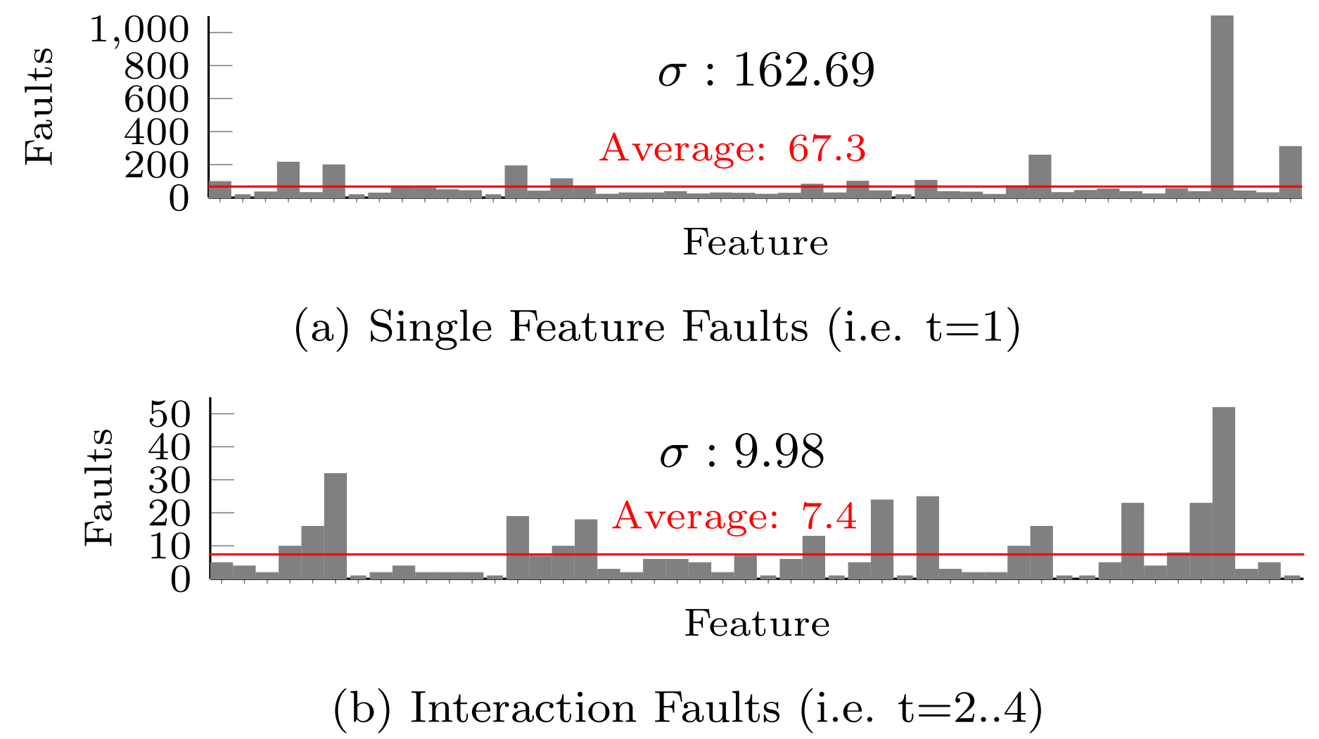
RQ1: Distribution of Faults

Slide 14
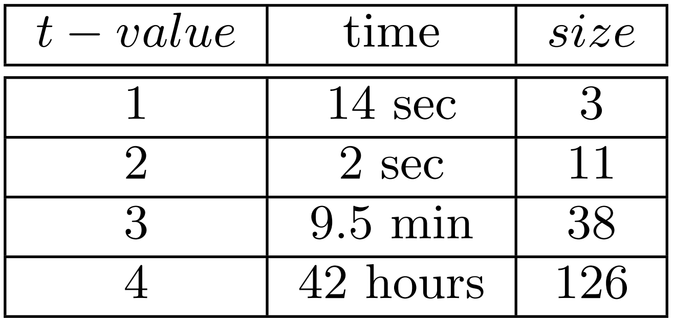
RQ2: Fault Detection Capability
How effective is the similarity based approach to generate configurations that contain feature interactions which were identified as faulty in Drupal
CASA:
Notes:
Rationale: Our goal is to assess how effective Henard et al.’s approach is to generate configurations that contain the feature interactions which were identified as faulty in Drupal.

Slide 15
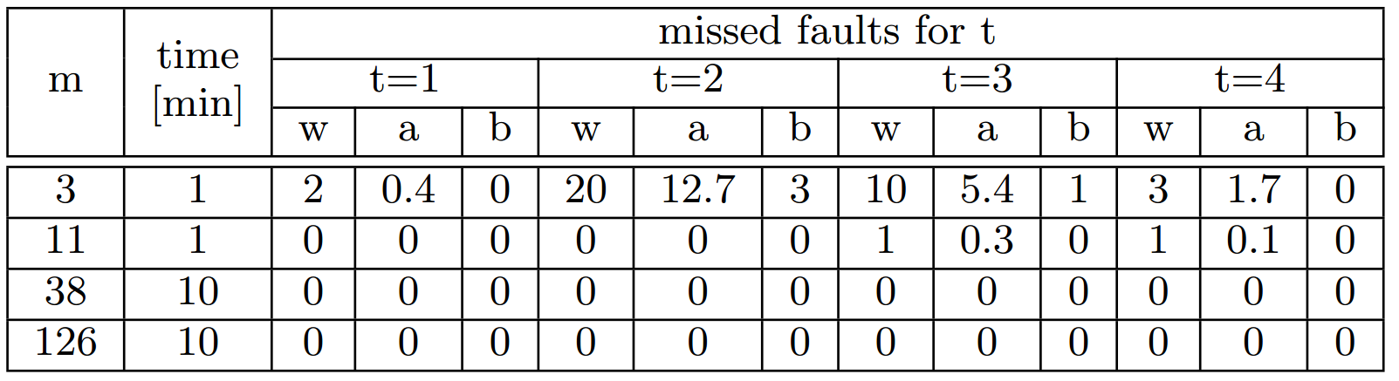
RQ2: Fault Detection Capability
m: number of products (Input to the approach)
time: time limit set for computation (Input)
w: worst, a: average, b: best results for missing faults over 10 runs

Slide 16
RQ3: T-wise coverage
The goal is to mimic t-wise product configurations generation while achieving decent coverage
Compare the coverage achieved by the similarity based approach with those implemented by CASA
Notes:
Rationale: The driving goal of Henard et al.’s approach is to mimic t-wise product configurations generation partially but efficiently while achieving decent coverage. In this regard, we are interested in comparing the coverage achieved by their approach with those implemented by an alternative tool. For this purpose, we selected the tool CASA which is capable of computing arrays of higher strength using simulated annealing

Slide 17
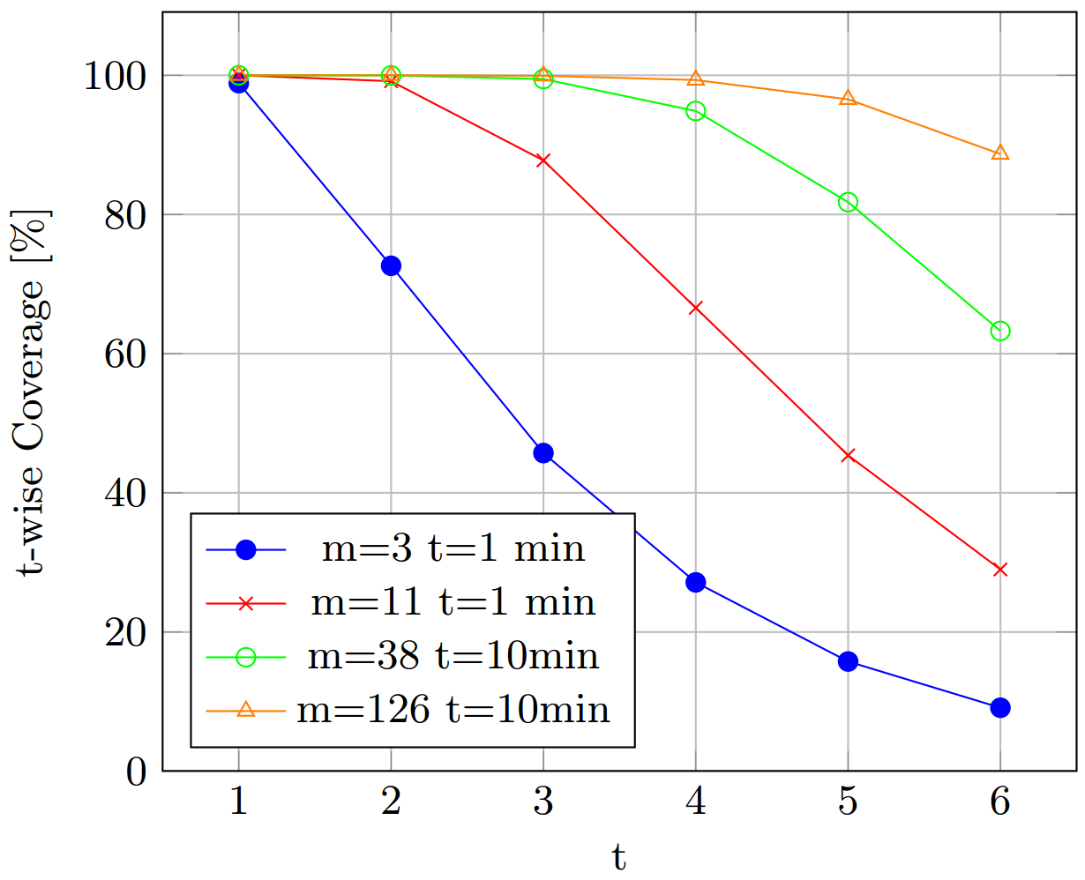
RQ3: T-wise coverage

Slide 18
Conclusions
Faults in Drupal are not evenly distributed over all t-wise interactions
Faults in Drupal can be fully detected with a low number of products
Similarity based results are competitive compared to t-wise coverage results

Slide 19
Future work
Gathering more empirical data of other case studies that provide variability as well as fault data
Abal et al. [ASE’14] used Linux commit data to identify faults
Use of other information when calculating covering arrays:
Sanchez at al. found a correlation between the number of faults and the LOC in Drupal features
Source code properties (e.g. dependencies between feature implementations)

Slide 20




Any Question?
Contact: stefan.fischer@jku.at

Slide 21
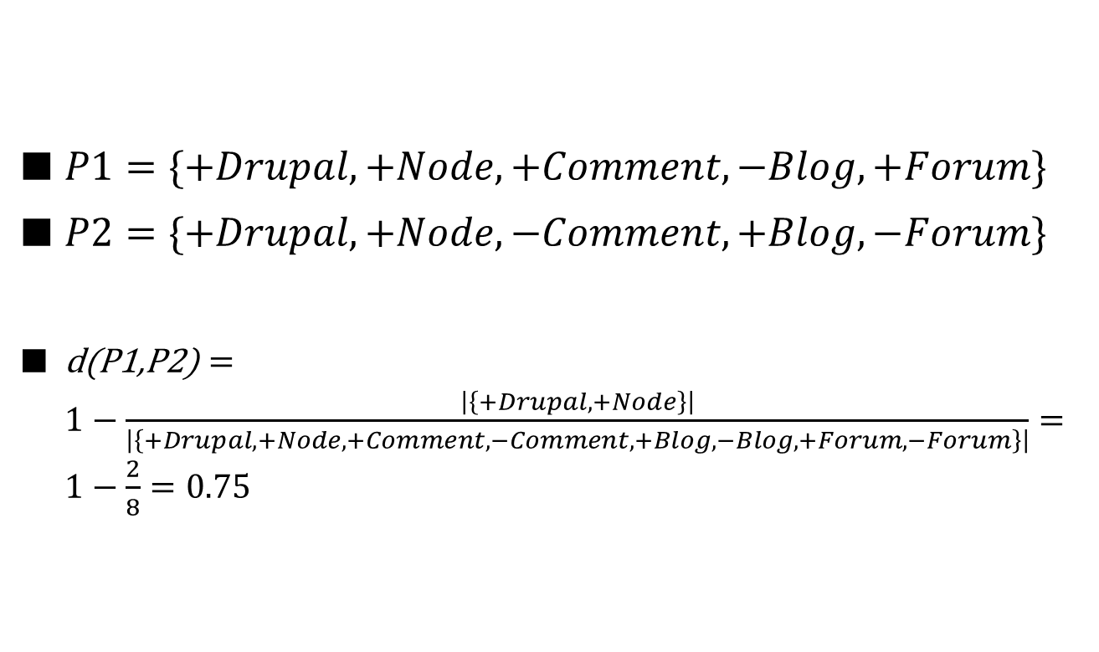
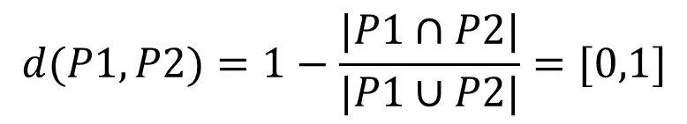
Jaccard Distance Metric
$$d(P1,P2)=1−\frac{|P1∩P2|}{|P1∪P2|}=[0,1]$$
$P1=\{+Drupal, +Node, +Comment,−Blog,+Forum\}$
$P2=\{+Drupal, +Node, −Comment,+Blog,−Forum\}$
$\text{d}\text{(}\text{P}\text{1,}\text{P}\text{2)}=1−\frac{\left|\left\{+Drupal, +Node\right\}\right|}{\left|\left\{+Drupal,+Node,+Comment,−Comment,+Blog,−Blog,+Forum,−Forum\right\}\right|}=1−\frac{2}{8}=0.75$
Notes:
0: equal products
1: totally different

Slide 22


Fitness Function
$f\left(P1,P2,P3\right)=d\left(P1,P2\right)+d\left(P1,P3\right)+d\left(P2,P3\right)$
Maximizing this function potentially results in a higher t-wise coverage
$$f(P1..Pm)=\sum_{j>i}^{m}{d(Pi,Pj)}$$

