Slide 1
MSDAP ASIC design Final Presentation
Mark Sears
Seoha Lee

Slide 2
Contents
MSDAP Specification
Architecture
Synthesis - Design Compiler
Simulation Waveforms
Physical Design - IC Compiler

Slide 3

System Algorithm
MSDAP filter convolution

Slide 4
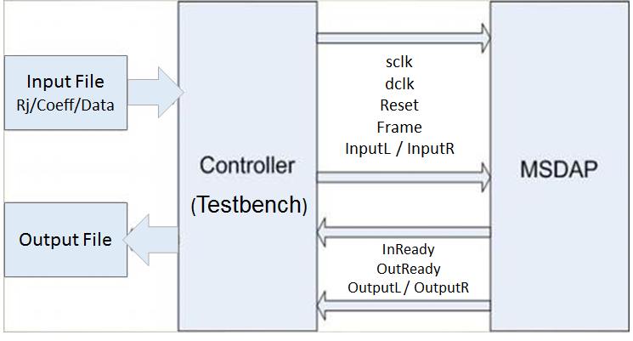
System top-level view

Slide 5
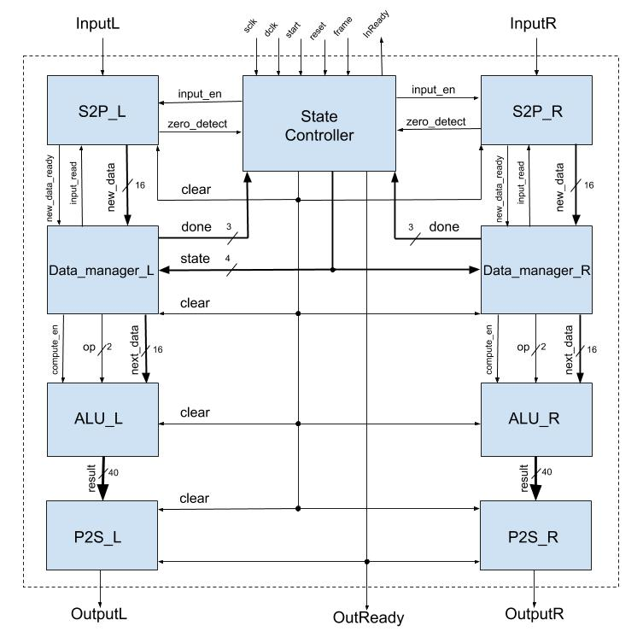
MSDAP Architecture

Slide 6
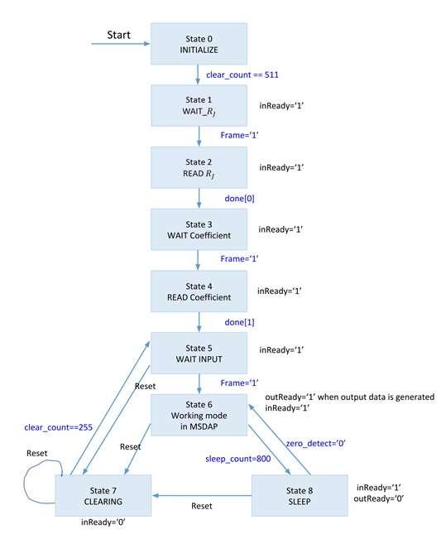
MSDAP FSM

Slide 7
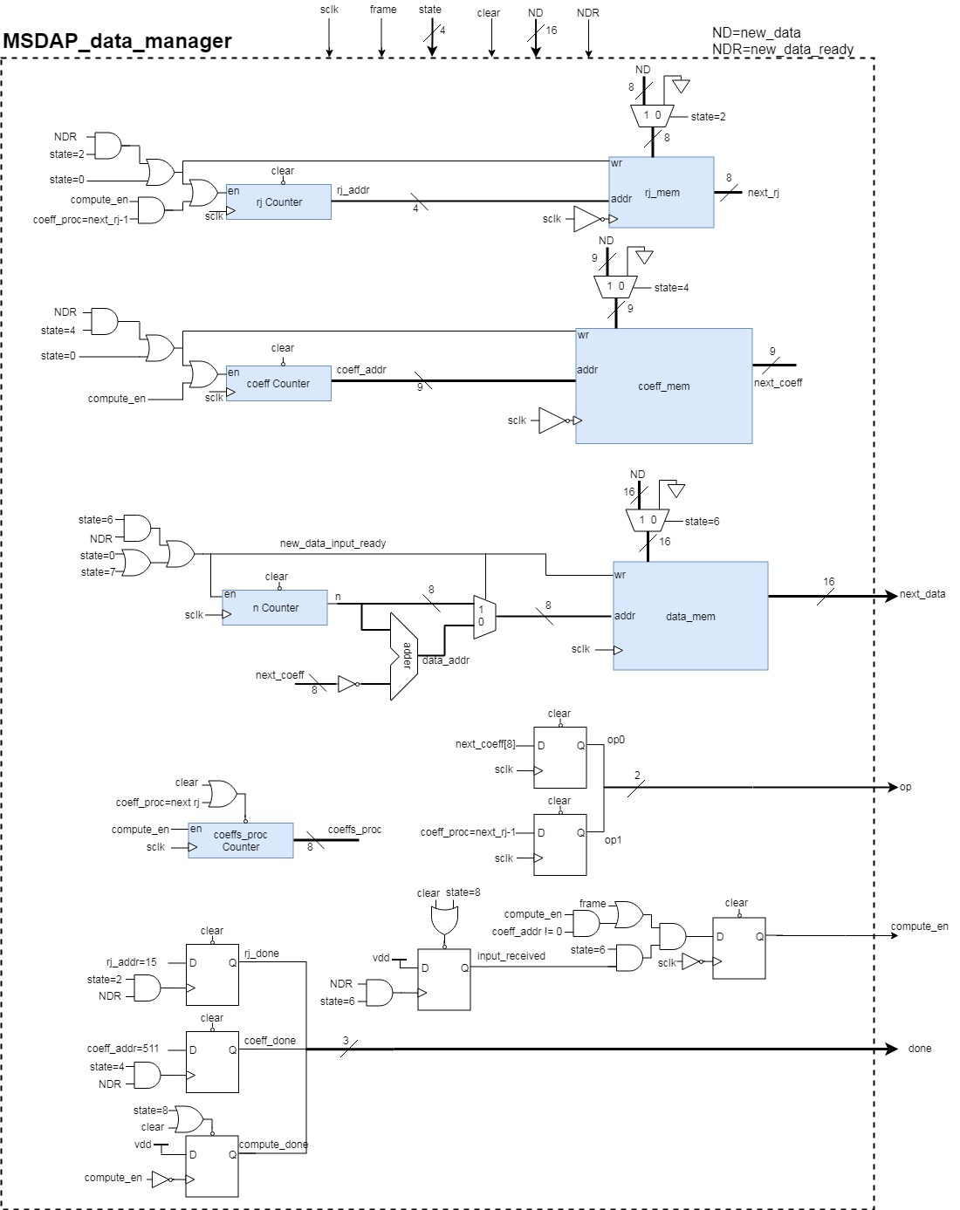
Data Manager

Slide 8
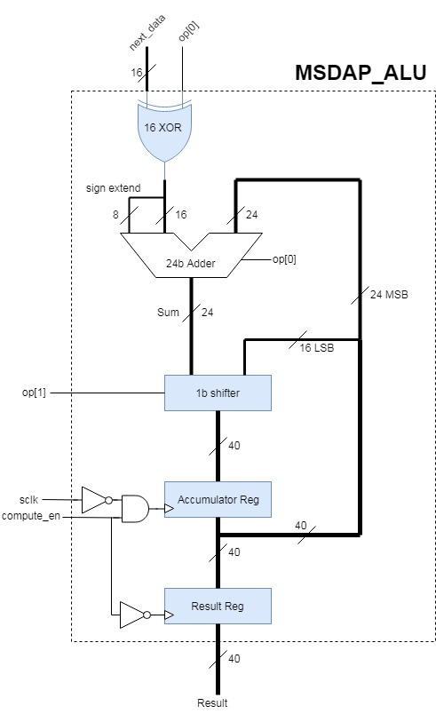
ALU

Slide 9
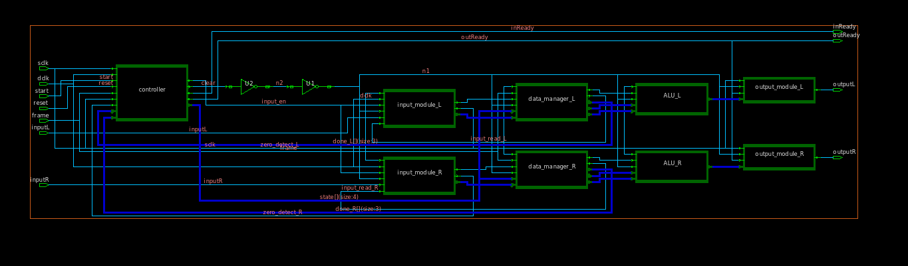
DC Block Schematic

Slide 10
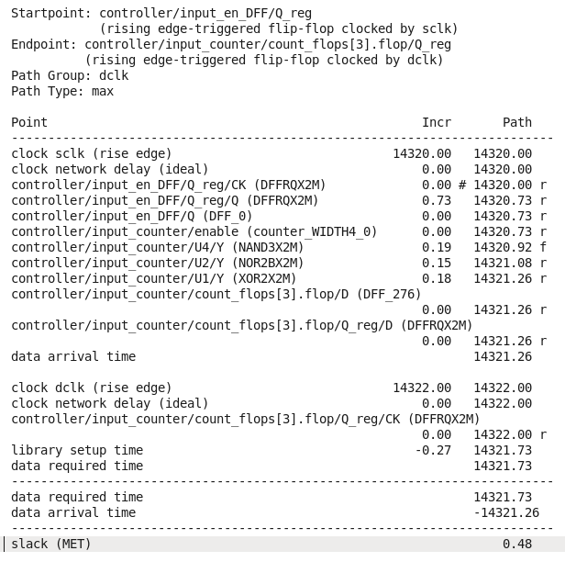
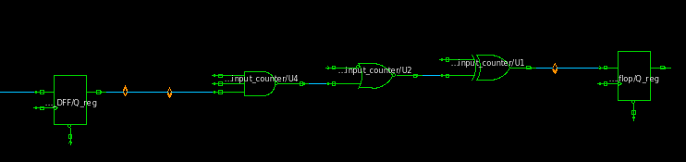
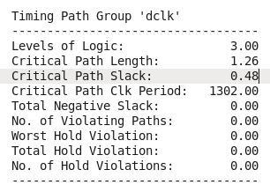
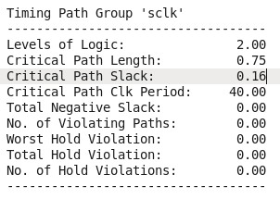
Critical Path

Slide 11
Simulation Waveforms

Slide 12
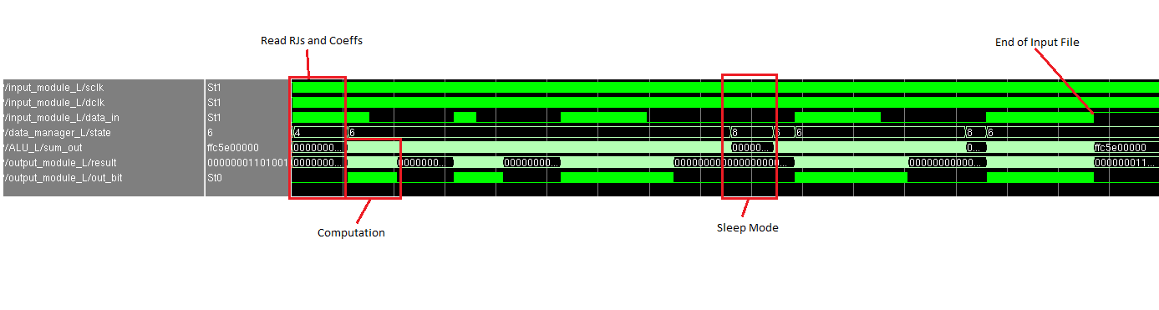
Overview of MSDAP Testbench (synthesized)

Slide 13
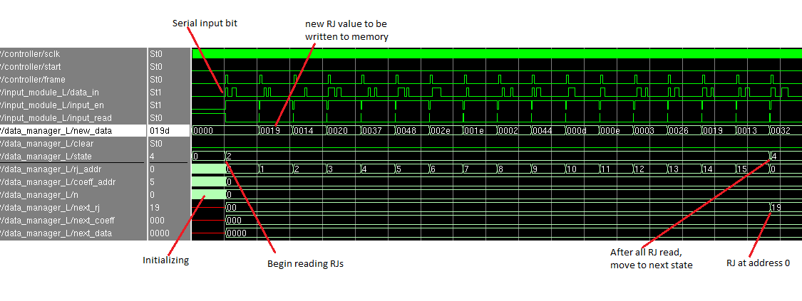
Read RJ (RTL)

Slide 14
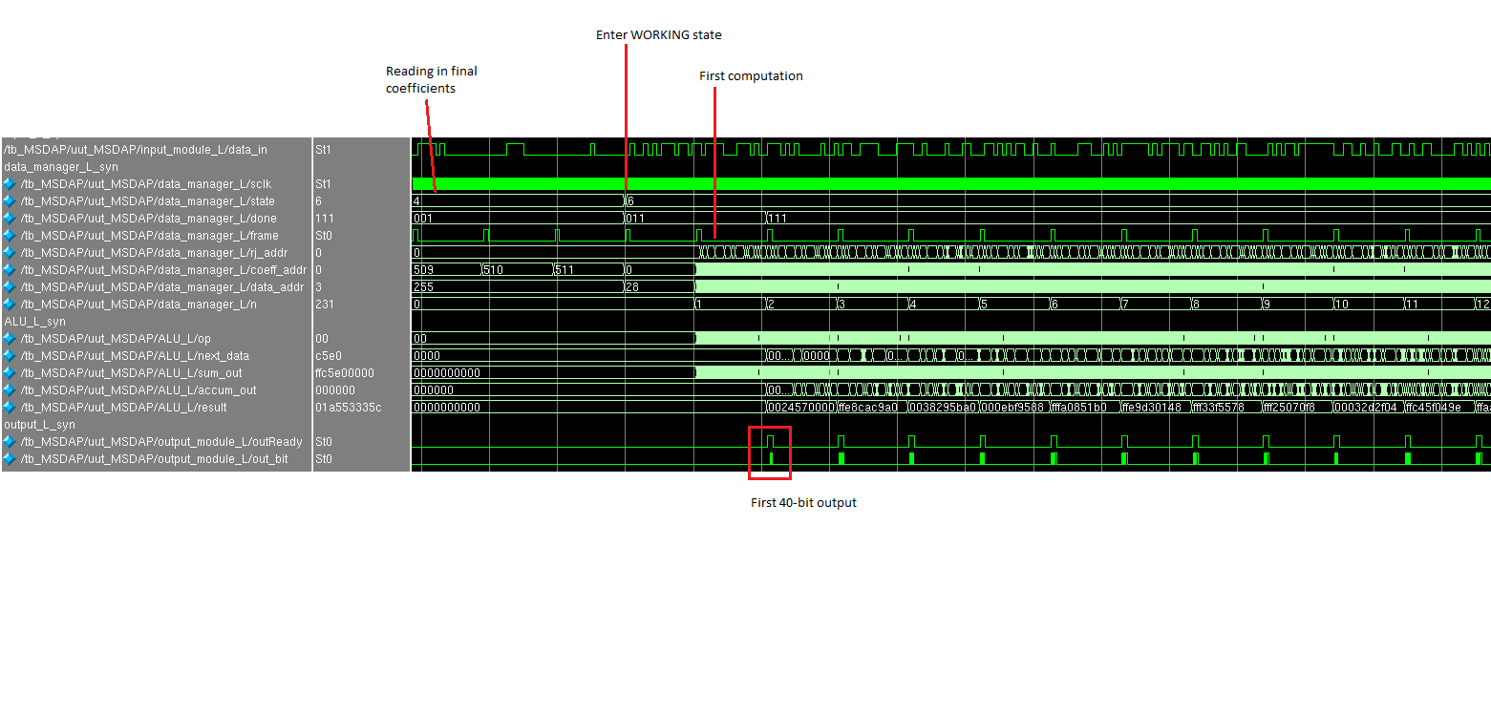
Computation Overview (synthesized)

Slide 15
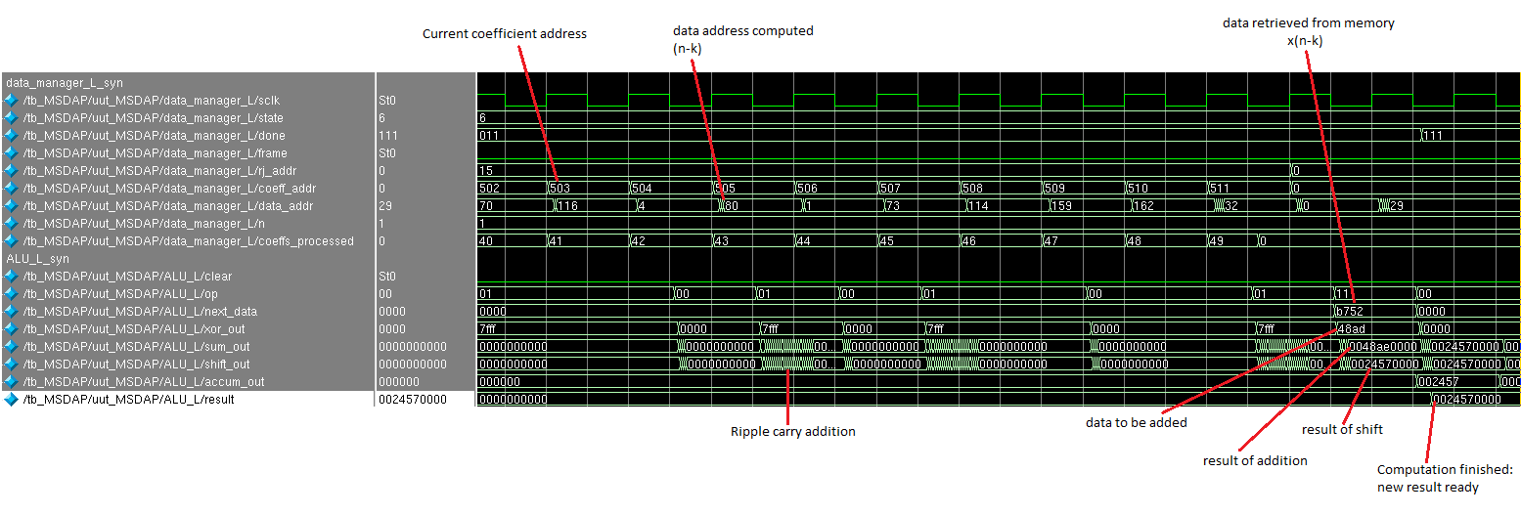
Computation detail (synthesized)

Slide 16
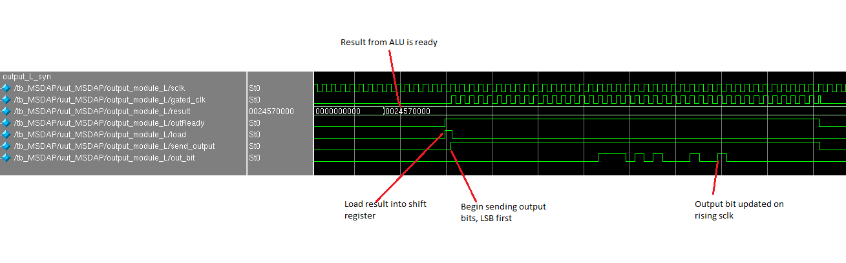
Send Output detail (synthesized)

Slide 17
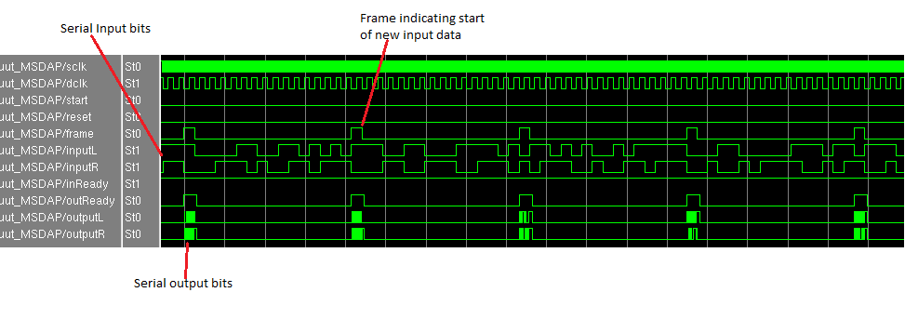
Computation from Top Level (RTL)

Slide 18
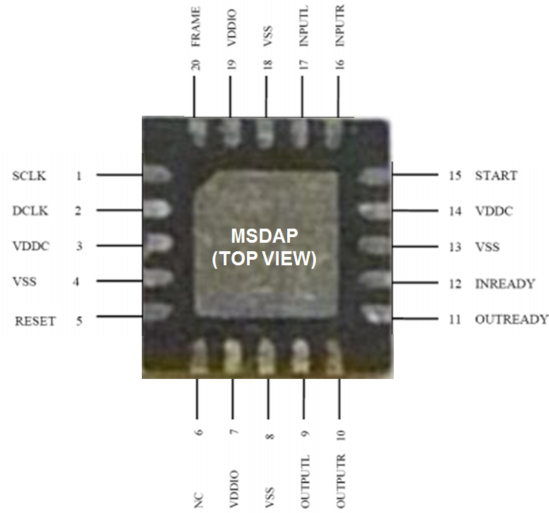
Physical Design
Pin settings for MSDAP Chip

Slide 19
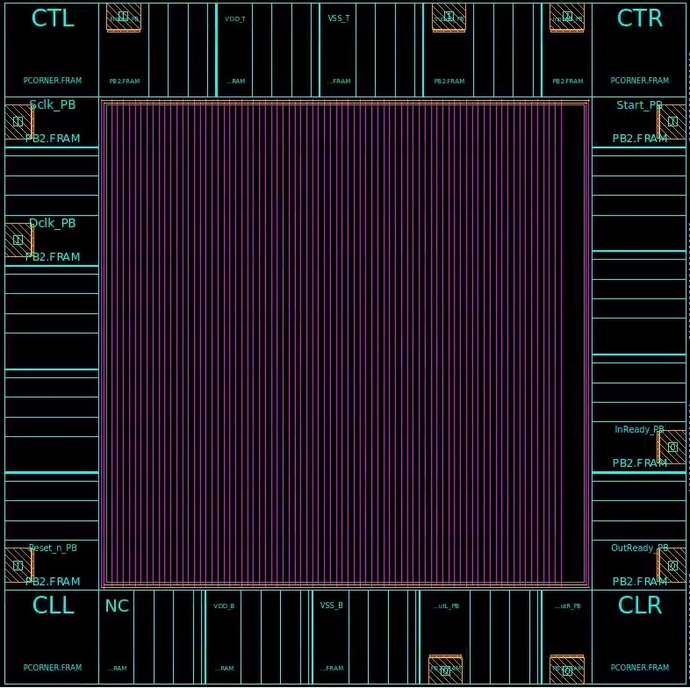
Floorplan
Power Network

Slide 20
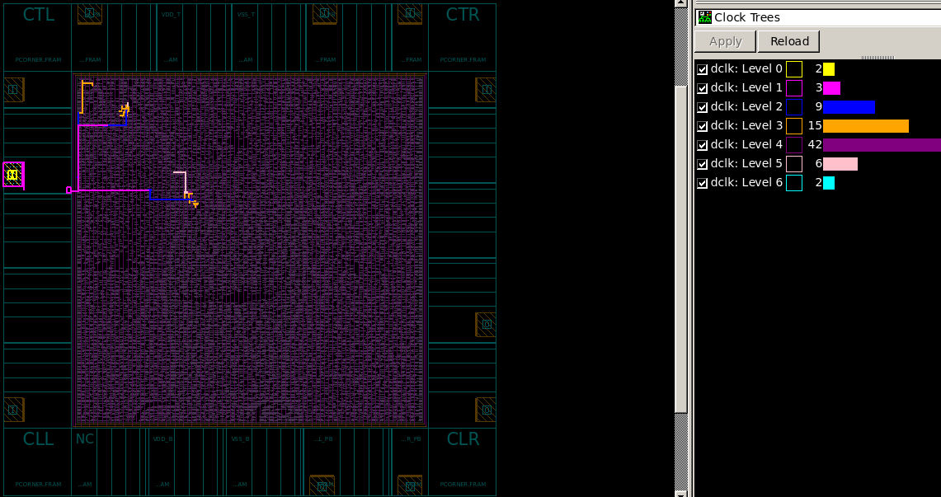
Clock Network (dclk)

Slide 21
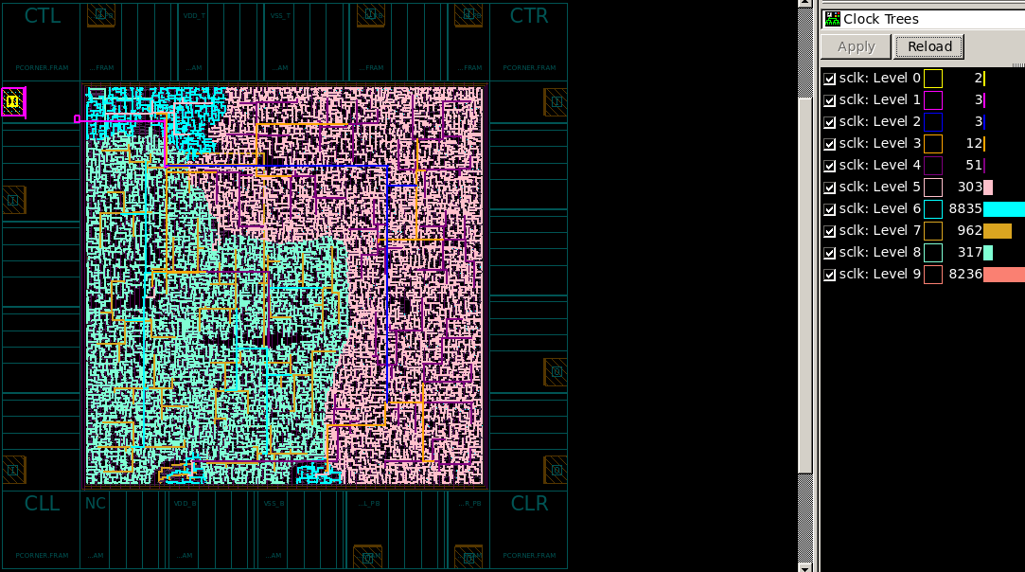
Clock Network (sclk)

Slide 22
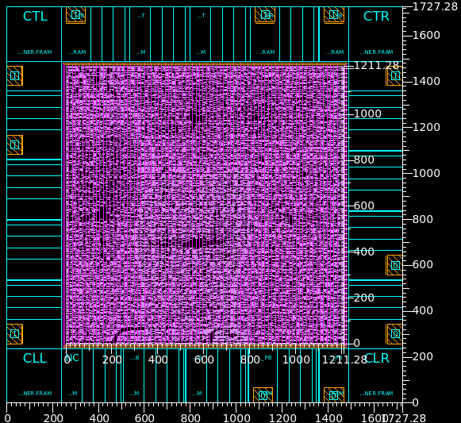
Physical Design
Layout

Slide 23
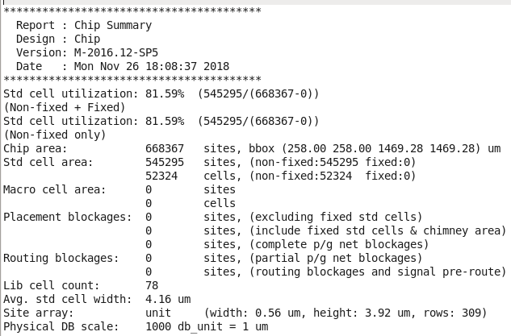
MSDAP Chip Summary
Frequency of sclk | 25MHz
Timing slack | No negative violation
Total Dynamic Power | 42.1118 mW (100%)
Leakage Power | 37.3090 uW
Core Chip Area | 668367 sites 1.4672 mm²
Total Chip Area | 2.9835mm²

Slide 24
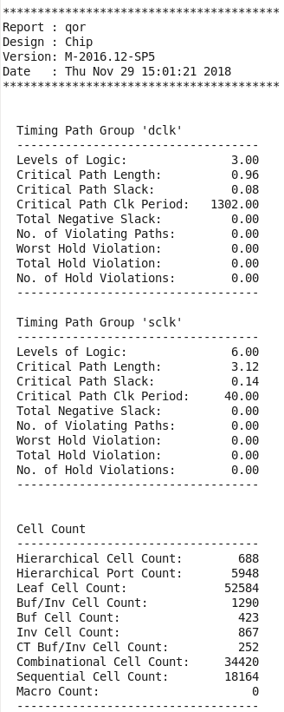
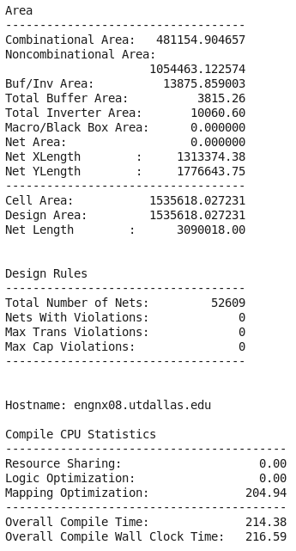
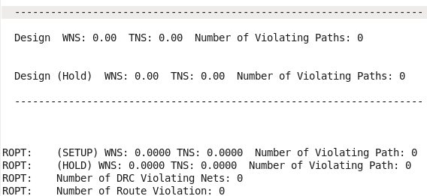
No Violations

Slide 25
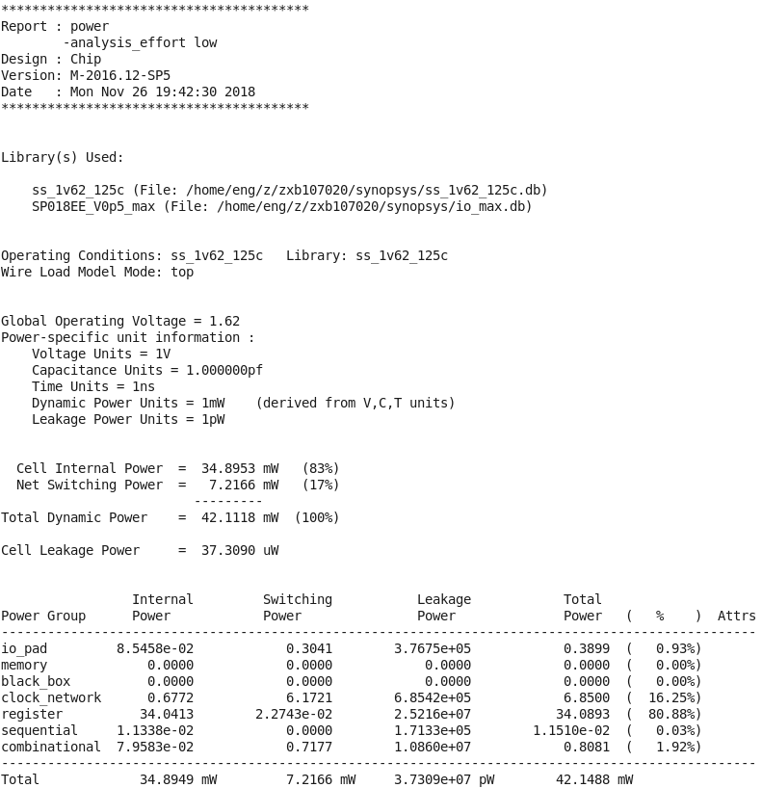
Power Consumption
report

Slide 26
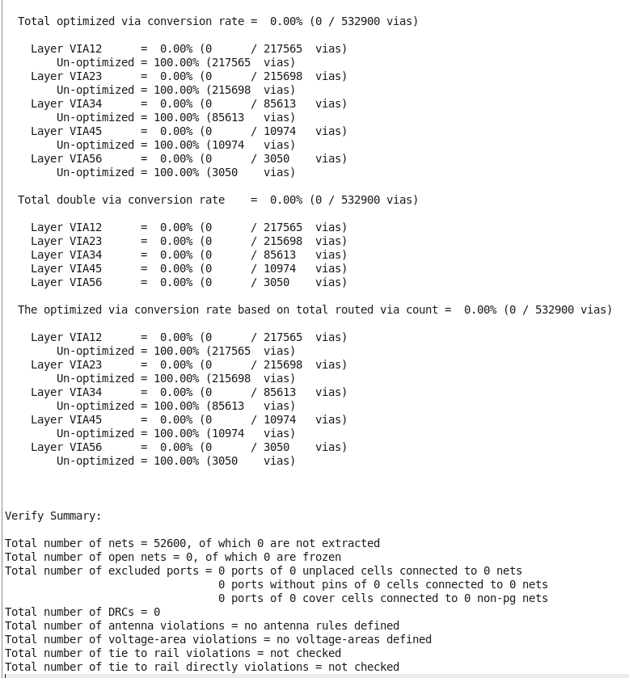
Verification Report
Result

Slide 27
Additional Slides

Slide 28
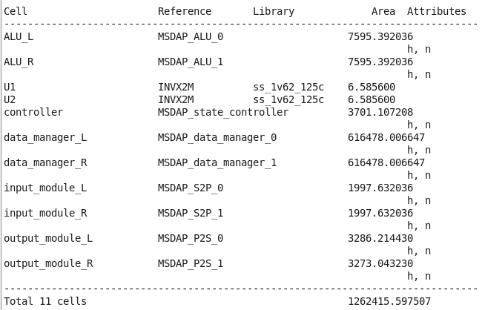
Synthesized Area
Area ≈ 1.26 mm²

Slide 29
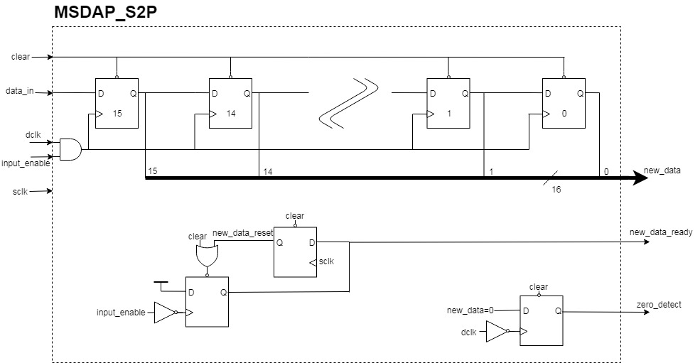

Slide 30
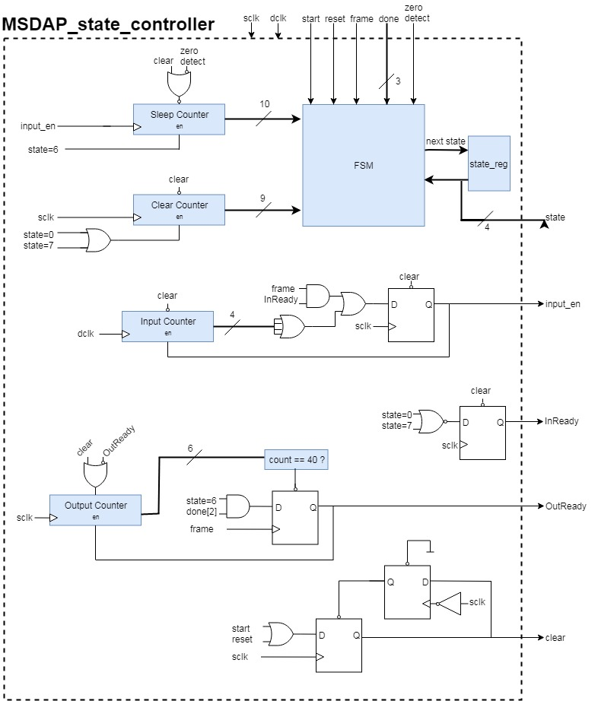
Controller

Slide 31
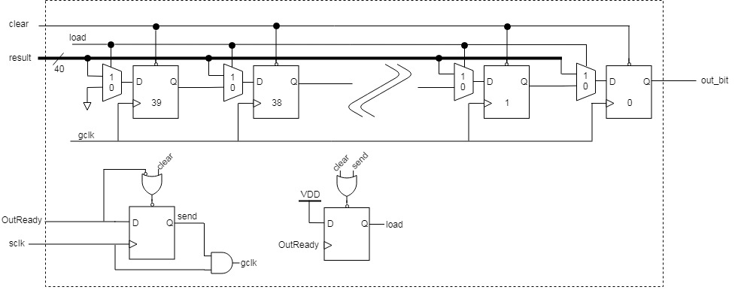
MSDAP_P2S

Slide 32
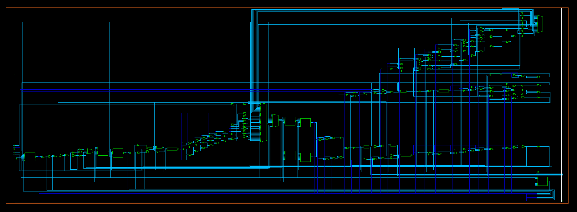
DC Schematic - Controller

Slide 33
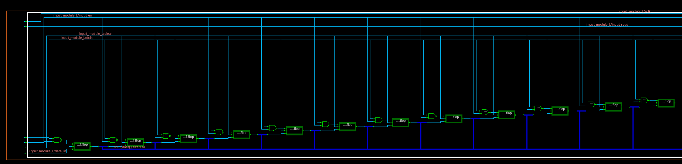
DC Schematic - Input Module

Slide 34
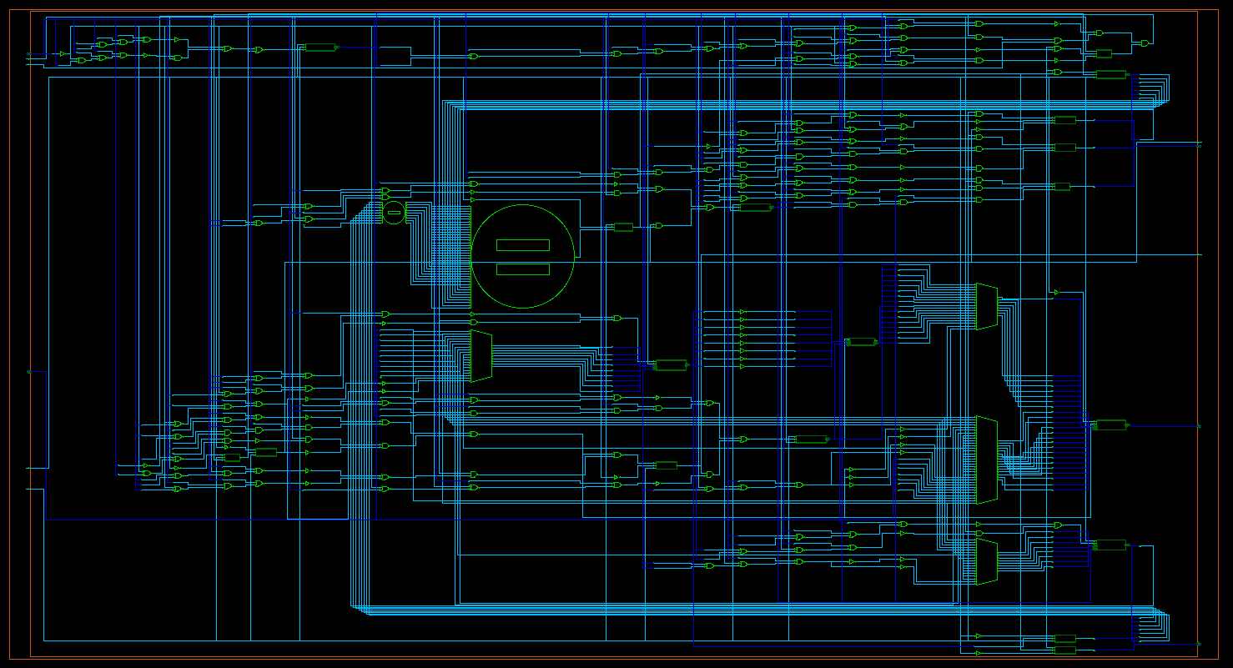
DC Schematic - Data Manager

Slide 35
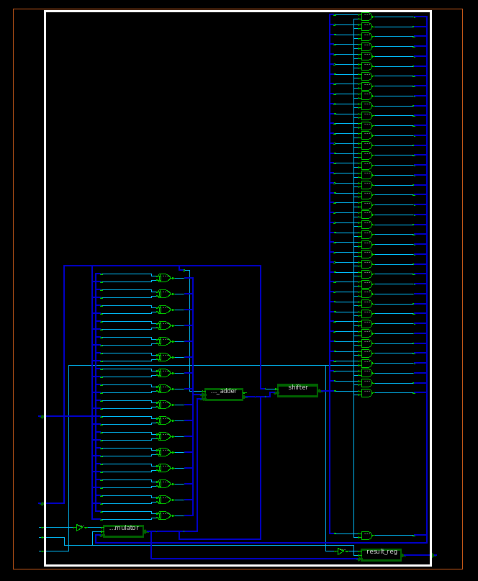
DC Schematic - ALU

Slide 36
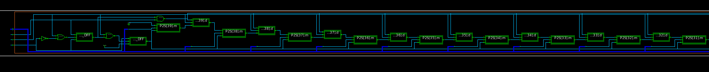
DC Schematic - Output Module

Slide 37
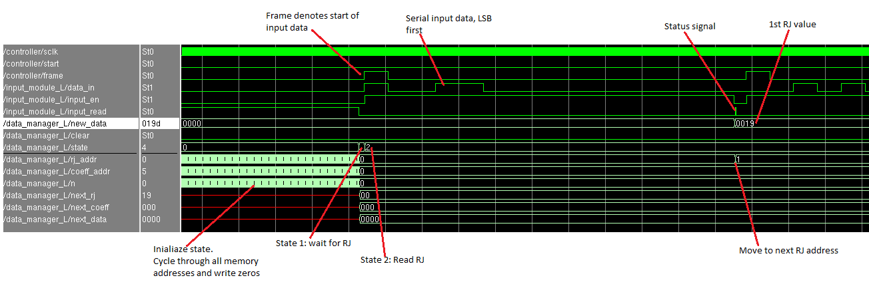
Read RJ detail (RTL)

Slide 38
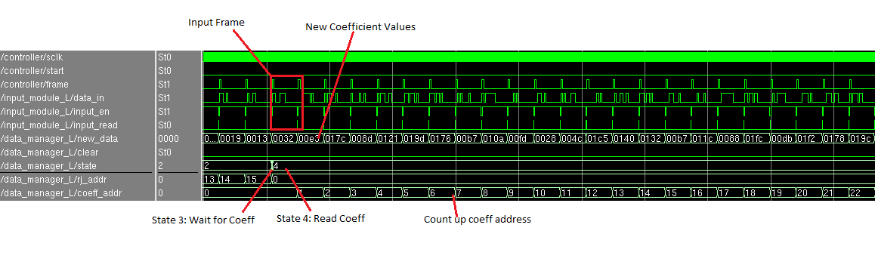
Read Coefficient values (RTL)

Slide 39
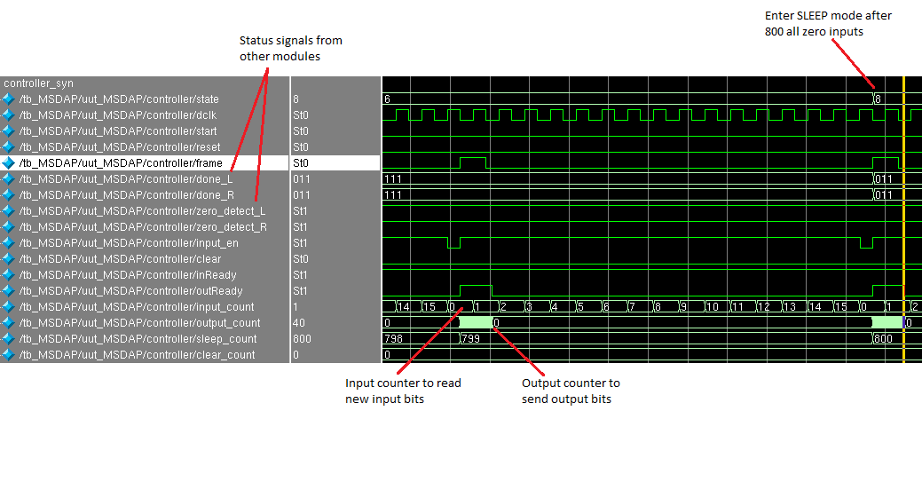
Counters and Sleep (synthesized)

Slide 40
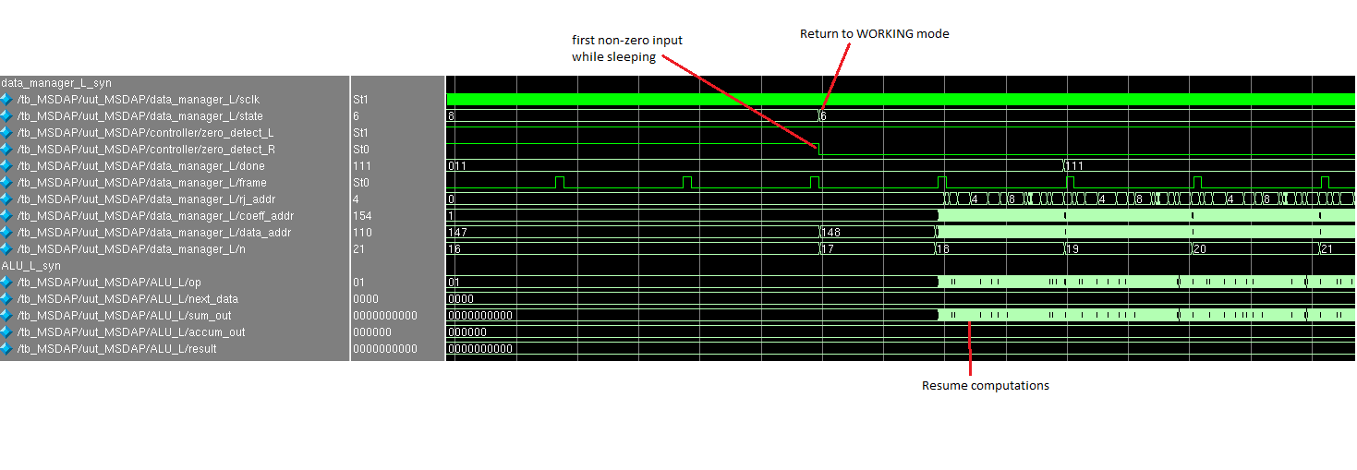
Wake up (synthesized)

Slide 41
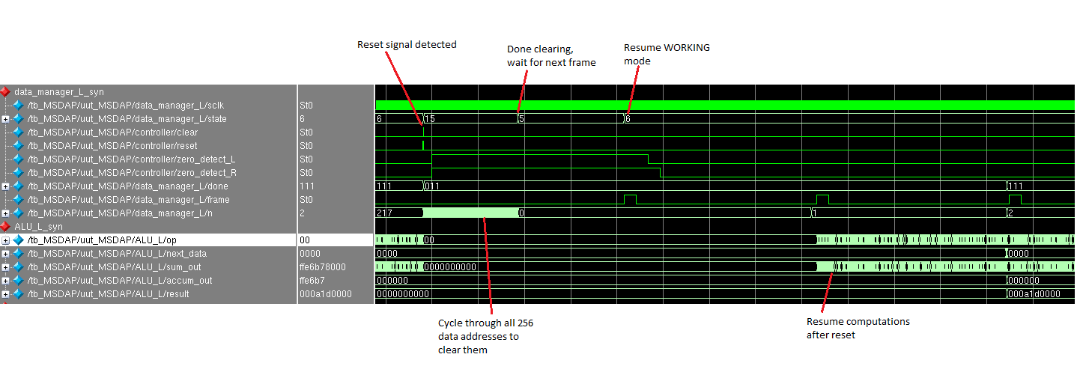
Reset (synthesized)

