Slide 1
Typical & Atypical Cognitive Development Unit 0. Introduction into course topics and course structure 15th February 2019 Paul Seitlinger, Kati Aus, Grete Arro School of Educational Sciences Tallinn University

Slide 2
Course structure and requirements
Structure
60 minutes lecture in English (introducing the topic); Paul Seitlinger
30 minutes break
followed by a 60 minutes seminar in Estonian (deepening the introduced course content); Grete Arro and Kati Aus
Requirements
Reflecting on previous unit (answering 1-2 questions)
Preparing for the next unit by reading a topic-related (short) article (answering 3-5 questions)
Taking part in the seminar
Taking online exam
Answering open-ended questions on presented course contents (to be returned within one week)
Course materials
https://seasense.github.io

Slide 3
Course topics
Unit 0 (15th of February, T-412)
Introduction: Why does Cognitive Science matter in the educational context?
Unit 1 (8th of March, T-412)
Cognitive development from the nature-nurture perspective? What is the impact of genes versus environment?
Unit 2 (15th of March, T-412)
How does the cognitive system develop? What are typical developmental stages? How do these stages relate to different cognitive components?
Unit 3 (22nd of March, T-412)
What are potential reasons for individual differences in (typical and atypical) cognitive development?
Unit 4 (5th of April, lecture provided as video; seminar in T-412)
How can we diagnose/measure and how can we train cognitive abilities?
Unit 5 (12th of April, lecture provided as video; seminar in T-412)
How can we design Discovery Learning in an inclusive way?
Exam (20th of April)

Slide 4
Why cognition matters
Determinants of scholastic achievement (based on Brühwiler & Helmke, 2018)
Which of these variables has the strongest impact?
Notes:
Countercheck

Slide 5
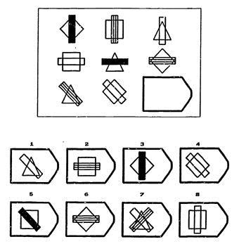
Why cognition matters
Intelligence is one of the strongest predictors of educational achievement (e.g., Hattie, 2009)
What is intelligence?
A general mental capacity to draw conclusions, to plan, to solve problems, to reason in abstract categories, to acquire new knowledge
Typically, the performance in tests with mentally demanding tasks
Relatively stable personality trait
Example of the Raven matrices IQ test
Notes:
https://www.iqmindware.com/iq-mindware/how-to-do-a-raven-matrices-test/

Slide 6
Why cognition matters
More intelligent/gifted students are better (faster and more effective) in
recognizing regularities and rules relevant for solving problems
acquiring and organizing knowledge (Hattie, 2009)
Learning scenarios of future school curricula become more challenging
E.g., Discovery Learning: Self-directed information search in addition to knowledge acquisition
Performance differences between more and less gifted students might become larger
Urgent questions in education:
How to design future education in an inclusive way?
What are effective strategies to help less well-equipped children in school?
Notes:
not so motivating
Trivial
There will always a gap …
But the point that I want to make – This gap might become even larger

Slide 7
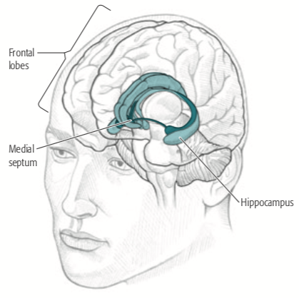
potential approach towards inclusive education
Looking at intelligence in a more nuanced way: what are the cognitive components that bring about intelligent behavior?
Basic functions (examples) | Emerging cognitive processes (examples) | Involved brain structures (examples)
Controlling attention | Drawing conclusions Imagination Planning Decision-making Problem solving … | Interplay of Working Memory (at the front of the brain = Pre-Frontal lobe) Long-Term Memory (e.g., Hippocampus, temporal lobe)
Retrieving from memory
Mentally manipulating pieces of information
Integrating new thoughts into memory
Identifying regularities in how these components develop during childhood
Deriving ways and strategies to support cognitive development

Slide 8
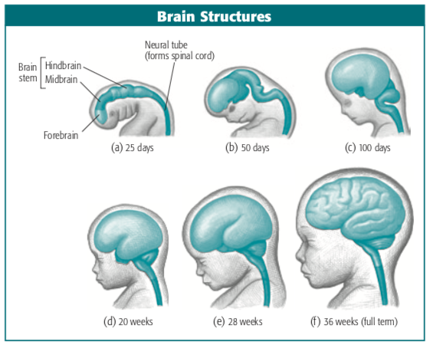
why we can influence cognitive development
Bio-psychological facts on our learnability (neural plasticity)
Humans have large brains relative to their body size
Much of neural development postponed until after birth
Though birth canal expanded to its limits, brain size can’t be larger than 350 cm³ at birth
Doubles in 1st year of life: 700 cm³
Soon after, growth rate slows down but the volume again doubles before reaching puberty: 1.400 cm³
Prolonged time of development
about 15 years ~ 1/5 of the human life span
needed to acquire complex cultural practices, such as language
Picture taken from Anderson (2015)

Slide 9
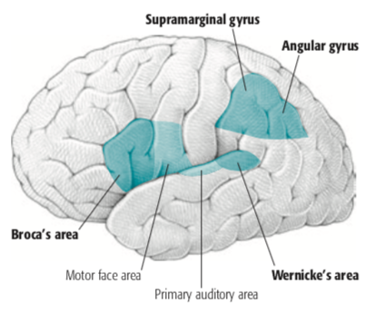
why we can influence cognitive development
Cognitive development (like learning your mother tongue) = Development of neural “communication structure”
All cognition (e.g., understanding and producing words) is distributed across specialized areas that
play specific roles, such as
comprehension of words (Wernicke’s area)
production of words (Broca’s area)
communicate to exchange their processing products (e.g., meaning and sound of a word)
Picture taken from Anderson (2015)
Notes:
- Diese lange Entwicklungszeit kommt uns entgegen, wo wir doch sehr viele komplizierte Dinge erlernen müssen, wie z.B. die Sprache
- Sieht man sich diese schematische Darstellung an, erkennt man etwas, das typisch fürs Gehirn ist, nämlich seineSpezialisierung
- Im Bereich der Sprache etwa kann man unterscheiden, zwischen dem Verstehen und dem Produzieren eines Wortes: W und B Areal
- Das Beispiel soll auch deutlich machen, dass die Verarbeitung von Information auf der Kommunikation dieser Areale ist

Slide 10
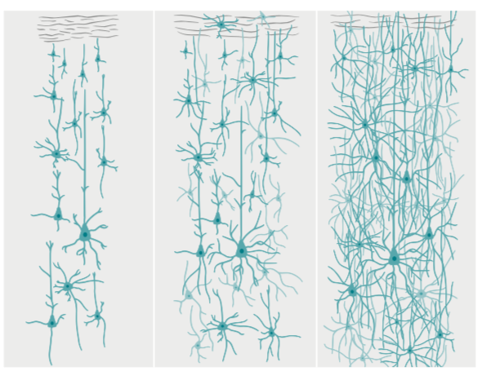
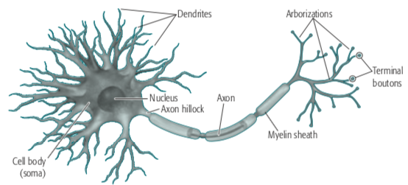
why we can influence cognitive development
Cognitive development = Development of neural “communication structure”
Brain development around Broca’s area
Neural communication is based on
neurons (basic processing units)
connections between neurons = Synapses
Learning to represent knowledge (e.g., word meaning) by building up new synaptic connections between neurons
Synaptogenesis peaks around the age of 2
Soon after, elimination of unnecessary structure = Synaptic pruning for neural efficiency (saving energy)
Newborn
3 months
24 months
Picture taken from Anderson (2015)
Notes:
Communication is based on connections between neurons = synapses
One single neuron can’t represent knowledge, such as the meaning of a word
Only possible through the communication among a large number of neurons
Therefore synaptogenesis (explosion of synapse formation in infancy)
It peaks at the age of 2. Broca area and how synapses increase
Soon after, it starts removing unnecessary synapses: Pruning for neural efficiency
“Use it or lose it” principle; synaptic pruning (between 2 and 16)
Whether or not a synapse is pruned is influenced by the experiences a child makes. Constant stimulation causes synapses to grow and become permanent. But if a child receives little stimulation the brain will keep fewer of those connections.
Environment and education to separate important from less important things
Interplay of biology and learning experiences

Slide 11
why we can influence cognitive development
Cognitive development = Development of neural “communication structure”
Brain development around Broca’s area
Synaptic pruning https://www.youtube.com/watch?v=rxPT78F_ZVE
Between the ages of 2 and 16
“Use it or lose it” principle
Constant stimulation → synapses become stronger and permanent
Little stimulation → elimination
Interplay of biology (nature) and learning experiences (nurture)
Implication for Education?
Reflect on it in the first assignment 1a (see slide 13)
Newborn
3 months
24 months
Picture taken from Anderson (2015)

Slide 12
Why does cognition matter for education?
Summary and some first conclusions
New learning scenarios place high cognitive demands on students
→ A need for strategies to let less gifted students participate and benefit as well
Human cognition
is distributed across communicating and specialized brain areas
Neural communication based on synapses connecting simple processing units (neurons)
Synaptic pruning
helps to save energy and fine-tune the brain
Learning and cognitive development takes place as an interplay between
the formation of important and the pruning of unimportant synapses
genetic factors and environmental learning experiences
→ Specific knowledge about our cognitive system and how it develops to realize beneficial learning experiences in everyday school life

Slide 13
Assignment
Assignment 1a
Go to https://seasense.github.io and select the link ‘Courses’
Go to ‘CogniDev’ and then,
click on ‘Slides” to recapitalize today’s course content
click on ‘Reflection’ to open a document providing further instructions
Assignment 1b
Download and read the article for the next session (Unit 1)
click on ‘Questions’ to open a document providing further instructions
Send your reflections and answers (in English) to me (paul.seitlinger@tlu.ee) by the 1st of March the latest.

Slide 14
Literature of today’s Session
Anderson, J. (2015). Cognitive psychology and its implications (8th edition). New York, NY: Worth Publishers.
Parts of chapter 1 (“The Science of Cognition”) and chapter 14 (“Individual Differences in Cognition”)
Can be retrieved from https://tamlyvanbang2k04.files.wordpress.com/2017/08/cognitive-psychology-and-its-implications-john-r-anderson.pdf

