Slide 1
How Much Beer Do I Need to Stock? An Automated Approach to Demand Forecasting
Jenna Ford
Christian Nava
Jonathan Tan
Advisor: Dr. Bivin Sadler

Slide 2
Beer and Spirits are Perishable
Too much stock will go bad: distributor will have to throw it out or send it back. Cost associated with inventory.
Too little stock then you sell out and leave revenue on the table. If you can order more, costs will increase.

Slide 3
Dataset
High-level overview
Data from one large wholesale beverage alcohol distributor
Data is one metropolitan area
There are 4017 different products
34 different customer
37391 different product/customer combinations to forecast

Slide 4
What one person would do
One person could analyze every combination, but this is very time consuming and expensive to do.
Would require a team of people.

Slide 5
What we are going to do
Forecast sales at a store/customer level to know how much product the distributor should carry in inventory.
Automated approach that will quickly identify the best model with little human intervention.

Slide 6
What AutoML has mostly been used for
More widespread for non time-series applications
Lit review stuff
(30 seconds)

Slide 7
Why can’t I just do regression?
Why is it more complicated to do time-series analysis
Serially correlated data
A time series is any data that is influenced by its previous values; if yesterday rained, and humidity was high, today humidity will likely be high also.

Slide 8
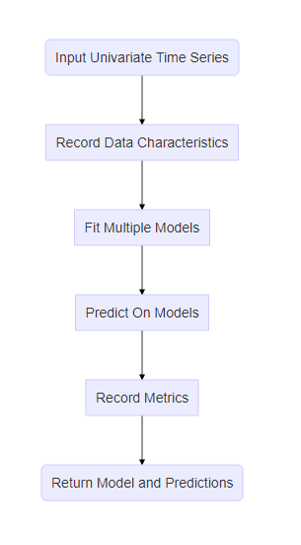
AutoML Framework
Flow diagram
Stationarity - flag
White noise - flag
Models
Evaluation metric
Pick winning model based on evaluation metric
Notes:
Placeholder simplified flowchart (kinda boring?)

Slide 9
Stationarity
Constant mean
Constant variance
Constant autocorrelations
Important because it’s an assumption for some models
Transformations on the data can correct for this
One reason why time-series analysis is different

Slide 10
White Noise
What is white noise: definition. No time in the past gives you any information about today or the future.
What is it important: if the time series is white noise it is a waste of time to attempt to model and forecast

Slide 11
Models
Traditional time series models
Deep learning models
List of models with pictures

Slide 12
Rolling-Window ASE
2 slides
Window | 1 | 2 | 3 | 4 | 5 | 6 | 7 | 8 | 9 | 10 | 11 | 12 | 13 | 14 | 15 | 16 | 17 | 18 | 19 | 20 | 21 | 22
Window 1 | Training Set |  |  |  |  |  |  |  |  |  |  |  | Forecast
Window 2 |  | Training Set |  |  |  |  |  |  |  |  |  |  |  | Forecast
Window 3 |  |  | Training Set |  |  |  |  |  |  |  |  |  |  |  | Forecast
Window 4 |  |  |  | Training Set |  |  |  |  |  |  |  |  |  |  |  | Forecast
Window 5 |  |  |  |  | Training Set |  |  |  |  |  |  |  |  |  |  |  | Forecast

Slide 13
Results 1 (not white noise)
White Noise Results | Model | Rolling-Window ASE
 |  | 3-Month Forecast | 12-Month Forecast
Not white noise | Equal Means | 7.49 | 9.07
 | ARMA | 6.44 | 6.87
 | ARIMA, d=1 | 9.90 | 9.31
 | ARIMA, s=12 | 8.66 | 9.98

Slide 14
Results (white noise)
White Noise Results | Model | Rolling-Window ASE
 |  | 3-Month Forecast | 12-Month Forecast
White noise | Equal Means | 0.74 | 0.57
 | ARMA | 0.88 | 0.75
 | ARIMA, d=1 | 0.86 | 0.72
 | ARIMA, s=12 | 1.47 | 2.18

Slide 15
Aggregation
Placeholder
(2 slides)

Slide 16
Box quote
All models are wrong, but some are useful (we need to look this up)

Slide 17
summary
2 slides

