Slide 1
Data Visualization
Journalists Killed Since 1992

Slide 2
People
Arnav – Online Section [aarnav@iu.edu]
Karen Sanchez Trejo – Residential Section [karsanc@iu.edu]

Slide 3
Introduction
Over the years journalists have had to face various perilous situations and many of them have been fatal.
In this project, we aim to visualize the information about the journalists who gave their life for the job

Slide 4
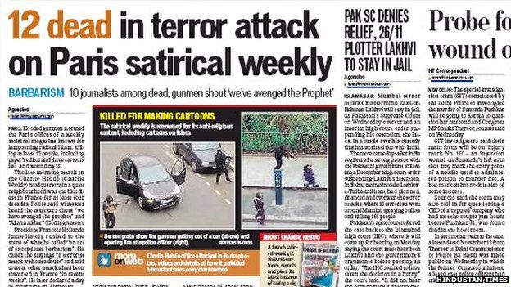
Motivation: Attacks on Journalists
One of the most noticeable attacks on the freedom of press in the recent past has been the attack on the office of the French satirical newspaper Charlie Hebdo in Paris in 2015.

Slide 5

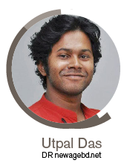
Motivation: Missing Journalists
Reports from Reporters Without Borders (RSF) about the two journalists who are missing since 2017 emphasize the need for protection of freedom of speech.
38 year old Pakistani
blogger missing since 2017
29 year old Bangladeshi reporter
missing 2017

Slide 6

Motivation: Organizations
The Committee to Protect Journalists (CPJ) is an American non-profit organization that was founded in 1981
Advocates press freedom and honor the journalists who face attacks, intimidation and even prison in order to report the world events.
The CPJ maintains a running list of the journalists killed across the globe

Slide 7

Motivation: Organizations
Reporters without Borders (RSF) is a non profit organization based in Paris, advocating freedom of press and information, since its foundation in 1981

Slide 8
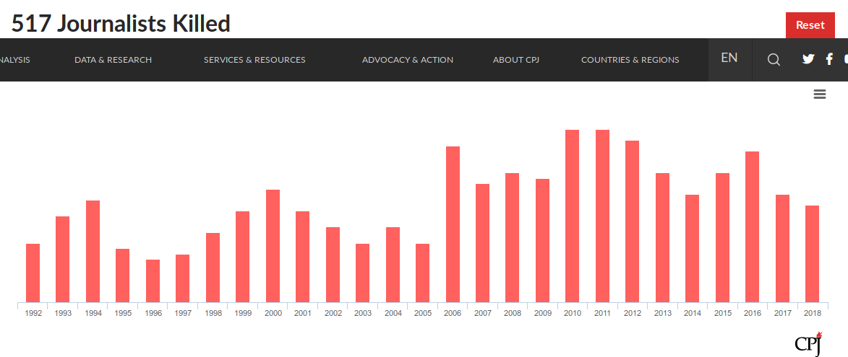
Related Work
CPJ Visualization for journalists killed between 1992 and 2018 by year

Slide 9
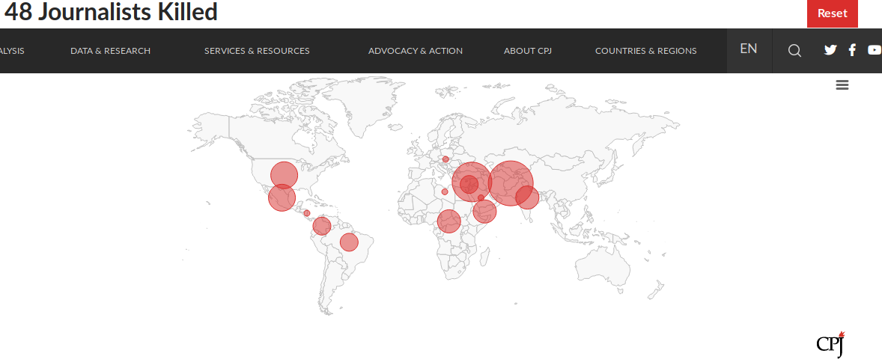
Related Work
CPJ data map for journalists killed in the year 2018

Slide 10
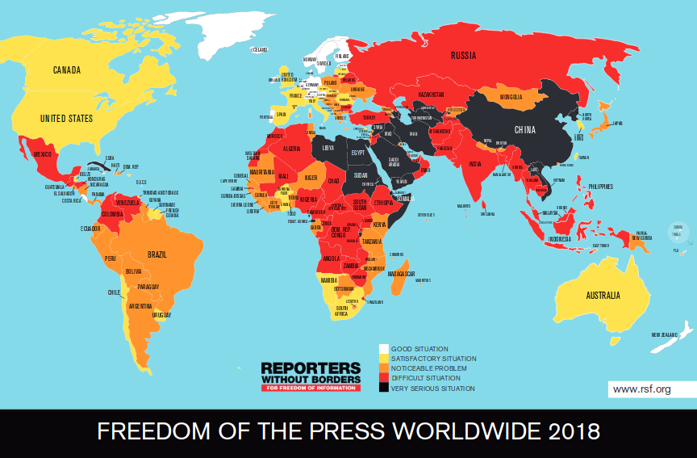
Related Work
RSF data map for Worldwide Press Freedom Index

Slide 11
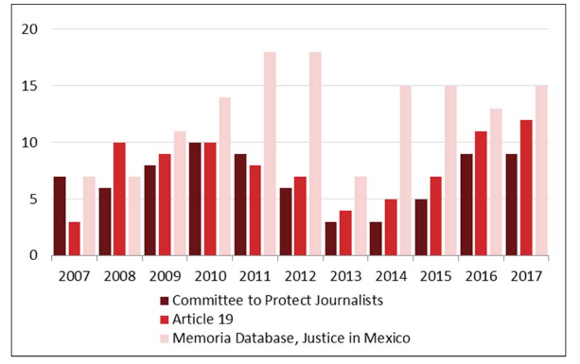
Related Work
Congressional Research Services compares homicides of media workers in Mexico for different years in 3 different databases

Slide 12
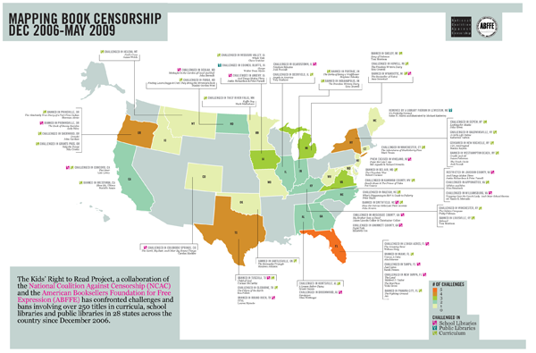
Related Work
National Coalition Against Censorship visualizes book censorship in different states in the U.S.

Slide 13
Data Description
This project uses the data from the CPJ provided on Kaggle
The data contains information about 1782 journalist deaths between 1992 and 2018
The data contains some interesting features:
date of death
coverage (topics being reported at the time of death)
Gender
Country killed
Organization

Slide 14
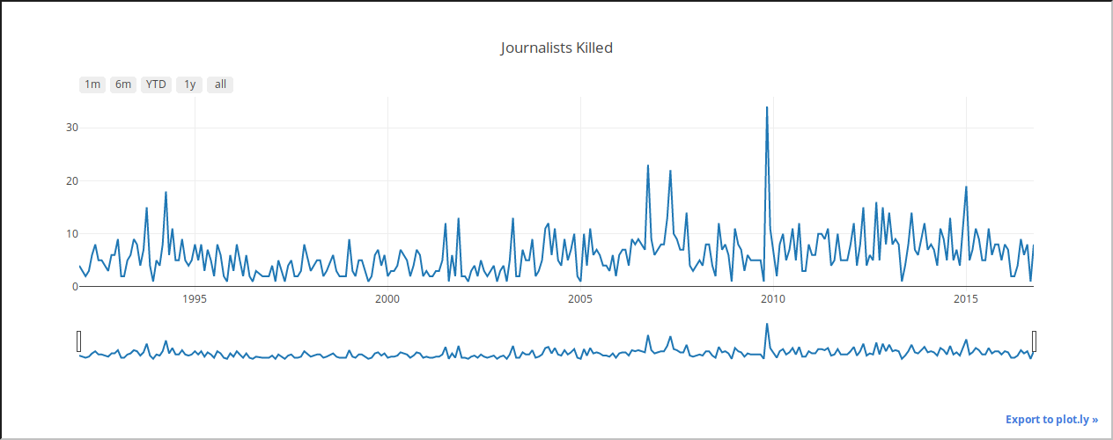
Exploratory Analysis: Time series
Interactive Time series plot of for the number of deaths in each month between 1992 and 2016

Slide 15
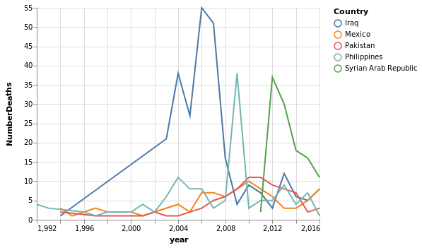
Exploratory Analysis: Time series
Number of deaths by year in top 5 countries with most deaths

Slide 16
Exploratory Analysis: Countries

Slide 17
Exploratory Analysis: Gender ratios

Slide 18
Exploratory Analysis: Tortured?

Slide 19
Exploratory Analysis: Medium

Slide 20
Exploratory Analysis: Source of Fire

Slide 21
Exploratory Analysis: Coverage

Slide 22
Data Map: Country Codes

Slide 23
Data Map: 1992 - 2016

Slide 24
Data Map: # some interesting years

Slide 25
Network Graph: 1992-2016

Slide 26
Network Graph: #some interesting years

Slide 27
Interesting Observations

Slide 28
Challenges

Slide 29
Future Work

Slide 30
References
https://ichef.bbci.co.uk/news/624/media/images/80127000/jpg/_80127035_0b2b0a90-e3b4-4c0a-b1b3-06569f774e57.jpg

