Slide 1
dsfas
sadfsf

Slide 2
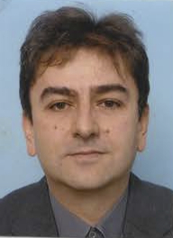
People
Lead Prof Damir Cavar – Department of Linguistic, Indiana University [website, dcavar@iu.edu]
Arnav – Data Science [aarnav@iu.edu]
Abhishek Babuji – Data Science [ababuji@iu.edu]
Shreejith Panicker – Data Science [skpanick@iu.edu]
Prashant Modak – Computer Science [prkumoda@iu.edu]

Slide 3
asdf

