Slide 1
Data Visualization
Journalists Killed Since 1992

Slide 2
People
Arnav – Online Section [aarnav@iu.edu]
Karen Sanchez Trejo – Residential Section [karsanc@iu.edu]

Slide 3
Introduction
In this project, we aim to visualize the deaths of journalists across the world from 1992 to March 2016, and hope to shine some light on these deaths, provided by the CPJ.
Over the years journalists have had to face various perilous situations and many of them have been fatal.
A good visualization would help understand the importance of the issue and aid in further analysis of the problem

Slide 4
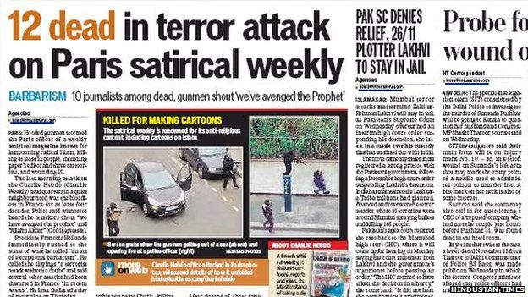
Motivation: Attacks on Journalists
One of the most noticeable attacks on the freedom of press in the recent past has been the attack on the office of the French satirical newspaper Charlie Hebdo in Paris in 2015.

Slide 5
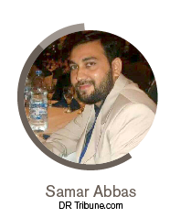
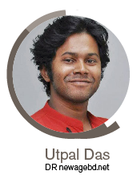
Motivation: Missing Journalists
Reports from Reporters Without Borders (RSF) about the two journalists who are missing since 2017 emphasize the need for protection of freedom of speech.
38 year old Pakistani
blogger missing since 2017
29 year old Bangladeshi reporter
missing 2017

Slide 6

Motivation: Organizations
The Committee to Protect Journalists (CPJ) is an American non-profit organization that was founded in 1981
Advocates press freedom and honor the journalists who face attacks, intimidation and even prison in order to report the world events.
The CPJ maintains a running list of the journalists killed across the globe

Slide 7

Motivation: Organizations
Reporters without Borders (RSF) is a non profit organization based in Paris, advocating freedom of press and information, since its foundation in 1981

Slide 8
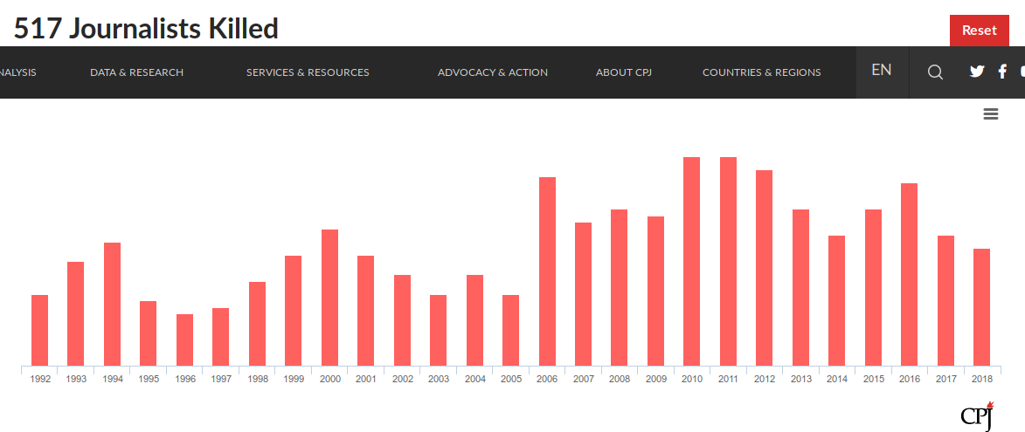
Related Work
CPJ Visualization for journalists killed between 1992 and 2018 by year

Slide 9
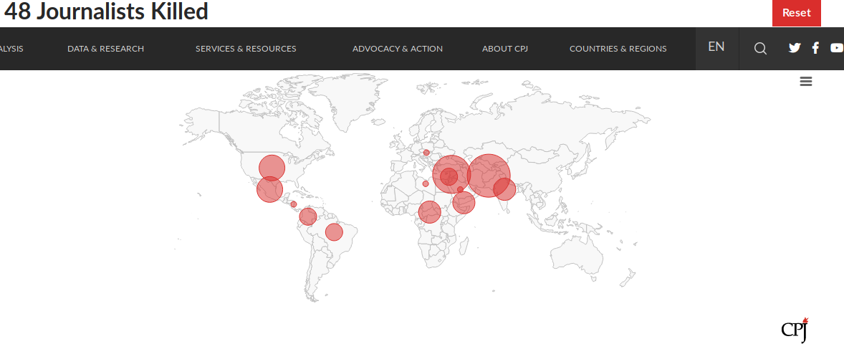
Related Work
CPJ data map for journalists killed in the year 2018

Slide 10
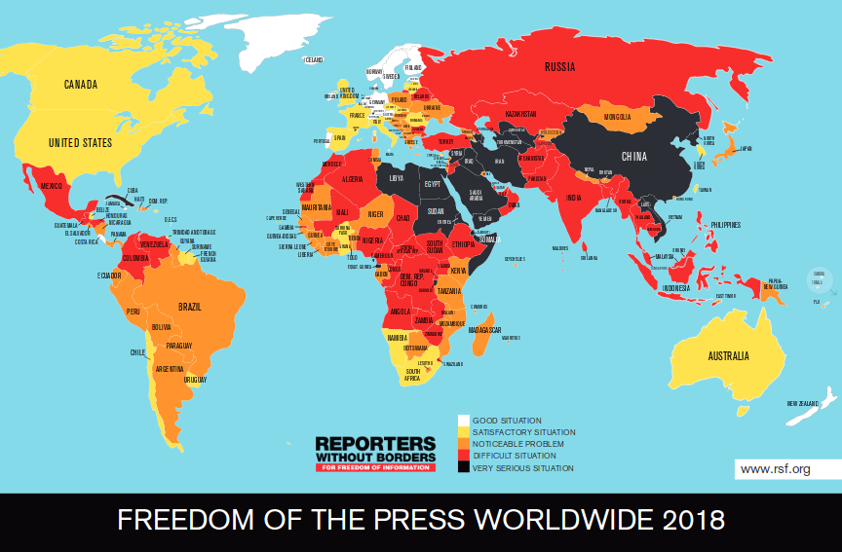
Related Work
RSF data map for Worldwide Press Freedom Index

Slide 11
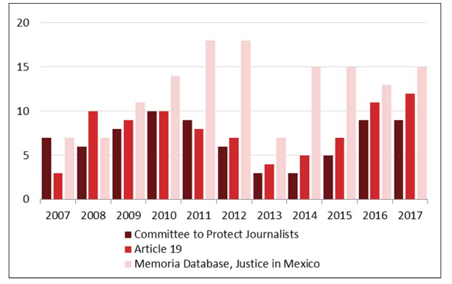
Related Work
Congressional Research Services compares homicides of media workers in Mexico for different years in 3 different databases

Slide 12
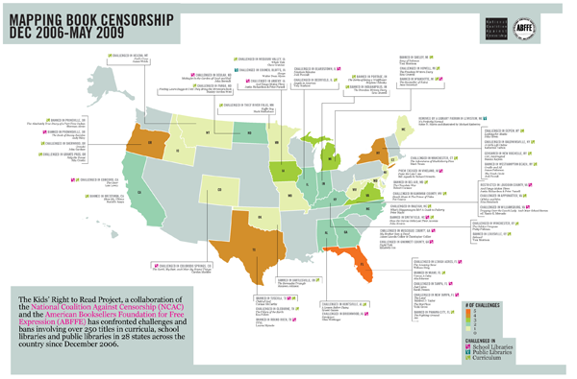
Related Work
National Coalition Against Censorship visualizes book censorship in different states in the U.S.

Slide 13
Objectives
Visualize the information about the journalists who gave their life for the job:
Through exploratory analysis, data maps and network diagrams
Use interactive visualizations
Improve upon previous visualizations for the same problem
Discover interesting insights in the data

Slide 14
Data Description
This project uses the data from the CPJ provided on Kaggle
The data contains information about 1782 journalist deaths between 1992 and 2018
The data contains some interesting features such as:
date of death
coverage (topics being reported at the time of death)
Gender
Country killed
Organization

Slide 15
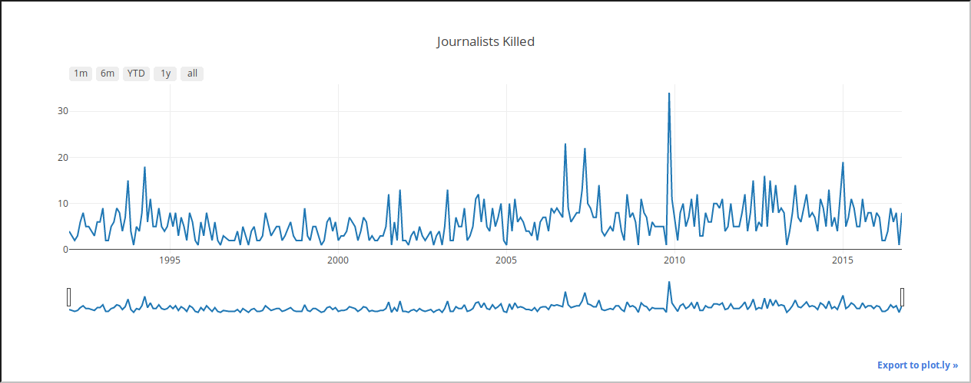
Exploratory Analysis: Time series
Interactive Time series plot of for the number of deaths in each month between 1992 and 2016

Slide 16
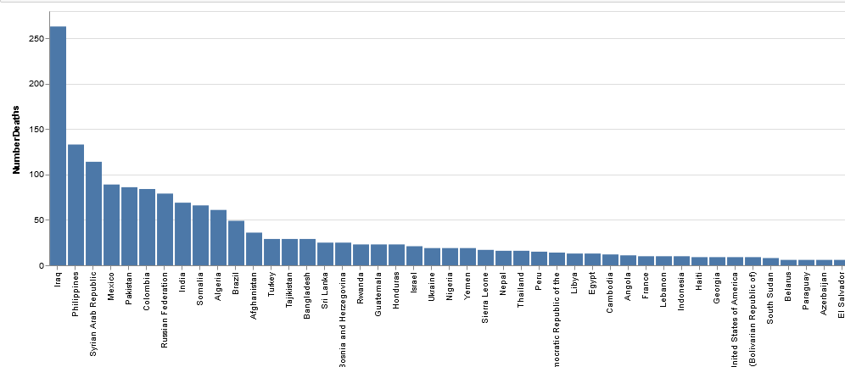
Exploratory Analysis: Countries
Number of deaths by each country between 1992 and 2016

Slide 17
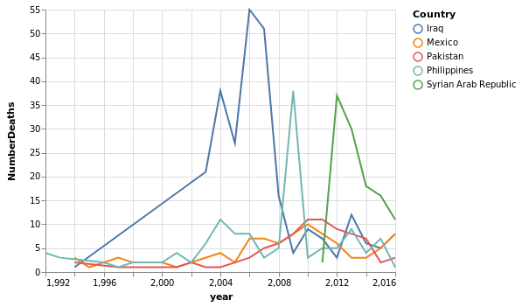
Exploratory Analysis: Time series
Number of deaths by year in top 5 countries with most deaths

Slide 18
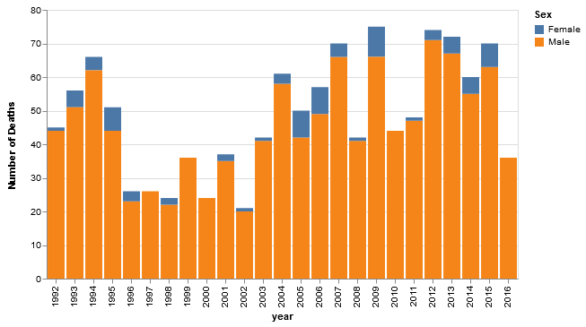
Exploratory Analysis: Gender ratios
Number of male and female journalists killed by year

Slide 19
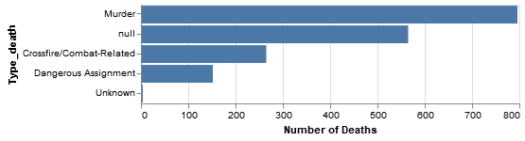
Exploratory Analysis: Type of Death
Type of deaths by year

Slide 20
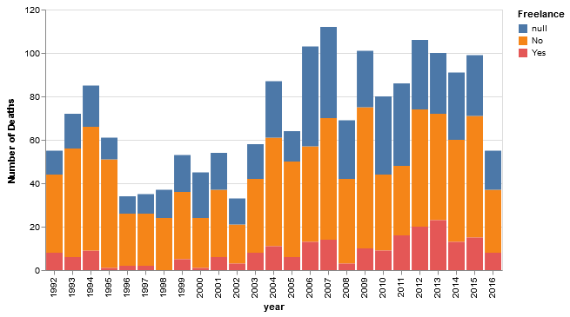
Exploratory Analysis: Freelance

Slide 21
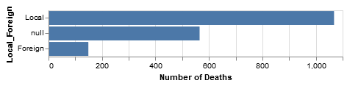
Exploratory Analysis: Local

Slide 22
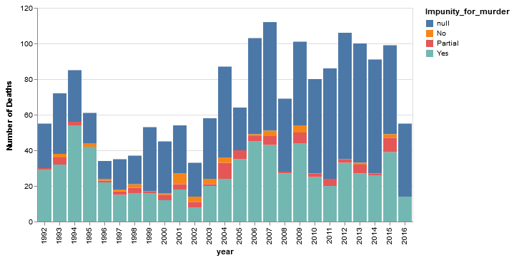
Exploratory Analysis: Impunity of Murder

Slide 23
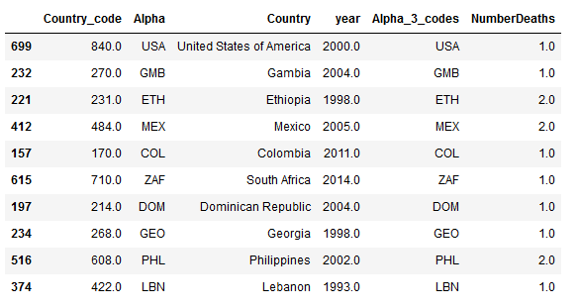
Data Map: Country Codes

Slide 24
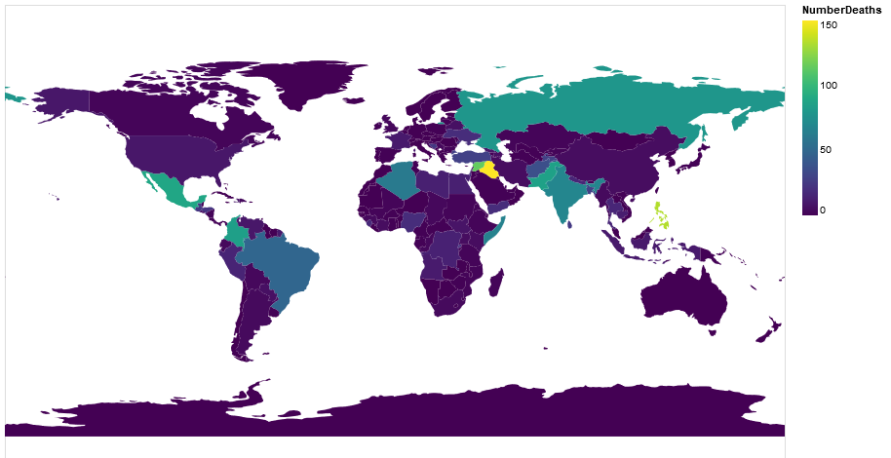
Data Map: 1992 - 2016

Slide 25
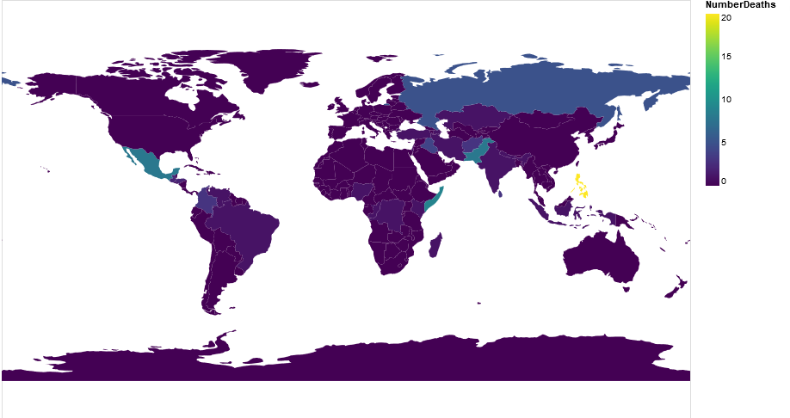
Data Map:2006 Philippines massacre

Slide 26
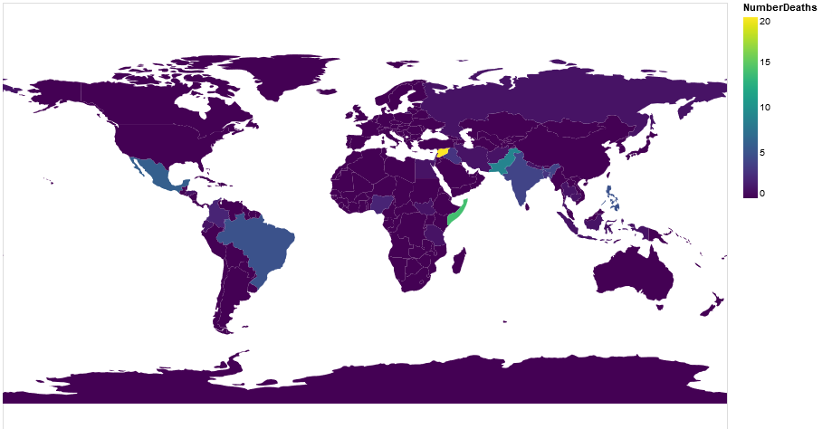
Data Map:2012 rise of deaths in Syria

Slide 27
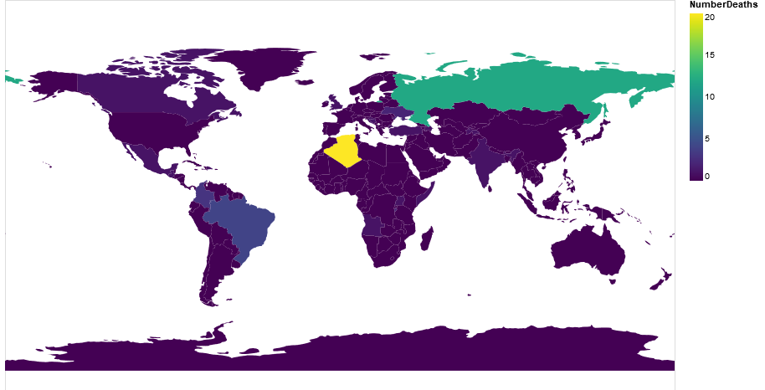
Data Map:1995 Algerian Civil War

Slide 28
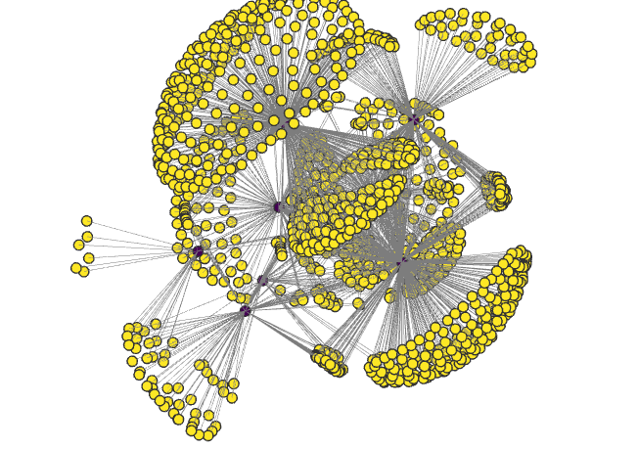
Network Graph: 1992-2016
Network of Journalists and coverage

Slide 29
Demo
Webpage: https://seashiva94.github.io/data_viz_project/

Slide 30
Challenges
Learning to make interactive maps in altair
Maps do not support some common functionality
Slider for year selection in python did not work
Used jquery in the end

Slide 31
Future Work
Get information about the deaths of various journalists from twitter and news articles to better describe each of the deaths
Use this information to perform detailed analysis on the data
Perform deeper network analysis

Slide 32
References
https://ichef.bbci.co.uk/news/624/media/images/80127000/jpg/_80127035_0b2b0a90-e3b4-4c0a-b1b3-06569f774e57.jpg
[Reporters Without Borders 2018c] Reporters Without Borders. 2018c. Missing journalists. Reporters Without BordersWebsite.
[Reporters Without Borders 2018c] Reporters Without Borders. 2018c. Missing journalists. Reporters Without Borders Website.
[Committee to Protect Journalists 2018c] Committee to Protect Journalists. 2018c. Committee to protect journalists. CPJ website.
[Reporters Without Borders 2018a] Reporters Without Borders. 2018a. 2018 world press freedom index. Reporters Without Borders website
[Seelke 2018] Seelke, C. R. 2018. Violence against journalists and media workers in Mexico and u. s. policy
[National Coalition Against Censorship 2018] National Coalition Against Censorship. 2018. Visualizing censorship. National Coalition Against Censorship website.
[Committee to Protect Journalists 2016] Committee to Protect Journalists. 2016. Journalists killed worldwide since1992. Kaggle.

